Slide 1
Unit 1
Taxonomy and Classification

Slide 2
Taxonomy and classification
Design, measurement, and analysis
  Optional reading material: http://www.creative-wisdom.com/teaching/WBI/dma.shtml
Descriptive statistics and inferential statistics
Exploratory data analysis and Confirmatory data analysis
  Optional reading material: http://www.creative-wisdom.com/teaching/WBI/EDA.shtml

Slide 3
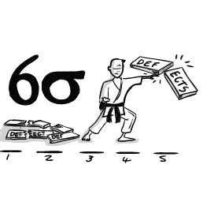
Common misconception
“Quantitative research is statistical analysis.”
“Hey! Yu! I had collected a large amount of data since five years ago. I need to publish an article now. Can you help me by analyzing the data? You can do the magic, right?”

Slide 4
Three stages
Research design
Measurement
Data analysis

Slide 5
Design
A plan of the overall framework
What type of study? Experiment? Non-experiment?
"If your result needs a statistician, then you should design a better experiment." (British physicist Ernest Rutherford).
Design precedes statistics: If you have a good and clean research design, you don't need complicated statistics to interpret the result.
“Frequently conclusions are easily drawn from a well-designed experiment, even when rather elementary methods of analysis are employed. Conversely, even the most sophisticated statistical analysis cannot salvage a badly designed experiment.” (Box, Hunter, & Hunter, 1978)

Slide 6
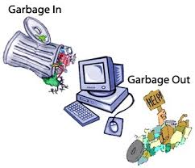
Measurement
Measurement is a process of assigning numbers to the attributes and properties of something.
If I want to study intelligence, I need an IQ test.
Garbage in, Garbage out.
Bond and Fox (2015): Although psychologists and others in human sciences have been effective in applying sophisticated statistical procedures to their data, there is no way to replace bad measurement with good statistical procedures.
Never make up your own test without validation. Why?

Slide 7
analysis
to make sense out of the data.
not to make things more complicated, rather it is data reduction and clarification (Pedhazur, 1982).
Data analysis is NOT equated with statistical analysis.
Statistical analysis is tied to probability. Data analysis involves probability when it is needed, but avoids probability when it is improper.
Exploratory data analysis and data mining focus on the data pattern rather than on probabilistic inferences.

Slide 8
Descriptive and Inferential
Population
  Target population
  Accessible population
Sample
Descriptive statistics vs. Census
Inferential statistics: infer from the sample to the population

Slide 9
Population
The target population is the group to which the inference (or the generalization) is made.
The accessible population is the group from which I can draw the sample.
If I conduct a study about the relationship between smoking and lung cancer, then the target population consists of all smokers regardless of their locations. However, I cannot randomly select smokers from all locations. Thus, the accessible population might be the smokers in Phoenix, Arizona.

Slide 10
Common mistake
“My sample population is…”
There is no such thing as “sample population.”
A sample is a subset of the population.
There are one superset and two subsets. Can you put the right labels into the proper sets?
Sample
Target
population
Accessible
population

Slide 11
Exercise
Use Google search or any search engine to find the definitions of descriptive statistics and inferential statistics.

Slide 12
Common mistake
“Descriptive statistics are brief descriptive coefficients that summarize a given data set, which can be either a representation of the entire or a sample of a population.”
“Descriptive statistics, in short, help describe and understand the features of a specific data set by giving short summaries about the sample and measures of the data.”
“With descriptive statistics you are simply describing what is or what the data shows. With inferential statistics, you are trying to reach conclusions that extend beyond the immediate data alone.”

Slide 13
Common mistake
“Inferential statistics makes inferences about populations using data drawn from the population. Instead of using the entire population to gather the data, the statistician will collect a sample or samples from the millions of residents and make inferences about the entire population using the sample.”

Slide 14
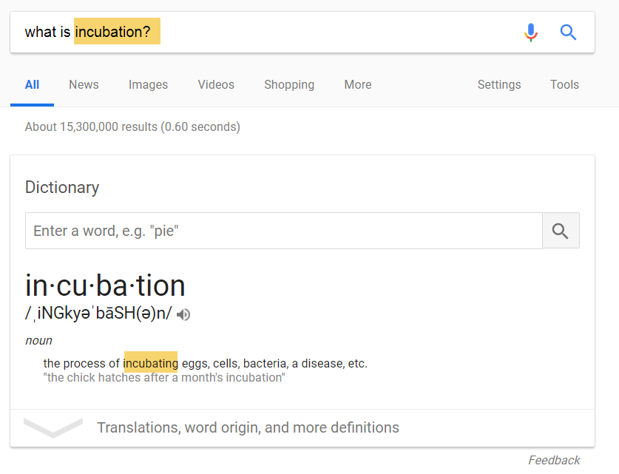

Slide 15
Tautology
Saying the same thing twice.
  Inferential statistics is a branch of statistics for making inferences from the sample to the population.
  Descriptive statistic is a branch of statistics for describing the sample characteristics.
It is like saying:
  An engineering professor is a professor that teaches engineering classes
  A computer is an electronic device for computing.
  A hammer is a tool to hammer nails and fit parts.

Slide 16
Better definitions
Inferential statistics is quantitative research methodology for generalizing from the sample to the population.
Descriptive statistics is quantitative research methodology for reporting and summarizing the characteristics of the sample at hand and its conclusion is not extended beyond the sample.

Slide 17
UNGRADED Exercise
  An administrator at John Smith College looks at the verbal Scholastic Aptitude Test (SAT) scores for the entire class of students admitted in the fall of 2017 (mean = 660) and the verbal SAT scores for the entire class admitted in the fall of 2018 (mean = 540) and concludes that the class of students admitted to John Smith in 2017 had higher verbal scores than the class of students admitted in 2018.
  Is it descriptive statistics or inferential statistics?

Slide 18
Answer
Strictly speaking, it is descriptive, but not descriptive statistics, because the data set contains the entire population. In other words, it is a census. We use the sample statistics to estimate the population parameters. But when we have the population parameters at hand, there is no need to make any estimation based on statistics.

Slide 19
UNGRADED exercise
Donald Clinton is the data analyst at Hilary Trump University. He has access to all student records and therefore he said, “I have census-level data. I don’t need any inferential statistics. I ca report the number as is.” Is he right?

Slide 20
Answer
It depends!
If the target population consists of all students in USA, then his data are just a sample and he still needs inferential statistics.
If the target population is confined to Hilary Trump University, then he can report the number as is.

Slide 21

UNGRADED Exercise
  An administrator takes a random sample of 45 John Doe College students in the fall of 2017 and asks them to self-report how often they engage in binge drinking. Members of the sample report an average of 2.1 binge drinking episodes per week. The administrator writes a report that says, "The average level of binge drinking among all John Doe College students is about 2.1 episodes per week."

Slide 22
Answer
This is inferential statistics because the analyst infers from the sample statistics to the population parameter.

Slide 23
Confirmatory data analysis (CDA)
Traditional (classical) approach
Developed in late 19th and early 20th centuries.
Hypothesis testing
  The researcher draws a plan: formulate a hypothesis based upon a theory (Design)
  Collect data (Measurement)
  Run statistical tests to confirm or disconfirm the hypothesis (Analysis)
What is the problem/limitation?

Slide 24


Problem
In CDA the research might have a tunnel vision: focus on one theory or hypothesis.
If your mind is fixed, usually you can find some evidence to support your pre-conceived idea.
You might overlook the big elephant in the room!

Slide 25
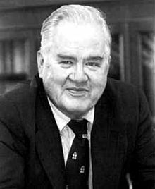

Exploratory data analysis (EDA)
Developed by John Tukey in the 1970s
EDA endorses openness.
Does not start with a rigid hypothesis
Explore alternate explanations
Let the data speak for themselves
Tukey often related EDA to detective work. In EDA, the role of the researcher is to explore the data in as many ways as possible until a plausible "story" of the data emerges.
So, from now on you can call me "Detective Yu."

Slide 26
Caution
EDA is not “fishing” or trying everything.
When some people claim that their methodology is exploratory, actually what they mean is that they don't know what they are doing.
In data collection researchers flood the subjects with hundred pages of surveys since research questions are not clearly defined and variables are not identified.
EDA does not require a pre-determined hypothesis, but it doesn't justify the absence of research questions and ill-defined variables.

