Slide 1
Measurement Scale
Chong Ho Yu, Ph.D.

Slide 2
Exercise
Form a small group of 3-4
Use APU library, Google, or any tool you like to look up the definition of “data.”
Share your finding with your teammates and select one or two best definitions.
The team leader will share the best definition(s) with the whole class.

Slide 3
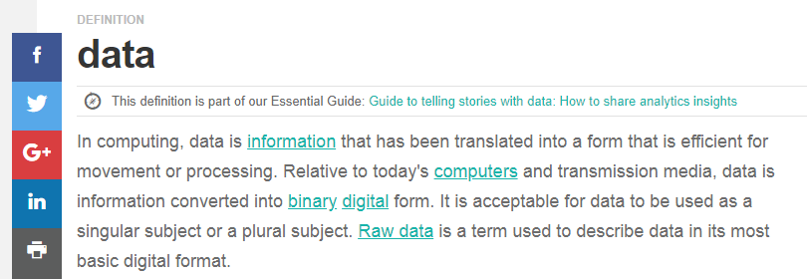
What I found
https://searchdatamanagement.techtarget.com/definition/data

Slide 4
problem
Data cannot be equated with information.
 | Data | Information
Definition | Data are unprocessed, raw “materials” without a context. | Information is data processed and formatted to give the context. It might lead to actionable item.
Example 1 | My weight over the last 10 years | My weight has been increasing since 10 years ago. Exercise more or my wife will claim the benefit of my life insurance!
Example 2 | The history of global temperature for the past 10,000 years. | The global temperature is rising. Use green energy or facing “The day after tomorrow”!

Slide 5
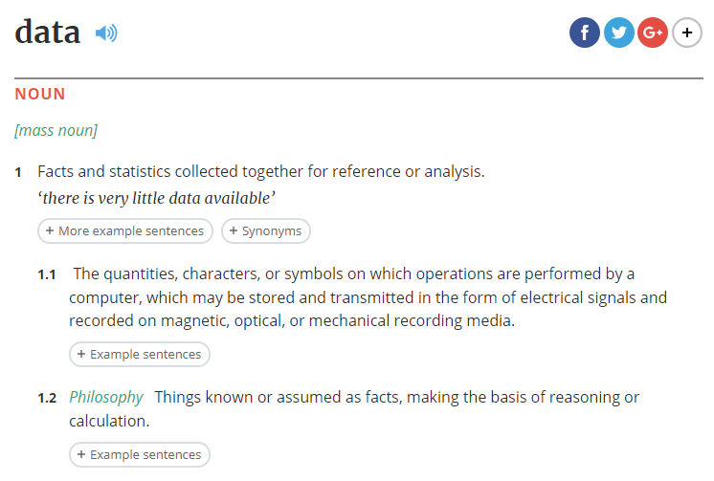
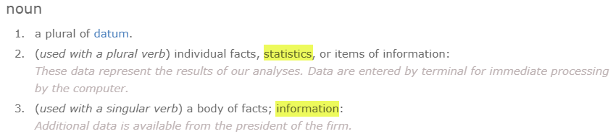
What I found

Slide 6
problem
It is too narrow to confine data to statistical figures.
Two data types:
  Quantitative data: Numbers (structured)
  Qualitative data: text, audio, image, video (Unstructured)
You can quantify qualitative data by counting and classifying the instances e.g. how many times the students mention the word “job” when they respond to the question “why do you attend graduate study?”

Slide 7
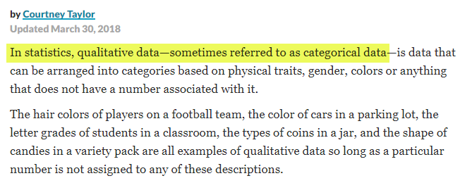
Common Mistake
Qualitative data are NOT the same as categorical data.
Qualitative data has a broader meaning: e.g. open ended, essay-type textual data

Slide 8
Another taxonomy
Within quantitative data, data can be classified into:
  Individual level data: e.g. I obtain GPA of each student at APU.
  Summary data: I obtain the average GPA of students by major (e.g. psychology, sociology, physics…etc.)

Slide 9
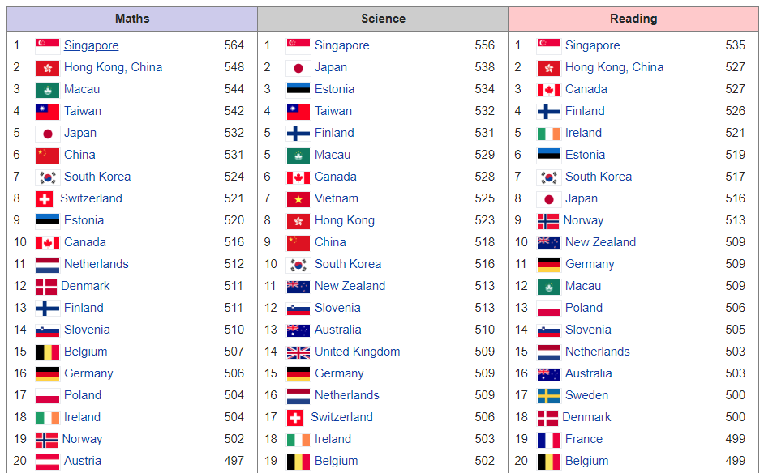
Example: PISA

Slide 10

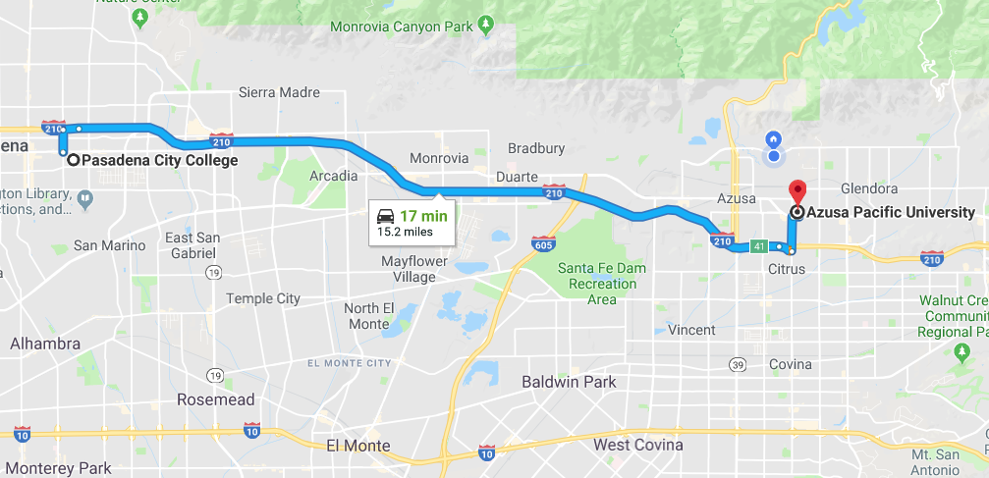
Another taxonomy
4 levels of measurement
Categorical
  Nominal: Names, labels e.g. classroom number
  Ordinal: rank order e.g. Gold medal, silver, bronze
Continuous
  Interval: equal spacing e.g. temperature in Celsius
  Ratio: has absolute zero e.g. distance

Slide 11
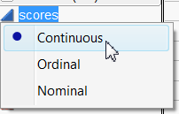
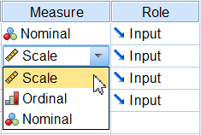
Three levels in practice
In computation there is no difference between interval and ratio
No matter whether the scale has an absolute zero or not, it won’t affect the statistical procedure.
Average of 2, 3, 4, 5 = (2 + 3 + 4 + 5)/4
Average of -1, -2, 2, 4 = (-1 + (-2) + 2 + 4)/4

Slide 12
What are their
Measurement levels?
Social Security Number
Gender
Race
Academic year (e.g. freshman, sophomore, junior, senior)
Income

Slide 13

What are their
Measurement levels?
Asset: Is it interval or ratio?
If you owe more than you have, you can have a negative asset on the balance sheet.
I bought a house in 2007: $430K
In 2010 the value dropped to $330K

Slide 14
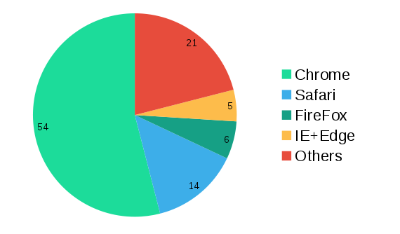
Ordinal or continuous?
Market share of Web Browser

Slide 15
Ordinal or continuous?
If you use the rank: 1. Chrome, 2. Safari, 3. Firefox, 4. IE, then these are ordinal data.
If you use the percentage: 64, 21, 14, 6, and 5, then these are ratio or continuous.

Slide 16

GPA
What is the measurement level of GPA? Ordinal? Interval?
GPAs are converted from letter grades
Letter grades are converted from points
A: could be 100 or 90
B: could not 80 or 89
Lack of precision

Slide 17
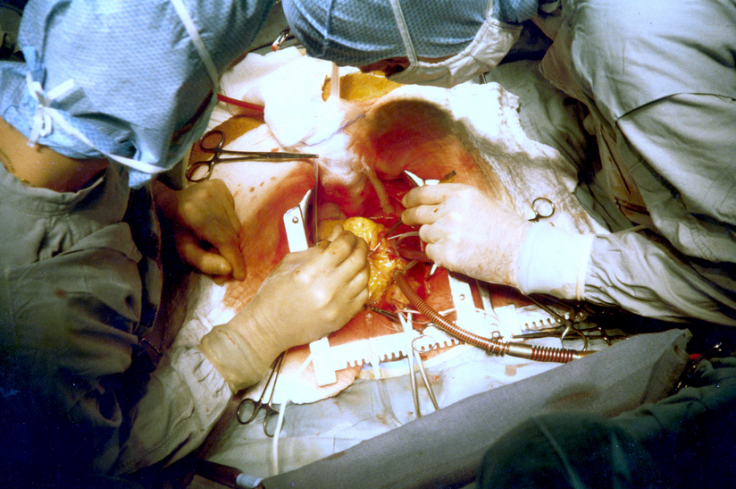
How about Binary or Dichotomous?
  Only two outcomes
  Competency (1 = pass the exam, 0 = fail the exam)
  Survival: You need a triple bypass open heart surgery (1 = alive, 0 = dead)
  Ordinal or continuous?

Slide 18
Binary? Dichotomous?
  For individual students, one can either pass or fail the exam. For individual patients, one can either be alive or dead.
  As a group, the data can be treated as continuous.
  100 students took the exam and 20 passed (1, 1, 1, 0, 1, 1…etc.). The chance of passing the exam is 20/100 = .2
  100 patients took the surgery and 90 of them recovered. The probability of recovery is: 90/100 = .9

Slide 19
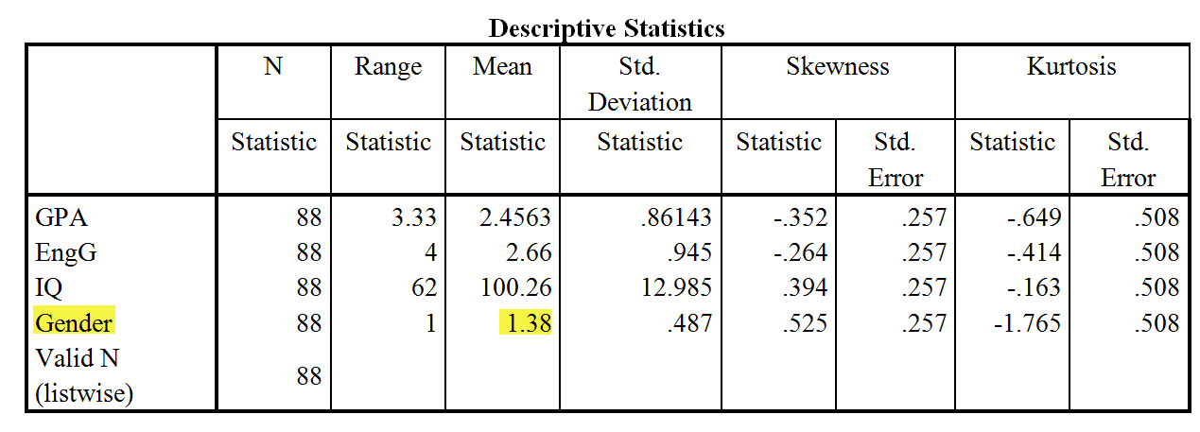
Don’t make these mistakes!
Even some graduate students are confused by the nominal scale. The following is a real report produced by a real student.
What’s wrong in the following table?

Slide 20
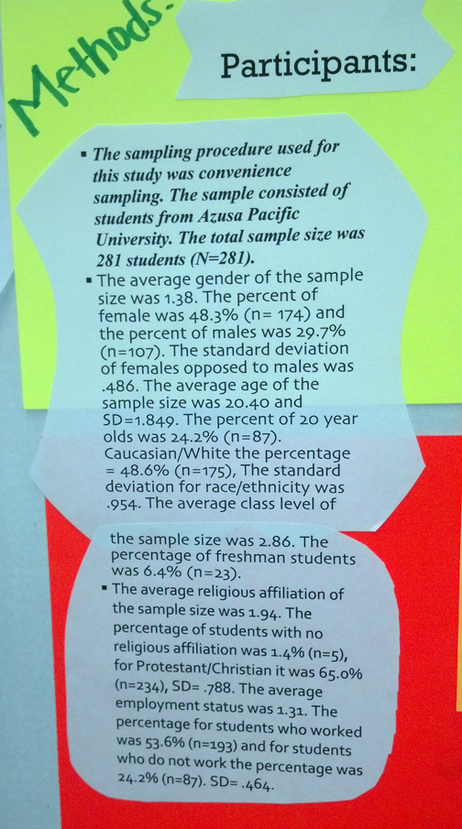
Don’t make these mistakes!
What’s wrong in this poster presentation?

Slide 21
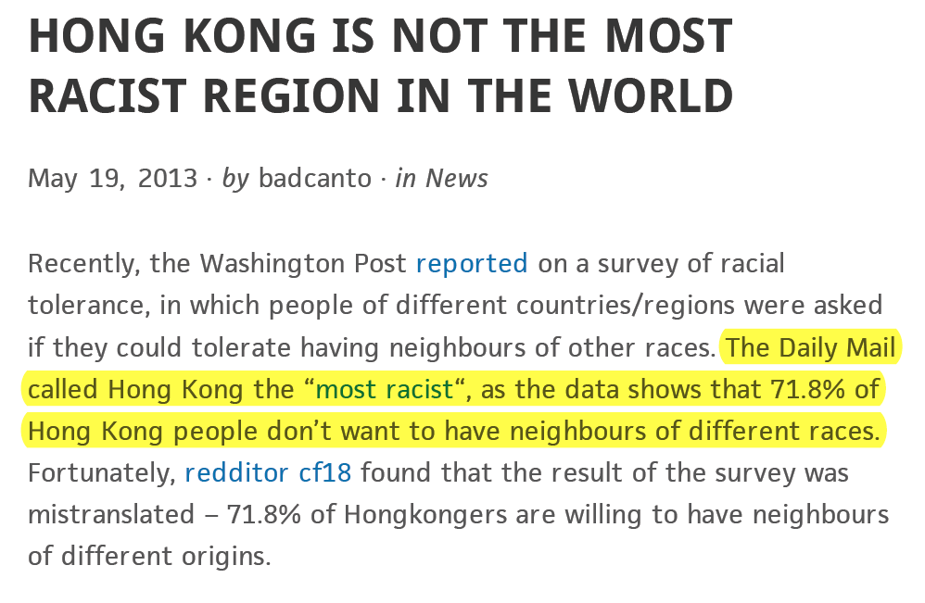

Slide 22
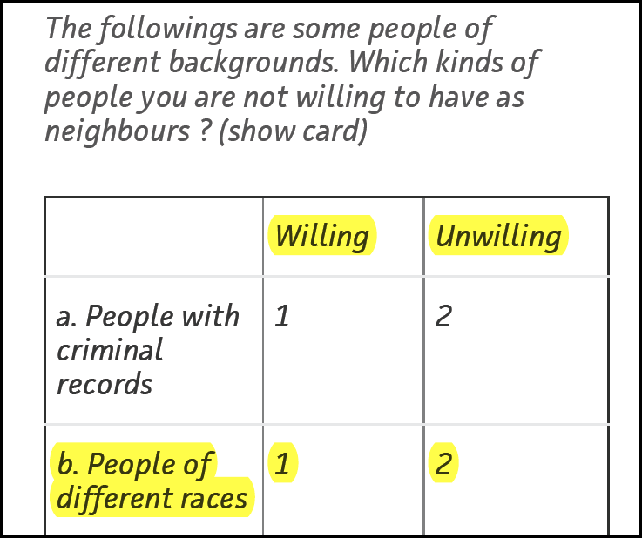
By common sense:
Yes = 1
No = 0
Why “not willing” = 2?

Slide 23
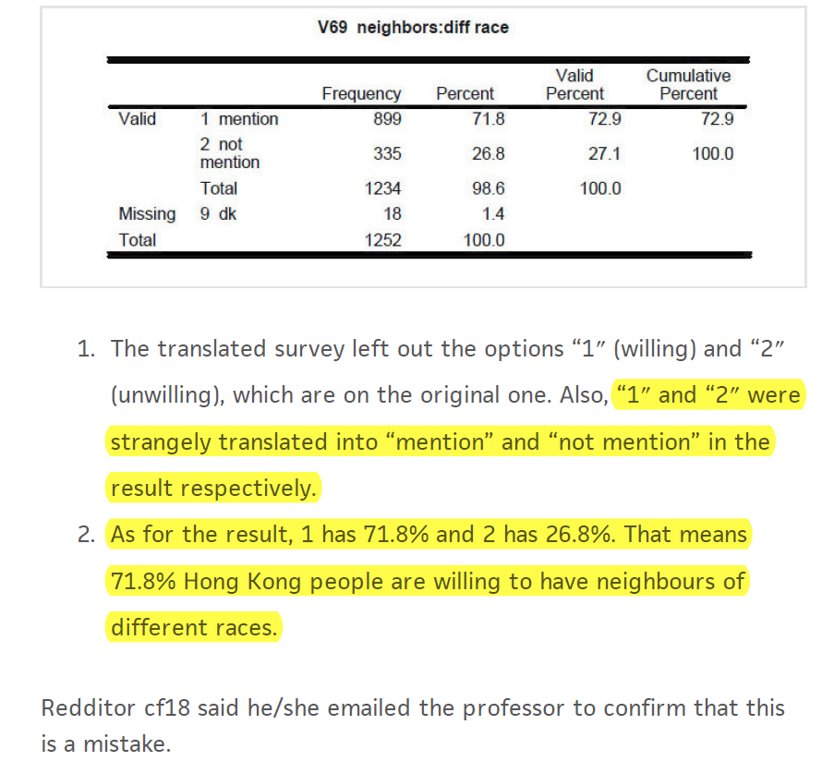

Slide 24
Variable
Data can be classified into dependent (DV) and independent variables (IV).
Opposite to constant
The value can vary
DV: outcome, response
IV: factor

Slide 25
Assignment (Canvas)
Very often researchers collect demographic data by range. For example, instead of asking for the exact age of the participant (e.g. 18, 20, 40…etc.), the survey provides the respondents with age ranges (e.g. Under 18, 18-24, 25-34, 35-44, 45-54, 55-65…etc.).
In public health research even though the researcher is capable of making precise measurement (e.g. blood pressure), later he or she classifies the ratio-scaled data into ordinal.

Slide 26
Assignment (Canvas)
Blood Pressure Classification | SBP | DBP
 | mmHg | mmHg
Normal | <120 | and <80
Prehypertension | 120–139 | or 80–89
Stage 1 Hypertension | 140–159 | or 90–99
Stage 2 Hypertension | ≥160 | or ≥100
SBP, systolic blood pressure; DBP, diastolic blood pressure

Slide 27
Assignment (Canvas)
In both cases the measurement scale is “demoted,” resulting in losing precision. Why do those researchers do that? You cannot find the answer from the PowerPoint slides. Please conduct your own research. Your grade depends on how well you articulate your argument, rather than reporting the “right answer.”
Discuss with your group members and post a brief report on Canvas (Max: 1 page. Hint: There could be several reasons).
Please post individual answer, not a group paper.

