Slide 1
Normal Distribution
Chong Ho (Alex) Yu

Slide 2
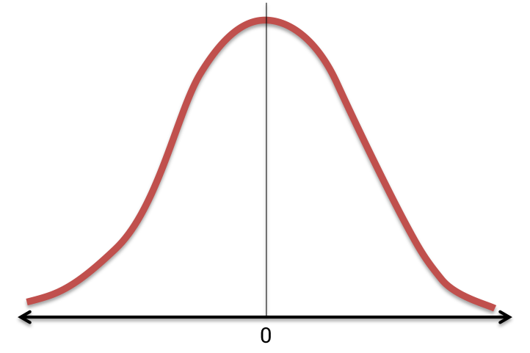
Standard Normal Distribution
symmetric
continuous
unimodal
bell-shaped
asymptotic
the mean, median, and mode are the same.

Slide 3
Normal distribution
Normal curve is a theoretical construct.
Geary (1947) stated that normality could be viewed as a special case of many distributions rather than a universal property. Geary suggested that future editions of all existing textbooks and new textbooks should include this warning: “Normality is a myth; there never was, and never will be, a normal distribution” (p. 241).

Slide 4
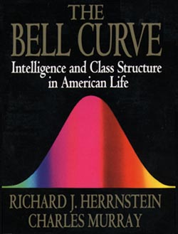
IQ Test and Bell Curve
Herrnstein and Murray (1994): A very controversial book.
The bell-curve (a spread of ability) exists in spite of intervention (e.g. education, affirmative action...etc.)

Slide 5
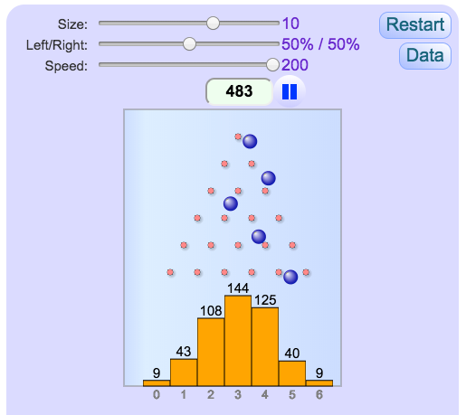
Class activity:
Pascal Triangle (Quincunx)
In the past this experiment was done in a physical box, but today we can use a computer simulation
Nails were punched into a box to form a triangular shape.

Slide 6
Pascal Triangle (Quincunx)
On top there is only one nail. The second row has two nails. Each subsequent row has one additional nail.
When a ball is poured into the box from top and lands on the first nail, the probability of going to the left is .5 and to the right is also .5.

Slide 7
Pascal Triangle
Subsequently, the probability of going to which direction gets more and more complicated. Nonetheless, the process is random.
But this random process always produces a normal distribution!

Slide 8
Pascal Triangle
Open https://www.mathsisfun.com/data/quincunx.html
How long does it take to make a normal distribution.
When you think you have a normal curve, please raise your hand.

Slide 9
Skewness and kurtosis
There is no perfectly normal curve.
Skewness refers to the degree of asymmetry in the distribution. The normal distribution is symmetric and hence has zero skewness.
Kurtosis is the relative ratio of the mass of the distribution located in the center versus in the tails. The kurtosis of the normal distribution is 3

Slide 10
Computation
Download the data “Visualization_data” from the Unit 4 folder.
There are two versions: Excel and SPSS. Download all of them.
If you don’t have Excel, you can use either Google Sheet or Open Office, which are free.
I will use SAT to do a demo. Then you will use GPA.

Slide 11
Computation in Excel
Skewness:
  In the cell where you want to place the output, type =skew(first cell of the data column: last cell).
  For example, if you want to calculate the skewness of SAT, type =skew(I2:I91).
  Caution: the function “skew” is for the sample, the function “skew.p” is for the population.
Kurtosis: = kurt(first:last)

Slide 12
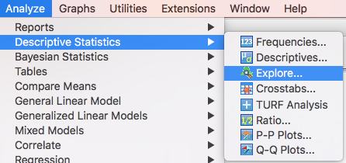
Computation in SPSS
Analyze → Descriptive Statistics → Explore
(This screen capture is made in a Mac. It might looks different in Windows)

Slide 13
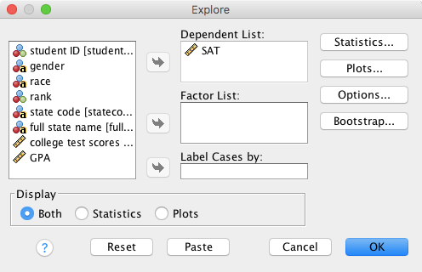
Computation in SPSS
Drag the variable(s) that you want to investigate into Dependent list.
Press OK

Slide 14
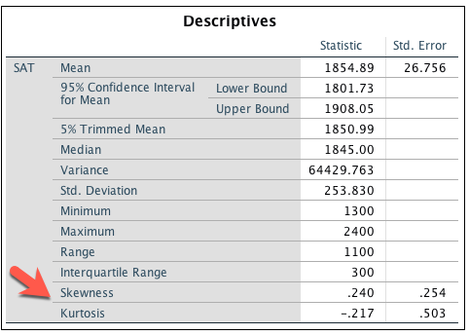
Computation in SPSS
SPSS shows skewness and kurtosis statistics by default.

Slide 15
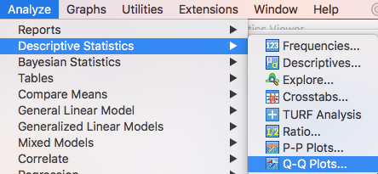
Normal Quantile Plot
We can use the normal quantile plot, also known as quantile-quantile plot (Q-Q plot) to examine whether a distribution is "fairly" normal.
In SPSS:

Slide 16
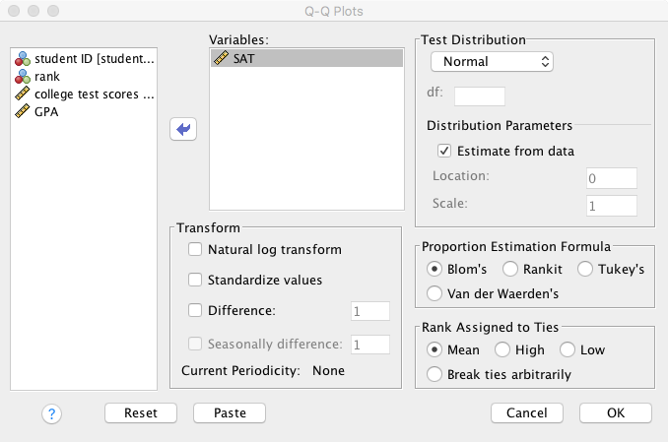
Normal Quantile Plot
SPSS:

Slide 17
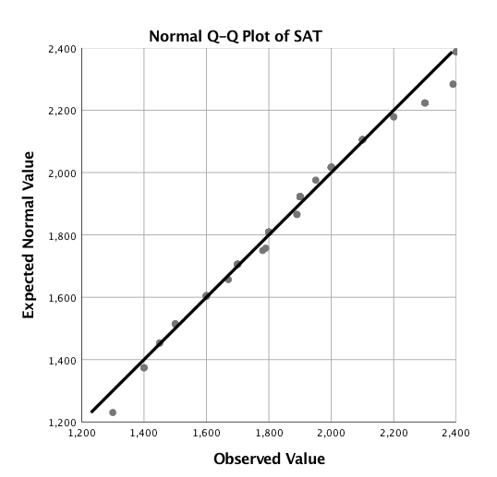
Q-Q plot
The 45-degree diagonal line represents an ideal normal distribution.
If the data are normally distribution, then every point should fall along the line.

Slide 18
Ungraded Exercise
Use any tool you like (Excel, Google Sheet, Open Office, or SPSS).
Compute the skewness and kurtosis of GPA
Plot a normal quantile plot, also known as Q-Q plot, for GPA.

Slide 19
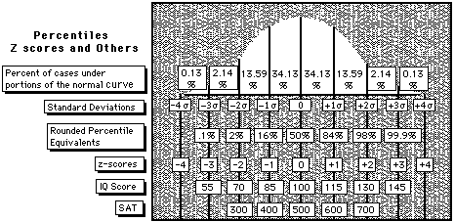
Theoretical normal distributions
Notice that Z scores are expressed in terms of standard deviation units. In other words, standard deviations are the units of measure for Z scores.

Slide 20
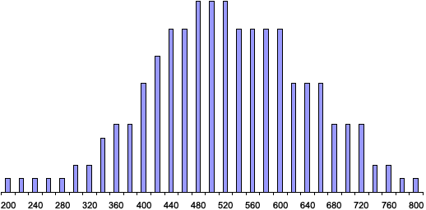
The real SAT distribution

Slide 21
Theoretical normal distributions
For an IQ score with Z=1.5, the score is 1.5 standard deviation units above the mean

Slide 22
Theoretical normal distributions
Z scores not only give the distance of the score from the mean in standard deviation units, but also the direction of the score from the mean by using the sign of the Z score (+ or -).

Slide 23
Theoretical normal distributions
The mean of a set of Z scores is 0 and the variance and standard deviation of a set of Z scores are 1.

Slide 24

Can you compare raw scores?
John and Annie are in two different classes (morning session and afternoon session). John got a 90 in his test and Annie got a 80. John laughs at Annie and said: “My test result is 10-point higher than yours. I am much better than you! Ha! Ha! Ha!” Could John say that to Annie?

Slide 25
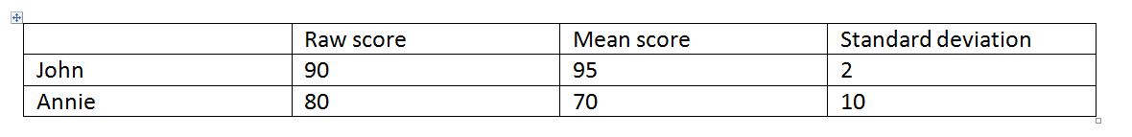
We need standard scores!
Z score is standardized score
Normality ← Norm
Norm = standard
Mean = 0 and SD = 1
Z = (raw score – mean score)/SD

Slide 26
Ungraded Exercise:
Calculate Z score
Hand calculation: Z = (raw score – mean score)/SD
Compute the z score of John: (90-95)/2=-5/2=-2.5
What is the z score of Annie?
Which person is a better student?

Slide 27
Exercise (Continue)
The mean of GRE score is 500 and the SD is 100.
My GRE score (raw score) is 587. What is my z score?
You can verify your answer at: https://www.socscistatistics.com/tests/ztest/zscorecalculator.aspx

Slide 28
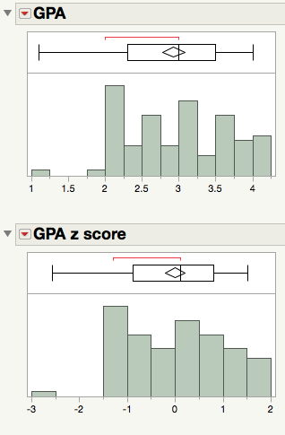
Z-score transformation
Myth: Transforming raw scores to z scores can turn a skew distribution to be a normal distribution.
The transformation to z scores does not change the shape of the distribution.
If the distribution of X is positively skewed, then the distribution of z scores computed from the X scores is also positively skewed.

Slide 29
Computation of John’s position
There are many online z calculator on the Internet:
http://davidmlane.com/hyperstat/z_table.html
https://homepage.stat.uiowa.edu/~mbognar/applets/normal.html

Slide 30
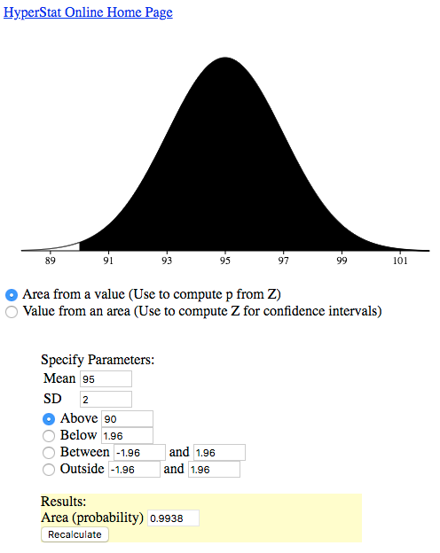
Computation of John’s position
Assume a normal distribution, I want to know how many students are ranked higher than John.
Actually 99.38% students outperform John!

Slide 31
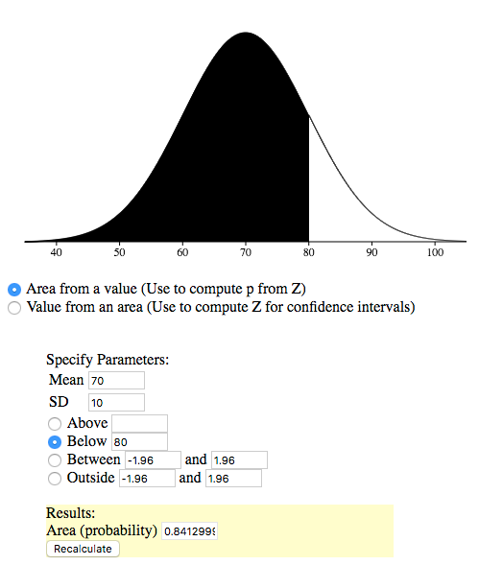
Computation of Annie’s position
I want to know how many students are outsmarted by Annie.
84.13%!

Slide 32
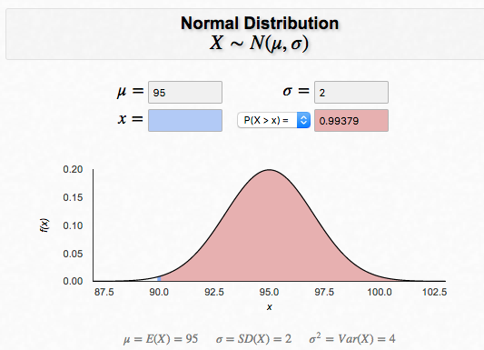
Computation of John’s position
μ is mean
σ is standard deviation
X is score
The same result: 99.38% students can do better than John!

Slide 33
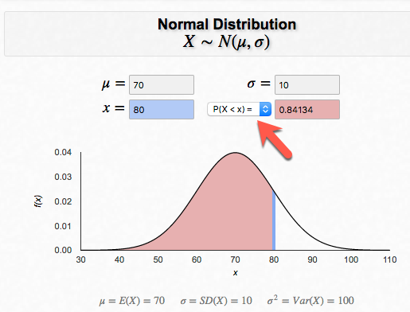
Computation of Annie’s position
Change p(X > x)= to P(X < x) = because we want to know how many students are worse than Annie.
84.13%

Slide 34
Assignment 4 (Canvas)
Use an online z to p calculator (NOT z score calculator).
Assume there is a normal curve. Sarah’s IQ is 140. How many people (in terms of percentage) in the general population does she outsmart? (Hints: The mean of IQ is 100 and the SD is 15).
Assume there is a normal curve. The mean is 75 and the SD is 5.3. What is the proportion of the students whose scored between 60 and 90?

