Slide 1
Unit 5
Correlation

Slide 2

Relationship
Just like it takes two persons to have a romantic relationship, you need at least two variables to form a statistical relationship.
A relationship can be shown by a plot or by a number.

Slide 3
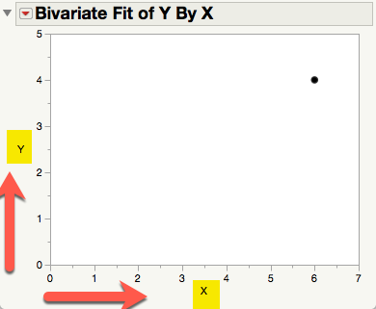
Scatterplot/Scattergram
The plot for displaying a bivariate relationship is called “scatterplot” or “scattergram” (Cartesian coordinate system).
The left-right (horizontal) direction is commonly called the X axis.
The up-down (vertical) direction is commonly called the Y axis..

Slide 4
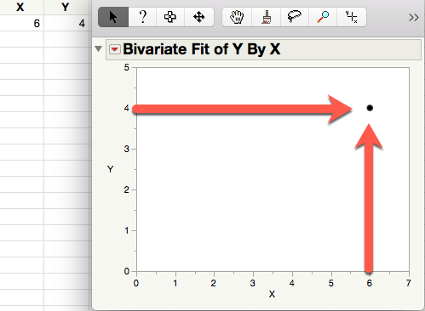
Scatterplot
When y = 6, the vertical line goes up by six units.
When x = 4, the horizontal line goes across 4 units.
The data point is put into the intersection of two lines.

Slide 5
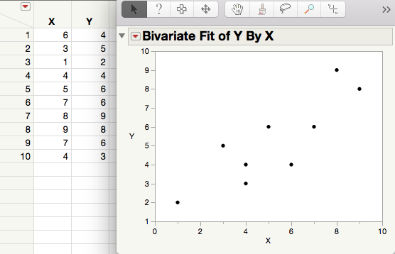
Scatter: Spread out
Variations in the data → Scatter everywhere

Slide 6
Different types of correlation coefficient
The number to show a correlation is called correlation coefficient.
Pearson’s r is applicable to measure the association between two continuous-scaled variables (Our focus).
Spearman is suitable to rank-order/ordinal data
We will go through the calculation later.

Slide 7
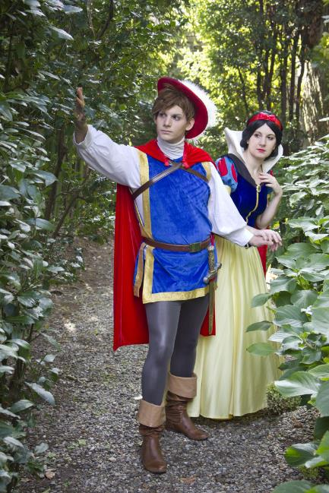
Pearson’s correlation coefficient
Range: From -1 to +1.
Pearson’s r = 1 → Perfect relationship (It may be too good to be true!)
Pearson’s r = 0 → No relationship
Positive but less than 1: Positive relationship
Negative but less than -1: Negative relationship
Common mistake: When the coefficient is high, it must be a strong relationship!

Slide 8
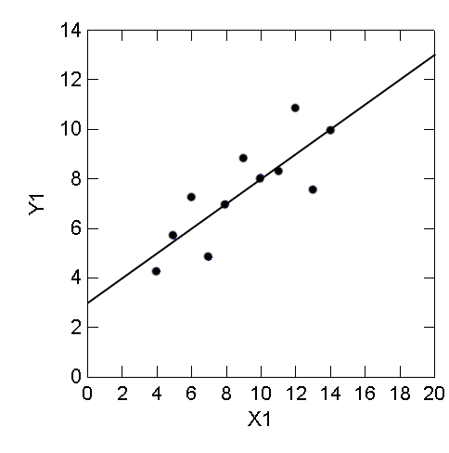
Pearson’s r = .83

Slide 9
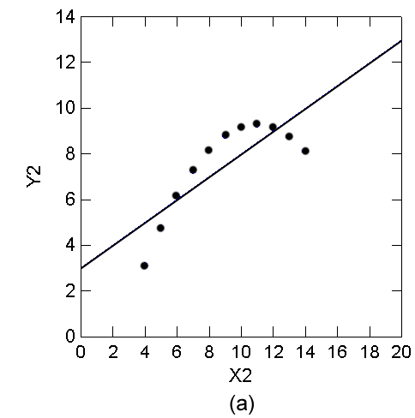
Pearson’s r =.83

Slide 10
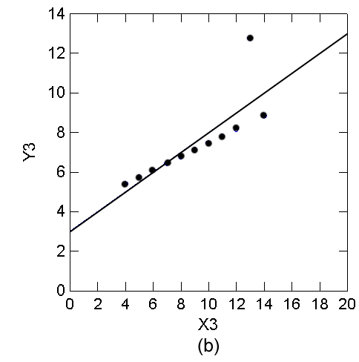
Pearson’s r =.83

Slide 11
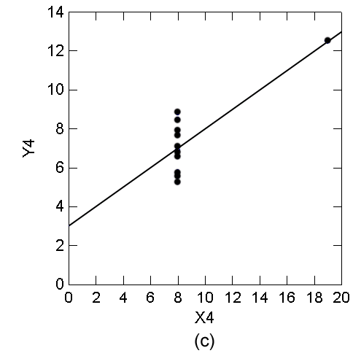
Pearson’s r =.83

Slide 12
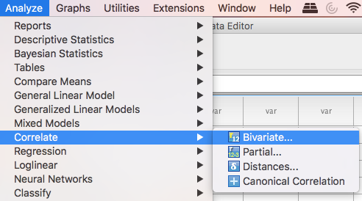
Computation in SPSS
Use visulization_data.sav in Unit 4
Analyze → Correlate → Bivariate

Slide 13
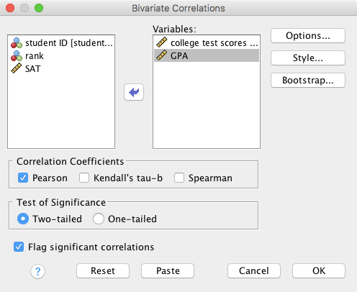
Computation in SPSS
There is no distinction between DV and IV.
Put both college test scores and GPA into variables.
The order doesn’t matter.
Press OK

Slide 14
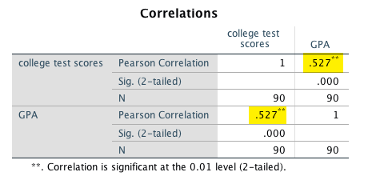
Computation in SPSS
The correlation of test scores and GPA = the correlation of GPA and test scores
Don’t worry about what “significance” (sig) means.

Slide 15

Confidence interval
Why do we need a bracket (Confidence interval) to estimate the population correlation coefficient? Because we cannot access to the entire population, we are not sure.
If you ask me to guess how old you are and I am not sure, I would also put my estimates within a bracket (interval). Because you are in college, I guess your age is between 18 and 22.

Slide 16
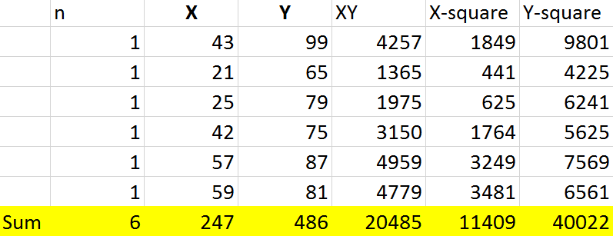
Semi-hand calculation
To make it easier and faster, use r_hand_calculation.xlsx

Slide 17
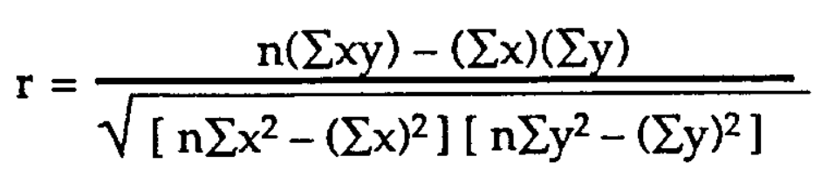
Semi-hand calculation
The Greek symbol Σ = Sum
Plug the numbers into the equation:
6(20,485) – (247 × 486) / [√[[6(11,409) – (247²)] × [6(40,022) – 486²]]] = 0.5298

Slide 18
Ungraded Exercise
Mary’s highs school GPA is 3.5 and her college GPA is 3.7. Tom’s HS GPA is 3.8 and his college GPA is 4.0. If these data are used for computing correlation, what result would you expect? Write down your expectation before making any computation. Next, use SPSS or JMP to compute the correlation coefficient. Does the result match your expectation? Is it a valid result? Why or why not?

Slide 19
Assignment 5 (Canvas)
Use visualization_data (Unit 4).
Compute the Pearson’s r of GPA and SAT. There is no distinction between DV and IV. You can put them in any order.
You can use SPSS, Excel (semi-hand calculation) or hand-calculation.

