Slide 1
What is randomness?
What is probability?
Chong Ho Yu, Ph.Ds.
Azusa Pacific University

Slide 2
Conventional definition
Typical textbook definition: Random sampling is a sampling process in which every member of the set has an equal probability of being selected.
It is true in an ideal world or a closed system.
But is it true in the empirical world?

Slide 3
Equal? Independent?
Phenomena appear to occur according to equal chances, but indeed in those incidents there are many hidden biases and thus observers assume that chance alone would decide.
Random sampling is a sampling process that each member within a set has independent chances to be drawn. In other words, the probability of one being sampled is not related to that of others.

Slide 4
I want a prize! Equal chance?

Slide 5

Examples of bias tendency
Throwing a prize to a crowd
Putting dots on a piece of paper
Drawing a winner in a raffle
Not everyone has an equal chance!

Slide 6
Is it truly random (equal chance)?
I am a quality control (QC) engineer at Intel. I want to randomly select some microchips for inspection. The objects cannot say “no” to me.
When you deal with human subjects, this is another story. Suppose I obtain a list of all students, and then I randomly select some names from the list.

Slide 7
Is it truly random (equal chance)?
Next, I sent email invitations to this “random” sample. Some of them would say “yes” to me but some would say “no.”
This “yes/no” answer may not be random in the conventional sense (equal chance). If I offer extra credit points or a $100 gift card as incentives, students who need the extra credit or extra cash tend to sign up.
Self-selection → convenience sampling

Slide 8
Changing population
Assume that your population consists of all 1,000 adult males in a hypothetical country called USX.
I want to select 2 participants.
Based on the notion that randomness = equal chance, the probability of every one to be sampled is 2/1000, right?
But the population is not invariant! Every second some minors turn into adults and every second some seniors die.
The probability keeps changing: 2/1011, 2/999, 2/1003, 2/1002…etc.

Slide 9
Raffle again
I want to give away three gift cards to students.
There are 20 tickets in the bag.
Does everyone has equal chance? 3/20?
Assume sampling without replacement (Once the name is drawn, you don’t put it back into the bag)
  First ticket: 1/20
  Second ticket: 1/19
  Third: 1/18

Slide 10
What if the population is fixed?
Assume that we have a fixed (finite) population: no baby is born and no one dies. The population size is forever 1,000.
I want to select 5 participants, but not in one-sitting.
When I select the first subject, the probability is 1/1000 (sampling without replacement).
When the second subject is selected, the probability is 1/999.
Next, the p is 1/998…etc.
How could it be equal chance?

Slide 11

Future samples?
McGrew (2003): A statistical inference based upon random sampling, by definition implies that each member of the population has an equal chance of being selected. But one cannot draw samples from the future. Hence, future members of a population have no chance to be included in one’s evidence; the probability that a person not yet born can be included is absolutely zero. The sample is not a truly random.
This problem can be resolved if random sampling is associated with independent chances instead of equal chances.

Slide 12
Statistics is tied to probability.
Random sampling is about “chance”, which means probability.
Statistics is partial and incomplete information based on samples. Whenever there is uncertainty, the statistical conclusion is a probabilistic inference. But, there are several important questions:
  Is probabilistic inference the best or the only way?
  What is probability? Are there diverse perspectives to probability?

Slide 13
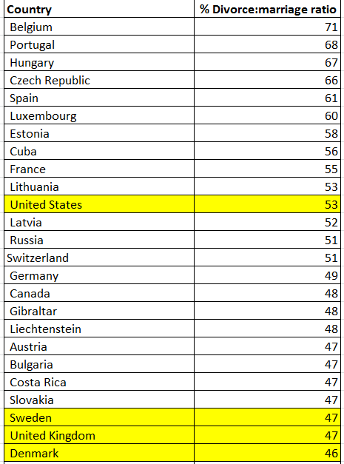

Slide 14
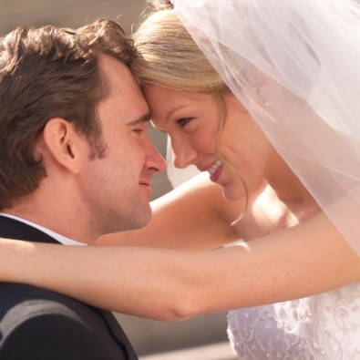
Statistical Reasoning
Mr. X and Miss Y just got married. Their statistician friend Dr. Statistics says, "According to previous data, the divorce rate in the US is 53%. Thus, this couple has 53% chances that they will divorce."
Their philosopher friend Dr. Human says, "You should not judge people by a probabilistic model. You should judge X and Y based upon what you know about them. They are our friends! You know that they are mature people and the chances that they will divorce is almost zero! Your approach is mechanical and formulaic."
Who is right?

Slide 15
Probability models
In many textbooks, the concept of probability, which is the foundation of statistical reasoning and methods, is presented as one single unified theory. Actually, throughout history there are many different schools of probability

Slide 16
Direct probability
Dr. Statistics views Mr. X and Miss Y as members of a super-population, "the entire American population."
The event "divorce" is a member of a super-set, "all marriages in America." In other words, Dr. Statistics treats Mr. X and Miss Y as everybody else.
In the direct probability model, it is assumed that every event of the set is equi-probable and probability is derived from a statistical law governing the given population. Based on these premises, the probability of getting divorce is said to be 53%.

Slide 17
Bayesian probability
Someone may argue that it is unfair to judge this couple by the membership "American." Besides citizenship, there are many other dimensions in their lives. For instance, there are Asian Americans (race), Evangelical Christians (religion), middle class (social-economic status), master's degree holders (education), and Republicans (political orientation).
Does this supplementary information change their probability of getting divorce? The Bayesian probability model uses new information as evidence. Even if there is no empirical divorce rate for those sub-populations, one can introduce subjective probabilities into the model

Slide 18
Modes of reasoning
Dr. Statistics and Dr. Human apply two different ways of reasoning. The former approach is called statistical reasoning or probabilistic reasoning while the latter one is rational reasoning or reasoning by direct evidence.

Slide 19
Conditional probability (Given X what is the probability of Y?)
Wilcox and Williamson (2007) pointed out that protestants who attend church on a regular basis are 35% less likely to divorce compared to secular couples. But nominally attending conservative Protestants are 20 percent more likely to divorce.
Initially Wright and Stetzer’s (2010) found that Christians have a divorce rate of about 42%. But worship attendance is a crucial predictor of divorce. To be more specific, Six in ten evangelicals who never attend church had been divorced or separated, compared to 38% of weekly attendees.

Slide 20

Statistical reasoning
In statistical reasoning, the judgment is made with reference to a class.
Almost everyone applies statistical reasoning to some degree. For example, you pay higher car insurance premiums than me. Why?

Slide 21


No matter what the statistics indicates, many people refuse to be identified as a member of a certain reference class.
For example, when I talked to parents about the problem of lowering academic standard in American schools, many of them admitted the problem but also claimed that their children are exceptionally bright.
Someone says, "Well, 97 percent of American high school students have above average academic performance!"

Slide 22


This "above-average fallacy" is a common blind spot and thus sometimes we cannot trust individual information. In a study when the researcher asked the female participants to estimate the probability of being attacked if a woman walks alone in the Central Park, New York, most subjects reported a relatively high probability. But when the question was reframed to "how likely that YOU will be attacked," the estimated probability became much lower

Slide 23

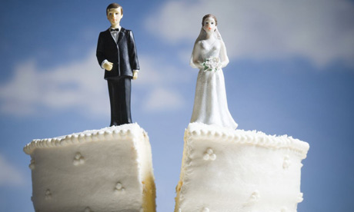

“Statistics and probability are irrelevant to me! Someone else will divorce, but not me!”
The Clark University Poll of Emerging Adults reported that over eighty percent of people between the ages 18 to 29, including both single and married, expected that their marriages will last a lifetime.
Amato and Hohmann-Marriott (2007) found that about half of the people who divorced within 6 years of marriage, reported to have a high degree of marital happiness before divorcing and also had a low projected likelihood of divorce.

Slide 24
Big questions
Is probabilistic inference the best or the only way?
What is probability? Are there diverse perspectives to probability? If so, which one is right?
At the end of the day, we can see that there isn’t a single best answer.
But for the sake of computation, we would adopt the conventional way by seeing probability as: events that happen/all events in the long run. There are two simple rules only.

Slide 25
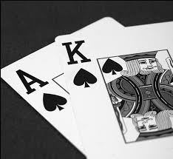
Addition rule
Even A or event B (they are not mutually exclusive): Probability of A + probability of B
I randomly draw a card from a stack of poker. What is the chance that the card is a “A” or a “K”.
4/52 + 4/52 = 8/52.

Slide 26
Multiplication rule
Multiplication rule
Event A and Event B (They are independent): Probability of A X probability of B.
I parked my car in a parking lot, in which the maximum time is 3 hours. The patrol used a chalk to put a mark the front and the rear tires of each vehicle there. Three hours later the patrol found that the chalk marks on my tires remained at the same position, and therefore he gave me a ticket.

Slide 27

Multiplication rule
I appealed to the court by offering the following explanation: Two hours after I parked my car, I moved my car out. And then I returned the car to the same spot. I didn’t violate the law.
What would the judge say?

Slide 28
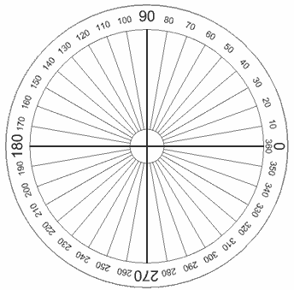

Ungraded in-class exercise
You are the judge. Can you find out the probability that I pulled the car out, returned to the same position, and the chalk marks remained the same?
Hints: There are two solutions.

Slide 29
Assignment 7
Read the question on Canvas
Form a small group of 3-5 people. There is no right or wrong answer. Although this is a group discussion, you need to submit an individual essay.

