Slide 1
Hypothesis testing
Chong Ho Yu

Slide 2
Class activity: What is hypothesis?
Form a small group of 3-5 people.
Use Google and APU library to look for the definitions of scientific hypothesis
Collect three or more definitions
Discuss the strength and weakness of each.
Present your finding in class

Slide 3
Null and alternate hypotheses
Null hypothesis: No difference, no effect, no relationship. e.g.
  There is no significant difference between the control and the treatment groups in test performance.
  There is no significant treatment effect on the students.
  There is no significant relationship between the treatment program and student performance.
Alternate: Opposite to null. e.g. there is a significant difference; there is a significant relationship

Slide 4
Alpha and direction
Alpha level: Critical probability level—0.1, 0.05, 0.01
Directional hypothesis: The treatment by Professor Yu will improve your test performance in Applied Statistics (one-tailed test).
Non-directional: The treatment by Professor Yu will make a difference in your test performance in 299. It could be better or worse (Two-tailed test).

Slide 5
Cannot "prove" the hypothesis
Usually what we want to know is: given the data how likely the hypothesis, the model, or the theory is correct? It can be written as: P(H|D). However, the logic of hypothesis testing is: Given the null hypothesis how likely we can observe the data in the long run? It can be expressed as: P(D|H).
  If the hypothesis is right, then we should observe such and such data.
  We got the data as expected!
  We prove the theory! Ha! Ha!

Slide 6
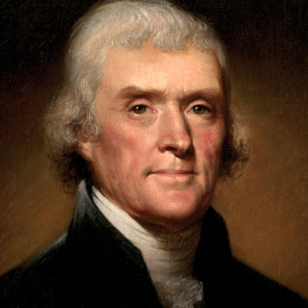
Cannot "prove" the hypothesis
If Thomas Jefferson was assassinated, then Jefferson is dead.
Jefferson is dead.
Therefore Jefferson was assassinated.
If it rains, the ground is wet.
The ground is wet.
It must rain.

Slide 7
Cannot "prove" the hypothesis
We can reject or fail to reject the null hypothesis. At most we can say that we either confirm or disconfirm a hypothesis.
There is a subtle difference between "prove" and "confirm." The former is about asserting the "truth" but the latter is nothing more than showing the fitness between the data and the hypothesis (theory).

Slide 8
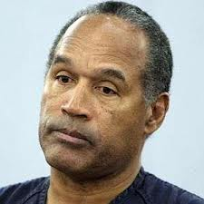
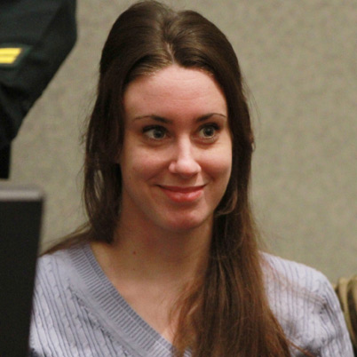
Cannot "prove" the hypothesis
In the O. J. Simpson case or the Casey Anthony's case, there is not enough evidence to convict the suspect, but it doesn't mean that we have proven the otherwise.
By the same token, failing to reject the null hypothesis does not mean that the null is true and thus we should accept it. At most we can say we fail to reject the null hypothesis.

Slide 9
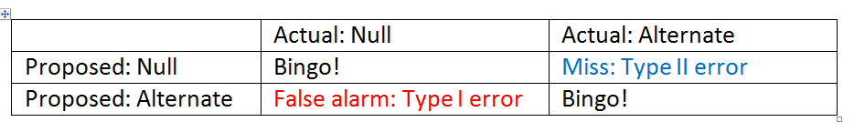
Balancing
Type I and Type II errors
In most cases the logic of null hypothesis testing follows the principle of "presumed innocence until proven guilty".

Slide 10
Precautionary principle
However, in public health it is often trumped by the precautionary principle, which states that if an action could potentially causing harm to the public or to the ecology, without scientific consensus, the burden of proof that it is not harmful is on the shoulder of the party taking the action.
In other words, the precautionary principle prefers "false alarm" (Type I) to "miss" (Type II).

Slide 11
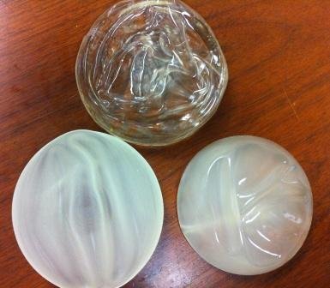
Silicone breast implants
Please do not Google.
Silicone breast implants have been commonly available since 1963, and Dow Corning was the major chemical company that manufactures silicone gel.
But after some women who received the implant complained that they were very ill and the possible cause was the silicone gel.

Slide 12

Silicone breast implants
As a precautionary measure, the FDA banned all silicone breast implants from 1992-2006. It is important to point out that the FDA did not have evidence to indicate that silicone breast implants are unsafe; rather, it demanded the evidence to ensure its safety.

Slide 13
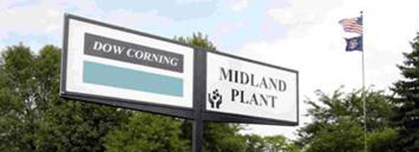
Silicone breast implants
It triggered a massive flood of lawsuits against Dow Corning. In 1993 Dow Corning lost more than $287 million.
Dow Corning was under Chapter 11 protection from 1993-2004.

Slide 14
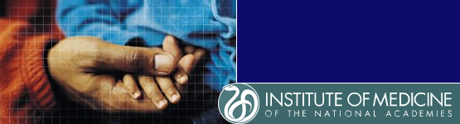
Silicone breast implants
Later many independent scientific studies, including the one conducted by U.S. Institute of Medicine (IOM), found that silicone breast implants do not seem to cause breast cancers or any fatal diseases.

Slide 15
Ungraded Class Discussion
Dow Corning's reputation had severely damaged, almost beyond redemption.
Form a small group of 3-5 to discuss the following question: Do you support “presumed innocence until proven guilty” or “precautionary principle”?

Slide 16
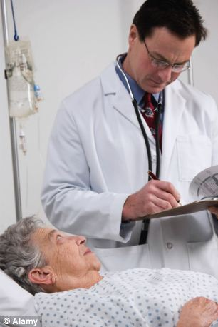
Not clear-cut
If a Type I error (false claim) is made and we jump into the conclusion that a new drug is safe, people will die.
If a life-saving drug is not approved because of a Type II error (miss), people will die, too, because they didn’t have access the the drug.

Slide 17
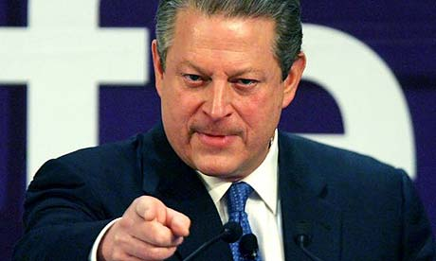
Review of Null, alternate, Type I and Type II
Null: Excessive CO emission does not cause global warming (climate change)
Alternate: Excessive CO emission causes global warming (climate change)
Type I error: False alarm, the null is right
Type II error: Miss, the alternate is right
Should you believe in the null or alternate? Which error (Type I and Type II) is more serious?

Slide 18
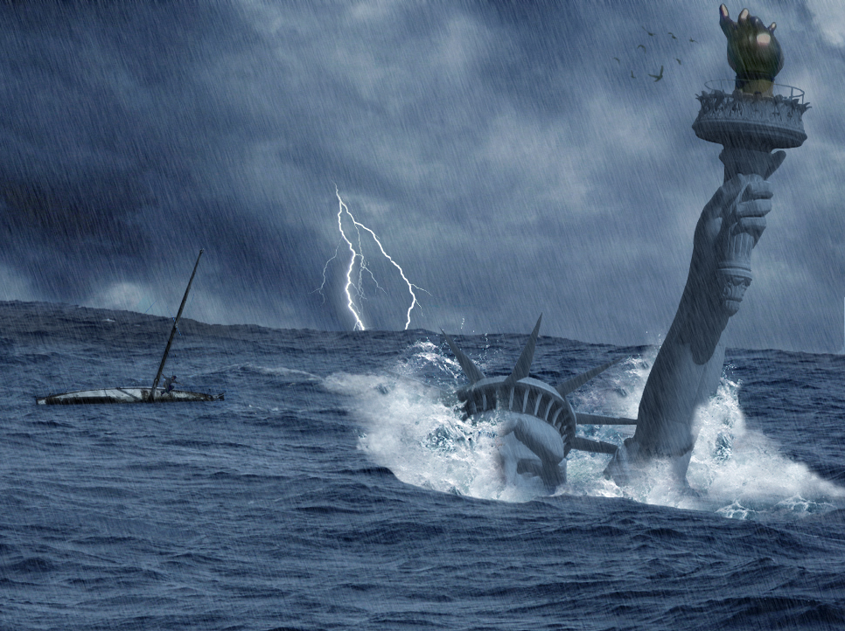
Consequence
Consequence of Type I: There is no climate change or CO emission does not lead to climate change. All investments in alternate energy are misdirected.
But we might have alternate energy sources that are greener and cleaner. The air quality will be better in big cities.

Slide 19
Consequence
Consequence of Type II: Global warming is real and CO emission is the cause. Sea level rises and coastal cities, including LA and New Orleans, are under water.

Slide 20

Null: There is no God and no afterlife.
Alternate: God and afterlife are real.
Type I error: False alarm, the null is right
Type II error: Miss, the alternate is right

Slide 21
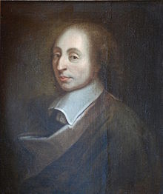
Pascal Wager
If you don't believe in God and you're right (There is no God), you earn nothing
If you don't believe in God but you're wrong (God is real), you lose everything.
If you believe in God and you're right, you win the eternal life.
If you believe in God but you're wrong, there is nothing to lose.

Slide 22
Hypothesis testing result
Two options only: null or alternate
The answer is dichotomous: reject the null or not to reject the null
But, is the real world as simple as black and white only?
The answers may be: “The treatment works for one population, but not for another.” “The construct is a continuum. The difference is not clear-cut.”

Slide 23
Faith integration
Some critics use “scientific methods” (e.g. hypothesis testing) to reject religion.
Did they correctly employ hypothesis testing or scientific methods?

Slide 24
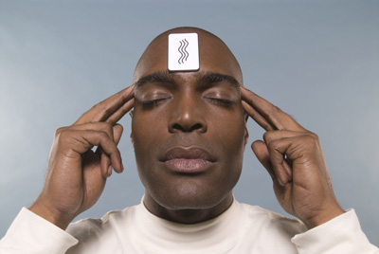
Null hypothesis:
Burden of proof?
American skeptic Michael Shermer used null hypothesis testing to challenge many extraordinary and supernatural claims.
The null hypothesis is a statement assuming that the claim is untrue.
For example, if a psychic claims that he can use extra-sensory perception to foresee the color of a card randomly drawn from a stack of pokers, our default position should be: there is no ESP. The burden of proof is on the shoulder of the psychic.

Slide 25
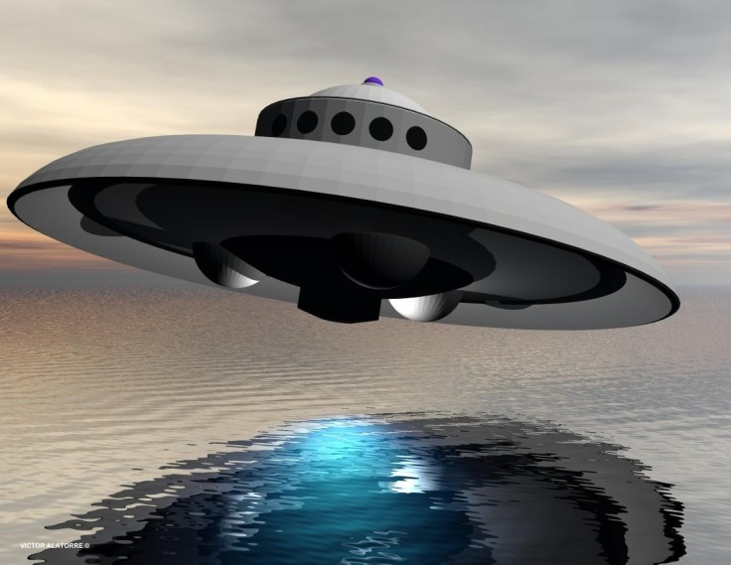
Null hypothesis: Burden of proof?
If someone insists that UFO and aliens had visited the earth, the burden of proof is on the people making the assertion. We should not believe in the existence of UFO or aliens unless we see strong evidence.

Slide 26
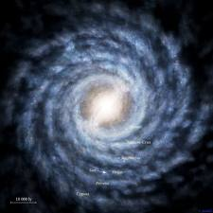
Argument against religion
Shermer applies the same argument into religion. This is a classic philosophical question: Why is there something rather than nothing? Why is there a universe? Why do we exist?
The theist’s answer to the question is that God existed before the universe and subsequently created it out of nothing.

Slide 27
Argument against religion
Shermer argues that this is the wrong question. Asking this question presumes “nothing” is the natural state of things and when there is something, we need an explanation. But maybe “something” is the natural state of things and “nothing” would be the mystery to be solved.

Slide 28
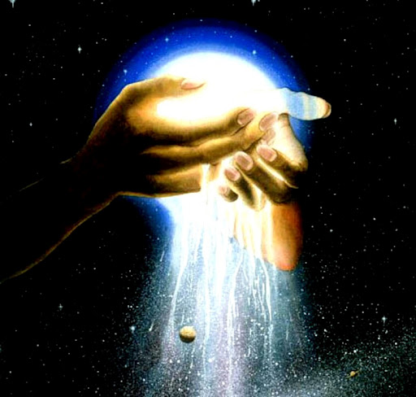
What is the default position?
Shermer cites physics to assert that there must have something because something is more stable than nothing.
Our default position should be accepting that nothing could happen spontaneously. God created something out of nothing is an extraordinary claim and we should see it as opposed to the null hypothesis. The burden of proof is on the shoulder of Christians.

Slide 29
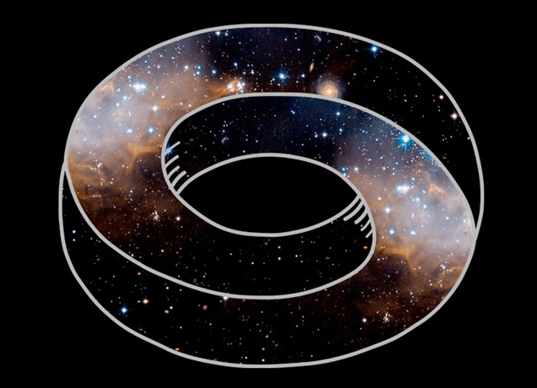
Cycle of Big bang/big collapse
Cycle: Cosmologist Sean Carroll suggests that our universe may be just one in a series of boom-and-bust cycles of expansion and contractions of the universe. Therefore there is no beginning of our universe and there is no God’s creation.

Slide 30
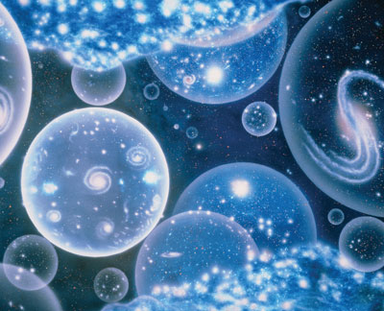
Multiverse
Multiverse: There could be many universes and each of them has a different set of natural laws. By chance our universe has a set of natural law that makes the earth suitable for humans to live.
Shermer said that some people may argue where the multiple-universe comes from. Scientists cannot explain the origin of multiple-universe, but theologians also cannot tell us who created God.

Slide 31
Extra-ordinary claims
Claiming that our universe is one in a series of boom-and-bust cycles of expansion and contractions of the universe is extraordinary. Saying that there are multiple universes is also a very profound proclamation.
The null hypothesis should be: there is no expansion and contraction cycle in the universe; there is no multiple-universe. My default position should be disbelieving in these theories until seeing very strong evidence.

Slide 32
Limitation of science
David Brewster (1781-1868) was a scientist living in the 18th to 19th century, but he knew the limitation of a theory/hypothesis: "The power of a theory … to explain and predict facts is by no means a test of its truth. …"
—David Brewster, “Observations on the Absorption of Specific Rays, in Reference to the Undulatory Theory of Light”

Slide 33
PHD and PDH
According to the likelihood principle, the probability of the observed data given the hypothesis [P(D|H)] is not the same as the probability of the hypothesis given the observed data [P(H|D)].
The former is about likelihood, while the latter is concerned with probability. For example, Let H be the hypothesis, “There are gremlins in the attic, and they make noise.” It means that if there actually were gremlins in the attic, we would expect to hear noise. In this case, P(D|H) is very high.
However, if we hear noise in the attic and guess that the noise is from gremlins, this case is P(H|D). This probability is not high at all because the noise could be from something else.

Slide 34
we CANNOT prove the hypothesis
Hypothesis testing cannot answer the question that we can want to solve: Given the data, how likely the model is correct? Rather, the logic is: Given the null is true, what is the probability of observing the data at hand? In other words, the logic of testing the null hypothesis is like: If H, then D. We can say -D --> -H (not D and so not H). But we CANNOT say D --> H.

Slide 35

we CANNOT prove the hypothesis
We CANNOT prove the hypothesis. To be specific, we can utilize the transposition rule of inference in classical logic to make this conclusion: C implies E, Not-E must also imply Not-C.
If it's raining outside, then the streets must be wet. If the streets are not wet, then it is not raining outside.
However, we can never say: the streets are wet. So it must be raining.

Slide 36
Assignment 8
Read the question on Canvas.
If you work alone, everything makes perfect sense to you. One of the objectives of team discussion is to let you appreciate diverse perspectives.
There is no right or wrong answer. Your grade depends on your reasoning process, not the “right” answer.

