Slide 1
Power analysis
Chong-ho Yu, Ph.Ds.

Slide 2

What is Power?
Researchers always face the risk of failing to detect a true significant effect. It is called Type II error, also known beta.
In relation to Type II error, power is define as 1 - beta.
Statistical power is the probability of detecting a true significant difference.

Slide 3
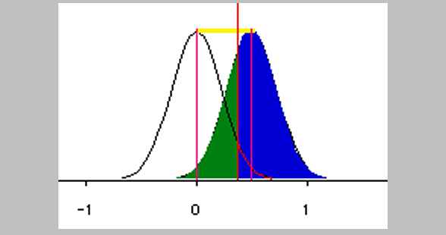
Factors
Power is determined by the following:
  Effect size
  Sample size
  Alpha level
  Direction (one or two tailed)

Slide 4
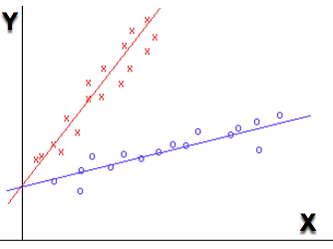
Effect size
The distance between the null and the alternate (how far away from zero?)
In regression, no effect = zero slope (flat line).
Red line: A very steep slope = stronger effect
Blue line: weaker effect → big increase of X (run) would lead to small increase of Y (rise).

Slide 5
Alpha level
The cut-off of the probability for determining whether there is a significant effect.
.1, 0.05, 0.01; Most common: 0.05 (5%)
Smaller is better
If I tell you I can correctly predict the gender of a randomly selected student, the probability that I am right by guessing is 50%. What a big deal!?
If I can correctly predict the numbers of the next Powerball, the probability that I am right by guessing is .0000000000001. I must have super power!

Slide 6
Alpha level
If most of my students can increase the test score by 50% after using my treatment, the probability that I achieved this result by luck might be as small as .05.
If the probability (p value) yielded from a statistical test for my treatment matches the alpha level (.05) or even lower, then I can declare that my treatment really works (significant), not due to dumb luck.

Slide 7


Direction of the test
Non-directional hypothesis (two-tailed test): My treatment would make a difference on your face (It could be better or worse)
Directional hypothesis (one-tailed test): My treatment would make things better.

Slide 8
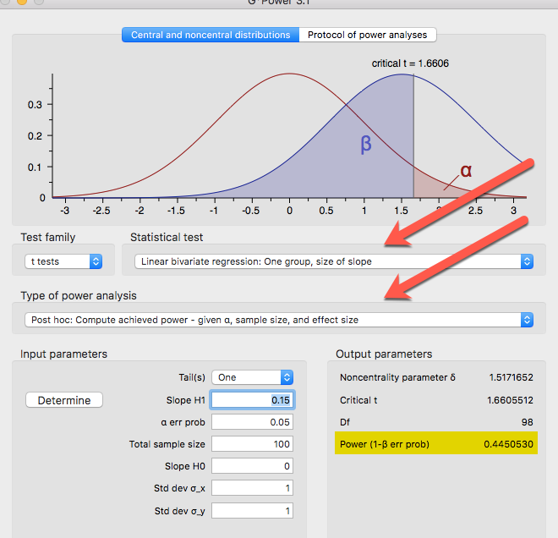
G*power

Slide 9
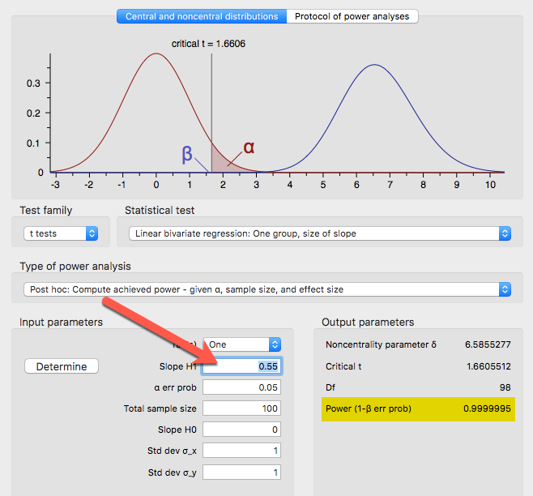
Larger effect size → Larger power
Bigger slope means bigger effect (stronger relationship between X and Y)
When the effect size (ES) increases from .15 to.55,, power increases from .44 to .99.

Slide 10
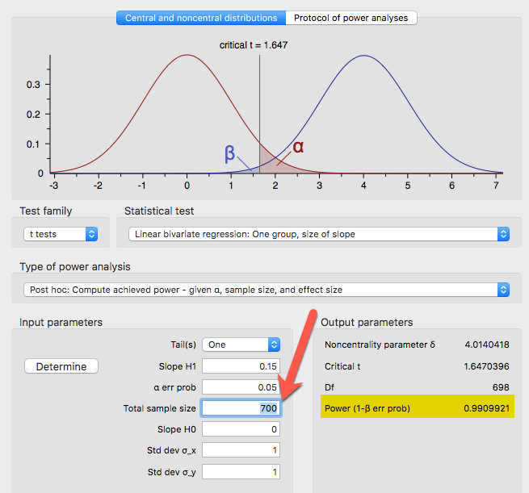
Larger sample size → Larger power
Revert ES to .15.
Change the sample size to 700.
When the sample size increases from 100 to 700, power increases from .44 to .99.

Slide 11
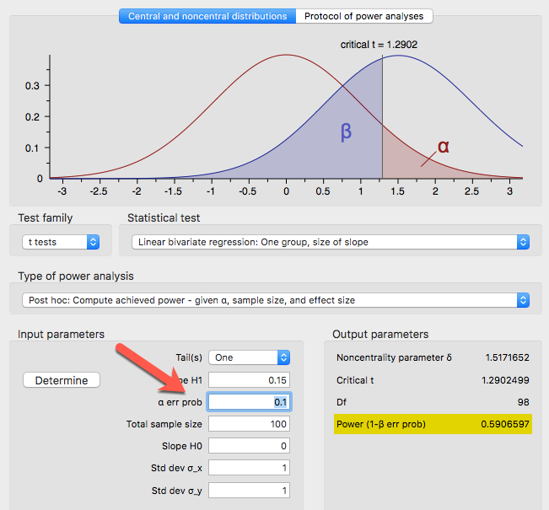
Larger alpha level → Larger power
Revert the sample size to 100
Change the alpha level to .1.
When the alpha level increases from .05 to 1, power increase to .59.
Caution: Don’t change the alpha level unless you have a good reason.

Slide 12
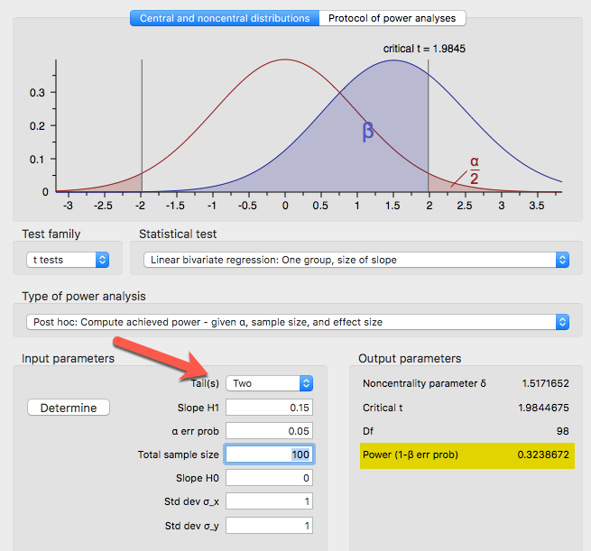
Two-tailed → smaller power
Revert the alpha level to .05.
Change the number of tails from 1 to 2.
When the test is two-tailed (non-directional) instead of one-tailed (uni-directional), power decreases from .44 to .32.

Slide 13

Absolute power, corrupt absolutely
Absolute power, corrupt (your research) absolutely i.e.
When the test is too powerful, even a trivial difference will be mistakenly reported as a significant one.
You can confirm virtually anything (e.g. Chinese food can cause cancer) with a very large sample size. This type of error is called Type I error (false claim).

Slide 14
Large sample → Over-power
In California the average SAT score is 1500.
A superintendent wanted to know whether the mean score of his students is significantly behind the state average.
  50 students,
  Average SAT score =1495
  Standard deviation is 100
  one-sample t-test yielded a non-significant result (p = .7252, over the alpha level .05)
The superintendent was relaxed and said, “We are only five points out of 1600 behind the state standard. This score difference is not a big deal.”
https://www.graphpad.com/quickcalcs/OneSampleT1.cfm?Format=SD

Slide 15
performance gap
But a statistician recommended replicating the study with a sample size of 1,000. As the sample size increased, the variance decreased. While the mean remained the same (1495), the SD dropped to 50. But this time the t-test showed a much smaller p value (.0016) and needless to say, this “performance gap” was considered to be statistically significant.
Afterwards, the board called for a meeting and the superintendent could not sleep. Someone should tell the superintendent that the p value is a function of the sample size and this so-called "performance gap" may be nothing more than a false alarm.

Slide 16
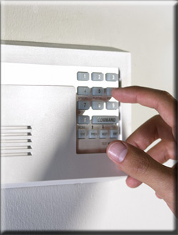
A balance
Power analysis is a procedure to balance between Type I (false alarm) and Type II (miss) errors. Simon (1999) suggested to follow an informal rule that alpha is set to .05 and beta to .2.
Power is expected to be .8. This rule implies that a Type I error is four times as costly as a Type II error.

Slide 17
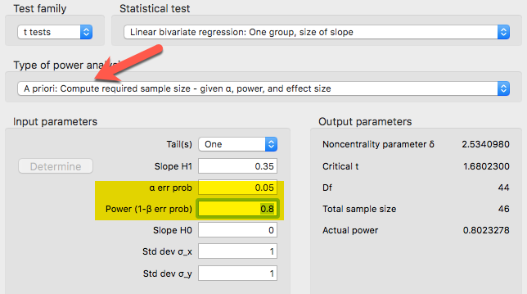
A priori power analysis

Slide 18

Practical power analysis
Muller and Lavange (1992) asserted that the following should be taken into account for power analysis:
  Money to spent
  Personnel time of statisticians and subject matter specialists
  Time to complete the study (deadline and opportunity cost)

Slide 19
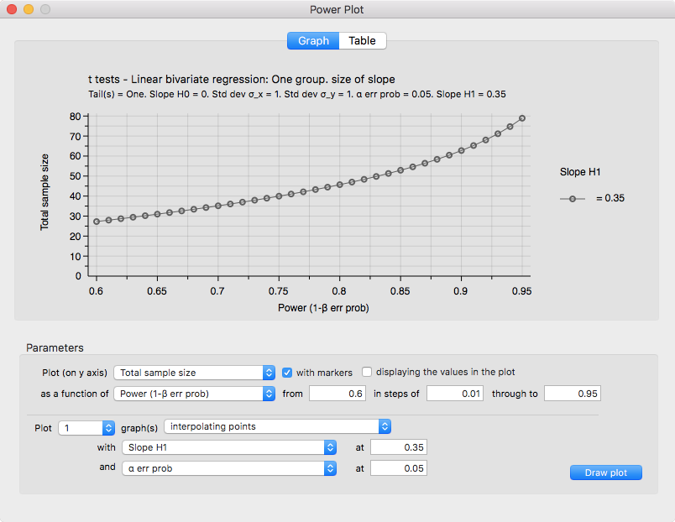
Power plot to determine the sample size

Slide 20

Post hoc power analysis
In some situations researchers have no choices in sample size. For example, the number of participants has been pre-determined by the project sponsor. In this case, power analysis should still be conducted to find out what the power level is given the pre-set sample size.

Slide 21
Ungraded exercise
A priori power analysis: You are going to conduct a study to find out how high school GPA can predict college test performance. Given that the desired power is .8, the effect size (slope) is .25, the alpha level is .05, and the test is 2-tailed, how many subjects do you need?
Post hoc power analysis: You are given a data set. The sample size is 500 and all other settings are the same as the above. What is the power level? Is it OK to proceed? Why or why not?

Slide 22
Assignment 9
Read the question on Canvas.
Although this is a group discussion, you need to submit an individual essay.

