Slide 1
Sampling distribution of the means and standard error
Chong Ho Yu, Ph.D.

Slide 2
Review: Probability
One of many views: target events / all events
10,000 applicants and 100 were accepted:
p = 100/10000 = 1% or .1
Assumption: The same event can repeat over and over in the long run.
What is long run? How long is long?
Infinite! (In theory only)

Slide 3
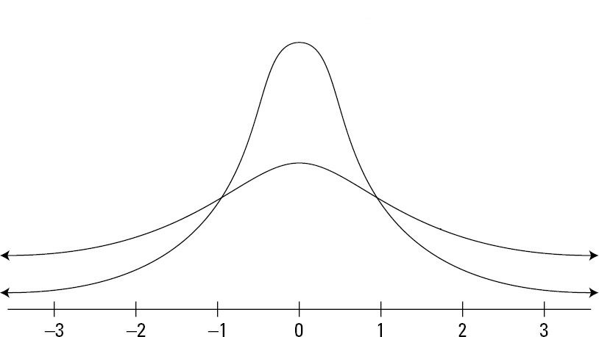
Sample of samples
The sampling distribution of the mean
  We draw a sample from the population.
  Obtain the statistics (e.g. mean) and then put the sample back.
  Do it again and again, then we have the sampling distribution of the sample means.
  In theory we can repeat the process forever. The two tails of the sample distribution curve should never touch down.

Slide 4
Sampling distributions
Sampling distribution is theoretical, NOT empirical, though we use simulations to illustrate the concept.
Sampling distribution can be about any test statistics. It is no necessarily about the mean only. But it is common to use the mean for illustration.

Slide 5
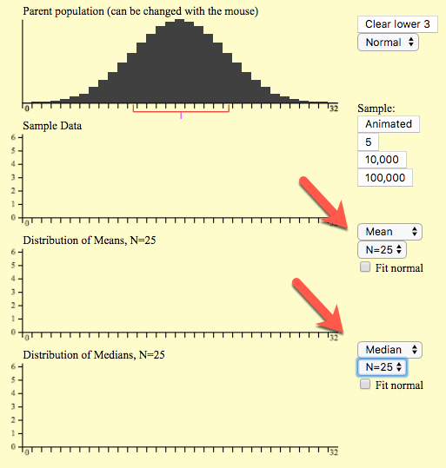
Class activity
Go to http://onlinestatbook.com/stat_sim/sampling_dist/index.html
Click begin
Choose Mean and N = 25 for the middle panel.
Choose Median and N = 25 for the bottom panel.

Slide 6
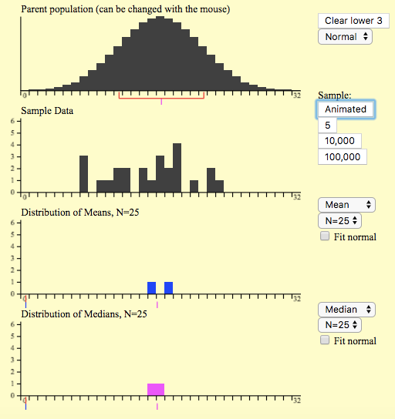
Class activity
Click animated.
Click animated again.
What do you see?
Can you explain what is going on?
Caution: Sample size and the number of samples are different. In this example you have 2 sample and each sample size is 25.

Slide 7
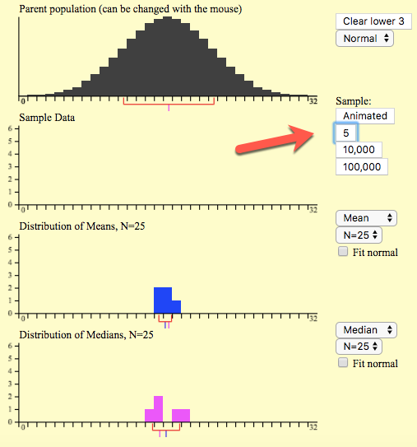
Class activity
You can manually add more means and medians into the graphs.
To speed up the process you can click ”5,” which means select 5 samples and each consists of 25 subjects.
Now what do you see?

Slide 8
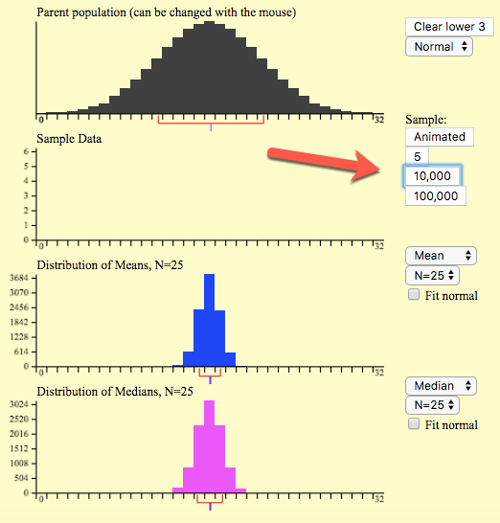
Class activity
Probably 5 samples are not enough to make a normal distribution.
Now choose 10,000 sample.
What do you see?
Next, choose 100,000
Check “Fit normal”
What do you see?

Slide 9
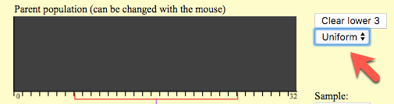
Class activity
Press Clear lower 3
Choose a uniform population
Repeat the same process by clicking on 10,000 samples.
Check Fit Normal.
Now what do you see?

Slide 10
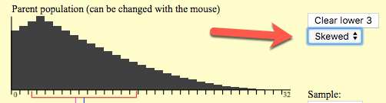
Class activity
Press Clear lower 3
Choose a skewed population
Repeat the same process by clicking on 10,000 samples.
Check Fit Normal.
Now what do you see?

Slide 11
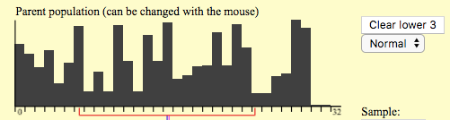
Class activity
Press Clear lower 3
You can use your cursor to “paint” a customized population.
Click on 10,000 samples.
Check Fit Normal
Now what do you see?

Slide 12
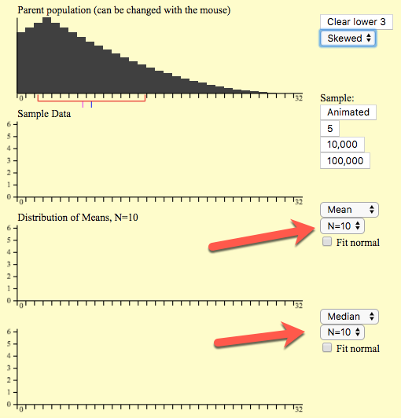
Class activity
Go back to the skewed population.
Now reduce the sample size from 25 to 10
Click 10,000 samples.
Check Fit normal
What do you see?

Slide 13
Class activity
Next, reduce the sample size to 5
Click on 10,000 samples.
What do you see?
Reduce the sample size to 5 and click on 10,000 sample.
Check Fit normal.
What do you see?

Slide 14
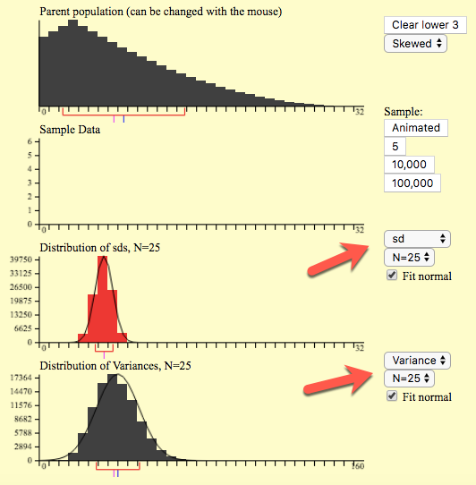
Class activity
Change the statistics of the lower 2 panels from mean and median to SD and variance.
Change the sample size to 25
Click on 100,000 samples.
Check Fit Normal.
What do you see?

Slide 15
Central Limit Theorem (CLT) and sampling distributions
No matter how messy or noisy the population is, the end result is always a normal sampling distribution!
Common myth 1: Sampling distribution is about the mean.
Fact: A sampling distribution can be constructed by any test statistics (e.g. median, SD, variance), not just the mean.
Common myth 2: You need at least 30 subjects to create a normal sampling distribution.
Fact: You can use much fewer subjects!

Slide 16

The bridge
The sampling distribution is the bridge between the sample and the population, or between the descriptive statistics and the inferential statistics.
CLT states that a sampling distribution becomes closer to normality as the sample size increases, regardless of the shape of distribution.
CLT is central to large sample statistical inference and is true by limitation--it is true given that the sampling distribution is infinite.

Slide 17
Common myth 3
Many people don’t know that hypothesis testing is based upon infinite sampling distributions, NOT the population distribution.
Sample size determination is mistakenly viewed as being based upon the ratio between the sample and the population.

Slide 18
Faith integration
Can you see divine providence in Central Limit Theorem?

Slide 19

Nassim Taleb
In the book “Fooled by randomness” Taleb asserted that many phenomena in the world happen randomly.
But we impose structure on it.

Slide 20

Leonard Mlodinow
Prominent physicist
His parents were both Holocaust survivors. His father was a leader in the Jewish resistance under Nazi rule in Poland.
When Nazi troops took over her mother’s home town, they randomly executed Jews. Her mother survived. Did it happen at random or due to a divine purpose? If God saved his mother, what would we say to those who were massacred?

Slide 21

Jesses Bering
The Belief Instinct: The Psychology of Souls, Destiny, and the Meaning of Life
A thief was eaten by a crocodile when he attempted to escape by jumping into a pool.
A criminal who was just released from the prison hit the jackpot in a casino.
Good things happen to both good and bad people
Bad things happen to both good and bad people
All things are random, but humans tend to find a pattern or a purpose in random events

Slide 22
Is the sequence random?
100111100110111001101
100111100110111001101100111100110111001101100111100110111001101

Slide 23

Short run vs. long run
Argentine-American mathematician and computer scientist Gregory John Chaitin: any attempt to decide the randomness of a sufficiently long binary string is inherently doomed to fail.

Slide 24
Short run vs. long run
The goal of statistics is to examine whether something happens at random (by chance alone) or has a systematic pattern
But it is unable to detect randomness or patterns in the short run

Slide 25
Short run vs. long run
Something appears to be random and purposeless to us because we, as finite human beings, can only observe the data in a short run.
A pattern can emerges in the long run.
Central limit theorem tells us that there is a hidden cosmic order!

Slide 26
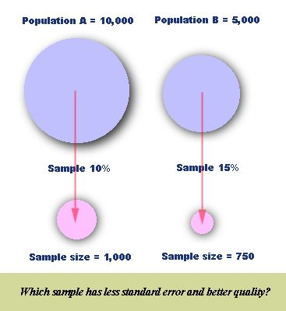

Slide 27
Should sample distribution resemble population distribution?
Questionable statements concerning the CLT and normal distribution could be found in statistics texts. For example, a statistical guide for medical researchers stated, "sample values should be compatible with the population (which they represent) having a normal distribution." (Airman & Bland, 1995, p.298).

Slide 28
Should sample distribution resemble population distribution?
Because the shape of the population distribution is unknown and could be non-normal, in statistical tests data normality resembles the sampling distribution, not the population. In other words, a test statistic from the sample will be compared against the sampling distribution.
Bigger sample → lower standard error.

Slide 29

Standard error
Why is it called “standard error”? Bias in estimation (off the target).
The sample statistics is the estimator of the population parameter (ideally, unbiased).
The standard error of the statistics is the standard deviation of those sample statistics over all possible samples drawn from the population (like repeated sampling in sampling distributions).

Slide 30
Standard error
The SE of small samples tend to systematically underestimate the population.
The question is not whether the estimation is totally bias-free. Rather, it is about how much bias? Standard error tells us how much bias.

Slide 31

What would James Bond do to save his girl friend?

Slide 32
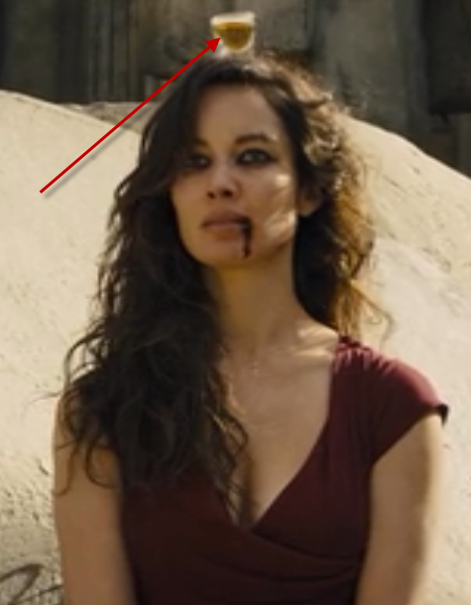

What would James Bond do to save his girlfriend?
In the movie “Skyfall,” the bad guy put a glass of wine on top of his girlfriend’s head, and forced James Bond to shoot the glass off her head.

Slide 33
What would James Bond do to save his girlfriend?
Mr. Bond could shoot as many times as possible and hopefully one of the bullets could hit the target (high variance approach), but one of the bullets might kill the girl, too.
Alternatively, he could focus and make one best shot only (unbiased approach), but he might miss the target.
If you were 007, what would you do?

Slide 34
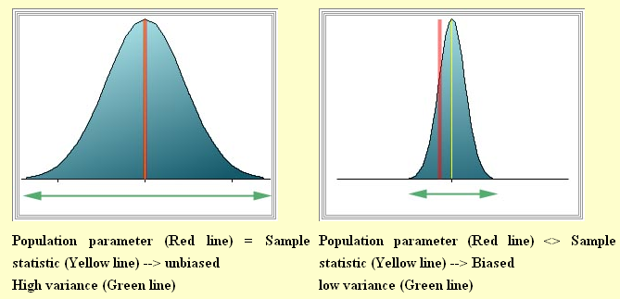
Bias and variance

Slide 35

Possible scenarios
Which one is the ideal?
We don’t know the population mean and variance, and thus we estimate the standard error.
As sample size increases, SE approaches 0.
The mean of the sampling distribution of the means approaches the population mean, and we can get an unbiased estimate of the population.

Slide 36

Take home message: Take n into account
We must take the sample size into account for a better estimate.
  S=sample SD
  N= sample size

Slide 37
Assignment 10
Read the question on Canvas
Although this is a group discussion, you need to submit your own essay.

