Slide 1
Z-test and T-test
Chong Ho (Alex) Yu

Slide 2
Z-test
A statistical test for which the test statistics can form a normal distribution owing to the central limit theorem.
Rarely used (I never used it in my whole life, so far).
Why? You can run a z-test if and only if the population variance is known.
But how often do you have access to the population-level information?
Let’s skip it.

Slide 3
One-sample t-test
One-sample t-test
Test the sample mean against the population mean
  To see whether there is a big gap between the sample and the population
  To see whether the sample comes from or belongs to the population.

Slide 4
Revisit the same example
In California the average SAT score is 1500.
A superintendent wanted to know whether the mean score of his students is significantly behind the state average.
  50 students
  Average SAT score =1495
  Standard deviation is 100
You don’t need a commercial software app. There are many online stat calculators e.g.
https://www.graphpad.com/quickcalcs/OneSampleT1.cfm?Format=SD

Slide 5
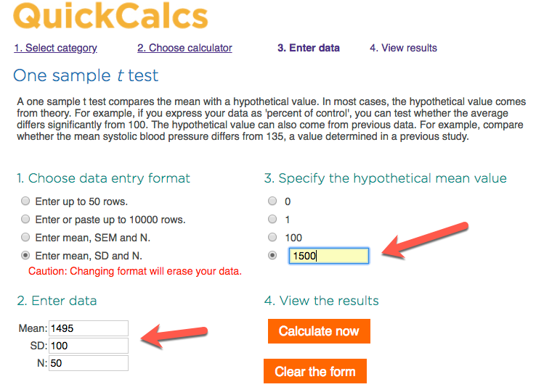
Online one-sample t-test calculator

Slide 6
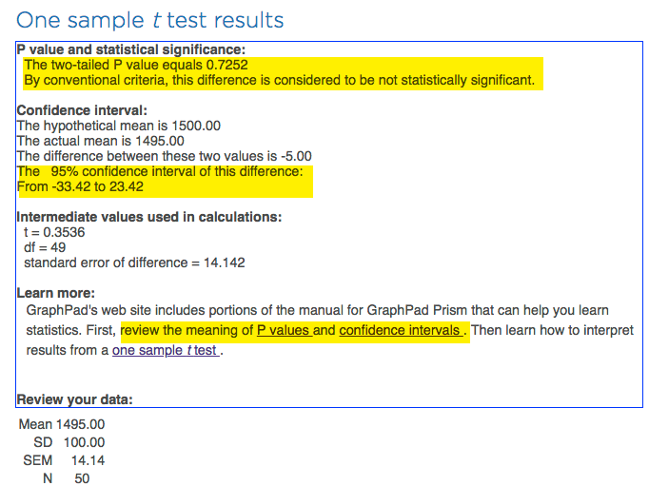
Online one-sample t-test calculator

Slide 7
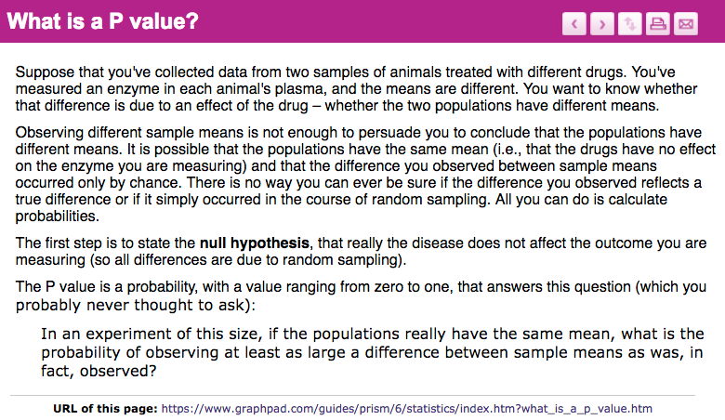
Online one-sample t-test calculator

Slide 8
P value
Simplified explanation: what is the probability (chance) of obtaining this test statistics in the long run given that the null hypothesis is true?
The so-called “performance gap” between his students and the state average is 5 points only. If this happens by chance alone, it would be about 7 out of 10 times (p = .7252).
It is not an extraordinary phenomenon. He should side with the null hypothesis: There is no significant performance gap between his students and others.

Slide 9
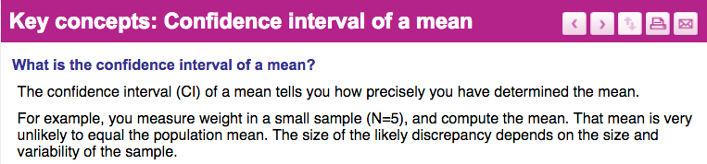
Online one-sample t-test calculator
You are not sure whether the true performance gap between your students and others is exactly 5. It could be as low as -33.42 or as high as 23.42.

Slide 10
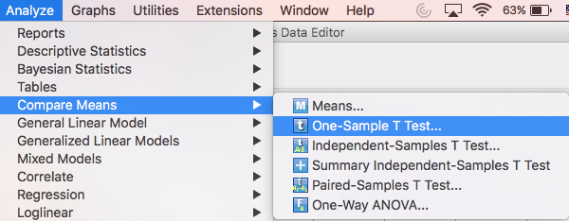
One-sample t-test in SPSS
JMP needs more steps for 1-sample t-test and so we will do it in SPSS only.
Open ”between_within.sav”

Slide 11
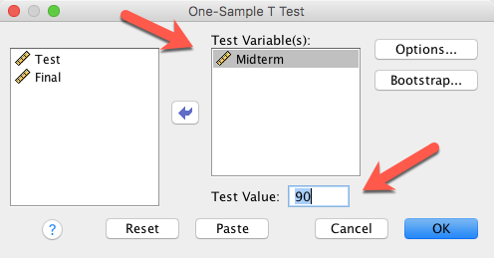
One-sample t-test in SPSS
Assume that at the university the average midterm score in psychology is 90.
I want to know whether there is any significant difference between the average midterm score of my student and that of all psychology majors.

Slide 12
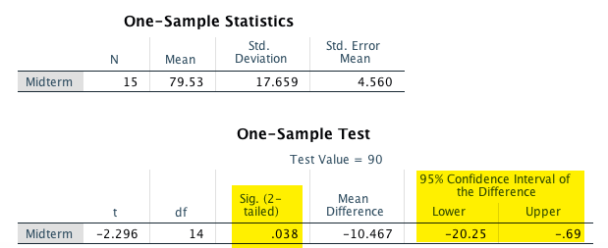
One-sample t-test in SPSS
The 2-tailed p value is .038, which is less than .05. By chance alone, it could happen about 3.8 time out of 100 in the long run.
There is a real performance gap!

Slide 13
Ungraded exercise
Use the online one-sample t-test calculator: https://www.graphpad.com/quickcalcs/OneSampleT1.cfm?Format=SD
The average state annual household income is $65,000.
In a sample of 500, the average county annual household income is $64,000. and the SD is 1,000.
Is there a significant difference between the state average and the county average?

Slide 14

Two independent sample t-test
You need two independent groups e.g. boys and girls.
Test whether there is a performance gap between boys and girls

Slide 15

T-test
T-test is a test to get the t-ratio.
The difference between two means based on the standard deviation.
Virtually any comparison test is about looking at the difference adjusted by a common standard
Otherwise, it will be comparing apples and oranges!

Slide 16
Assumptions
The observations (the behaviors of the participants) are independent (e.g. If students help each other in homework, then we cannot know their actual performance level).
The values in the dependent variable are normally distributed.
The variances (dispersion) of the two groups are similar.

Slide 17
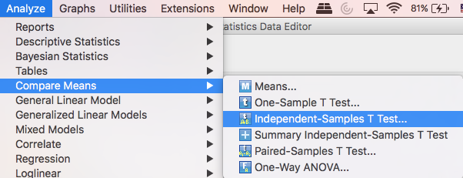
2- independent sample t-test in SPSS
Use the same data: between_within.sav

Slide 18
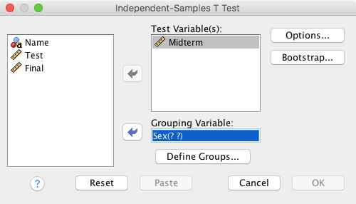
2- independent sample t-test in SPSS
Use the same data: between_within.sav

Slide 19
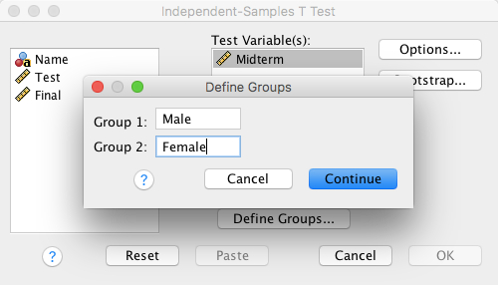
2- independent sample t-test in SPSS
Use the same data: between_within.sav

Slide 20
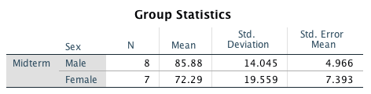
2- independent sample t-test in SPSS
Before we look at the inferential statistics, we should look at the descriptive statistics first.
The sample mean score of male students (85.88) is higher than that of females (72.29).
The standard error (SE shows how much bias) of male mean score is lower than that of females.
How many of you would say that boys are smarter than girls in terms of midterm test performance?

Slide 21
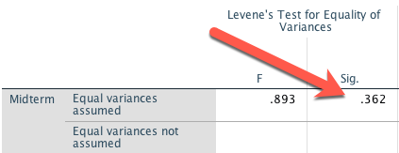
2- independent sample t-test in SPSS
Before we look at the t-test result, we need to look at the Levene’s test of equal (or unequal) variances. The p value (sig.) is .362.
The null hypothesis is: there is no significant difference between the male and female variances.
The data structure meets the assumption for t-test. Now we can proceed to look at the t-test result.

Slide 22
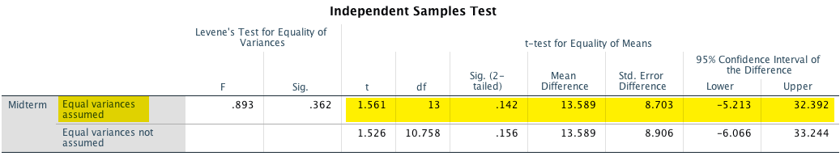
2- independent sample t-test in SPSS
Because the variances are equal, we need to look at the first row only.
The 2-tailed p value of the t-test is .142.
Despite that male students outperformed female students by more than 13 points (85.88 - 72.29)., the t-test shows that there is no significant performance gap.

Slide 23
Ungraded exercise
Use the data “between-within”
Run a 2-sample independent t-test.
Use the final as the DV
Use sex (gender) as the IV
Test whether the variances are equal before proceeding to the t-test.
Report the confidence intervals and the p value.
Is there any performance gap between boys and girls in final?

Slide 24
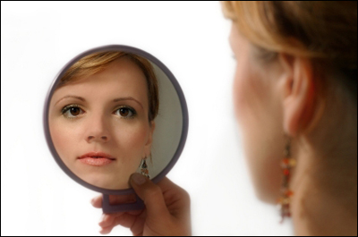
2 dependent sample t-test
Also known as 2 correlated sample t-test
Paired t-test
Match-paired
When you have no control group…
You are your own control. The person that is most similar to you is: YOU!

Slide 25
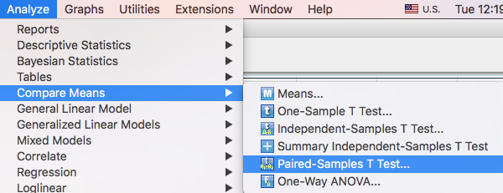
2- dependent sample t-test in SPSS

Slide 26
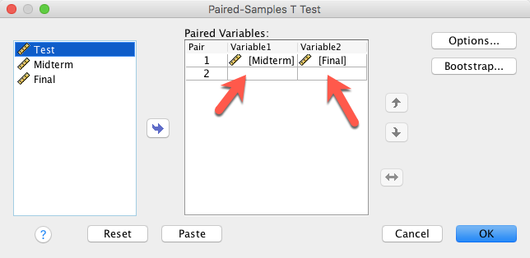
2- dependent sample t-test in SPSS

Slide 27
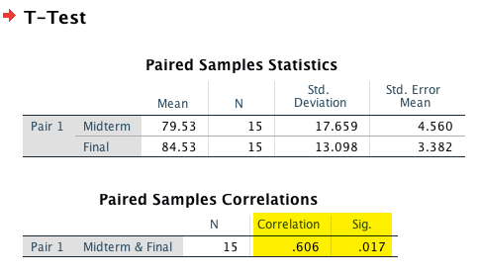
2- dependent sample t-test in SPSS
The correlation between midterm and final is .6. It is significant (p = .017).
Students who did well in midterm are likely to do well in the final, and vice versa.

Slide 28
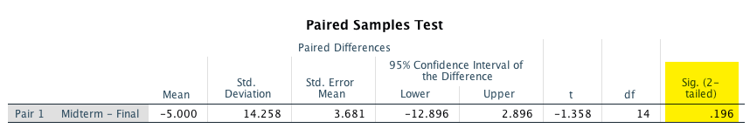
2- dependent sample t-test in SPSS
The two-tailed p value (sig.) is .196.
In the standpoint of the professor, I expect learners can improve their performance from midterm to final.
I want a one-tailed test! You can get that by manually divide the 2-tailed p value by 2.
.196/2 = .098

Slide 29
Assignment 11 (Canvas)
Use SPSS or JMP
Use the data “between-within”
Run a paired t-test
Use test and midterm as the variables
Spot and exclude students that show floor or ceiling effects, if there is any.
Report the correlation coefficient, the confidence intervals and the p value
Is there any significant change/growth between the test and the midterm?

