Slide 1
ANOVA Between-Subject Design:
A conceptual approach
Chong Ho (Alex) Yu

Slide 2
Objective
Illustrate the purpose, the concept, and the application of ANOVA between-subject design
By the end of the lesson you will understand the meaning of the following concepts:
  One-way ANOVA vs. Two-way ANOVA
  Grouping factor and level
  Parametric assumptions
  Variance and F-ratio
  Posy hoc multiple comparisons

Slide 3
What is ANOVA?
Analysis of variance: A statistical procedure to compare the mean difference when there are three groups or more
  Null hypothesis: all means are not significantly different from each other
  Alternate: Some means are not equal

Slide 4
One-way ANOVA
There must be three or more groups. If there are two groups only, you can use a 2-independent-sample t-test.
The independent variable is called the grouping factor. The group is called the level. In this example, there is one factor and three levels (Group 1-3).
.

Slide 5

Two-way ANOVA
There are two grouping factors.
Unlike one-way ANOVA, in this design it is allowed to have fewer than three levels (groups) in each factor.
In this example, there are two factors: A and B. In each factor, there are two levels: 1 and 2. Thus, it is called a 2X2 ANOVA between-subject design.
In this lesson we focus on one-way ANOVA only, but you need to know why on some occasions there are only two groups in ANOVA.

Slide 6
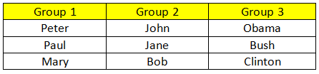
What is between-subject?
Between-subject: The subjects in each level (group) are not the same people (independent).

Slide 7
Parametric assumptions
Same as independent t-test
Independence: The responses to the treatment by the subjects in different groups are independent from each other.
Normality: The sample data have a normal distribution.
the variances of data in different groups are not significantly different from each other.

Slide 8
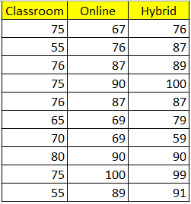
A hypothetical example
Three different teaching formats (levels) are used in three different classes

Slide 9
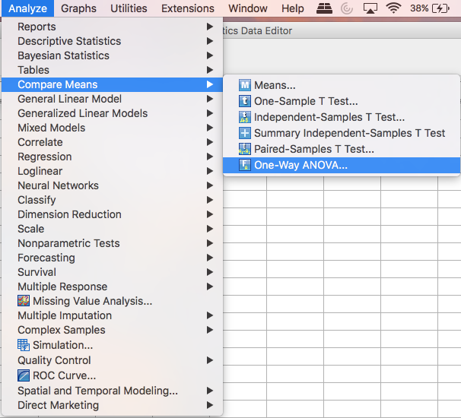
One-way ANOVA in SPSS
Data sets:
Oneway.sav (Try this first)
Oneway2.sav (Use this next)

Slide 10
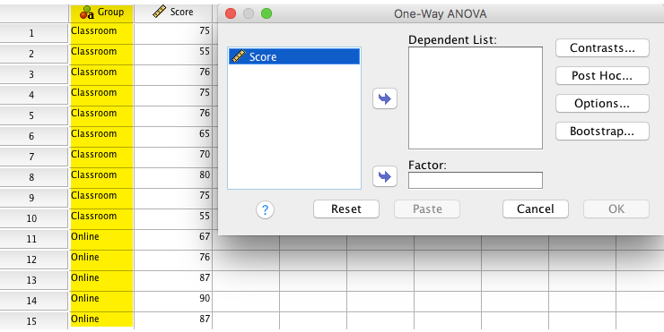
One-way ANOVA in SPSS
The grouping factor can NOT be shown if the data are characters (in “oneway.sav”)

Slide 11
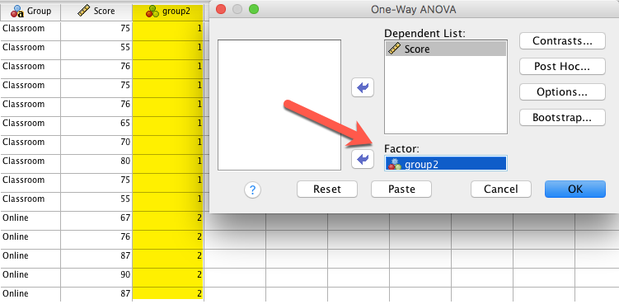
One-way ANOVA in SPSS
It can work if you assign numbers to different groups (use “oneway2.sav”)

Slide 12
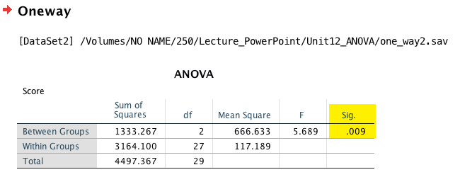
One-way ANOVA in SPSS
The p value (significance) is .009. The chance that I am lucky to see this group difference is extremely small.

Slide 13
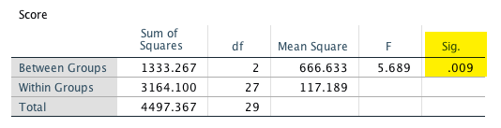
One-way ANOVA in SPSS
F = signal /noise(error)
Between-group variance is the signal; we want to see whether there is a significant difference (variability) between the groups.
Within-group variance is the noise or the error; it hinders us from seeing the between-group difference when the within-group variances overlap.
F = mean square between / mean square within

Slide 14
One-way ANOVA in SPSS
The p value tells me that there is a significant difference. But which pair?
  Classroom vs. online?
  Classroom vs. hybrid?
  Online vs. Hybrid?
But if I do three t-tests, the Type I error rate (False claim) may be very high.
More tests you do, more chances you get a significant result (like fishing).

Slide 15
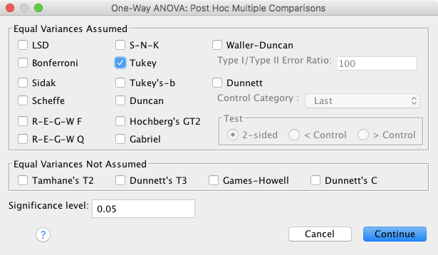
Post hoc multiple comparisons
To control the Type I error rate.

Slide 16
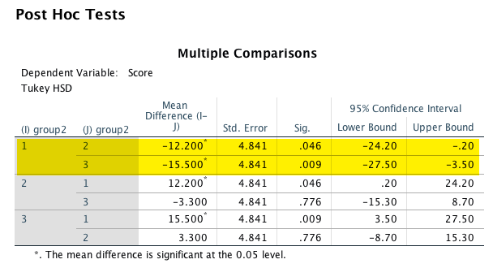
Post hoc multiple comparisons
Pairwise comparison results

Slide 17
Assignment 12 (Canvas)
In ANOVA the objective is to find out whether the group means are significantly different from each other. If so, why do we call this procedure Analysis of Variance, not Analysis of Means? Please use your own words to explain it.

