Slide 1

Health and Health Disorders
Eighth Edition
Chapter 2
Physical Changes

Slide 2
Learning Objectives (1 of 2)
2.1 Analyze theories of primary aging arguing in favor and against each
2.2 Assess physical changes during adult development including outward appearance, faculties, bodily systems and individual differences
2.3 Discuss changes in physical behavior like decline of stamina, dexterity, and balance; changes in sleep habits and sexual functioning

Slide 3
Learning Objectives (2 of 2)
2.4 Identify the proportionate relationship between aging and individual differences based on genetics, lifestyle, race and socio-economic factors
2.5 Discuss becoming young once again
2.6 Relate age to physical changes

Slide 4
Theories of Primary Aging
Objective 2.1 – Analyze theories of primary aging arguing in favor and against each

Slide 5

Theories of Primary Aging
Objective 2.1 Analyze theories of primary aging arguing in favor and against each
Oxidative Damage
  Antioxidants: Vitamin C, CoQ10
  No evidence they prevent aging

Slide 6
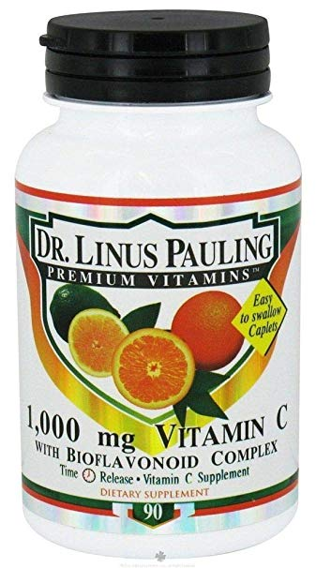
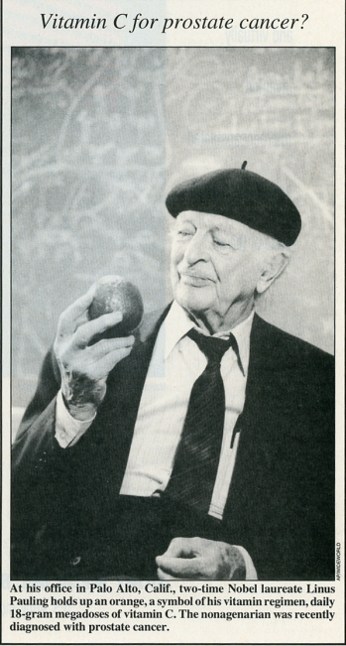

Slide 7
Theories of Primary Aging (1 of 2)
Objective 2.1 Analyze theories of primary aging arguing in favor and against each
Genetic Limits
  Hayflick limit: The number of divisions a species will undergo before reaching replicative senescence
  Telomere length:
    chromosomes in many human body cells have lengths of repeating DNA.
    the telomeres in the cells of a middle-aged adult are shorter than those of a young adult

Slide 8

2.1 Theories of Primary Aging
Objective 2.1 Analyze theories of primary aging arguing in favor and against each
  Caloric Restriction
  Eat less (2000 Cal. → 1400)
  Exercise more
  Easy to say but hard to do.
  https://www.youtube.com/watch?v=jxsnYsA549Y
  Discussion: In spite of the cultural difference, can we learn from Japan?

Slide 9
2.1 Theories of Primary Aging (2 of 2)
Objective 2.1 Analyze theories of primary aging arguing in favor and against each
  Caloric Restriction
  Eat less
  Exercise more
  Common sense! OK! Find a job that requires hard labor e.g. construction worker, postman, grocery store worker – stocking shelves)

Slide 10
2.1 Theories of Primary Aging (2 of 2)
Objective 2.1 Analyze theories of primary aging arguing in favor and against each
  Caloric Restriction
  The key is leisure time exercise.
  researchers did not find significant health benefit in work-related ”exercises” such as stocking shelves in a grocery store
  Exercise in a relaxing mode vs. “exercise” under stress

Slide 11
2.1 Theories of Primary Aging (2 of 2)
Objective 2.1 Analyze theories of primary aging arguing in favor and against each
  Caloric Restriction
  affect life quality?
  lower sexual desire
  the psychological effects of extreme hunger
  social withdrawal
  irritability

Slide 12
2.1 Theories of Primary Aging (2 of 2)
Objective 2.1 Analyze theories of primary aging arguing in favor and against each
  Caloric Restriction
  It is a joke. Don’t take it seriously.
  Doctor: “How are you?”
  Client: “Good! Doctor! My lifestyle is healthy. I go to bed at 11:00 am. I never stay up to watch YouTube movies, like my roommate. Unlike him, I never do anything risky, such as hiking in Half Dome, Yosemite. I eat healthy and tasteless food only, such as Oat meal. I never go to fast food restaurants like MacDonald and KFC. You know, fried chickens are bad!
  Doctor: “Why do you live?”

Slide 13
Discussion and assignment
Objective 2.1 Analyze theories of primary aging arguing in favor and against each
  Quality of life vs. longevity? Can we have both?
  Check the ranking of life expectancy by country: https://en.wikipedia.org/wiki/List_of_countries_by_life_expectancy
  Check the ranking of happiness by country: https://en.wikipedia.org/wiki/World_Happiness_Report
  Is there an inverse relationship between happiness (assume that we can equate happiness with quality of life) and longevity?
  Which countries have both? Can we learn from them?
  Form a small group of 3-5 to work on it. Post a report on Canvas.

Slide 14
Physical Changes During Adulthood
Objective 2.2 – Assess physical changes during adult development including outward appearance, faculties, bodily systems and individual differences
Complexities of the physical changes of aging
No any one theory has the answer

Slide 15
2.2 Physical Changes During Adulthood (1 of 5)
Objective 2.2 Assess physical changes during adult development including outward appearance, faculties, bodily systems and individual differences
  Outward Appearance
  Weight and body composition and the
  body weight pattern of adulthood
  Increasing weight in young and middle adulthood due to being more sedentary
  Decreasing weight of later adulthood due to decline in bone density and muscle
  Distribution of weight varies with each stage of adulthood

Slide 16
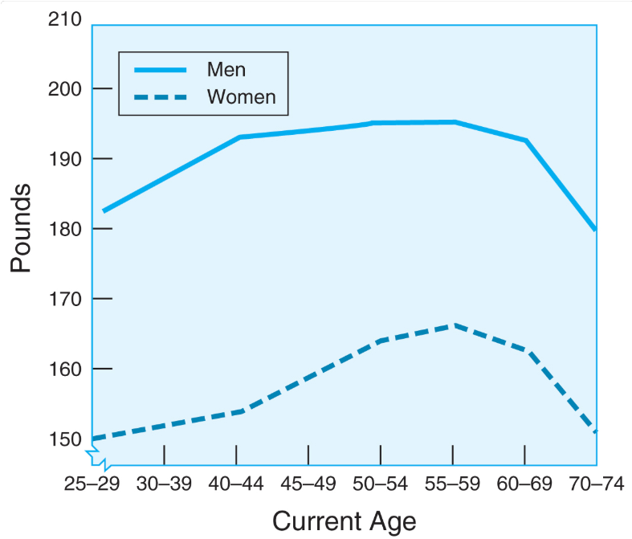

Slide 17
2.2 Physical Changes During Adulthood
Objective 2.2 Assess physical changes during adult development including outward appearance, faculties, bodily systems and individual differences
  Outward Appearance
  Obesity and the Body Mass Index (BMI)
  Over one third of adults are obese
  Formula for finding BMI: https://www.nhlbi.nih.gov/health/educational/lose_wt/BMI/bmicalc.htm
  Slowing down the aging process? Hair loss? Skin damage?

Slide 18
Repair skin damage: Retin A

Slide 19
2.2 Physical Changes During Adulthood (2 of 5)
Objective 2.2 Assess physical changes during adult development including outward appearance, faculties, bodily systems and individual differences
The Senses
Each of the senses decline with age
Vision: cataracts (Sunglass), short-sightedness
https://www.youtube.com/watch?v=EmtYivWUH7I

Slide 20
2.2 Physical Changes During Adulthood (2 of 5)
Objective 2.2 Assess physical changes during adult development including outward appearance, faculties, bodily systems and individual differences
Bones and muscles
Loss of bone density: Women’s bone loss rate shows a marked acceleration between the ages of 50 and 65, whereas men’s decline is more gradual.
Osteoporosis: Severe loss of bone mass makes the bones more likely to break than those of a younger person.

Slide 21
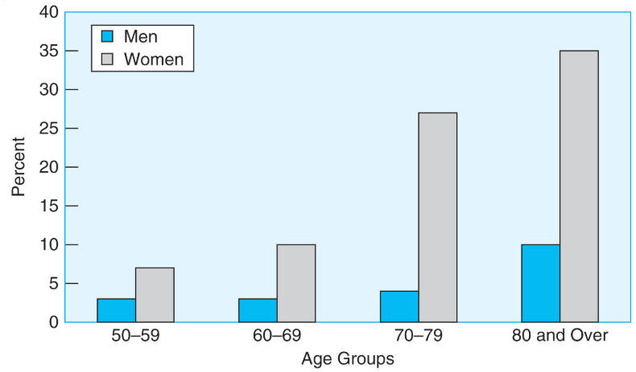

Slide 22
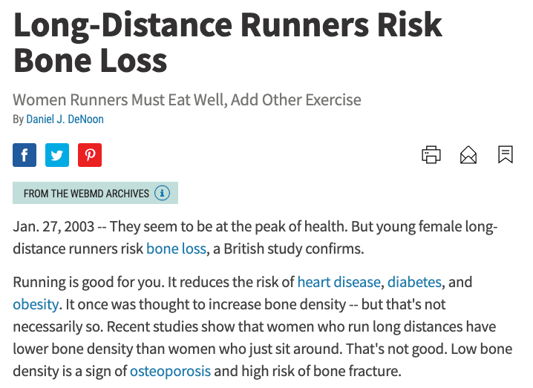
Maintain healthy bone?
Calcium
Vitamin D
Is running good?
Most textbooks say “yes”

Slide 23
2.2 Physical Changes During Adulthood (3 of 5)
Objective 2.2 Assess physical changes during adult development including outward appearance, faculties, bodily systems and individual differences
  Cardiovascular and Respiratory System
  Reasons for change: Thicker vessels inhibit blood flow
  Warning: You may not know it until it is too late
  Prevention:
    Regular exercise like walking,
    no smoking
  Treatment: Bypass open heart surgery, Stent
Notes:
Cardiovascular and respiratory system
Point 1 – Reasons for change
Heavy exercise, blood flow
Point 2 – Prevention
Brain and Nervous System
Point 1 – Neuron loss
Role of neurons and plasticity (pruning)
Point 2 – Neurogenesis
Occurs throughout adulthood which effects memory
Breakdown of myelin can effect cognitive speed
Diseases (diabetes, substance abuse, etc.) can contribute to myelin decline
Imaging techniques permit us to discover how myelin grows and decreases

Slide 24
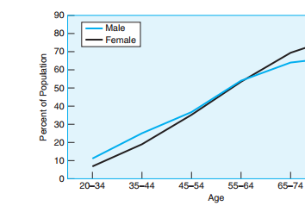
Figure 2.2
Physical Changes During Adulthood
The proportion of men and women who have been diagnosed with high blood pressure increases with age. Men are more likely to have this condition in earlier adulthood; women in later adulthood.
Notes:
Men generally get high blood pressure earlier than women
Men and women in middle adulthood have similar blood pressure levels
In later adulthood, male high blood pressure rates begin to decline and female rates increase
Source: American Heart Association (2012)

Slide 25
2.2 Physical Changes During Adulthood (3 of 5)
Objective 2.2 Assess physical changes during adult development including outward appearance, faculties, bodily systems and individual differences
  Brain and Nervous System
  Neuron loss
  In the past we thought older people lost cognitive abilities (e.g. memory) significantly.
  Misconception due to faculty experiment
  Most of the studies were conducted by young researchers between early afternoon and mid-evening.
  What is the problem?
Notes:
Cardiovascular and respiratory system
Point 1 – Reasons for change
Heavy exercise, blood flow
Point 2 – Prevention
Brain and Nervous System
Point 1 – Neuron loss
Role of neurons and plasticity (pruning)
Point 2 – Neurogenesis
Occurs throughout adulthood which effects memory
Breakdown of myelin can effect cognitive speed
Diseases (diabetes, substance abuse, etc.) can contribute to myelin decline
Imaging techniques permit us to discover how myelin grows and decreases

Slide 26
2.2 Physical Changes During Adulthood (3 of 5)
Objective 2.2 Assess physical changes during adult development including outward appearance, faculties, bodily systems and individual differences
  Can we grow new brain cells?
  Neurogenesis: A 2013 study found that the brain of older people can still produce about 700-1400 new neurons in the hippocampus per day.
  In 2018 another study published on "Nature" asserted that adults could NOT produce new cells in the hippocampus.
  All scientific conclusions are “inconclusive”?

Slide 27
2.2 Physical Changes During Adulthood (4 of 5)
Objective 2.2 Assess physical changes during adult development including outward appearance, faculties, bodily systems and individual differences
  Immune system protection
    B Cells: produced in the bone marrow, make proteins called antibodies
    T cells: reject and consume harmful or foreign cells, such as bacteria and transplanted organs
    Both get worse as we age

Slide 28
2.2 Physical Changes During Adulthood (4 of 5)
Objective 2.2 Assess physical changes during adult development including outward appearance, faculties, bodily systems and individual differences
  Immune system protection
    Nutritional supplement debate
    https://www.youtube.com/watch?v=weJQtqpOlmM
Notes:
FDA says that nutritional supplements do not work to strengthen the immune system but tests on lab animals seem to disprove the FDA
Supplements not necessary for those with a healthy lifestyle in early and middle adulthood
Should be taken in later adulthood when health has declined

Slide 29
Changes in Physical Behavior
  Objective 2.3 – Discuss changes in physical behavior like decline of stamina, dexterity, and balance; changes in sleep habits and sexual functioning
Notes:
Emphasizes behaviors as we age
Stamina, dexterity, and balance decline with age, as do sleep habits and sexual functioning
What happens when these behaviors decline

Slide 30
2.3 Changes in Physical Behavior (1 of 3)
Objective 2.3 Assess physical changes during adult development including outward appearance, faculties. bodily systems and individual differences
Question: when are we over the hill, physically speaking?
Athletic Abilities
Peak age: Top performers in teens, early 20s
Oxygen levels
Notes:
Athletic Abilities
Point 1 - Peak age
Top performers in teens, early 20s
Oxygen levels
Point 2 – Oxygen levels
Stamina, Dexterity, and Balance
Point 1 – Physical changes
Stamina declines soon after high school, related to cardiovascular
Dexterity related to changes in joints
Balance related to flexibility and muscle strength

Slide 31
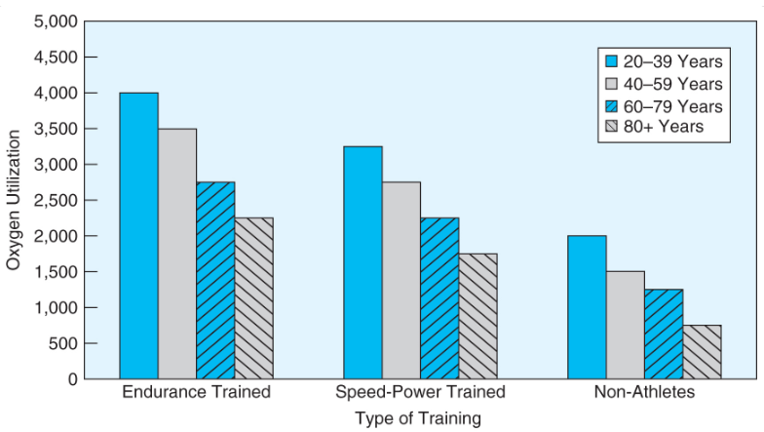

Slide 32
2.3 Changes in Physical Behavior (1 of 3)
Objective 2.3 Assess physical changes during adult development including outward appearance, faculties. bodily systems and individual differences
Stamina, Dexterity, and Balance
  Stamina: the ability to endure demanding actives declines soon after high school
  Dexterity: declines due to changes in joints
  Balance: the ability of adapting body position declines due to inflexibility
Exercise for old people: Tai Chi
  https://www.youtube.com/watch?v=MsbhtTwe5Kc

Slide 33
2.3 Changes in Physical Behavior (2 of 3)
Objective Discuss changes in physical behavior like decline of stamina, dexterity, and balance; changes in sleep habits and sexual functioning
  Sleep
  Recommended number of hours sleep for each stage of adulthood
  8.5 hours younger adults
  7.5 hours older adults
  Most adults get 7 hours per night

Slide 34
2.3 Changes in Physical Behavior (2 of 3)
Objective Discuss changes in physical behavior like decline of stamina, dexterity, and balance; changes in sleep habits and sexual functioning
  Sleep
  Different age groups have different sleep problems
  Younger adults sleep later in the morning; later school start time
  Younger adults have due to stress, work obligations
  Sleep apnea more common in older adults
Notes:
Sleep
Point 1 – Recommended number of hours sleep for each stage of adulthood
8.5 hours younger adults
7.5 hours older adults
Most adults get 7 hours per night
Point 2 – Different age groups have different sleep problems
Younger adults sleep later in the morning; later school start time
Younger adults have due to stress, work obligations
Sleep apnea more common in older adults
Point 3 – Insomnia
More prevalent in women
Use of electronic devices at night
Point 4 – Physical and behavioral causes
Diseases, medications, emotional issues

Slide 35
2.3 Changes in Physical Behavior (2 of 3)
Objective Discuss changes in physical behavior like decline of stamina, dexterity, and balance; changes in sleep habits and sexual functioning
  Sleep
  Sleep apnea: more common among older adults
  Insomnia
  More prevalent in women
  Physical and behavioral causes: alcohol, caffeine, lack of exercise, emotional issues.

Slide 36
Discussion (Ungraded)
Form a small group of 3-5 and share your experience and ideas about sleeping.
Do you usually sleep well? Why or why not?
What keep you awake at night? What is your method to counteract insomnia?
Can you sleep well during a long distance flight (e.g. 12-15 hours)?
If not, what did you do?

Slide 37
2.3 Changes in Physical Behavior (3 of 3)
Objective 2.3 Discuss changes in physical behavior like decline of stamina, dexterity, and balance; changes in sleep habits and sexual functioning
Sexual Activity
less frequent
Erectile dysfunction (ED) & and vaginal dryness
Treatment: Viagra and Cialis

Slide 38
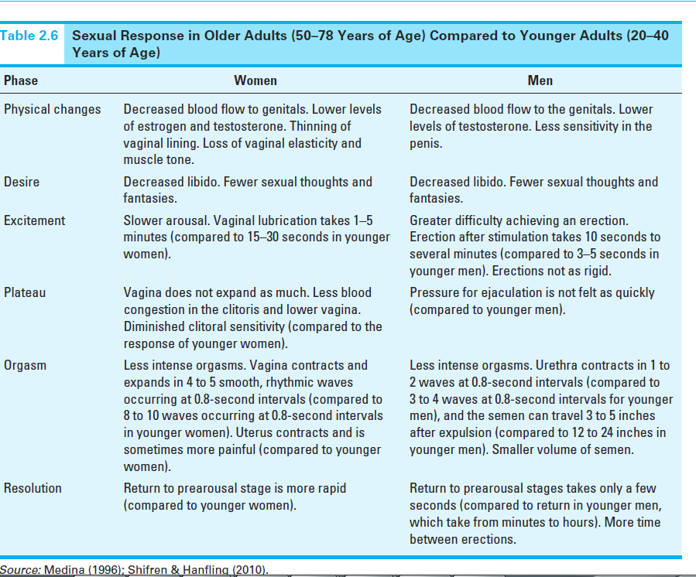
Figure 2.3
Changes of Physical Behavior
Notes:
Source: Medina (1996); Shifren & Hanfling (2010)

Slide 39
Individual Differences in Primary Aging
  Objective 2.4 – Identify the proportionate relationship between aging and individual differences based on genetics, lifestyle, race and socio-economic factors

Slide 40
2.4 Changes in Physical Behavior (1 of 2)
Objective 2.4 Identify the proportionate relationship between aging and individual differences based on genetics, lifestyle, race and socio-economic factors
Genetics
Twin studies: Show longevity can be hereditary (60%: genetic, 40% environmental)
Weight:
  Don’t be judgmental (a story of missionary)
  Can be hereditary

Slide 41
2.4 Changes in Physical Behavior (2 of 2)
Objective 2.4 Identify the proportionate relationship between aging and individual differences based on genetics, lifestyle, race and socio-economic factors
Lifestyle and attitude
Exercise, diet, tobacco, alcohol, etc.
Stress, love/hatred
Race, Ethnicity, and Socioeconomic Group
Low-income: food deserts
Access to healthcare

Slide 42

Look at this map. What is the pattern?

Slide 43

Look at another map. What is the pattern?

Slide 44
Discussion
Form a small group of 3-5 to discuss the following question:
Today unequal access to health care is a major social problem.
Propose a concrete plan to alleviate this problem (If your answer is: “providing universal health care to every one,” please suggest the concrete steps e.g. where can we obtain the funding?)
Post your answer on Canvas.

