Slide 1

Health and Health Disorders
Eighth Edition
Chapter 3
Health and Health Disorders

Slide 2
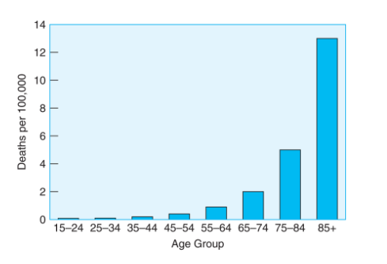
Learning Objectives
3.1 Discuss changes in mortality rates and causes of death as we move through adulthood

Slide 3

Causes of death in the US
Three of the top five causes of death for emerging adults (aged 15 to 24) are accidents, homicides, and suicides.
By young adulthood (25 to 44) accidents are still in first place, but cancer and heart disease are second and third.

Slide 4

Causes of death in the US

Slide 5

Causes of death in the US
Why are younger people more likely to take risky behaviors?

Slide 6

Causes of death in the US
Prior research found that younger and older people are equally capable of evaluating risk (Beyth-Marom, Austin, Fischoff, Pamlgren, & Jacobs-Quadrel, 1993), but youth still engage in risk behaviors.
Young people care about peer relationships (Larson & Richards, 1991) and are afraid of social exclusion.
What would you do? Just say “No”!
Notes:
https://www.psychologytoday.com/us/blog/the-wide-wide-world-psychology/201506/why-are-teen-brains-designed-risk-taking

Slide 7
Causes of death in the US
Middle-aged adults (aged 45 to 64) have cancer and heart disease in first and second place,
For older adults (aged 65 and over) these two diseases are reversed in first and second place, and Alzheimer’s disease is among the top five causes of death
How about other countries and in the past?
https://ourworldindata.org/causes-of-death

Slide 8
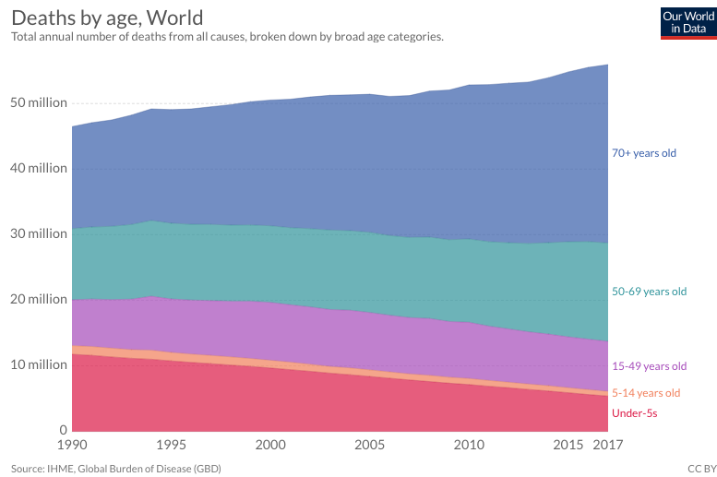
Causes of death around the world

Slide 9
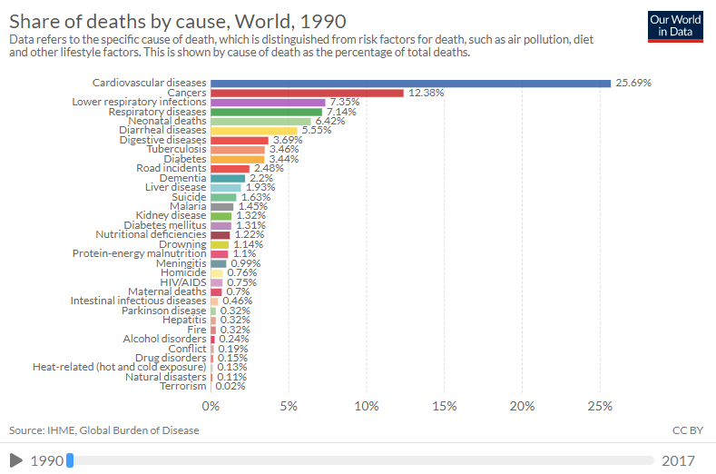
Causes of death around the world

Slide 10
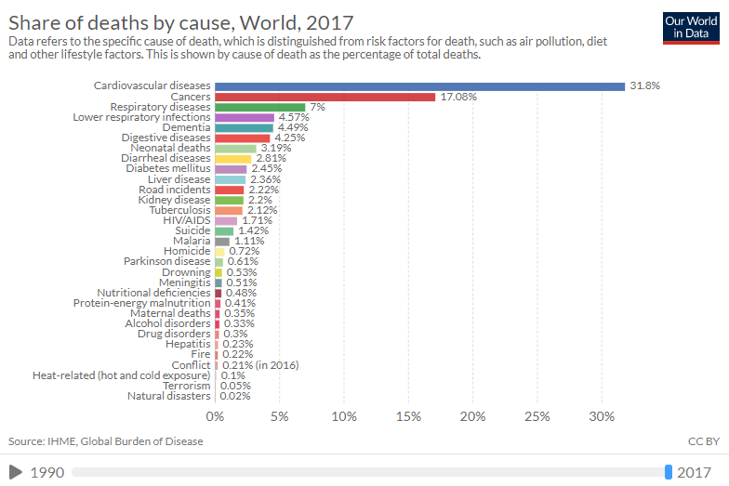
Causes of death around the world

Slide 11
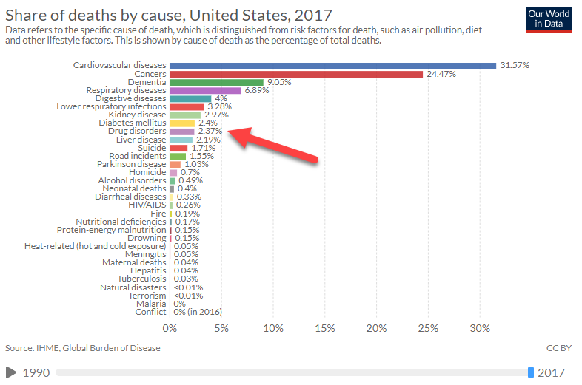
Causes of death in USA

Slide 12
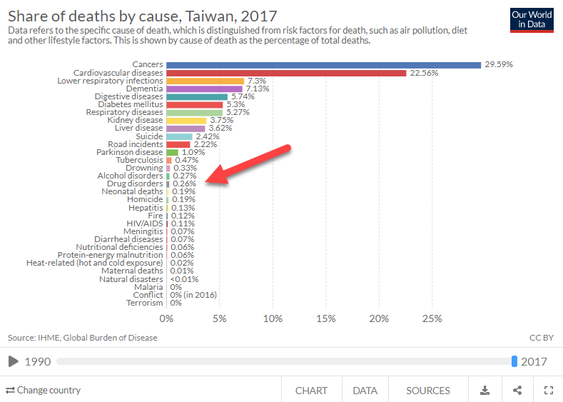
Causes of death in Taiwan

Slide 13
Ungraded class activity
Open your Web browser and go to https://ourworldindata.org/causes-of-death
Scroll down to graph “Share of deaths by cause, World 2017.”
Press the button “Change country” and choose a country.
Compare the causes of death of that country and USA. Are they different or similar?
Feel free to share your finding with the class.

Slide 14
Learning Objectives 3.2: Conditions
Acute conditions: Younger adults are about twice as likely as are those over 65 to suffer from short-term health problems, which physicians call, including colds, flu, infections, or short-term intestinal upsets.
Chronic conditions: Longer-lasting disorders, such as heart disease, arthritis, or high blood pressure.

Slide 15
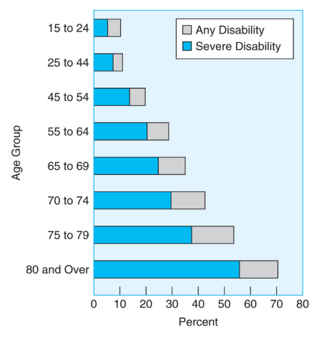
3.2 Disability

Slide 16
Manageable and normal conditions
Chronic illness <> disability
High blood pressure can be controlled with medication and exercise
Controversial: Some conditions (ED) are considered “normal” and might not affect the overall quality of life. And therefore most insurance companies do not cover Viagra.

Slide 17
Difference between CVD and CHD
Cardiovascular disease (CVD): a class of diseases that involve the heart or blood vessels. Vascular refers to all the blood vessels in the body.
Coronary heart disease (CHD): Plaque accumulates within the walls of the coronary arteries until the blood flow to the heart’s muscle is limited.

Slide 18
3.3 Specific Diseases
CVD is the number-one killer of women throughout the developed world. Why?
https://www.youtube.com/watch?v=_3fz8jYjr6I
Usually women do not know the signs: nausea, fatigue, dizziness, cold sweats, shortness of breath, and sharp pain in the upper body, neck, or jaw.
Factors that are uncontrolled: age > 50, family history
Factors that can be prevented: smoking, obesity, inactive lifestyle, diabetes, high cholesterol, high blood pressure.

Slide 19
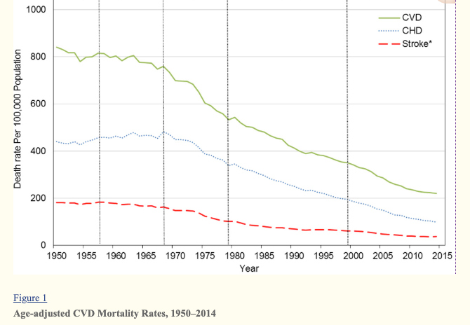

Slide 20
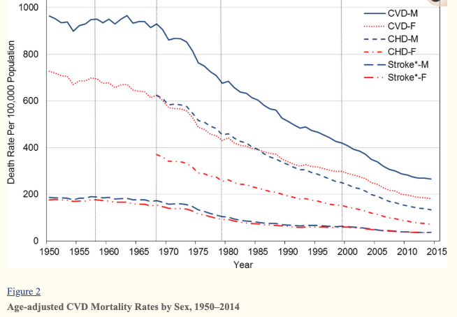

Slide 21
Question
What are some of the reasons that the rate of CVD/CHD is declining?
Ford et al. (2007) suggested that about 47% of the decline in CHD mortality rate between 1980 and 2000 could be attributed to better medical treatments whereas 44% could be resulted from reductions in major risk factors.
https://www.ncbi.nlm.nih.gov/pmc/articles/PMC5268076/

Slide 22
Cancer
Breast cancer is the most frequent cause of cancer deaths for women under 55.
https://www.youtube.com/watch?v=3ihwSdKVoO8
Leukemia is most frequent for young adult men.
Lung cancer is most frequent for middle-aged men.

Slide 23
Cancer
Uncontrollable factors: Age > 50, family history
Factors that are preventable: smoking, unhealthy diet, chemical and radiation exposure in the workplace, STD, inactive lifestyle, obesity, excessive alcohol use, unprotected exposure to sunlight.
https://www.youtube.com/watch?v=mufb0Hx2438

Slide 24
Additional references
Gonzales, M. C., Grayson, J., Lie, A., Yu, C. H., & Shiao, P. (2018). Gene-environment interactions and predictors of breast cancer in family-based multi-ethnic groups. Oncotarget, 9, 29019–29035. doi: 10.18632/oncotarget.25520.
Shiao, P., Grayson, J., & Yu, C. H. (2018). Gene-metabolite interaction in the one carbon metabolism pathway: Predictors of colorectal cancer in multi-ethnic families. Journal of Personalized Medicine, 8(3), Article 26. https://doi.org/10.3390/jpm8030026

Slide 25
Additional references
Shiao, P., Grayson, J., Lie, A., & Yu, C. H. (2018). Personalized nutrition—Genes, diet, and related interactive parameters as predictors of cancer in multiethnic colorectal cancer families. Nutrients, 10(6), Article 795.
Shiao, P., Grayson, J., Lie, A., & Yu, C. H. (2018). Predictors of the healthy eating index and glycemic index in multi-ethnic colorectal cancer families. Nutrients, 10(6) Article 674.

Slide 26
Additional references
Shiao, P., Lie, A., & Yu, C. H. (2018). Meta-analysis of homocysteine-related factors on the risk of colorectal cancer. Oncotarget, 9, 25681-25697.
Shiao, P., Grayson, J., Yu, C. H., Wasek-Patterson, B., & Bottiglieri, T. (2018). Gene environment interactions and predictors of colorectal cancer in family-based multi-ethnic groups. Journal of Personalized Medicine, 8(1), 1-21. doi:10.3390/jpm8010010.

Slide 27
Additional references
Shiao, P., & Yu, C. H. (2016). Meta-prediction of MTHFR gene polymorphism-mutations and risks on colorectal cancer for population health in the world. Biological Research for Nursing, 18, 357-369. DOI: 10.1177/1099800415628054. Retrieved from http://www.ncbi.nlm.nih.gov/pmc/articles/PMC4904378/

Slide 28
Diabetes
A disease in which the body is not able to metabolize insulin
  Type 1 appears in children and young adults
  Type 2 appears associated with age, obesity, physical activity
Increases risk of other acquiring other diseases
  Heart disease
  Blindness
  Kidney disease
  Amputations (narrow blood vessels reduce blood flow to the leg, cannot feel pain)
Notes:
https://www.healthline.com/health/diabetes/diabetes-amputation#is-it-needed

Slide 29
Diabetes
Rising in the United States and many developing countries.
Uncontrollable factors: Age > 45, family history
Factors that are preventable:
  Obesity
  high blood pressure
  high cholesterol
  inactive lifestyle.

Slide 30
Additional reference
Naccashian, Z., Hattar, M. H., Yu, C. H., & Avvazian, S. P. (2018). Prevalence and predictors of diabetes mellitus and hypertension in Armenian Americans in Los Angeles. Diabetics Educator, 44(2): 130-143. doi: 10.1177/0145721718759981 Retrieved from https://www.ncbi.nlm.nih.gov/pubmed/29490579

Slide 31
What do all these people have in common?

Slide 32
Specific Diseases
Alzheimer’s Disease
  Progressive irreversible deterioration of the brain
  Fifth leading cause of death for people over 64

Slide 33
Specific Diseases
Risk factors of Alzheimer’s Disease
  Over 50
  Head injury
  Family history
  High cholesterol
  High blood pressure
  Inactive lifestyle
  Tobacco use
  Obesity

Slide 34
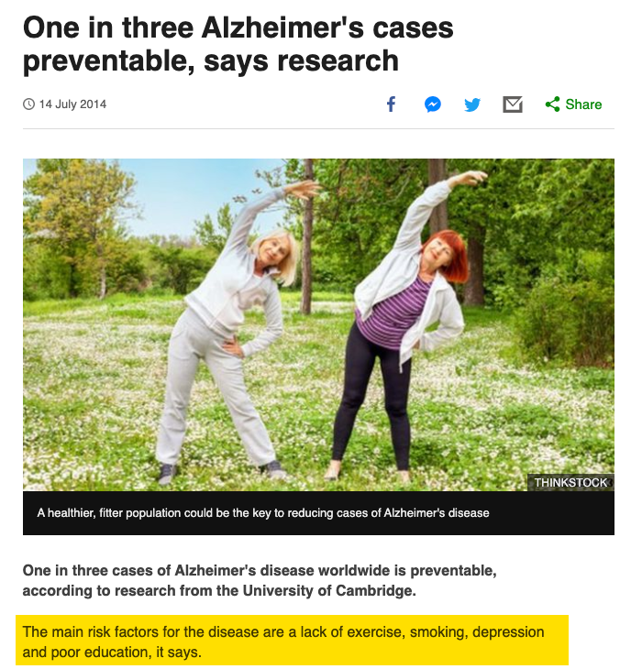
Notes:
https://www.bbc.com/news/health-28262878

Slide 35
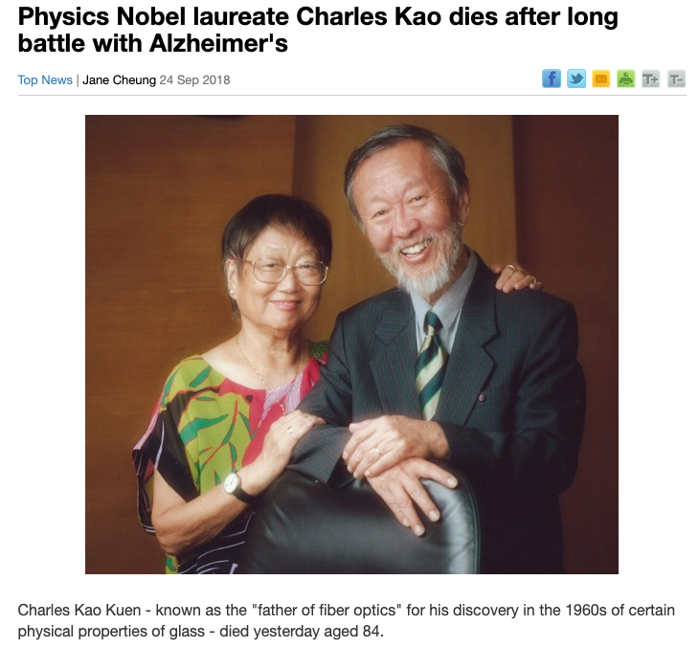

Slide 36
Table 3.6
Mental Health in the United States: Survey Results
DSM Classification | Examples | Lifetime Prevalence | 12-month Prevalence | Median age of Onset | % Male % Female
Anxiety Disorders | Phobias, PTSD, OCD | 28.8% | 18.1% | 11 years | 38% male 62% female
Mood Disorders | Depression bipolar disorder | 20.8% | 9.5% | 30 years | 40% male 60% female
Impulse Control Disorders | Conduct disorder, ADHD, explosive disorder | 24.8% | 8.9% | 11 years | 59% male 41% female
Substance Abuse Disorders | Alcohol and drug abuse or dependence | 14.6% | 3.8% | 20 years | 71% male 29% female
Any Disorder Above |  | 46.4% | 26.2% | 14 years | 48% male 52% female
.Mental Health Survey Results
Notes:
Source: Data from Kessler, Berglund, Demler, et al. (2005), Table 2, p. 595 & Table 3, p. 596; Kessler, Chiu, Demler, et al. (2005), Table 1, p. 619; Wang, Berglund, Olfson, et al. (2005), p. 605
Lifetime Prevalence
Percent who have had this type of disorder at least once in their lifetime
12-month Prevalence
Percent who have had this type of disorder in the last 12 months
Median Age of Onset
Age at which 50% of the cases appeared

Slide 37
Mental Disorders (1 of 5)
Anxiety Disorders
  Most common mental health disorder for adults
  Phobias: Fear and avoidance even no or little danger present
  Posttraumatic stress disorder (PTSD): Reaction to a traumatic event in the past
  Obsessive-compulsive disorder (OCD): guilt and anxiety over some thoughts or impulse
  Can you tell me some examples?

Slide 38
Examples of phobia
Aerophobia: Fear of flying
Claustrophobia: fear of confined space

Slide 39
Examples of COD
Perfectionism: everything must be done perfectly or I won’t stop
Hoarding: fear of losing anything, keep stacking up unused stuff

Slide 40
Mental Disorders (2 of 5)
Objective 3.4 Identify the various mental disorders and their treatment for adults of different ages
Mood Disorders
  Loss of control over emotions
  Results in feeling of distress
  Major depression: most common disorder in adults
  Depressive symptoms: Sadness and hopelessness, sleep, fatigue, loss of interest in activities, sense of worthlessness, suicidal thoughts

Slide 41
Mental Disorders
Objective 3.4 Identify the various mental disorders and their treatments for adults of different ages
Impulse Control Disorders
  Judgment and impulse control
  Affects ability to make judgments and control strong impulses
  More common in boys and men

Slide 42
Mental Disorders (3 of 5)
Objective 3.4 Identify the various mental disorders and their treatments for adults of different ages
Impulse Control Disorders
  Childhood conduct disorders
  Attention-deficit/hyperactivity disorder (ADHD)
  Will continue into adulthood for half the children

Slide 43
Mental Disorders (4 of 5)
Objective 3.4 Identify the various mental disorders and their treatments for adults of different ages
Substance Abuse Disorders
  Generally present by age 27
  Alcohol abuse is most common
    13% of people in the United States
    Second most common disorder after major depression
    Could affect anyone; may be situational

Slide 44
Additional reference
Sonmez, S.; Apostolopoulos, Y; Yu, C. H.; Mattila, A., & Yu, L. C. (2006). Binge drinking and casual sex on spring break. Annals of Tourism Research, 33, 895-917.

Slide 45

How are your (college students) mental health?
https://ccmh.psu.edu/

Slide 46
Mental health of college students
Low cut point indicates whether an individual is more likely to be in treatment than not in treatment.
Scores above the Low cut point indicates potential distress.
A score above the Elevated cut point does not indicate the presence of a diagnosable mental health condition, but further assessment is needed.

Slide 47
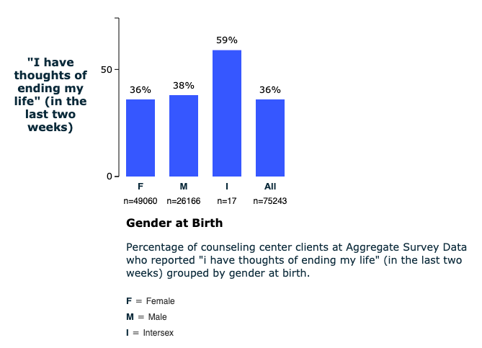
Mental health of college students

Slide 48
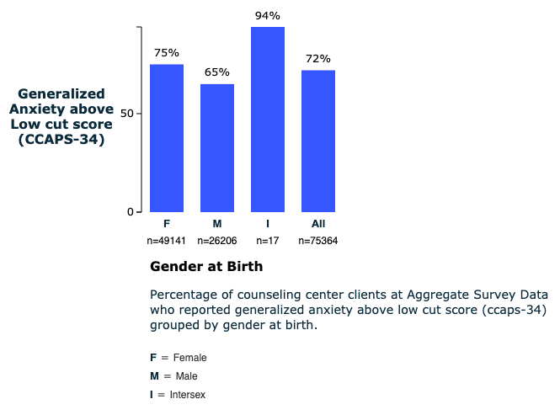
Mental health of college students

Slide 49
Assignment
Use the CCMH website to explore the data: https://ccmh.psu.edu/
Go to Data Navigator. Login: guest; password: guest
Look at two behavioral or mental issues (e.g. depression, eating disorder) by a demographic variable (e.g. gender, race…etc.)
Which group has a higher percentage? Why? You can make an educated guess or conduct a literature review.
Post your answer (0.5-1.5 pages) on Canvas.

