Slide 1

Health and Health Disorders
Eighth Edition
Chapter 4
Intelligence

Slide 2
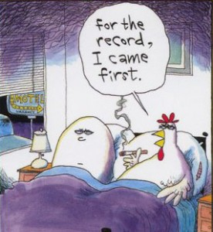
What is intelligence?
Chicken or egg first
Cognitive/developmental psychologist and psychometrics
We know what intelligence is and hence we know how to measure intelligence
We collect data by measuring intelligence and thus we know what intelligence is.

Slide 3
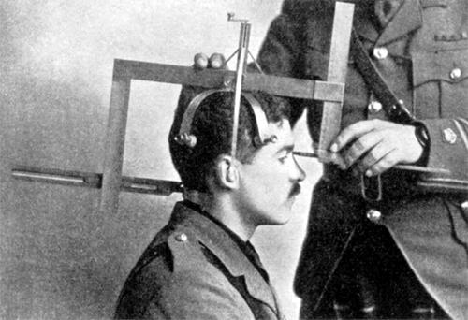
What is intelligence?
Psychometrics: measurement of psychology
Anthropometry : measurement of human
Before 20 century scientists believe that the skull size and intelligence have a positive association. Bigger head → more intelligent.

Slide 4
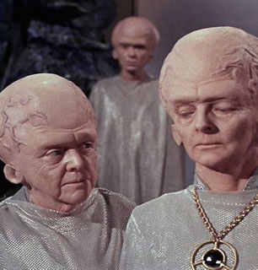
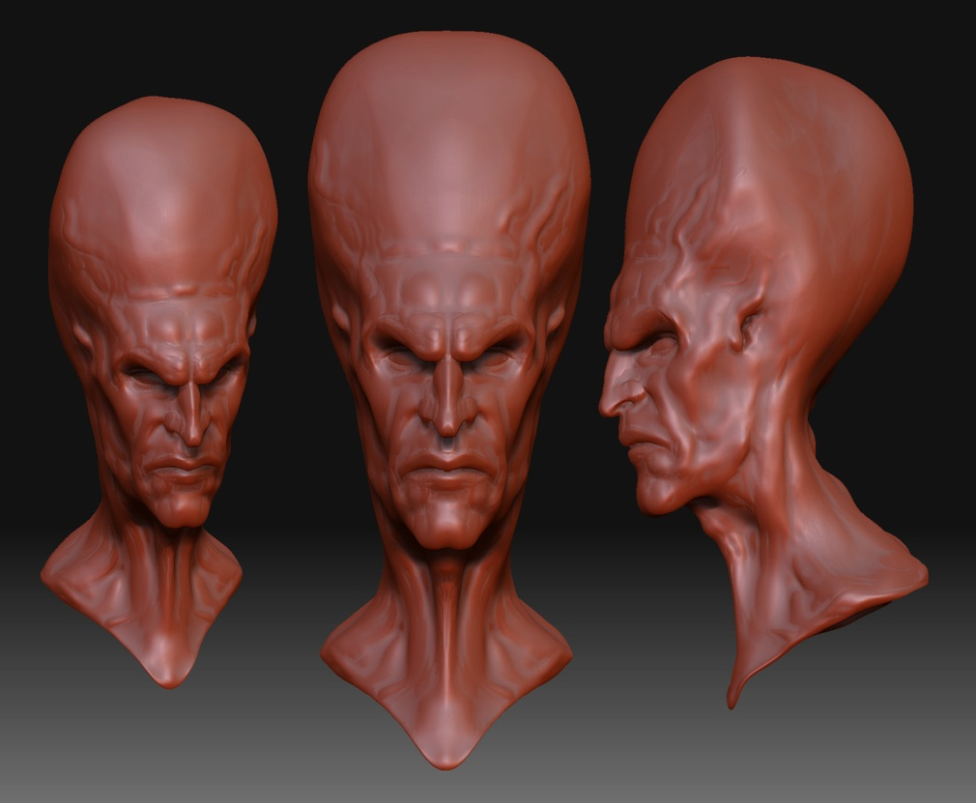

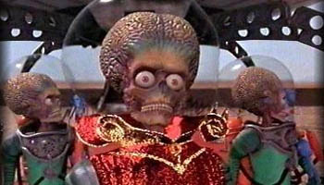

Slide 5
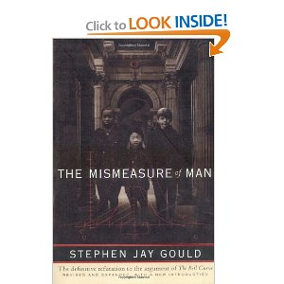
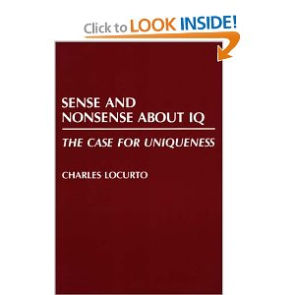
"Determinists arguments for ranking people according to a single scale of intelligence, no matter how numerically sophisticated, have recorded little more than social prejudice." (Gould, 1981, pp. 27-28) Gould’s book is controversial because some people said that he mis-cited certain studies.

Slide 6
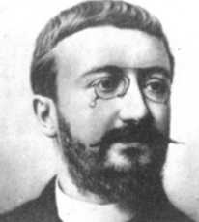
Alfred Binet
The purpose of IQ tests is to identify the children who need help and special education, not to classify normal people.
He declined to define IQ as fixed, inborn intelligence.
He refused to accept IQ as an absolute measure; intelligence is too complex to be captured by a single number. The scale is a rough guide only.

Slide 7
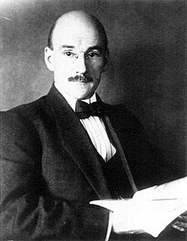
Henry H. Goddard
Invented the term “moron”: a person with a mental age in adulthood of between 8 and 12 (IQ of 51-70) on the Binet scale.
1914: testified in court that people with below-average intelligence should have limited criminal responsibility.

Slide 8
Dispersion between and within individuals
Thurstone asserted that perceptions have distributions between and within individuals. i.e. Not only different people have different perceptions. The same person may see things differently at different time.
The same principle applies well to other types of measurement. i.e. By chances you may get a "C" in the mid-term but an "A" in the final.

Slide 9
G Factor
All standardized tests of academic aptitude or achievement measure this general factor to some degree, but IQ test expressly designed for that purpose--measure it more accurately (Spearman, 1904)
At the turn of the 20th century Charles Spearman (1863-1945) used statistical methods such as Correlation and Factor Analysis to define mental abilities as factors.
When two apparently different abilities are shown to be highly correlated, Spearman took this as an evidence for the existence of a general factor G.

Slide 10
Other views
Thorndike: intelligence contains several unique factors (dimensions)
Thurstone: seven uncorrelated factors.
Guilford: three factors.
The Wechsler Adult Intelligence Scale – fourth edition (WAIS-IV): 4 dimensions
  verbal comprehension (VCI)
  perceptual reasoning (PRI)
  working memory (WMI)
  processing speed (PSI)

Slide 11
Intelligence
Age Changes in Overall Intelligence
  Some decline with age
  Less severely than previously thought (Young researchers collected data at the improper time)
  More substantial in the 80s

Slide 12
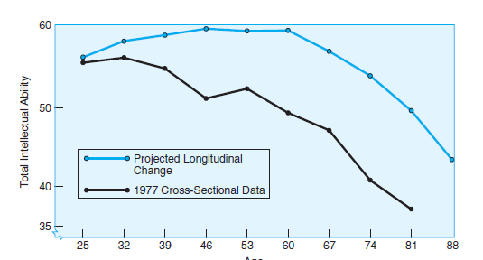
Figure 4.1
Age Changes in IQ (cross-sectional and longitudinal data)
Age changes in total IQ based on cross-sectional data (lower line) and longitudinal data (upper line) can show very different trajectories. Depending on cross-sectional data in the past led to erroneous conclusions that cognitive performance begins to decline around 40 and that the decline is very fast.
Notes:
Note that IQ changes with age, but that the method of study shows different results
Source: Data from Schaie (1983)

Slide 13
Multiple Intelligences
Gardner asserted that there are 9 dimensions of intelligence and all nine intelligences are of equal intrinsic value. It is the culture and social context that determine the value and importance of the dimension.
Scientists from the University of Sheffield, England, provided evidence that numerical reasoning and linguistic ability may be two independent entitles. They examined several patients who suffered severe damage to the language faculty of their brains, and found that their mathematical ability is intact.

Slide 14
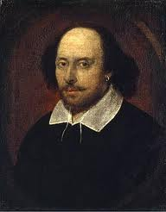
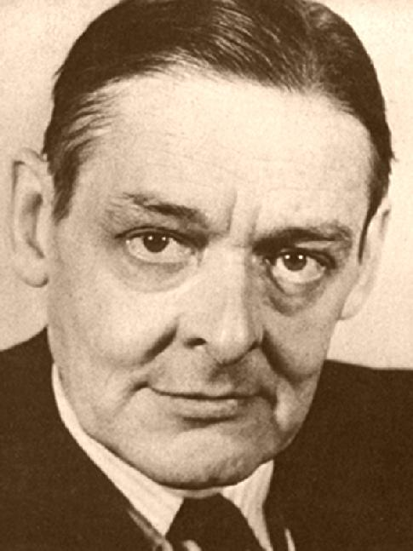
Linguistic

Slide 15
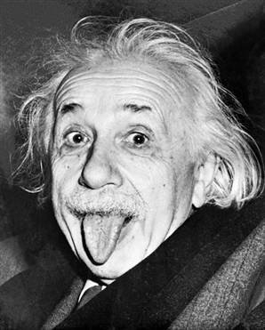
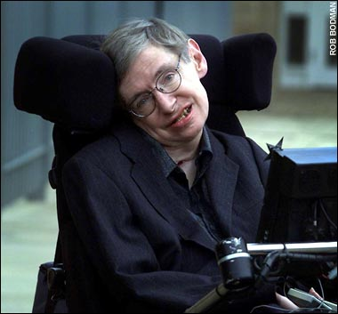
Logical-mathematical

Slide 16
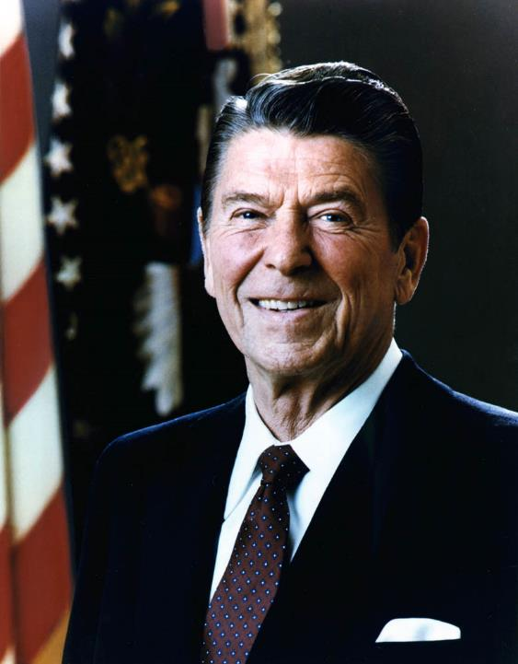

Interpersonal

Slide 17
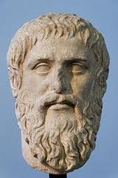
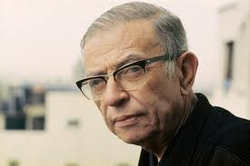
Intrapersonal

Slide 18

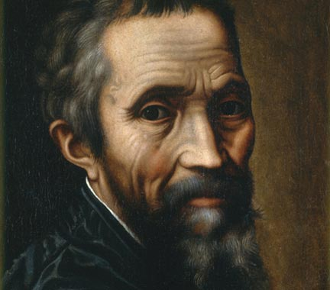
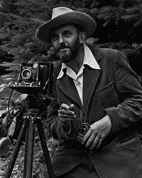
Artistic-spatial

Slide 19
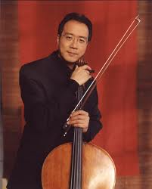

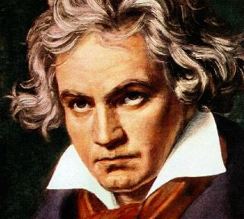
Musical

Slide 20


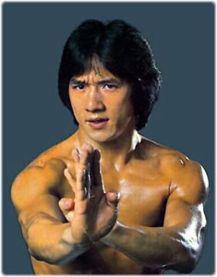
Kinesthetic

Slide 21
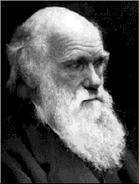
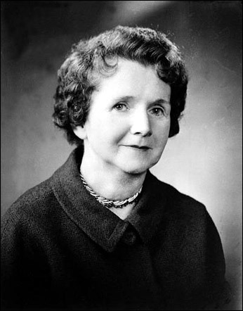
Naturalist

Slide 22
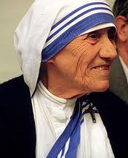
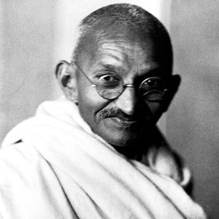
Moral

Slide 23
Assignment 4.1
Form a group of 3 to 4 people to discuss the following issue: The current Wechsler IQ test covers four aspects: Verbal comprehension, perceptual reasoning, working memory, and processing speed. The focus is on logical reasoning and information processing.
Gardner maintained that intelligence has 9 dimensions. If Gardner is right, then some dimensions of intelligence can grow, not decline, with aging.
Which dimension(s) can be benefitted from aging (experience) and which cannot? Why or why not? There is no right or wrong answer.
Post 0.5-1.5 pages on Canvas

Slide 24
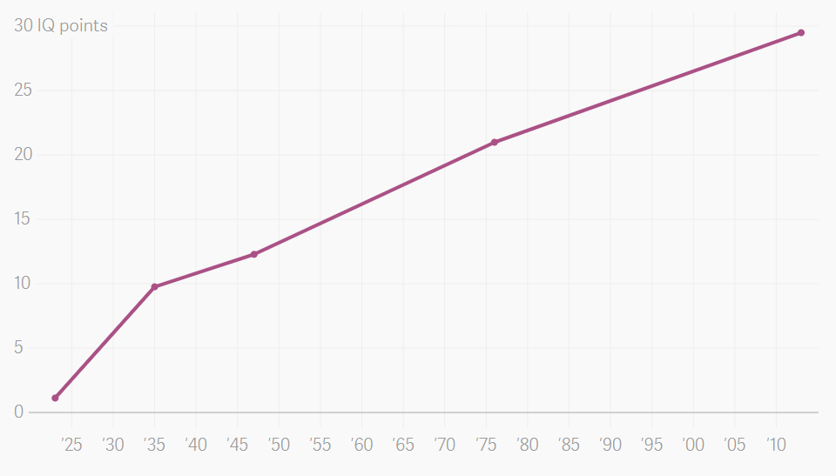
Flynn effect
First discovered by James Flynn
IQ test scores have been continuously increasing since the earliest years of testing.
A worldwide phenomenon
Why?
Technology?
Nutrition?
Notes:
https://www.theatlas.com/charts/BkbWZ3ODg

Slide 25

Technology
Symbolic manipulation → abstract reasoning

Slide 26
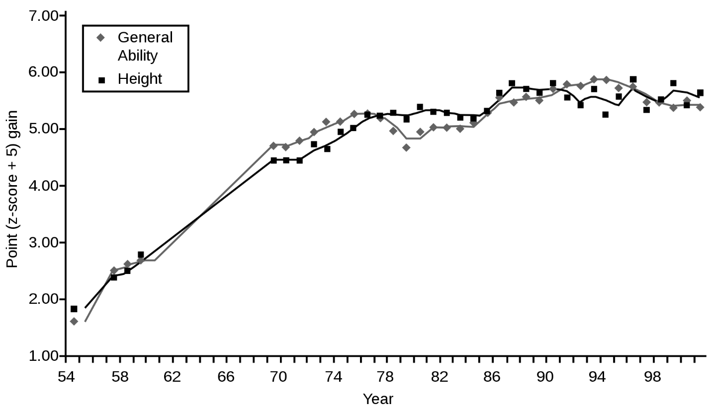

Slide 27
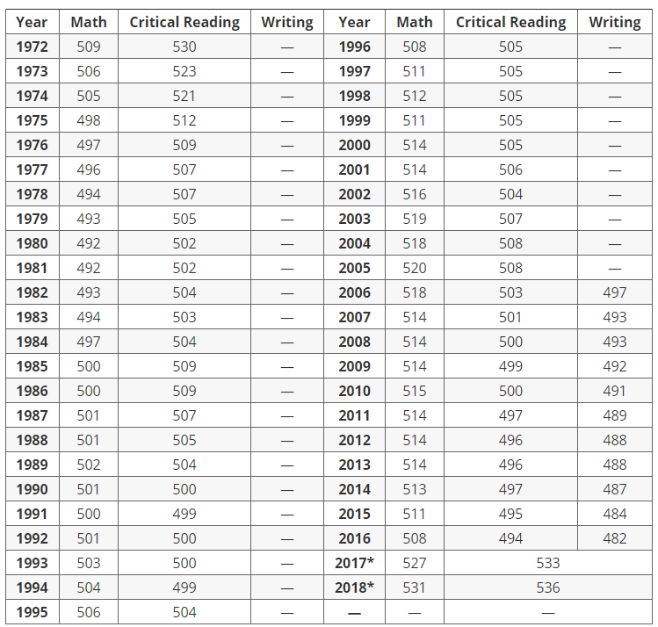
Notes:
https://blog.prepscholar.com/average-sat-scores-over-time

Slide 28
Grade decline
SAT scores in reading, writing and math decline in 2011 compared to 2010, and have been gradually declining for years. Critical reading scores are the lowest in 40 years.
In 2006 the SAT added a writing section to the verbal and math parts. Since then the average scores are down 6 points for reading; 4 points for math and 8 points for writing.
U.S. Department of Education reviewed student transcripts from 3,000+ universities and found that student grades have actually declined slightly over the last 20 years.

Slide 29
Assignment 4.2
Form a small group of 3-5 to discuss the following:
How can you explain the contradiction between rising IQ scores (Flynn effect) and declining SAT/other scores?
You are encouraged to search for additional references to answer the question.
Post 0.5-1.5 pages on Canvas.

Slide 30
Intelligence
Components of Intelligence
  Crystallized intelligence
    Skills and knowledge based on education and experience
    Verbal skills
  Fluid intelligence
    Influenced biologically
    Independent of learning
    Memory tests

Slide 31
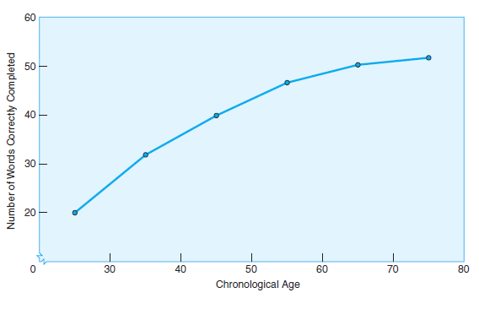
Figure 4.2
Number of Words Correctly Completed in NY Times Crossword Puzzle with Age
The number of words correctly completed in the New York Times crossword puzzle increases with age, showing the effect of mental “exercise” on crystallized abilities.
Notes:
Mental exercises can be very effective for adults
Source: Salthouse (2004)

Slide 32
Practical intelligence
Practical intelligence (street smart) (Sternberg, Wagner, Williams, & Horvath, 1995) vs. “academic intelligence,” “book smart” or “clever silliness” (Charlton, 2009).
Highly intelligent or well-educated people tend to be unable to solve practical problems due to lack of common sense or real-world experience.
Practical intelligence may grow with aging (experience).

Slide 33
Practical intelligence
Neisser (1976): academic intelligence tasks are:
  Formulated by others
  Often of little or no intrinsic interest
  Showing all needed information (in the real world usually a problem is not clearly defined and information is incomplete)
  Very remote from ordinary experience
  Have one correct answer (the real world is not black and white)
  One method to obtain the answer

Slide 34
Intellectually changeling but impractical
How often do we solve a logical problem like the following?
  “In a certain flight crew, the positions of pilot, copilot, and flight engineer are held by three persons, Allen, Brown, and Carr, though not necessarily in that order. The copilot, who is an only child, earns the least. Carr, who married Brown’s sister, earns more than the pilot. What position does each of the three persons hold?”
Source: Copi, I. M., Cohen, C., & McMahon. (2011). Introduction to logic

Slide 35
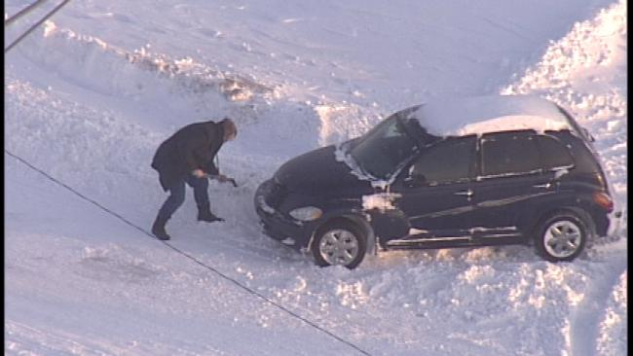
Test of practical intelligence
Examples of practical IQ test:
  What would you do if your car broke down in the wilderness during a blizzard and there is no cell phone signal?
  If you are from the east coast, you need this type of intelligence.
  How engineers resolve the problem of vehicle break-down?

Slide 36

Test of practical intelligence
Examples of practical IQ test:
  You are a woman. You are walking back to your apartment on a quiet street at night. You realize that a man is following you. Your cell phone has no battery!
  What would you do?

Slide 37
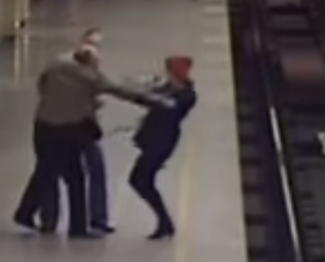
Test of practical intelligence
In a train station you saw a man and a woman quarreling.
Suddenly the man pushed the woman from the platform into the railway track.
What would you do?
https://www.youtube.com/watch?v=OPqDSDrx_1o
Woman is pushed onto RAIL Tracks in Underground Station, St Petersburg, Russia

Slide 38
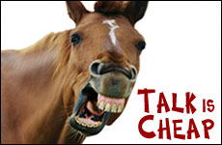
Problem of hypothetical scenario
When facing the challenge in real life, people usually do not do what they answer they would do in the hypothetical situation.
This phenomenon is known as the attitudinal fallacy or talk is cheap (Jerolmack & Khan, 2014).

Slide 39
Examples of scenario-based (real) test:
Some may go even further to create a real test:
  A real test (2:50; there are two bad words in the movie clip. I will mute the audio): https://www.youtube.com/watch?v=8-T_uhQ0iE4
  When the examinees are told to enter data into a computerized system, suddenly the computer crashes and all data are “lost”.
  In the US Navy Seal the trainer is talking to his trainees, suddenly a “terrorist” emerges, shoots at them, and then goes away.
  When the nursing professor is talking to the examinees, he fakes a heart attack.

Slide 40
Ungraded in-class activity
Create a problem that can test practical intelligence. It can be about any subject matter. Present your problem to the class and evaluate the answer.

Slide 41
Is emotion contradicted with intelligence?
Conventional IQ tests focus on logical reasoning and information processing.
Emotion is put at the other polar of the spectrum. If we say someone is emotional, it means that he or she cannot make a rational judgment or a wise decision. Is it true?

Slide 42

Buridan's intelligent donkey

Slide 43

Buridan's intelligent donkey
Named after the 14th century French philosopher Jean Buridan
The paradox is about how a rational being is unable to make a rational decision:
An intelligent donkey is placed between two identical piles of hay. Because they are equally good, there is no compelling reason to favor one over the other. The donkey is unable to choose between the two. At last it starves to death.

Slide 44
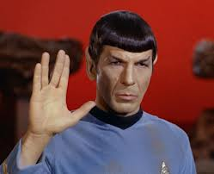
Damasio's research
Neuroscientist Antonio Damasio studied a patient who had head injuries but lost emotion, while other intellectual abilities are intact.
His ability to make decisions was impaired. He could logically analyze the pros and cons of different options, and was aware of what should be done. But he could not make a simple decision, such as which restaurant to go for lunch.
A pure rational being without emotion, such as Spock in Star Trek, CANNOT function in the real world.

Slide 45


Emotional Intelligence
Definition of EQ (Bar-On, 2006): “a cross-section of interrelated emotional and social competencies, skills, and facilitators that determine how effectively we understand and express ourselves, understand others and relate with them, and cope with daily demands.”
Older people tend to better-control their emotion and have better social skills.

Slide 46
Memory
Learning Objective 4.2 Define memory, its type and reversing its decline
Short-Term and Working Memory
  Primary memory: Passive maintenance of information
  Working memory: Amount of information held in mind while performing some type of operation on it
  Age decline: Primary memory remains stable but working memory declines
  Executive function
    Processes involved in regulating attention and determining what to do with information
    Declines in older adults

Slide 47
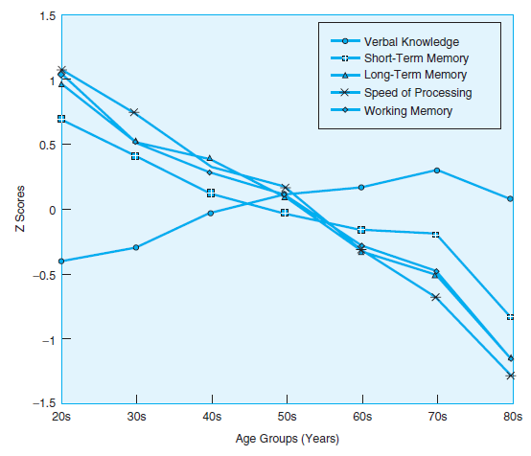
Figure 4.3
Age-Related Cross-Sectional Changes on Cognitive Tasks
Age related cross-sectional changes are demonstrated on a variety of cognitive tasks. Note that although both short-term (primary) and working memory decline with advancing age, the decline is steeper for working memory.
Notes:
Working memory declines more quickly than primary memory
Source: Park, Lautenschlager, Hedden, et al. (2002)

Slide 48
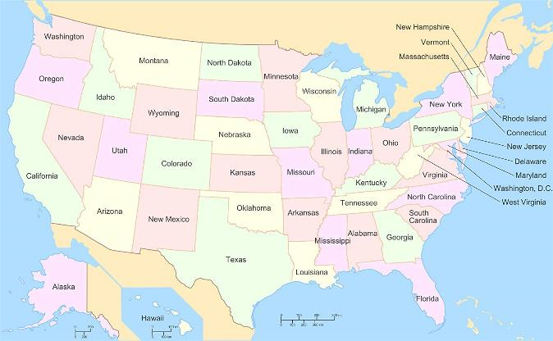

Memory
Declarative (or explicit) Memory
  Semantic memory: Non-personal, verbal (e.g. There are 50 states in USA)
  Episodic memory: Personal (e.g. My family and I had a memorable vacation in Europe in 1995)

Slide 49
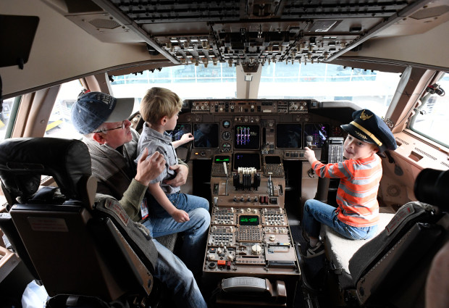

Memory
Nondeclarative (procedural) memory: skill (e.g. how to play piano, how to use fly a Boeing 747, I hope they are not my pilots)
Prospective Memory: Remembering to do something later (e.g. you will celebrate your girlfriend's birthday tomorrow. If you forgot, the consequence will be…)

Slide 50
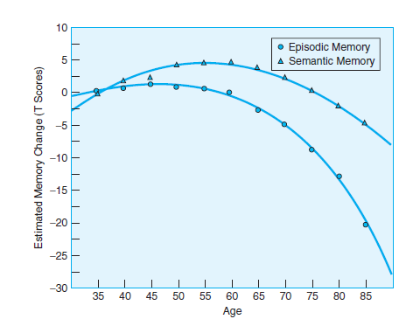
Figure 4.4
Estimated Age-Related Changes in Semantic and Episodic Memory Abilities
Estimated age-related changes in semantic and episodic memory abilities. Semantic memory abilities show increases over middle adulthood and a slow decline in older age, whereas episodic abilities display a sharper decline in the mid-60s.
Notes:
Semantic memories increase, then decrease, while episodic abilities decline more quickly
Source: Rönnlund, Nyberg, Bäckman, et al. (2005)

Slide 51
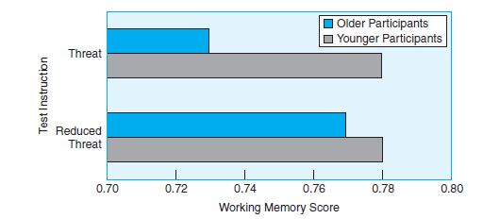
Figure 4.5
Effects of the Negative Age Stereotype
Working memory scores for older adults decreased sharply when they were reminded of the negative age stereotype. When this reminder was reduced, their scores were more similar to the younger group.
Notes:
Negative age stereotype affects memory
Source: Mazerolle, Régner, Morisset, et al. (2012)

Slide 52
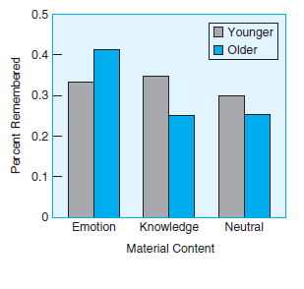
Figure 4.7
Memory Content
Older participants remember more information than younger participants when material has emotional appeal; younger participants remember more when material has knowledge or neutral appeal.
Notes:
Emotional appeal is important to help memory
Source: Fung & Carstensen (2003)

Slide 53
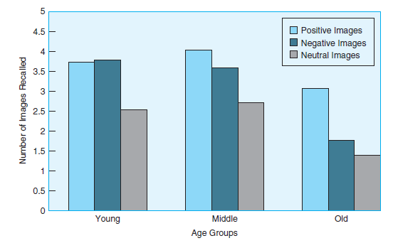
Figure 4.8
Positivity Bias
The number of positive, negative, and neutral images recalled is a function of age, with older adults showing a distinct positivity bias.
Notes:
Effects of positivity bias
Source: From Charles, Mather, & Carstensen (2003)

Slide 54
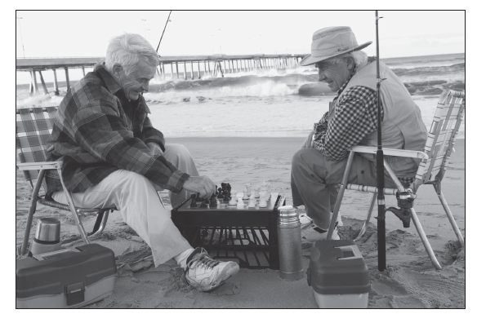
Be active!
Older people who exercise cognitive skills, like these chess players, retain those skills well into late adulthood.
Notes:
Mental exercise helps maintain cognitive skills

Slide 55
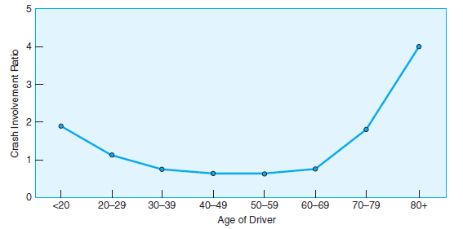
Figure 4.11
Risk of Crash by Age
Drivers under 20 years of age and those in their 70s have similarly high rates of two-vehicle fatal crashes, but the highest rated group is 80 years and older.
Notes:
Source: National Highway Traffic Safety Administration (2009)

