Slide 1
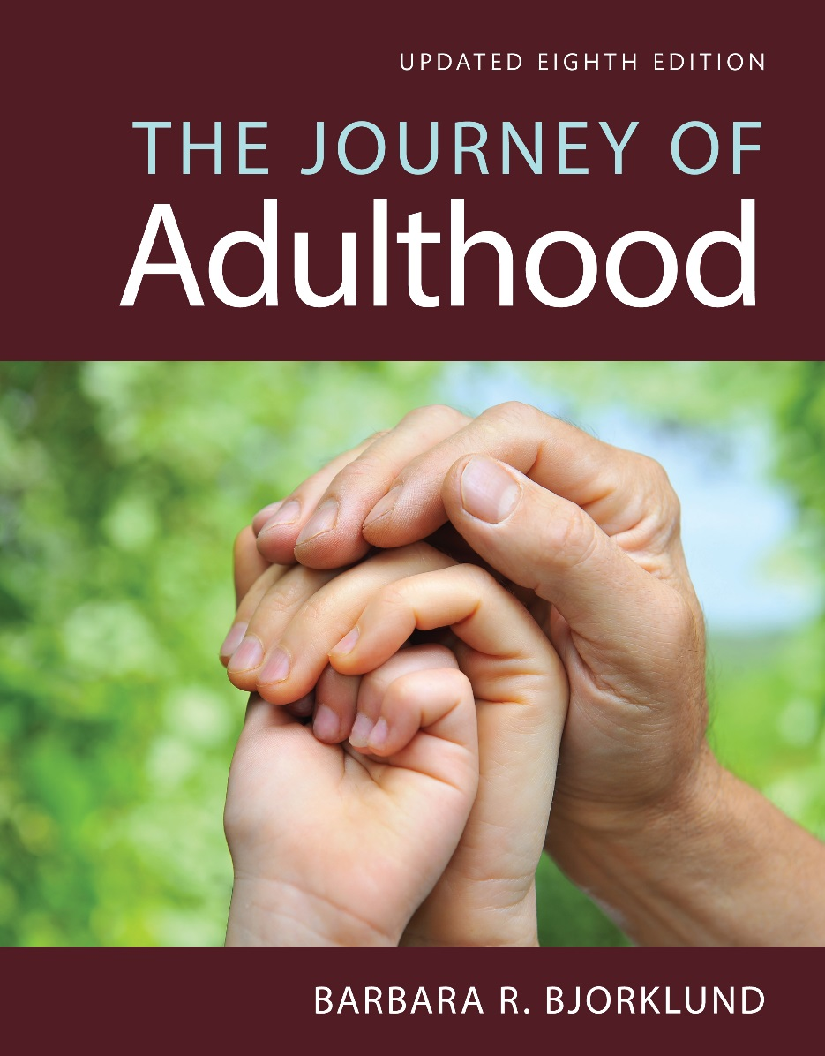
Health and Health Disorders
Eighth Edition
Chapter 5
Social Roles

Slide 2
Social Roles and Transitions
Objective 5.1
  Social roles: Expected behaviors and attitudes that come with one’s position
  Role transitions: not gain or loss; roles change with life circumstances
  Social clock: Similar to a biological clock (readiness, maturity)

Slide 3
Gender Roles and Gender Stereotypes
Objective 5.2
  Gender roles
  Gender stereotypes
    Sets of shared beliefs or generalizations about what men and women in a society have in common
    Male – instrumental qualities: aggressive, logical, good at science & engineering
    Female – communal qualities: kind, intuitive, good at helping & nurturing

Slide 4

Gender Roles and Gender Stereotypes
Objective 5.2
  True story 1: Long time ago an instructor told the class: “Girls don’t have to work hard to earn a good grade. You can marry a good man.”
  What is the hidden message (stereotype)? Do you think it is appropriate for the instructor to say so?

Slide 5

Gender Roles and Gender Stereotypes
Objective 5.2
  True story 2: Long time ago a woman told a group of friends that her major was engineering. Her male friends said, “Wow! You are a strong woman!”
  What is the hidden message? Do you think it is appropriate for her friends to say so?

Slide 6

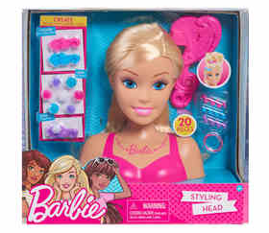
Theories of Gender Roles and Gender Stereotypes
Objective 5.2
Learning-schema theory – see the world through a gender-polarized lenses.
What kind of toys will you buy for your son and daughter?

Slide 7

Theories of Gender Roles and Gender Stereotypes
Objective 5.2
Social role theory – observing division of labor of adults (e.g. A child sees that the doctor is a man and the nurse is a woman)
Evolutionary psychology – genetic pre-disposition to behave in different ways
Biosocial perspective – interaction between cultural bias and biological difference.

Slide 8
Assignment 5
https://www.youtube.com/watch?v=vvIzGbWq7Ko
https://www.youtube.com/watch?v=8FyG5y4nXUU
Format a small group of 3-5 to discuss the following two questions:
Should the government ban ads that reinforce gender stereotypes?
Is the concept of expecting communal behavior from females and instrumental behavior from men becoming outdated? Why or why not?
Post a short report (0.5-1.5 pages) on Canvas.

Slide 9
Marriage and quality of life
Objective 5.3
  https://www.youtube.com/watch?v=wTSniXFsV_Q
  Married are happier and healthier
  Of married adults 40 percent call themselves very happy, compared to 23 percent of never-marrieds do (Seligman, 2002).
  Based on World Values Survey data, in 16 of 17 industrialized nations, marital status was significantly related to well-being (Stack & Eshleman).

Slide 10
Marriage and quality of life
Objective 5.3
  Marital selection effect: Happy people tend to get married (Cause and effect is reversed)
  Marital resources effect: Pull together resources of two
  Marital crisis effect: No divorce
  Marital stability not same as marital quality

Slide 11
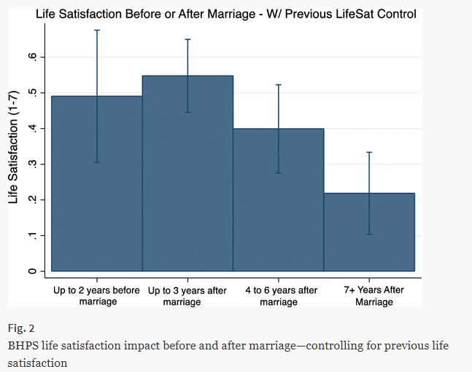
Marriage and quality of life
Objective 5.3
https://link.springer.com/article/10.1007/s10902-017-9941-3#Sec6

Slide 12
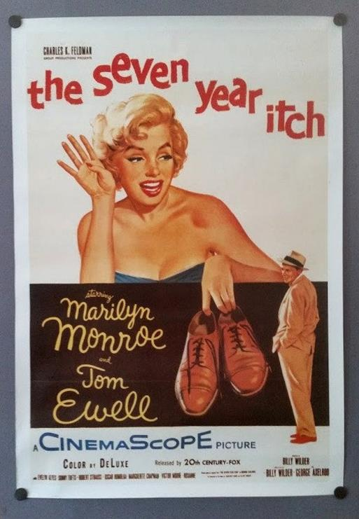
The seven year itch?
A1955 American comedy film.
A middle-age man met a charming model.
Someone told the man that almost all men are driven to have extra-marital affairs in the seventh year of marriage.
After facing many temptations, at the end he said “no”.
https://www.youtube.com/watch?v=LxWJ4QT74hA

Slide 13
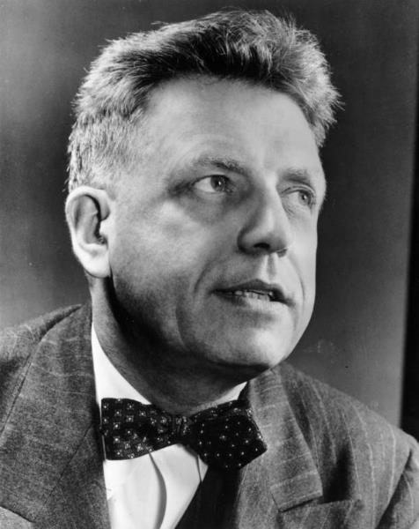
The seven year itch?
Alfred Kinsey’s 1948 and 1953 sex studies found that 50% of US men sought an affair.
Katherine Hertlein, Professor of Human Development at the University of Nevada, estimated the number at 40%.
Difficult to obtain the true numbers. Why?

Slide 14
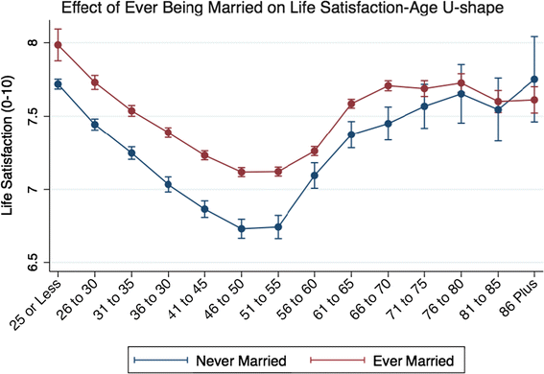
U-shaped or nonlinear pattern
If you can survive your marriage’s lowest point, it will get better!

Slide 15
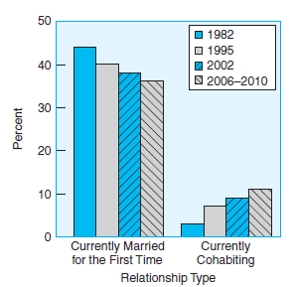
Figure 5.2
Women and Relationship Type, by Year
  Cohabitation
  Decrease of marriage rate
  Later marriage
  More U.S. women between the ages of 15 and 44 are currently living in marriages than in cohabiting relationships.
  The proportion who are married has decreased since 1982 and the proportion who are cohabiting has increased.
Notes:
Marriage is decreasing as cohabiting is increasing
Source: Copen, Daniels, Vespa, et al. (2012)

Slide 16
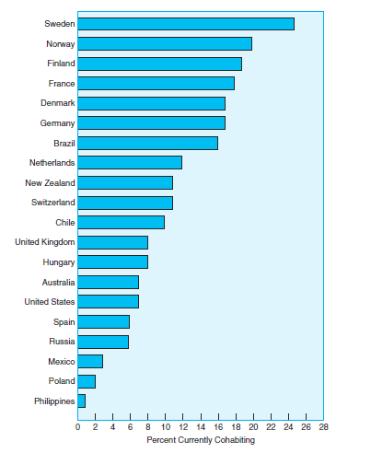
Figure 5.3
Women’s Cohabitation Rates by Country
International data show that the proportion of women between 18 and 75 years of age living in cohabitation relationships ranges from 25% in Sweden to less than 1% in the Philippines.
Notes:
Note the large percentage of Europeans who are cohabitating
Source: Data from Lee & Ono (2012)

Slide 17
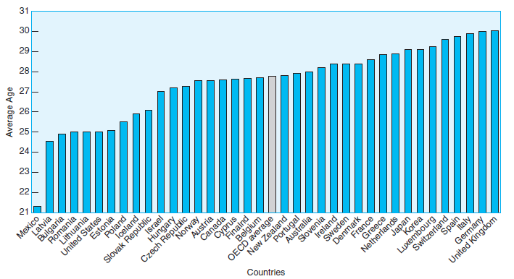
Social Roles in Young Adulthood: Parents
Objective 5.3
  Later and later age
The average age at which women first give birth ranges from just over 21 in Mexico to almost 30 in the United Kingdom and Germany. The worldwide average is almost 28 and the United States is relatively low at 25.

Slide 18

Social Roles in Young Adulthood: Parents
Objective 5.3
Gender roles among couples with children (related to evolutionary psychology)
Parental imperative:
  A newborn horse can walk, but a human child is helpless.
  Humans need a bigger brain to be intelligent.
  A big head baby threatens the mother due to the narrowness of birth canal
  Humans are born with smaller brains and then grow later.

Slide 19


Parents
Objective 5.3
Parental investment theory:
  Women invest 9-10 months of pregnancy and several years of care for children, but males contribute little physically.
  Men are hardwired to be less faithful due to low investment.

Slide 20
Parents
Objective 5.3
Economic exchange theory: Men and women function as a couple to exchange goods and services
Parenthood and marital happiness: Joy at first, decrease in happiness

Slide 21
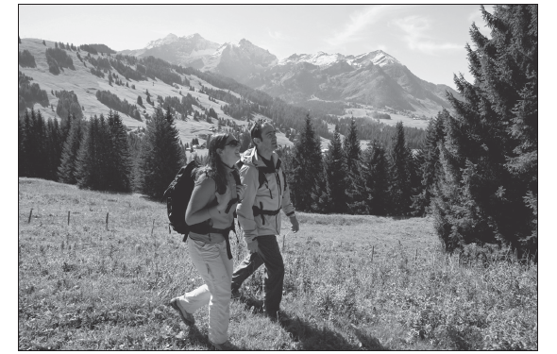
Social Roles in Middle Adulthood
The Departure of the Children: The Empty Nest
  Positive experience
  Higher levels of happiness
  New opportunities
Gender Roles at Midlife
  Crossover of gender roles
  Expansion of gender roles

Slide 22
Discussion
What is your opinion on the empty-nest syndrome? Have you observed this in your parents or perhaps in yourself? Did this time of life bring an increase in life satisfaction? A decrease?

Slide 23
Social Roles in Middle Adulthood (2 of 2)
Becoming a Grandparent
  More grandparents than ever
  Grandparents raising grandchildren (due to problems of parents e.g. in jail, finance, drug, alcohol…etc.)
Caring for an Aging Parent
  Gender and caregiving
  Impact of caregiving: Caregiver burden

Slide 24
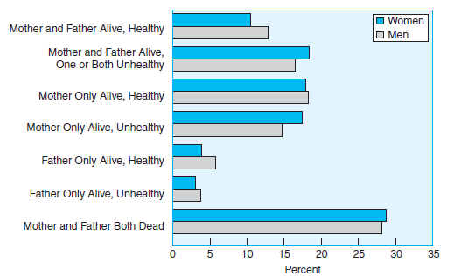
Figure 5.5
Middle-Aged Adults and Their Parents’ Health
About 78% of middle-aged adults (aged 40–59) have at least one living parent, and for over a third of those, one or more of their parents is not in good health.
Notes:
Note the aging population overall
Source: Data from Marks, Bumpass, & Jun (2004)

Slide 25
Social Roles in Late Adulthood
Living Alone
  Change of role
  Living arrangements
Becoming a Care Receiver
  Remaining independent
  Loss of freedom
  Care from family
Notes:
Living Alone
Point 1 – Change of role
Widowhood, divorce
Point 2 – Living arrangements
Gender
Number of children
Resources
Becoming a Care Receiver
Point 1 – Remaining independent
Important, no matter where living
Point 2 – Loss of freedom
Mourn loss of freedom
Point 2 – Care from family
Benefits (mend ties)
Disadvantages (stressful)

Slide 26
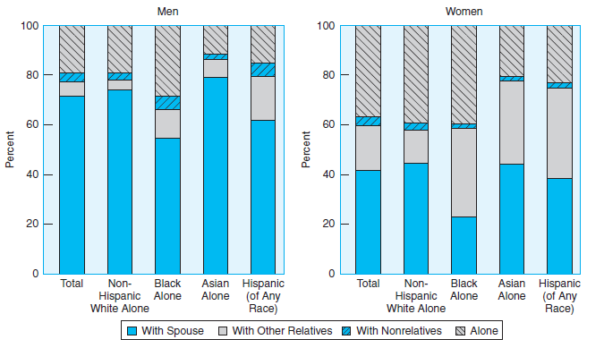
Figure 5.6
Living Arrangements of People over 65
Over 70% of men 65 years of age or older live with their spouses and almost 20% live alone. For women this age, only 42% live with their spouses and almost that many live alone (37%). The proportion living with relatives depends on the racial/ethnic group and gender.
Notes:
Source: Federal Interagency Forum on Aging Related Statistics (2012)

Slide 27
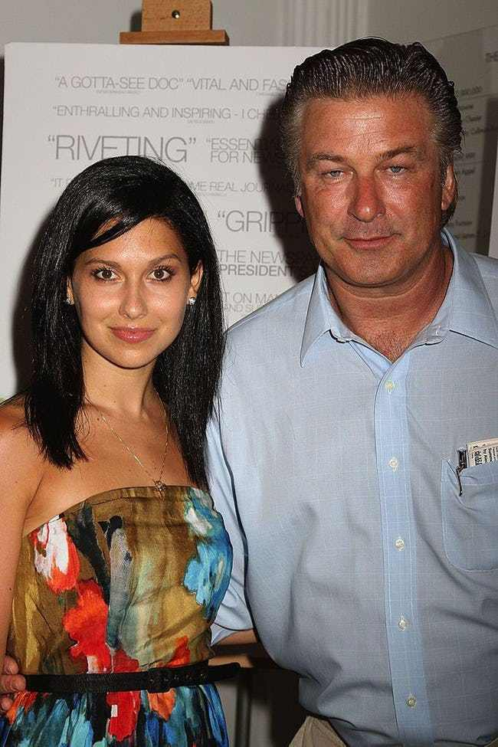
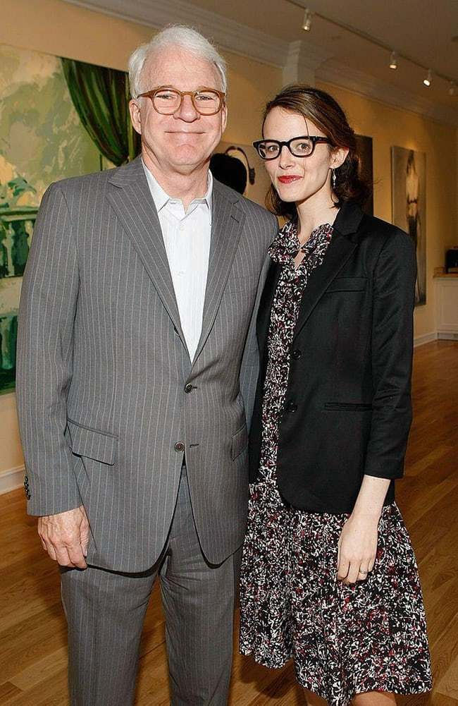
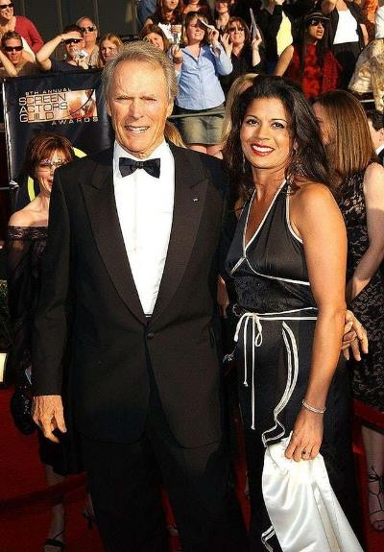
More men than women over 65 live with their spouses, especially since men tend to marry younger women

Slide 28
Ungraded Discussion
It is more common for an older man to marry a much younger woman (e.g. 30 years apart), but not the other way around. Why?
In some cultures it is acceptable for an older man to marry a much younger woman, but in some cultures it is not acceptable? What are the reasons for objection?

Slide 29
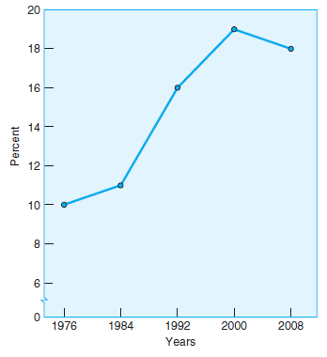
Percent of Women Aged 40 – 44 Who Have Had No Children
Lifelong Singles
The Childless
The percent of U.S. women aged 40 to 44 who have had no children has increased over the last three decades, declining slightly since 2000.
Possible cause: technology
Notes:
Note the sharp increase of childlessness
Source: Data from U. S. Census Bureau (2013)

Slide 30
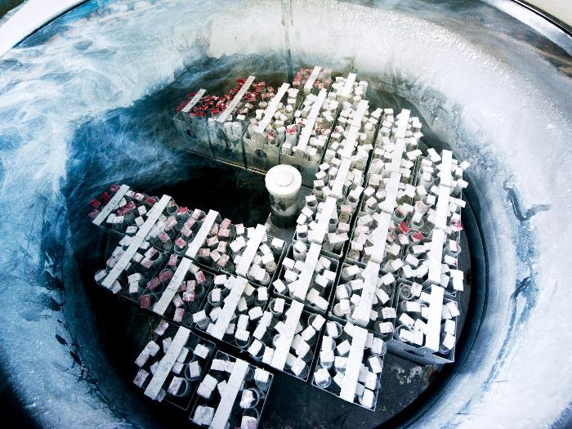
Egg freezing can preserve a woman's eggs so that women to postpone pregnancy to a later date.
The success rates are between 1.5% and 31.5%

Slide 31
Ungraded Discussion
What do you think are some of the reasons for the increase in voluntary childlessness in the United States and around the world?

Slide 32
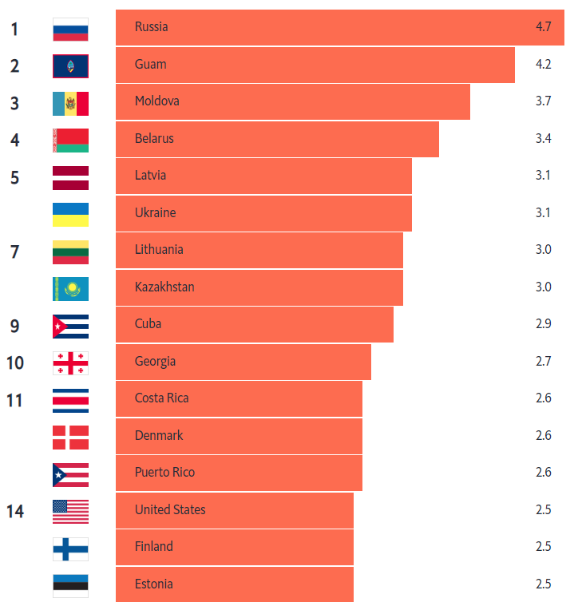
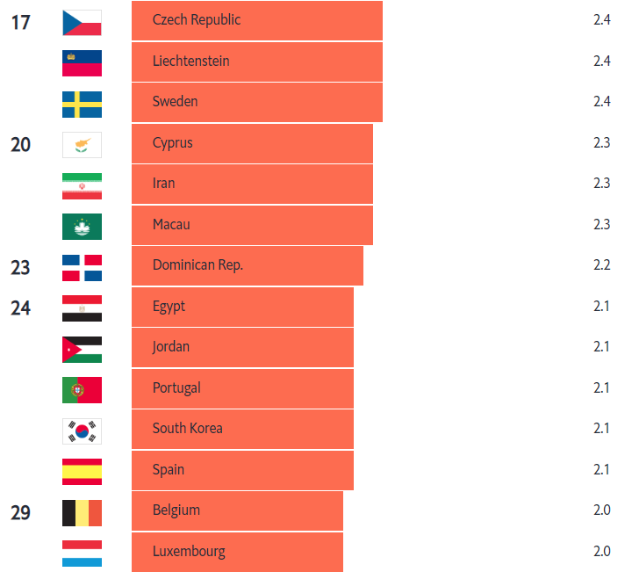
Divorce
Number of divorces per 1,000 population 2017 or latest available
Notes:
Point 2 – New roles
Blended families
Gender roles
Stepmothers

Slide 33
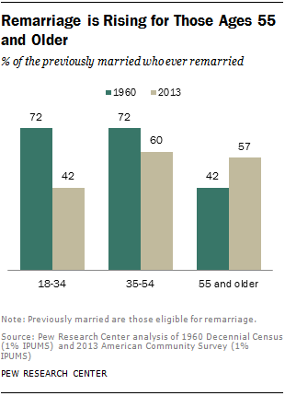
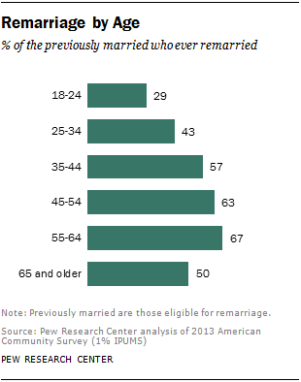
Divorced and remarried

Slide 34
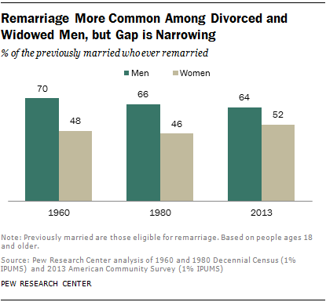
Divorced and remarried

Slide 35
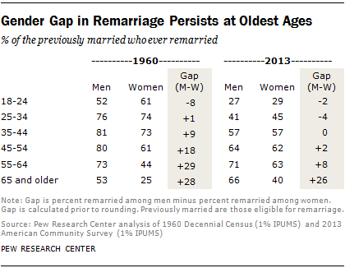
Divorced and remarried

Slide 36
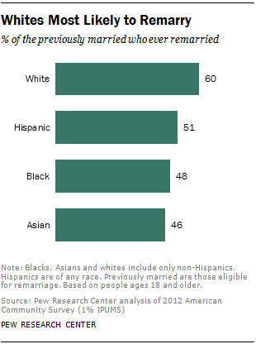
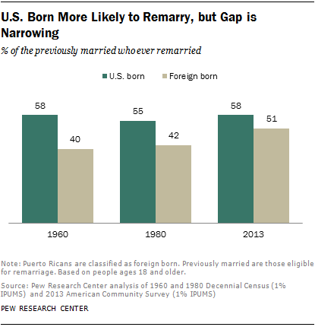
Divorced and remarried

Slide 37
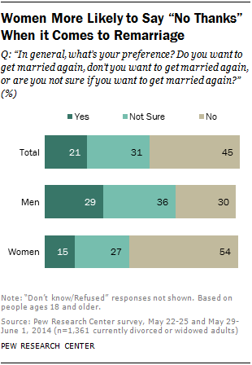
Divorced and remarried
In 2013 About 40% of all the new marriages in 2013 were not first marriages.
Only 7% of people who are remarried live in poverty, compared to 19% of people who are not remarried.
Men are much more interested in remarriage than women are.
Why? What do you think?

Slide 38
Divorced and remarried
Women tend to live longer
Women now have more economic freedom and independence.
Women may be still resentful: “I will never make the same mistake again!”

Slide 39
Assignment 5.2: Faith integration
According to a statistics, the divorce rate of Christians is 42%, which is lower than that of the general population (53%).
In some Christian churches, divorcees carry a stigma because Matthew 5:32 is interpreted as a clear argument against divorce.
Some churches disallow divorcees to serve in any key positions (e.g. missionary, deacon…etc.)
If you were a pastor, what message would you tell your church member who had been divorced?

