Slide 1

Health and Health Disorders
Eighth Edition
Chapter 7
Work and Retirement

Slide 2
The Importance of Work in Adulthood
Objective 7.1 – Explain the importance of careers in adult life and gendered career patterns

Slide 3
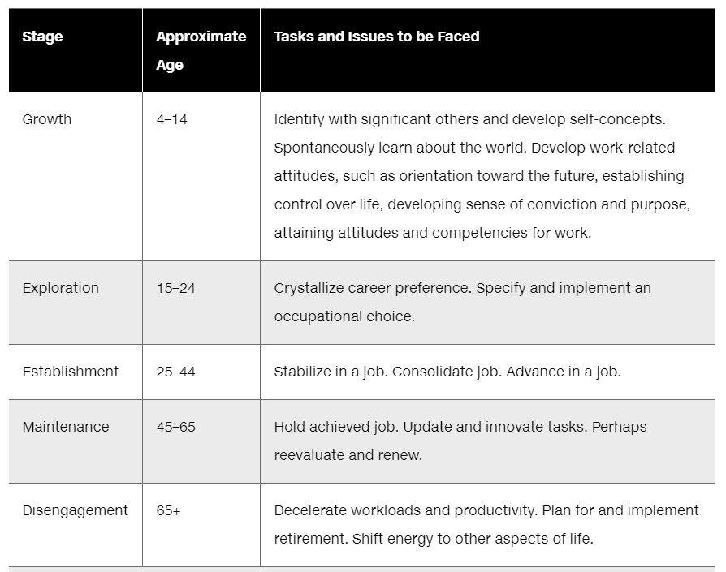
Super’s Five Stages of Career Development

Slide 4
The Importance of Work in Adulthood
Gender Differences in Career Patterns
  More men work full-time: 70% of men; 57% of women
  Men stay in full-time jobs longer
  Women work more part-time jobs: 26% women; 13% men

Slide 5
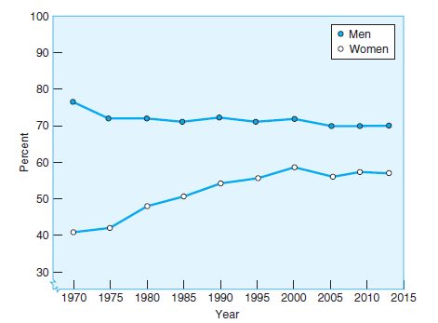
Figure 7.1
Percent of Men and Women Working Full-Time Jobs
A greater number of men than women hold full-time jobs, but the gap is closing because of an increase in the percent of women who work outside the home.
Notes:
More women are entering and staying in the workforce
Source: Data from U.S. Bureau of Labor Statistics (2013c)

Slide 6
Selecting a Career
Objective 7.2 – Explain various career selection theories with reference to gender, family influence and genetics

Slide 7
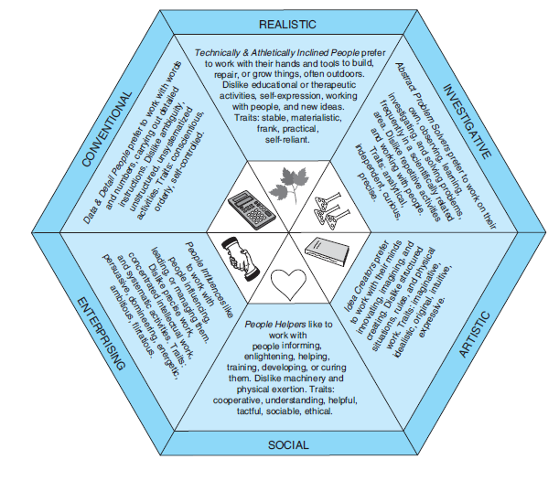
Selecting a Career
Theories of Career Selection: John Holland

Slide 8
Selecting a Career
Theories of Career Selection: John Holland
Finding a job that fits one’s vocational interests may lead to greater job satisfaction, but it does not predict that one will advance in the job or stay with it over the long term.

Slide 9
Selecting a Career
Theories of Career Selection: James E. Marcia
  Diffusion stage: Don’t care (No exploration, no commitment).
  Foreclosure stage: A career is chosen without much thought (commitment, no exploration).
  Moratorium stage: Exploration, no commitment.
  Achievement stage: Exploration and commitment.

Slide 10
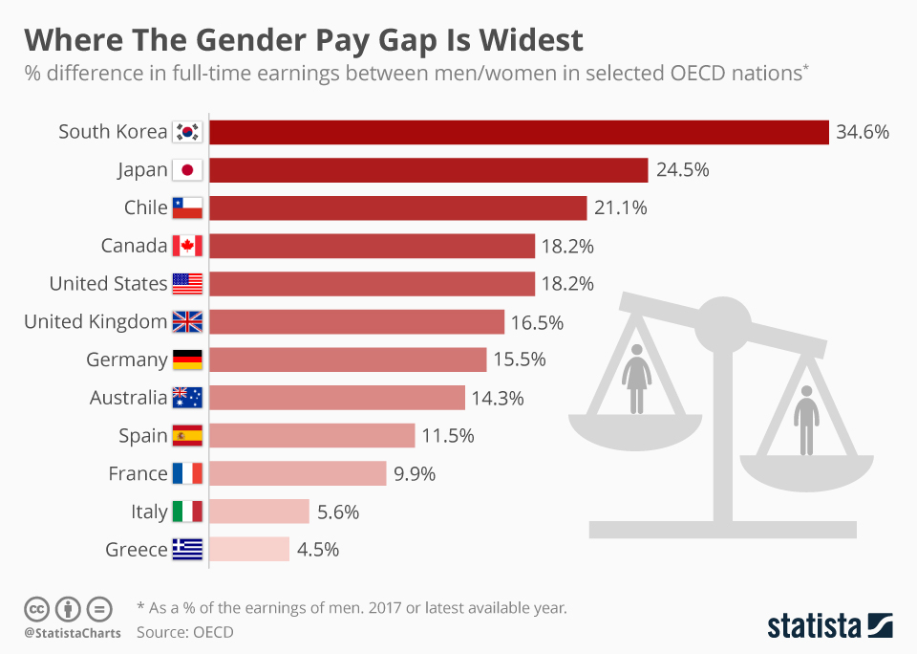
Gender gap in Salary worldwide
Source: https://www.statista.com/chart/13182/where-the-gender-pay-gap-is-widest/

Slide 11
Gender gap in Salary in USA
Women’s career discontinuities (e.g. having a child) result in lower salaries and lack of job advancement.
Women earn less money than men even when they work full time. In 2016 women’s salaries average only 79% of men’s.
https://www.youtube.com/watch?v=13XU4fMlN3w

Slide 12
Gender Gap: Why?
Meta-analysis: Women are more interested in working with people, and men are more interested in working with things.
Men plan to work steadily until retirement, and women plan to move in and out of the paid workforce as they have children.
Women are discouraged from going into STEM.
https://www.youtube.com/watch?v=tn3yqmiwKAk
Notes:
The Effects of Gender
Point 1 – Occupational gender segregation
Income differentials
Pink collar jobs
STEM
Point 2 – Reasons
Different career interests
Different career patterns
Discouragement

Slide 13
Assignment
Form a small group of 3-5 to discuss the following questions. Please try to form a mixed-gender group:
What can we so to rectify the situation of gender gap in salary?
What are plausible explanations for gender equality paradox in STEM?
Post a brief report (0.5-1.5 page) on Canvas

Slide 14

Selecting a Career (2 of 2)
Family Influence: Educational attainment: Middle-class parents are far more likely than working-class parents to encourage their children to attend college
Role modeling: e.g. Children of professors tend to be faculty

Slide 15
Selecting a Career
Stereotype: mothers who believe that girls are not as good at math as boys produce daughters whose own math performance is lowered.
Marital status of the parents: single parents do not provide the same level of encouragement and financial support as married parents to children

Slide 16
Age Trends in Work Experience
Objective 7.3 – State effects of age-related declines in cognitive abilities, reaction time, physical strength and sensory abilities

Slide 17
Age Trends in Work Experience
Older workers are better
more citizenship behaviors (compliance to norms, not complaining about trivial matters, helping fellow workers) and more on-the-job safety behaviors.
engage in fewer counterproductive work behaviors (workplace aggression, on-the-job substance abuse, tardiness, and voluntary absences from work).
are more satisfied with their jobs than younger workers. This might be a partial explanation of why job performance does not always decline as workers get older.
Notes:
Job Performance
Point 1 – General ability
May decline with age
Point 2 – Job expertise
Increases with age
Ability/expertise trade-off
Job Training and Retraining
Point 1 – Career recycling
Super’s stages
Point 2 - Nontraditional college students
38% of college students are over 25

Slide 18
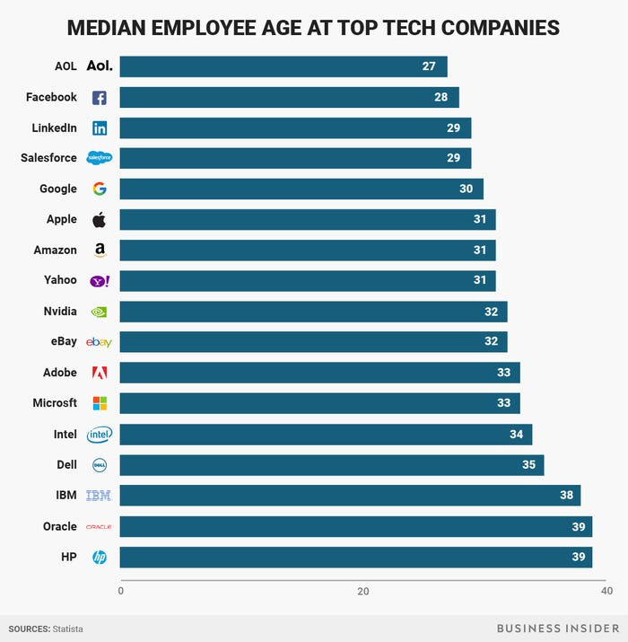
Ageism in high tech industry
Older people faced layoffs. In 2018 IBM removed 20,000+ jobs held by employees aged 40+
Older startup founders (age > 36) are refused.
https://www.youtube.com/watch?v=xDphVJS9Aos
Is it fair? What do you think?

Slide 19
Nontraditional college students
The National Center for Education Statistics defines nontraditional students as:
  delayed enrollment into postsecondary education
  attends college part-time
  works full time
  is financially independent for financial aid purposes
  has dependents other than a spouse
  is a single parent;
  or does not have a high school diploma

Slide 20
Nontraditional college students
According to Stamats, more than 47 percent of students who are currently enrolled in colleges and universities in the US are 25+.
Most of them have been in the workforce or have been working in the home raising their children and are now back for retraining to take the next step in their careers.

Slide 21
Nontraditional college students
Implications for me (faculty):
  I cannot keep my work hours from 9 to 5 only.
  Use more online resources for remote access
  Provide dinner or snack for night classes
  De-emphasize memorization on tests.

Slide 22
Ungraded discussion
Have you ever encountered any non-traditional students? Are you a nontraditional student?
In your experience what are the differences between traditional and nontraditional students?
What can we do to help them/you succeed?

Slide 23
Work and Personal Life
Objective 7.4 – Relate work to the individual, relationships, and family

Slide 24
Work and Personal Life
https://www.youtube.com/watch?v=Sceo_3BVv0s
Job turnout: job-related stress
exhaustion, depersonalization, and reduced effectiveness (lack of accomplishment)
common among workers whose jobs involve dealing with demanding people/situations, such as doctors, nurses, paramedics, social workers, counsellors, teachers, professors, customer service, retail staff, military, police, and prison officers.

Slide 25

Work and Personal Life

Slide 26
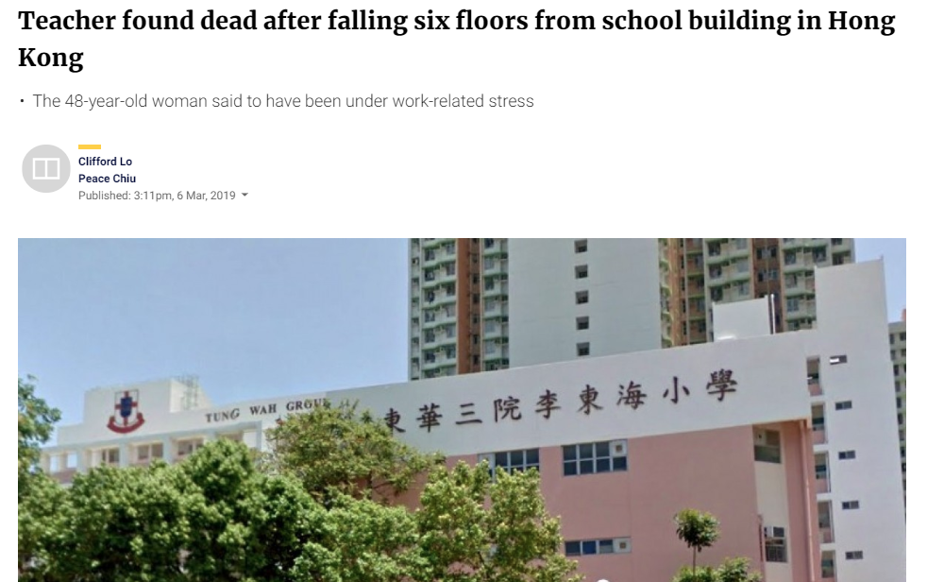
Work and Personal Life

Slide 27
Work and Personal Life
Sometime some people may unintentionally cause people burnout. How?
When someone is unhappy with the product or service, she yells on the customer service, even though the person on the phone is not responsible.
When a high school student is unhappy with his grade in a difficult subject matter, his parent complaint to the superintendent, even though the teacher has already offering extra help to the student.

Slide 28
Work and Personal Life
Protective factors of burnouts:
  Strong social support
  Better general health
  Open to suggestions and less resistance to change
  Open to criticism and less defensive
  Internal locus of control (attribute the outcome to oneself rather than blaming others)
  Do not validate self-worth by achievement or approval by other people

Slide 29
Ungraded discussion
What other jobs would you predict have high rates of job burnout?
Have you ever experienced burnouts? How and why?
Have you ever unintentionally done something to make people burnout?
What else would you do to avoid burnout?

Slide 30
Retirement
Objective 7.5 – 1. Discuss retirement in terms of reasons, timings and effects / 2. List reasons for retirement

Slide 31
Retirement
Preparation for Retirement
  Planned event
  56% have not planned financially
  Gender differences (women do not plan as well)
Timing of Retirement
  66-67 official
  Many before (FIRE: Financially independent, retire early) and after
  More older workers in the US than Europe

Slide 32
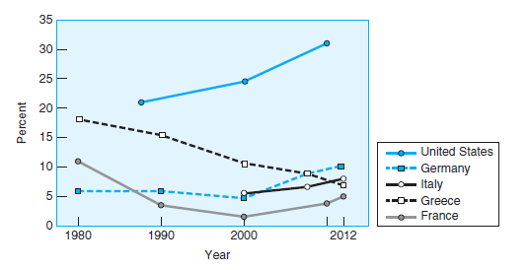
Figure 7.5
Percent of Older Workers by Year, Country
The percent of workers past traditional retirement age (65–69 years) has increased considerably in the United States in the last few decades. In contrast, it declined in several European countries until 2000
Notes:
Source: Data from United Nations Economic Commission for Europe (2013)

Slide 33
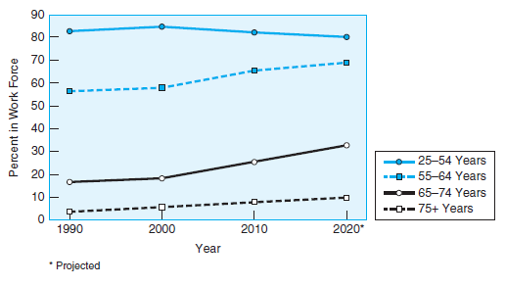
Figure 7.4
Percent in Work Force by Age
The percent of people in the U.S. workforce has remained about the same since 1990 for those 24 to 54 years of age, but has increased for older workers.
Notes:
Source: Data from Toossi (2012)

Slide 34
Retirement (2 of 3)
Reasons for Retirement: Finances
  Work-related values: increase in pension and Social Security benefits to be received later if he or she continues working
  https://www.ssa.gov/OACT/quickcalc/
  Retirement-related values: savings, investments, home equity, and other assets.

Slide 35
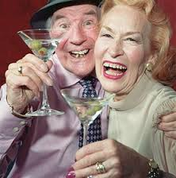
Retirement (2 of 3)
Other reasons for Retirement or keep working
  Psychological: afraid boredom and loss of purpose
  Health
  Family: e.g. pressured by husbands
  Career commitment: like the job or not
  Leisure time interests: Hobbies, travel

Slide 36
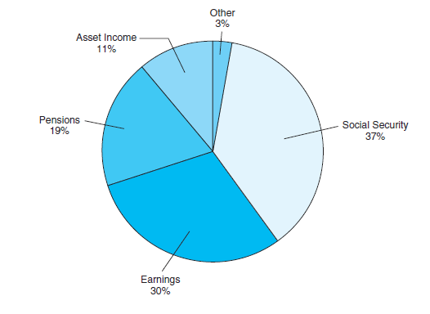
Figure 7.6
Sources of Income for Adults 65 and Older
Social Security is the largest source of income for people in the United States aged 65 and older, accounting for 37% of their income.
Notes:
Source: Data from Federal Interagency Forum on Aging-Related Statistics (2012)

Slide 37

Gender difference in retirement
Women have even more need than men to plan for retirement; at retirement age they have typically worked fewer years at lower salaries and have more years to live than their male counterparts.
Notes:
Women tend not to plan as well for retirement as men

Slide 38
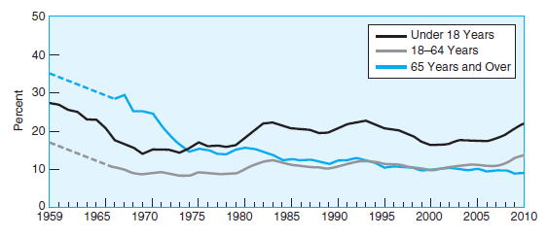
Figure 7.7
Poverty Rate by Age
The percent of older adults (65 years and older) living in poverty has declined slowly since the mid 1970s, whereas the percent of children (younger than 18 years) has increased. The percent of working age adults (18–64 years) have remained fairly stable.
Notes:
Poverty rates among youth have risen, while dropping for older adults
Source: Federal Interagency Forum on Age-Related Statistics (2012)

Slide 39
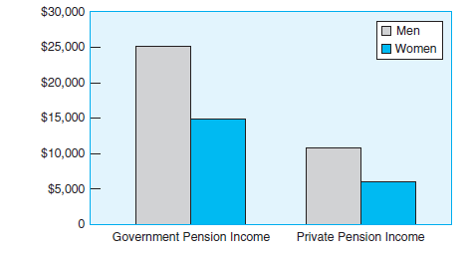
Figure 7.8
Pension Income by Gender
Women who are 65 years of age and older receive considerably less than men in both government pensions and private pensions.
Notes:
Women have significantly less income than men
Source: AARP (2012)

Slide 40
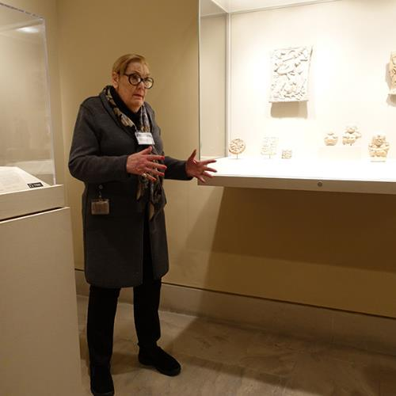
Retirement
Alternatives to Full Retirement
  Shunning retirement: Highly educated; Spouses with similar professions
  Returning to the workforce
  Gradual retirement: bridge job (more relaxing)
  Volunteer work: e.g. Tour guide at museum, oversea missionary
  Phased retirement: Transition to part-time

Slide 41
How to enjoy life after retirement?
Some retirees are unhappy (life is boring)
https://www.youtube.com/watch?v=8XQMQMP8Nn0
Ungraded discussion: What else would you do to enjoy your life after retirement?

