Slide 1

Health and Health Disorders
Eighth Edition
Chapter 8
Personality

Slide 2
Personality Structures
Objective 8.1 – Explain the trait theory of personality stability during adult years

Slide 3
Personality Defined
Traits, Types, and States
  Personality states : What I do in a particular situation (I am angry because he insults me when I lost my financial aids)
  Personality traits: This trait is one of my attributes or characters (bad-tempered, impatience )
  Personality types: this is what you are!!!! This defines you (e.g. You are a psychopath; you will rape and kill people no matter what. You are Type A, you are always nervous)

Slide 4

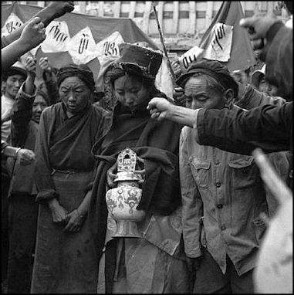
Personality state and Situational factors
Milgram’s study
Zimbardo’s Stanford prison experiment
How could many Germans who were Christians support the Nazi party during WWII?
Why did many Chinese people persecute their parents during the Cultural Revolution in Communist China?
https://www.youtube.com/watch?v=7G0UXnXpABw

Slide 5

Personality state and Situational factors
Sonmez, S.; Apostolopoulos, Y; Yu, C. H.; Mattila, A., & Yu, L. C. (2006). Binge drinking and casual sex on spring break. Annals of Tourism Research, 33, 895-917.
People will do unusual things in unusual situations

Slide 6
Drawback of personality assessment: Vagueness
You have a great need for other people to like and admire you. You have a tendency to be critical of yourself. You have a great deal of unused capacity which you have not turned to your advantage. While you have some personality weaknesses, you are generally able to compensate for them. Your sexual adjustment has presented problems for you. Disciplined and self-controlled outside, you tend to be worrisome and insecure inside.

Slide 7
Drawback of personality assessment: Vagueness
At times you have serious doubts as to whether you have made the right decision or done the right thing. You prefer a certain amount of change and variety and become dissatisfied when hemmed in by restrictions and limitations. You pride yourself as an independent thinker and do not accept others’ statements without satisfactory proof. You have found it unwise to be too frank in revealing yourself to others. At times you are extroverted, affable, sociable, while at other times you are introverted, wary, reserved. Some of your aspirations tend to be pretty unrealistic. Security is one of your major goals in life.

Slide 8
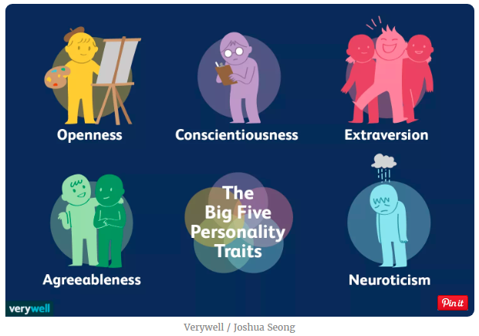
Personality Structures: Big Five
Notes:
Source: https://www.verywellmind.com/the-big-five-personality-dimensions-2795422

Slide 9
Openness
High
  Very creative
  Open to trying new things
  Focused on tackling new challenges
  Happy to think about abstract concepts
Low
  Dislikes change
  Does not enjoy new things
  Resists new ideas
  Not very imaginative
  Dislikes abstract or theoretical concepts
Notes:
https://www.verywellmind.com/the-big-five-personality-dimensions-2795422

Slide 10
Conscientiousness
High
  Spends time preparing
  Finishes important tasks right away
  Pays attention to detail
  Enjoys having a set schedule
Low
  Dislikes structure and schedules
  Makes messes and doesn't take care of things
  Fails to return things or put them back where they belong
  Procrastinates important tasks
  Fails to complete necessary or assigned tasks
Notes:
https://www.verywellmind.com/the-big-five-personality-dimensions-2795422

Slide 11
Extraversion
High
  Enjoys being the center of attention
  Likes to start conversations
  Enjoys meeting new people
  Has a wide social circle of friends and acquaintances
  Finds it easy to make new friends
  Feels energized when around other people
  Say things before thinking about them
Low
  Prefers solitude
  Feels exhausted when having to socialize a lot
  Finds it difficult to start conversations
  Dislikes making small talk
  Carefully thinks things through before speaking
  Dislikes being the center of attention
Notes:
https://www.verywellmind.com/the-big-five-personality-dimensions-2795422

Slide 12
Agreeableness
High
  Has a great deal of interest in other people
  Cares about others
  Feels empathy and concern for other people
  Enjoys helping and contributing to the happiness of other people
  Assists others who are in need of help
Low
  Takes little interest in others
  Doesn't care about how other people feel
  Has little interest in other people's problems
  Insults and belittles others
  Manipulates others to get what they want
Notes:
https://www.verywellmind.com/the-big-five-personality-dimensions-2795422

Slide 13
Neuroticism
High
  Experiences a lot of stress
  Worries about many different things
  Gets upset easily
  Experiences dramatic shifts in mood
  Feels anxious
  Struggles to bounce back after stressful events
Low
  Emotionally stable
  Deals well with stress
  Rarely feels sad or depressed
  Doesn't worry much
  Is very relaxed
Notes:
https://www.verywellmind.com/the-big-five-personality-dimensions-2795422

Slide 14

Big Five
Solomon and Robertson: If a couple is incompatible in Big Five, the probability of divorce is very high. If you have a boy friend or girl friend, please consider taking the Big Five assessment with him/her together.
Solomon, B. C., & Jackson, J. J. (2014). Why do personality traits predict divorce? Multiple pathways through satisfaction. Journal of Personality and Social Psychology, 106(6), 978-996. doi:10.1037/a0036190

Slide 15
Assignment
Form a small group of 3-5 to discuss the following:
The Big Five sounds like common sense. Most people know that it is good to be conscientious, open; it is detrimental to be neurotic.
However, it seems that most people deviate from what ought to be. Why?
There is no right or wrong answer.
Post a short report (0.5-1 page) on Canvas

Slide 16
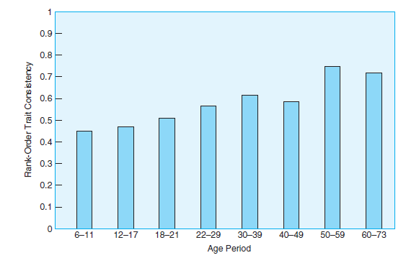
Personality continuity and change?
Rank-Order Trait Consistency and Age Period
Differential continuity is demonstrated in results from 152 studies showing that individuals’ correlations from age to age in scores on various personality tests remain high from early childhood through late adulthood and increase in middle adulthood.
Notes:
People ranking high in some personality trait at one age tend to rank high in that trait on tests given to them at later
ages, and the same is true for people who are in the middle or lower ranks
Source: Roberts & DelVecchio (2000)

Slide 17
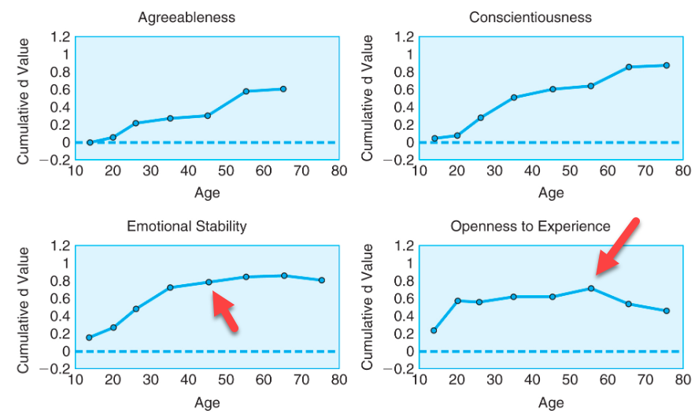
Figure 8.2
Change of Personality Traits Across the Life Span
Cumulative change for six personality traits show distinct patterns across the life span.
Notes:
Personality traits can change over the life span
Source: Roberts, Walton, & Viechtbauer (2006)

Slide 18

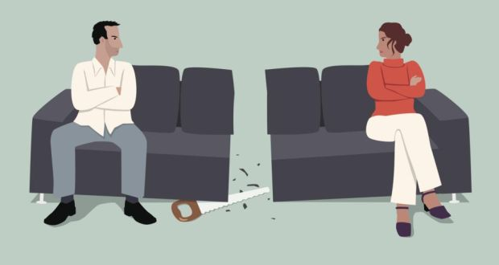
What Do Personality Traits Do?
The higher a person is in Neuroticism and the lower in Agreeableness, the more apt he or she is to be in conflicted, dissatisfying, and abusive relationships, and the more quickly the relationships will dissolve.

Slide 19

What Do Personality Traits Do?
Men who had wives with high scores on Conscientiousness reported better health than those with low-scoring wives, and the same was true for women who had husbands with high scores in Conscientiousness.

Slide 20

What Do Personality Traits Do?
Conscientiousness predicts work-related markers of achievement, such as occupational attainment and job performance.

Slide 21
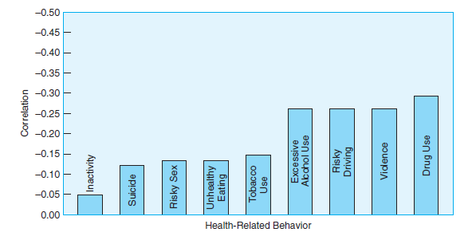
Figure 8.3
Conscientiousness and Health-Related Behaviors
Conscientiousness is negatively correlated with a number of health-related behaviors. The higher the Conscientiousness score, the less likely a person will engage in drug use, violence, risky driving, excessive alcohol use, and other unhealthy behaviors.
Notes:
Source: Roberts, Walton, & Bogg (2005)

Slide 22
Explanations of Continuity and Change
Objective 8.2 – State the factors that influence personality traits

Slide 23
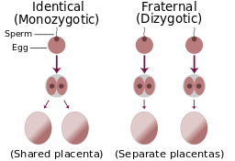
Explanations of Continuity and Change (1 of 2)
Objective 8.2 State the factors that influence personality traits
Genetics
  Inherited personality: 40-60% from genetics
  Twin study
  Monozygotic (MZ) twins: Identical twins.
  Dizygotic (DZ) twins: fraternal, each twin develops from a separate egg and each egg is fertilized by its own sperm cell,

Slide 24
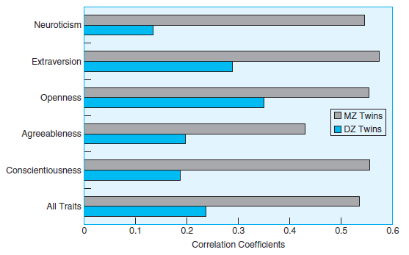
Figure 8.4
Big Five Factors Among Twins
Monozygotic twins’ scores for five personality factors show higher correlations than scores for dizygotic twins, suggesting that there is a genetic influence for personality structures.
Notes:
Twin study reveals genetic influences on personality
Source: Based on data from Riemann, Angleitner, & Strelau (1997)

Slide 25
Explanations of Continuity and Change
Environmental Influences
  Genetics more influential in childhood
  Environment more influential in adulthood (Cultural product)
  Are we free? Are we responsible for who I am and what I do?
  You can choose your environment!

Slide 26
Explanations of Continuity and Change
Evolutionary Psychology Explanations
  It was important for our species to have indicators of who was good company (Extraversion), who was kind and supportive (Agreeableness), who put in sustained effort (Conscientiousness), who was emotionally undependable (Neuroticism), and who had good ideas (Openness).
  Adaptive: The survival of our species
  My reaction: This theory is always right. Whatever exists now can be retrospectively explained by evolution.
  https://www.youtube.com/watch?v=vJdc9zGYVjU

Slide 27
Ungraded discussion
Form a small group of 3-5 to discuss the following:
EP is a descriptive theory: It describes what had happened or what is happening now.
Do you think evolutionary psychology is a good theory that can explain we are who we are?

Slide 28
Cultural Differences
Big Five: Western bias?
Chinese Personality Assessment Inventory
Chinese factor of Interpersonal Relatedness did not correspond to any of the five factors, and Openness did not correspond with any of the Chinese factors.
The Chinese Personality Assessment Inventory has been translated into Korean, Japanese, and Vietnamese,
Interpersonal Relatedness is found in these collectivist cultures.

Slide 29
Theories of Personality Development
Objective 8.3 – Explain the early theories of personality development

Slide 30
Ego Development
1. Impulsive stage: aware of themselves as separate entities
2. Self-protective stage: a preoccupation with taking advantage of others
3. Conformist stage: identify themselves with their reference group
4. Self-aware stage: aware that they don’t always live up to the social standards

Slide 31
Ego Development
5. Conscientious stage: formed their own ideals and standards
6. Individualistic stage: interpersonal relationships are mutual and are preoccupied with a sense of individuality
7. Autonomous stage: see the multifaceted nature of the world, not just the good and the bad. Life is complex, and situations don’t have simple answers or even one best answer.

Slide 32
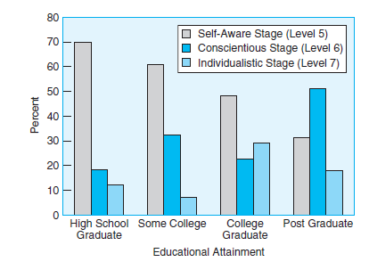
Figure 8.7
Ego Development and Education
In older adults (55 to 85 years of age), higher education is related to higher levels of ego development.
Notes:
For older adults, education is related to ego development
Source: Based on data from Truluck & Courtenay (2002)

Slide 33
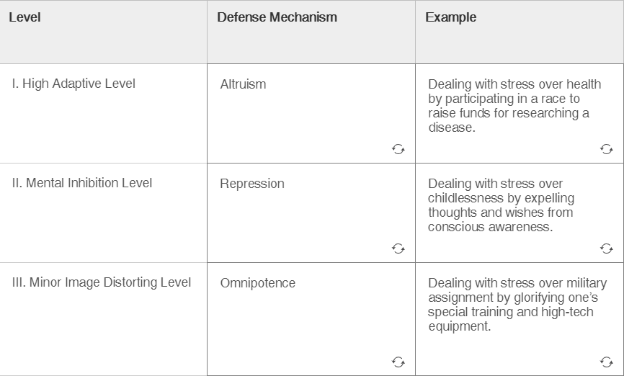
Vaillant’s Six Levels of Defense Mechanisms

Slide 34
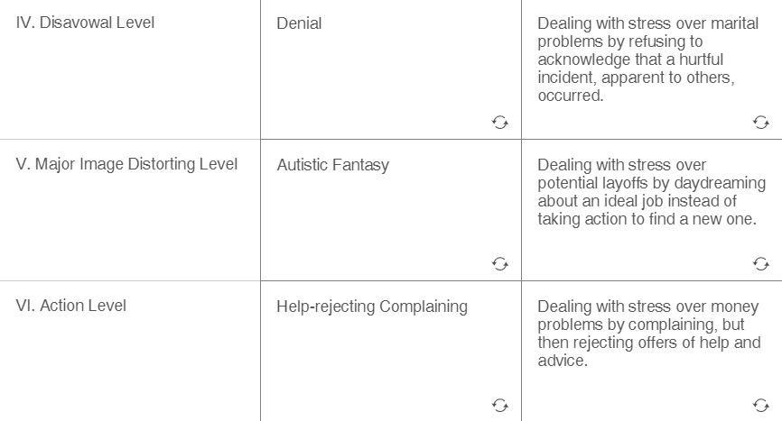
Vaillant’s Six Levels of Defense Mechanisms

Slide 35
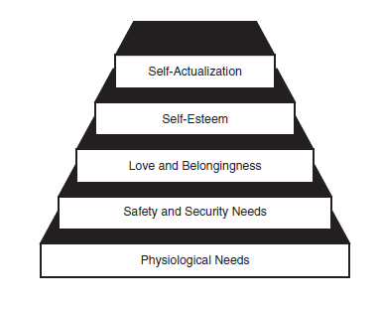
Maslow’s Hierarchy of Needs
Maslow’s hierarchy of needs proposes that lower needs dominate the individual’s motivations and that higher needs become prominent only late in life and when the lower needs are satisfied.
Notes:
The first four levels are deficiency motives; the final level is a being motive
Source: From Maslow (1968/1998)

Slide 36
Maslow’s Hierarchy of Needs
Some of the key characteristics of self-actualized people, such as Eleanor Roosevelt, Albert Schweitzer, and Albert Einstein, are having
  1. an accurate perception of reality,
        2. being involved in deep personal relationships,
        3. being creative,
        4. and having a good-natured sense of humor.
Peak experiences—feelings of perfection and momentary separation from the self when one feels in unity with the universe
Limitation: Maslow’s theory is not empirically tested.
Notes:
The first four levels are deficiency motives; the final level is a being motive
Source: From Maslow (1968/1998)

Slide 37

Positive psychology
Martin Seligman
Turns away from a disease model of human behavior that is fixated on curing or preventing negative conditions such as mental illness.
Self-determination theory: personality is based on individuals’ evolved inner resources for growth and integration
You don’t have to be the best; Be all that you can be
https://www.youtube.com/watch?v=E_OCDJIT344

Slide 38
Assignment
Forma small group of 3-5 to discuss the following:
According to self-determination theory, you can achieve self-actualization by being all that you can be.
What actions would you take to find out what you can be? Please be specific.
What actions would you take to become what you can be? Please give concrete examples.
Post a short report (0.5-I page) on Canvas.

