Slide 1
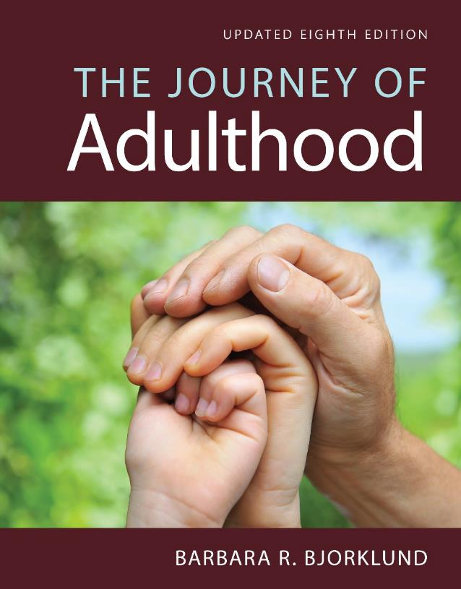
Health and Health Disorders
Eighth Edition
Chapter 9
The Quest for Meaning

Slide 2
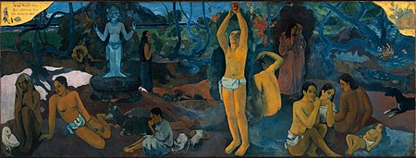
Why a Chapter on the Quest for Meaning?
  Self-transcendence: Coming to know oneself as part of a larger whole
  Why talk about meaning?
    The quest for meaning is a basic human characteristic
    “Where Do We Come From? What Are We? Where Are We Going?” by French artist Paul Gauguin

Slide 3
Why a Chapter on the Quest for Meaning?
  “Man’s search for meaning” (1946) by Viktor Frankl
  Do you have a strong “why” in your life?
  https://www.youtube.com/watch?v=SVhuCpgLCTE

Slide 4
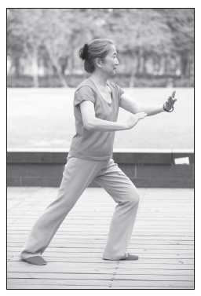
Why a Chapter on the Quest for Meaning?
  Why talk about meaning?
    It is the meaning we attach to experience that matters, rather than the experience itself
    Grounded theory: We retrospectively interpret our experience.
    Most cultures support the tradition that spirituality and wisdom increase with age.
    The second half of life brings a change from outward to inward concerns and from physical to spiritual values

Slide 5
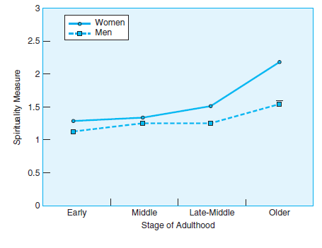
Spirituality and Age
Both genders are stable in their spirituality until middle adulthood
Women begin an increase in middle adulthood, and this continues into late adulthood
Men don’t begin an increase until late middle adulthood

Slide 6
The Study of Age-Related Changes in Meaning Systems
Objective 9.2 – Appraise the directly proportionate relationship between spirituality and age with reference to gender and race

Slide 7
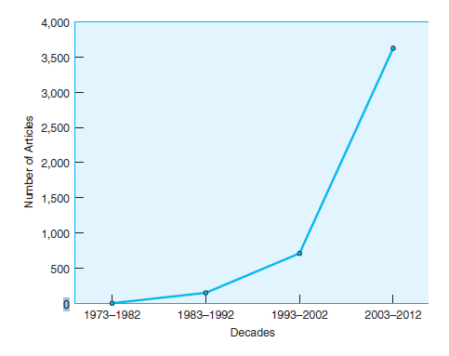
The Study of Age-Related Changes in Meaning Systems
Changes in the Quest for Meaning
  Research on religion and spirituality increases
  The number of empirical journal articles on religion or spirituality has increased from zero to over 3,500 in the past four decades.

Slide 8
The Study of Age-Related Changes in Meaning Systems
What is the difference between religiosity and spirituality?
Koening, King, and Carson (2012):
  Religion is community-driven, visible, formal, systematic, behavior-oriented, and tradition-oriented
  Spirituality is individualistic, hidden, informal, unsystematic, and emotion-based.
The line between them is blurred.

Slide 9
The Study of Age-Related Changes in Meaning Systems
Religiosity can also be individualistic and emotion-driven.
William James (1902/1985) defined religion as “the feelings, acts, and experiences of individual men, in their solitude, so far as they apprehend themselves to stand in relation to whatever they may consider the divine” (p. 34).

Slide 10
The Study of Age-Related Changes in Meaning Systems
Spirituality can be loosely defined as an awareness and yearning for a higher power (Bowland et al., 2012; Hill & Pargament, 2003).
This type of inclusive definition, however, is not consensual (Aten & Leach, 2009), thus resulting in ‘‘ungrounded, nebulous, imprecise, and vague’’ conceptualizations of the term (Milacci, 2006, p. 230).
No sharp demarcation between religiosity and spirituality.
What do you think?

Slide 11
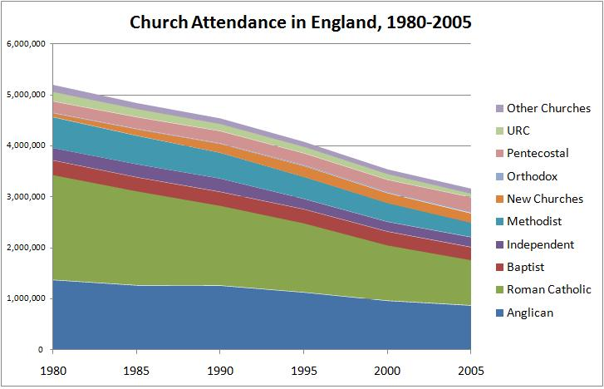
The Study of Age-Related Changes in Meaning Systems
Changes in the Quest for Meaning
  Research on religion and spirituality increases
  Drop in church attendance and religious belief

Slide 12
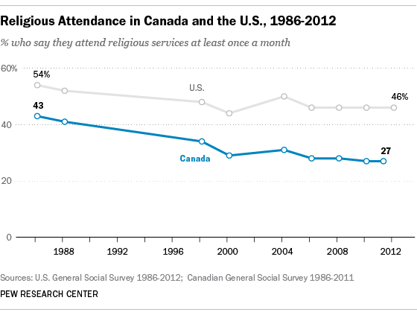
The Study of Age-Related Changes in Meaning Systems
Opinion polls indicated that more than 40 percent of Americans attend church every week.
By examining church attendance records, Hadaway and Marlar (2005) concluded that the actual attendance was fewer than 22 percent

Slide 13
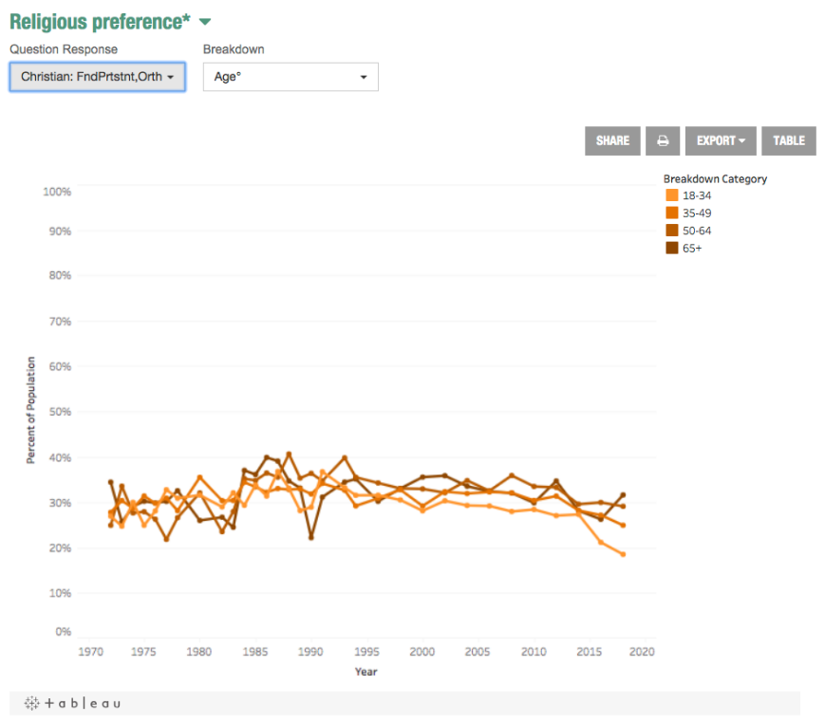
The Study of Age-Related Changes in Meaning Systems
National Opinion Researcher Center
Percentage of Conservative Christians from 1970 to 2018 by age.
Losing young Christians in recent years

Slide 14
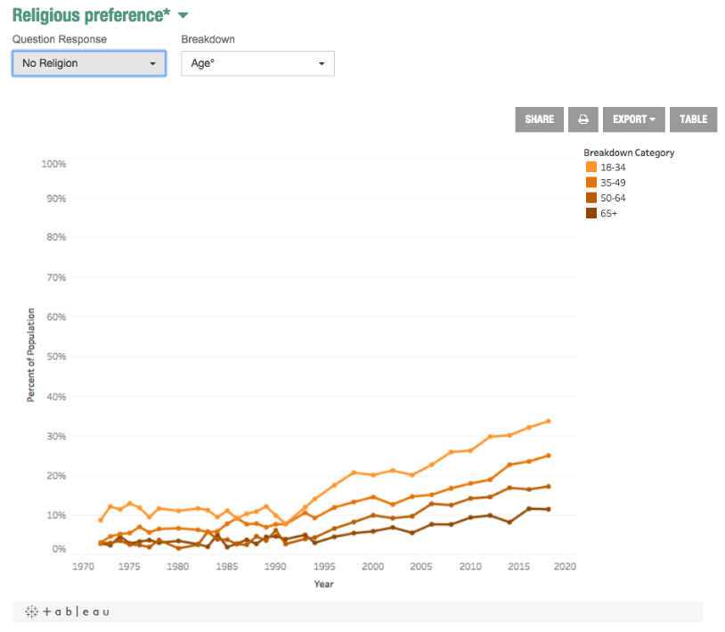
The Study of Age-Related Changes in Meaning Systems
Percentage of non-religious people from 1970 to 2018 by age
More and more people become a-religion.
Biggest increase in the younger group

Slide 15
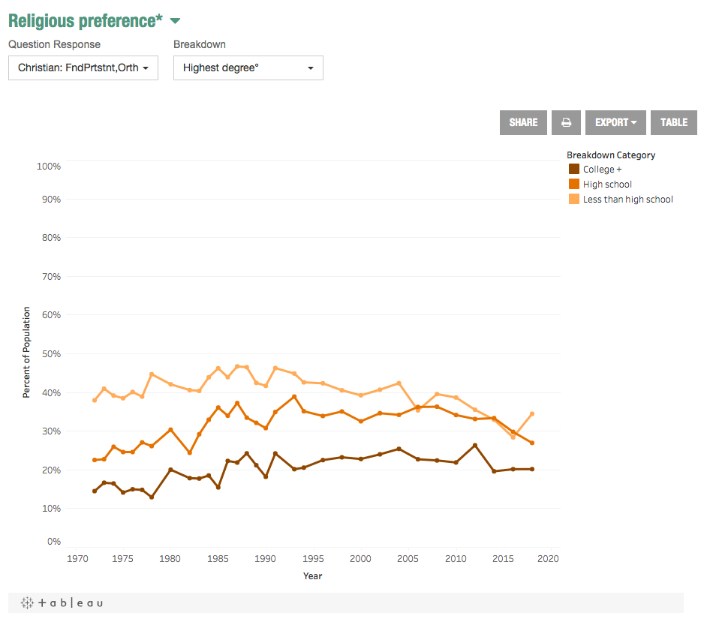
The Study of Age-Related Changes in Meaning Systems
Percentage of Conservative Christians from 1970 to 2018 by education
Less than high school is rising.
College + had dropped and now is stable.

Slide 16
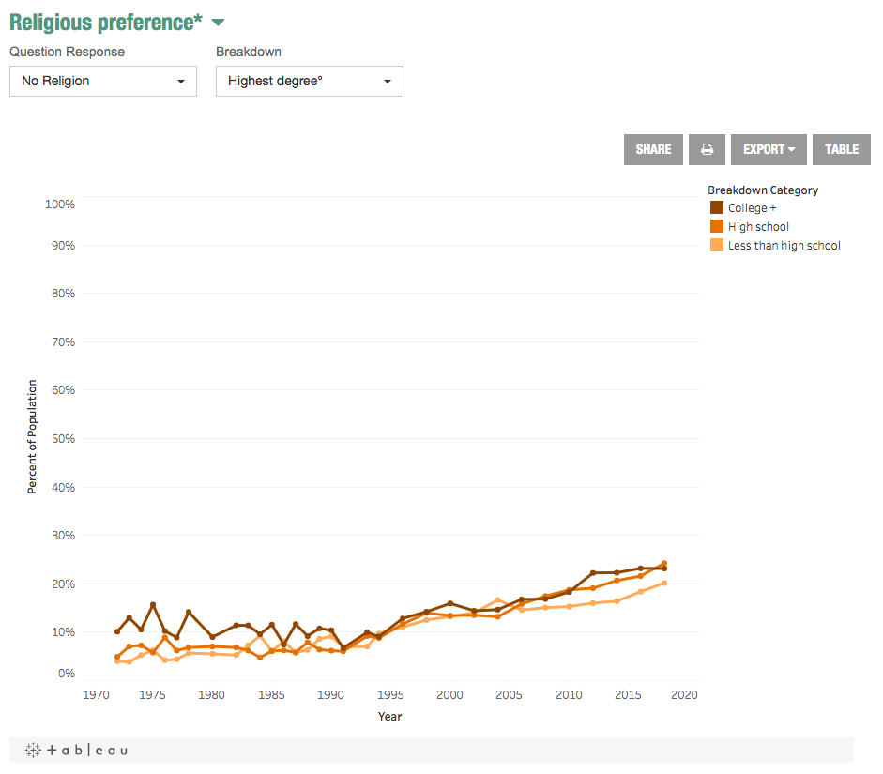
The Study of Age-Related Changes in Meaning Systems
Percentage of non-religious people from 1970 to 2018 by education
All groups are increasing.

Slide 17
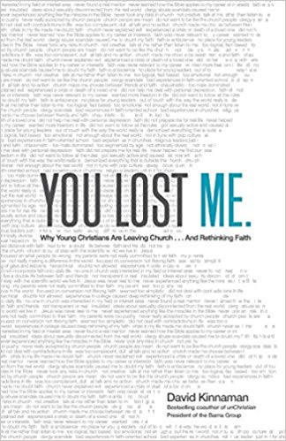
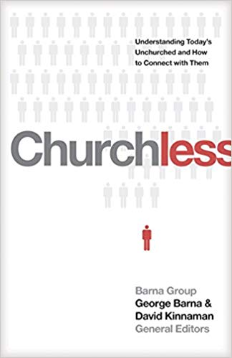
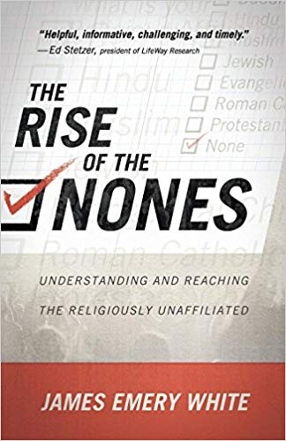
The Study of Age-Related Changes in Meaning Systems
https://www.youtube.com/watch?v=eD1iWqPERNw

Slide 18
Assignment
Form a small group to discuss the following:
Church attendance has been gradually deceasing for many years. This unchurching phenomenon is especially severe among young people.
What are the reasons? Please feel free to look for additional information via Google or/and APU library.

Slide 19
The Study of Age-Related Changes in Meaning Systems
Religion, Spirituality, and Health
  Longer life
  religion could improve mental wellbeing by
  fostering joy or hope, (Cole & Pargament, 1999)
  offering people a sense of meaning and a purpose in life (Oman & Thoresen, 2003)
  providing individuals with a social support network (Oman & Reed, 1998)
  equipping people with coping mechanisms (Bryant-Davis & Wong, 2013).

Slide 20
The Study of Age-Related Changes in Meaning Systems
Religion, Spirituality, and Health
  meditation and prayer leads to a peaceful and serene state of consciousness.
  When activities in the parietal areas of the brain are reduced, the person experiences a sense of timelessness, spacelessness, and peacefulness (Newberg & Waldman, 2013).

Slide 21
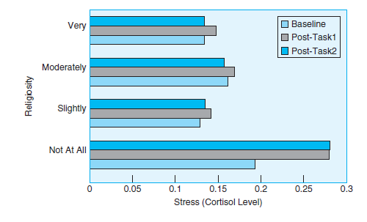
Figure 9.4
Religiosity and Stress
Young adults who described themselves as “not being religious at all” had greater stress reactivity than those who described themselves as being “slightly,” “moderately,” or “very”
religious.
Notes:
Religion is tied to lower levels of stress
Source: Tartaro, Luecken, & Gunn (2005)

Slide 22
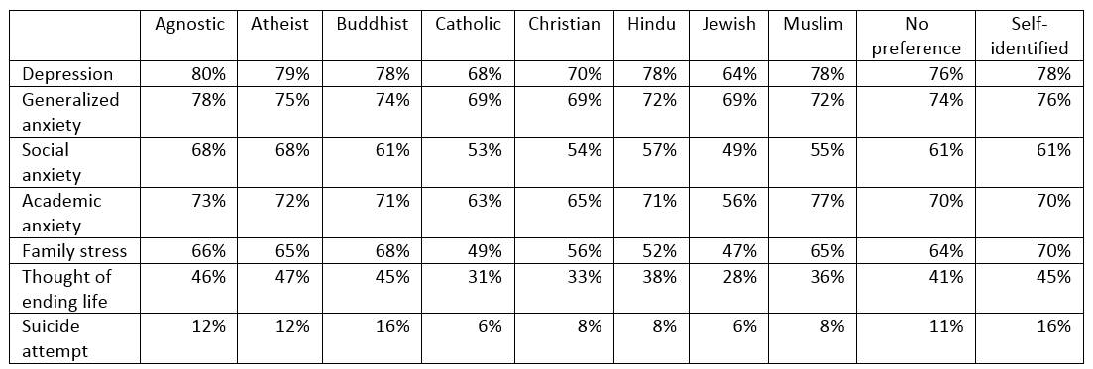
Center for Collegiate Mental Health’s (CCMH)
Mental distress by religious and spiritual preference among US college students

Slide 23
Assignment
Form a small group to discuss the following:
Please observe the CCMH table. What did you find about how different religious preferences are related to mental health? What are their differences? Please give an explanation (It can be an educated guess or based upon literature review)

Slide 24
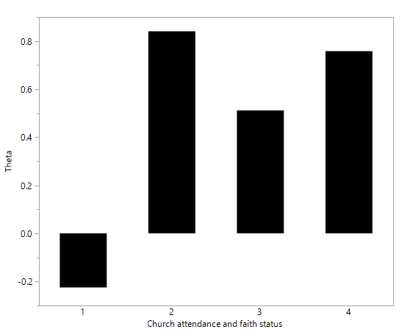
The Study of Age-Related Changes in Meaning Systems
Protective factor
Theta: severity of mental distress (lower is better)
1 = I continue to attend church and have faith in Christ
2 = I still attend church but have serious doubts of my faith in Christ
3 = I have not attended church for over one year but I maintain my faith in Christ
4 = I am not attending church and have abandoned my faith in Christ

Slide 25
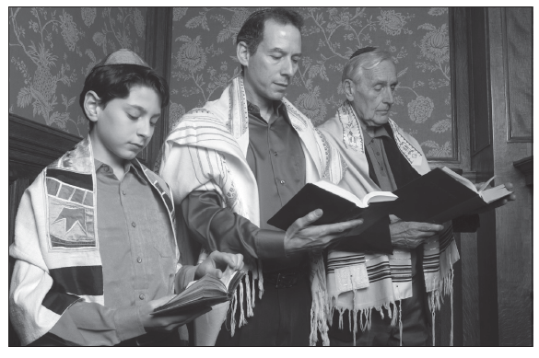
Photo 9.2
Participating in religious services is related to better coping skills, less severe stress reactions, better health, and longer lives.
Notes:
Religion is tied to better health

Slide 26
The Process of Transition
Objective 9.5 – Explain the transition process from one stage of faith and equilibrium to another

Slide 27
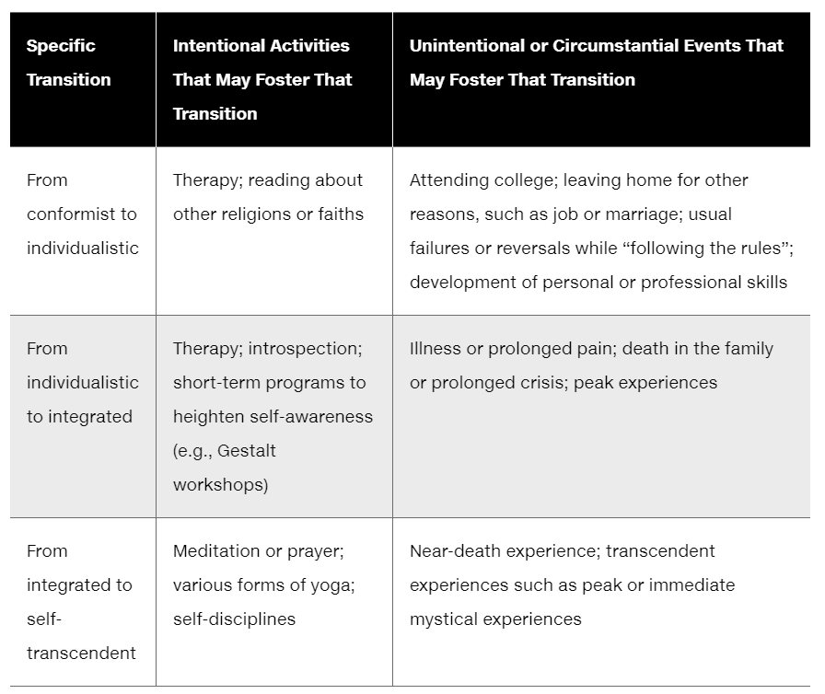
The Process of Transition

Slide 28

Transition by college education
College-educated people tend to make moral decisions at higher levels than those who have not attended college.
Some suggest it is the education they receive.
Some argue it is the exposure to diverse classmates and ideas.
What do you think?
Notes:
Triggers for change

Slide 29
Transition by work experience
The transition from college to first job can be a triggering situation for new growth in meaning systems.
Notes:
Triggers for change

Slide 30


Transition by therapy
Traditional forms of therapy do little to assist the transition from integrated person to a level of self-transcendence.
This transition requires or is assisted by a different form of active process, such as meditation or other forms of yoga or systematic prayer
Notes:
Triggers for change

Slide 31
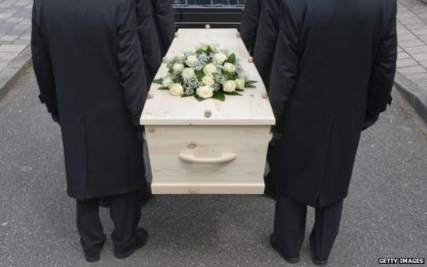

Transition by painful experience
The death of a child or of a parent may reawaken our concern with ultimate questions of life and death.
A failed marriage or discouragement at work may lead to questioning or to a loss of the sense of stability of one’s present model.
Notes:
Triggers for change

Slide 32
Conclusion
  Most adults search for meaning
  Not necessarily deliberate process
  Not always natural: Some people accept what they have and don’t look for alternative pathways

