Slide 1
Cognitive Neuroscience
How does an idea move a muscle?

Slide 2
Some Questions We Will Consider
What is cognitive neuroscience, and why is it necessary?
How is information transmitted from one place to another in the nervous system?
How are things in the environment, such as faces and trees, represented in the brain?
What does studying the brain tell us about cognition?

Slide 3
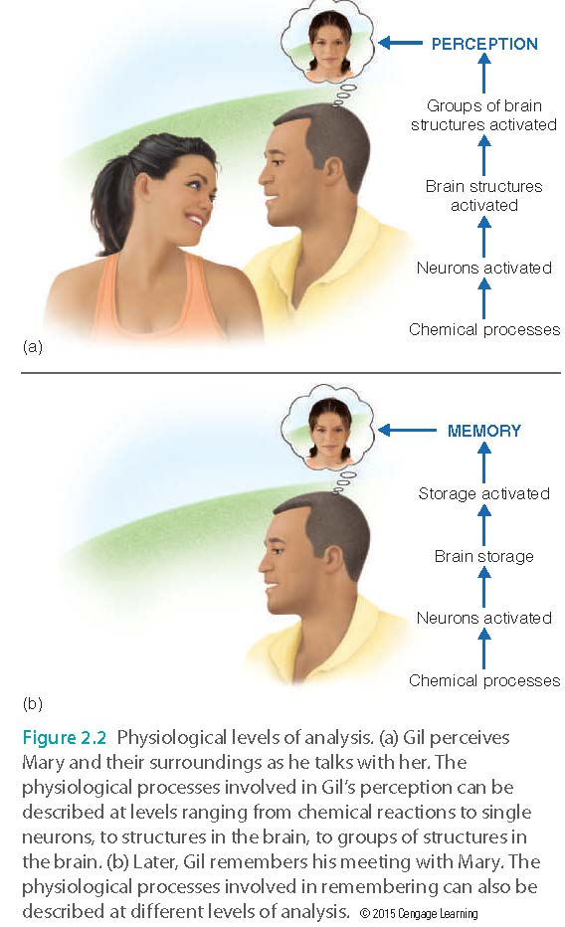
Levels of Analysis
We do not examine topics of interest from a single perspective, but rather we look at them from multiple angles and different points of view
Each “viewpoint” can add small amounts of information which, when considered together, leads to greater understanding

Slide 4
Building Blocks of the Nervous System
Neurons (85B): cells specialized to receive, interpret and transmit information in the nervous system
Each neuron has a soma (cell body), an axon, and dendrites
https://www.youtube.com/watch?v=6qS83wD29PY
Which part is doing what?

Slide 5
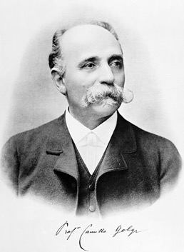
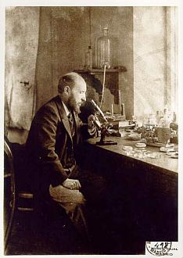
Nerve Nets & the Neuron Doctrine
Camillo Golgi (1870s)
Ramon y Cajal (1880s)
Stained a slice of brain tissue.
Interconnected network of neurons believed to be continuous.
Problem? Used adult brains where neuron density is high.
Used newborn animals.
Lower neuron density meant clearer picture of the nerve net.
Individual nerve cells transmit signals, and are not continuous with other cells.

Slide 6
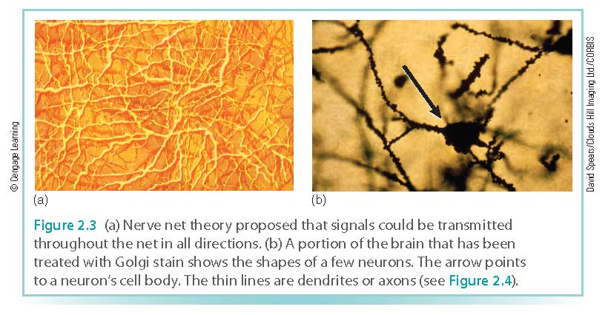
Nerve Nets

Slide 7
Building Blocks of the Nervous System
Cell body (Soma): contains mechanisms to keep cell alive.
Responsible for cell growth & maintenance
Question: Can you grow new brain cells?
Notes:
Responsible for cell growth & maintenance

Slide 8
Building Blocks of the Nervous System
  Neurogenesis: A 2013 study found that the brain of older people can still produce about 700-1400 new neurons in the hippocampus per day.
  In 2018 another study published on "Nature" asserted that adults could NOT produce new cells in the hippocampus.
  All scientific conclusions are “inconclusive”?
  Even if a person cannot grow new neurons, how does the brain change in order to accommodate new learning?
  Answer: New structure or networks
Notes:
Responsible for cell growth & maintenance

Slide 9
Building Blocks of the Nervous System
Dendrites: multiple branches reaching from the cell body, which receives information from other neurons
Axon: tube filled with fluid that transmits electrical signal to other neurons.
Notes:
Responsible for cell growth & maintenance

Slide 10
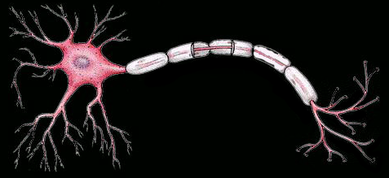
Building Blocks of the Nervous System
Dendrites: multiple branches
reaching from the cell body, which detects o receives information from other neurons
Notes:
Responsible for cell growth & maintenance

Slide 11


Slide 12
Min-Internet?
Our brain is a mini-internet! What does it mean?
Father of AI: Minsky
Our intelligent mind is composed of mindless agents (parts)

Slide 13

How Neurons Communicate
If a neuron is stimulated beyond a certain threshold it will “fire”
All-or-none firing (binary: 1 or 0)
Like a gun shot
When a neuron “fires” electrochemical changes occur with the cell: Action potential
https://www.youtube.com/watch?v=FEHNIELPb0s

Slide 14
How Neurons Communicate
Measuring action potentials
  The size is not measured; size remains consistent
  The rate of firing is measured
    Low intensities: slow firing
    High intensities: fast firing

Slide 15
How Neurons Communicate
Synapse: space between axon of one neuron and dendrite or cell body of another
When the action potential reaches the end of the axon, synaptic vesicles open and release chemical neurotransmitters
Neurotransmitters, chemicals that affect the electrical signal of the receiving neuron, cross the synapse and bind with the receiving dendrites
  Excitatory: increases chance neuron will fire
  Inhibitory: decreases chance neuron will fire

Slide 16
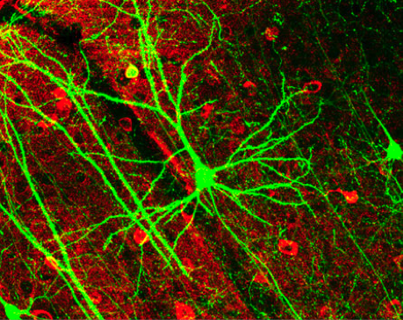
Neural circuits
Many neurons are connected together
But, not randomly
Form connections only to specific neurons

Slide 17
Localization of Function
Specific functions are served by specific areas of the brain
Cognitive functioning breaks down in specific ways when areas of the brain are damaged
Cerebral cortex (3-mm thick layer that covers the brain) contains mechanisms responsible for most of our cognitive functions

Slide 18
Double Dissociation
Two related mental processes function independently of each other.
Example: speech (production) and language comprehension. Although both processes pertain to use of language, the brain structures that control them work independently.

Slide 19
Localization of Function: Language
Language production is impaired by damage to Broca’s area
  Frontal lobe
  Combine sound and words
Language comprehension is impaired by damage to Wernicke’s area
  Temporal lobe
https://www.youtube.com/watch?v=fFGmCRc0njk

Slide 20
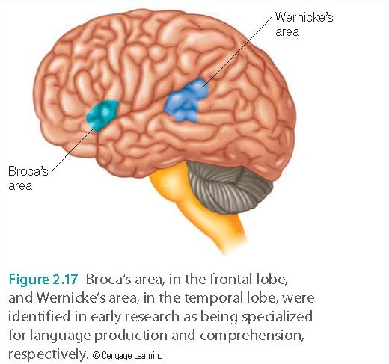
Localization of Function: Language

Slide 21
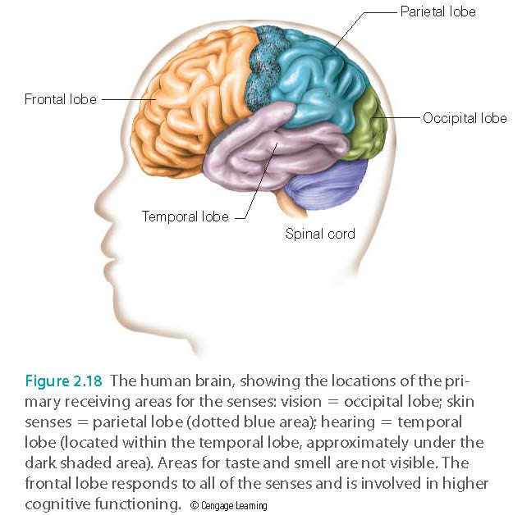
Lobes of the Cerebral Cortex
0
Notes:
21

Slide 22
Localization of Function: Perception
Primary receiving areas for the senses
  Occipital lobe: vision
  Parietal lobe: touch, temperature, pain
  Temporal lobe: hearing, taste, smell
Coordination of information received from all senses
  Frontal lobe: Inhibit what you should not say

Slide 23

Damasio's research
Neuroscientist Antonio Damasio studied a patient whose frontal lobes was damaged by a tumor. He lost emotion, while other intellectual abilities are intact.
His ability to make decisions was impaired. He could logically analyze the pros and cons of different options, and was aware of what should be done. But he could not make a simple decision, such as which restaurant to go for lunch.
A pure rational being without emotion, such as Spock in Star Trek, CANNOT function in the real world.

Slide 24

Capgras Syndrome
When the injury happens in the back of the right hemisphere of the brain, it causes Capgras syndrome.
Also known as imposter syndrome
People who experience this syndrome will have the irrational belief that someone they know has been replaced by an imposter.
“You are not my wife! You are not my son!”
https://www.youtube.com/watch?v=dqBGzkz1oDU

Slide 25
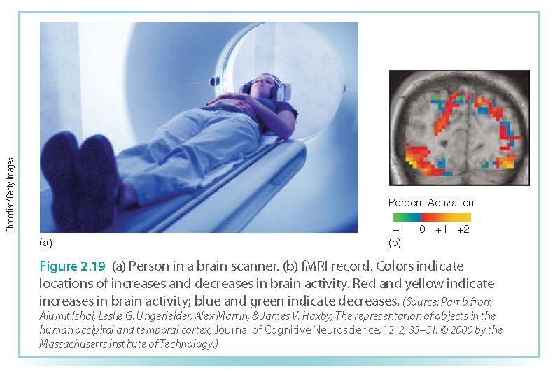
Organization: Brain Imaging
Magnetic Resonance Imaging (MRI)
Functional Magnetic Resonance Imaging (fMRI)

Slide 26
Brain Imaging:
Evidence for Localization of Function
Fusiform face area (FFA) responds specifically to faces
  Temporal lobe
  Damage to this area causes prosopagnosia (inability to recognize faces)
Parahippocampal place area (PPA) responds specifically to places (indoor/outdoor scenes)
  Temporal lobe
Extrastriate body area (EBA) responds specifically to pictures of bodies and parts of bodies

Slide 27
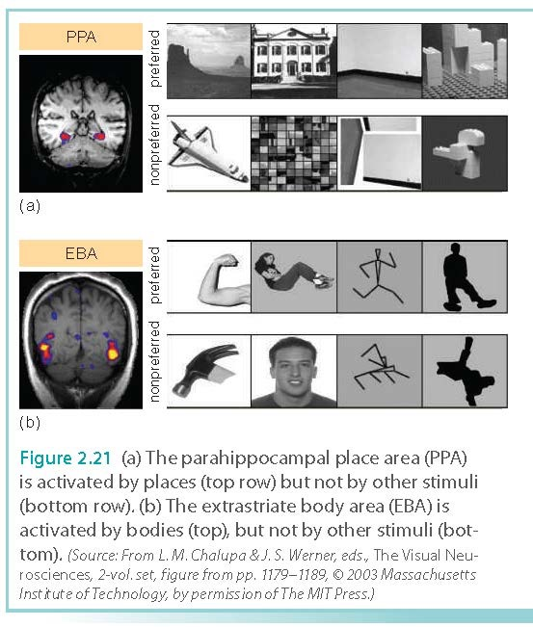
Brain Imaging:
Evidence for Localization of Function

Slide 28
Distributed Representation in the Brain
  In addition to localization of function, specific functions are processed by many different areas of the brain
  Many different areas may contribute to a function
  May appear to contradict the notion of localization of function, but the two concepts are actually complementary

Slide 29
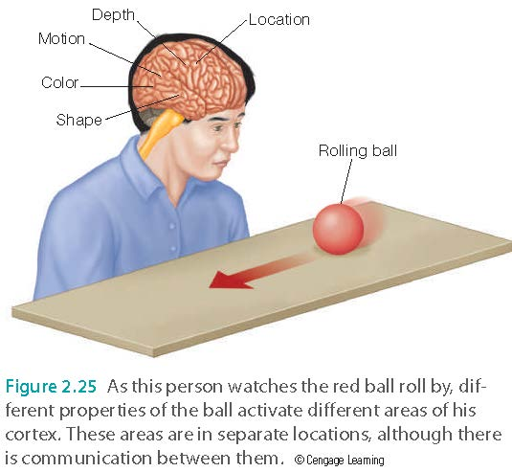
Distributed Representation in the Brain (Mini-internet?)

Slide 30
Discussion and home-work
According to classical Christian dualism, the soul (mind) and the body are separated.
According to neuroscience, the function of the mind comes from the physical neuro network.
If the brain is damaged, you lost your mind or part of your mind.
Some scholars go even further to assert that we are nothing more than a pack of neurons!

Slide 31
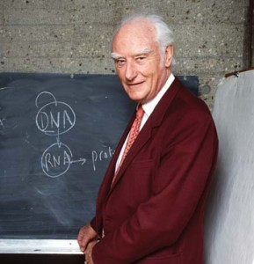

Astounding hypothesis: Francis Crick
“Your joys and your sorrows, your memories and your ambitions, your sense of personal identity and free will, are in fact no more than the behavior of a vast assembly of nerve cells and their associated molecules. As Lewis Carroll’s Alice might have phrased it: ‘You’re nothing but a pack of neurons.’” (p.3).

Slide 32
Discussion and homework
Form a group of 3-5 to discuss the following: Is neuroscience challenging the Christian view of the human nature? How can we reconcile the two views?
You are welcome to Google search for more information.
There is no right or wrong answer.
Write a ½ to 1-page essay individually and submit it to Canvas.

