Slide 1
Unit 4: Ungraded review questions

Slide 2
Can you explain your answer?
Use your fingers to indicate your answer: 1=A, 2=B, 3=C, 4=D.
After viewing the question, show me your answer in 15 seconds.
Next, turn to your neighbor and you have one minute to convince him/her that you are right.

Slide 3
Red Blue Green
The Stroop effect demonstrates
how automatic processing can interfere with intended processing
a failure of divided attention
the ease of performing a low-load task
support for object-based attention

Slide 4

In a photo, features like bright colors and motion are often considered _____________ determinants of visual attention.
signal
top-down
Bottom-up
Both bottom-up and top-down

Slide 5
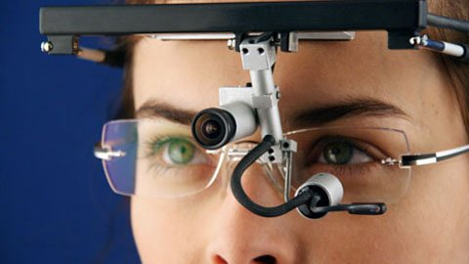
The use of a machine that tracks the movement of one's eyes can help reveal the shifting of one's ________ attention:
overt
covert
divided
dichotic

Slide 6
According to Treisman's feature integration theory, illusory conjunctions occur because features of an object are free floating (no context) during the __________ stage.
feature analysis
focused attention
pre-attentive
Lateral analysis

Slide 7
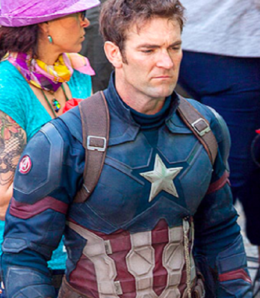
In the movie “Avengers: End Game” a stuntman played the role of Captain America whenever there was any dangerous action. Their faces are different but you cannot tell. This is an example of:
the late-selection model of attention
attentional blink
change blindness
inattentional blindness

Slide 8
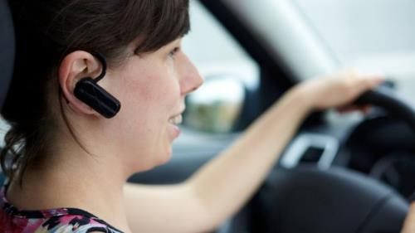
Given the principles of divided attention, which of the following conditions would pose the biggest safety risk on the road?
Someone 17 years old driving a 2018 Jeep Cherokee with blue tooth connection to the cell phone
Someone 40 year old driving a 2017 Lincoln Continental with blue tooth connection to the cell phone.
Someone 60 years old driving a 2015 Hyundai Genesis with basic center console.
All of the above

