Slide 1
Attention

Slide 2
Some Questions to Consider
In Chapter 1 we see the problem of inattentional blindness. Is it always bad to ignore some information?
Under what conditions can we pay attention to more than one thing at a time? (Is multi-tasking possible?)
Is it possible to focus attention on just one thing, even when lots of other things are going on at the same time?
Is it true that we are not paying attention to a large fraction of the things happening in our environment? (Is human a screening machine?)

Slide 3
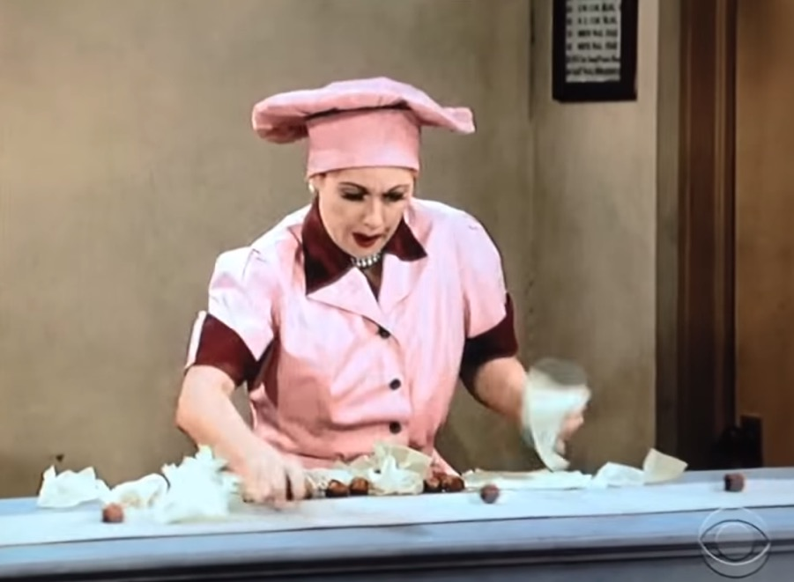
I love lucy
https://www.youtube.com/watch?v=Jm1VEO9C4VQ
If we are unable to filter information…

Slide 4
Selective Attention
Ability to focus on one message and ignore all others
  Selective: attending to one thing while ignoring others
  Divided: paying attention to more than one thing at a time
We do not attend to a large fraction of the information in the environment
We have to filter out some information and promote other information for further processing

Slide 5
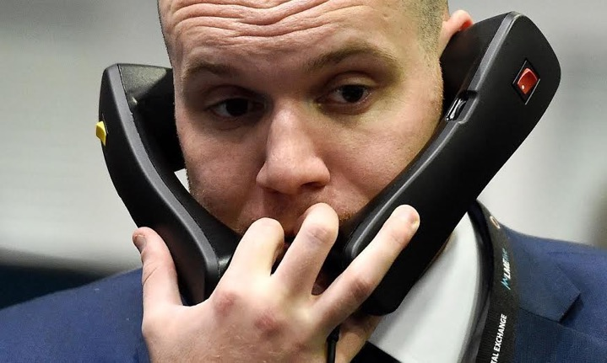
Research Method: Dichotic Listening
One message is presented to the left ear and another to the right ear
Participant “shadows” one message to ensure he is attending to that message
Can we completely filter out the message to the unattended ear and attend only to the shadowed message?

Slide 6
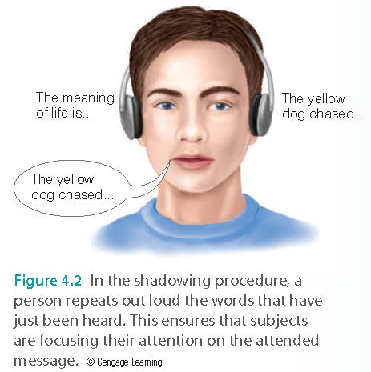
Research Method: Dichotic Listening

Slide 7
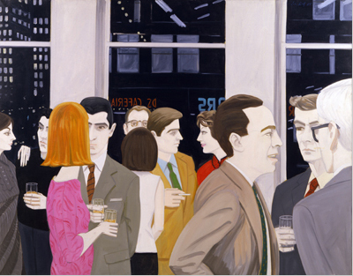
Results of Dichotic Listening
Participants could not report the content of the message in unattended ear
  Knew that there was a message
  Knew the gender of the speaker
However unattended ear is being processed at some level
  Cocktail party effect: You hear your name in a noisy environment
  https://www.youtube.com/watch?v=LTGFT4tdtB8
Notes:
Think about the surrounding stimuli has a sensational part and meaningful part.

Slide 8
Models of Selective Attention
0
Where does the attention filter occur?
  Early in processing
  Later in processing
Early selection model
  Broadbent’s filter model
Intermediate selection model
  Tresiman’s attenuation theory
Late selection model
  e.g. McKay (1973)
Notes:
Explain the filter.

Slide 9
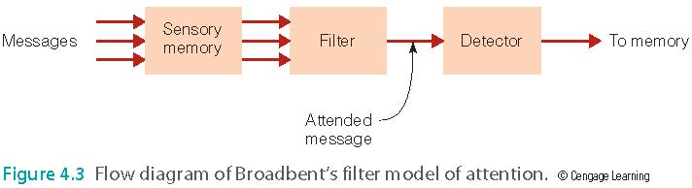
Broadbent’s Filter Model
Early-selection model
  Filters message before incoming information is analyzed for meaning

Slide 10
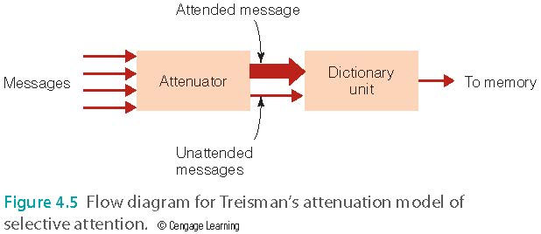
Treisman’s Attenuation Theory
Intermediate-selection model
  Attended message can be separated from unattended message early in the information-processing system
  After you married many years…
  https://www.youtube.com/watch?v=MtObrnaovrI
  Selection can also occur later

Slide 11
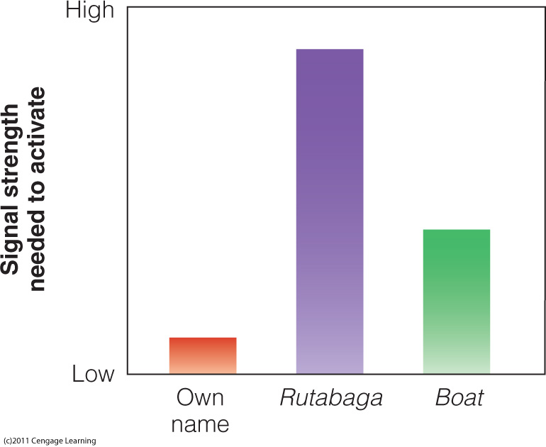
Caption: The dictionary unit of Treisman’s model contains words, each of which has a threshold for being detected. This graph shows the thresholds that might exist for three words. The person’s name has a low threshold, so it will be easily detected. The thresholds for the words rutabaga and boat are higher, because they are used less or are less important to this particular listener.
Notes:
How intense must the signal be to draw your attention?
How much attentional resources are required for you to be consciously aware of something or for you to fully process information.

Slide 12
Top 10 sounds most likely to wake Men and Women
men:
women:
Car alarm
Howling wind
Buzzing fly
Snoring
Noise from drains
Crickets chirping
Sirens
Clock ticking
Drilling/workmen
Dripping tap
Baby crying
Dripping tap
Rowdiness outside
Snoring
Buzzing fly
Drilling/workmen
Sirens
Car alarm
Howling wind
Noise from drains

Slide 13
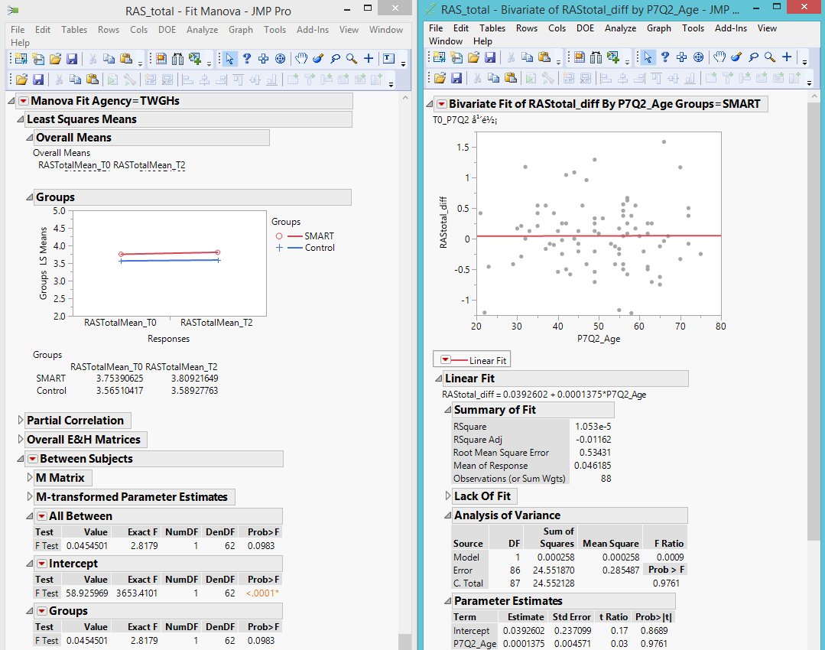
Late Selection Models
MacKay (1973): Selection of stimuli for final processing does not occur until after information has been analyzed for meaning.
When do we do this?
Data analysis, reading research paper.

Slide 14
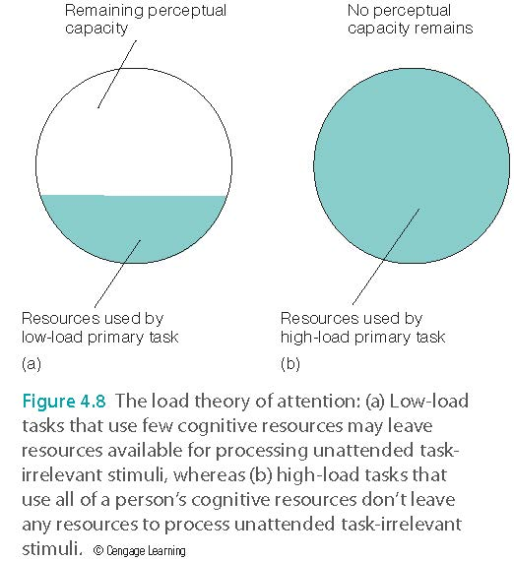
Load Theory of Attention
Processing capacity – how much information a person can handle at any given moment
Perceptual load – the difficulty of a given task
  High-load (difficult) tasks use higher amounts of processing capacity
  Low-load (easy) tasks use lower amounts of processing capacity

Slide 15
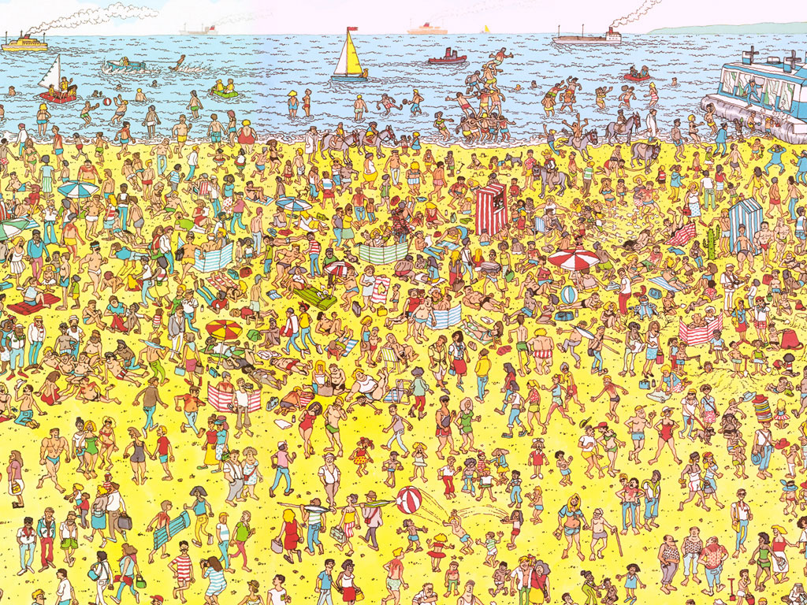

Slide 16
Cognitive overload!!!!!

Slide 17
Ungraded discussion
Have you ever encountered a situation in which you have to pay attention to multiple things simultaneously and you cannot throw out the information until you figure out its meaning?
What strategy do you use to deal with this situation and get things done?

Slide 18
The Stroop Test
Stroop effect
  The situation gets worse when you receive competing or even contradictory information
  Name of the word interferes with the ability to name the ink color
  Cannot avoid paying attention to the meanings of the words
  Anyone want to volunteer?
  https://www.youtube.com/watch?v=gjesfzWozo4
Notes:
In some ways attention is about our ability to ignore stimuli or to inhibit extraneous stimuli from influencing our performance on a given task.

Slide 19
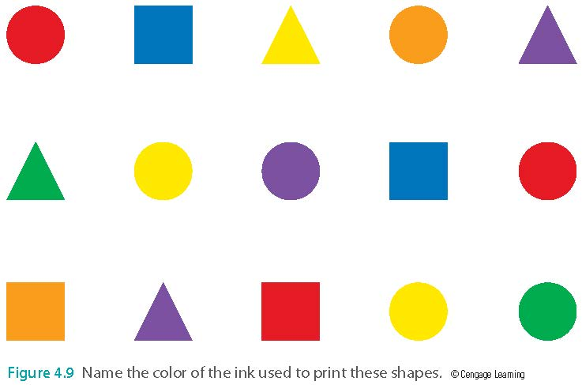
The Stroop Test

Slide 20
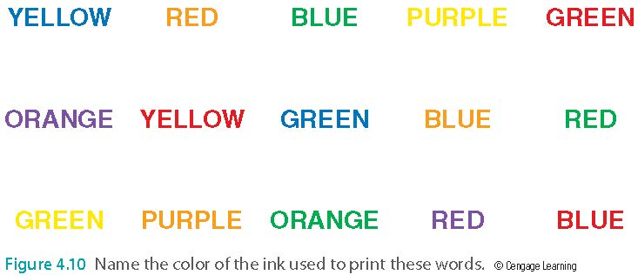
The Stroop Test

Slide 21
Overt Attention
Eye movements, attention, and perception
  Saccades: rapid movements of the eyes from one place to another
  Fixations: short pauses on points of interest
  Studied by using an eye tracker.
  e.g. Study whether a website is effective to capture your attention (so that I can find out how to sell you my product or service)

Slide 22
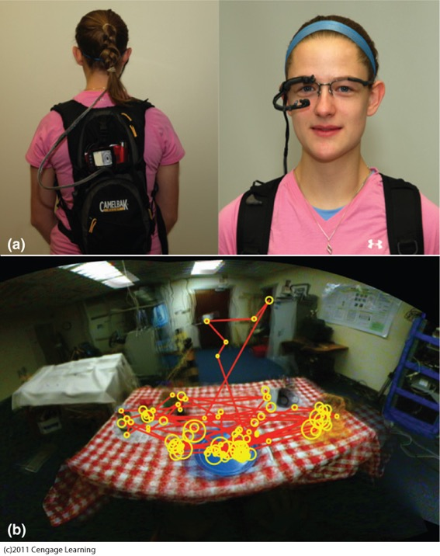
Field-based eye tracking study
https://www.youtube.com/watch?v=WqD2pXqT0Z0

Slide 23
What draw your attention?
I will show you several pictures.
When you see the photo, use a piece of paper to write down the area of the photo that draws your attention immediately.
We will see whether there are any common patterns.

Slide 35
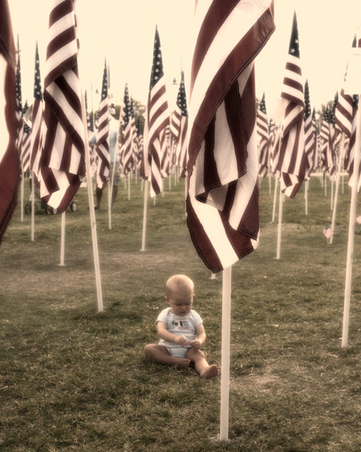

Slide 36
Bottom-up Determinants of Eye Movement
Stimulus salience: areas that stand out and capture attention
  Bottom-up process: about sensation
  Depends on characteristics of the stimulus
  Color and motion are highly salient

Slide 37
Top-Down Determinants of Eye Movements
Scene schema: knowledge about what is contained in typical scenes
  Help guide fixations (focus) from one area of a scene to another
  There is a sequence of fixation (eye movement), depending on the task or the situation

Slide 38
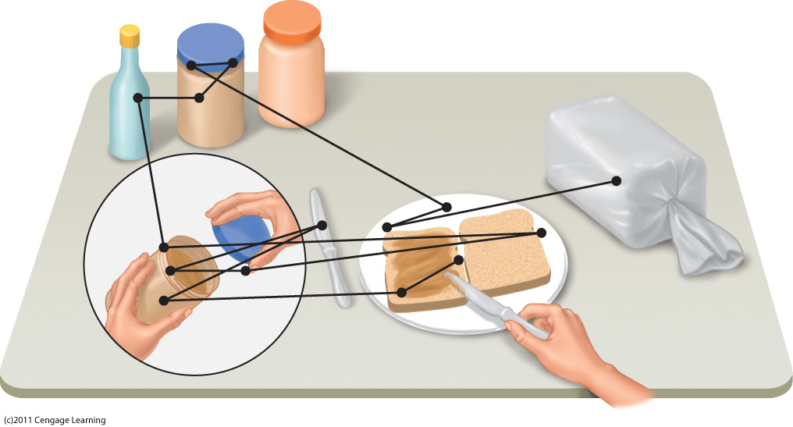
Caption: Sequence of fixations of a person making a peanut butter sandwich. The first fixation is on the loaf of bread.

Slide 39
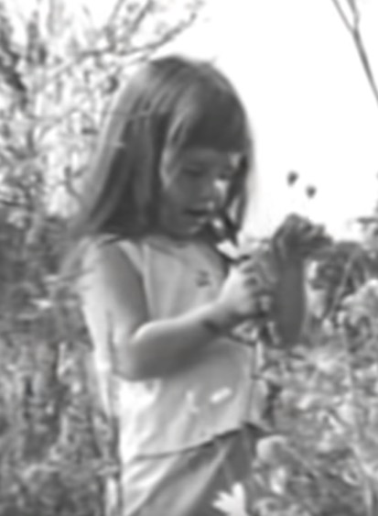
Emotion drives attention
“Daisy” attach ad in 1964 Presidential Election: LBJ vs. Goldwater
https://www.youtube.com/watch?v=dDTBnsqxZ3k
A little girl can effectively draw our attention by appealing to our emotion.
At the end it implies that the nuclear bomb toasted the lovely little girl. It is emotional!
LBJ won by a landslide!

Slide 40
Application and Discussion
Application: In marketing you need to create messages or images that are most likely to draw the attention of the target audience.
Let’s go back to the photos that you have just looked at. What are the most common salient features (areas that most people pay attention to)?
Which one can be explained by the bottom-up or top-down determinant (knowledge or emotion?

Slide 41
Assignment
Show the photos that I used in class to one male subject and one female subject.
Ask the participants to mark down the area of the photo that can immediately catch their attention.
Are their responses similar or difference? You can use a table to indicate whether the man and the woman agree in each viewing.
Explain one of the differences: the top-down determinant or the bottom-up determinant?
(Caution: In a real experiment or quasi-experiment, we need a bigger sample size and also the order of the photos should be shuffled. This exercise is highly simplified.)

Slide 42
Assignment: Example
Photo | Agree? | Male | Female
1 | Y | mountain peak | same
2 | N | waterfall | house
3 | Y | bright area | same
4 | Y | houses | same
5 | N | animal | woman
6 | N | supreme court | security
7 | Y | center | same
8 | Y | angel | same
9 | N | globe | girl
10 | N | sword | man's body
11 | N | girl's face | fire
12 | Y | baby | same
The male participant immediately paid attention to the Supreme Court whereas the female subject focused on the man at the corner. Perhaps it is due to top-down processing based on prior preferences. Men tend to like grand object while women are social-oriented.

Slide 43
Divided Attention
  http://www.youtube.com/watch?v=CeVn6_iwtJQ
Can you really do multi-tasking?
It depends!
Notes:
Before, we looked at selective attention which was basically ones ability to focus on one task one stimulus and ignore others. During this discussion we learned that it was more important to discuss this ability in terms of cognitive load or task load. Here, we now understand that a high load task utlizes most if not all of our cognitive resources making it easier for us to ignore distractors. Such task typically provided evidence that supported a early selection model. On the other hand, we learned that low load task spares much of our cognitive resources which in turns leaves room for the processing of distractors which makes it more difficult to ignore said distractors. Now, we want to discuss divided attention which simply ones ability to perform two tasks at once.

Slide 44
Automated process
I can drive, drink a cup of tea, and listen to music at the same time.

Slide 45
Control process
Doing statistical analysis or reading a boring research paper written by Dr. Yu

Slide 46
Question
How about mixing several automated and controlled tasks? Can you name some examples? What would happen? (2:50)
https://www.youtube.com/watch?v=PkBa5oHXgsE

Slide 47
Divided Attention – Distractions While Driving
100-car naturalistic driving study
  Video recorders placed in cars
  Risk of accident is four times higher when using a cell phone
Strayer and Johnston (2001)
  Simulated driving task
  Participants on cell phone missed twice as many red lights and took longer to apply the brakes
  Same result using “hands-free” cell phone

Slide 48
Are there exceptions?
But why professional drivers (e.g. Uber) can do multi-tasking?
A typical Uber driver has to constantly check the smart device to receive orders and to communicate with the customer about the meeting location.

Slide 49
Divided Attention
Practice enables people to simultaneously do two things that were difficult at first
Schneider and Shiffrin (1977)
  Divide attention between remembering target and monitoring rapidly presented stimuli.
  Controlled and automatic processing is based on the same cognitive processes.
By training a controlled process can become an automated process.

Slide 50
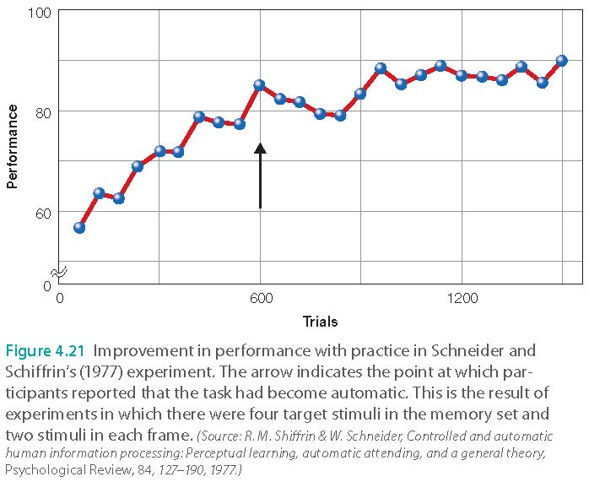
Divided Attention

Slide 51
Attention and Visual Perception
  Inattentional blindness
  Do not look at the next slide.
  Can you see something wrong in the following movie clip?
  https://www.youtube.com/watch?v=JcgJvJqCdrw

Slide 52

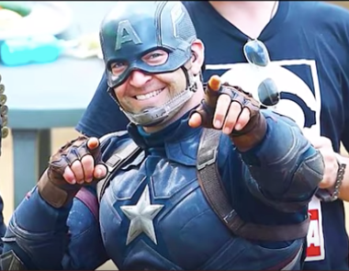
The doubles
The doubles don’t look like the real Captain America at all!

Slide 53
Attention and Visual Perception
  Change blindness: if shown two versions of a picture, differences between them are not immediately apparent
  Task to identify differences requires concentrated attention and search
  Person swap:
  https://www.youtube.com/watch?v=VkrrVozZR2c

Slide 54
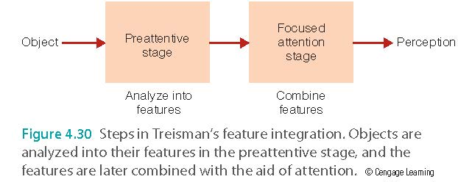
Feature Integration Theory (FIT)
Features first, Objects later

Slide 55
Feature Integration Theory (FIT)
Preattentive stage
  Automatic
  No effort or attention
  Unaware of process
  Object analyzed into features

Slide 56
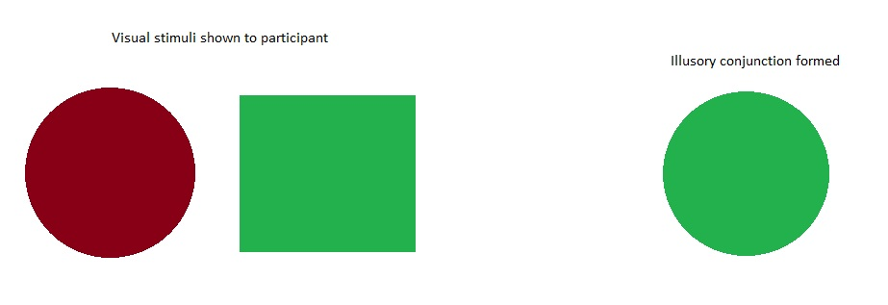
Feature Integration Theory (FIT)
Treisman and Schmidt (1982)
  Participants report combination of features from different stimuli
  Illusory conjunctions occur because features have no context.

Slide 57

Feature Integration Theory (FIT)
Treisman and Souther (1986)
  When participants were told that they were looking at a carrot, lake, and tire (in place of the orange triangle, blue oval, and black circle, respectively), illusory conjunctions did not occur.
  Top-down processing (prior knowledge) can help

