Slide 1
Chapter 5
Short-Term and Working Memory

Slide 2
Some Questions to Consider
Why can we remember a telephone number long enough to place a call, but then we forget it almost immediately?
How is memory involved in processes such as doing a math problem?
Do we use the same memory system to remember things we have seen and things we have heard?
Is memorization an important skill today? Why or why not?

Slide 3
What Is Memory?
Memory: processes involved in retaining, retrieving, and using information about stimuli, images, events, ideas, and skills after the original information is no longer present
Memory is active any time; some past experience has an impact on how you think or behave now or in the future

Slide 4
Modal Model of Memory
Atkinson and Shiffrin (1968)
Three different types of memory:
  Sensory Memory – Initial stage that holds all incoming information for seconds or fractions of a second
  Short-term Memory – Holds five to seven items for about 15 to 20 seconds.
  Long-term Memory – Can hold a large amount of information for years or even decades

Slide 5
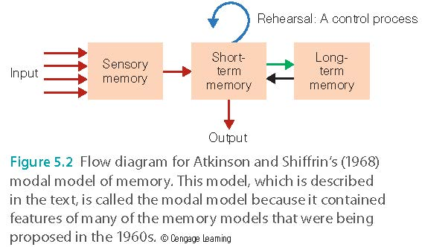
Modal Model of Memory

Slide 6
Modal Model of Memory
Control processes: Active processes that can be done by the person
  Rehearsal
  Strategies used to make a stimulus more memorable
  Strategies of attention that help you focus on specific stimuli

Slide 7
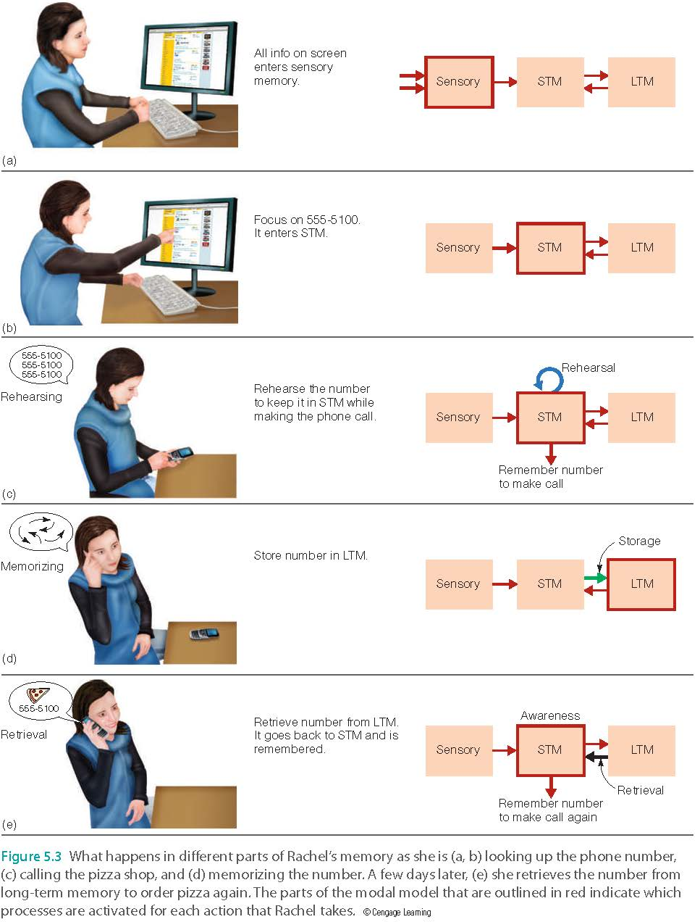

Slide 8
Modal Model of Memory: Sensory Memory
Sensory Memory: The retention, for brief periods of time, of the effects of sensory stimulation.
  Information decays very quickly
Iconic Memory
  Persistence of vision: retention of the perception of light
    Sparkler’s trail of light
    Frames in film (a movie is composed of still frames)
Echoic Memory
  Persistence of sound
    Brief lapse in understanding what someone just said.

Slide 9


Slide 10


Slide 11


Slide 12



Slide 13


Slide 14



Slide 15
Modal Model of Memory: Sensory Memory
Holds large amount of information for a short period of time
  Collects information
  Holds information for initial processing
  Experiments show that after delay and distraction recalling decreases rapidly.

Slide 16
Strategies of transferring info from STM to LTM
Practice makes perfect!
Repeat! Repeat! Repeat!......
You can re-read and re-verbalize the information over and over, or use some smart strategies
  Mnemonics
  Drawing: Visual clue
  Mind palace (filing system, data structure)
  Chunking (grouping)

Slide 17
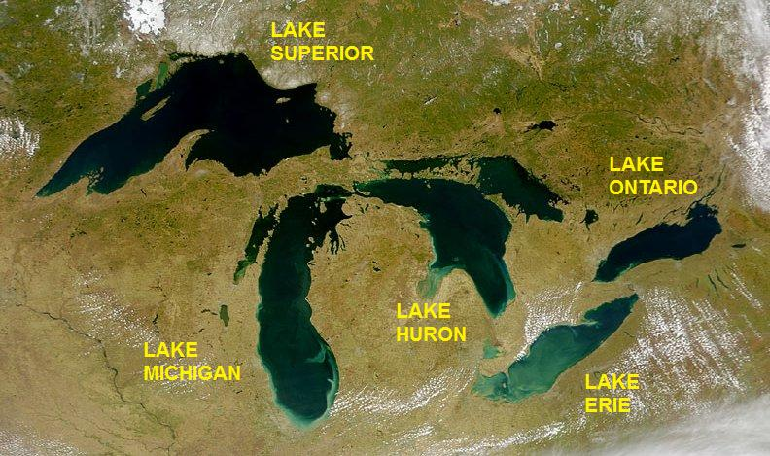
Mnemonics
Example: how to remember the names of all five Great Lakes?
Superior, Michigan, Huron, Erie, Ontario
Super man helps every one (SMHEO)

Slide 18
Mnemonics
Another way: HOMES
Huron, Ontario, Michigan, Erie, Superior

Slide 19
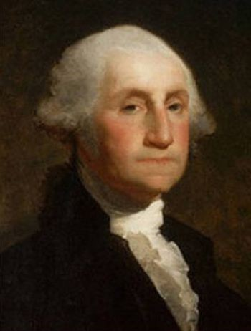
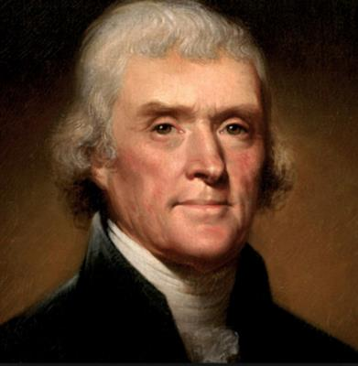
Mnemonics
How to remember the names of the first 8 US presidents?
Will a jolly man make a jolly visitor?
George Washington
John Quincy Adams
Thomas Jefferson
James Madison
James Monroe
John Quincy Adams
Andrew Jackson
Martin Van Buren

Slide 20

Mnemonics
Can you remember the order of all eight planets in our solar systems?
Mercury, Venus, Earth, Mars, Jupiter, Saturn, Uranus, Neptune
My Very Educated Mother Just Sent Us Nowhere

Slide 21
Mnemonics
Ungraded discussion: Do you have some useful mnemonics that you want to share with your classmates and me?
Now you can use your laptop or phone to Google.

Slide 22
Drawing
Jeffrey Wammes’s experiment
After viewing the item pops up on the screen, the subjects were told to draw or write down the item.
Delay and distraction: they were told to do unrelated tasks and resume later to recall the items.
The drawing group outperformed the writing group.
Implications: When you do rehearsal or take notes, use graphical illustration!

Slide 23
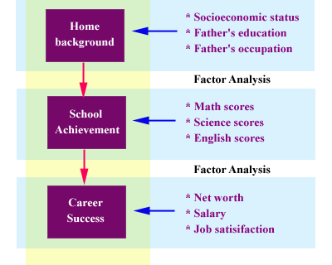
Drawing
Example: try to write down and memorize these relationships:
Home background includes SES, father’s job, father’s education. Math, science, and language test scores indicate academic achievement. Net worth, income, and job satisfaction indicate career success. Home background influences school achievement, and this influences career success.
Draw it!
Notes: This model above was developed a few decades ago and thus family background includes father only, but not mother.

Slide 24

Mind palace
https://www.youtube.com/watch?v=3vlpQHJ09do
A fancy name of data structure or filing system
When you have a piece of information in your STM, identify its category and decide ”where” to put it.
I have my own mind palace: My website: http://www.creative-wisdom.com

Slide 25
Modal Model of Memory: Short-Term Memory
Classical Experiment: Measuring the duration of short-term memory
  Read three letters, then a number
  Distraction: Begin counting numbers backwards
  Delay: After a set time, recall three letters
After three seconds of counting, participants performed at 80%
After 18 seconds of counting, participants performed at 10%
  Interference Theory vs. Decay Theory

Slide 26
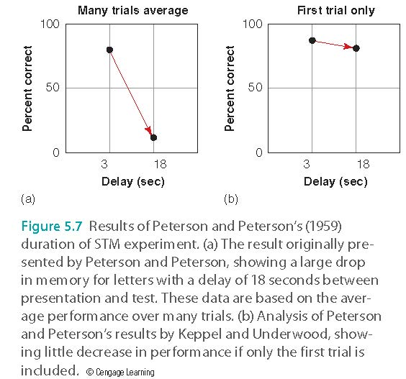
Modal Model of Memory: Short-Term Memory

Slide 27
Modal Model of Memory: Short-Term Memory
Proactive interference: Occurs when information learned previously interferes with learning new information
  Example: Your native language may make it more difficult to learn and remember a new foreign language
Retroactive interference: Occurs when new learning interferes with remembering old learning
  Example: After you get a new telephone number and use it for a while, you may have difficulty remembering your old phone number

Slide 28
My experience
Usually in a five-week summer class my students can retain more information and perform better in the exam (And I got better end-of-course evaluation).
My theory:
In a summer course we meet three to four days a week. When I lecture new concepts on Tuesday, students still remember the previous related concepts that I taught on Monday. There is no delay causing memory gap.
In a 5-week summer course most students take one to two classes only. They are fully occupied because they have to do the reading and assignments every day. No other interference or distraction affects their learning.
How about making all classes like summer classes?

Slide 29
Assignment
Format a small group of 3-5 to discuss the following:
Some schools use a super-short semester system: Students are allowed to take one 4-week class only before taking another 4-week class. The argument is: without proactive or retroactive interference students can learn better by focusing on one subject matter at one time.
A theological seminary disallows students to take New Testament Greek and Old Testament Hebrews in the same semester. The argument is the same.
Do these schools correctly apply cognitive psychology into their pedagogy? Can this strategy lead to better learning outcomes?
Post 0.5-1.5 pages on Canvas.

Slide 30
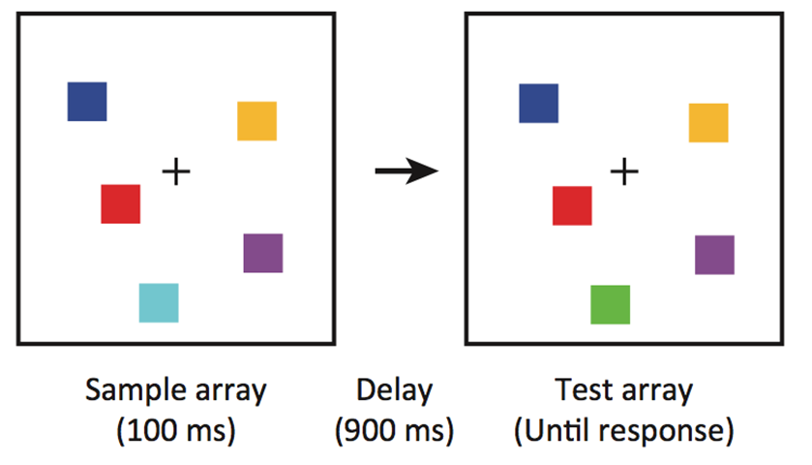
Modal Model of Memory: Short-Term Memory
Capacity of short-term memory
  Digit span: how many digits a person can remember
    Typical result: 5-8 items
  Change detection - Luck and Vogel (1997)
    4 items

Slide 31
My reaction
Usually an experimental setting is highly artificial and unrealistic.
In real-life we do not perform tasks with pure color and pure shape without a context.
How we behave or perform in a naturalistic setting might not be the same as how we behave or perform in an experimental setting.
How far can we generalize the finding from experiments to real-life situations?

Slide 32

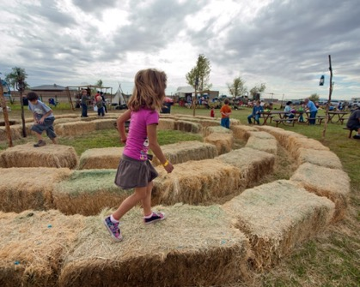
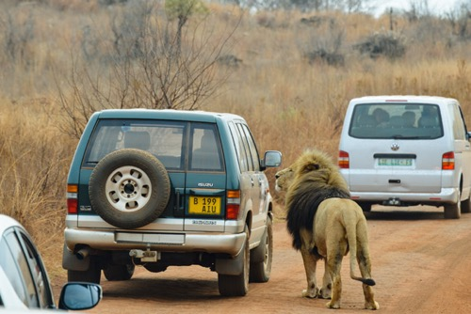
Modal Model of Memory: Short-Term Memory
Chunking: small units can be combined into larger meaningful units
Chunk is a collection of elements strongly associated with one another but weakly associated with elements in other chunks.
Examples: Handsome man, crazy professor, boring class, young child, fun zoo,

Slide 33
Modal Model of Memory: Short-Term Memory
Ericcson et al. (1989)
  Trained a college student with average memory ability to use chunking
    He had an initial 7 elements
  After 230 one-hour training sessions, he could remember up to 79
  Chunking them into meaningful units

Slide 34
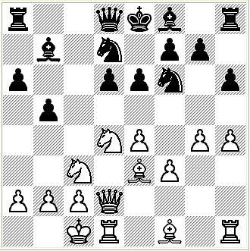
Modal Model of Memory: Short-Term Memory
Chase and Simon (1973)
  Memory for chess pieces on a board
  Chess masters and beginners
  Pieces positioned for a real chess game or randomly positioned

Slide 35
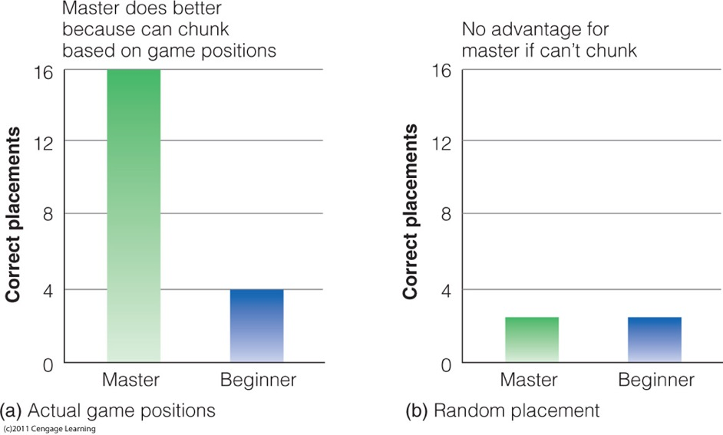
Results
Caption: Results of Chase and Simon’s (1973a, 1973b) chess memory experiment. (a) The chess master is better at reproducing actual game positions. (b) Master’s performance drops to level of beginner when pieces are arranged randomly.

Slide 36
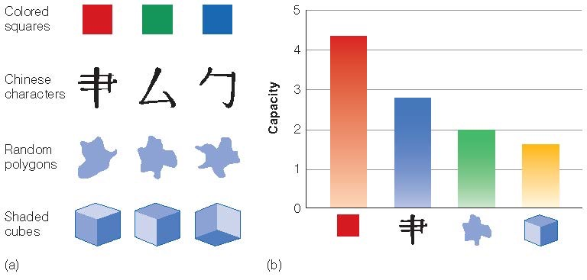
Modal Model of Memory: Short-Term Memory
Alvarez & Cavanagh’s (2004) change detection experiment
These are NOT complete Chinese characters

Slide 37
Working Memory
Similar concept to short-term memory
Baddeley and Hitch (1974)
Working memory: limited capacity system for temporary storage and manipulation of information for complex tasks such as comprehension, learning, and reasoning

Slide 38
Working Memory
Working memory differs from STM
  STM holds information for a brief period of time
  WM is concerned with the processing and manipulation of information that occurs during complex cognition
ALSO
  STM is a single component
  WM consists of multiple parts

Slide 39
Working Memory
WM is set up to process different types of information simultaneously
WM has trouble when similar types of information are presented at the same time
ADHD and WM
https://www.youtube.com/watch?v=Nls3wxRZEoE
Ungraded discussion: How can you help people with ADHD or people who have other problems in working memory?

Slide 40
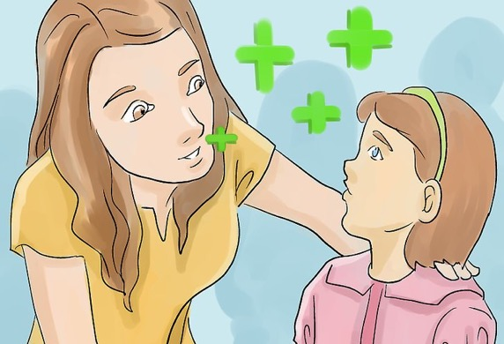
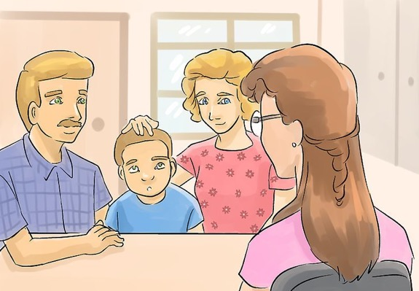
How to help
Divide tasks into smaller manageable pieces
Limit or remove distractions
Encourage think aloud (verbalize what they have in mind)
Allow more breaks for them to refresh

Slide 41
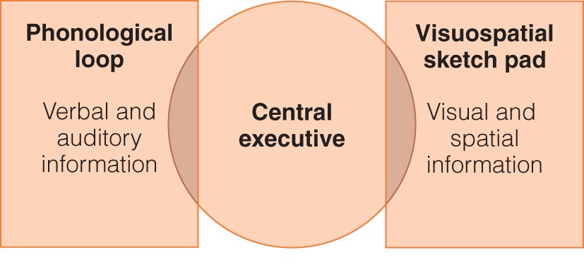
Baddeley’s working memory model
Baddeley and Hitch (1974); Baddeley (2000)

Slide 42

Phonological loop
deals with auditory information
phonological store: holds words we hear
articulatory process:
  allows us to repeat words in a loop to prevent them from decaying
  “inner voice”

Slide 43
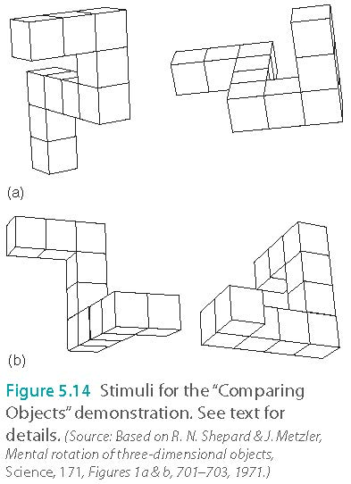
Visuospatial Sketch Pad
Visual imagery: The creation of visual images in the mind in the absence of a physical visual stimulus
  Shepard and Metzler (1971)
  Manipulation: Mental rotation task
  Tasks that called for greater rotations took longer

Slide 44
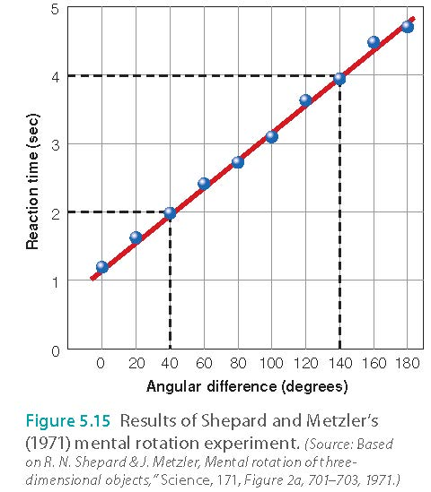
Working Memory

Slide 45
Mental rotation
Pietsch and Jansen (2012, 2013) showed that people who were athletes or musicians had faster reaction times than people who were not.
https://www.ncbi.nlm.nih.gov/pmc/articles/PMC3700661/
Why?
Spatial intelligence

Slide 46
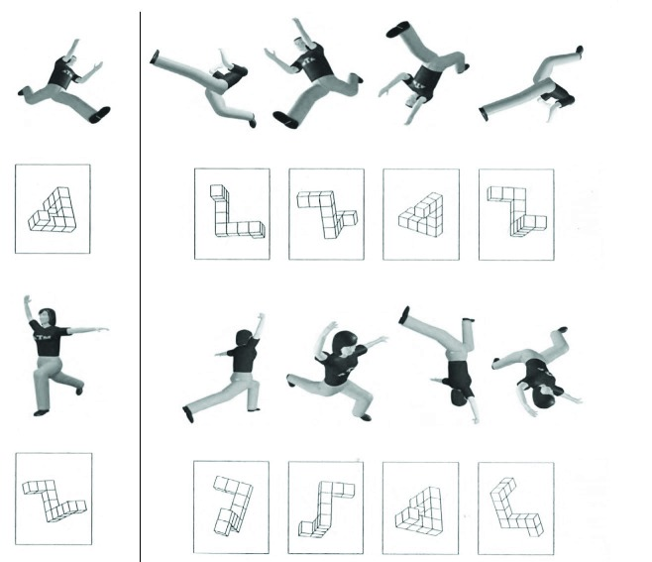
Mental rotation

Slide 47
The Central Executive
Attention controller
  Focus, divide, switch attention
Controls suppression of irrelevant information
Damage to the Frontal lobe
  Perseveration: repeatedly performing the same action or thought even if it is not achieving the desired goal

Slide 48
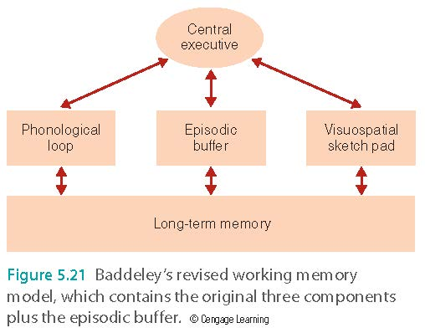
Episodic Buffer
Communicates with LTM and WM components
Hold information longer and has greater capacity than phonological loop or visuospatial sketch pad

Slide 49
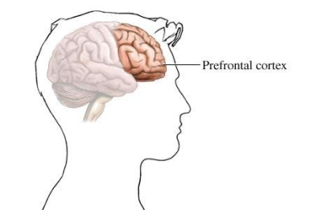
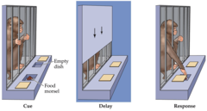
WM and the Brain
Prefrontal cortex responsible for processing incoming visual and auditory information
  Delay response task: Monkeys without a prefrontal cortex have difficulty holding information in WM

Slide 50
Anxiety and memory
Choking under pressure
Dual task: to do math while holding six letters in the memory

Slide 51
Anxiety and memory
Test anxiety
Before taking the posttest the participants in the experimental group were asked to write for 10 minutes about their thoughts and feelings regarding the math problems they were about to perform.

Slide 52
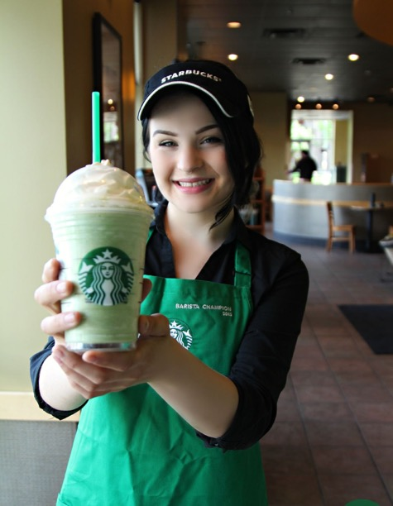
Anxiety and memory
Myra Fernandoes (2018)
Brian Sciences
People have high anxiety levels can better remember the words with negative images (e.g. car accident)
Implication: Memory bias
You started with a bad day (slept through your alarm)
The waiter at Starbucks asked you a natural question: “Do you want whipped cream on your mocha?”
You might remember him being rude or hostile.

