Slide 1
Autobiographical Memory &
Memory Errors
https://www.youtube.com/watch?v=RD5OJeLeunc
Most men, they'll tell you a story straight through. It won't be complicated, but it won't be interesting either.
- Big Fish

Slide 2
Some Questions to Consider
What kinds of events from their lives are people most likely to remember?
Is there something special about memory for extraordinary events like the 9/11 terrorist attacks?
What properties of the memory system make it both highly functional and also prone to error?
Why is eyewitness testimony often cited as the cause of wrongful convictions?
Why would someone confess to a crime they didn’t commit?

Slide 3
Autobiographical/personal Memory
Mental Time Travel
Sensory Component
Semantic
Knowledge & Facts
Episodic
What, When, Where

Slide 4
Autobiographical Memory
AB Memory – your life narrative.
  Memory for specific experiences from our life, which can include both episodic and semantic components
  Connects the past you with the present you helps make predictions about the future you.
  It is more than just what happened (i.e. EM), it is what happened to me (i.e., AM).
  Emotional component: Thoughts with personal history: what I thought and felt then, and how I think feel about it now.

Slide 5
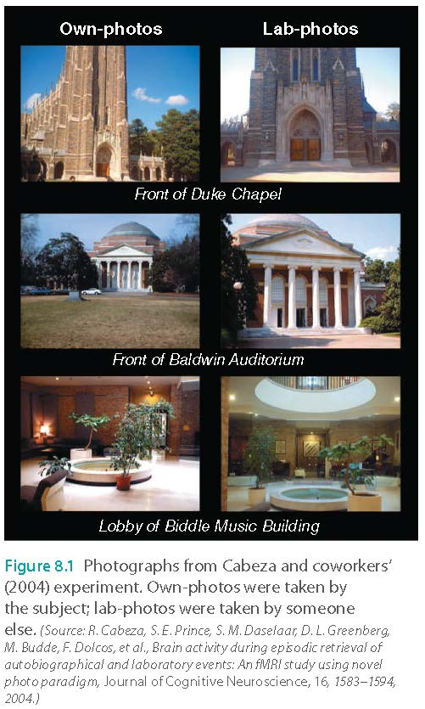
Autobiographical Memory
Cabeza and coworkers (2004)
  Comparing brain activation caused by autobiographical memory and laboratory memory
  Participants viewed
    Photographs they took
    Photographs taken by someone else

Slide 6

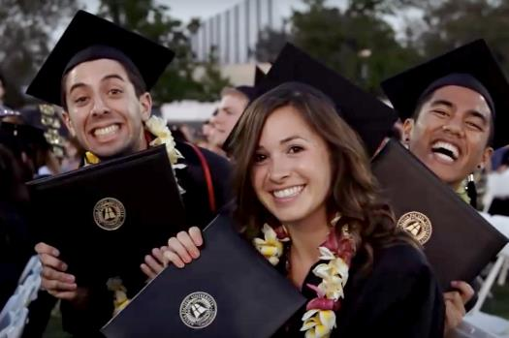
AB Memory Over the Lifespan
What events are remembered well?
  Significant events in a person’s life
  Highly emotional events
  Transition points

Slide 7
Breakout session
What is your most vivid autobiographical memory?
What type of emotional component do you tend to remember (e.g. love, trauma, frustration, religious experience [very close to God]…etc.)?

Slide 8

Reminiscence Bump
Participants over the age of 40 asked to recall events in their lives
Memory is high for recent events and for events that occurred in adolescence and early adulthood (between 10 and 30 years of age)
https://www.youtube.com/watch?v=d56fyWMh6bI

Slide 9
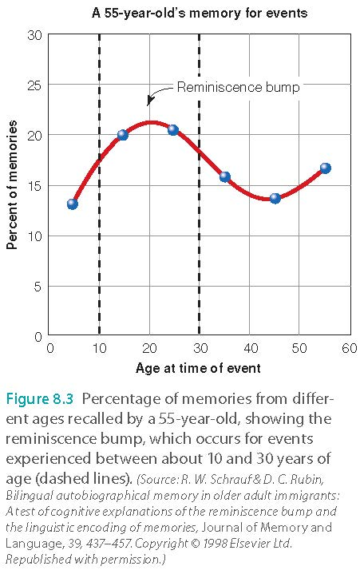
Reminiscence Bump

Slide 10
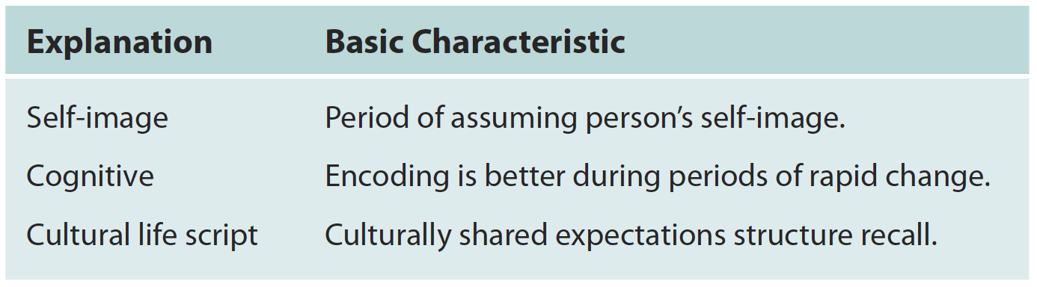
Reminiscence Bump
Hypotheses about the reminiscence bump

Slide 11
Reminiscence Bump
Self-image hypothesis (Rathborne et al.,)
  Memory is enhanced for events that occur as a person’s self-image or life identity is being formed
  People assume identities during adolescence and young adulthood
  Many transitions occur between ages 10 and 30

Slide 12
Reminiscence Bump
Cognitive hypothesis
  Encoding is better during periods of rapid change that are followed by stability
  Evidence from those who emigrated to the US after young adulthood indicates reminiscence bump is shifted

Slide 13
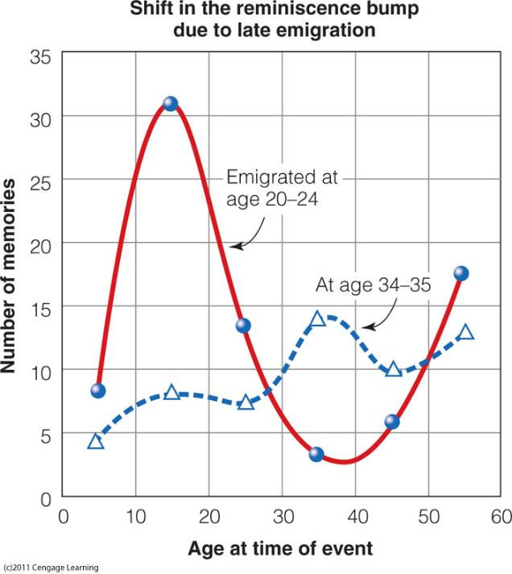
Caption: The reminiscence bump for people who emigrated at age 34 to 35 is shifted toward older ages, compared to the bump for people who emigrated between the ages of 20 to 24. (Reprinted from Journal of Memory and Language, 39, R.W. Schrauf & D.C. Rubin, “Bilingual Autobiographical Memory in Older Adult Immigrants: A Test of Cognitive Explanations of the Reminiscence Bump and the Linguistic Encoding of Memories,” pp. 437-457, Fig. 2, Copyright © 1998 with permission from Elsevier.

Slide 14
Reminiscence Bump
Cultural life-script hypothesis
Each person has
  A personal life story
  An understanding of culturally expected events (e.g. baptism)
Personal events are easier to recall when they fit the cultural life script

Slide 15
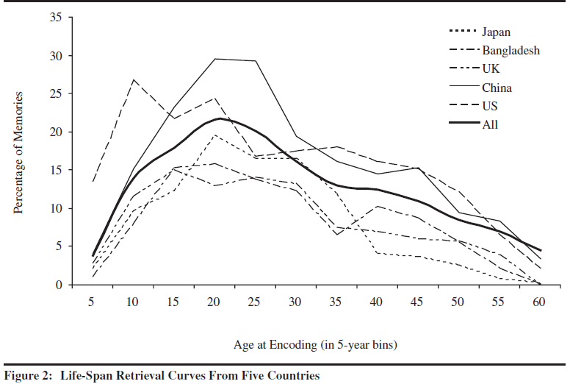
Conway et al. 2003
The reminiscent bump appears semi-universal

Slide 16
Pop quiz (ungraded): Which of the following is NOT one of the hypotheses that can explain reminiscent bump?
Events that define your self-identity, such as graduated from college and became a professional
Events with extreme emotion, such as trauma
Events with rapid change
Events that fit into culturally shared expectations, such as entering adulthood

Slide 17
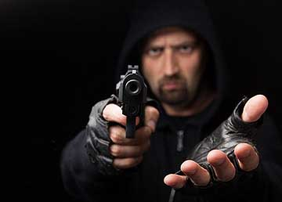
Memory for Emotional Stimuli
Emotional events remembered more easily and vividly (e.g. Romantic experience)
Weapons focus: tendency to attend to a weapon during a crime, but will remember less about other details, or the perpetrator of a crime (Forensic psychology).

Slide 18
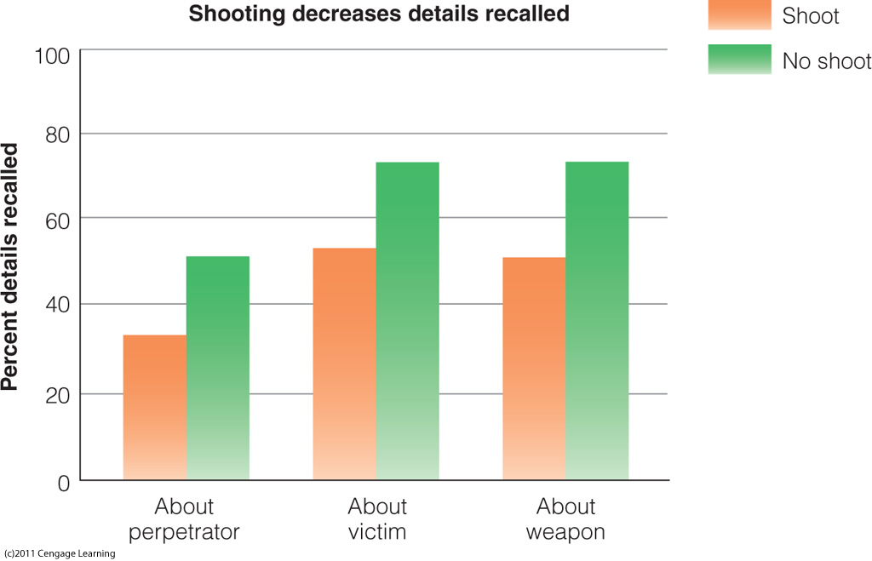
Caption: Results of Stanny and Johnson’s (2000) weapons-focus experiment. Presence of a weapon that was fired is associated with a decrease in memory about the perpetrator, the victim, and the weapon.

Slide 19
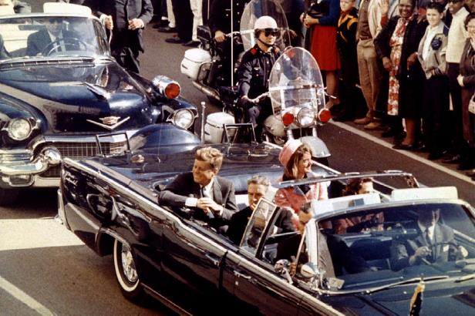
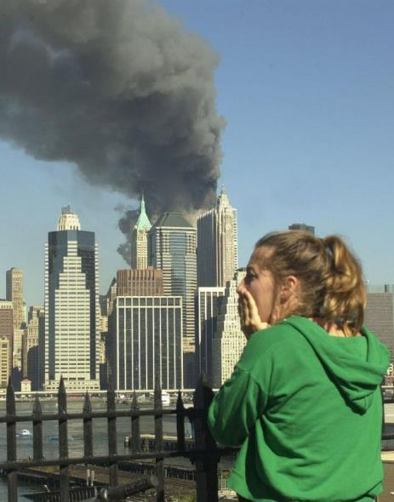
Flashbulb Memories
Memory for circumstances surrounding shocking, highly charged important events
  9/11/2001
  Kennedy assassination
  Challenger explosion
Where you were, and what you were doing?
Highly emotional, vivid, and very detailed

Slide 20
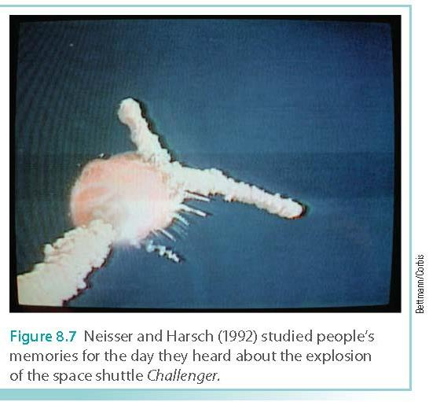
Flashbulb Memories
Flashbulbs are not “photograph” memories, as they can change with the passage of time
Repeated recall
  Initial description: baseline
  Later reports compared to baseline

Slide 21
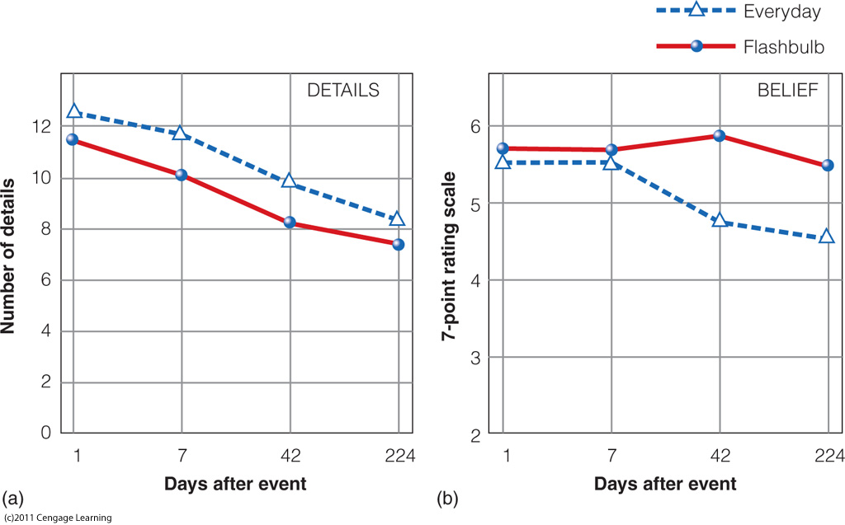
Flashbulb Memories
Talarico & Rubin (2003)
  Asked college students about 9/11.

Slide 22
Pop quiz: Which of the following statements about flashbulb memories is TRUE?
When someone points a gun to anther person, that person would not look at the weapon to avoid provoking the gunman.
If the gunman opens fire, the eyewitness tends to recall more details about the crime scene.
People tend to keep accurate memories when the event is significant (e.g. JFK assassination, 911 terrorist attack…etc.).
Most people are very confident about their flashbulb memories, but the level of confidence and the accuracy of recalled details are disconnected.

Slide 23
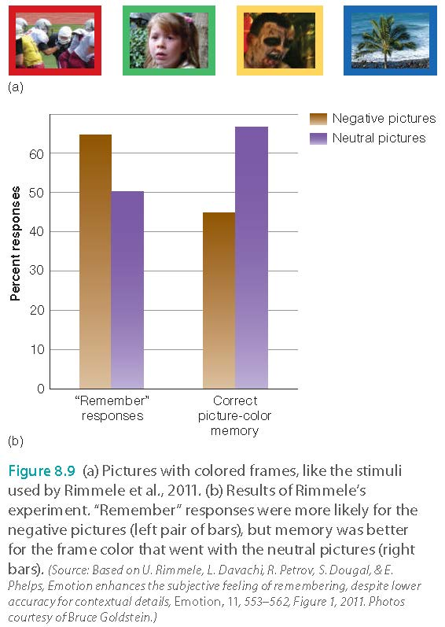
Flashbulb Memories
Rimmele and coworkers (2011)
  Memories for negative emotional pictures were stronger, and associated with greater confidence

Slide 24
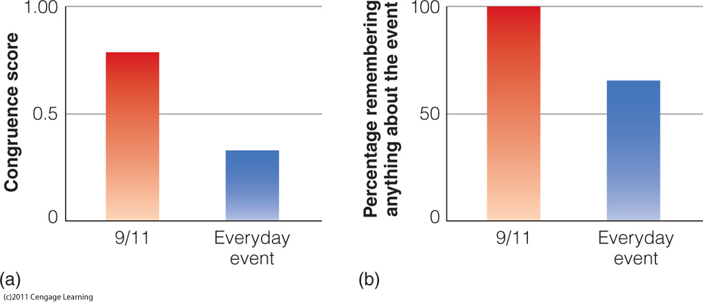
Flashbulb Memories
Davidson and coworkers (2006)
  Memories for 9/11/01 more resistant to fading than memory for other events around that time

Slide 25
Flashbulb Memories
Narrative rehearsal hypothesis
  Repeated viewing/hearing of event
    TV, talking with others
    Could introduce errors in own memory

Slide 26
Flashbulb Memories
Results suggest that these memories can be inaccurate or lacking in detail
Even though participants report that they are very confident and that the memories seem very vivid
Discrepancies are common (I am not accusing anyone)
Hilary Clinton’s 1996 Bosnia trip: https://www.youtube.com/watch?v=SfaxA9Q-9AQ
Brain Williams’s story of helicopter being shot down in Iraq: https://www.youtube.com/watch?v=VSJuyIbumqQ

Slide 27
Breakout session
Do you think Hilary Clinton and Brian Williams lied or they mis-remembered?
There is no right or wrong answer. Please try your best to articulate your argument.

Slide 28
Let’s test your Eyewitness Memory!!
https://www.youtube.com/watch?v=qQ-96BLaKYQ
Please answer the questions.

Slide 29
The seven sins of memory (Schacter, 1999)
Transience: Decreasing accessibility of information over time e.g. forgot what happened a year ago.
Absent-mindedness: Inattentive or shallow processing that contributes to weak memories e.g. forgot where I put my credit card
Blocking: The temporary inaccessibility of information that is stored in memory e.g. looks familiar, but forgot the name of an actor.

Slide 30
The seven sins of memory (Schacter, 1999)
Misattribution Attributing a recollection or idea to the wrong source e.g. mixing up people or events
Suggestibility: Memories that are implanted as a result of leading questions or expectations e.g. sexual abuse in childhood
Bias: Retrospective distortions and unconscious influences that are related to current knowledge and beliefs e.g. divorcee reinterpreted his/her marriage
Persistence: Pathological remembrances-information or events that we cannot forget, even though we wish we could e.g. experience in a war zone

Slide 31

One more sin:
Desirability of outcome
Aschengrau & Seage III (2008)
The reliability of our memory is tied to the desirability of the outcome.
When a medical researcher tries to collect data from mothers whose babies are healthy and mothers whose kids are malformed, the data from the latter is usually more accurate than that of the former.
Why?

Slide 32
One more sin:
Desirability of outcome
The outcome of the latter is not desirable.
Mothers of malformed babies have been carefully reviewing every illness that occurred during the pregnancy, every drug taken, every detail directly or remotely related to the tragedy in an attempt to find an explanation.
Mothers of healthy infants do not pay much attention to this information.

Slide 33
Breakout session
Form a small group of 3-5 to discuss the following:
Did you or someone who experience one or more of the seven sins of memory?
Share your story in class.

Slide 34
The Constructive Nature of Memory
Bartlett’s “war of the ghosts” experiment
  Had participants attempt to remember a story from a different culture (Canadian vs. English)
  Repeated reproduction

Slide 35


The Constructive Nature of Memory
Results
  Over time, reproduction became shorter, contained omissions and inaccuracies
  Changed to make the story more consistent with their own culture (Canoe vs. boat)

Slide 36
Source Monitoring
Source memory: process of determining origins of our memories
Source monitoring error or source misattributions
Cryptoamnesia: Unconscious plagiarism of another’s work due to a lack of recognition of its original source
Brown & Murphy (1989): 3 to 9% of cases people would unconsciously attribute other people’s ideas to themselves.
Sound familiar? https://www.youtube.com/watch?v=gDpvVmp4_Yo
“I’ve written over 100 songs and if you check out each song thoroughly you’d hear the influence of a 100 other songs that I didn’t write. That’s just the nature of the beast.”
-Jack Ashford aka “The Tambourine Man”

Slide 37
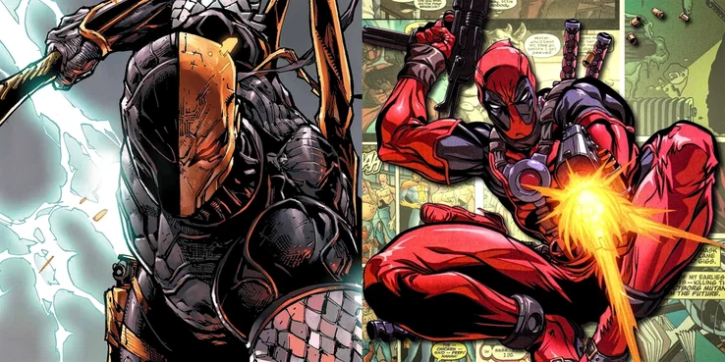
Cryptoamnesia?
DEATHSTROKE AND DEADPOOL

Slide 38

Cryptoamnesia?
GREEN ARROW AND HAWKEYE

Slide 39

Cryptoamnesia?
ELONGATED MAN AND MR. FANTASTIC

Slide 40
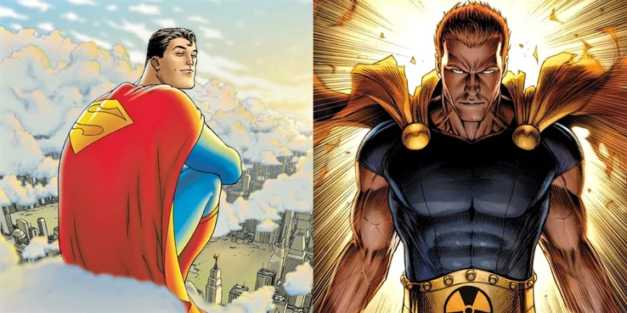
Cryptoamnesia?
SUPERMAN AND HYPERION

Slide 41
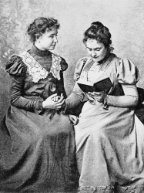
Is Crytoamnesia legally accountable?
There is a debate about whether cryptomnesia is real or is an excuse.
Helen Keller is a well-known author. She was blind and deaf, and thus her story is inspirational.
In 1891, Keller published a story entitled The Frost King.

Slide 42
Is Crytoamnesia legally accountable?
Later it was discovered that the story is similar to another novel entitled Frost Fairies by Margaret Canby.
Someone read Frost Fairies to Kelly and perhaps her writing was influenced by Canby.

Slide 43
Is Crytoamnesia legally accountable?
Kelly said, “But the fact remains that Miss Canby’s story was read to me once, and that long after I had forgotten it, it came back to me so naturally that I never suspected that it was the child of another mind.”
Keller was tried by a school committee. The panel split by 4 to 4 on whether she had intentionally plagiarized.

Slide 44
Breakout session
What do you think about the case of Helen Keller?
Is Crytoamnesia legally accountable?

Slide 45
Source Monitoring
Jacoby et al. (1989)
After 24 hours, some non-famous names were misidentified as famous
Explanation: some non-famous names were familiar, and the participants misattributed the source of the familiarity
  Failed to identify the source as the list that had been read the previous day

Slide 46
Read the following sentences
The flimsy Shelf weakened under the weight of the books.
The children’s snowman vanished when the temperature reached 80.
The store glass was damaged when the rock hit it.

Slide 47
Making Inferences
Memory can be influenced by inferences that people make based on their experiences and knowledge
Pragmatic inferences: based on knowledge gained through experience
Memory often includes information that is implied by or is consistent with the to-be-remembered information but was not explicitly stated
Notes:
I believe this also explains

Slide 48
Fill in the blank
The store glass was ______________ when the rock hit it.
The children’s snowman ____________ when the temperature reached 80.
The flimsy Shelf ___________ under the weight of the books.

Slide 49
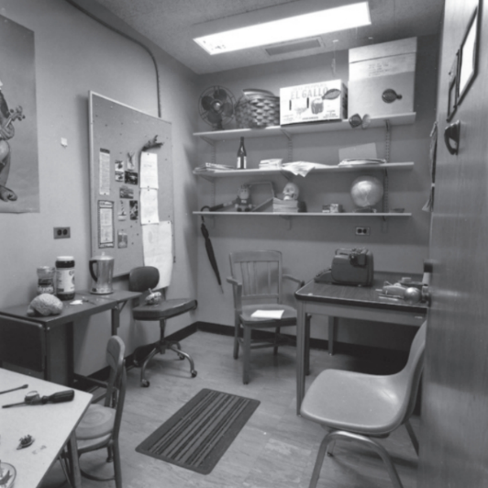
Schemas and Scripts
Schema: knowledge about some aspect of the environment
  e.g., Post office, ball game, classroom
  Subjects membered there were “books” in the office.
Script: conception of sequence of actions that usually occurs during a particular experience
  Going to a restaurant; playing tennis
We might infer information to our memory.

Slide 50
Power of Suggestion
Misinformation effect: misleading information presented after a person witnesses an event can change how that person describes the event later
  Misleading post-event information (MPI)

Slide 51
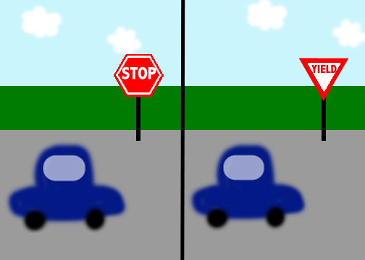
Power of Suggestion
Loftus and coworkers (1975)
  See slides of traffic accident with stop sign
  Introduce MPI: yield sign
  Participants remember what they heard (yield sign) not what they saw (stop sign)

Slide 52
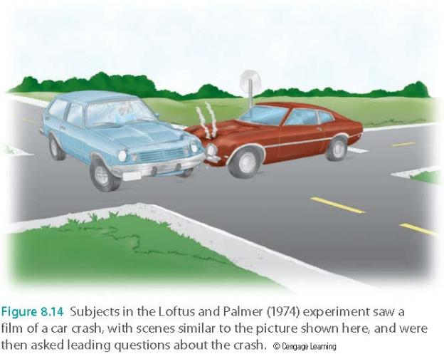
Power of Suggestion
Loftus and Palmer (1974)
  Hear “smashed” or “hit” in description of car accident
  Those hearing “smashed” said the cars were going much faster than those who heard “hit”

Slide 53
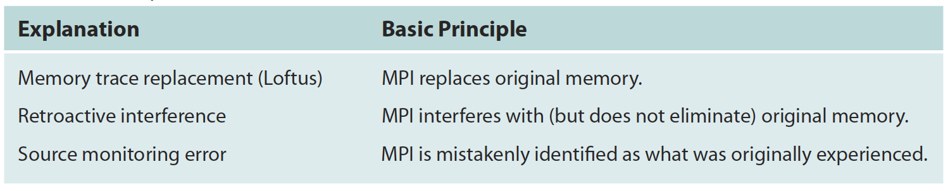
Power of Suggestion
Hypotheses about the misinformation effect
Caption: Explanations for the misinformation effect

Slide 54
Pop quiz: Which of the following statements is TRUE?
People tend to remember what they saw, not they heard.
According to the hypothesis of memory trace replacement, misleading post-event information (MPI) happens when the correct information is interfered by the incorrect information.
MPI can be caused by misattributing the source (e.g. mixed up two things, two persons, or two events)
Source monitoring errors occur when we infer information to our memory e.g. After looking at the photo of an office, we mistakenly remembered that there was a computer in the office.

Slide 55
False Memories
Hyman and coworkers (1995)
  Participants’ parents gave descriptions of childhood experiences
  Participant had conversation about experiences with experimenter; experimenter added new (false) events
  When discussing it later, participant “remembered” the new (false) events as actually happening

Slide 56
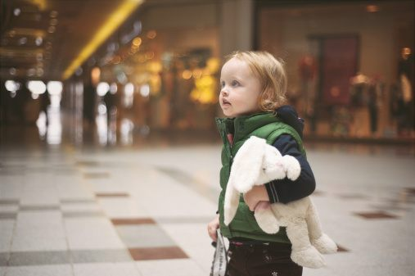
Pezdek & Hodge, 1999
The Role of Plausibility
Participants
  19 5 to 7 year old children
  20 9 to 12 year old children
Methods
  Read description of two true and two false events that supposedly happened when they were 4.
  False Events
    Lost in mall (plausible)
    Receive Rectal Enema (implausible)

Slide 57
Pezdek & Hodge, 1999
The Role of Plausibility
Results
  54% (21) of the children did not remember the false events.
  14 children recalled the plausible, but not the implausible event.
  3 of the younger children recalled both false events.
How does something become plausible?
Notes:
Event must be relatively plausible and there must be script relevant knowledge in memory. In other words, to imagine something, you need a the necessary information in memory.

Slide 58
Repressed or Constructed memories of Abuse?
American survey – average therapist estimated that 11% of the population have “repressed memories” of child abuse.
British and American doctoral level therapist – 7 in 10 said they had used techniques (hypnosis, drugs, etc.) to help clients recover suspected repressed memories of abuse.

Slide 59
Repressed or Constructed memories of Abuse?
Roughly 60-80% of clinicians, psychoanalysts, and therapists surveyed agreed to some extent that traumatic memories are often repressed and can be retrieved in therapy, compared to less than 30% of research-oriented psychologists. (2013)
https://www.youtube.com/watch?v=8fGC87zdLag
http://www.salon.com/2010/09/20/meredith_maran_my_lie_interview/

Slide 60
Errors in Eyewitness Testimony
Testimony by an eyewitness to a crime about what he or she saw during the crime
One of the most convincing types of evidence to a jury
  Assume that people see and remember accurately
But, like other memory, eyewitness testimony can be inaccurate
  Mistaken identity
  Constructive nature of memory

Slide 61
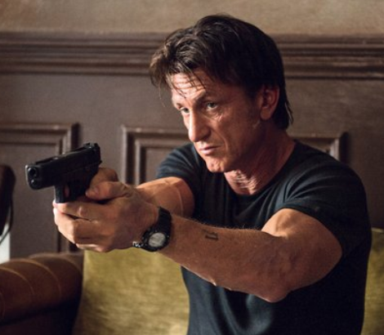
Errors in Eyewitness Testimony
Wells & Bradfield (1998)
  Participants view security videotape with gunman in view for 8 seconds
  Everyone identified someone as the gunman from photographs afterwards
  The actual gunman’s picture was not presented.

Slide 62
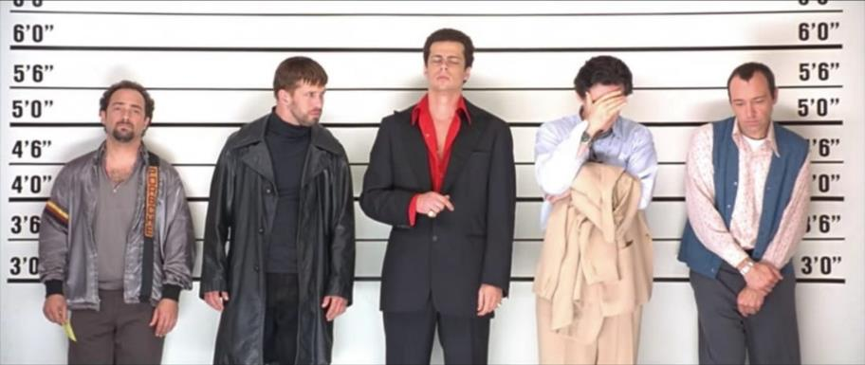
Errors in Eyewitness Testimony
Common practice: Police Lineup
increases the chances that the witness will pick someone because: “Well, the guy with the beard looks more like the robber than any of the other men, so that’s probably the one.”

Slide 63
Errors in Eyewitness Testimony
Errors due to attention and arousal
  Low: attend to irrelevant information
  High: focus too narrowly (Weapon Focus)
  Moderate: best for being aware of relevant information

Slide 64
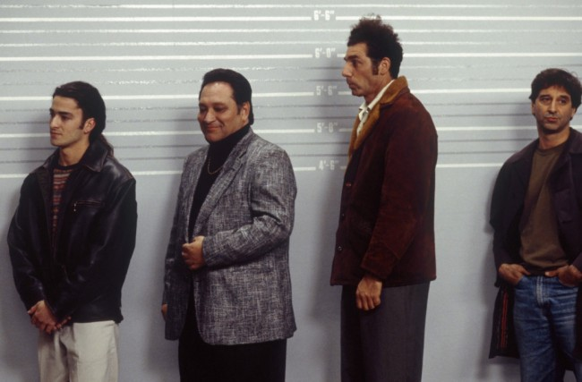
Errors in Eyewitness Testimony
Errors due to familiarity
  Source monitoring (Ross et al.,1994)
  You met that person before

Slide 65
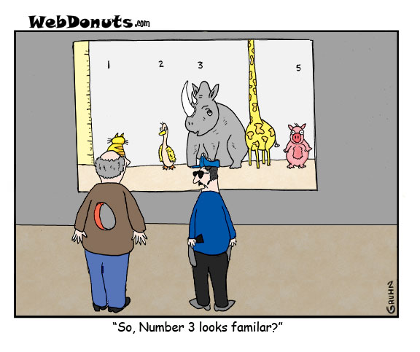
Errors in Eyewitness Testimony
Errors due to suggestion
  Suggestive questioning
      “Which one of these men did it?”
      Should have said: “is one of these men the perpetrator?”
  Confirming feedback
    Boasts participants confidence

Slide 66
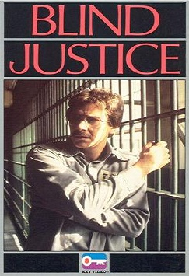
A true story
Mr. A was arrested for a minor offense, but he was identified by witnesses as the criminal in relation to the rapes and robberies.
Although he was innocent, the case against him was so strong that he started questioning himself.
He lost everything: marriage, job…etc.
At last he cleared his name after the police arrested the real criminal.
The story was adapted into a 1986 film.

Slide 67
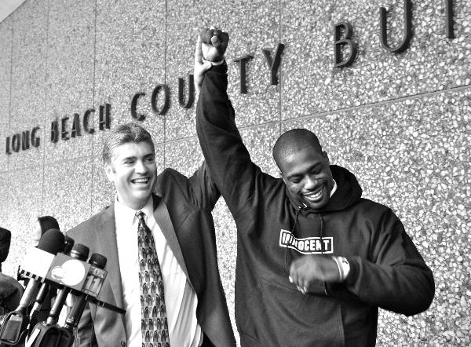
Innocence Project
Many innocent people were mistakenly convicted based on eyewitness testimony.
Now DNA testing can prove their innocence.
Exonerated 274 People
https://www.youtube.com/watch?v=Cgg35eNBllA
http://www.innocenceproject.org/understand/Eyewitness-Misidentification.php

Slide 68
Wise et al. (2009)
What US Prosecutors and Defense Attorneys Know about Eye witness testimony.
  73 Prosecutors
  1184 Defense attorneys
The Results
  Prosecutors had significantly less knowledge than defense lawyers.
  Prosecutors were less skeptical of jurors knowledge of eyewitness testimony.

Slide 69
Pop quiz: Which of the following statements is TRUE?
Some men are falsely accused by their daughters of sexual abuse after psychotherapists used questionable methods to extract so-called repressed memory.
In the experiment conducted by Wels and Bradfield, after viewing a videotape about a crime, every participant identified someone as the gunman from the photographs presented later when the actual gunman was not in the photos.
In a typical police lineup, the witness tends to pick someone that looks like a criminal.
All of the above

Slide 70
What Is Being Done?
Inform witness perpetrator might not be in lineup
Use “fillers” (foils or innocent people) in lineup similar to suspect
Use sequential presentation (not simultaneous)
Improve interviewing techniques: Avoid leading questions

Slide 71
Faith integration
Matthew 7: Do not judge, or you too will be judged. For in the same way you judge others, you will be judged, and with the measure you use, it will be measured to you. Why do you look at the speck of sawdust in your brother’s eye and pay no attention to the plank in your own eye? 4 How can you say to your brother, ‘Let me take the speck out of your eye,’ when all the time there is a plank in your own eye?

Slide 72
Faith integration
Consider this scenario: Someday you become very famous: You are a senator, a prominent scholar, or a movie star.
Everything you do or you say is recorded by the media or is documented.
Your rival wants to discredit you. He or she keeps searching for your inconsistency. Eventually he or she can find something!

Slide 73
Faith integration
Intellectually we should be critical.
Spiritually perhaps we should be open-minded and forgiving.
Presumed innocent until proven guilty; give people the benefit of the doubt.
We all committee the “sins” of memory, but we may not be aware of our own mistakes.

Slide 74
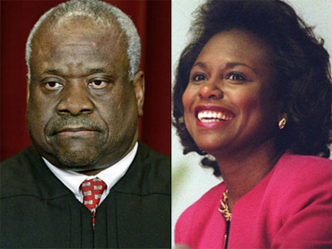
Assignment
This assignment is about sexual harassment. If you feel uncomfortable with this topic and the video, you can opt out.
Form a group of 3-5 to discuss the following.
Clarence Thomas vs. Anita Hill

Slide 75
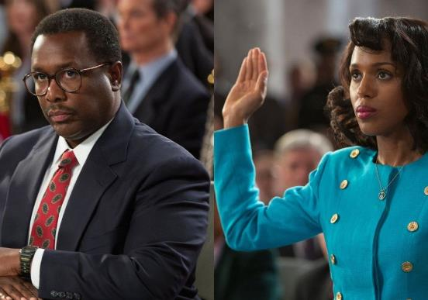
Assignment
In 1991 President Bush nominated Judge Clarence Thomas for the Supreme Court of the United States. Anita Hill, a law professor at the University of Oklahoma who had previously worked under Thomas, accused him of sexual harassment.
After the initial hearing, the committee said that both are credible witnesses.
The committee called additional witnesses for both sides.

Slide 76
Assignment
https://www.youtube.com/watch?v=1lEEDD2vxaE
Did one or both of them lie? If neither Judge Thomas nor Professor Hill lied, is it possible that the discrepancy between their stories is caused by “sins” of memory? (e.g. misattribution, bias…etc.) Please explain.
You are a forensic psychologist. You are assigned to guide the witnesses to give testimony. What would you do to help them?
There is no right or wrong answer. You are welcome to be creative.

