Slide 1
American culture and American Christianity
Chong Ho Yu

Slide 2
American culture and American Christianity
Does religion reflect the culture in which the religion is situated?
Characteristics of the US culture/Christianity
  Individualism / Biblical individualism: personal gain
  Optimism / Positive thinking: everything is possible
  Blessed nation / Bootstrapping Christianity (one can pull oneself up by personal effort alone) : those who achieve a higher status are hardworking, self-sufficient, and morally superior to those who remain in the lower classes ; attribute our “blessed” lives to our personal spirituality

Slide 3
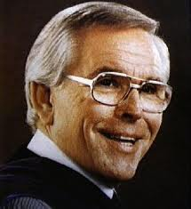

Prosperity Gospel
When I was a young boy, one of the most influential books at that time was “Positive thinking” by Pastor Robert Schuller, the founder of the Crystal Cathedral in California, the host of the program “Hour of Power.”
The message is simple: always be positive; with God’s help you can make it.
In 2000 the spokesman of the White House said: “The president (George Bush) believes that we are a blessed nation.”

Slide 4
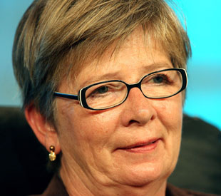
Bright-sided
Ehrenreich, B. (2010). Bright-sided: How positive thinking is undermining. America. New York: Picador.
Evangelical mega-churches preach the good news that you only have to want something to get it, because God wants to “prosper” you.
“Major religious leaders, especially on the Christian right, buttress this conceit with the notion that Americans are God’s chosen people and that America is the designated leader of the world.”

Slide 5
Irrational optimism
British observer Godfrey Hodgson has written that the American sense of exceptionalism has become harder and harder.
“Those who set themselves up as instructors in the discipline of positive thinking— coaches, preachers, and gurus of various sorts—have described this effort with terms like “self-hypnosis,” “mind control,” and “thought control.” In other words, it requires deliberate self-deception, including a constant effort to repress or block out unpleasant possibilities and “negative” thoughts.”
Irrational optimism would result in disasters.

Slide 6
Russell Jeung: Biblical individualism
Today evangelical churches emphasize more the personal gains of Christianity and less the fear of God’s judgment.
The goals center on bringing people into a celebrative encounter with God and helping them grow in personal lives.
Churches provide the audience with worship experiences that are uplifting and intimate, as well as programs to help an individual's own spiritual development.
The Gospel is customized to fit into the postmodern American culture by placing personal autonomy and individual fulfillment before God’s demands.

Slide 7
Bruggemann:
A deeper root beyond post-modernism
Since the Enlightenment the self has become the center of everything.
The notion of individual freedom was further reinforced by Descartes’s establishment of the human doubter as the norm of epistemology.
Later Freudian psychoanalysis promoted removing self-repression as the path of mental health. These cultural trends facilitate a self-centered religion.

