Slide 1
Orientation: What it takes to do good research
Chong Ho (Alex) Yu

Slide 3
82% chance you will fail!
National Institute of Health (NIH) received 51,073 research project grant applications
Funded: 9,241, resulting
Success rate: 18.1 percent.

Slide 4
82% chance you will fail!

Slide 5
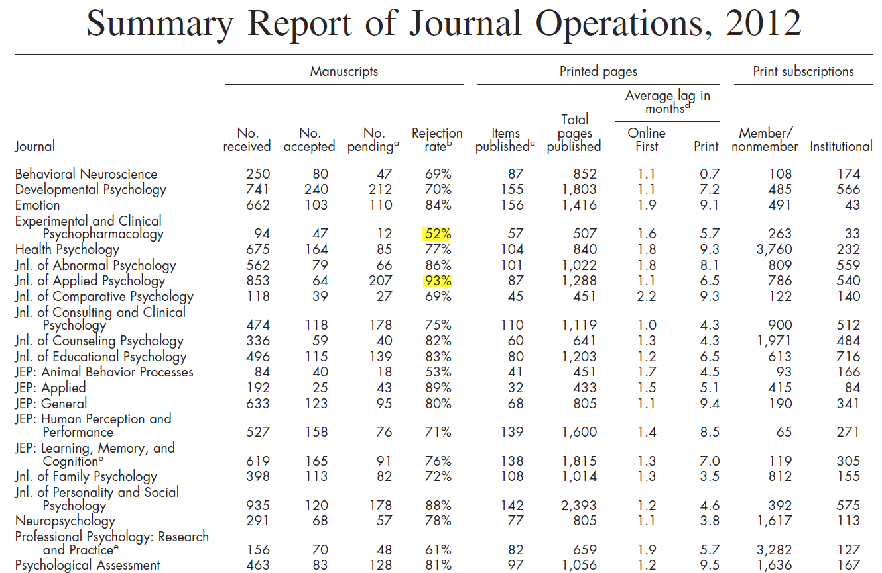
Peer review: Rejection is normal

Slide 6
Harsh comments are normal
“The paper was not well written by professional journal standards. A reviewer said confidentially that he thought it was written by an undergraduate student. I read and immediately saw that much of the introduction was a too-long general overview of the area instead of a tight, focused, logical argument that lead directly to this study. It should have been at most half its present length, maybe less. Stated in summary notation: There were redundancies. There were wording problems, lots of them. There were things said that need not be said because the readers already know them -- plenty of them. “

Slide 7
But don’t be discouraged
The manuscript was submitted to another journal and it was accepted.
Yu, C. H. (2015). Are positive trait attributions for the deceased caused by fear of supernatural punishments?: A triangulated study by content analysis and text mining. Journal of Psychology and Christianity, 34, 3-18.

Slide 8
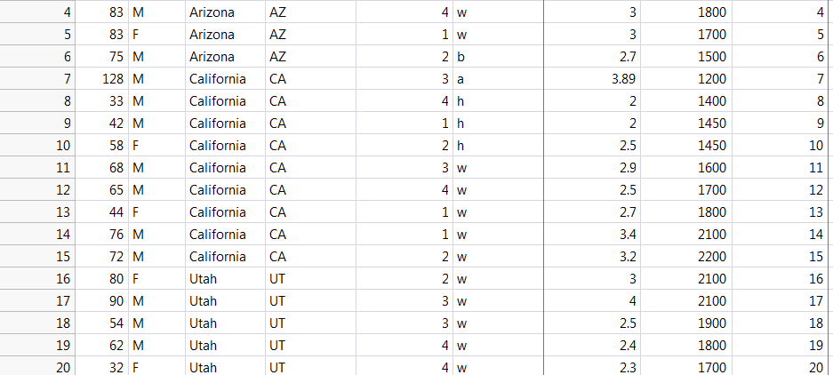
Quiz: T/F
In scientific research, only the information and observations that are made into the structure of scientific inquiry (database) are considered data.

Slide 9
Answer
Indeed, data also include virtually everything that is relevant to your research questions. Numbers in your database are called structured data, but there are many unstructured data, such as webpages.
Actually unstructured data far outnumber structured data.
For example, if you want to know how young people perceive religion, you look at blogs and Facebook.

Slide 10
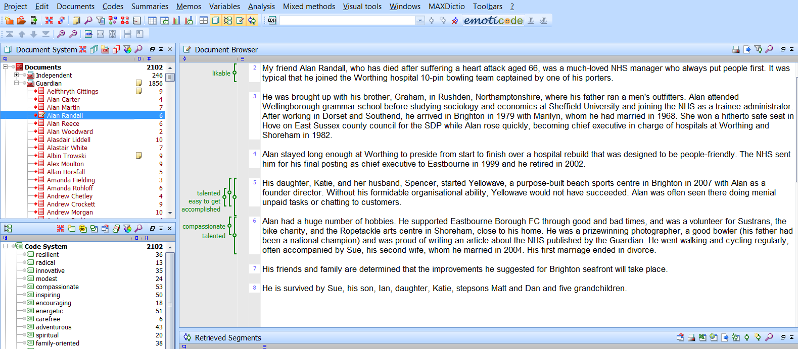
MAXQDA: Max Qualitative Data Analysis
But, they are so “messy” (unstructured?) How can I organize and analyze these data?

Slide 11
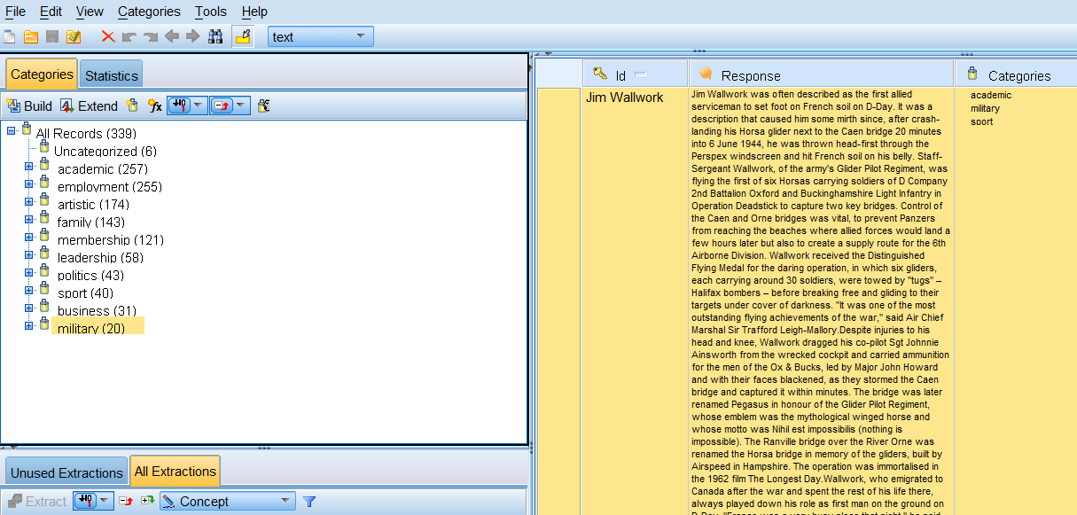
SPSS Text Analytics/SAS Text Miner

Slide 12
Quiz: T/F
Professor Dataman introduces a new treatment program and collecting data at the same time. Afterwards, he hands over the data to the best statistical consultant at the University and asks him to analyze the data. Is Dataman doing the right thing?

Slide 13
Proactive!
No sophisticated statistical procedures can rescue a project flooded with faulty or/and messy data.
Good research design and good planning of data collection will make things easier and better in the subsequent stages.

Slide 14
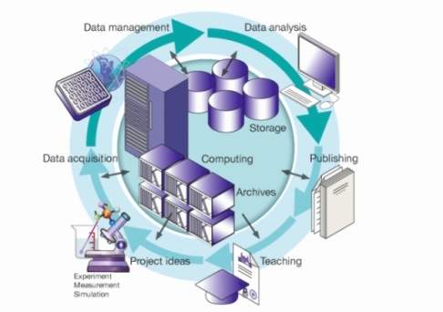
Data Management

Slide 15
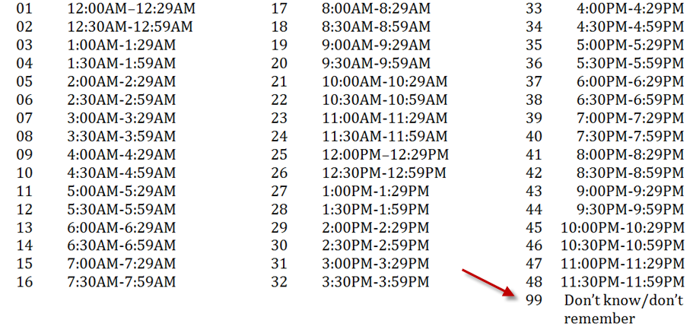
Examples
What time usually do you go to work?

Slide 16
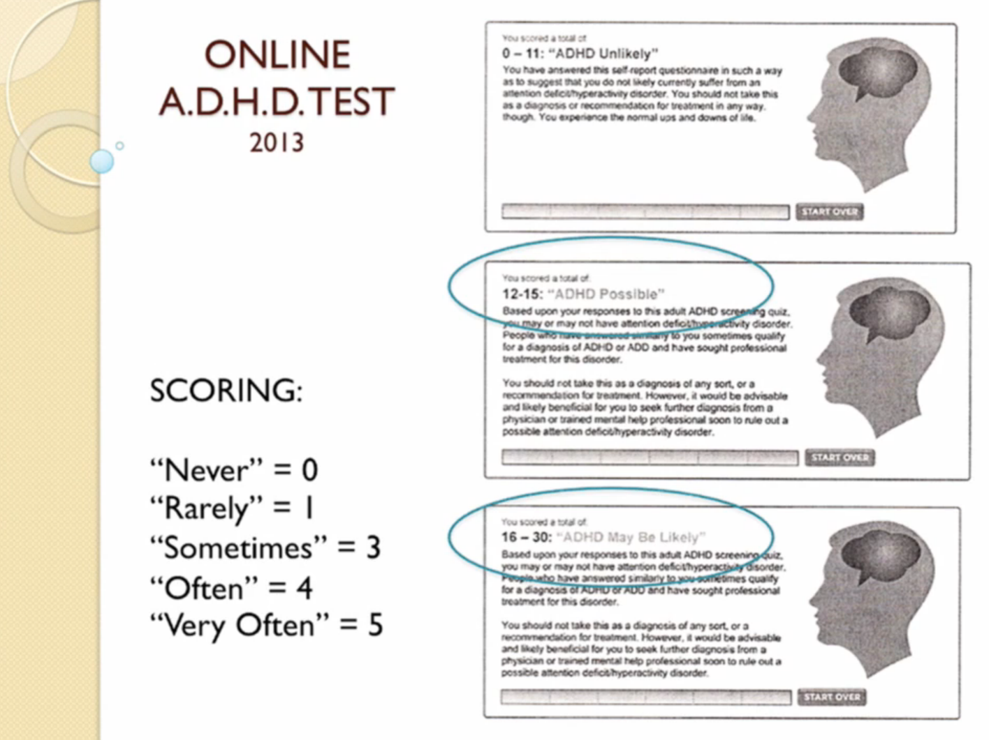
Examples
Source: Alan Schwarz (2015). Keynote of SAS Global Forum. Dallas, TX

Slide 17
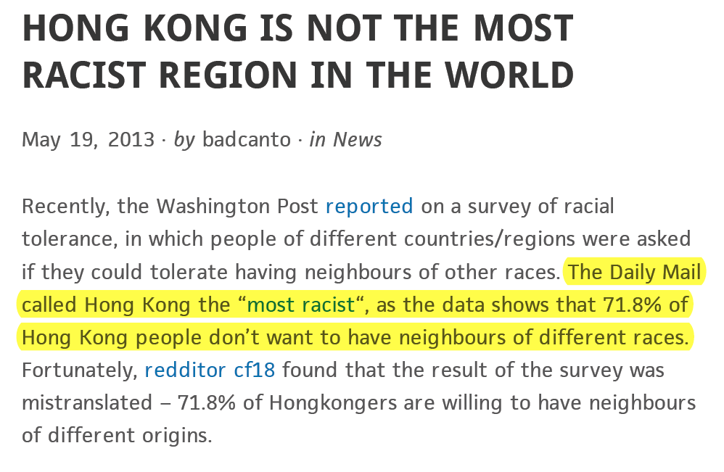
Examples

Slide 18
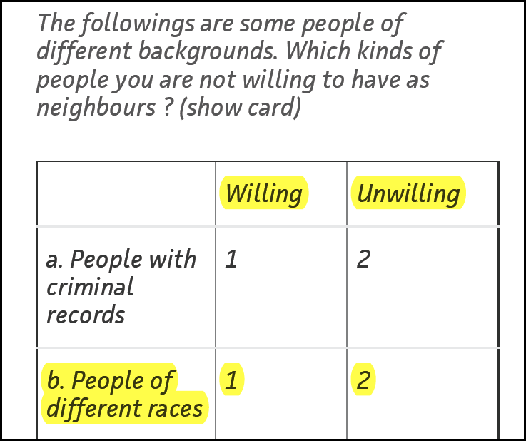
Examples
By common sense:
Yes = 1
No = 0
Why “not willing” = 2?

Slide 19
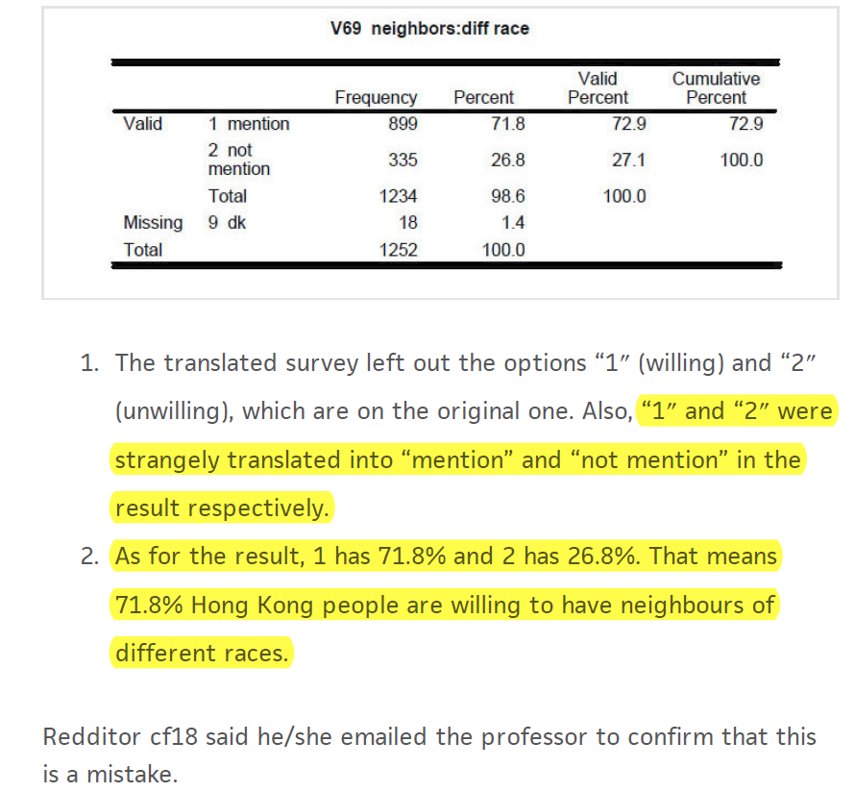

Slide 20
What is the best codebook?
The best codebook is no codebook or fewer codes!
Many people code the data in this way:
  Gender : Male = 1, Female = 2
  Race: White = 1, Black = 2, Hispanic = 3, Native American = 4, Asian = 5
Why not directly put down “M” as Male, “F” as female, “W” as white, “B” as black, “Y” as yes, and “N” as no…etc.? The letters are intuitive and you will never make any mistake by miscoding.

Slide 21
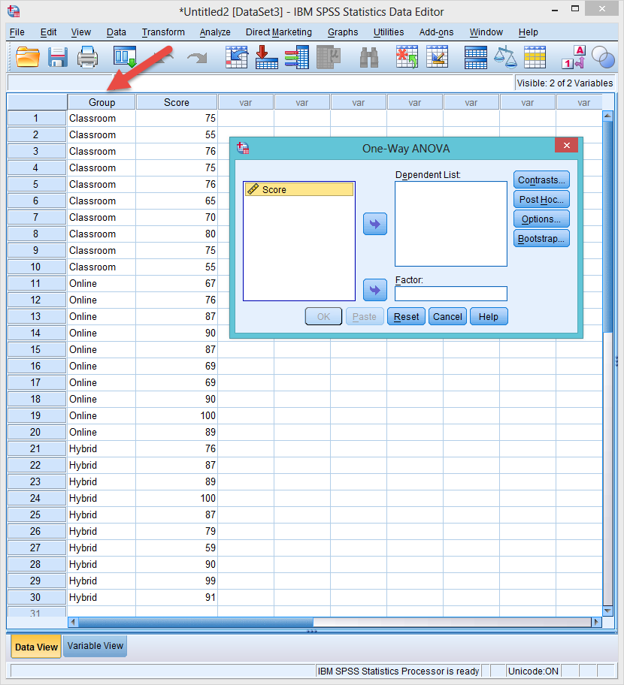
Disappearing factor
Sometimes it is understandable why people use numbers.
In SPSS when letters are used in a grouping factor, it cannot show up!

Slide 22
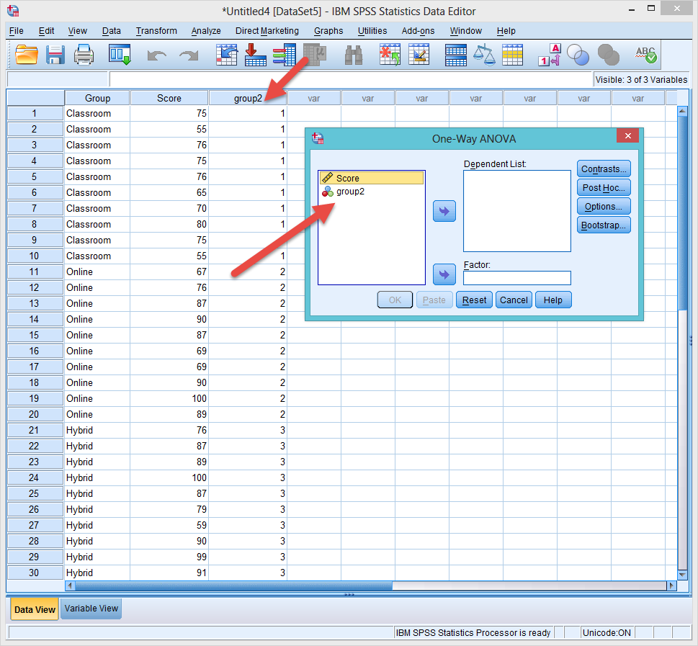
Recode to numbers
To see the grouping factor, you need to recode the letters to numbers.

Slide 23
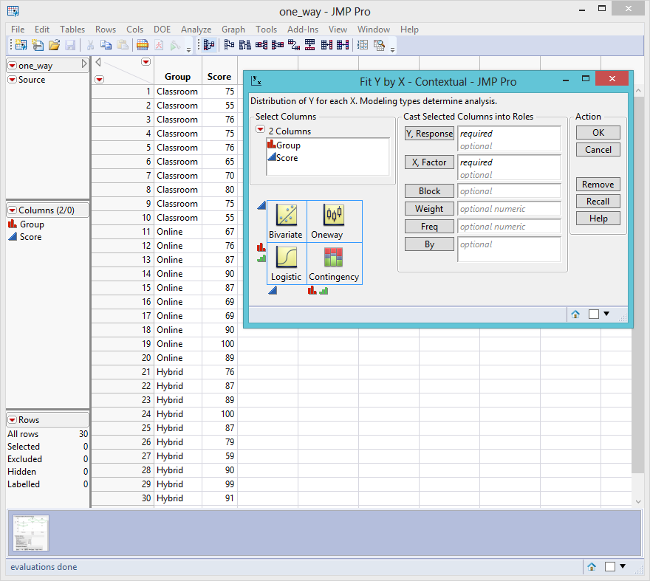
SAS and JMP are OK with numbers

Slide 24
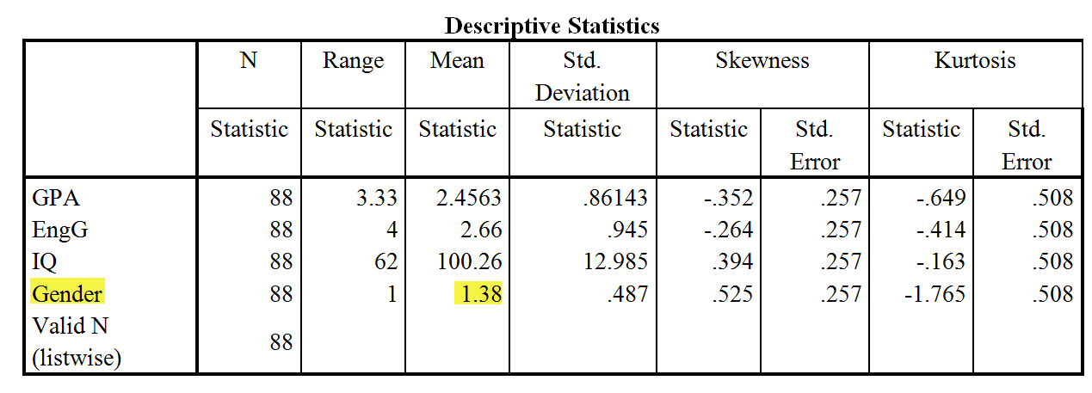
Don’t make these mistakes!
The following is a real report produced by a real student.
What’s wrong in the following table?

Slide 25
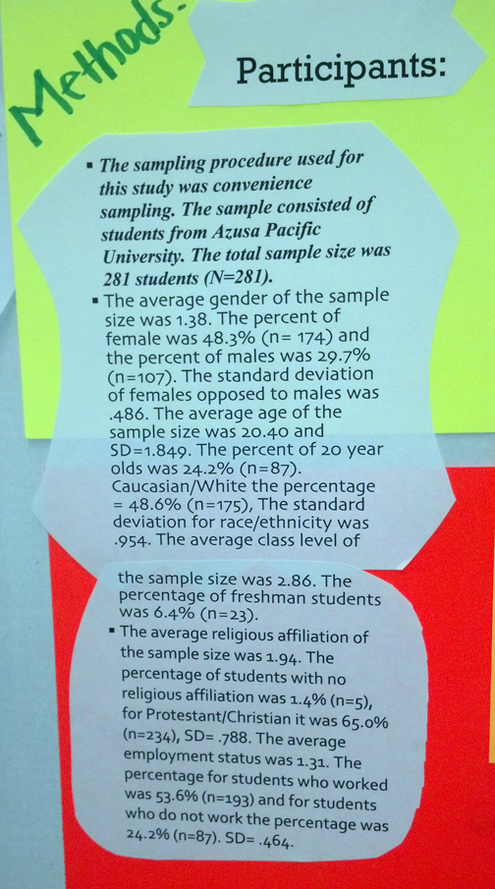
Don’t make these mistakes!
What’s wrong in this poster presentation?

Slide 26
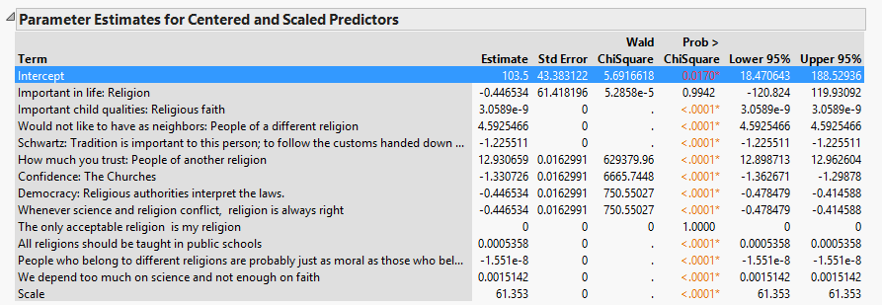
Your life is easier if…
I use very descriptive labels. I can work much faster in my analysis.
The output is ready to be pasted into the paper without changing the names.

Slide 27
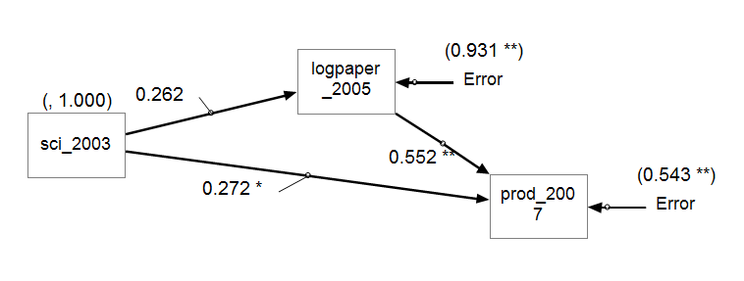
Exception 1: CFA/SEM
If you run Confirmatory Factor Analysis (CFA) or/and Structural Equation Model (SEM) in SPSS’s AMOS, JMP, or SAS, you have to use shorter labels.
  These programs cannot accept long variable names.
  Even if they can, you confuse yourself when the long names jam together on the small icons.

Slide 28
Exception 2: Programming
Data one; input Q1 Q1b Q1c Q1d Q1other Time_SH Time_Wk Com_Ex Web_Ex Res_Ex Q4a Q4b Q5c Q5d; cards; | Data one; input Q1-Q26; cards;
If you handle large databases and write programs for automation, use numbers at the end of variable names rather than characters.
In SAS you can assign variables as "Q1-Q26," but you cannot assign variables as "Qa-Qz."
If you use numeric variable names, you can be more efficient by saving time from typing and from matching the names on the hard copy and the variable names on the screen. When you have many variables, using character labels makes referencing extremely difficult.

Slide 29
Exception 2: Programming
Data one; input Q1 Q1b Q1c Q1d Q1other Time_SH Time_Wk Com_Ex Web_Ex Res_Ex Q4a Q4b Q5c Q5d; cards; | Data one; input Q1-Q26; cards;
When someday you want to rename the variables, using numeric names will be very convenient. For example, to rename Q1-Q100 as Question1-Question100, the code is: data new(rename=(q1-q100 = question1-question100));
When you want to do array manipulation, you will find that it is much easier to assign an array like array question(*) question1-question100;

Slide 30
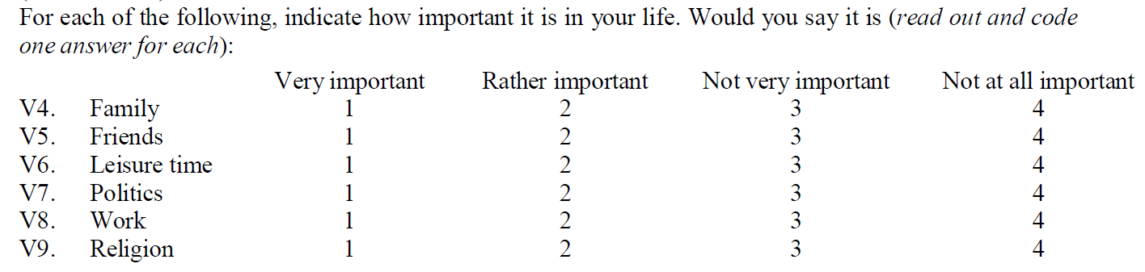
If you use numbers…
This example items are found in “World value survey”.
Sometimes you have to use numbers when you want to treat the data as continuous.
If so, use a more “natural” or “intuitive” way: bigger is better! e.g. 4 is “very important” and 1 is “not important”

Slide 31
If you use numbers…
It will be very difficult and confusing to interpret the result. You have to make mental reversal.
Sometimes you may forget and give the opposite conclusion!
One may argue that you can reverse the scale while doing data analysis. But why not do it right at the beginning?

Slide 32
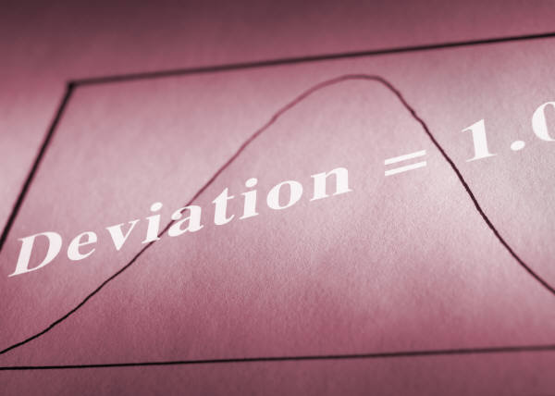
Always eyeball the data
Don’t rely on numbers alone. Always use data visualization to examine the data patterns.
If I tell you in a study the Pearson’s coefficient is .83, what would be in your mind?

Slide 33
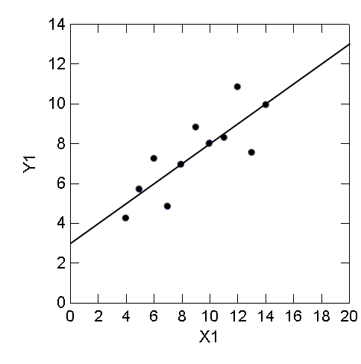
correlation of .83

Slide 34
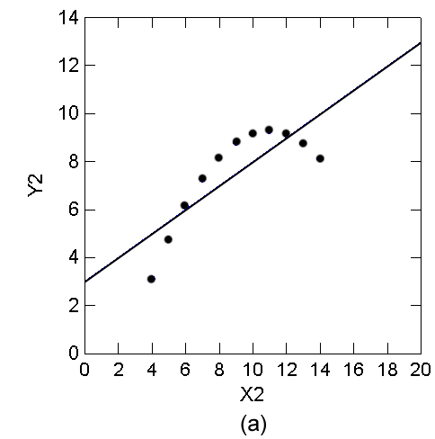
correlation of .83

Slide 35
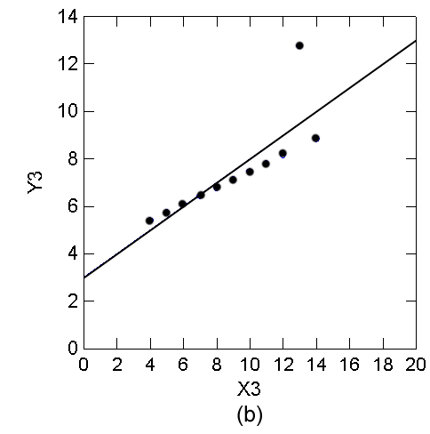
correlation of .83

Slide 36
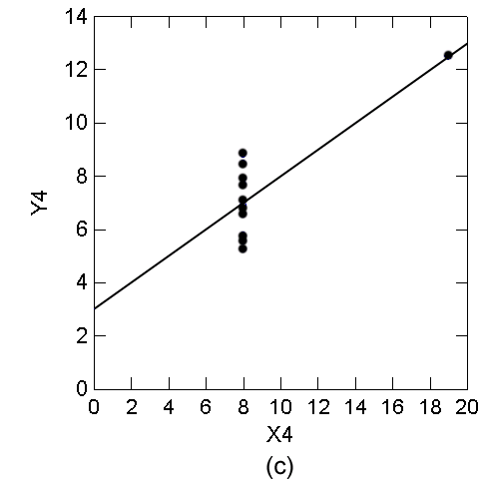
correlation of .83

Slide 37
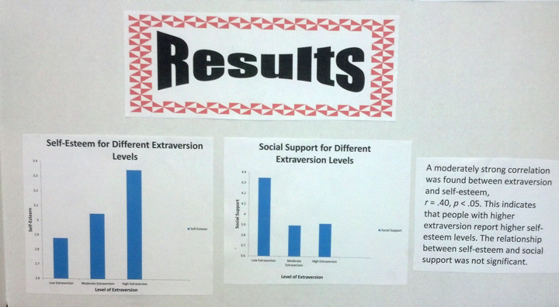
Make sure you use the right graphic: Scatterplot and regression line

Slide 38
Question
Under what circumstances is it acceptable in your field of research to exclude an anomalous data point from analysis? If data were excluded from an analysis, then how should the published manuscript reflect that not all data are reported?

Slide 39
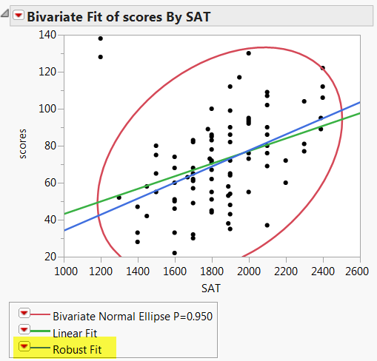
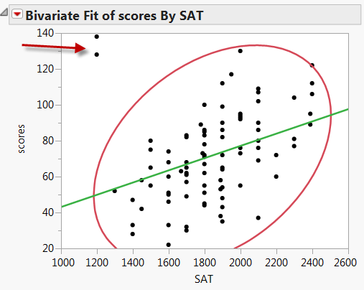
Robust procedures

Slide 40

Question
Is it unethical to choose a statistical test only after seeing which of several tests provide the result considered the best by you? Why or why not?

Slide 41
Answer
If you are doing confirmatory data analysis (hypothesis testing), you cannot use “cooking” or “fishing” to get the results that you want. You either reject or fail to reject the pre-determined hypothesis. You cannot change your bet in the middle of the game.
But if you are doing exploratory data analysis or data mining, which does not start with a strong hypothesis, you can choose the best model by balancing fitness and parsimony.

Slide 42


Question
You are a pilot in the US Air Force. Which jetfighter will you use to fight a battle?

Slide 43
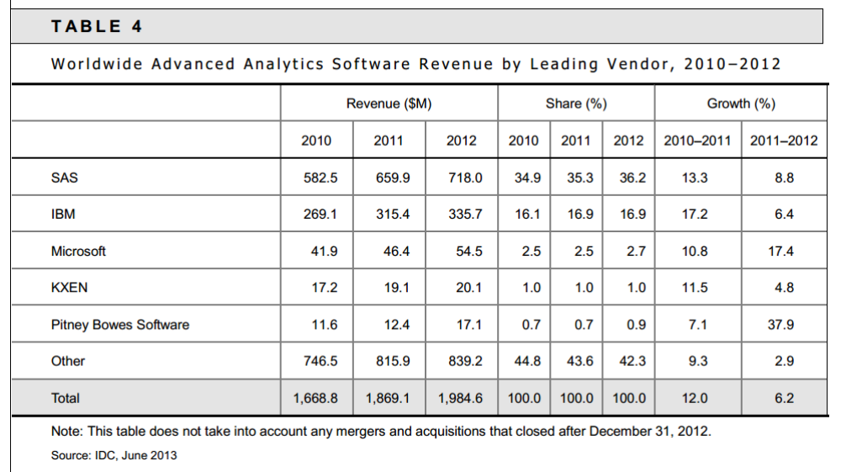
Forrester report: Big Data Predictive Analytics Solutions, 2013

Slide 44
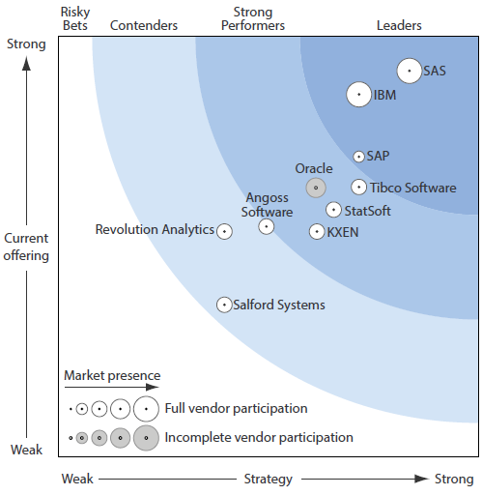
IDC Report, 2013

Slide 45
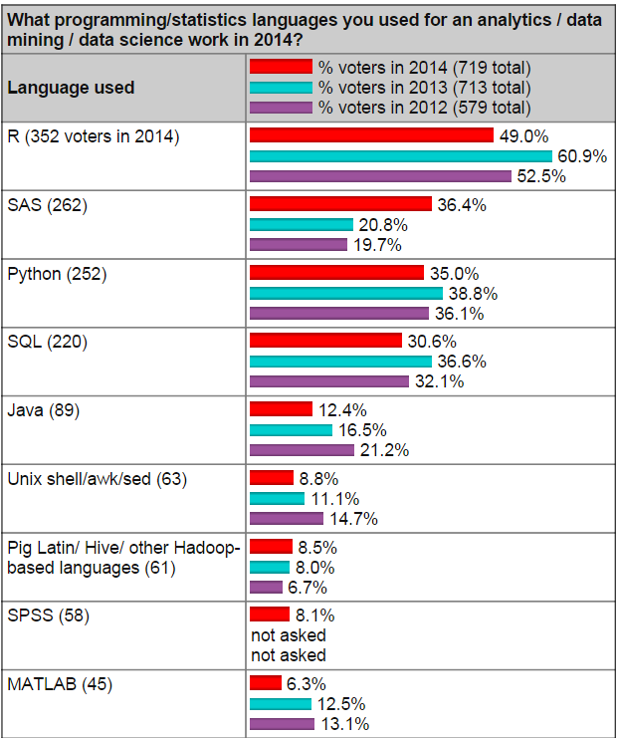
KDnuggets poll
SAS: From 21% (2013) to 36% (2014)
SQL: From 37% to 31%
Python: From 39% to 35%
R: From 61% to 49%

Slide 46
What is SAS?
SAS = Statistical Analysis System, or Short and Sweet, Sing Along Song, South African Society, Saudi Arabia Soldiers.
SAS Programming environment: You need this to manipulate complex and large-scaled data set.
SAS Enterprise Guide: Point and click, drag and drop…etc.
SAS Enterprise Miner: for data mining
JMP: conventional statistics + exploratory data analysis + data visualization + data mining
JMP Pro: JMP + advanced features, e.g. bootstrap forest, HLM

Slide 47
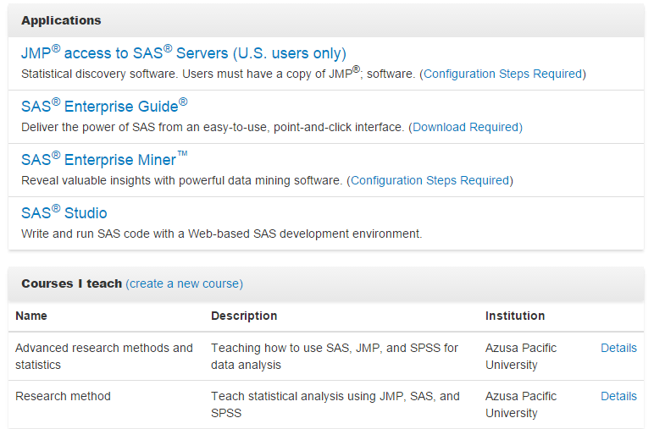
SAS on Demand is free to academics!

Slide 48

Question
What can you do with $12?
You can buy a meal at Red Lobster (with a coupon)
But you can also use $12 to change your life!

Slide 49
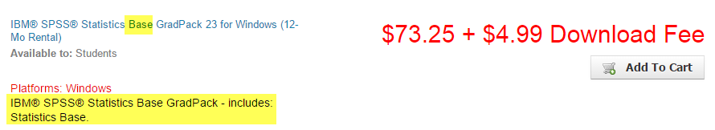
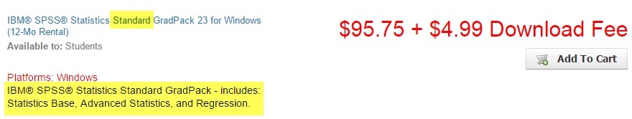
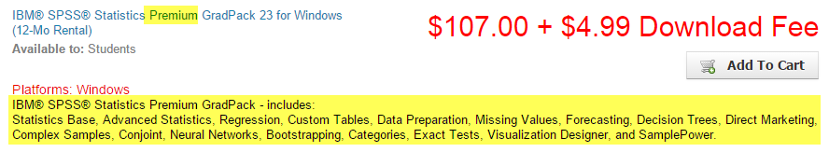
Difference between stanard and Premium SPSS: $12

Slide 50

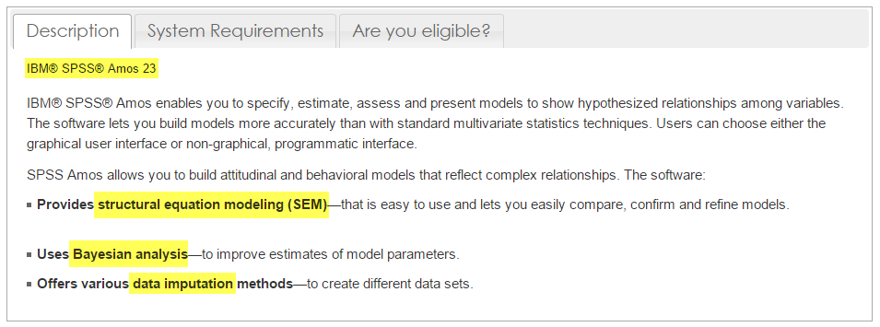
AMOS for CFA and SEM
It is better to get AMOS, too.
Not this AMOS →

Slide 51


You need modeling!
Not this kind of modeling

Slide 52
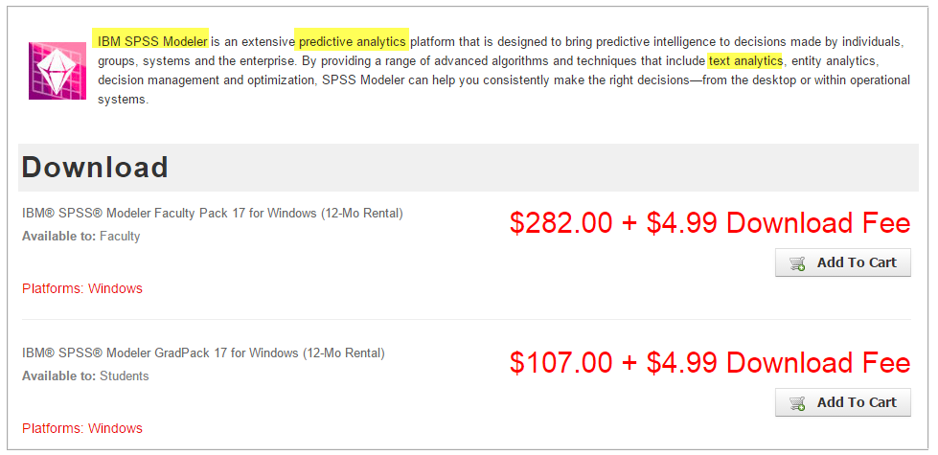
SPSS Modeler

