Slide 1

Hypothesis testing:
A die-hard tradition
Chong Ho Yu (Alex)

Slide 2
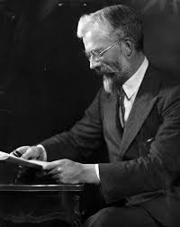
Ford's Model T in Statistics
Most statistical procedures that we still use today were invented in the late 19th century or early 20th century.
The t-test was introduced by William Gosset in 1908.
ANOVA was invented by R. A. Fisher around the1920s and 30s.

Slide 3

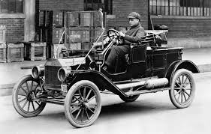

Will you do these?
Will you drive your grandfather's Ford Model T?
Will you use a Sony's Walkman instead of a MP3 player?
Will you use a VHS tape instead of BlueRay?

Slide 4
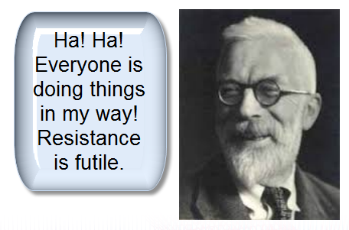
The Number 1 reason is...
“Everybody is doing hypothesis testing.”
“90% of the journals require hypothesis testing.”
“All textbooks cover hypothesis testing.”

Slide 5
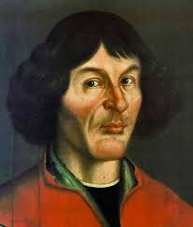
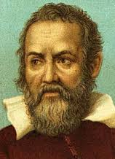
Is it a sound rationale?
“Everybody is doing this” is NOT an acceptable rationale to defend your position.
Before the 16th century, almost everyone believed that the sun, the moon, and the stars orbit around the earth (Geocentric model).
Had Copernicus and Galileo followed what everyone was doing, there would not have been any scientific progress!

Slide 6
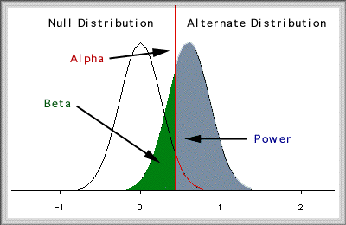
Hypothesis: A fusion
R. A. Fisher: Significant testing (null)
Karl Pearson and Neyman: Hypothesis testing: (Alternate hypothesis, Type I error, Type II error [beta], power...etc.)

Slide 7

Shortcoming of conventional approach
Over-reliance on hypothesis testing/confirmatory data analysis (CDA) and p values.
The logic of hypothesis testing is: Given that the null hypothesis is true how likely we can observe the data in the long run? P(D|H)?
What we really want to know is: Given the data what is the best theory to explain the data no matter whether the event can be repeated : P(H|D)?

Slide 8
Affirming the consequent
P(D|H) <> P(H|D): “If H then D" does not logically imply "if D then H".
If the theory/model/hypothesis is correct, it implies that we could observe Phenomenon X or Data X.
X is observed.
Hence, the theory is correct.

Slide 9
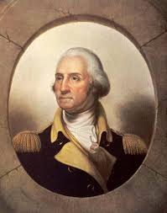
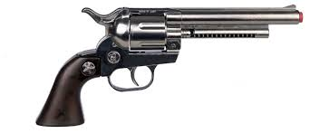
Affirming the consequent
If George Washington was assassinated, then he is dead.
George Washington is dead.
Therefore George Washington was assassinated.
If it rains, the ground is wet.
The ground is wet.
It must rain.

Slide 10
Can we “prove” or “disprove”?
Hypothesis testing or confirmatory data analysis (CDA):
  Start with a strong theory/model/hypothesis
  Collect data to see whether the data match the model.
  If they fit each other, did you “prove” the theory?
  If they don't, did you “disprove” it?
  At most you can say whether the data and the model fit each other. In philosophy it is called “empirical adequacy.”

Slide 11



God: Failed hypothesis
Prominent physicist Victor Stenger:
“Our bones lose minerals after age thirty, making them susceptible to fracture and osteoporosis. Our rib cage does not fully enclose and protect most internal organs. Our muscles atrophy. Our leg veins become enlarged and twisted, leading to varicose veins. Our joints wear out as their lubricants thin. Our retinas are prone to detachment. The male prostate enlarges, squeezing and obstructing urine flow.”
Hence, there is no intelligent designer.

Slide 12
Logical fallacy
Hypothesis: If there is a God or intelligent designer, he is able to design a well-structured body. To prove the existence of God, we look for such data: P(D|H)
No such data: Our bones start losing minerals after 30, and there are other flaws, and thus God is a “failed” hypothesis.
You will see what you are looking for.
But there are other alternate explanations that can fit the data.
e.g. God did not make our body last forever, and thus dis-integration and aging is part of the design.

Slide 13
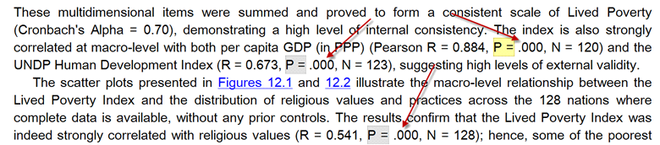
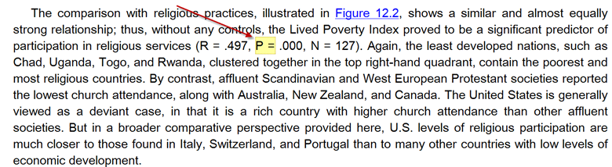
Common mistakes about p values

Slide 14
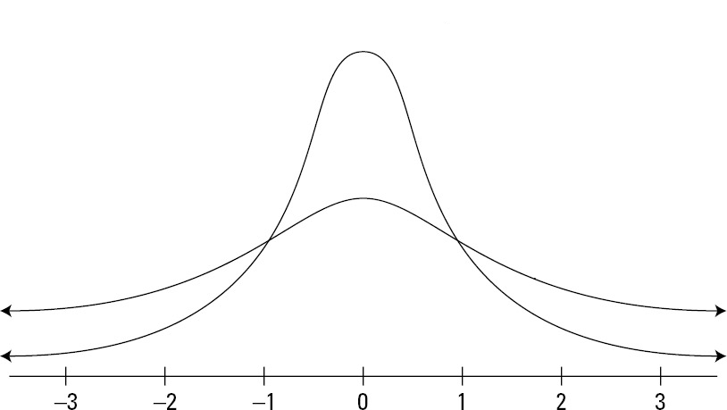
Can p be .000?
P = probability that the statistics can be observed in the long run.
“Long run” is expressed in terms of sampling distributions, in which sampling, in theory, is repeated infinitely.
The two tails never
touch down the x-axes.
In an open universe
anything has a remote probability.

Slide 15
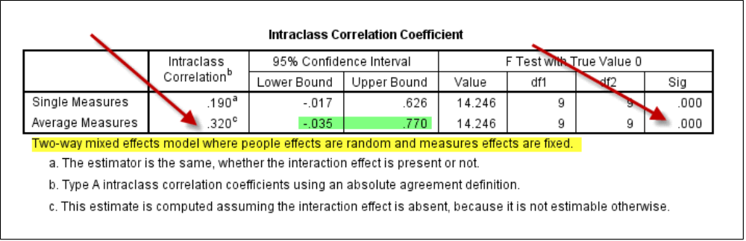
Can p be .000?
If p = 0.000, then it means there is no chance for such event to happen. Does it make any sense?
When the p value is too small, SAS uses the e-notation and JMP reports it as p < .001, but SPSS shows it as .000.

Slide 16
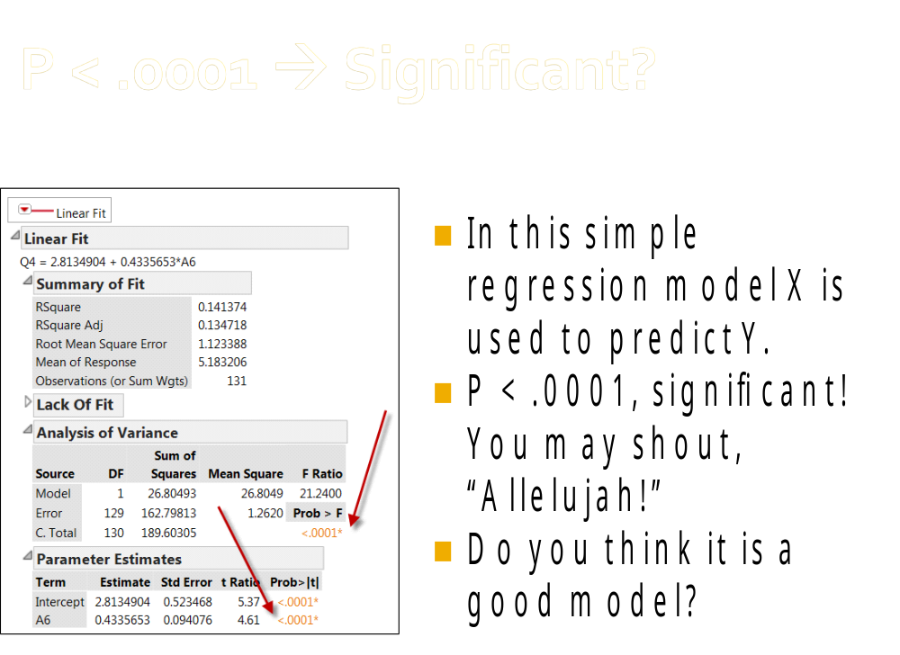

Slide 17
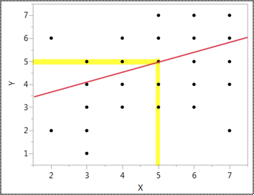
Significant: How rare the event is
○ If my score on X is 5, the regression model predicts that my score on Y is also 5.
○ Actually, it could be 3, 4, 5, 6, or 7.
○ Five of out of seven! This “predictive” model is usefulness!
○ Lesson: the p value can fool you!!!

Slide 18
A picture is worth a thousand p values
In 1989, when Kenneth Rothman started the Journal of Epidemiology, he discouraged over–reliance on p values. However, the earth is round. When he left his position in 2001, the journal reverted to the p–value tradition.
In A Picture is Worth a Thousand p Values, Loftus observed that many journal editors do not accept the results reported in mere graphical form. Test statistics must be provided for the consideration of publication. Loftus asserted that hypothesis testing ignores two important issues:
  What is the pattern of population means over conditions?
  What are the magnitudes of various variability measures?

Slide 19

How about sample size?
This is a common criticism: The sample size of the study is too small.
How small is small? How big is big?
It depends on power analysis.
Power = the probability of correctly rejecting the null.

Slide 20

Effect size
To perform a power analysis, you need the effect size. Small? Medium? Large? (Just like choosing a t-shirt)
Cohen determined the medium effect size using Journal of Abnormal and Social Psychology during the 1960s.
Welkowitz, Ewen, Cohen: One should not use conventional values if one can specify the effect size that is appropriate to the specific problem.

Slide 21
Meta-analysis?
Wilkinson and APA Task Force (1999): "Because power computations are most meaningful when done before data are collected and examined, it is important to show how effect-size estimates have been derived from previous research and theory in order to dispel suspicions that they might have been taken from data used in the study or, even worse, constructed to justify a particular sample size."
Sounds good! But how many researchers would do a comprehensive lit review and meta-analysis to get the effect size for power analysis?

Slide 22
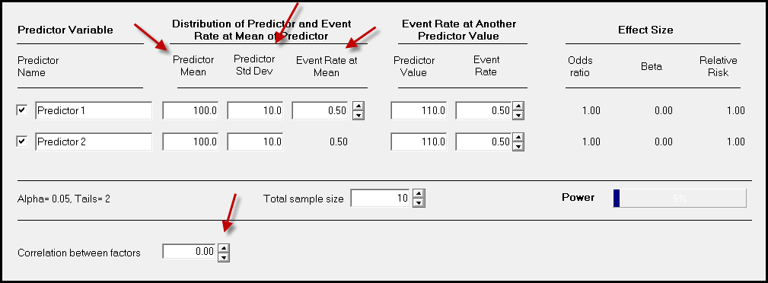
Power analysis
To get the sample size for logistic regression, I need to know the correlation between the predictors, the predictor means, SDs...etc.

Slide 23

Chicken or egg first?
The purpose of power analysis is to know how many observations I should obtain.
But if I know all those, it means I have already collected data.
One may argue that we can inquire prior studies to get the information, as what Cohen and APA suggested.
But how can we know the numbers from the past research are based on sufficient power and adequate data?

Slide 24


Why must you care?
Sample size determination based on power analysis is tied to the concepts in hypothesis testing: Type I & Type II error, sampling distributions, alpha level, effect size...etc.
If you do not use HT, do you need to care about power? You can just lie down and relax!

Slide 25
What should be done?
Reverse the logic of hypothesis testing.
What people are doing now: starting with a single hypothesis and then computing the p value based on one sample: P(D|H)
We should ask: given the pattern of the data, what is the best explanation out of many alternate theories (inference to the best explanation) using resampling, exploratory data analysis, data visualization, data mining: P(H|D)

Slide 26
Bayesian inference
P(H|D) = P(H) X P(D|H) / P(D)
Posterior probability = (probability that the hypothesis is true X probability of the data given the hypothesis) / probability of observing the data.
To what degree we can believe in the theory = the prior probability of the hypothesis updated by the data
Bayesians select from competing hypotheses rather than testing one single hypothesis.
Other ways: Exploratory data analysis, data mining

Slide 27
Common misconceptions about EDA and data mining (DM)
“It is fishing”: Actually DM avoids fishing and capitalization on chance (over-fitting) by resampling (e.g. cross-validation).
“There is no theory”: Both EDA and CDA have some theories. CDA has a strong theory (e.g. Victor Stenger: There is no God) whereas EDA/DM has a weak theory.
In EDA/DM when you select certain potential factors into the analysis, you have some rough ideas. But you let the data speak for themselves.

Slide 28
Common misconceptions about EDA and data mining (DM)
“DM and EDA are based on pattern recognition of the data at hand. It cannot address the probability in the long run”
Induction in the long run is based on the assumption that the future must resemble the past. Read David Humes, Nelson Goodman, and Nissam Taleb.
Some events are not repeatable (Big bang).
It is more realistic to make inferences based on the current patterns to the near future.

