Slide 1

Parametric tests:
Please treat them well
Chong Ho Yu

Slide 2
Parametric test assumptions
In a parametric test a sample statistic is obtained to estimate the population parameter.
Because this estimation process involves a sample, a sampling distribution, and a population, certain parametric assumptions are required to ensure all components are compatible with each other.
To run a legitimate parametric test, the data structure must need all or most parametric assumptions (conditions).

Slide 3
Pop quiz
True or false
A statistical guide for medical researchers stated, "sample values should be compatible with the population (which they represent) having a normal distribution." (Airman & Bland, 1995, p.298).

Slide 4
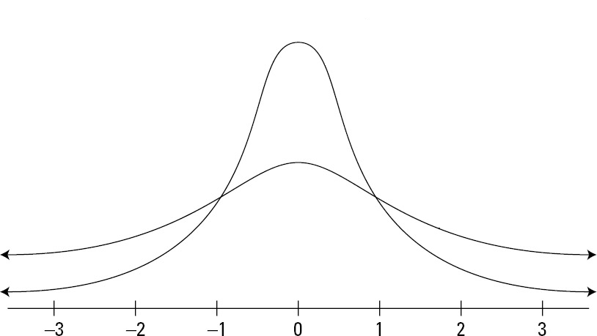
Sampling distribution
In hypothesis testing we never directly compare the sample statistics against the population.
Actually we compare the statistics against the sampling distribution.
A sampling distribution becomes normal by repeated sampling, no matter what the shape of the population is.

Slide 5

What kind of military is that?
General Trier will lead an army to defend our nation, but this army is willing to fight if and only if the conditions on the next slide are met:

Slide 6
What kind of military is that?
State of the art weapons; superior to the enemy
One year of supply, no shortage of anything
Fight under perfect weather and clear visibility
Intelligence precedes all actions; must know the exact location and movement of the enemy.
No deployment can be longer than six months
Air-conditioning inside all tanks
Entertainment center, gym, and swimming pool in all military bases

Slide 7
Conditions for regression
Residuals have constant variance (homoscedasticity)
Independence of Residuals
Normality of Residuals
Residuals have mean as zero
The relationship between Y and X is linear.
The absence of multicollinearity
http://www.creative-wisdom.com/computer/sas/regression_assumption.html

Slide 8
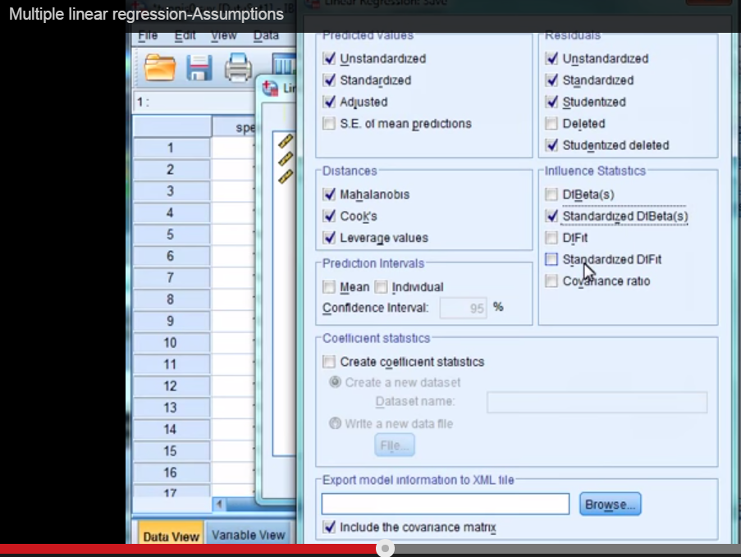
Use SPSS to check assumptions
It looks very complicated! Are you trying to scare us away from using regression and other conventional procedures?
Let's watch this youtube video about how to use SPSS to check regression assumptions: https://www.youtube.com/watch?v=DB-oKeNxjFs

Slide 9
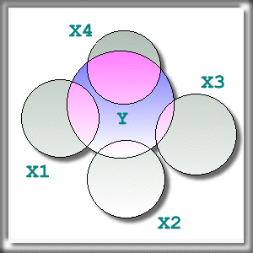
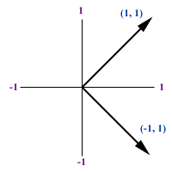
A clean regression model
The overlapping area of Y and Xs is variance explained.
All predictors are independent (orthogonal), making unique contribution to predict or explain Y.
Wow! We must be in Heaven.

Slide 10
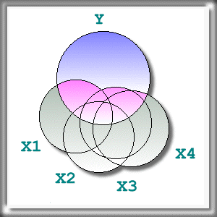
Multicollinearity
Usually it is too ideal to be true. There is no Heaven on earth yet!
In social sciences the diagram shown here is closer to reality.
When the predictors are related, we cannot tell which predictor is doing what to Y.
The order of entering the predictors in the model may change the result.

Slide 11
Real world data
Trends for International Mathematics and Science Study (TIMSS) sample design is a two-stage stratified cluster sampling scheme.
In the first stage, schools are sampled.
Next, one or more intact classes of students from the target grades are drawn at the second stage.
The students form the same class are not independent! They are taught by the same teachers and learn together.

Slide 12
Real world data
Parametric-based ordinary Least Squares (OLS) regression models are valid if and only if the residuals are normally distributed, independent, with a mean of zero and a constant variance.
TMISS data are collected using a complex sampling method, in which data of one level are nested with another level (i.e. students are nested with classes, classes are nested with schools, schools are nested with nations)
It is unlikely that the residuals are independent of each other.

Slide 13
Assumptions of ANOVA
Data are normally distributed
Group variances are homogenous (equal)
Observations are independent (uncorrelated): But in social sciences usually it is unrealistic. To rectify this situation, we need to use Hierarchical linear modeling (HLM), also known multi-level modeling or mixed modeling. We will discuss this in another unit.

Slide 14
Orthogonal factors again
In regression we want uncorrelated predictors.
In 2-way or multiway ANOVA we also expect that the grouping factors are orthogonal.

Slide 15
ANOVA example
The effects of binge drinking and illegal drug use on GPA are investigated by a 2X2 ANOVA.
Assume that the student behaviors are independent; they didn't influence each other in drinking, using drugs, and study.
We need to check whether the data distribution is normal, the group variances are equal, and the two factors are correlated or independent.

Slide 16

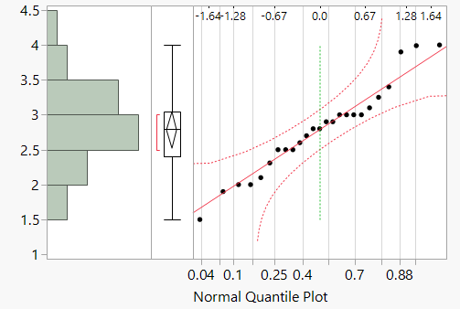
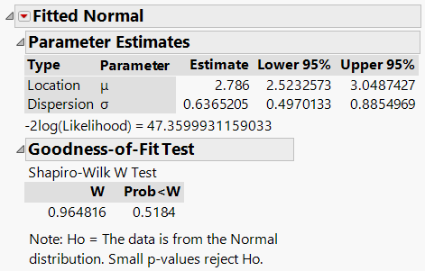
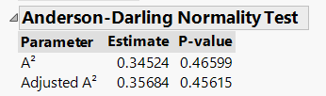
Check normality
Normal quantile plot and Darling

Slide 17
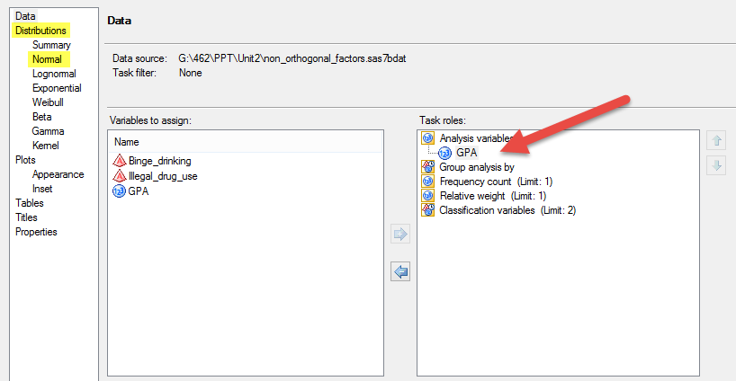
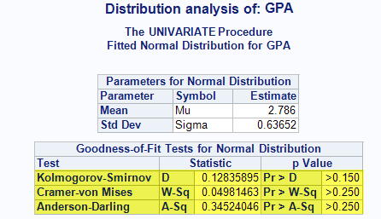
Check normality
More tests in SAS

Slide 18
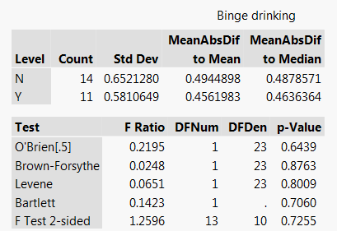
Test of equal or unequal variance
Multiple tests
None shows any problem

Slide 19
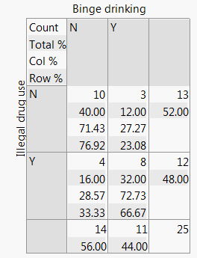
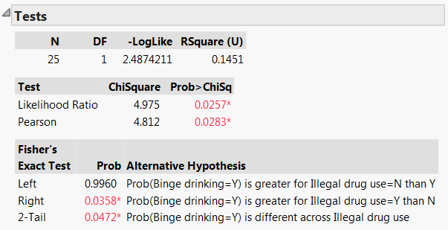
Non-orthogonal factors
2 factors are related: People who drinks excessively tend to use drug, and vice versa.
Hard to tell the main effect of a factor on GPA.

Slide 20
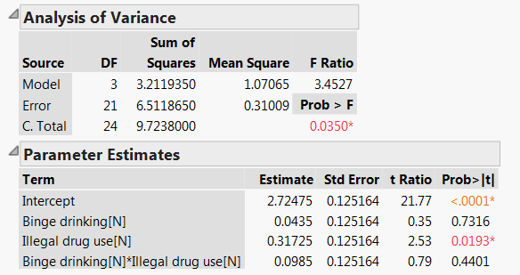
ANOVA test result
Drug use influences GPA, but not drinking.
No interaction effect
But the 2 factors are related.

Slide 21
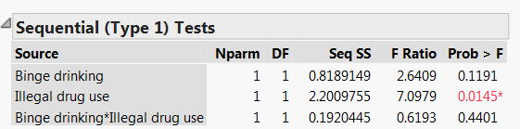
Sequential Test
The effect of Binge drinking on GPA is tested when the effect of illegal drug use is ignored.
The p value of binge drinking is 0.1191.
If one-tailed test is used, p = 0.05955 (This is slightly over .05, does it still mean something?)

Slide 22
Assignment
Download the data set “non_orthogonal_factors.jmp” from Unit 2 folder.
Check whether the variances of GPA are equal by illegal drug use
Download and install Anderson-Darling Normality test from community.jmp.com
Run a normality test of GPA.
Copy and paste the graphs in a Word document, write down your answers and then post it to Sakai.

