Slide 1


Abduction: The logic of discovery
Chong Ho Yu

Slide 2
Deduction
Hypothesis testing is said to be a hypothetico-deductive method.
  All observed statistics beyond the .05 cutoff are significant (True).
  This observed statistic is beyond the .05 cutoff (True).
  Significant; reject the null hypothesis (True).

Slide 3
Deduction
  All observed statistics beyond the 0.05 cutoff are significant (True).
  This observed statistic is not beyond the .05 cutoff (False).
  Not significant; not to reject the null hypothesis (False).
Test a single theory or hypothesis; yes or no, let me go.

Slide 4

Deduction
What will a researcher conclude if neither the proposition “all observed statistics beyond the 0.05 cutoff are significant” nor the statement “this observed statistic is beyond the .05 cutoff” is true?

Slide 5


False, False, True!
If Congress passes serious campaign finance reform, then I am the Pope!”
The sentences are false, but following the rule of material implication, two false antecedents create a true conditional (F ^ F -> T)!

Slide 6
Phenomenon and data
Hypotheico-deductive method deals with the relationship between the theory and the data, not the phenomenon (Haig)
Phenomena are relatively stable and keeps recurring.
Data are fleeting.
Good model → fitness between the theory and the data at hand assuming the recurring data are stable, but indeed they are not!!!

Slide 7
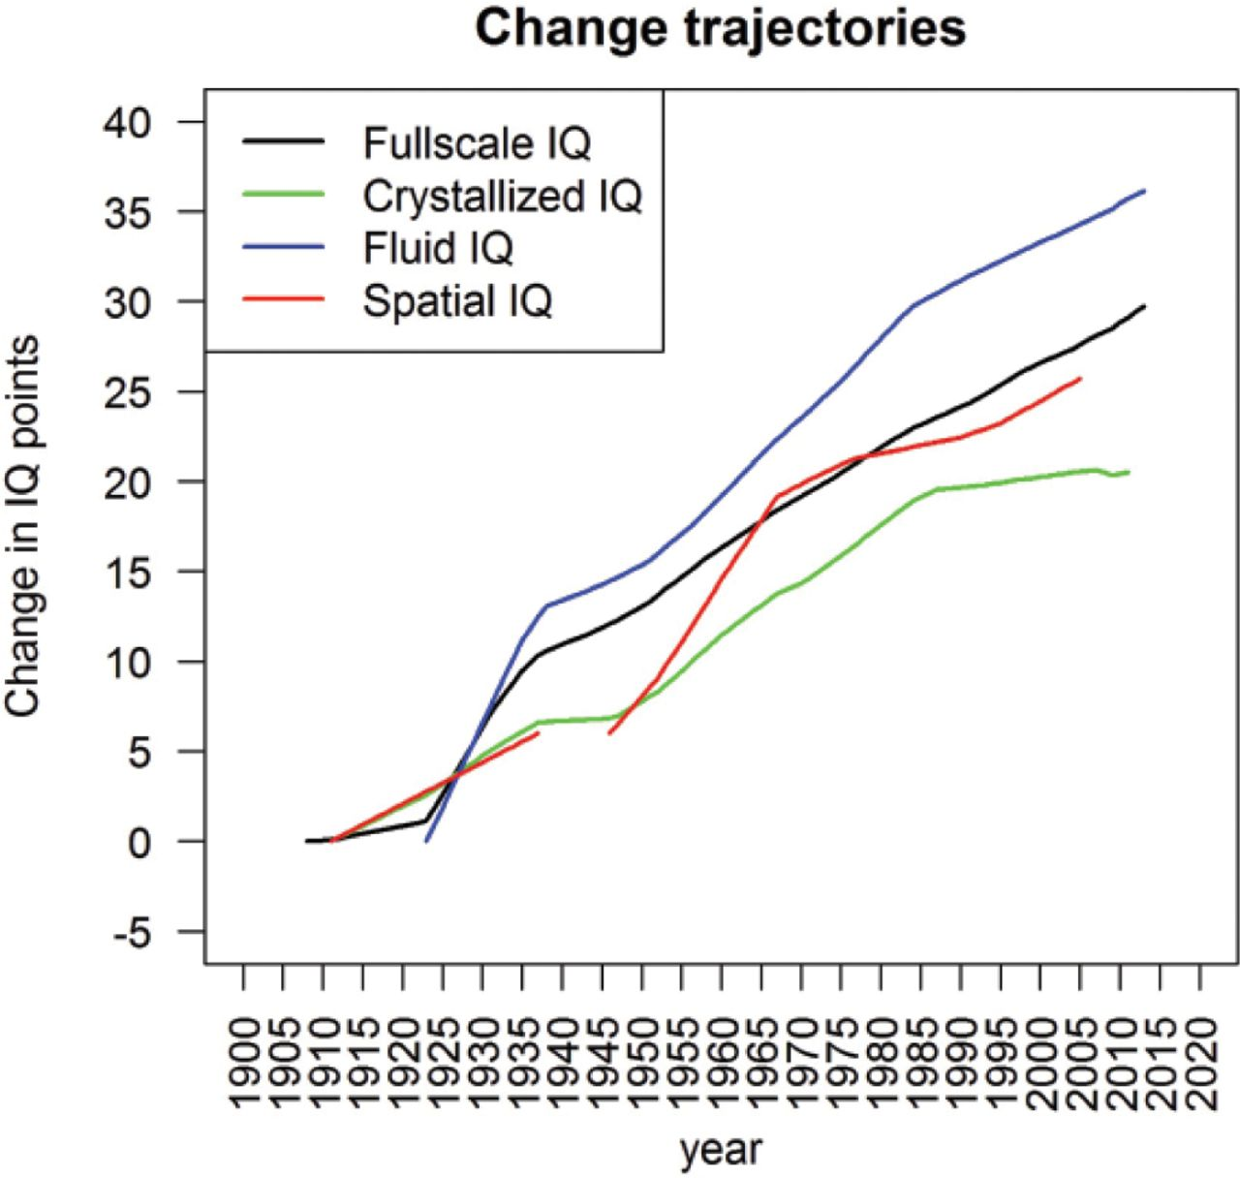
Example from Test and Measurement
Flynn effect is a phenomenon.
IQ scores have been rising from generation to generation.
Data are changing. If we look at data in isolation, we will be missing the phenomenon.

Slide 8
Induction
Knowledge is generated from accumulating data and inquiry is a self-correcting process.
Logical positivism: There is only empirical knowledge (driven by observable data).
Based on reasoning with long run: Assume that the future would resemble the past. However, regression entails the tendency of falling back to the mean)

Slide 9

What's wrong?
An alien civilization visited our planet and collected data about our physical growth.
They observed our children (from 1-10 years old) and constructed a regression model of their age and height.
The aliens conclude that human is a dangerous species that will threaten them. What’s wrong with their regression model?

Slide 10


What's wrong?
In the 1980s many experts predict that by the end of the 20th century Japan would overtake the US to become the world’s largest economy. Today many experts make similar predictions about China. What is the shortcoming of this predictive model?

Slide 11

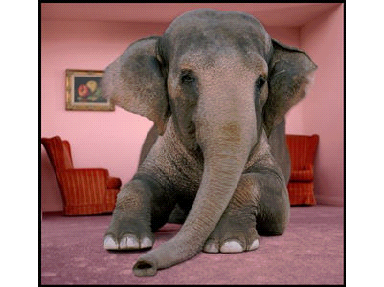
Black swan vs. elephant in the room
• The book entitled "The Signal and the Noise" by Nate Silver also used the collapse of Japan in the early 1990s as an example. The bloom of Japan in the 1980s was unrealistic because the real estate price could not go up forever.
• Before 2008 the majority of the US experts could not predict a crash like that of Japan would happen in the US. But Silver asserted that the 2008 crash is not a Black Swan; rather, it is an elephant in the room.

Slide 12
Is there always a long run?
In the Fisherian tradition, probability is defined in the long run, which is comparable to inductive reasoning. P = how likely you can observe the statistics in the long run?
A new phenomenon or an unrepeatable event may not have a corresponding probabilistic distribution in the Fisherian sense, let alone a null hypothesis, an alternate hypothesis, and a Type I error rate.

Slide 13
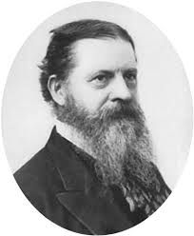
Abduction
Introduced by Charles Pierce.
  The surprising phenomenon, X, is observed.
  Among hypotheses A, B, and C, A is capable of explaining X.
  Hence, there is a reason to pursue A

Slide 14
Abduction
Unlike hypothesis testing that starts with a strong theory, it starts with the phenomenon.
  P(H|D), not P(D|H)
  A subtle difference between phenomenon and data-- Phenomenon: Stable; Data: varying.
It takes multiple plausible explanations into account, not just testing a single theory or hypothesis.

Slide 15
Abduction
At most, abduction could provide a conjecture or a potential hypothesis A to pursue, but it would not confirm or disconfirm A
Inference to the best explanation (IBE): similar to abduction, modified by Harmon.
After inquiry, we found multiple competing theories that can explain the phenomenon. Pick the best one!
Criterion: most explanatory power

Slide 16


IBE: Pick the best!
It is like that you interviewed ten girls selected from e-harmony or Christian Mingle, and then you pick the best one to be your bride.

Slide 17

Example of abduction
Yu, C. H. & Wu, S. F. (2014, October). Teaching math and science as a value system: Lessons from Asia. Paper accepted for Asian Conference in Education, Osaka, Japan.
A puzzling phenomenon: According to PISA and TIMSS, East Asian students outperform their US counterparts in math, science, and reading.

Slide 18
Mixed method
Sequential Exploratory Design
When the problem is ill-defined and the variables are unknown, the researcher could employ qualitative methods to understand the problem rather than imposing a theory on the phenomenon.
This design is particularly useful when the researcher needs to develop an instrument to collect data, but is not sure about what constructs should be measured and what questions should be asked.

Slide 19

Mixed Method
Yu spent five weeks in Hong Kong, Macau, and Taiwan, talking to professor, teachers, parents, and school children, and also submersing himself into the cultures.

Slide 20


Mixed Method
The resulting is surprising: Instead of framing the research question as “because of,” Yu changed the question as “in spite of” and “regardless of.”
In the second phase quantitative design will be employed to study the proposed theory.

Slide 21
Example of IBE
Yu, C. H., Hui, C. H., Lau, Y. Y., & Cheung, S. F. (2014, April). A typology of Christian believers according to the values they hold. Paper presented at the 12th Annual Mid-Year Conference on Religion and Spirituality, La Mirada, CA.
Two-step clustering analysis is used to classify Christians into two groups: personal-focused and social-focused.

Slide 22
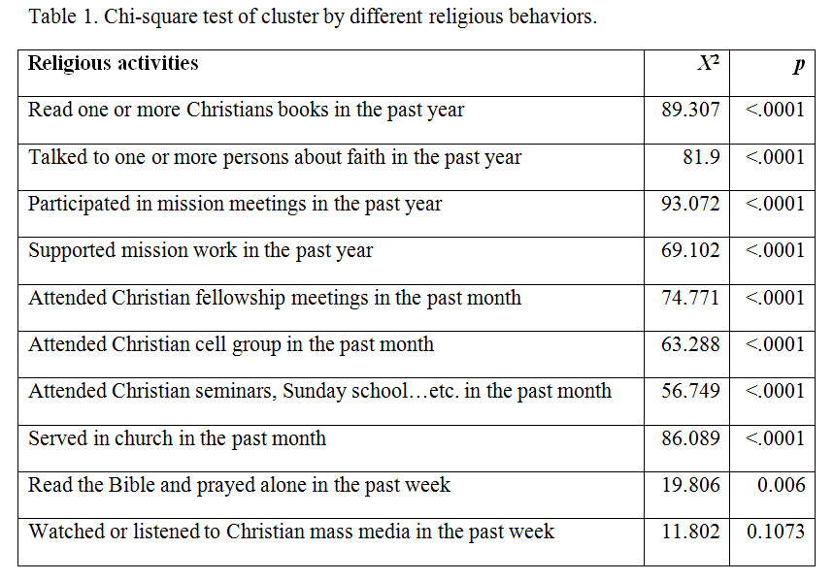
Example of IBE
The grouping factor can predict their religious behaviors.

Slide 23
Multiple competing theories
Do Christians read more Christian books, support mission works, and do other “religious things” because their values are more social-focused,
or have they become social-focused in their values because their religious behaviors shaped their personal values?
Another possibility is that personal values and religious behaviors are in a positive feedback loop, being both cause and effect at the same time.

Slide 24
Mixed method
Sequential explanatory design
Utilizing the insight gained from qualitative data to explain significant (or non-significant) results, outliers, or puzzling findings yielded from quantitative data.
The p values and other numbers cannot give you a causal explanation. You need to interview the participants.

Slide 25
Example of abduction in assessment
Instead of using a top-down approach (blue print), go to the bottom (what outcome do you want to see?)
Reverse engineering or converse reasoning: “What concept is required to successfully deliver the product? Which cognitive component is missing if the result is not desirable? What is the required concept just one step before the previous component?”

Slide 26

Example of abduction in assessment
The content expert may explain, “A Maglev, which stands for magnetically levitating train, is a form of mass transit system that suspends, guides and propels trains using electromagnetic forces.”
The test developer may ask, “How is EM force used in Maglev?”

Slide 27
Example of abduction in assessment
The expert may say, “One way to do it is to use the attractive magnetic force of a magnet beneath a rail to lift the train up. Another way is to use a repulsive force between two magnetic fields to push the train away from the rail. What it requires is the concepts of attractive and repulsive forces of magnets.”
Keep asking questions to create casual links between concepts.
Create items based on these conceptual links.

Slide 28
Assignment
Currently several states adopt the common core standards. However, different teachers have different opinions about the standards, and implementation face a strong resistance.
You receive a grant to design a study to address this issue. Can you apply hypothesis testing into this case? Why or why not?
How can you apply abduction, IBE, or both into the research design?

