Slide 1
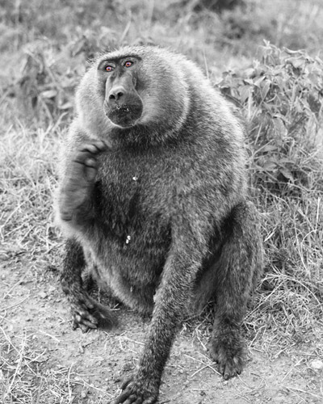
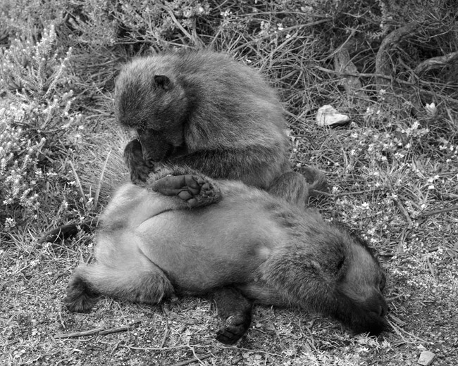
From OLS to Generalized Regression
Chong Ho Yu
(I am regressing)

Slide 2


OLS regression has a long history
Ordinal least squares (OLS) regression, also known as standard least squares (SLS) regression, was discovered by Legendre (1805) and Gauss (1809) when our great grandparents were born.

Slide 3
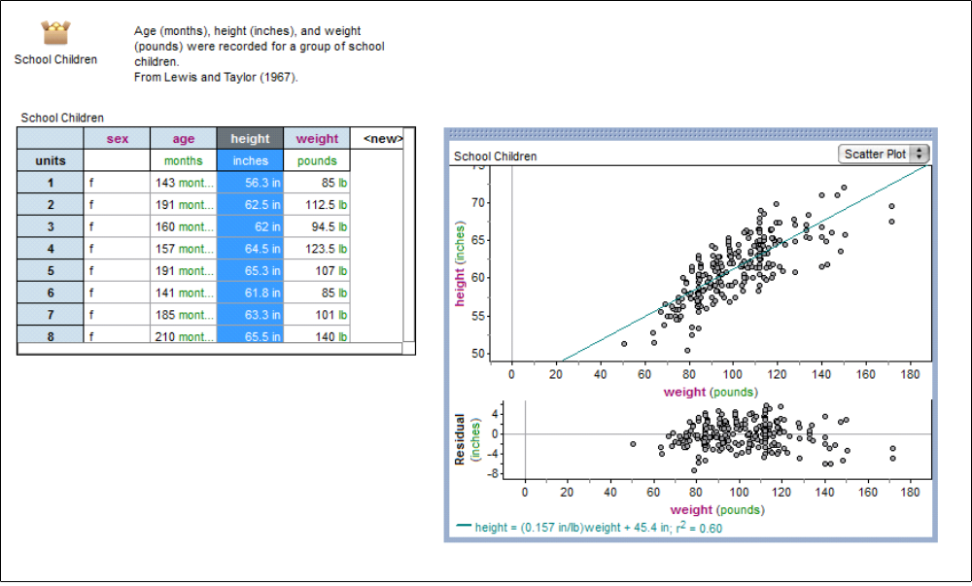
OLS regression
Least square = least square of residuals
Residual = distance between actual and predicted
Best fit

Slide 4

R square
The purpose of simple regression is to find a relationship (but not the one in the picture below).
When there are multiple predictors, the multiple-relationship is denoted by the R-square (variance explained).

Slide 5
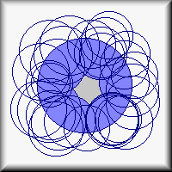
Inflated variance explained
Picture that the overlapping area between Y and Xs is the variance explained (multiple-relationship).
When you put more and more Xs on Y, the circle of Y is almost fully covered. R-square = .89! Wow! Voila! Allelujah!

Slide 6
Useless model
A student asked me how he could improve his grade. I told him that my fifty-variable regression model could predict almost 89% of test performance: study long hours, earn more money, buy a reliable car, watch less TV, browse more often on the Web, exercise more often, attend church more often, pray more often, go to fewer movies, play fewer video games, cut your hair more often, drink more milk and coffee...etc.
This complicated model is useless!

Slide 7
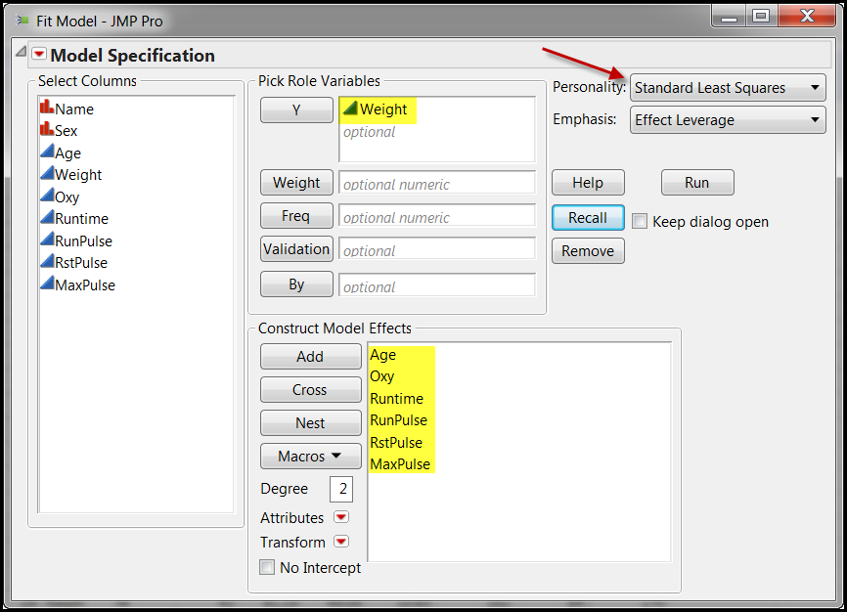
Fitness
In this example I want to use six variables to predict weight. The method is OLS regression.

Slide 8
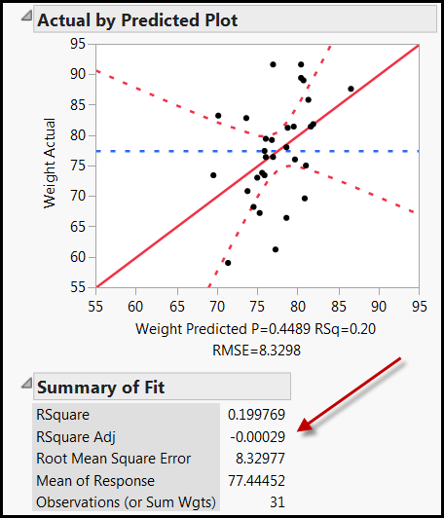
Negative adjusted R-square!
The R-square is .199. Not bad! This model can explain 20% of the weight variance.
But when many predictors are used, the program used adjusted R-square to adjust the inflated R-square.
It is negative! What is that?

Slide 9
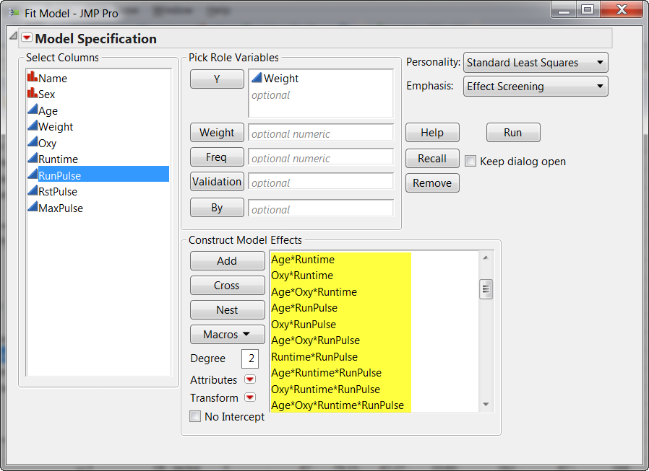
How about all possible interactions?

Slide 10
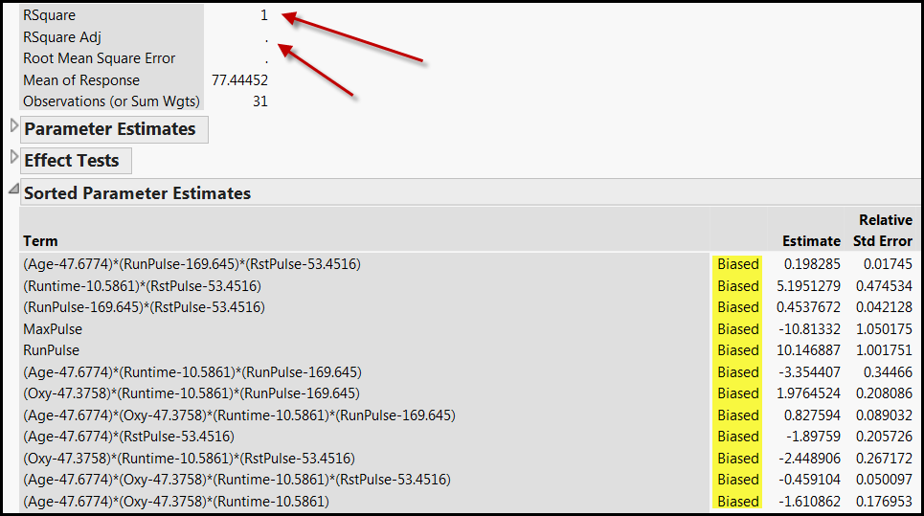
100% R-square but biased?
If I use all possible interactions, the R-square is 100%, but JMP cannot estimate the adjusted R-square, and every parameter estimate is biased. What is happening?

Slide 11
Problems of OLS regression
Too many assumptions about the residuals and the predictors
It tends to overfit to the sample.
The model is unstable when some predictors are strongly correlated (collinearity)
There is no unique solution with a large data set.
It must be a linear model.

Slide 12
Generalized regression
Also known as regularized regression (R2).
Introduced by Friedman (2008)
Similar to abduction or IBE: don't fix on one single answer, consider a few.
There may be many solutions to solve the problem. Why not explore different paths?
Start with no modeling or zero-coefficient.
Try out a series of models. The solution is elastic (changeable).
Pick the best (by the algorithm, not by you)!

Slide 13

Four alternatives in JMP
Maximum likelihood (Classical)
Penalized regression: give the model a penalty if it is too complicated or the fitness is inflated → Keep it simple, stupid (KISS)!
  Lasso
  Ridge
  Elastic (use this)

Slide 14

Lasso
Will zero out the regression coefficient → select variables by dropping some out.
If there are too many predictors and too few observations (high p, low n), LASSO will saturate very fast (stop further selection of variables).
When there are too many collinear predictors, LASSO select just one and ignore others.

Slide 15
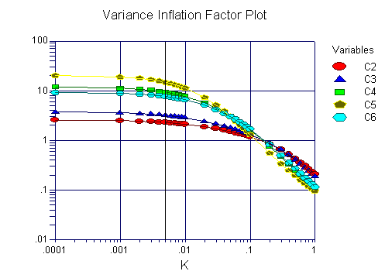
Ridge
Counter measure against collinearity & variance inflation: Shrinking the regression coefficients towards zero.
But regression coefficients will not be zero. You may end up with all the coefficients or none.
It controls the cancer cell, but won't remove it.

Slide 16

Elastic
Adaptive, versatile
It combines the penalties of the lasso and ridge approaches.
Why not use the best method only?

Slide 17
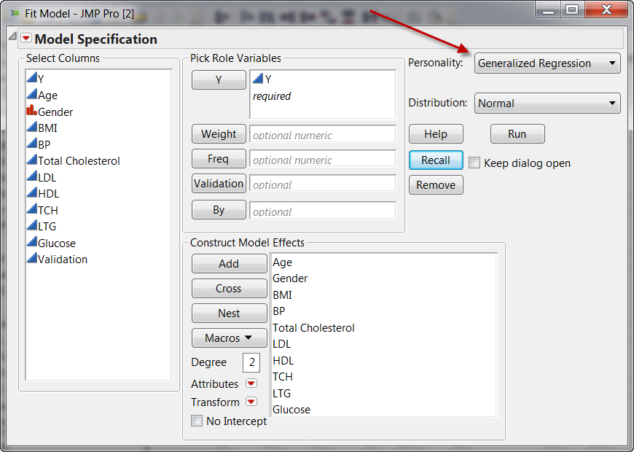
Example
Use multiple predictors to predict diabetics progression (Y).

Slide 18
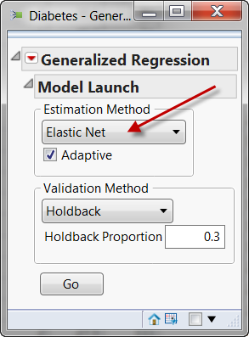
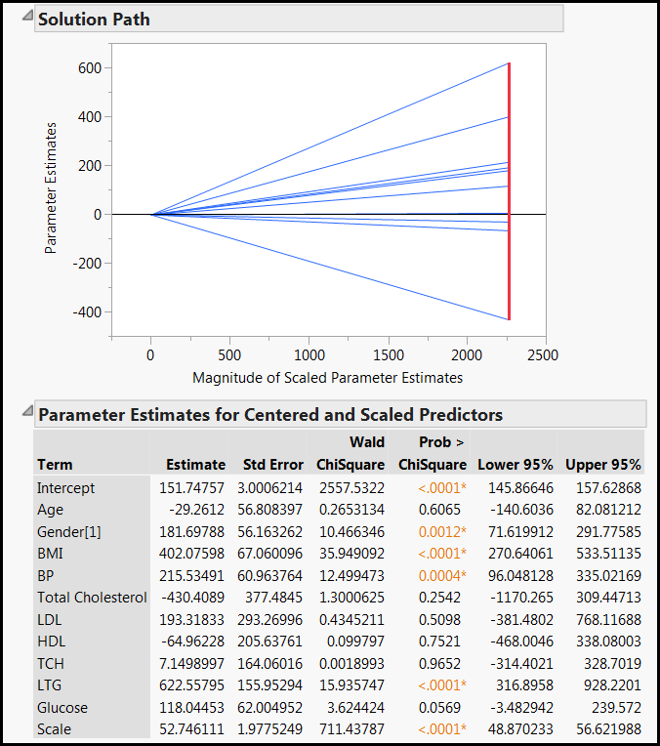
The JMP's GR output looks like a standard regression output.

Slide 19
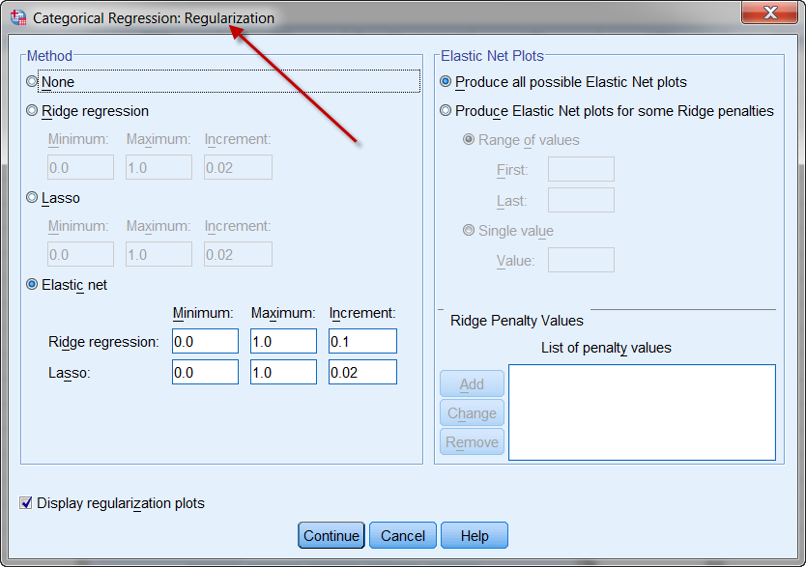
SPSS
SPSS can also do regularized regression,

Slide 20
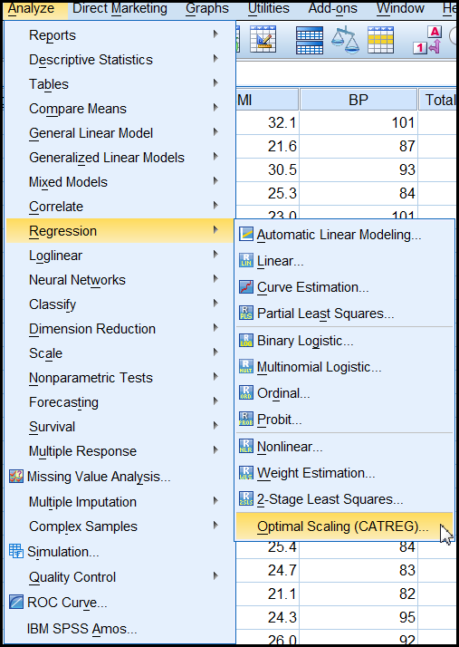
SPSS
You can access this feature from: Analyze → Regression → Optimal scaling (CATREG) → regularized.
Categorized regression: quantify categorical variables.
It is harder to interpret the SPSS output.

Slide 21
Pros and cons
Pros
  It can solve the problem of collinearity.
  It can avoid ovefitting.
  It is the best of all possible paths.
Cons
  It is still a global model (one size fits all). Unlike hierarchical regression, it cannot discover local structures or specific solutions for special population segments.
  It is still a linear model. What if the real relationship is non-linear?

Slide 22
Suggestions
If your colleague or the reviewer wants a conventional solution (wants to see the term “regression”), use generalized regression.
If there are many predictors and some are collinear, use GR.
If the data structure has other problems in addition to collinearity, consider the decision tree and bootstrap forest (will be covered later).
If the relationship is nonlinear, use artificial neural network (will be covered later).

