Slide 1

Logistic regression
Chong Ho Yu (Alex)
Notes:
1

Slide 2

What is logistic?
Odds: events/non-events. e.g.
  12 students took a test, 2 pass/10 failed = .2
  In Item Response Theory (IRT) the exam wants to “beat” the students, the expected event is failure, the test difficulty is 10/2 = 5.
Notes:
2

Slide 3
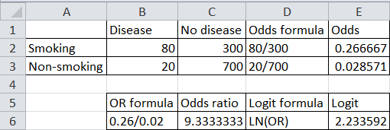
Odds ratio and Logit
The “event” that I go after is “cancer”: I want to know the odds of getting cancer if people smoke (Risk factor).
The reference group is “non-smoking”
Logit = Natural log of odds ratio

Slide 4
Assignment
There are 600 students in Psychology.
120 of them received tutoring and passed Applied Statistics.
30 did not receive tutoring and passed.
150 received tutoring and failed.
300 did not receive tutoring and failed.
What is the odds of passing Applied Statistics if students received tutoring (compared with those who didn't)?

Slide 5
Logistic regression
Model a binary outcome (pass? fail?) or multiple nominal outcome (excellent, average, poor...etc.)
Which one is the reference group depends on your research question.
  I want to identify the factors to predict competency/success so that I can select the best students.
  I want to identify the risk factors to predict failure so that I can implement a remedial program.
Notes:
5

Slide 6
JMP
Categorical DV, One categorical IV → Chi-square (Fit Y by X)
Categorical DV, multiple categorical IVs → Logistic regression (Fit model)
Categorical DV, one continuous IV → Logistic regression (Fit Y by X)
Categorical DV, multiple continuous IVs → Logistic regression (Fit model)
Notes:
6

Slide 7
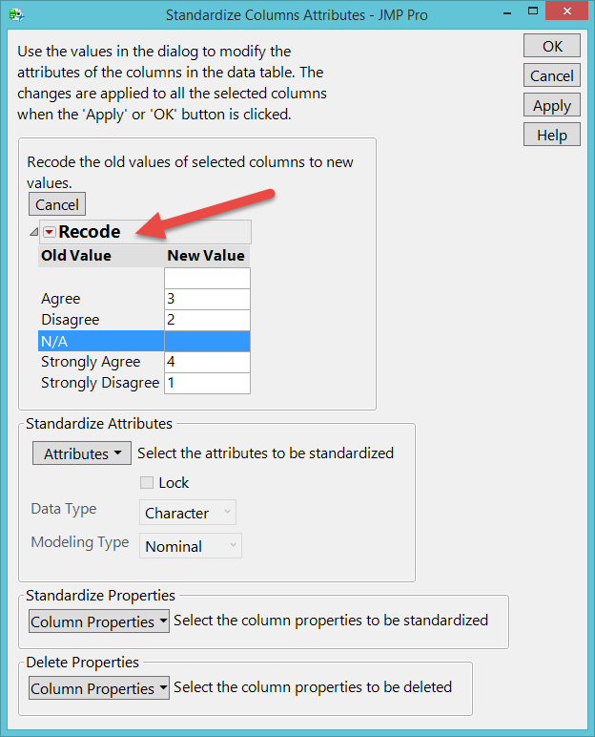
JMP
You can easily convert the data back and forth.
Notes:
7

Slide 8
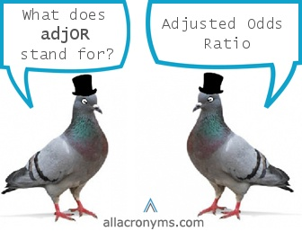
Adjusted odds ratio (Adjor)
When you have multiple predictors, the adjusted odds ratio is used.
The adjusted odds ratio of a particular variable is computed by holding the values of other variables constant.

Slide 9

Adjusted odds ratio (Adjor)
For example, if I want to know how gender affects the outcome, I assume that the odds ratio of gender is the same for all levels of marital status (no matter if the subject is single, married, or divorce).

Slide 10
Example
Tse, S., Davidson, L., Chung, K. F., Yu, C. H., Ng, K. L., & Tsoi, E. (2014). Logistic regression analysis of psychosocial correlates associated with recovery from schizophrenia in a Chinese community. International Journal of Social Psychiatry, 6, 50-57. doi: 10.1177/0020764014535756. Retrieved fromhttp://isp.sagepub.com/content/61/1/50

Slide 11
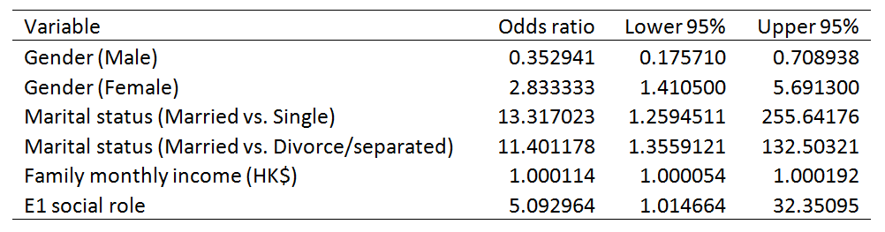
Adjusted odds ratio
In this example I would like to know how gender, marital status, family income, and perception of social role affect the odds of recovering from mental illness.
The outcome variable has two categories: Cluster 1 (better recovery), cluster 2 (worse recovery). The desirable event is better recovery.
Notes:
11

Slide 12
Adjusted odds ratio
The baseline is 1 (neither more likely nor less likely)
If the participant is a male, the odds of being in Cluster 1 (better) instead of Cluster 2 (worse) decreases by a factor of .352941. In other words, he is 35.29% less likely to be in Cluster 1.
When the subject is a female, the odds increases by a factor of 2.83333. Simply put, she is almost three times more likely to be in Cluster1.
Notes:
12

Slide 13
Adjusted dds ratio
For the continuous-scaled regressors, the improvement or decline is expressed in terms of per unit change.
For instance, if the participant increases the monthly income by HK$1, the odds of being in Cluster 1 rather than being in Cluster 2 improves by a factor of 1.000114. It does not sound much, but usually a normal increase of the income level would be leaped by a few hundred or a few thousand dollars rather than one dollar.
Notes:
13

Slide 14
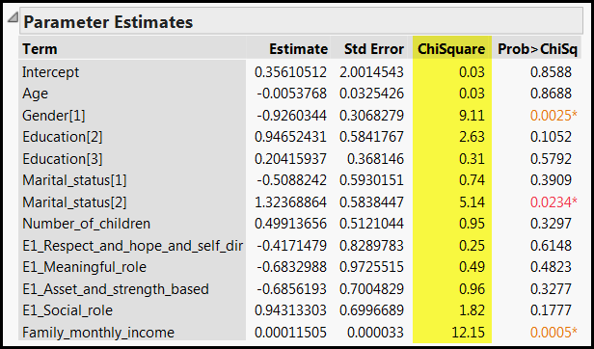
Chi-square? Regression?
Notes:
14

Slide 15
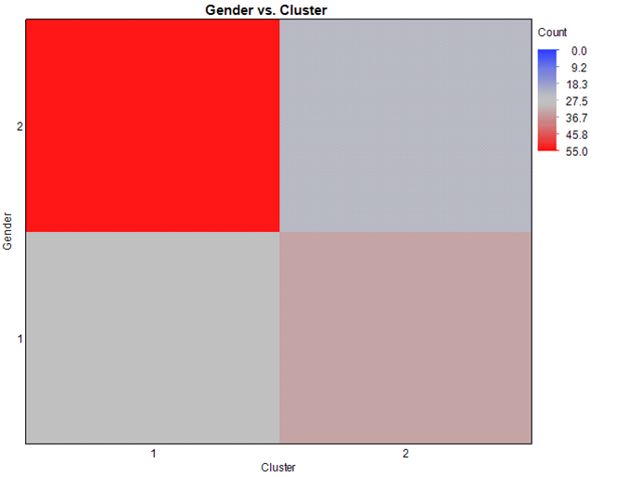
Heatmap: Visual crosstab
Females (2) tend to concentrate on Cluster 1 (Worse) whereas it is more likely that males (1) belong to Cluster 2 (Better).
Notes:
15

Slide 16
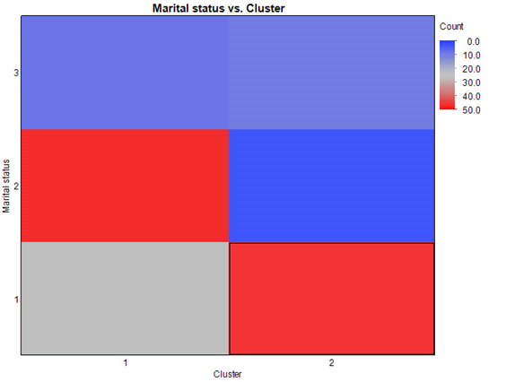
Married participants tend to belong to Cluster 1 (better) whereas single participants have a tendency to join Cluster 2 (Worse).
Notes:
16

Slide 17
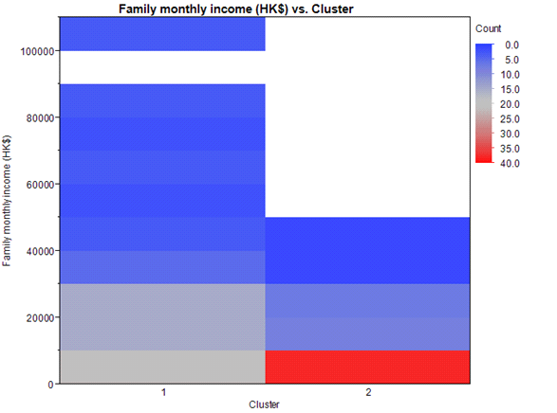
The heatmap of family monthly income vs. cluster clearly shows a disparity between the two clusters. It is obvious that all Cluster 2 members concentrate at the low end of the income level whereas many Cluster 1 members scatter along the medium and the high end.
Notes:
17

Slide 18
Findings
Unfortunately, it is not easy to translate some of these findings into actionable items.
Specifically, even though it was found that females and married participants tend to be in Cluster 1 (better), gender is unchangeable and need to say it is not sensible to encourage mental patients to get married just for the sake of recovery.
Notes:
18

Slide 19

Findings
Nevertheless, family monthly income could yield more practical implications because this finding indicates that recovery may be positively influenced by financial well-being and resource availability.
Notes:
19

Slide 20
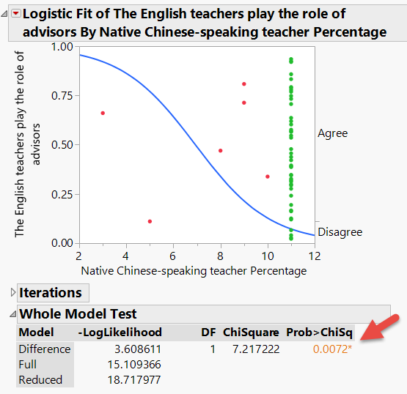
Don’t let the p value fool you!
This “model” is driven by a few data points.
Notes:
20

Slide 21
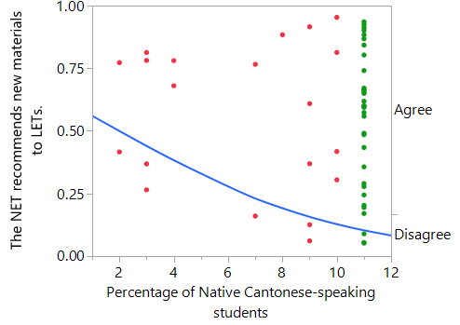
Don’t let the p value fool you!
Another LR model
P = .0324
Significant!
But, what is the problem?
Notes:
21

Slide 22
Don’t let the p value fool you!
The whole “model” is driven by sparse data points.
If the percentages are collapsed into two levels (Level 11: “91-100%” and all others), one can picture the green dots would also appear on everywhere along the probability line.
Notes:
22

Slide 23
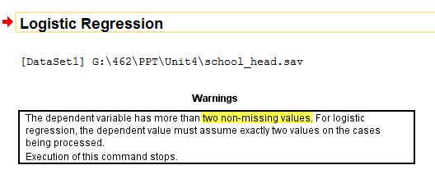
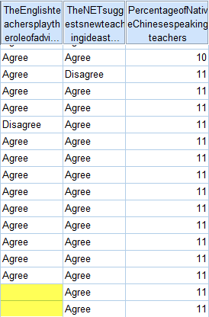
SPSS
Cannot do it with missing values
Notes:
23

Slide 24
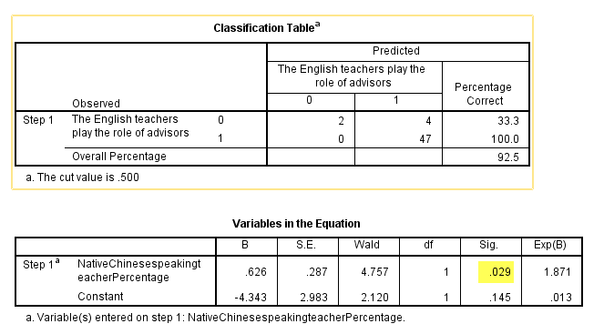
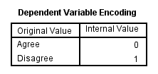
Don’t let the p value fool you!
SPSS shows that it is significant.
Is there any graph showing the data pattern?
Notes:
24

Slide 25
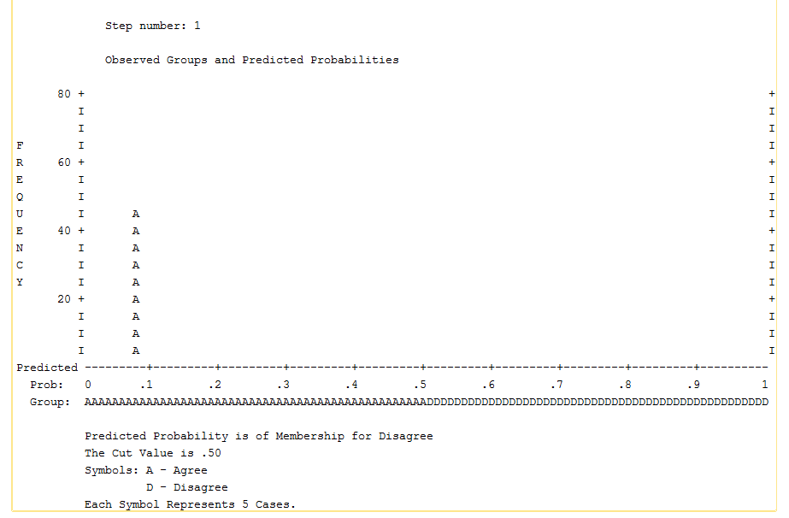
SPSS Logistic regression graph
Notes:
25

Slide 26

Two major problems
Model equivalency
Model instability:
  Lack of degrees of freedom (like North Korea)
  When there are too many parameters to be estimated than what the number of observations can support.
Notes:
26

Slide 27
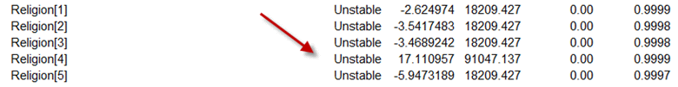
More is less
When there are too many categories (levels) in a variable, the parameter estimate becomes unstable.
Religion has six categories, but in dummy coding you need five (Christian vs. non-Christian; Buddhist vs. non-Buddhist...etc.)
When you see there are 6-10 options in a survey item, red alert!
Notes:
27

Slide 28
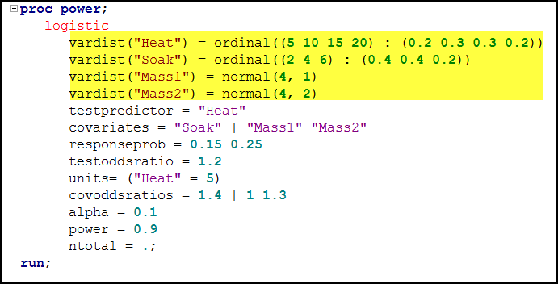
Sample size requirement
It is painful to compute the n requirement in SAS.
You need to specify the measurement scale and the range of each predictor.
Notes:
28

Slide 29
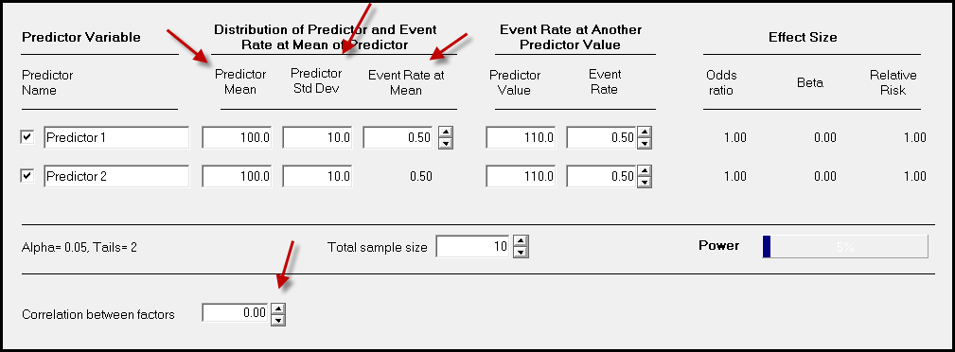
How about using SPSS?
To get the n for logistic regression in SPSS, I need to know the correlation between the predictors, the predictor means, SDs...etc.

Slide 30
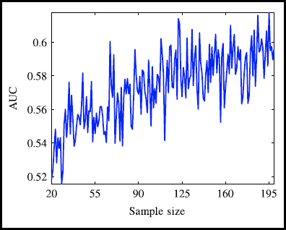
Sample size requirement
Classification or prediction accuracy is commonly used for evaluating the goodness of a logistic regression model, and therefore cross-validation is proposed for calculating the minimum sample size (Mortrenko, Strijov, & Weber, 2014).
In logistic regression and many other models, classification accuracy is defined by the area under curve (AUC) in the Receiver Operating Characteristic (ROC) curve.
Notes:
30

Slide 31
Sample size requirement
Without any modeling the chance that anyone can be correctly identified as a recovered patient is 50%. In ROC's terminology, AUC = 0.5 is the baseline. In order to yield better-than-chance results, 125 participants are needed to obtain AUC = 0.7.
Mortrenko, A., Strijov, V., & Weber, G. W. (2014). Sample size determination for logistic regression. Journal of Computational and Applied mathematics, 255, 743-752.
Notes:
31

Slide 32
Another example
Hege, A., Johnson, A., Yu, C. H., Sonmez, S., & Apostolopoulos, Y. (2015). Surveying the impact of work hours and schedules on commercial motor vehicle driver sleep. Safety and Health at Work. DOI:http://dx.doi.org/10.1016/j.shaw.2015.02.001. Retrieved fromhttp://www.sciencedirect.com/science/article/pii/S2093791115000104
Notes:
32

Slide 33

Are you sleepy?
In a study about sleep and work patterns of truck drivers, work pattern variables are used to predict the sleep quality.
It was found that miles driven per week (L-R Χ2 = 5.639; p = 0.018), irregular daily hours worked (L-R Χ2 = 4.555; p = 0.0330, and working over the daily hour limit (L-R Χ2 = 17.192; p = 0.002) were statistically significant predictors of sleep quality.
Notes:
33

Slide 34
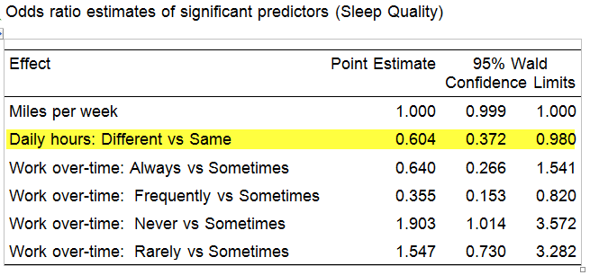
If daily hours of the drivers are different instead of being the same, the odds of being in the higher categories of sleep quality decreases by a factor of .604. In other words, the driver is 60.4% less likely to enjoy a high quality sleep.
Notes:
34

Slide 35

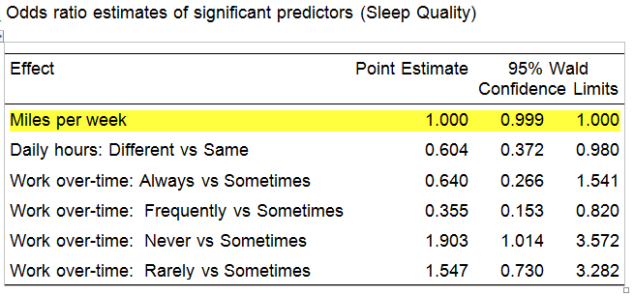
But there is a puzzle. What is it?
Notes:
35

Slide 36
At first glance, the odds ratio of miles per week is puzzling because at the odds ratio of 1 it seems that miles of driving per week had no impact on sleep quality, yet the p value is significant.
Notes:
36

Slide 37
The odds ratio for a continuous independent variable tends to be close to one, but it does not necessarily imply that the coefficient is not significant.
Notes:
37

Slide 38
A significant p value implies a departure from 0 even though the difference is very small.
In this case, when the odds ratios equal to 1, it indicates a 50/50 chance that the sleep quality will change due to a small change in the independent variable.
Notes:
38

Slide 39
Predictive accuracy
You can use either ROC curves or lift chart to examine the overall model goodness.
What is the rate of correct classification/prediction?
What is the rate of mis-classification?
We will go over ROC curves in decision trees and now let's focus on lift chart.
Notes:
39

Slide 40
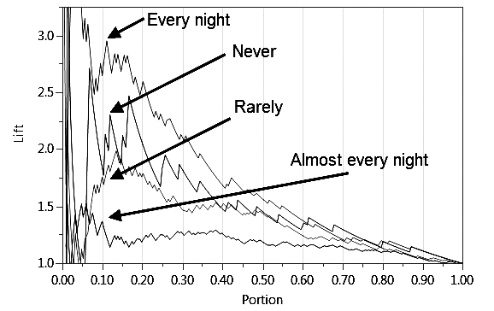
The X-axis depicts the portion of the population whereas the Y-axis shows the improvement by modeling.
Without any modeling there would be no improvement (any number multiplies itself is equal to the original number).
Notes:
40

Slide 41
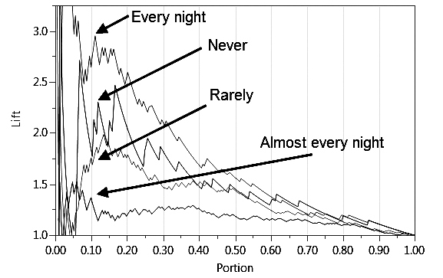
when 10% truck drivers are randomly drawn from the population, without modeling the predictive accuracy remains the same (10% X 1 = 10%).
Notes:
41

Slide 42
Lift Chart
Predictive power or classification accuracy
Notes:
42

Slide 43
Given this model the predictive accuracy for the category “every night” surges to almost 30%.
Notes:
43

Slide 44
All lift curves would eventually converge to 1 because when the full population can be accessed, we have the exact information and hence no prediction is needed.
Notes:
44

Slide 45
this model has the greatest predictive power for the category of “every night” but the weakest for “almost every night.”
Notes:
45

Slide 46
Too many variables
Previously we discuss the problem of too many levels in a variable.
When there are too many variables, regression faces a major problem: the order of entering the predictors would affect the result.
You can tell the program to examine the contribution of each variable step by step (stepwise).

Slide 47
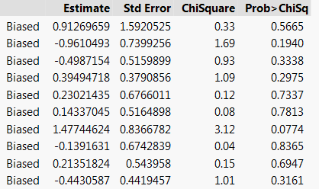
Redundancy
When some variables are strongly related to each other, the parameter estimates are biased. Red alert!
In this case, it is better to trim those redundant variables that cause the problem.

Slide 48

Ordinal stepwise regression
To make the result easier to interpret, the DV can be converted from nominal to ordinal. e.g.
  1: better 0: worse
  1: pass 0: fail
  1: proficient 0: not proficient
  1: Nikon photographers 0: Canon :)
  1: Mac users 0: Windows users :)
Notes:
48

Slide 49
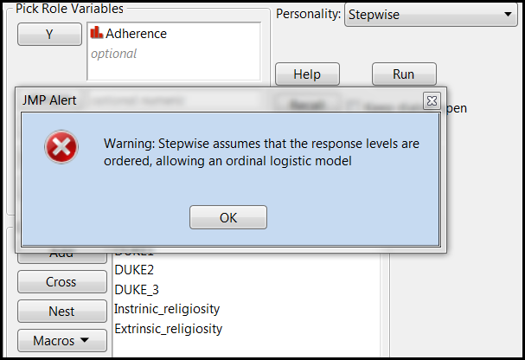
Ordinal stepwise regression
If the dependent variable is nominal, stepwise regression will force it to be ordinal. But if your coding is incorrect, you may misinterpret the result.

Slide 50
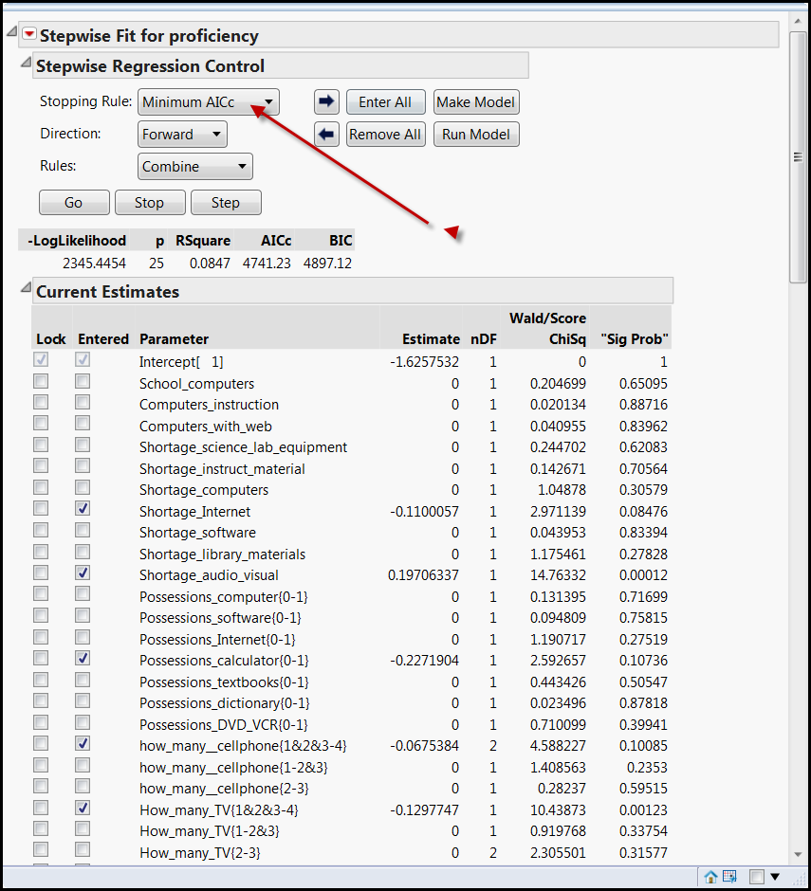
You will be punished if the analysis is not done properly!
Akaike Information Criterion Corrected (AICc): Penalty against complexity

Slide 51
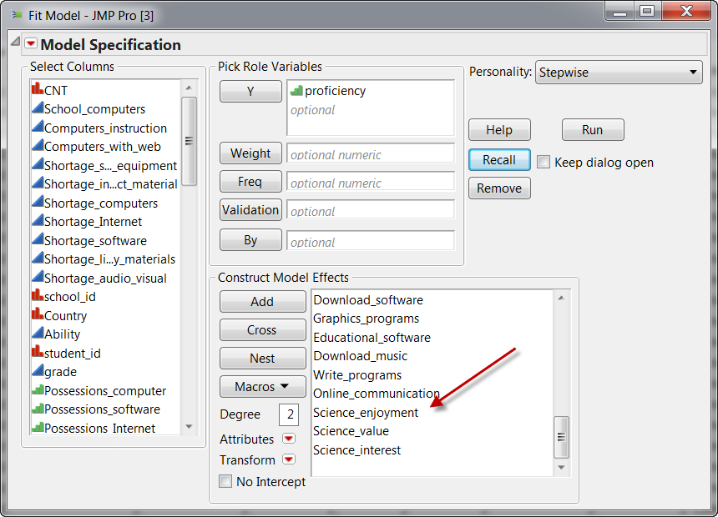
Science enjoyment is near the end of the list. But stepwise regression identifies it as the first most important predictor (see next slide)!

Slide 52
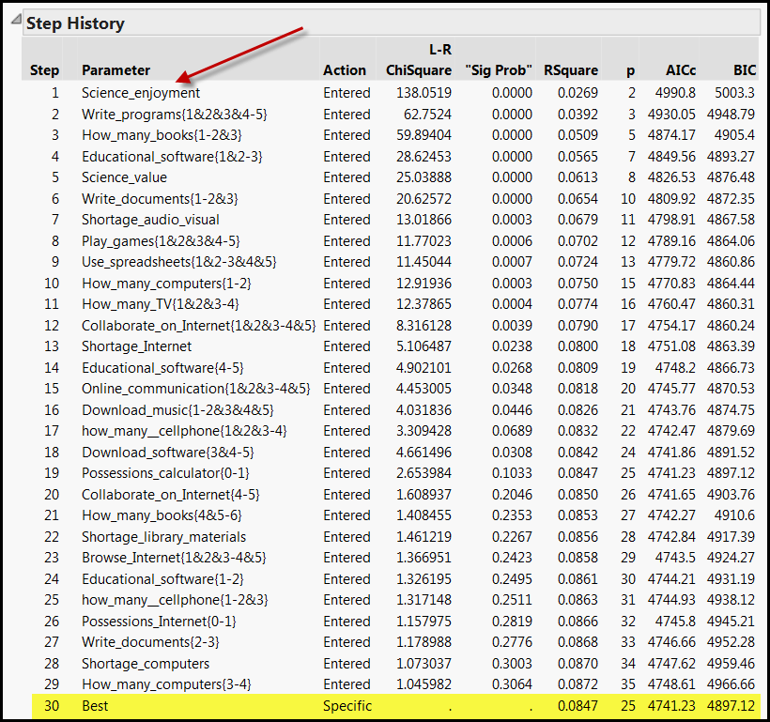
Smallest AICc = Best

Slide 53

The finding is still too complicated
Stepwise regression identifies 17 variables that can predict PISA test performance.
If a student asks me, “Professor, what can I do to improve my test performance in PISA?” Can I give him/her any practical advice?
Compare with the decision tree (will be discussed later), stepwise regression tends to yield a more complicated model.

Slide 54
Assignment
Open the sample data set “Children's popularity” from JMP. The data set contains children ratings of perceived importance of traits for gaining popularity. What variables can predict their goals?
Open Fit Model from Analyze. Put goals into Y.
Add gender, grade, age, race, urban/rural, and the four traits (grades, sports, looks, money) into “Construct model effects”.
Run a logistic regression model. Do the p values look good? Can you trust the result? Why or why not?

