Slide 1




Mixed modeling
Chong Ho Yu

Slide 2
Violation of assumption
In between-subject ANOVA one of the parametric assumptions is independence of observations.
This assumption is violated when you use multi-stage sampling e.g. sample states → school districts → schools → classes → students.
Responses from the same group (class, school...etc.) are correlated.

Slide 3

Violation of assumption
In within-subject ANOVA (repeated measures) one of the assumptions is that the covariance matrix structure meets the requirement of compound symmetry (the covariance between measurement times is constant; don't worry about what it means now).
Very often it is violated.

Slide 4
HLM= Multi-level modeling
Hierarchical linear modeling (HLM)
Multi-level modeling
  Take the data structure into account
  The data structure is hierarchical or multi-level (e.g. state, school district, school, class, student)
  The data are correlated and repeated (e.g. week1, week2, week3, week4...etc.)

Slide 5
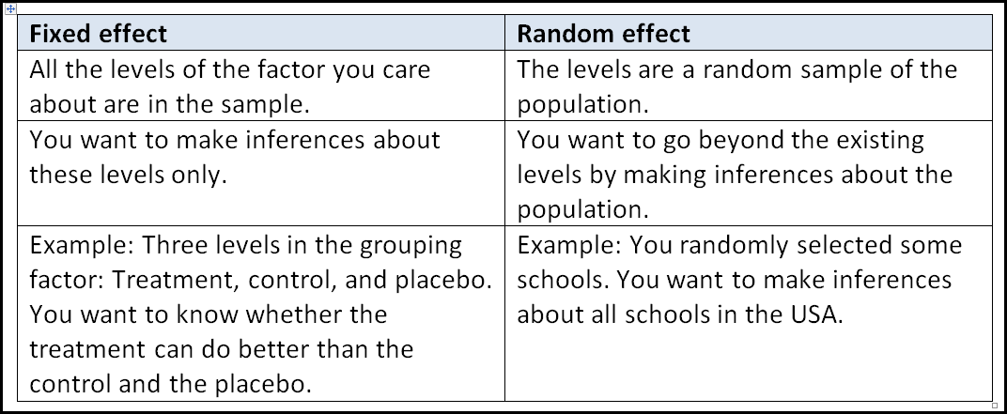
Other names
Random coefficient regression
Covariance component modeling
Mixed modeling: Fixed and random effects

Slide 6
Questions
I selected 1,000 students from 10 colleges and universities.
I want to see whether there is any test performance gap between boys and girls. Is gender effect fixed or random?
I want to see whether students in different schools perform differently. Is school effect fixed or random?

Slide 7

Free at last!
Thanks God Almighty! I am free at last!
Thanks God Almighty! I am free at last!
Thanks God Almighty! I am free at last!
And no more assumptions to be violated!

Slide 8

Caution!
Mixed modeling relaxes the assumption of independence and compound symmetry, but others are still needed e.g.
  Residuals are normal.
  Equal variances

Slide 9
Not yet free from huge sample size requirement!
Castelloe and O'Brien (2000): no generally accepted standard for power computations in HLM.
The major factors: effect size, sample size, and covariance structure (Fang, 2006). But the covariance structure is not known before data collection.
Autoregressive structure is widely adopted for growth modeling (Singer & Willett, 2003).
For autoregressive structure, power level = .8, effect size = .5, n per group = 200 (Fang, 2006).

Slide 10
Sample size for HLM
If I have three groups, I need n = 600! It is impractical!
Solution: get as many as you can, and do resampling (will be covered later).
What if the covariance matrix structure is NOT autoregressive?
Solution: Make your best guess. If it is not autoregressive, use “unstructured” (i.e. I don't know).

Slide 11
Example from JMP: Yield study
Yield study (wheat.jmp)
10 varieties of wheat are randomly selected from the population.
They are randomly assigned to six lands.
In each land the amount of moisture is determined (fixed).
You want to know whether moisture can affect yield.

Slide 12
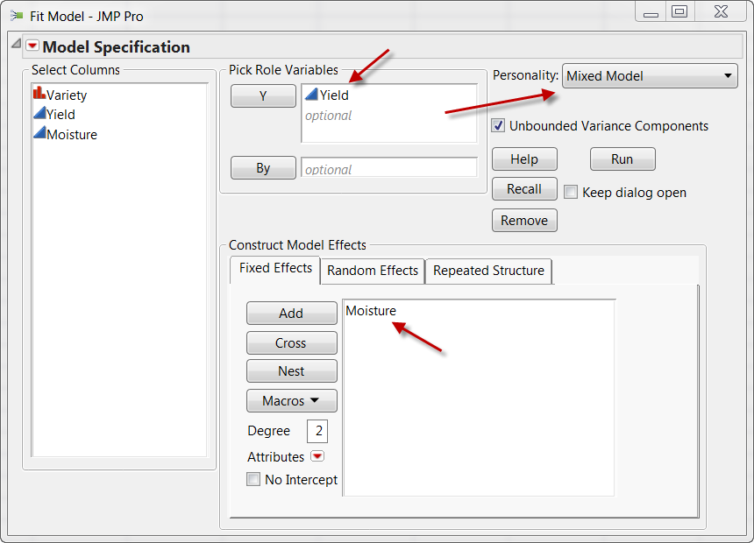
Define the fixed effect

Slide 13
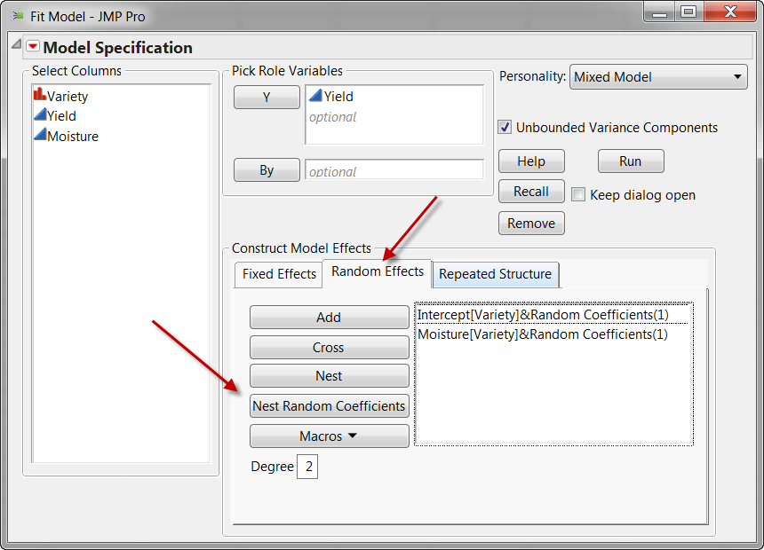
Define the random effect

Slide 14
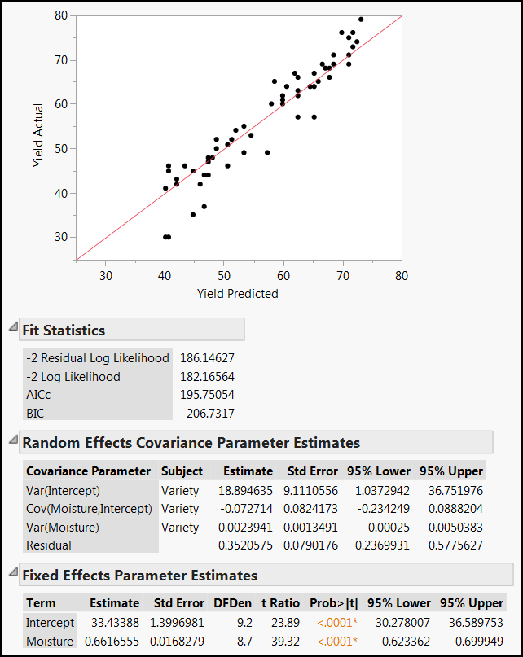
You can see a fixed effect report and a random effect report.
The fixed effect report is straight-forward. The moisture significantly influences the yield (p<.0001).

Slide 15
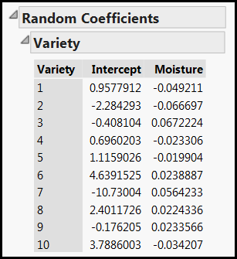
Random effect
The intercept and the slope of each variety is different.
Can I see the actual regression slope of each?

Slide 16
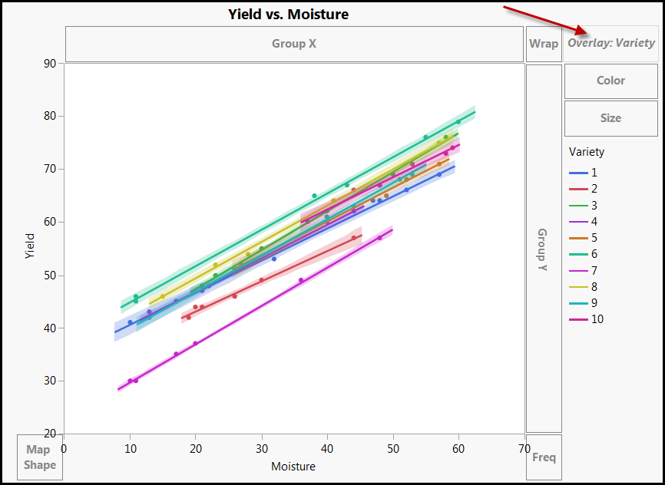
Use Graph Builder
Plot yield by moisture and use variety as overlay

Slide 17
Example from JMP
Test 2 new cholesterol drugs against the control and the placebo conditions.
5 patients are randomly assigned into 4 conditions.
Each patient's cholesterol level was measured 6 times: First day in April, May & June, and in the morning and afternoon.
Want to know whether the drug can lower patients' cholesterol level and whether there is an interaction of treatment and time.

Slide 18
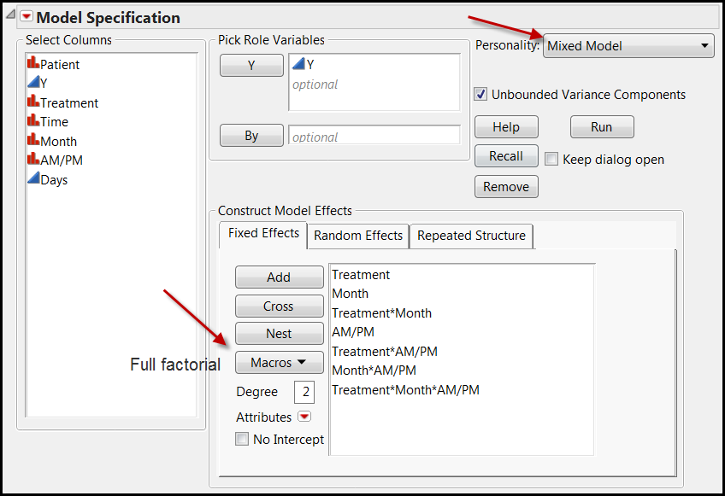
Define the fixed effect

Slide 19
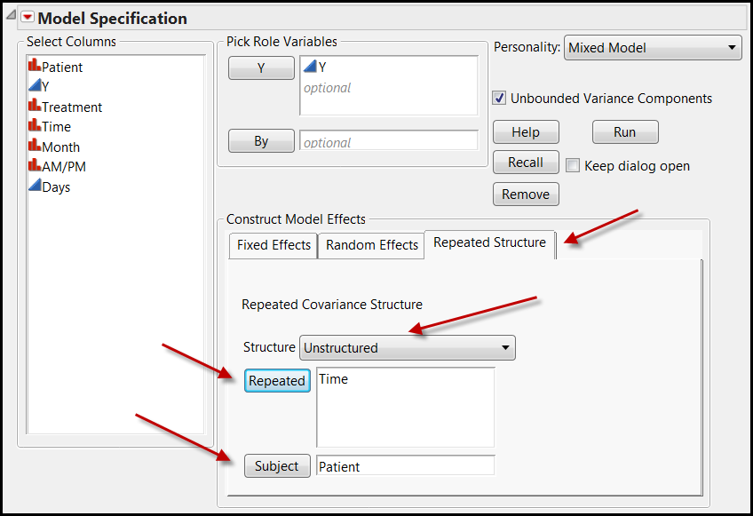
Define the repeated structure
You don't have to assume a covariance structure.

Slide 20
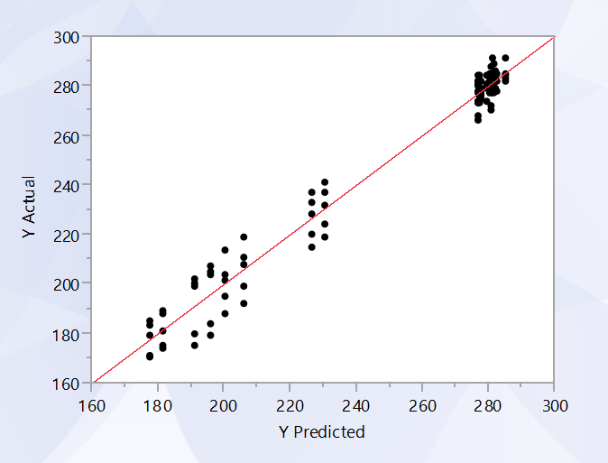
How well the model can predict?

Slide 21
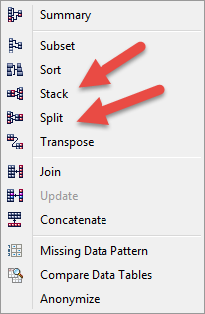
Data structure
ANOVA repeated measure: wide structure
Mixed modeling: Tall structure
JMP Table features make it easier:

Slide 22
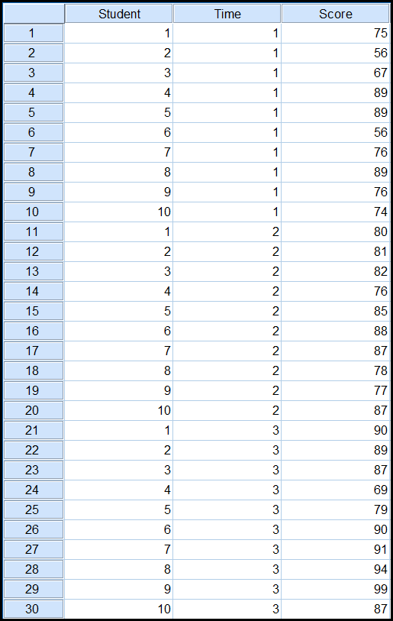
SPSS Example:
Repeated measures
Ten students
Test1, Midterm, Final
I want to see whether my teaching style could lead to any improvement over time.

Slide 23
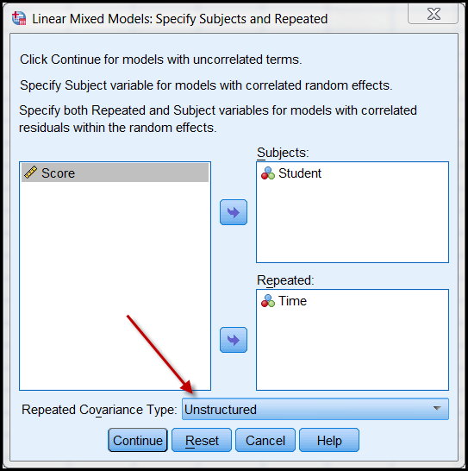
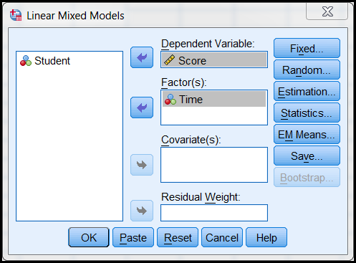
SPSS
Set the covariance matrix to unstructured.

Slide 24
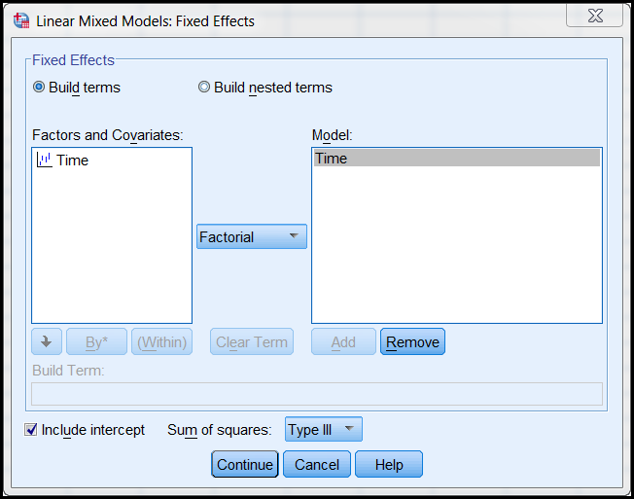
SPSS
Define the fixed effect: I want to know what happened between the pretest and final.
The three levels are all what I need.

Slide 25
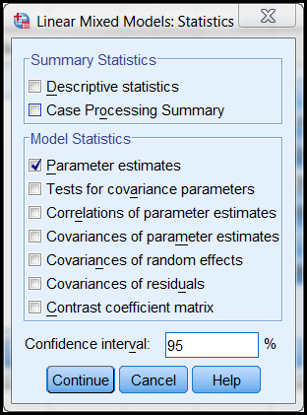
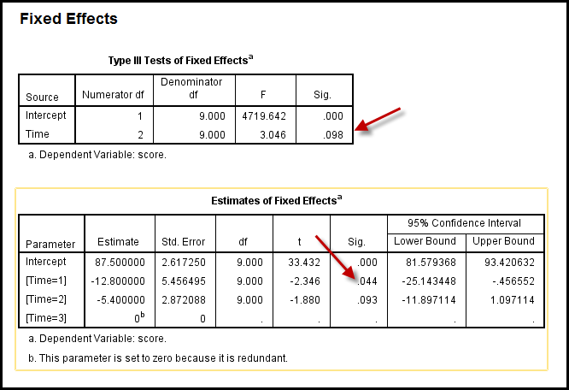
Get parameter estimates
All together it seems there is no improvement over time.
But Test 1 is significantly different from others.

Slide 26
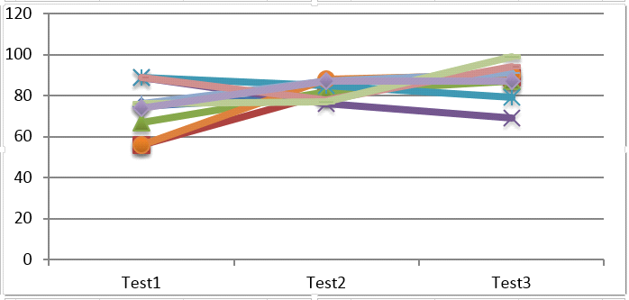
Parallel co-ordinate plot
When the three sets of scores are displayed side by side, you can see that the variation of test 1 and test 3 is high but test 2 has a short range. There may be a short equalizing effect, but at the end the scores spread out again.
Indeed Test 3 shows substantial improvement, but two students who are the best in Test 1 get worse and worse over time.

Slide 27
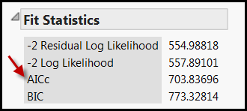
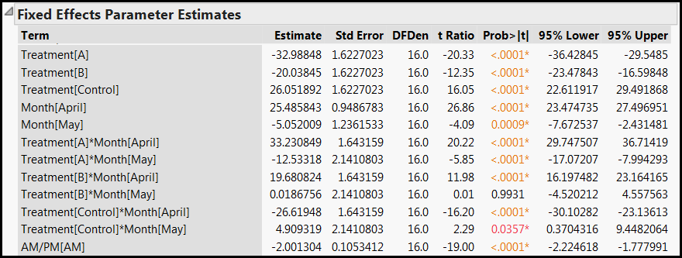
Results
AIC corrected: lower is better

Slide 28
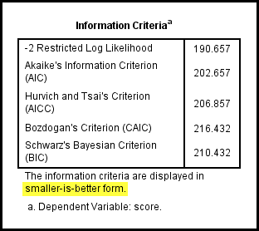

IC: Smaller is better
Unlike what people say in Texas (bigger is better), for information criteria small is better: Occam razor.

Slide 29
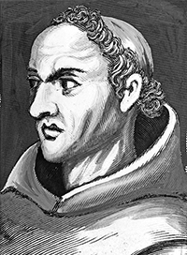
What is AIC?
AIC, AICc, BIC are all based on Ockham’s razor: Given all things being equal, the simplest model tends to be the best one.
Named after William of Ockham (c.1285-1347/49): Entitles should not be multiplied unnecessarily.

Slide 30
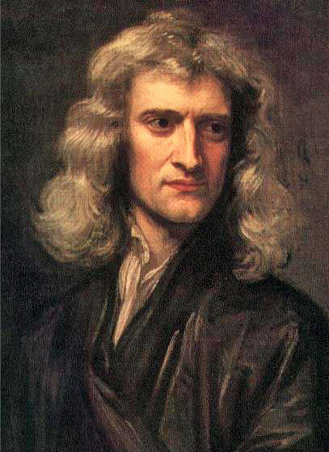
Issac Newton
“We are to admit no more causes of natural things than such as are both true and sufficient to explain appearances.”
Translation: when there are two competing and equally good models, pick the simplest one.

Slide 31
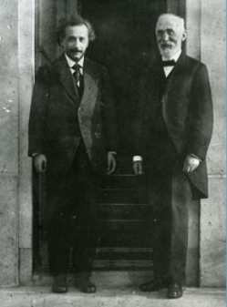
Einstein vs. Lorentz
Both proposed a model to explain the space-time continuum. Einstein's model is simpler.
Can you guess who is right?

Slide 32

What is simplicity?
Keep it simple, stupid (KISS).
Simplicity is a function of the number of parameters to be estimated (e.g. regression coefficient).
AIC is a fitness index for trading off the complexity of a model against how well the model fits the data.

Slide 33
AIC
The general form of AIC is: AIC = 2k – 2lnL
k is the number of parameters
L is the likelihood function of the estimated parameters. (Don't worry about what it means).
AIC not only rewards goodness of fit, but also includes a penalty when the number of estimated parameters increases.

Slide 34
AICc
SPSS uses AIC
JMP uses AICc (AIC corrected)
AICs: Greater penalty
Burnham and Anderson (2002) recommend replacing AIC with AICc, especially when the sample size is small and the number of parameters is large.

Slide 35
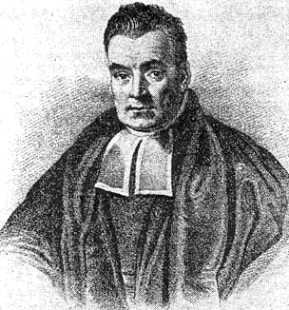
BIC
Named after Thomas Bayes
Heavier penalty than AIC
AIC is more optimal than BIC.
The Bayesian approach needs a prior input (a guess based on background information or prior knowledge), but it is debatable.

Slide 36
Assignment 5.1
Open the data set “cholesterol_stacked” from the JMP sample database.
Run a mixed model using the same set-up.
But in the repeated structure choose “Residual” (don't worry about what it means)
What is the AICc? Compare with the model using the unstructured covariance matrix, which one is better?

Slide 37
Assignment 5.2
Download the data set “students nested with school” from Unit 5 folder.
You want to know whether tutoring hours can predict test scores, but students are not independent. They are randomly selected from five schools.
In Graph builder put scores into the Y-axis and hours into the X-axis. Choose a linear regression line.
Drag school into overlay and and deselect confidence of fit.
Which school has the weakest relationship between tutoring hours and test scores? Which school has the strongest one?

