Slide 1


Dancing with the data
Chong Ho Yu (Alex)

Slide 2
Agenda
Difference between static and dynamic graphics
Visualization techniques from 1 to 5 dimensions
Future trend: multi-panel visualization to go beyond 5 dimensions
Hand-on exercises using JMP.

Slide 3
Opposition
Fisher (1932) said:
  Diagrams prove nothing, but bring outstanding features readily to the eye; they are therefore no substitute for such critical tests as may be applied to the data.
Today many researchers insist that reporting the numbers is sufficient.
How can we spot outliers, check assumptions (e.g. linearity, normality), identify patterns (e.g. clusters), evaluate model adequacy (e.g. residuals) without looking at the data?

Slide 4

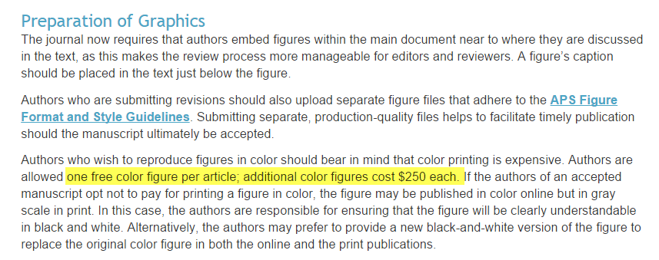
Opposition
“Many journal articles do not display graphics.”
Because it is expensive! It’ll cost you an arm and a leg!

Slide 5
See beyond the horizon!
Can you do this in a print journal?
Yu, C. H., & Stockford, S. (2003). Evaluating spatial- and temporal-oriented multi-dimensional visualization techniques for research and instruction. Practical Assessment, Research & Evaluation, 8(17). Retrieved fromhttp://pareonline.net/getvn.asp?v=8&n=17

Slide 6
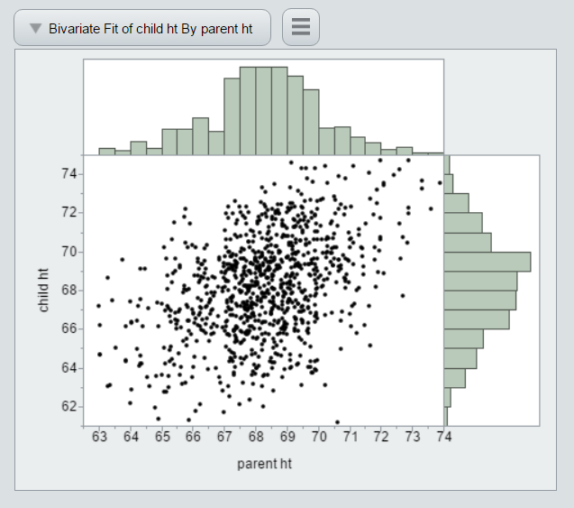
See beyond the horizon!
Can you do this in a hard copy?
http://www.creative-wisdom.com/teaching/WBI/galton.htm

Slide 7
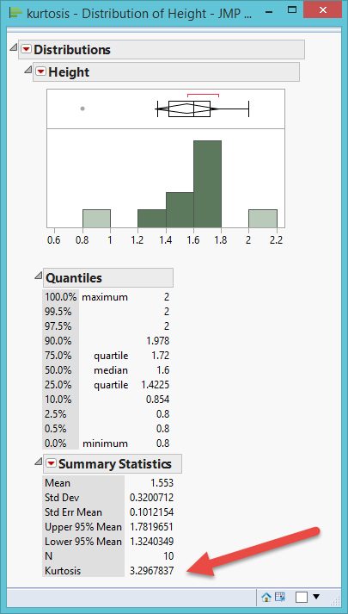
Numbers may fool you!
Anscombe's data is a classical example.
Another one: Kurtosis is the relative ratio of the mass of the distribution located in the center vs. in the tails. Kurtosis = 3 → Normal curve.
In this example, Kurtosis = 3.2, fairly normal, right?
No, there is a lot of central mass, but the histogram shows that the distribution is skewed and there are two outliers.

Slide 8
Static vs. dynamic
Static
  What you see is what you get.
  After the graph is made, you cannot manipulate the graph (changing the background color or the line width is not considered “data manipulation because it cannot give you any insight about the data)
Dynamic
  The data table and different graphic panels are linked. Changing one would change all others.
  You can manipulate the graph to explore the data through different perspectives.

Slide 9
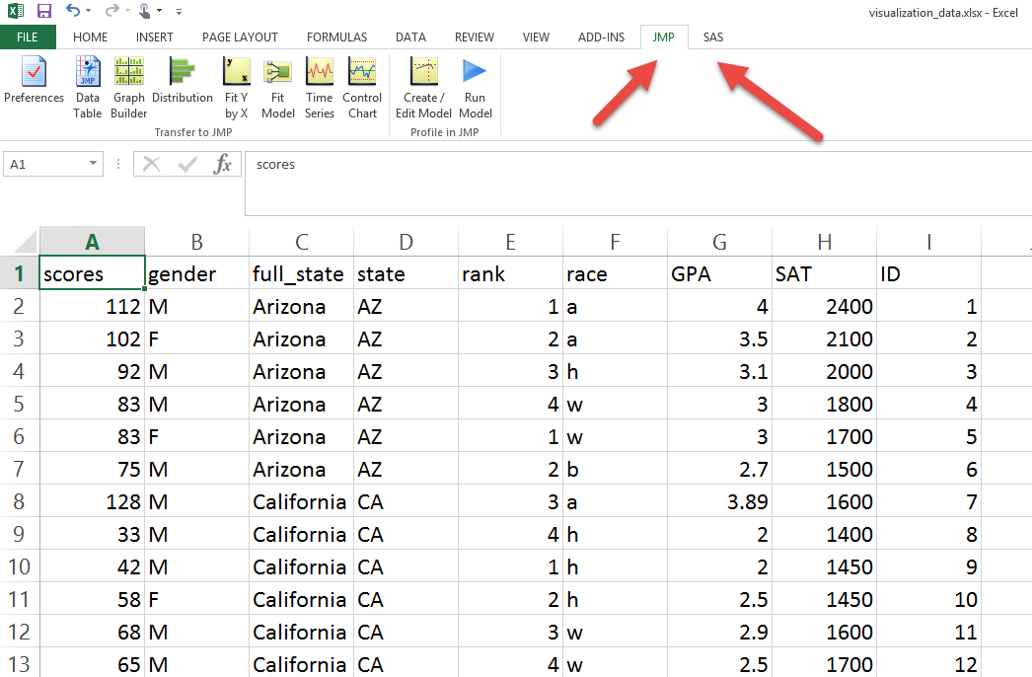
Invoke JMP/SAS in Excel

Slide 10
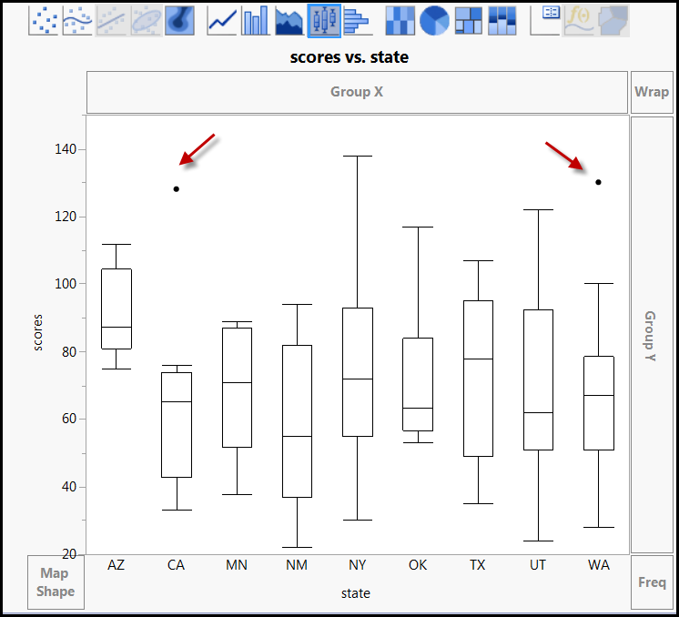
Boxplot of scores by state

Slide 11
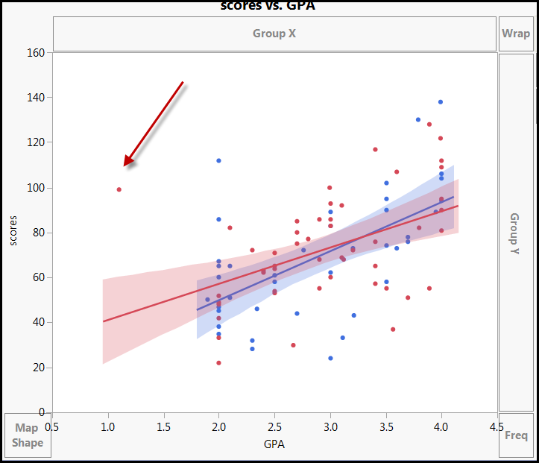
Regression lines by gender
The two lines do not look the same, but there is an outlier.

Slide 12
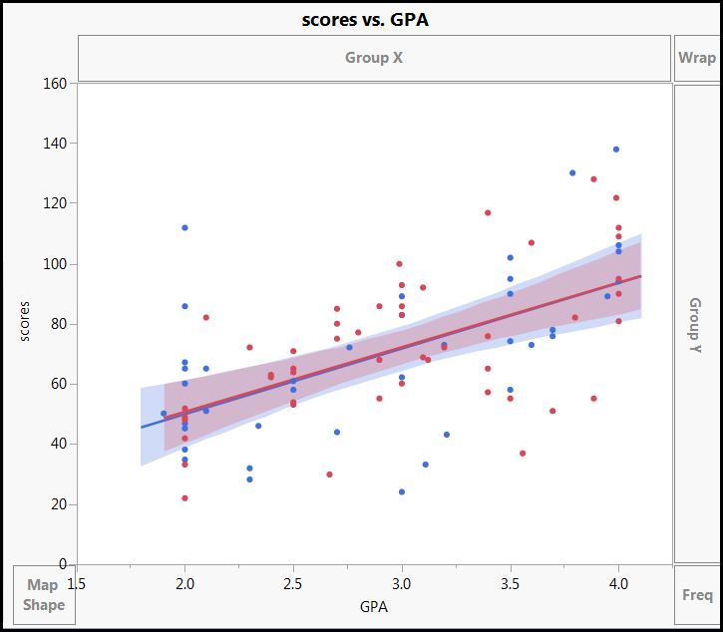
Regression lines by gender
Put on a pair of sun glass (don't look at the outlier)

Slide 13
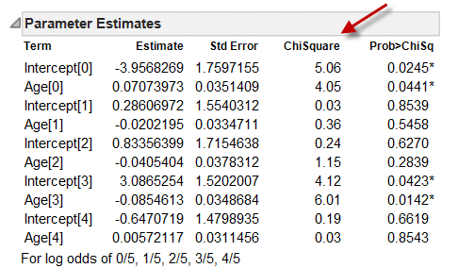
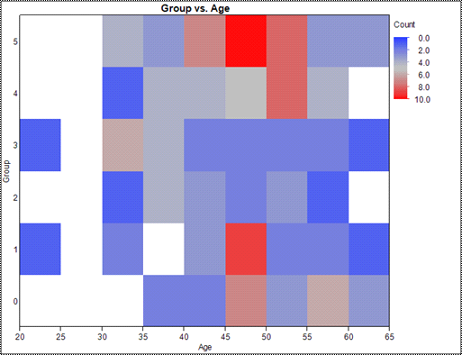
Example: Logistic regression
Aged between 45 and 50 → in group 1 and 5.

Slide 14
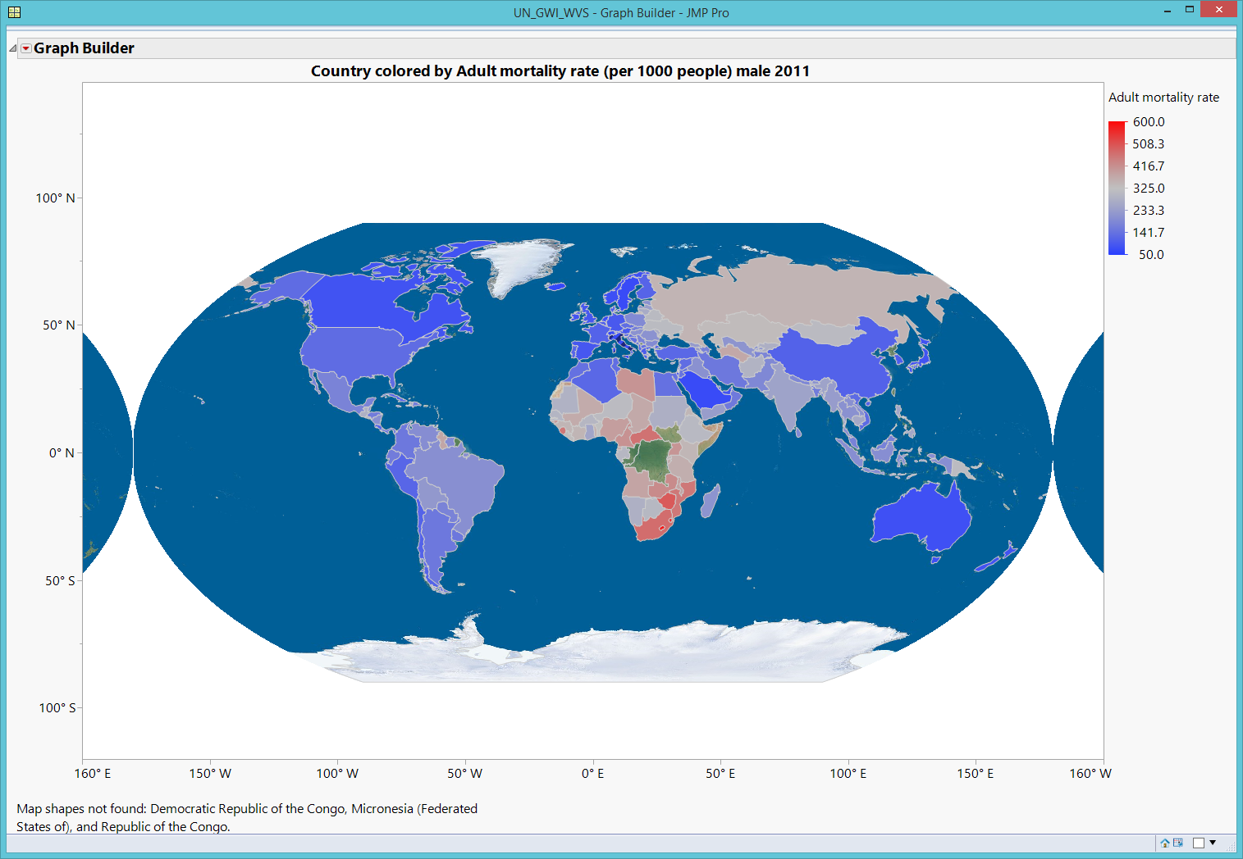
GIS Map: World

Slide 15
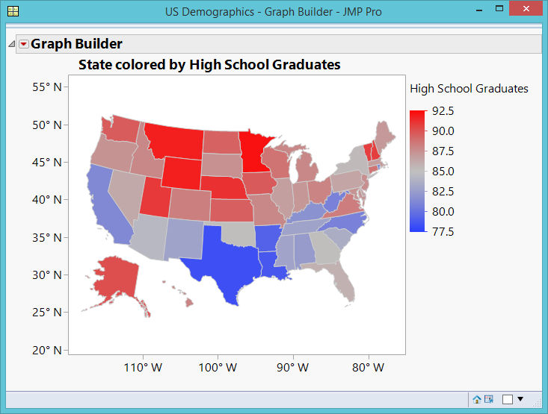
GIS Map
The Yankees (Northern states) are doing better.
But usually people perceive “red” as “risk”.

Slide 16
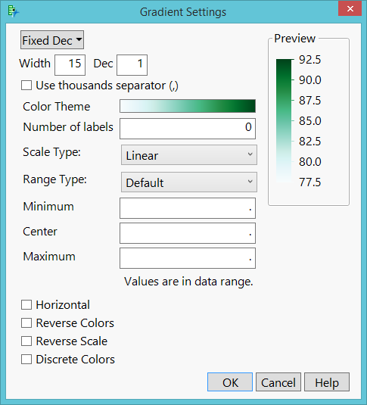
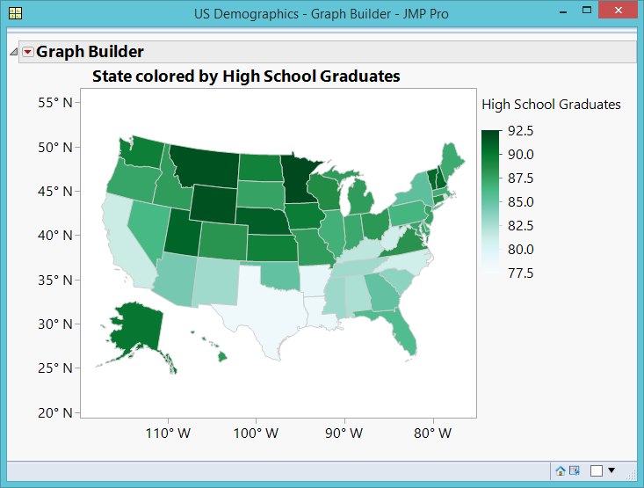
Customized GIS Map

Slide 17
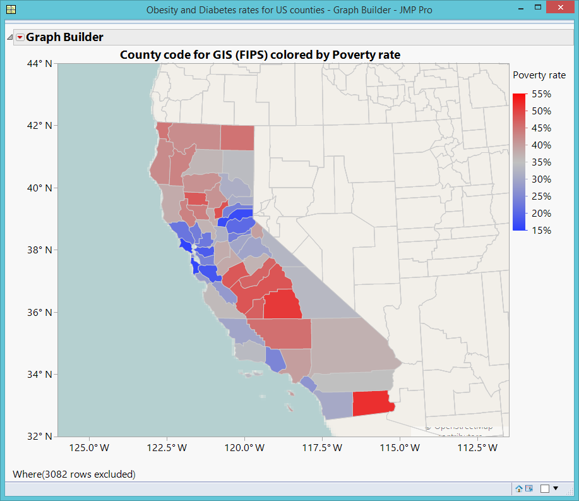
GIS Map: County

Slide 18
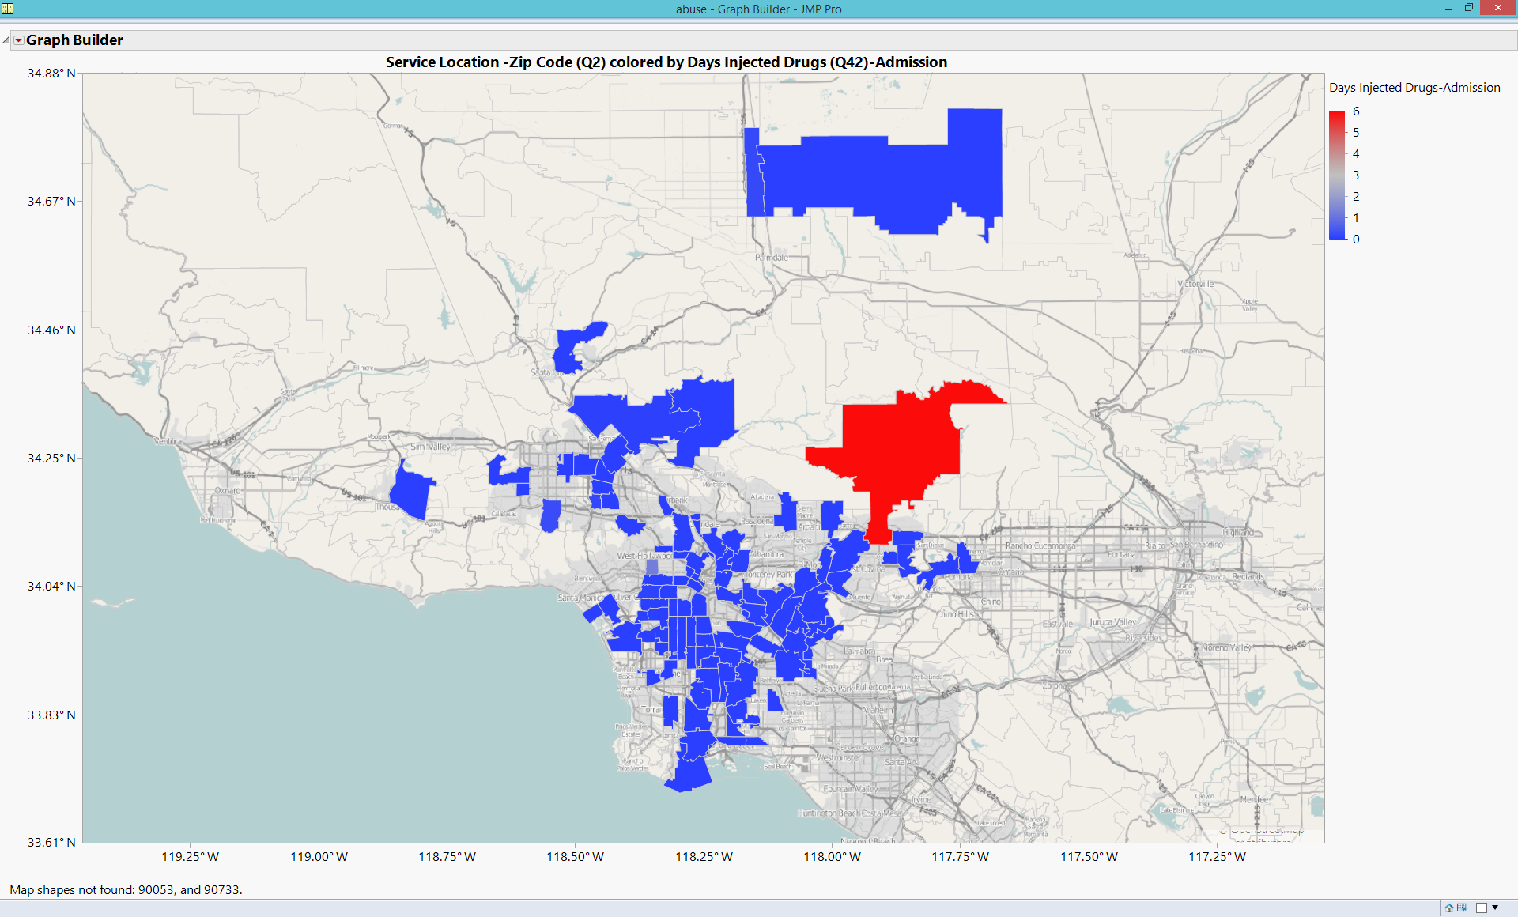
GIS Map: Zip

Slide 19
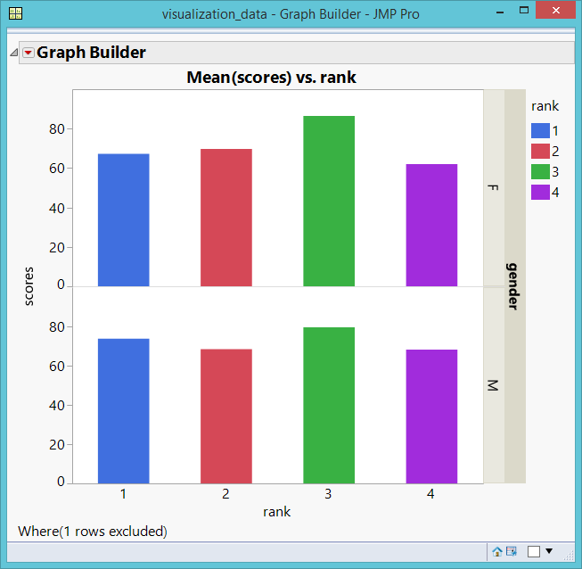
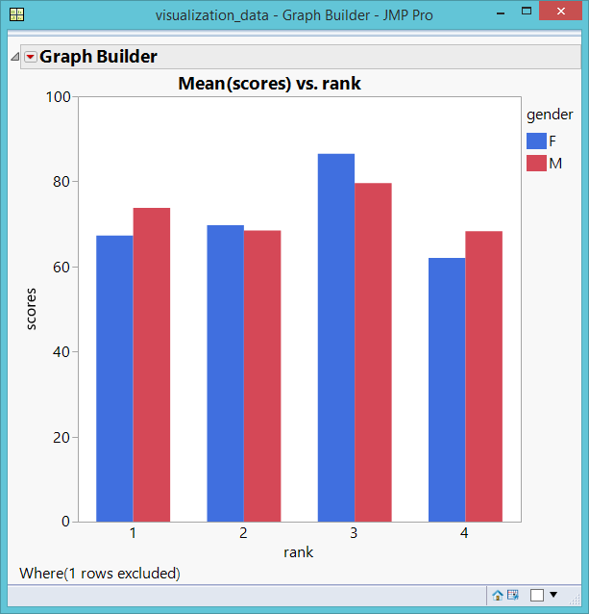
Coplot: scores X rank * sex

Slide 20
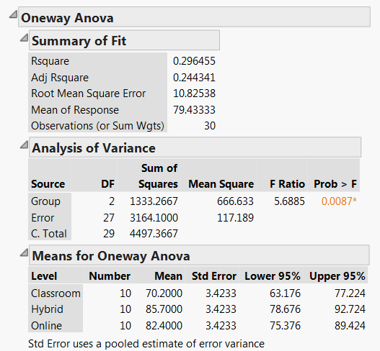
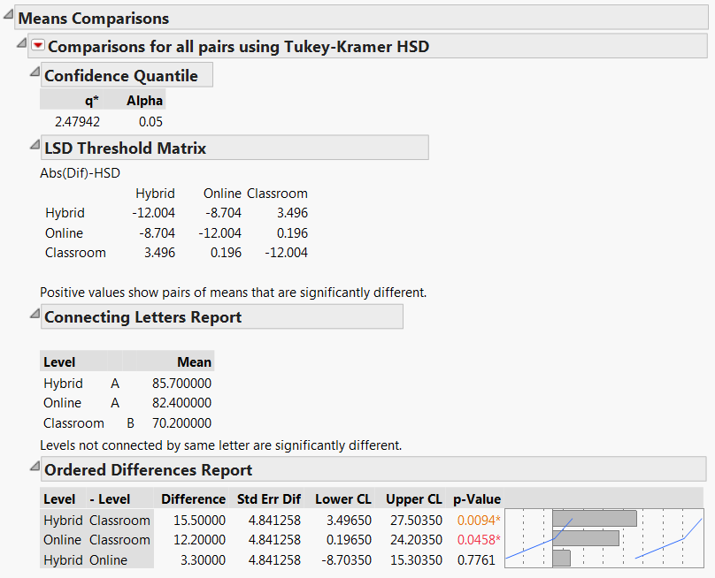
ANOVA and multiple comparison

Slide 21
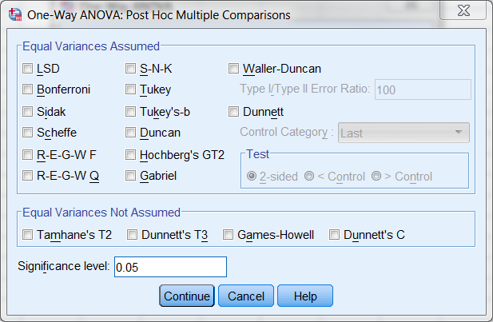
SPSS Post hoc multiple comparison
In SPSS you have 18 options. When I was a graduate student, I took a course on it.

Slide 22
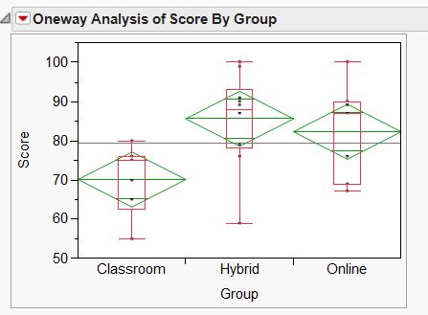
Diamond plot
Grand sample mean:
horizontal black line
Group means:
horizontal line inside each diamond.
Confidence intervals: The top of the diamond is the upper bound while the bottom is the lower bound.
Quantile: boxplot

Slide 23
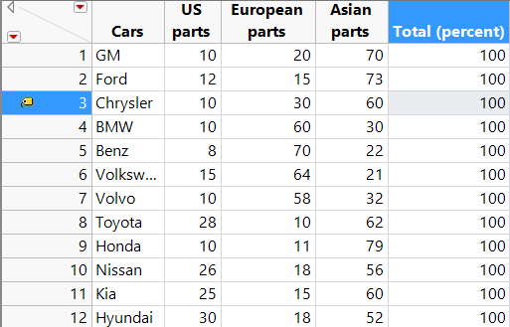
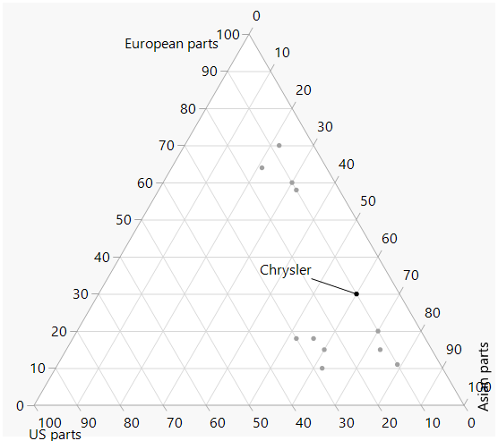
Ternary plot:
Clustering and Profiling
In the era of globalization, how can we define what a USA company is? One argue that if you buy a Korean Kia, you may help reducing the trade deficit.

Slide 24
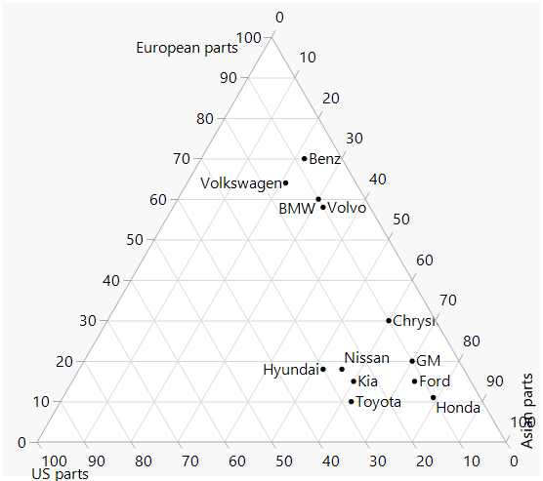
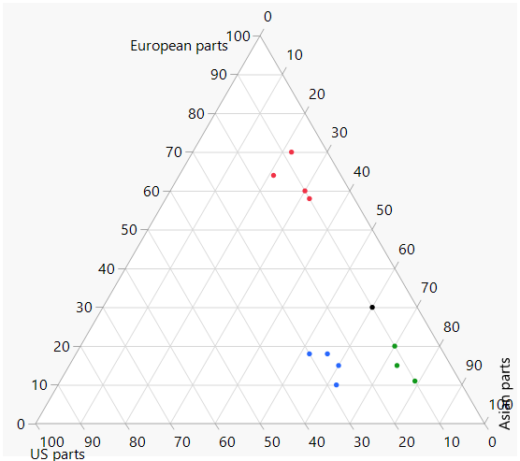
Clustering pattern
There are three clusters, but one company does not belong to any.

Slide 25
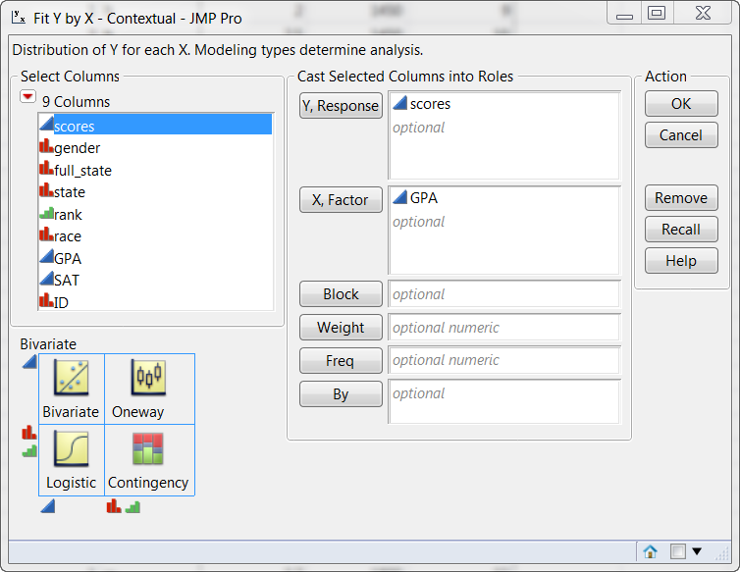
Visualizing multiple dimensions by colors and markers
I want to know how academic rank and gender moderate the relationship between high school GPA and university test scores.

Slide 26
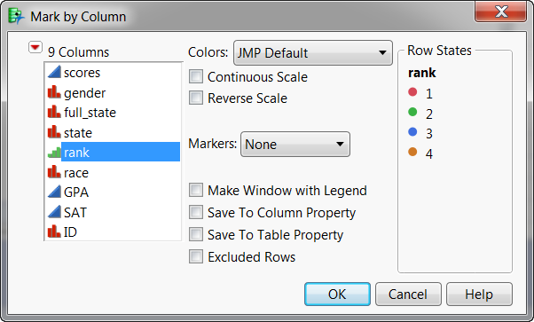
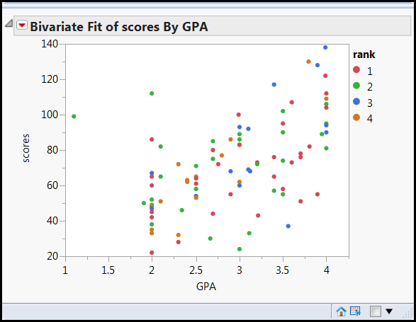
Right click on the scatterplot and choose row legend.
Keep the default color assignment of rank.
Now you are viewing three dimensions.
Everything is everywhere! Good! No systematic concentration.

Slide 27
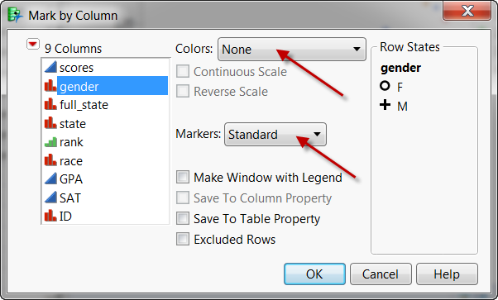
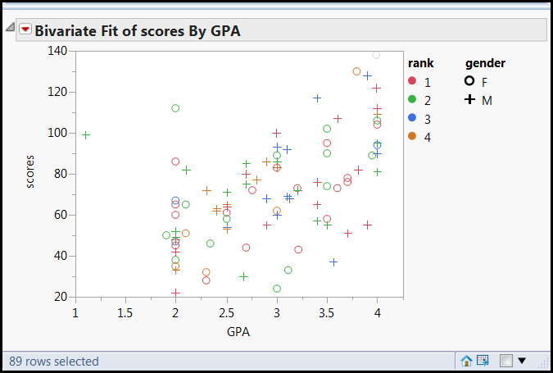
Do not assign colors to gender.
Use sex symbols for gender marker.
A green O is a female sophomore; a red + is a male freshman.
Four dimensions
Everything is everywhere! Good!

Slide 28
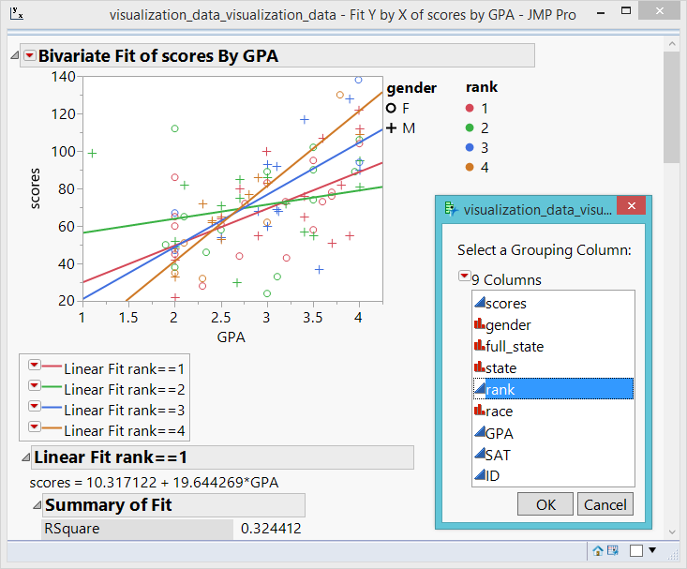
Regression by rank

Slide 29
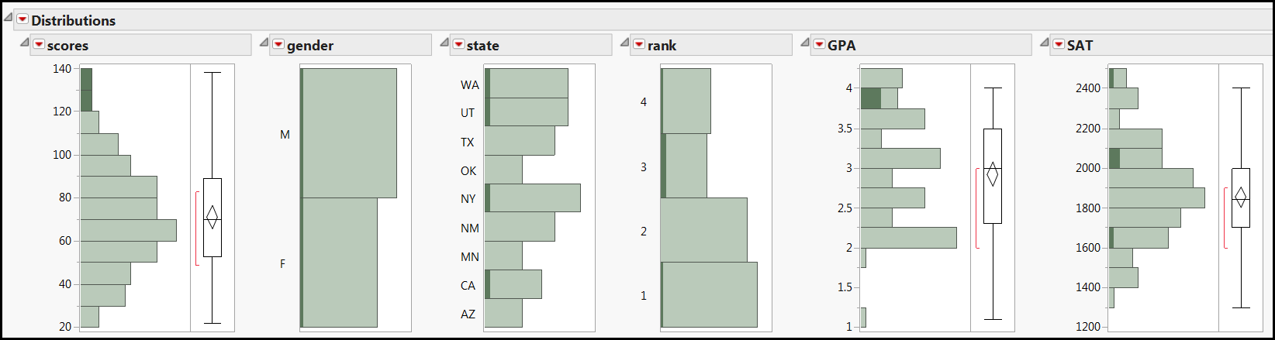
Linking and brushing
What are the characteristics of top performers in college test scores?
They are from WA, UT, and CA.
Their high school GPA is good but their SAT is not necessarily good.

Slide 30
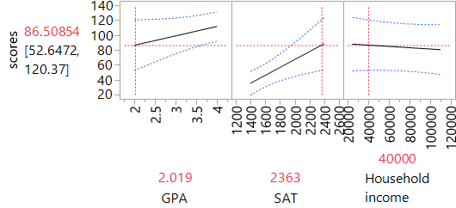
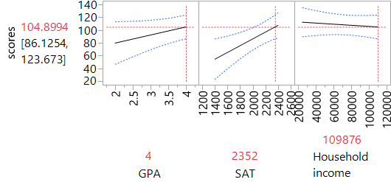
Prediction Profiler
What would the scores be if GPA is low, SAT is high, and household income is low?
What would it be if GPA is high, SAT is high, and household income is low?
What if….?

Slide 31
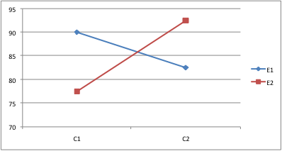
Two-way interaction is easy
You can do it in Excel.
We can extend the two-way plot to three-way in Mathematica or Maple.
How about putting 2 two-way plots together?

Slide 32
Dancing with three-way interaction
The objective of showing you these graphics is to let you be aware what options you have if you want to do multi-dimensional data visualization in the future. It is NOT required to learn how to create these graphics now.
A regression equation is a function. Y is a function of Xs.
http://www.creative-wisdom.com/multimedia/regression.html

Slide 33
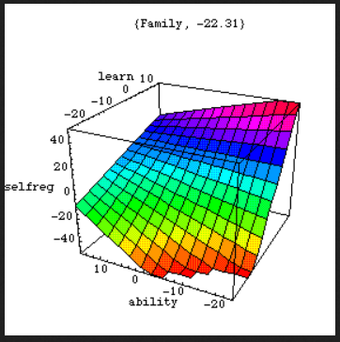
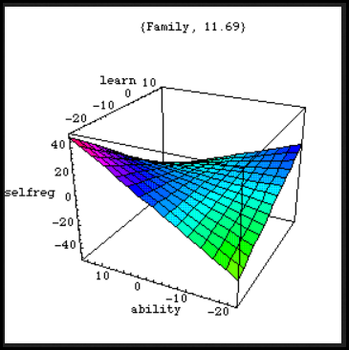
Dancing with three-way interaction
Detecting and interpreting three-way interactions in regression may be very complicated. Using a mesh surface is much clearer.
Interaction: the effect of X on Y is not consistent across all levels of A and B → regression lines vary
If there is NO interaction, there should be no curving or dancing in the movie. Every frame should look the same.

Slide 34
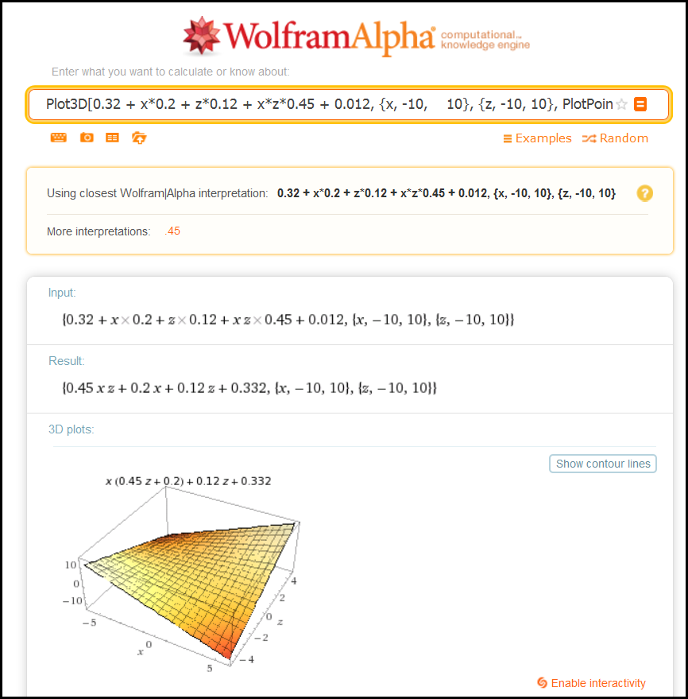
WolframAlpha
If you do not have Mathematica or Maple, you can use WolframAlpha. It is free!

Slide 35
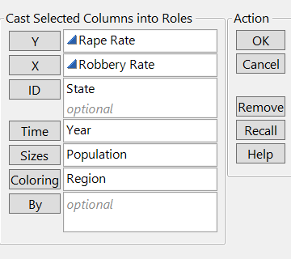
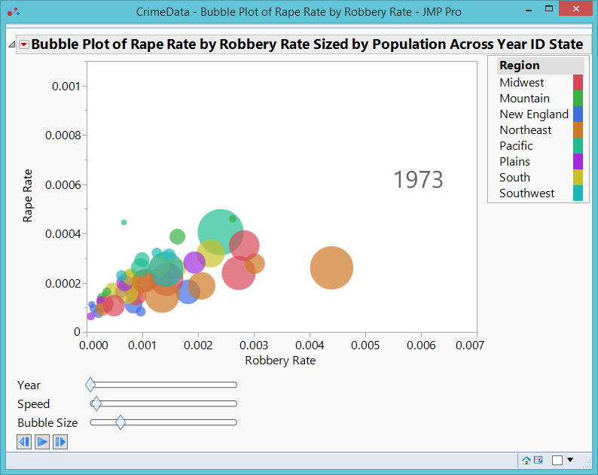
How about five dimensions? Bubble plot

Slide 36
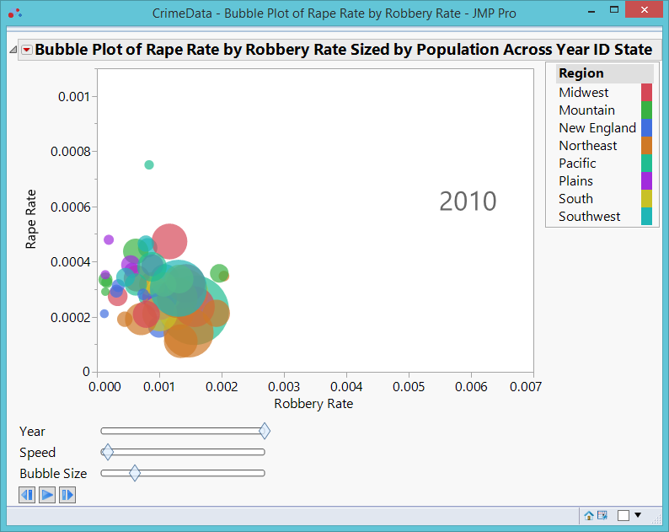

Slide 37
What the bubble dance tell you?
In 1973 a strong association was found between the two crime rates, but in 1993 their connection became weaker.
In both years big cities with a large population size tended to suffer from higher crime rates, with the Northeast region being the worst.
The US crime rate has been steadily declining since the 1990s. In 2010, the crime rates appear to be under control. The robbery rate and the rape rate seemed to be negatively correlated.
Big cities and Northeast are no longer the most dangerous places to live.

Slide 38
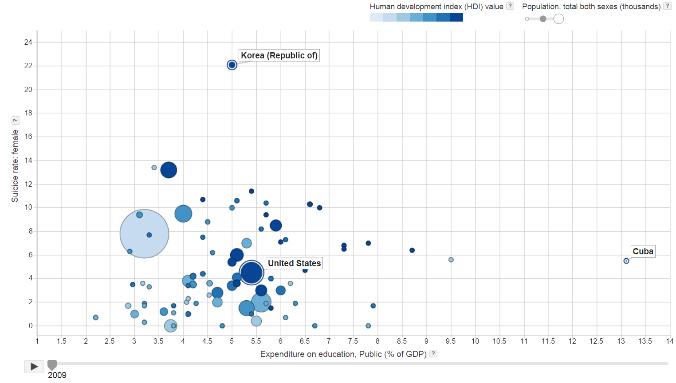
UN Public Data Explorer

Slide 39
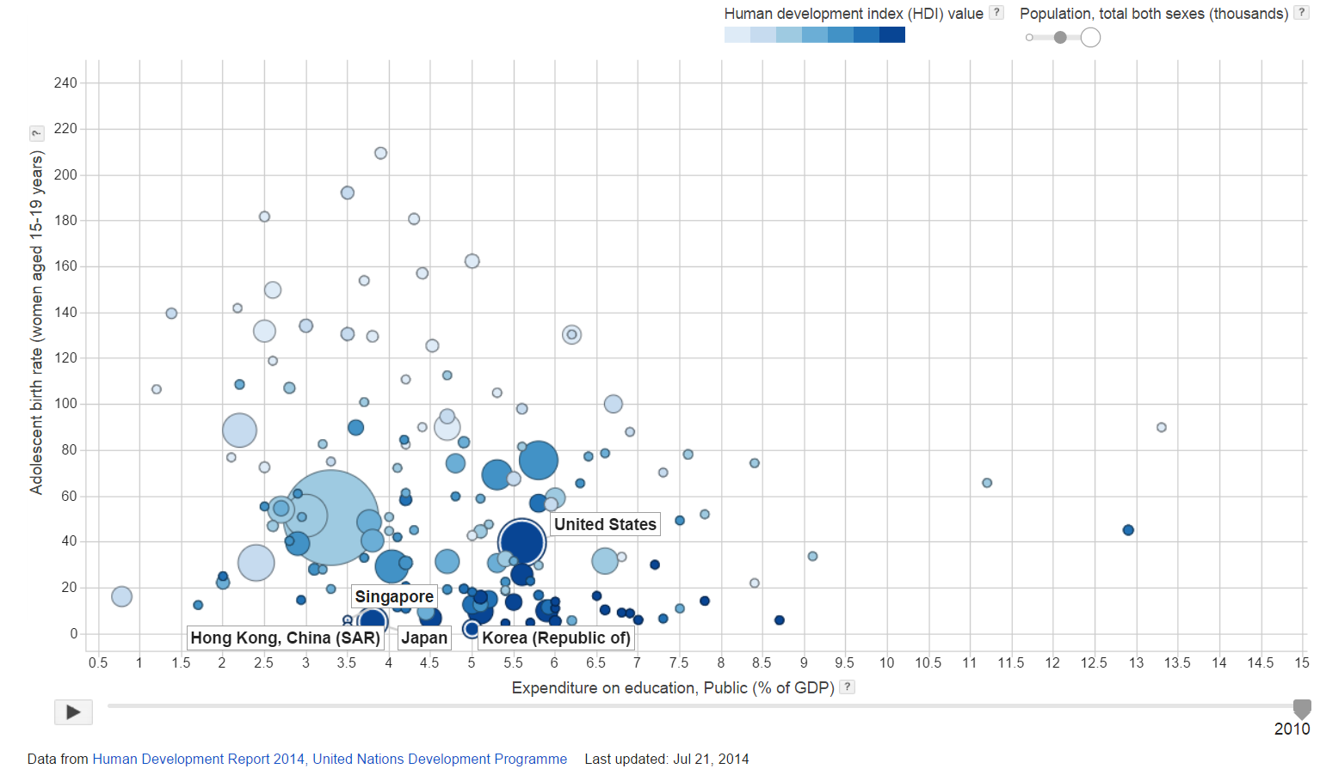
UN Public Data Explorer

Slide 40
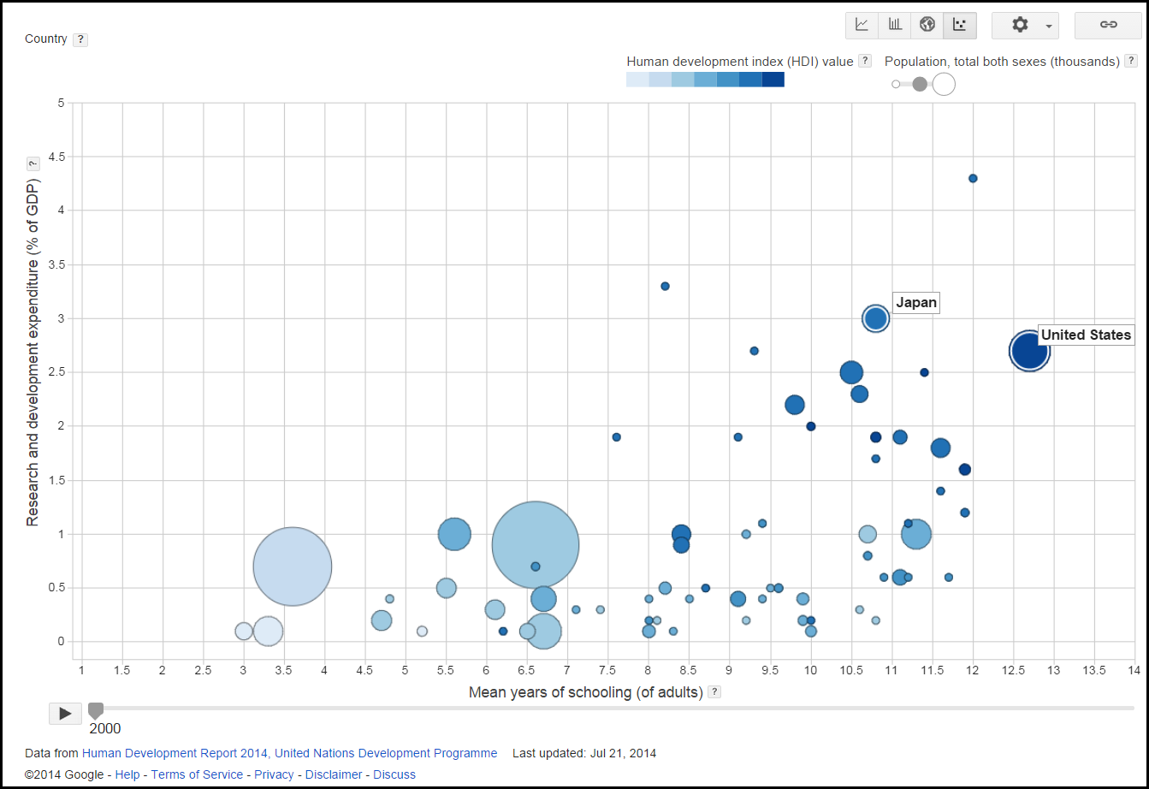
UN Public Data Explorer

Slide 41
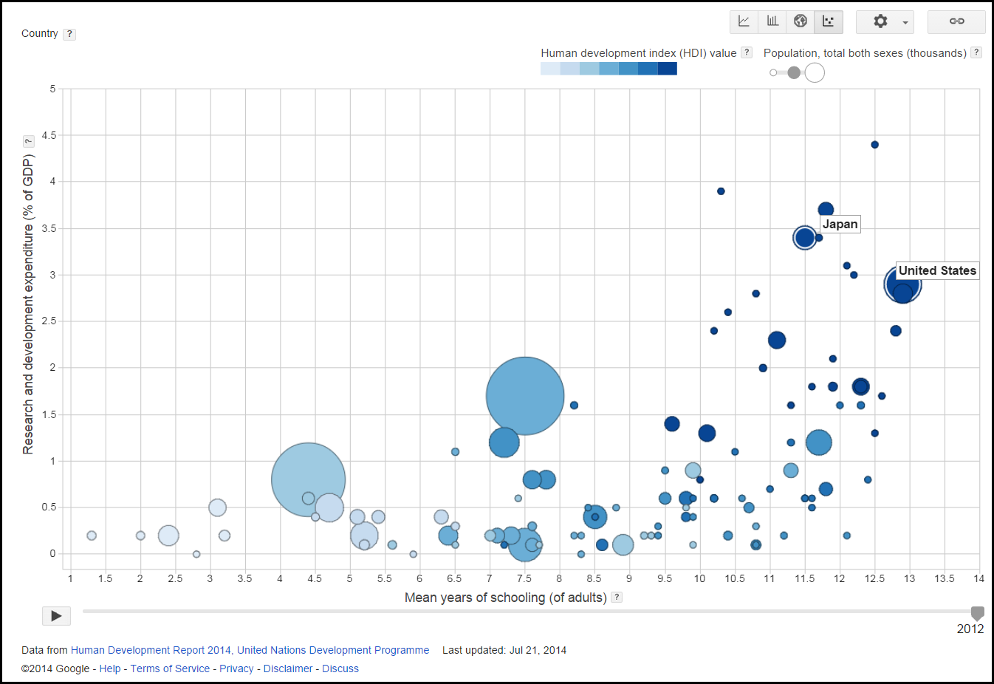
UN Public Data Explorer

Slide 42
Observations
Mean years of adult schooling and R&D have a positive relationship.
This relationship has been stable for over a decade.
Countries that are doing well in both are high in Human Development Index.
Size doesn't matter. Some very populated countries are not doing well in both.

Slide 43
Observations
Japan has been ahead of the US in spending money for R&D (as a percentage of GDP) for over a decade.
On the average Japanese people spend fewer years in school than their American counterparts, but they still invest more in R&D.
Compare with other nations, US and Japan are among the top in terms of years of schooling and R&D.
US has been leading in years of schooling and Germany catches up in recent years.

Slide 44
SAS Visual Analytics:
Multi-panel visualization

Slide 45
SAS Visual Analytics:
Multi-panel visualization

Slide 46
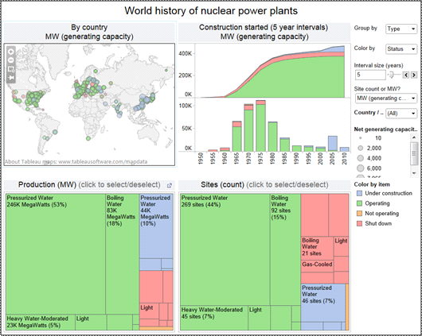
Tableau: Multi-panel visualization

Slide 47
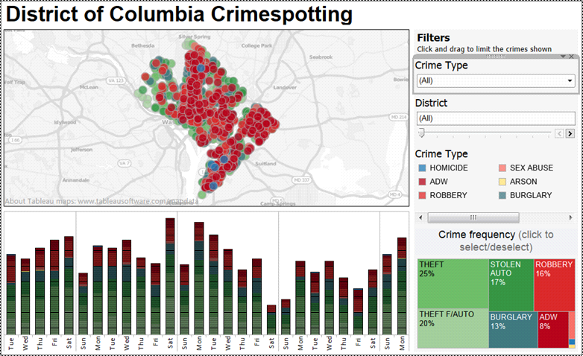

Slide 48
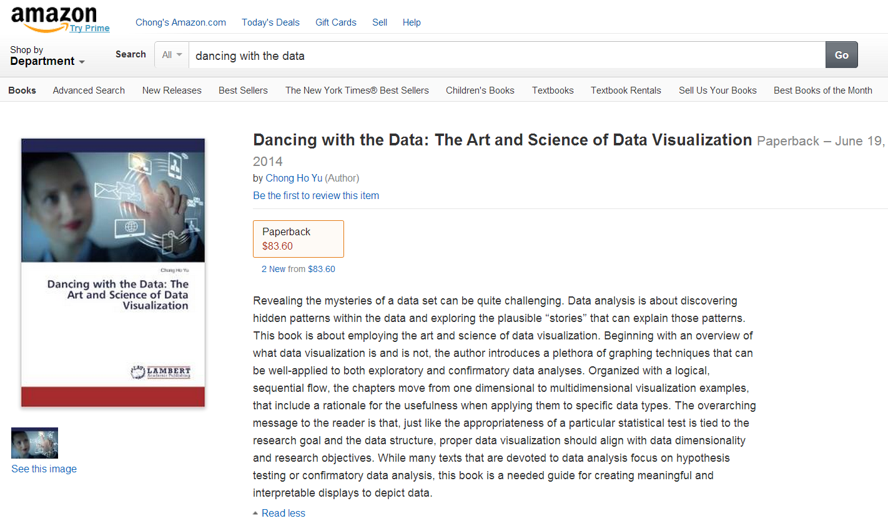
The contents are based upon

Slide 49
Assignment 7.1
Open the data set visualization_data.jmp
Use Graph builder to make a US map. Show the SAT scores on the map. Which states have best and worst average SAT scores?
Do the same as above for GPA.
Create boxplots of GPA by academic rank. What are the characteristic?

Slide 50
Assignment 7.2
Create a scatterplot using (X: GPA, Y: scores)
Use Race and gender as the Row legends.
Is there a systematic pattern? Do race and gender moderate the relationship between high school GPA and college test scores?
Use “distributions” to show all variables. Click on Females. Who are they in terms of their attributes of other variables?
Do the same for students whose GPA is 3.0 or higher.

Slide 51
Assignment 7.3
Go to http://hdr.undp.org/en/data-explorer and press “Click here to access the data”
Under Health, put Expenditure on health, total (% of GNP) into Y.
Under Poverty, put Population living below $1.25 per day into X.
Under Inequality, put Income Gini coefficient into size
Under Composite Index, put Human development index value into color.
Choose any two countries as the reference states.
Press the play button. What do you see?

