Slide 1
Resampling: Making up data?
Chong Ho Yu

Slide 2

Definition
Reuse the same data
Root: Monte Carlo simulation – researchers "make up" data and draw conclusions based on many possible scenarios.
"Monte Carlo" comes from an analogy to the gambling houses on the French Riviera.
Study how to maximize their chances of winning by using simulations.

Slide 3
Common ground & difference
Common ground: Both find the probability by generating all or many possible scenarios.
Difference: Monte Carlo simulations create totally hypothetical data whereas resampling must start with some real data.
Application of MCS: test the test – If you want to know whether a robust test can accept a messy data structure, you can utilize MCS to generate different types of strange data to examine the robustness of the test.

Slide 4

Making up data?
Some people rejected resampling because the idea of 'making up' data seems very unethical.
Indeed we experience similar things everyday.

Slide 5

Extrapolation
You took a picture of Grand Canyon last summer. The picture is great!
Most camera sensors can capture an image with 16-24 mega pixels.
The picture will be very sharp even if you enlarge it to 16X20.

Slide 6
Extrapolation
But if you want to enlarge your photo to the poster size or the billboard size, there will not be enough pixels to fill up the canvas. NP!
Some software package, such as OnOne's Perfect Resize, can sample from the existing pixels, duplicate them, and use the resampled pixels to populate the canvas.

Slide 7
Resampling in CLT
The idea is not completely new.
Remember the Central Limit Theorem (CLT) and sampling distributions?
Regardless of what the distribution of the underlying population is (mesa, camel back, skew, normal...etc), the distribution of the sample statistics approaches normality as repeated sampling is done.

Slide 8
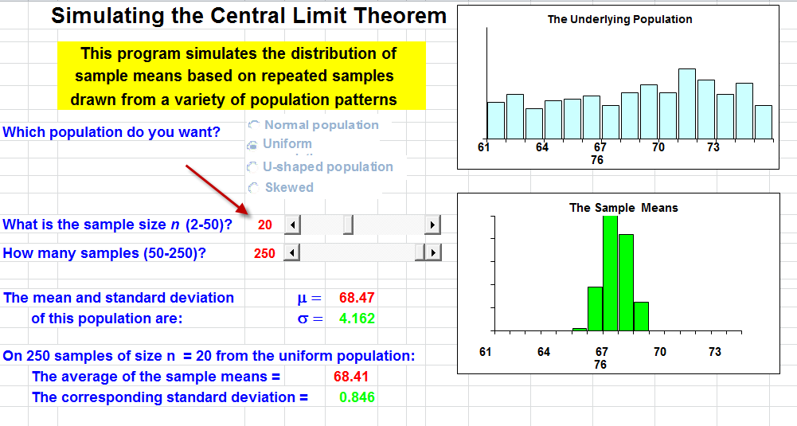
Sampling distribution from unifrom

Slide 9
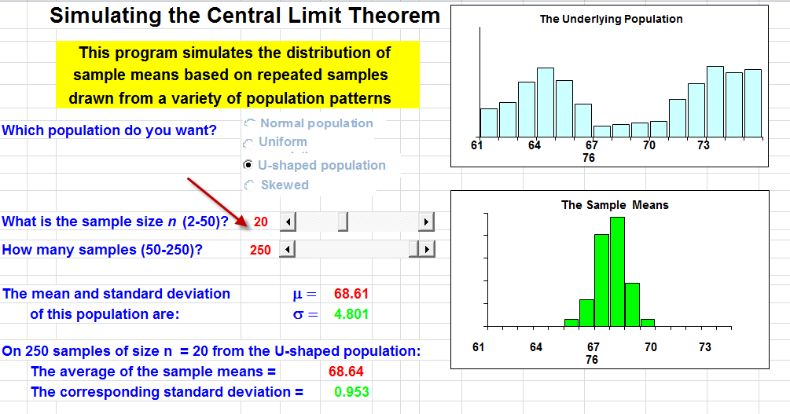
Sampling distribution from camel back

Slide 10
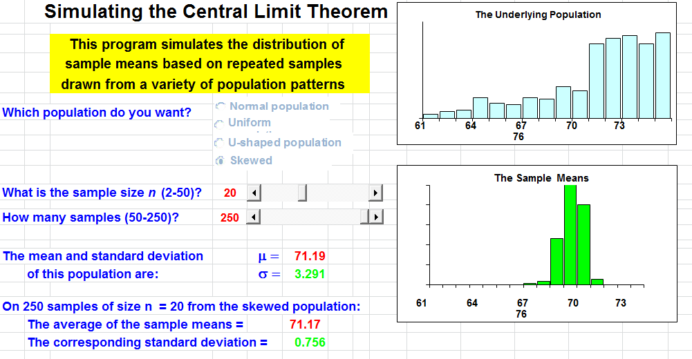
Sampling distribution from skew

Slide 11
Why resampling?
Common criticisms of any research study
  The sample size is too small (Many dissertations end with a sentence like this: In the future more studies with a larger sample size is needed.)
  The data are not normally distributed and do not conform to the parametric assumptions.
  This is one study only. It can be capitalized on chance. You may not be able to replicate the finding next time.
  The n is too large. The test is over-powered.
Resampling can help.

Slide 12

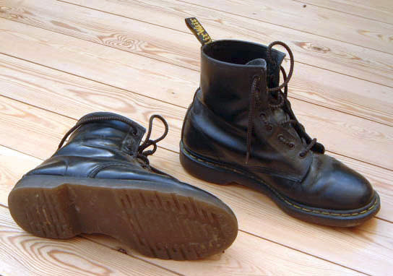
4 types of resampling
Randomization exact test: Permutate different possibilities
Cross-validation: divide one sample into 2 or more subsets.
Jackknife: leave one out
Bootstrap: one sample gives rise to many others by resampling (pulling yourself up by your own bootstrap)

Slide 13

Exact test
R, A, Fisher met a lady who insisted that her tongue was senstive enough to detect a subtle difference between a cup of tea with the milk being poured first and a cup of tea with the milk being added later.
He tested the lady with eight cups of tea. She was right 6 out of eight trials!

Slide 14
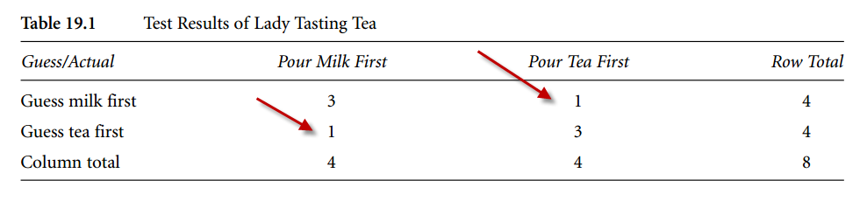
Exact test
With eight observations only, you cannot do a Pearson's chi-square test (some cell count is as low as one).
What can Fisher do?

Slide 15
Exact test
In classical tests we compare the sample statistics against the theoretical sampling distribution.
The p value tells you how rare the sample statistics is in the long run (sampling distributions).
Fisher permuted all possible scenarios to create an empirical sampling distribution.
Compare the observed data to the empircal distribution.

Slide 16
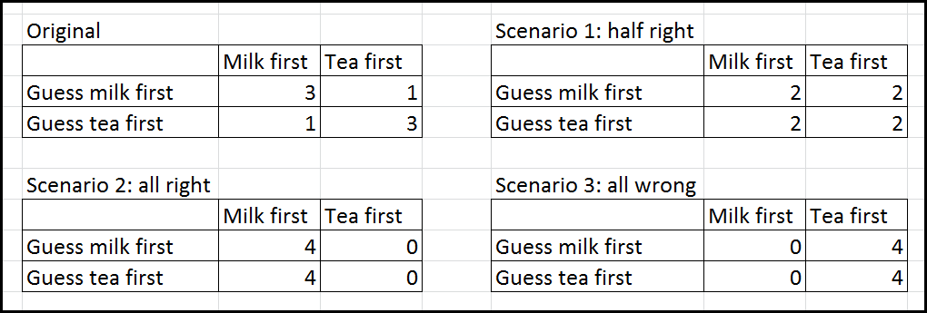
Exact test
Exact test is so named because in classical parametric tests you can obtain the approimate p value.
In Exact test you can know exactly how often or how rare the event can happen given all possible scenarios.

Slide 17
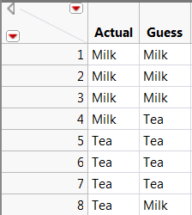
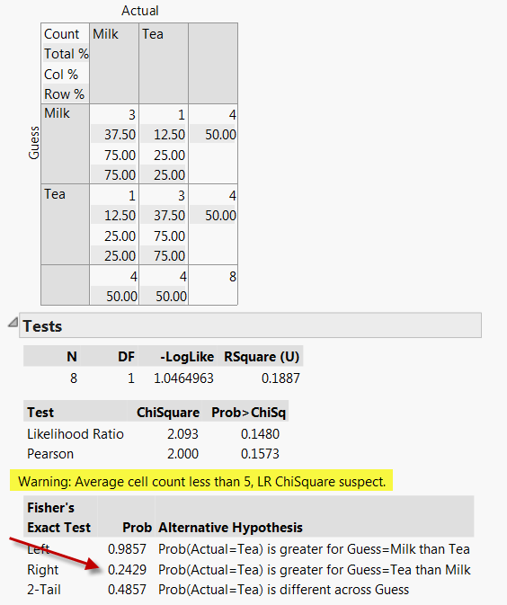
Exact test in JMP

Slide 18
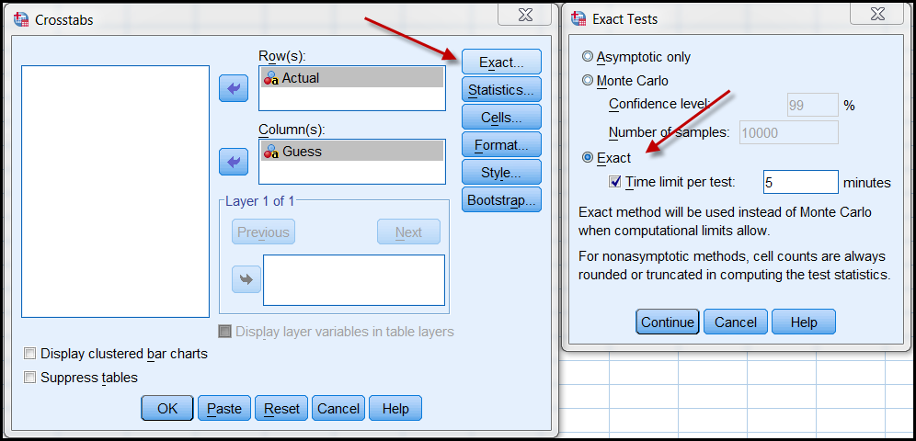
Exact test in SPSS
(full version only)

Slide 19
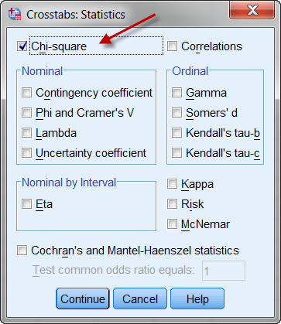
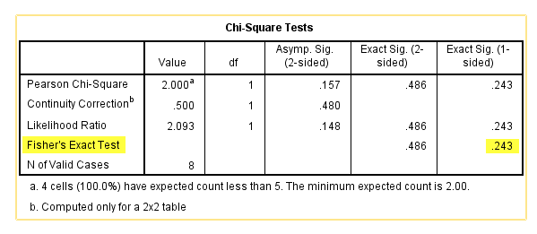
Exact test in SPSS
(full version only)

Slide 20
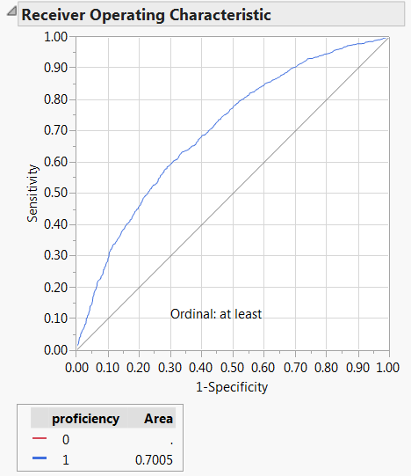
Cross-validation
Many conventional tests tend to overfit the model to a single sample.
How can you know the result can be replicated in another study?

Slide 21
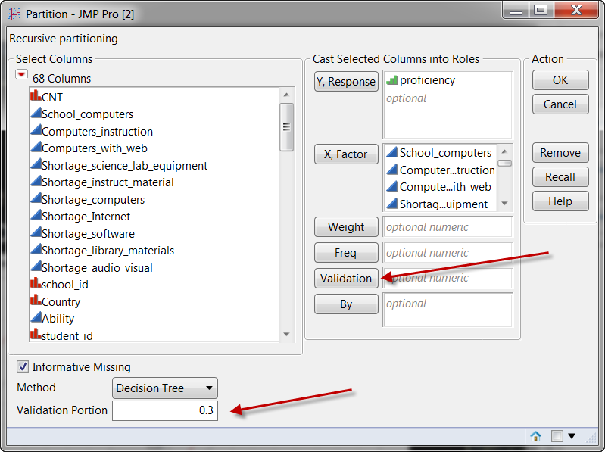
Cross-validation
You can hold back a portion of your data for cross-validation.
If you let the program randomly divide your data, you cannot get the same result next time.
If you assign a group number (validation ID) to the observations, you have the same subsets to recreate the same result.

Slide 22
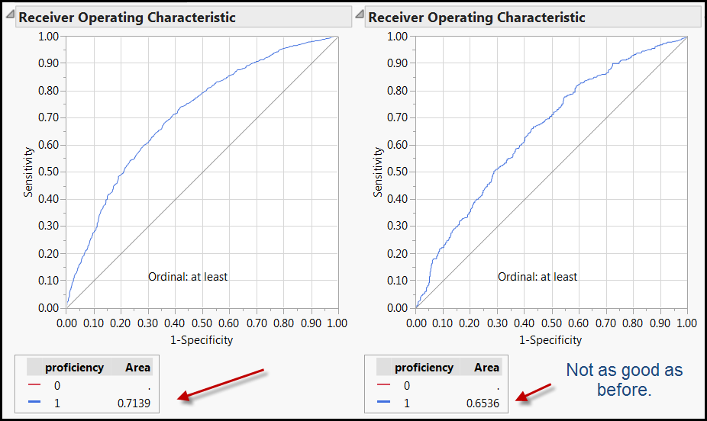
Cross-validation
Divide the sample into two or n subsets. Revise the proposed model derived from the first set by fitting the model into the subsequent set.

Slide 23

Too much power can hurt you!

Slide 24
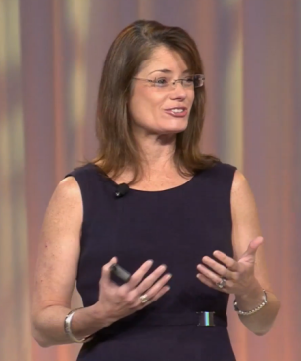
“Tell someone to do a t-test with a billion subjects!”
In California the average SAT score is 2000. A superintendent wanted to know whether the mean score of his students is significantly behind the state average. After randomly sampling 50 students, he found that the average SAT score of his students is 1999 and the standard deviation is 100. A one-sample t-test yielded a non-significant result (p = .8419).
http://www.graphpad.com/quickcalcs/OneSampleT1.cfm?Format=SD

Slide 25
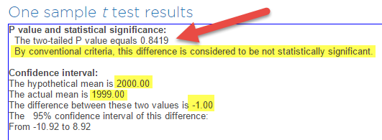
How about doing a t-test with
2,000 subjects”
The superintendent was relaxed and said, “We are only one point out of 2,000 behind the state standard. Even if no statistical test was conducted, I can tell that this score difference is not a big deal.”

Slide 26
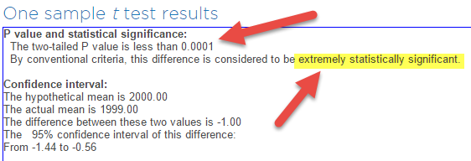
“Doing a t-test with a billion n”
But a statistician is bored and wants to find something to do. He recommended replicating the study with a sample size of 1,000. As the sample size increased, the variance decreased. While the mean remained the same (1999), the SD dropped to 10. But this time the t-test showed a much smaller p value (.0001) and needless to say, this “performance gap” was considered to be statistically significant.

Slide 27
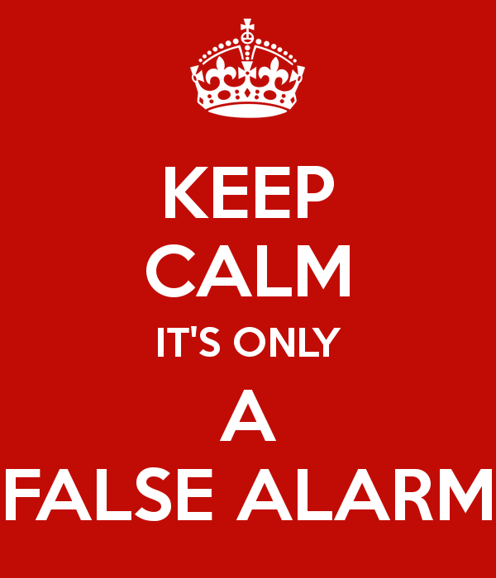
“Doing a t-test with a billion n”
Afterwards, the board called for a meeting and the superintendent could not sleep. Someone should tell the superintendent that the p value is a function of the sample size and this so-called "performance gap" may be nothing more than a false alarm.

Slide 28
Cross-validation
If you have a huge sample size (e.g. 2000), you can easily reject the null hypothesis. Any trivial effect may be mis-identified as significant.
If you divide your large sample into 10 subsets for CV, then each subset contains 200 subjects only. No test is over-powered.
But if n = 50, then sub-dividing them may not be practical.

Slide 29
Jackknife
Co-invented by John Tukey, the Father of EDA.
Jackknife: all-purpose tool.
Leave out one observation at each analysis.
Re-do the analysis n-1 times. Why?
  To see how extreme cases and outliers influence the result (senstivity analysis)
  To counteract the issue of non-independent data.

Slide 30
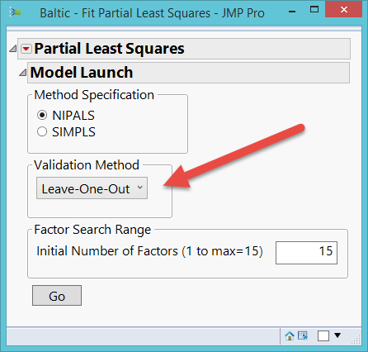
When to use Jackknife
Jackknife is available in many JMP procedures.
If the sample size is very huge, your CPU may burn.
e.g. 10,000 – 1 = re-running the test 9,999 times!
Use JF with a smaller sample.
Leave-one-out assumes every observation is treated equally (100%).

Slide 31
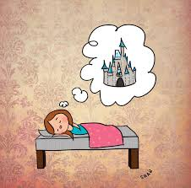

Jackknife
The good old day of using simple random sampling is gone!
In recent years more and more researchers employ multi-stage sampling for complex populations. Now we have nested/multi-level/hierarchical data.
The parametric assumption that observations are uncorrelated can be met in your dream only.

Slide 32
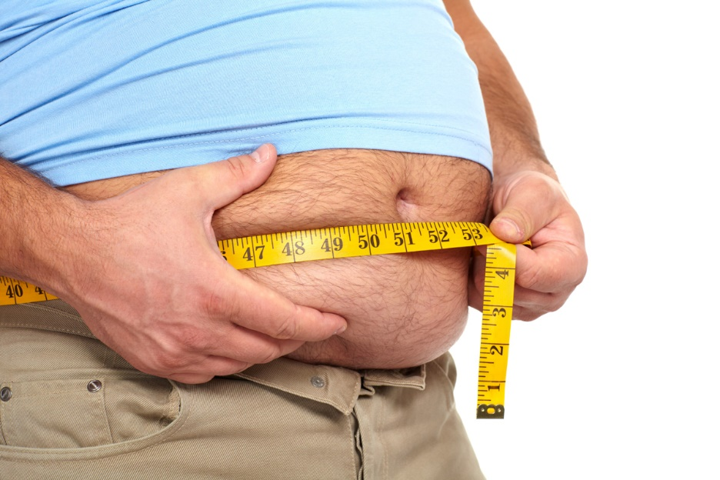
Jackknife
To counter this problem, I need to work on my weight!
Not this one. That’s Sampling weight!
A US researcher would like to obtain a representative sample across the entire nation. What shoud she do?

Slide 33
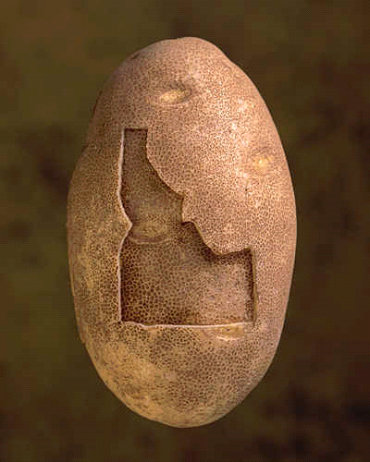
Jackknife
If she blindly believes that simple random sampling treats every American equally, and takes the entire US population as a single sampling space, it is more likely that many people from larger states, such as California, Texas, and New York, will be sampled. But residents in Idaho and Wyoming might never appear on her radar screen.

Slide 34
Jackknife
To rectify this situation, she might start with randomly selecting several states out of 50 (first stage).
Next, each state is divided into non-overlapping segments, and then certain counties in the chosen states are randomly drawn (second stage).
In the last stage, subjects are randomly chosen from each county.

Slide 35
Sampling weights
Sometimes it is necessary to oversample certain smaller subsets. For instance, the researcher may include 10% Rhode Islanders (105,130) but only 1% Californians (376,919) into her sample.
In this case, a sampling weight is required to compensate for the over- or under-sampling segments of the population. If the sampling scheme entails a multi-stage design, then there will be several sampling weights.

Slide 36
TIMSS
Trends for International Mathematics and Science Study (TIMSS) adopted a multi-stage sampling scheme.
In the first stage, schools are sampled with probability proportional to size.
Next, one or more intact classes of students from the target grades were drawn at the second stage.
Because of its large population size, the Russian Federation added an additional stratum: regions. Singapore also had a third sampling stage, from which students were sampled within classes.

Slide 37
Too abstract? Example:
School weight: The school weight is computed by the inverse of the probability of a school being selected from the region.
For example, if there are 10 schools in the region and 2 were selected, then the weight is 1/(2/10) or 10/2 = 5.
In other words, each school in this region represents itself and four other schools.

Slide 38
Example
Student weight: The student weight is computed by the inverse of the probability of a student being sampled from the school.
For example, if there are 100 students in the school and 10 participated in the survey study, then the student weight is 1/(10/100) or 100/10 = 10. In other words, each student in this school speaks for himself and other nine students.

Slide 39
Example
Raw sampling weight: The overall raw sampling weight is computed by multiplying the school weight and the student weight.
Because the weighed frequency is much bigger than the original frequency, it is counter-intuitive and is difficult to interpret.

Slide 40
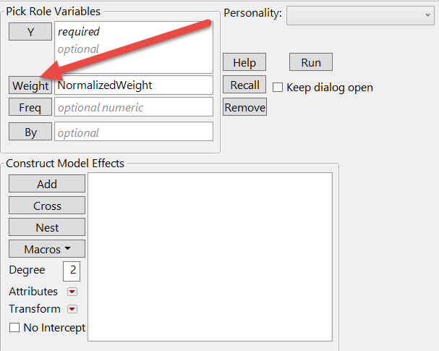
Example
Normalized sampling weight: To rectify the preceding situation, the raw sampling weights were converted into normalized sampling weights by dividing the raw weights by the mean of the raw weights.

Slide 41
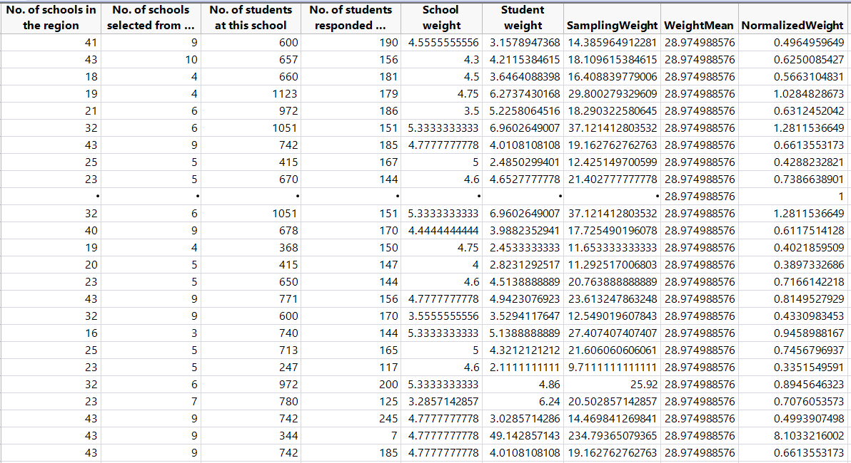
Example

Slide 42
Refresh your memory
Ordinary Least Squares (OLS) regression models are valid if and only if the residuals are normally distributed, independent, with a mean of zero and a constant variance.
However, when data are collected using a complex sampling method, in which the data of one level are nested within another level (i.e. students are nested within grade levels), and thus it is unlikely that the residuals are independent of each other.

Slide 43
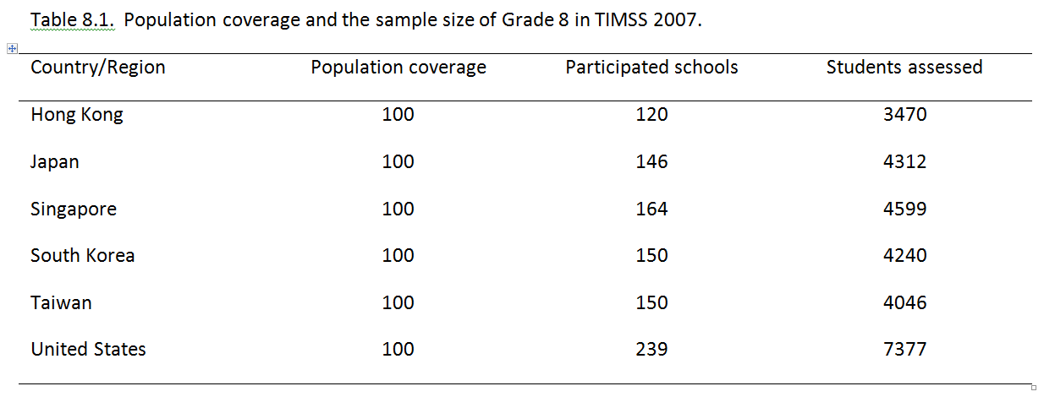
Problem of multi-level sample
We can estimate the population standard deviation by using the sample SD if simple random sampling is used, but it cannot work for multi-stage sampling.
Look at the difference between the sample sizes of Singapore and USA. USA is much bigger than Singapore.

Slide 44
Jackknife
You can use HLM (mixed modeling) or Jackknife.
HLM still plays by the rules of parametric tests (e.g. hierarchical regression to estimate the slope for each group).
Jackknife regression can estimate the regression coefficient without making any distributional assumption (Good bye! Parametric!). The errors and bias can be suppressed by re-analysis.

Slide 45
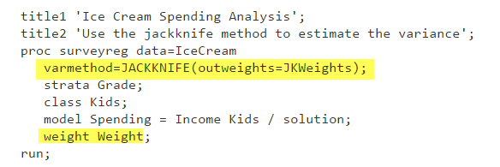
SAS example
Don’t worry about what it means now.

Slide 46
Assignment 8.1
Download the dataset “sampling_weight_exercise” from Unit 8 folder.
Populate the columns from “school weight” to “Normalized weight.”
Upload the file to Sakai.

Slide 47
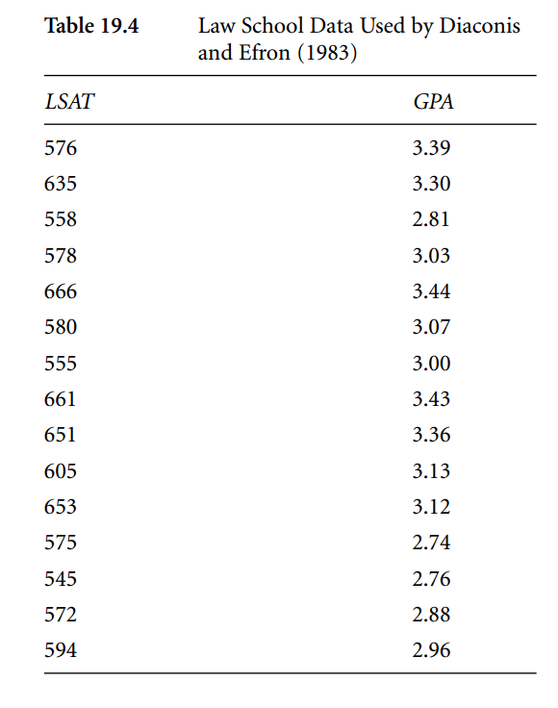
Bootstrap
The idea of bootstrapping originated from Bradley Efron (1979, 1981) and further developed by Efron and Tibshirani (1993).
"Bootstrap" means that one available sample gives rise to many others by resampling (a concept reminiscent of pulling yourself up by your own bootstrap).

Slide 48
Bootstrap
LSAT data: What can you do with 15 observations?
The Pearson' r of the original data set is .776.
Diaconis and Efron duplicated the data set 1 billion times. 15 → 15 billions.
Treated the new data set as the proxy or virtual population.

Slide 49
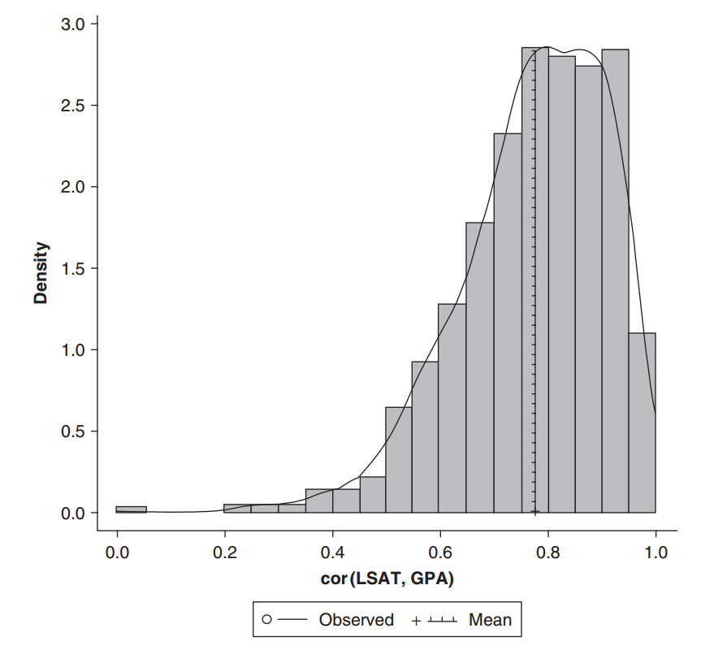
Bootstrap
Draw 1000 random samples from the virtual population (with replacement).
In each draw compute the Pearson's r.
Sometime the r is big, sometimes it is small. You have a sampling distribution, but it is not necessarily normal.

Slide 50
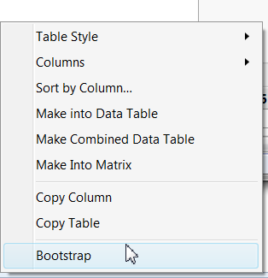
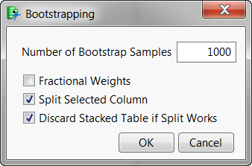
Bootstrap in JMP
Run a regular Pearson's r using multivariate methods.
Go to pairwise correlation from the inversed red triangle.
Right click to select bootstrap

Slide 51
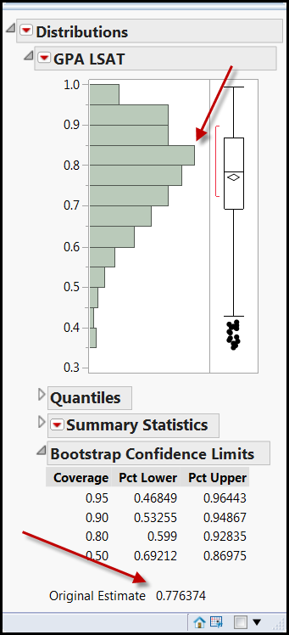
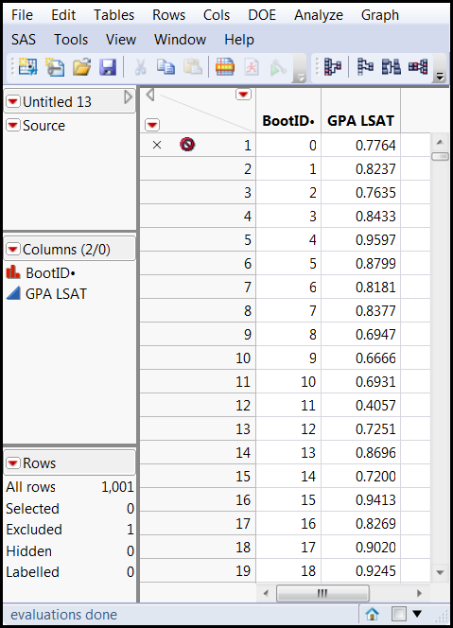
Bootstarp in JMP
The observed r is 0.77.
In the bootstarpped distribution of r, the most frequent recurring r is .8.
Very close!

Slide 52
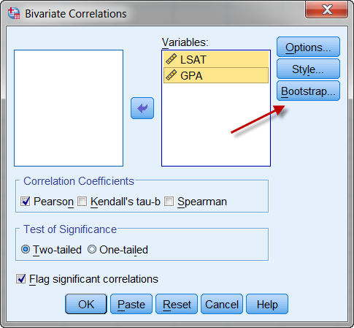
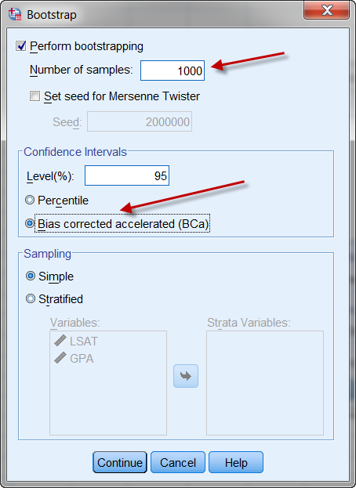
Bootstrap in SPSS
(Full version only)

Slide 53
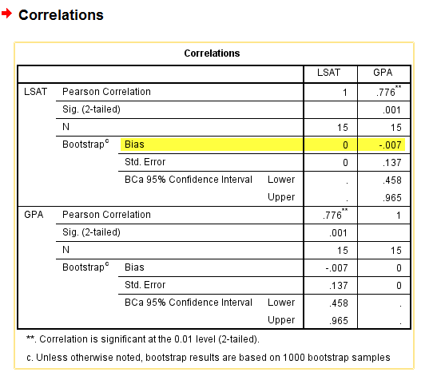
Bootstrap in SPSS
The bias is the distance between the observed and the resampled.
Very small (-0.007)

Slide 54
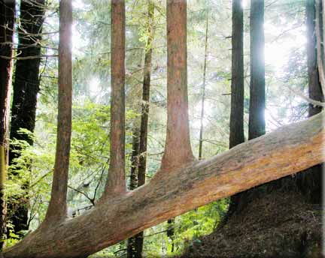
Utilmate bootstrap
The ultimate bootstrap weapen is the bootstarp forest, also known as the random forest.
It will be covered in the unit related to the decision tree.
You need to grow trees in order to make a forest.

Slide 55
Assignment 8.2
In SAS, JMP, and SPSS You can improve any conventional statistical result by bootstrapping.
Use the data set 'visualization_data' in the Unit 7 folder.
In JMP run an OLS regession. Use GPA and SAT to predict scores.
Right click on parameter estiamtes and do a bootstrap with 1000 samples.
Use Distributions to examine the resampled results.

