Slide 1
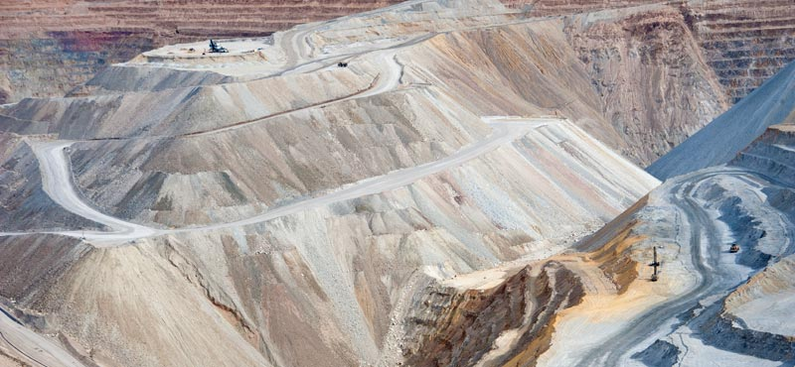
Data Mining (DM)
Chong Ho Yu

Slide 2
What is data mining?
Data mining (DM) is a cluster of techniques, including decision trees, artificial neural networks, and clustering, which has been employed in the field Business Intelligence (BI) for years.
DM inherits the spirit of exploratory data analysis (EDA) but there is a crucial difference: no learning in EDA.

Slide 3
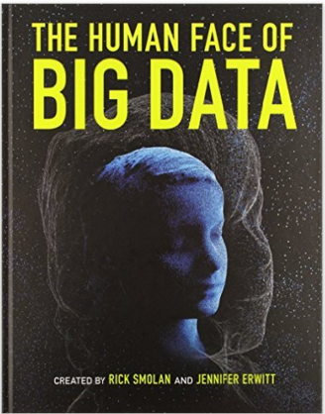
The era of Big data
Big data are everywhere now.
Everyday we create 2.5 quintillion bytes of data.
From sensors, social media, e-commerce, cell phones, GPS…etc.

Slide 4


The era of Big data
These are real data that reflect your actual psychological state and behavior.
Self-report data are not highly reliable.
If a survey item asks abut what my favorite movies are, I may not tell you the truth.
But my Netflix records will not lie!

Slide 5
Characteristics of data mining
Use large quantities of data: Big data analytics
Exploration and pattern recognition. Like EDA, it does not start with a strong hypothesis. The logic is P(H|D), not P(D|H).
Resampling (e.g. cross-validation, bootstraping)
Automated algorithms; machine learning

Slide 6
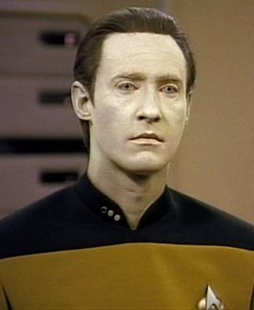
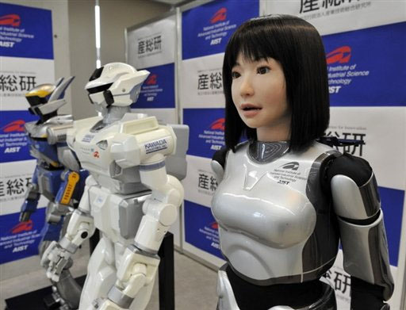
Machine learning
Data analysis can be more efficient and effective if a machine can learn (think).

Slide 7
Five schools of machine learning
Name | Origin | Approach
Symbolists | Logic, philosophy | Some form of deduction
Connectionists | Neuroscience | Networking, pathway
Evolutionists | Evolutionary biology | Genetic programming
Bayesians | Statistics | Probabilistic inference
Analogists | Psychology | Learn by examples

Slide 8
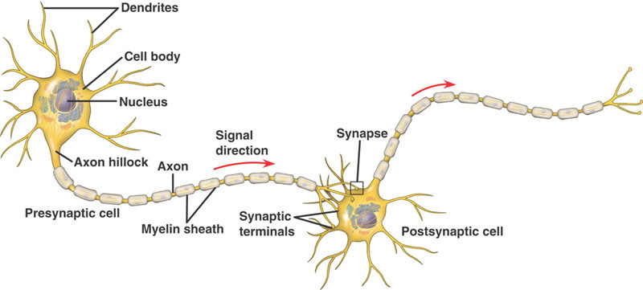
Neuropathway
Can a machine think like us if we can mimic the neuropathway?

Slide 9

Machine learning
Supervised: Train the algorithm by giving labelled training data (examples).
Unsupervised: try to find the hidden structure in unlabeled data (without examples).

Slide 10
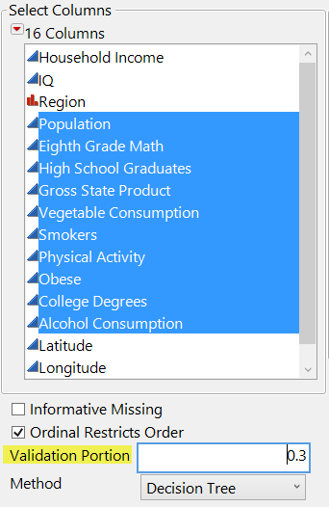
Machine learning
In resampling we can do cross-validation (CV).
CV is a form of supervised machine learning.
You can hold back a portion of your data (e.g. 30%).
The first subset is for training and the remaining is for validation.

Slide 11
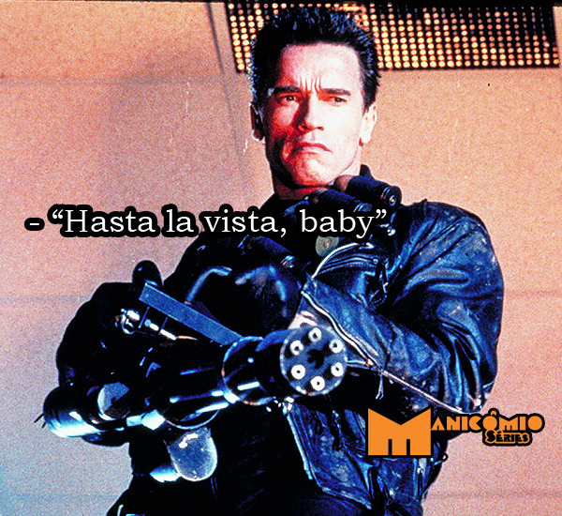
Advantages
Data mining can handle large data sets without the problem of excessive statistical power.
Non-parametric. Say “Hasta la vista, baby” to parametric assumptions.

Slide 12
Advantages
Can handle different data types (nominal, ordinal, continuous). If you use categorical data as IV in regression, you need dummy coding.
Immune to outliers.
Some can do data transformation for you.
Machine learning: avoid overfitting.
Replication (bootstrap forest)

Slide 13
Different types of data mining
Decision tree (classification tree, recursive partition tree)
Bootstrap forest (random forest)
Multivariate adaptive regression splines (MARS)
Support vector machine
Clustering
Artificial Neural Network (ANN)

Slide 14
Why not regression?
ANN is a good example of data mining: machine learning
In some cases ANN is better than conventional OLS regression.
OLS regression is linear; it imposes a simple structure on the data.
When you have collinear predictors, you need to “orthogonalize” the problematic variables.
Non-linear regression may overfit the data.

Slide 15
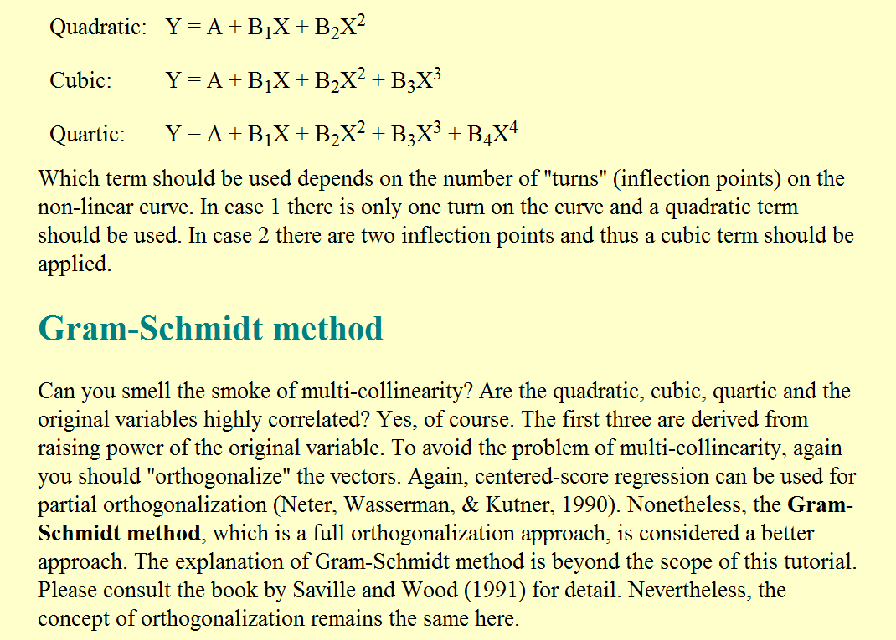

Slide 16
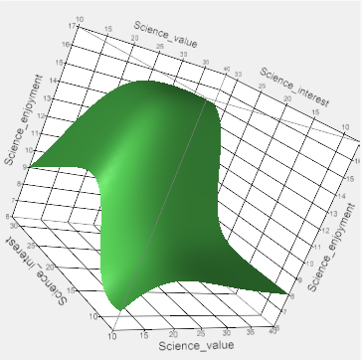
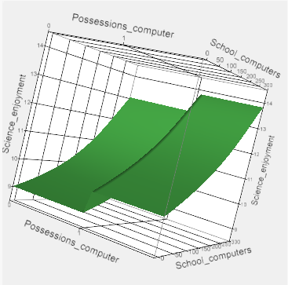
Artificial neural network: Stopping rule to prevent overfitting
It can work with different data types: nominal, ordinal, and continuous

Slide 17
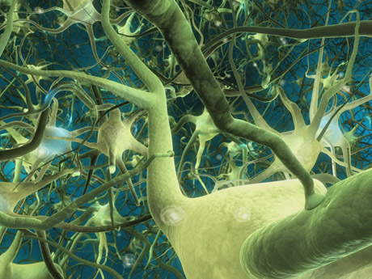
Neural networks, as the name implies, try to mimic interconnected neurons in the brain in order to make the algorithm capable of complex learning for extracting patterns and detecting trends.

Slide 18
It is built upon the premise that real world data structures are complex, and thus it necessitates complex learning systems.
Usually regression is “one-shot”; you cannot “train” a regression model. In other words, regression cannot “learn”.

Slide 19

A trained neural network can be viewed as an “expert” in the category of information it has been given to analyze. This expert system can provide projections given new solutions to a problem and answer "what if" questions.
Flexible models for regression and classification
Higher predictive power than regression and classification trees

Slide 20
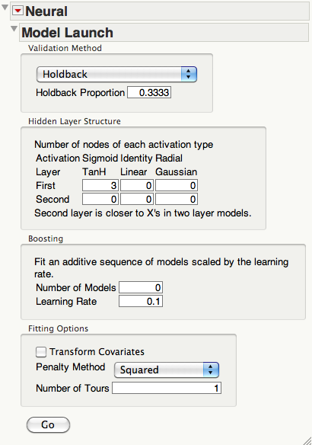
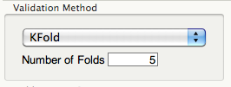
ANN in JMP
Artificial Neural Network in Education (ANNIE).
For CV you can hold back a certain portion of the data or choose K-fold.

Slide 21
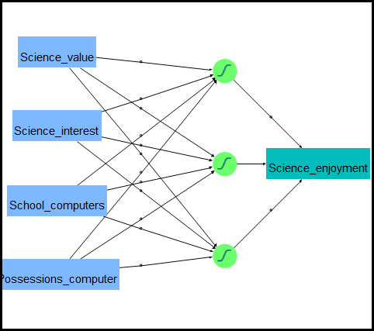
A typical neural network is composed of three types of layers
  input layer: data
  hidden layer: data transformation and manipulation
  output layer
Data transformation? We were there before!

Slide 22
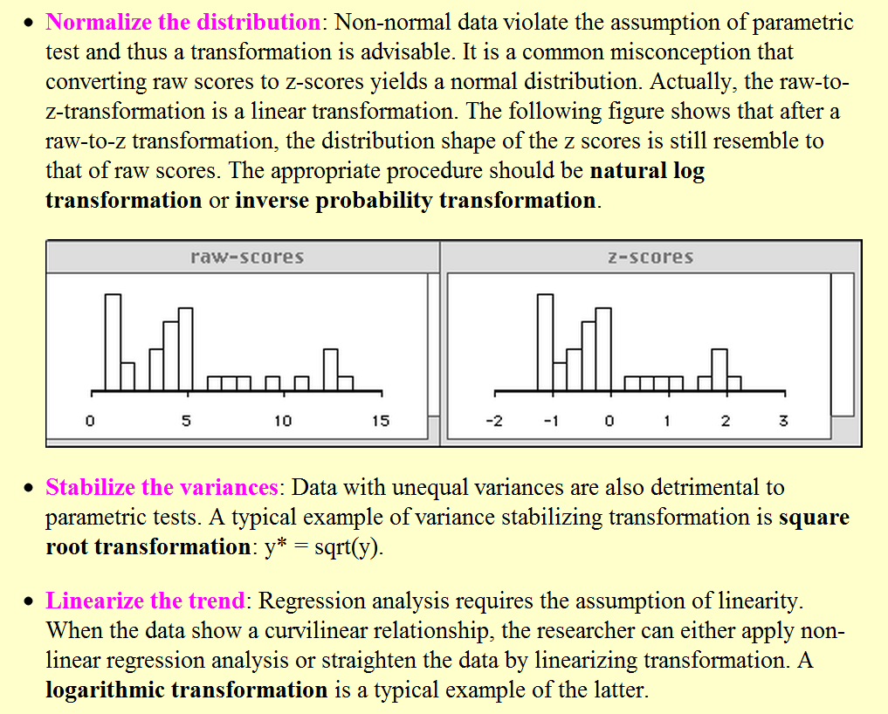

Slide 23
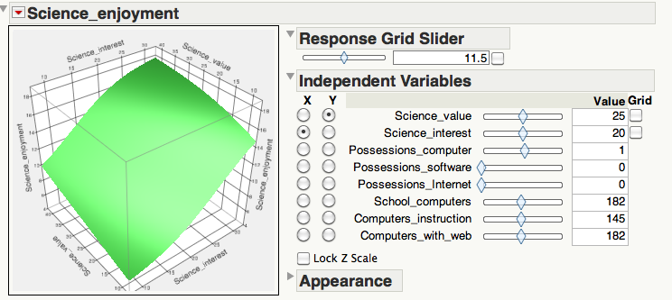
Contour profiler
You can explore the inter-relationships among many variables in a single panel.

Slide 24
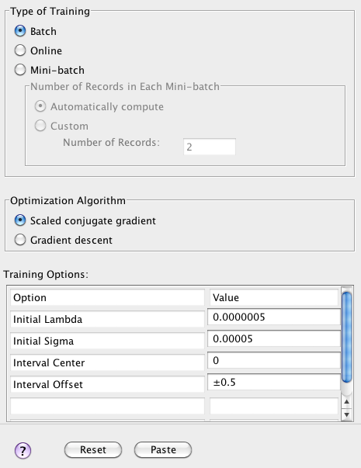
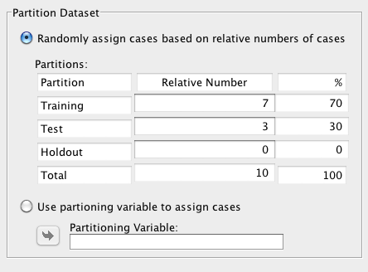
Neural networks in SPSS
You can partition your data for machine learning.

Slide 25
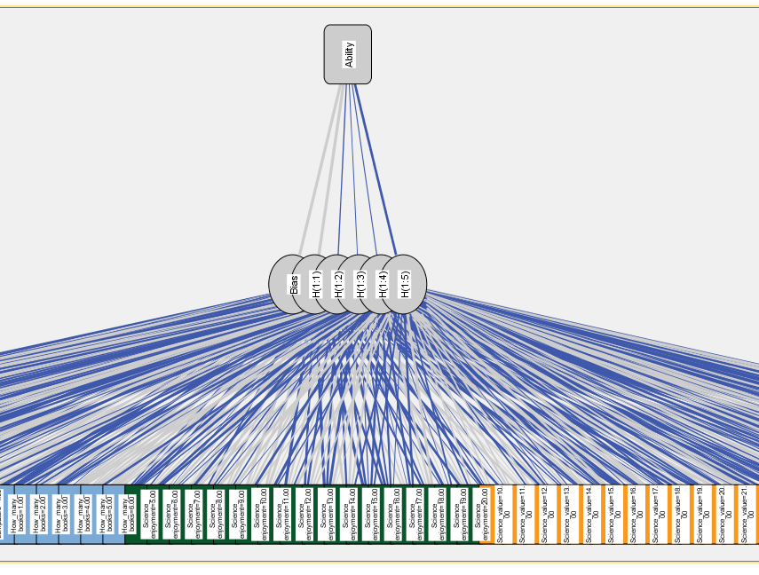
Neural networks in SPSS
Difficult to interpret

Slide 26
Drawbacks
There are three types of layers, not three layers, in the network. There may be more than one hidden layer and it depends on how complex the researcher wants the model to be.
Because the input and the output are mediated by the hidden layer, neural networks are commonly seen as a “black box.”
Harder to interpret and understand

Slide 27
Recommendations
Use it when predictive accuracy is the most important objective
When you need a non-linear fit but do not want over-fitting and want to avoid the tedious work of orthogonalization
When you have mixed data type, such as nominal, ordinal, and continuous, but want to avoid the laborious data transformation

Slide 28
Assignment
Download the data set ‘PISA_ANN.jmp’ from the Unit 9 folder.
Run a neural network.
Use ability as Y, use all science interest, science value, and science enjoyment as Xs.
Use Surface profiler to explore the relationships among ability, science interest, science value, and science enjoyment (It may be hard to see the back of the graph. Rotation is necessary).

