Slide 1

Decision Tree &
Bootstrap Forest
C. H. Alex Yu
Park Ranger of National Bootstrap Forest

Slide 2
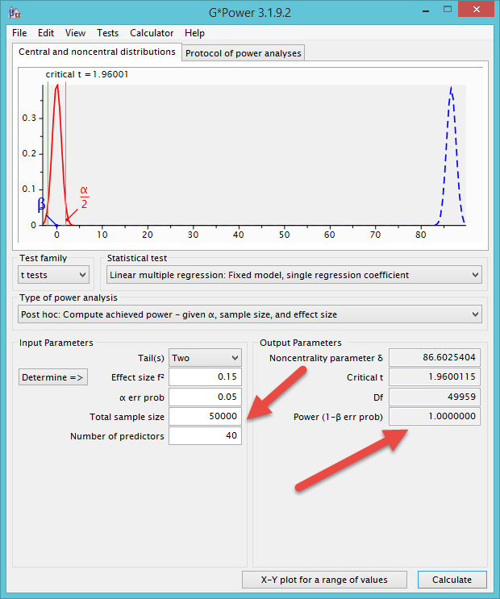
What not regression?
OLS regression is good for small-sample analysis.
If you have an extremely large sample (e.g. Archival data), the power level may aproach 1 (.99999, but it cannot be 1).
What is the problem?

Slide 3
What is decison tree?
We need to grow trees first in order to grow a forest.
Classification tree, recursive partition tree
Developed by Breiman et al. (1984)
Aim to find which independent variable(s) can make successively a decisive partition of the data with reference to the dependent variable.

Slide 4

We need a quick decision!
When heart attack patients are admitted to a hospital, physiological measures, including heart rate, blood pressure, and background information of the patient, such as personal medical history and family medical history, are usually obtained.
But can you afford any delay? Do you need to run 20 tests before doing anything?

Slide 5

We need a decision tree!
Breiman et al. developed a three-question decision tree.
  What is the patient's minimum systolic blood pressure over the initial 24-hour period?
  What is his/her age?
  Does he/she display sinus tachycardia?

Slide 6
Nested-if logic
If the patient's minimum systolic blood pressure over the initial 24 hour period is greater than 91, then
  if the patient's age is over 62.5 years,
    then if the patient displays sinus tachycardia, then and only then the patient is predicted not to survive for at least 30 days.

Slide 7
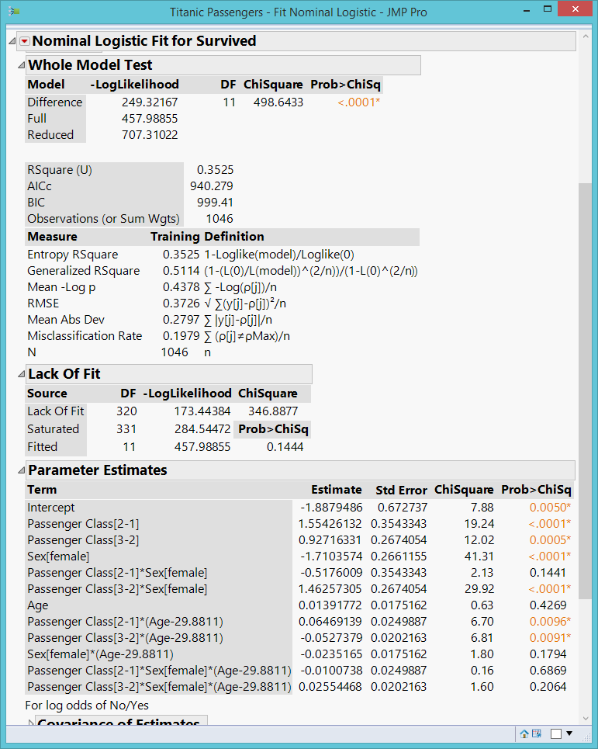

Titanic survivors
A night to remember!
After the disaster, people asked: What types of people tend to survive?

Slide 8
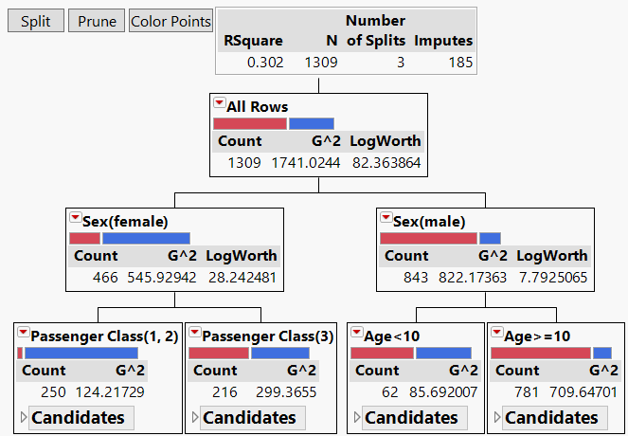
Decision tree

Slide 9
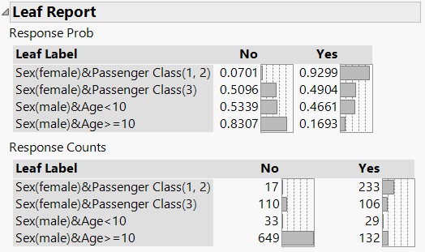
Leaf report:
Nested-if and interaction
If the passenger is a female and she has a first-class ticket, then the probability of survival is .9299 (sex X class interaction).
If the passenger is a male and he is not a young boy ( age > = 10), then his chance of survival is .1693 (sex and age interaction).

Slide 10


Leaf report:
Nested-if and interaction
How unfair! Prior research shows that women are more robust against hypothermia!

Slide 11
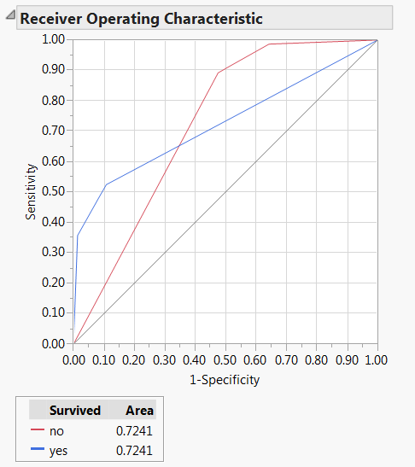
ROC curves and AUC
4 possible outcomes:
  true positive (TP)
  false positive (FP)
  false negative (FN)
  true negative (TN).
Sensitivity = TP/(TP+FN)
1 - Specificity = 1 - [TN/(FP+TN)]
No model = 50% chance

Slide 12
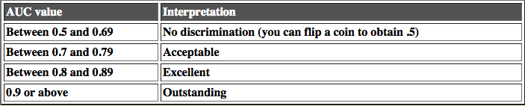
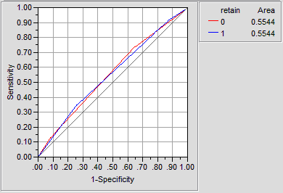
Criterion of judging ROC curves
The left is a coin-flipping model.
This cut-off is a suggestion only. Don't fall into the alpha < 0.05 reasoning.

Slide 13
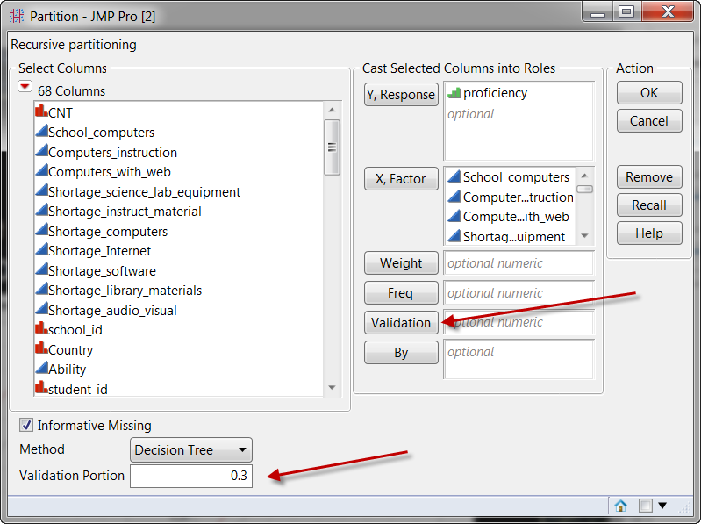
Cross-validation
You can hold back a portion of your data for cross-validation.
If you let the program randomly divide your data, you may not get the same result every time.
If you assign a group number (validation ID) to the observations, you have the same subsets every time.

Slide 14
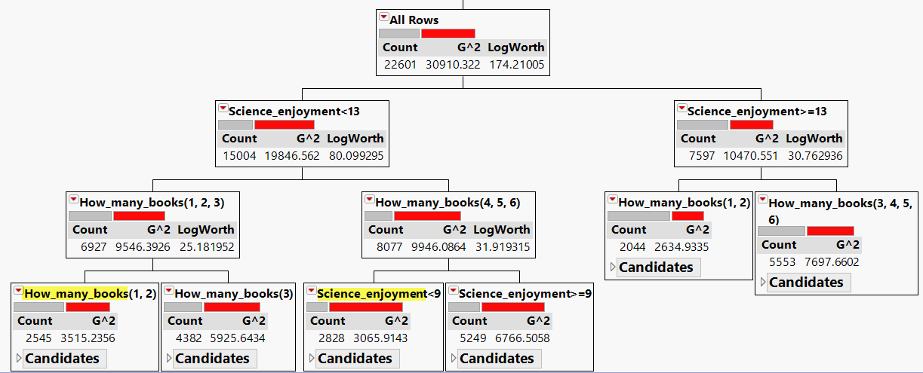
Example from PISA: Saturated
The same variable recurs.
It is saturated. You cannot add anything to make it better.

Slide 15
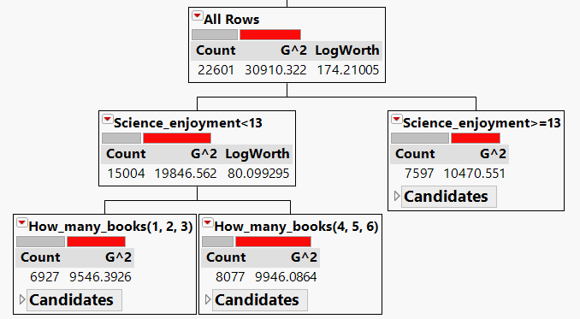
After pruning
A very simple model

Slide 16
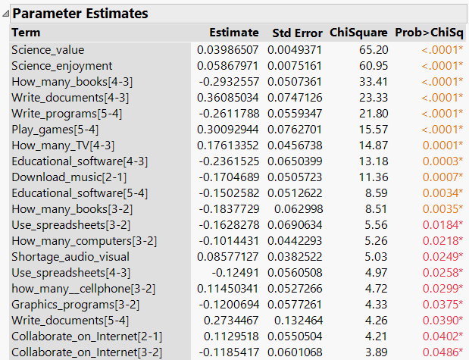
Compare DT with logistic regression

Slide 17
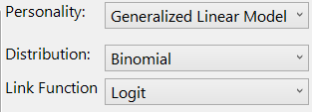

How about?
Stepwise regression: Take a long time
Generalized regression: Take forever. Go to high tea ay Hotel Hilton and come after

Slide 18
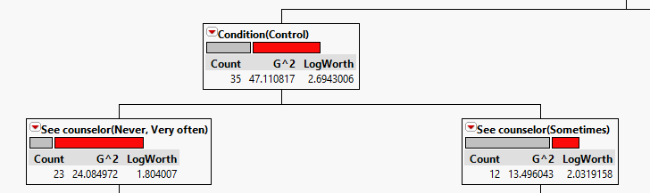
Non-linear relationship
Unlike regression that is confinded to linear modeling, the decision tree can detect non-linear relationship, e.g.
In a data set about relapse to drug use collected by Dr. Rachel Castaneda, it was found that participants who never or very often see a counselor tend to use drug.
Participants who sometimes see a counselor tend to be drug-free.

Slide 19
What is the decision criterion?
Splitting criterion: LogWorth
examines each independent variable to identify which one can decisively split the sample with reference to the dependent variable.
If the input is continuous (e.g. household income), every value of the variable could be a potential split point.
If the input is categorical (e.g. gender), then the average value of the outcome variable is taken for each level of the predictor variable.

Slide 20
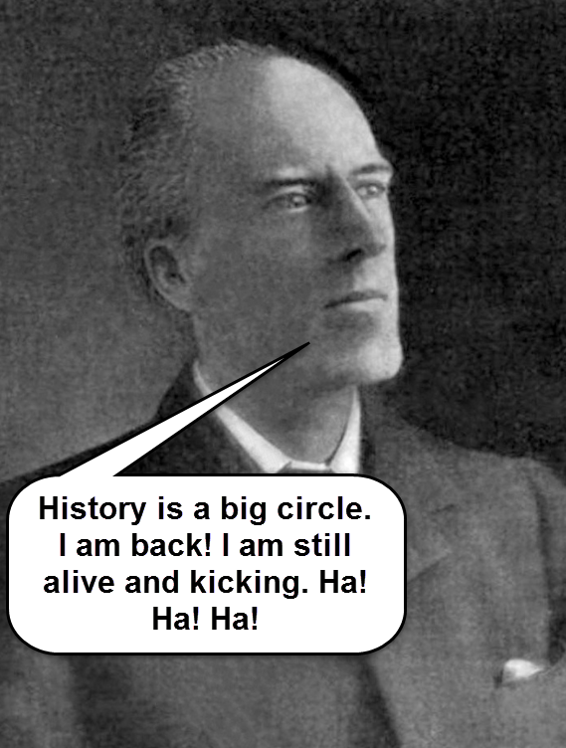
What is the decision criterion?
Afterwards, a 2x2 crosstab table is formed (e.g. [‘proficient’ or ‘not proficient’] x [‘male’ or ‘female’]).
Next, Pearson’s Chi-square is used for examining the association between 2 variables.
But the result of Chi-square is dependent on the sample size. When the sample size is extremely large, the p-value is close to 0 and virtually everything appears to be ‘significant.’

Slide 21
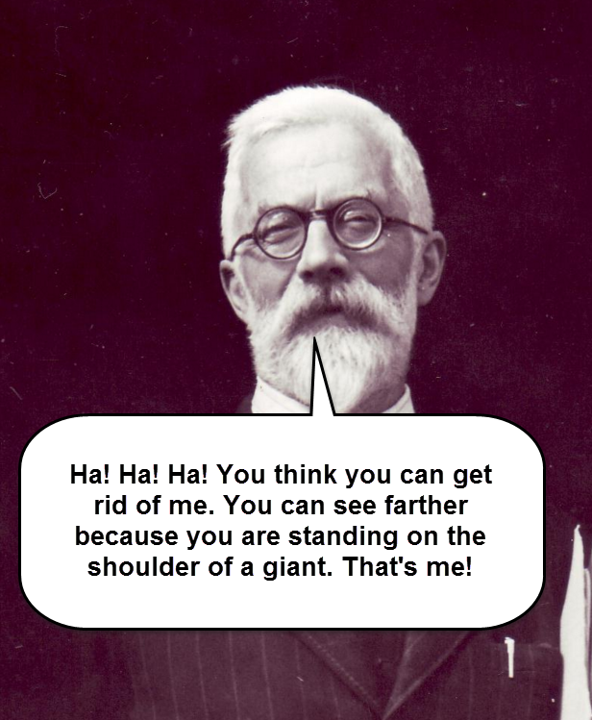
What is the decision criterion?
As a remedy, the quality of the split is reported by LogWorth, which is defined as –log10(p).
Because the LogWorth statistics is the inverse of the p value, a bigger LogWorth is considered better.
If the outcome variable is categorical, G^2 (the likelihood ratio of chi-square) is reported.
LogWorth was invented by R. A. Fisher!

Slide 22
Decision tree in SPSS
Chi-square automatic interaction detection (CHAID): Pick the predictor that has the strongest interaction with the DV.
Exhaustive CHAID: modification of CHAID that examines all possible splits for each predictor
Quick, unbiased, efficient statistical tree (QUEST): Fast and avoids bias.
Classification tree and regression (CRT): try to make each subgroup as homogeneous as possible.

Slide 23
Decision in SPSS
Shih (2004): when the Pearson chi-square statistic is used as the splitting criterion, in which the splits with the largest value is usually chosen to channel observations into corresponding subnodes, it may result in variable selection bias.
This problem is especially serious when the numbers of the available split points for each variable are different.
On many occasions CRT and JMP’s tree produce virtually the same results.

Slide 24
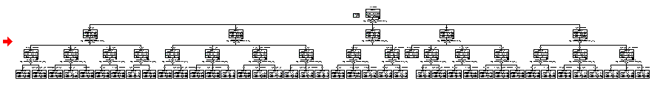
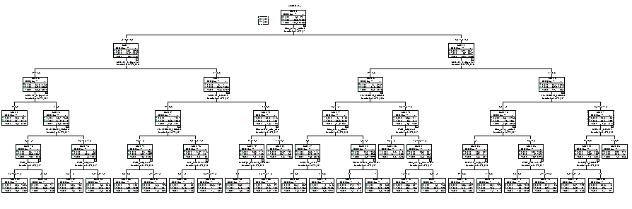
Decision in tree
It may be too complicated. But you cannot prune it.

Slide 25

Bootstrap forest
Bootstrap forest is built on the idea of bootstrapping.
Originally it is called random forest, and it is trademarked by the inventor Breiman (1928-2005).
RF pick random predictors & random subjects.
JMP calls it bootstrap forest (pick random subjects only)
TETRAD or path searching (pick random predictors)

Slide 26
Random forest
Breiman synthesized statistics and computer sciences.
The idea of random forest was published in the journal named “Machine learning.”
Unsupervised learning: fully data-driven.
In a single tree the data are partitioned based on MSE (MSW) at the most.
A single tree has another form of resampling feature: Cross-validation, but that is resampling without replacement.

Slide 27
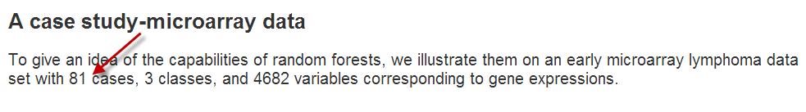
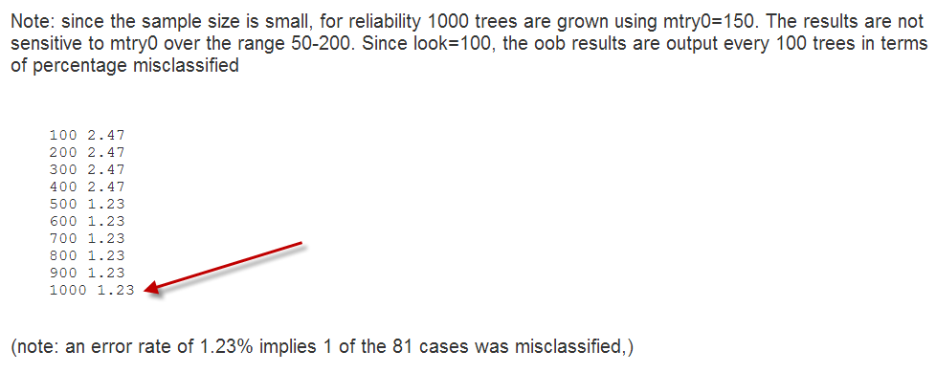
The power of random forest!

Slide 28
Exanple of PISA
Yu, C. H., Wu, S. F., & Mangan, C. (in press). Identifying crucial and malleable factors of successful science learning from the 2012 PISA. In Myint Swe Khine (Ed.), Science Education in East Asia: Pedagogical Innovations and Best Practices. New York, NY: Springer
What factors can predict PISA science test performance?
OECD collects data about student attitudes, family background, teacher qualification, school resources.
There are about 400 predictors. It is inappropriate to run a regression model.

Slide 29
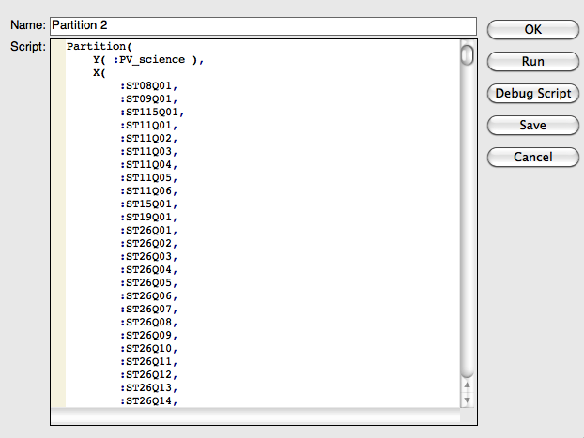
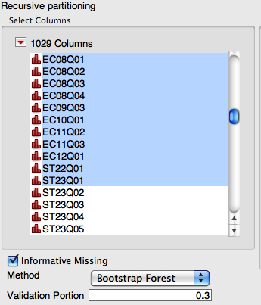
Bootstrap Forest in JMP Pro

Slide 30
Bootstrap forest in JMP
The bootstrap forest is an ensemble of many classification trees resulting from repeated sampling from the same data set (with replacement). Afterward, the results are combined to reach a converged conclusion.
While the validity of one single analysis may be questionable due to a small sample size, the bootstrap can validate the results based on many samples.

Slide 31
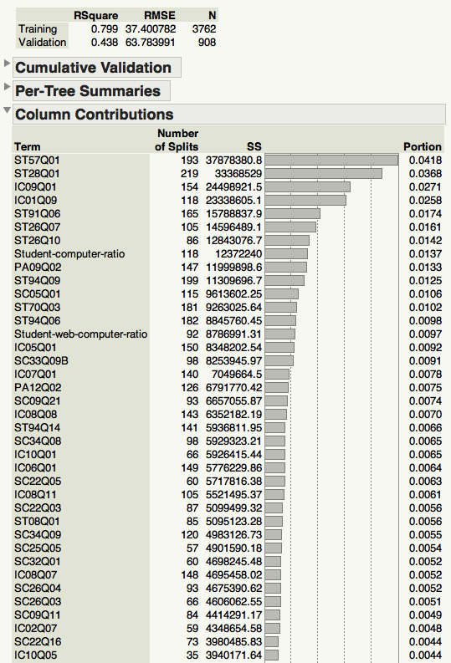
Column contributions
The importance of the predictors is ranked by both the number of split and the sum of squares statistics, and these results are presented in a table called column contributions.
The number of splits is simply a vote count: How often does this variable appear in all trees?

Slide 32
Committee decision
It is important to point out that the column contribution table lists all the important predictors shown in all trees, but it is not necessarily to accept all of them.
The committee of experts: Each tree is a judge that can vote. The final decision is based on the vote counts.
Common rule (suggestion ony):
  If the DV is binary (1/0, P/F) or multi-nominal, we use majority or plurality rule voting.
  If the DV is continuous, we use average predicted values.

Slide 33
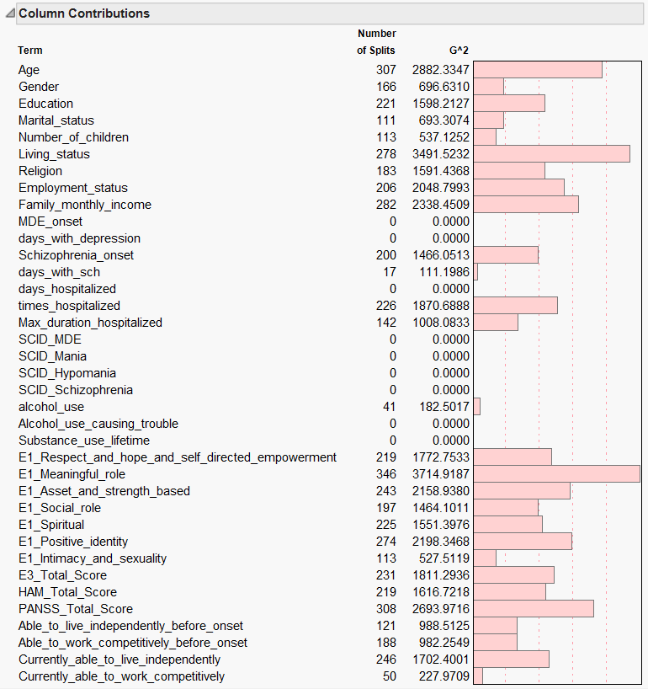
When the dependent variable is categorical, the splits are determined by G2, which is based on the LogWorth statistic.
LogWorth is similar to the likelihood ratio Chi-square statistic.
The observations are analyzed in a crosstab table and the fitness between the observed and the actual counts are compared. In other words, the fitted values are the estimated proportions within the groups.

Slide 34
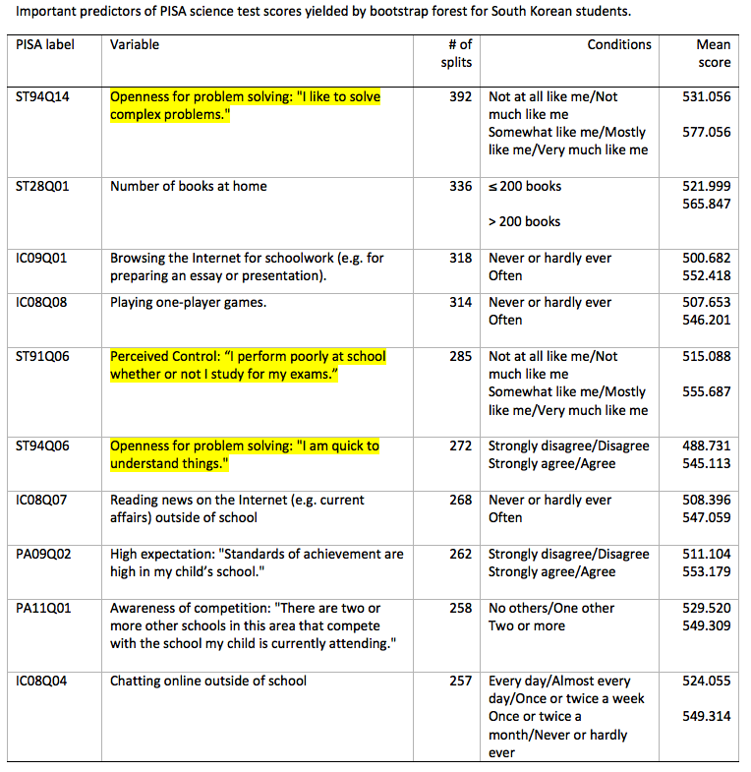

Slide 35
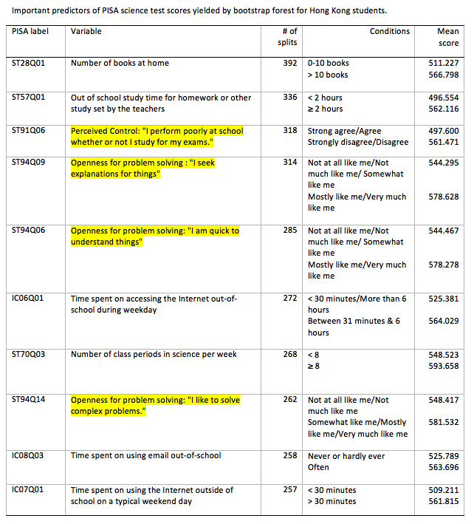

Slide 36
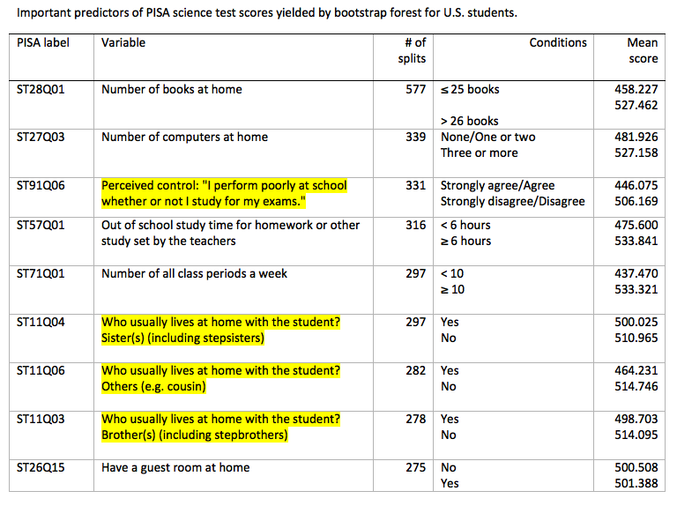
Findings of PISA study

Slide 37
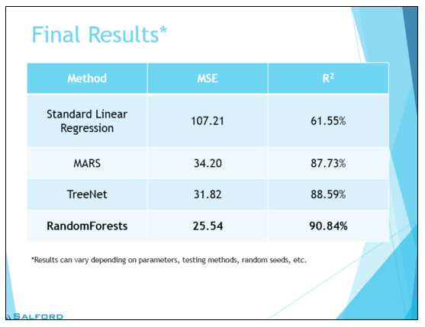
Much better than regression!
Salford systems (2015) compared several predictive modeling methods using an engineering data set.
It was found that OLS regression could explain 62% of the variance whereas the mean square error is 107! But in the random forest the R-square is 91% while the MSE is as low as 26%.

Slide 38

Recommended strategies
If the reviewer gives you harsh comments and demands more evidence, you can drop bootstrap forest on their head as the ultimate “nuclear weapon.” But if you use bootstrap forest the first time, then you have nothing more to do.
Decision tree (classification tree, recursive partition tree) has another form of resampling (cross-validation). Do not use bootstrap forest in the first paper submission. Usually CV is good enough for validation.

Slide 39

Recommended strategies
You can use two criteria (the number of splits and G2 or the number of splits and SS) to select variables if and only if the journal welcomes technical details (e.g. Journal of Data Science; Journal of Data Mining in Education...etc.)
If the journal does not like technical details, use the number of splits only. If the reviewers don't understand SS, Logworth, G2...etc., it is more likely that your paper will be rejected.

Slide 40
Assignment 10.1
Open the data set 'US demographics' from the JMP sample data library.
Use Household income as Y.
Use almost all others as the predictors, except region, gross state product, latitude, and longitude.
Use decision tree and hold back 30% of the data as validation portion.
What is the best predictive model?

Slide 41
Assignment 10.2
Download the data set 'PISA_ANN.jmp' from the Unit 9 folder.
Choose Analyze → Modeling → Partition
Put ability into Y and all others into X, except proficiency.
Run a bootstrap forest. Hold back 30% of the data as validation portion.
Number of trees: 100
Which predictors would you retain?

