Slide 1

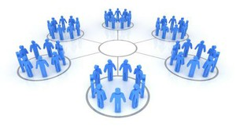
Cluster analysis
Chong Ho Yu

Slide 2
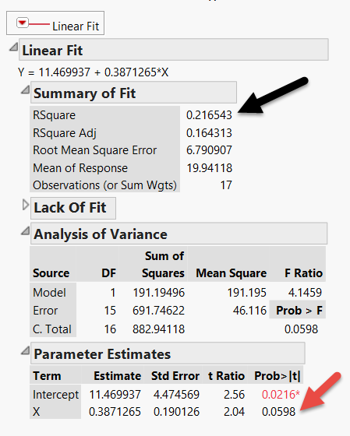
Why do we look at grouping (cluster) patterns?
This regression model yields 21% variance explained.
The p value is not significant (p=0.0598)
But remember we must look at (visualize) the data pattern rather than reporting the numbers

Slide 3
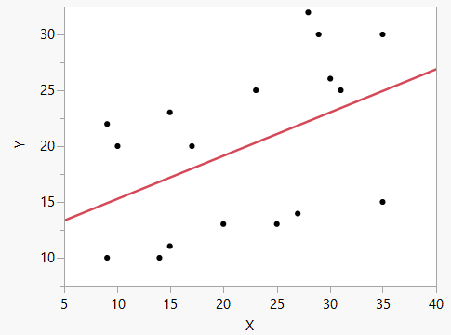
These are the data!

Slide 4
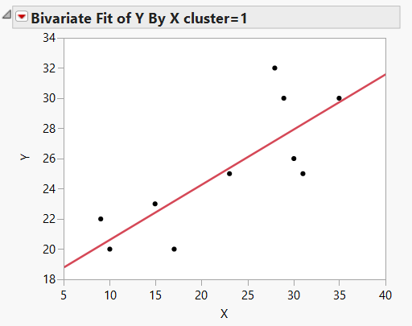
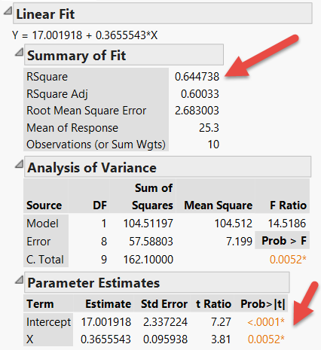
Regression by cluster

Slide 5
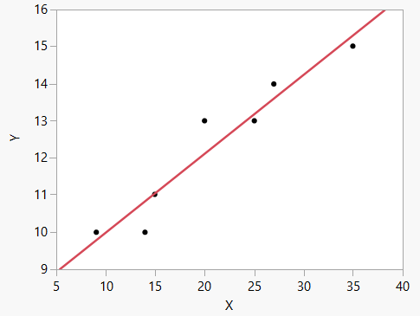
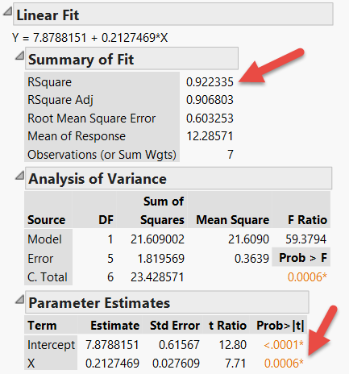
Regression by cluster

Slide 6

Netflix original
How is “House of cards” related to cluster analysis?

Slide 7
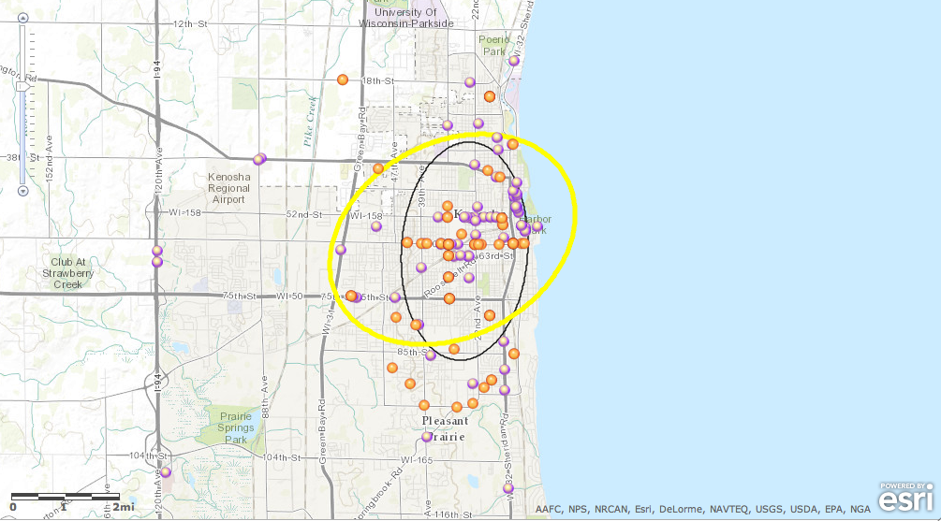
Crime hot spots
How can criminologists find the hot spots?

Slide 8
Data reduction
    Group variables into factors or components based on people’s response patterns
      PCA
      Factor analysis
    Group people into groups or clusters based on variable patterns
      Cluster analysis

Slide 9
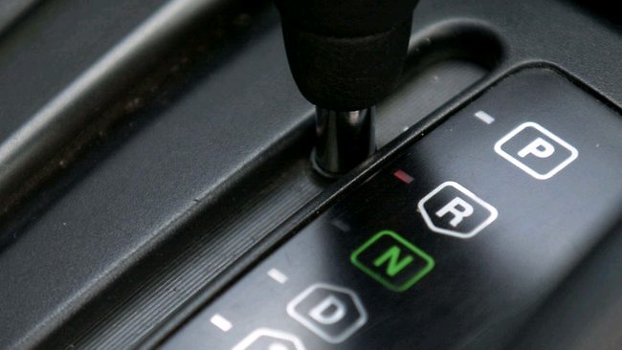
CA: ANOVA in reverse
In ANOVA participants are assigned into known groups.
In cluster analysis groups are created based on the attitudinal or behavioral patterns with reference to certain independent variables.

Slide 10
Discriminant analysis (DA)
There is a test procedure that is similar to cluster analysis: Discriminant analysis (DA)
But in DA both the number of groups (clusters) and their content are known. Based on the known information (examples), you assign the new or unknown observations into the existing groups.

Slide 11
Cluster analysis
Types:
  K-mean clustering (SAS, JMP, SPSS)
  Density-based clustering (SAS)
  Hierarchical clustering (SAS, JMP, SPSS)
  Two-step clustering (SPSS)
Warning: If there are too many missing data, no clustering algorithm can yield good results.

Slide 12
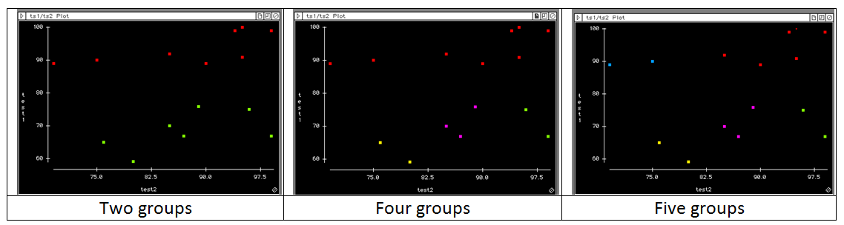
Eye-balling?
In a two-dimensional data set (X and Y only), you can “eye-ball” the graph to assign clusters. But it may be subjective.
When there are more than two dimensions, assigning by looking is almost impossible.

Slide 13
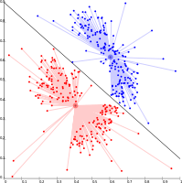
K-mean
Select K points as the initial centroids
Assign points to different centroids based upon proximity
Re-evaluate the centroid of each group
Repeat Step 2 and 3 until the best solution emerges (the centers are stable)

Slide 14
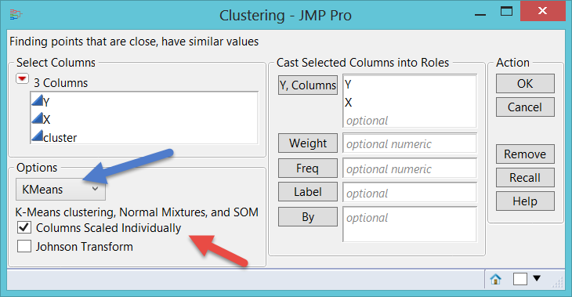
Sometimes it doesn’t make sense

Slide 15
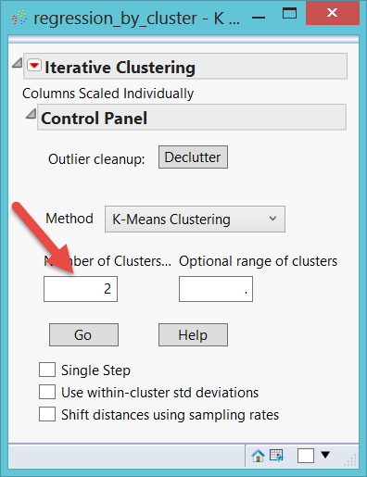
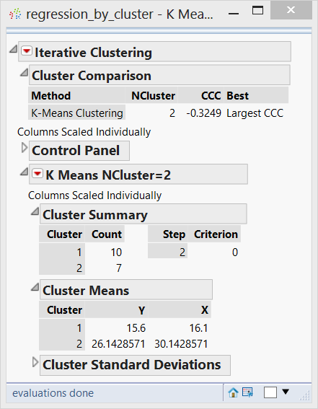

Slide 16
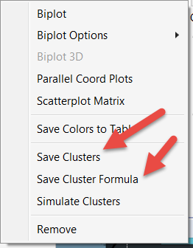
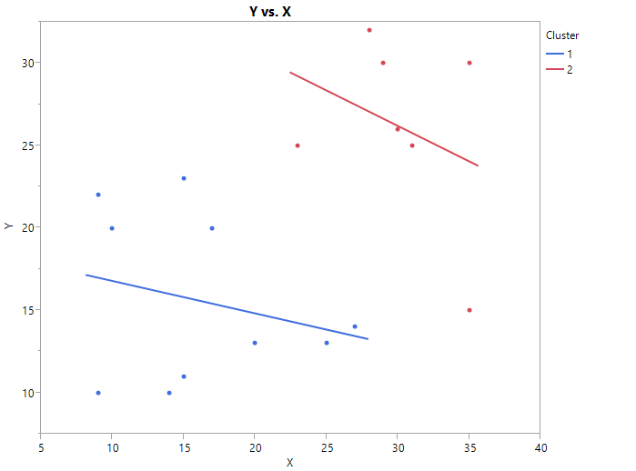
Do these 2 groups make sense?

Slide 17
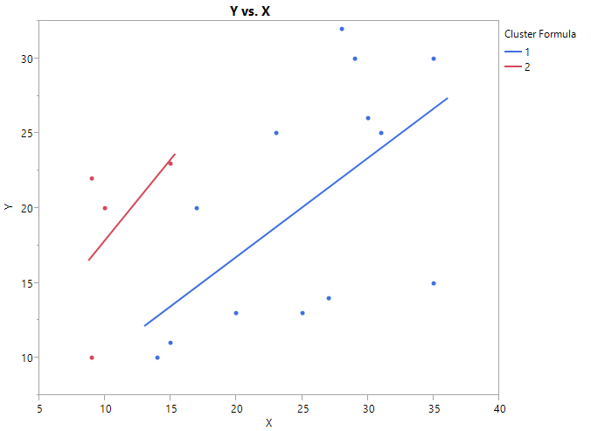
Neither does this make sense
Johnson-transform → Within-cluster SD

Slide 18
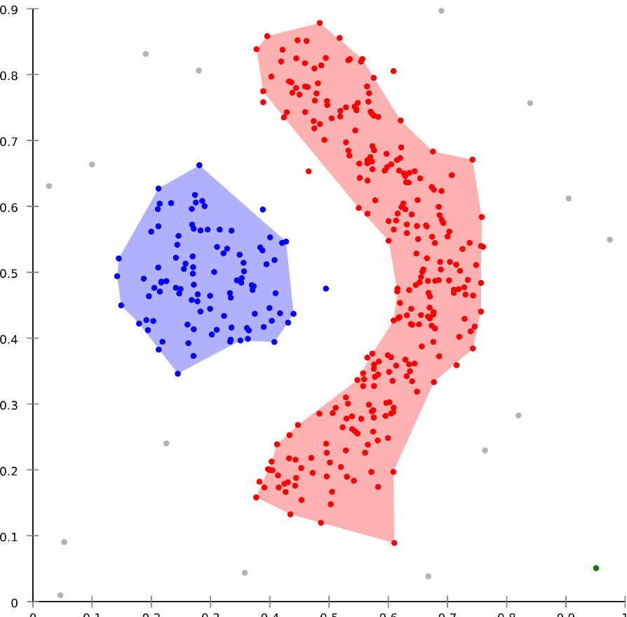
Density-based Spatial Clustering of Applications with Noise (DBSCAN)
Groups nearest neighbors together.
Available in SAS/Stat
Invented in 1996
In 2014 the algorithm won the Test of Time Award at Knowledge Discovery and Data Mining Conference.

Slide 19
Density-based Spatial Clustering of Applications with Noise (DBSCAN)
Unlike K-mean, it may not form an ellipse based on a centroid.
Could be a string-shaped cluster.
Outlier/noise excluded

Slide 20
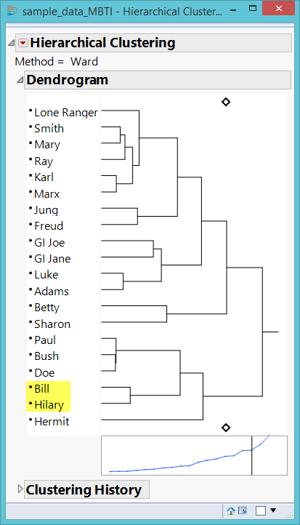
Hierarchical clustering
Grouping/matching people like what e-harmony and Christian-Mingle do.
Who is the best match?
Who is the second best? The third…etc.

Slide 21
Hierarchical clustering
Top-down or Divisive: start with one group and then partition the data step by step according to the matrices
Bottom-up or Agglomerative: start with one single piece of datum and then merge it with others to form larger groups

Slide 22
Example: Clustering recovering mental patients
What are the relationships between subjective and objective measures of mental illness recovery?
What are the profiles of those recovered people in terms of their demographic and clinical attributes based on different configurations of the subjective and objective measures of recovery?

Slide 23
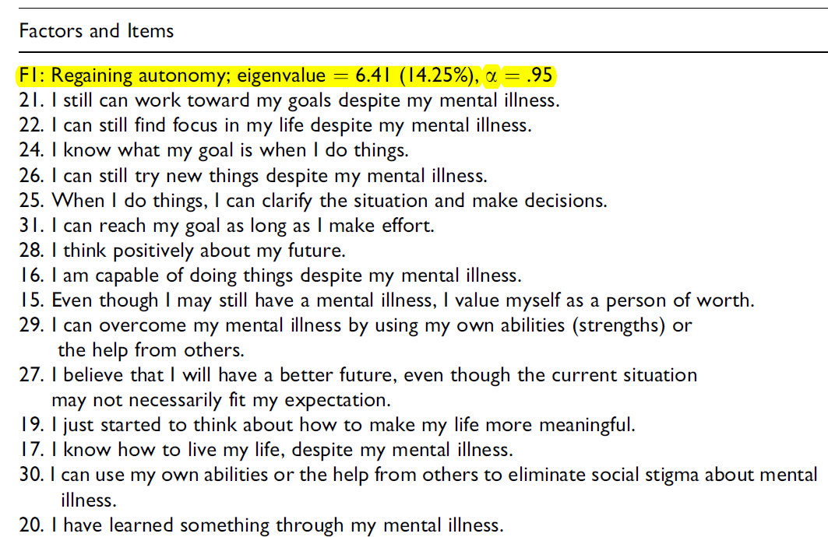
Subjective recovery scale (E2 Stage model)

Slide 24
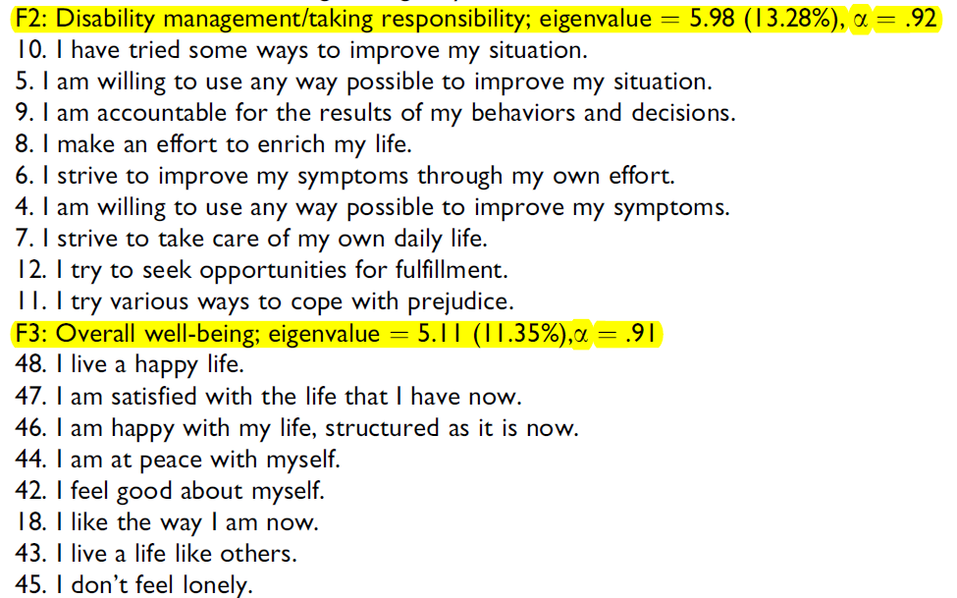
Subjective recovery scale

Slide 25
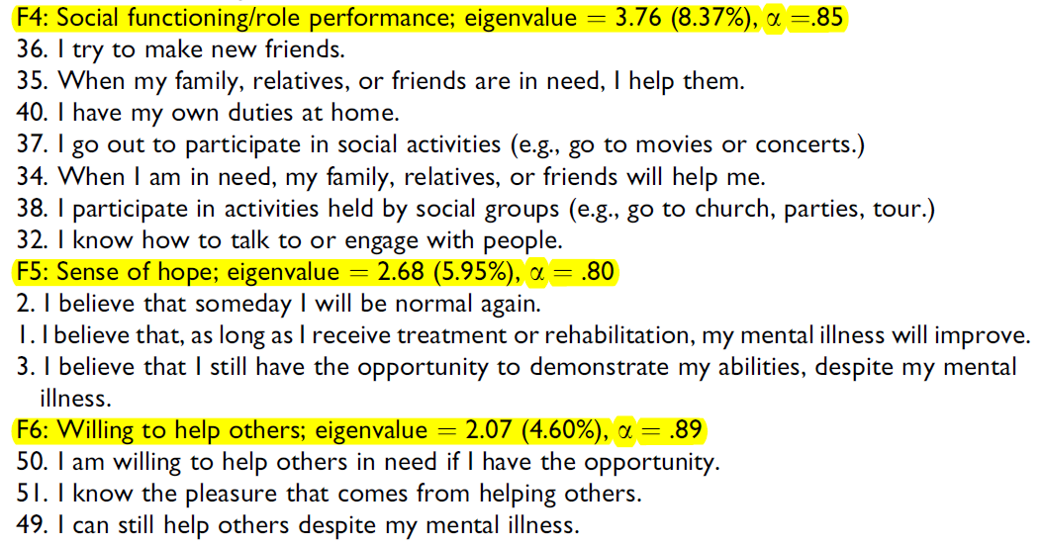
Subjective recovery scale

Slide 26
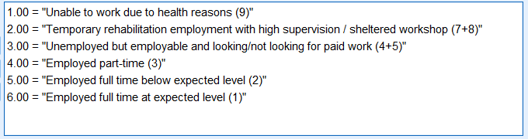
Objective scale 1:
Vocational status
The numbers on the right are the original codes. They were recoded to six levels so that the scale is ordinal. e.g. Employed full time at expected level is better than below expected level.

Slide 27
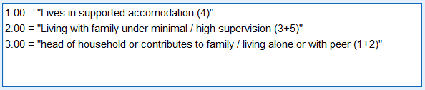
Objective recovery scale 2:
Living status
The numbers on the right are the original categories. They were collapsed and recoded so that the scale is converted from nominal to ordinal. e.g. Head of household is better than living with family under supervision.

Slide 28

Participants
150 recovering or recovered patients (e.g. bipolar, schizophrenia) in Hong Kong.
Had not been hospitalized in the past 6 months.

Slide 29
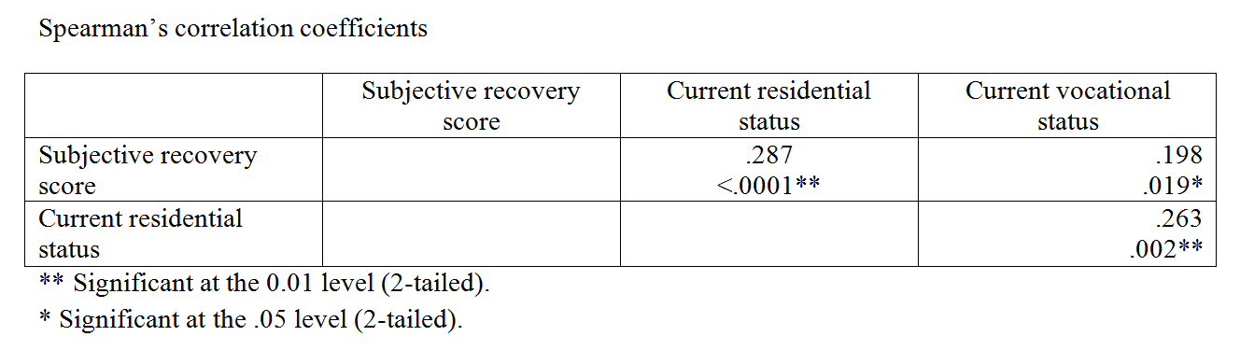
Analysis:
Correlations among the scales
The Spearman’s correlation coefficients are small but significant at the .05 or .01 level. However, the numbers alone might be misleading and further insight could be unveiled via data visualization.

Slide 30
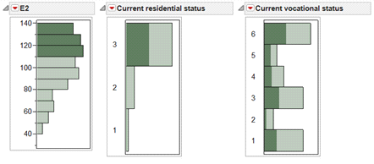
Data visualization
The participants who scored high in the subjective scale (E2) also ranked high in the current residential status, but they are all over the vocational status, implying that the association between the subjective scale and the vocational status is weak.

Slide 31
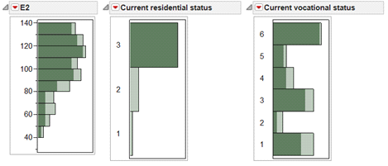
Data visualization
The reverse is not true. The subjects who scored high in the residential status (3) spread all over in the subjective scale (E2) and the vocational status

Slide 32
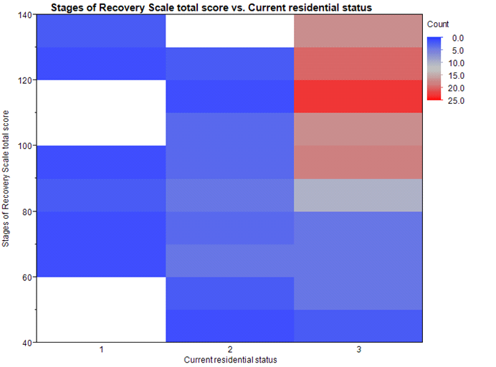
Heat map

Slide 33
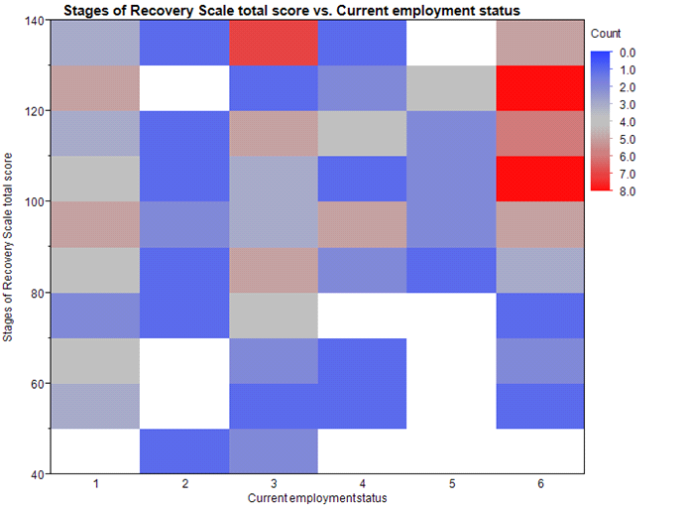
Heat map

Slide 34
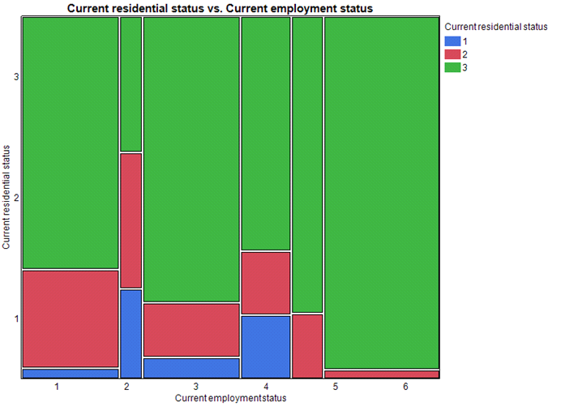
Mosaic plot

Slide 35
Two-step cluster analysis
In this study one subjective and two objective measures of recovery were used to measure the rehab progress of the participants, and thus MANOVA could be used by treating each scale score as a separate outcome measure.
To avoid unnecessary complexity, cluster analysis condenses the dependent variables by proposing certain initial clusters (pre-clusters).

Slide 36
Two-step cluster analysis
Available in SPSS
Use AIC or BIC to avoid over-complexity
Can take both continuous and categorical data (vs. K-mean clustering accepts continuous scales only)
Truly exploratory and data-driven (vs. K-mean prompts you to enter the number of clusters)
Group sizes are almost equal (vs. K-mean groups are highly asymmetrical)

Slide 37
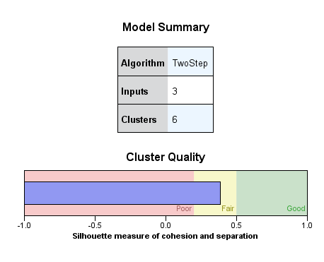
Cluster quality
Yellow or green: go ahead
Pink: pack and go home

Slide 38
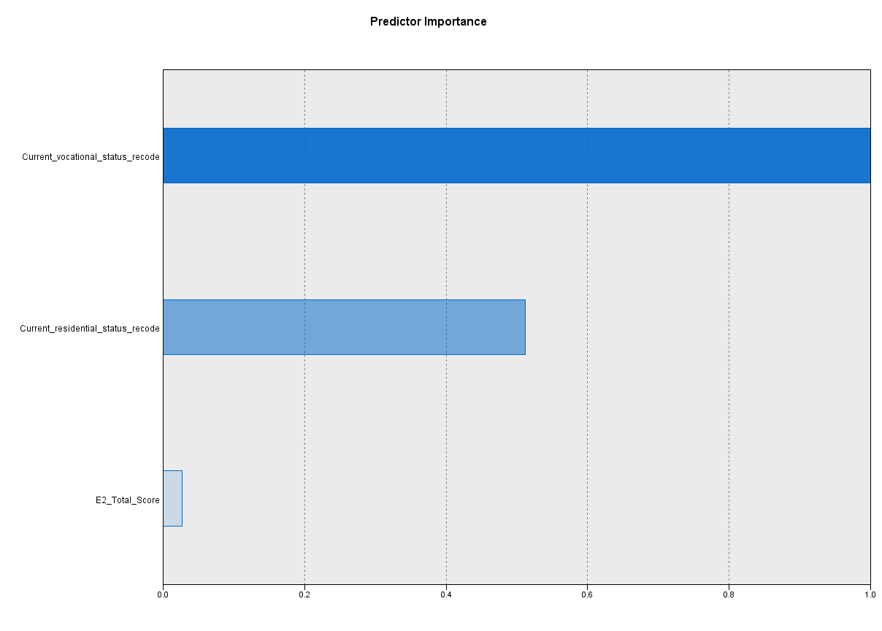
Predictor importance

Slide 39
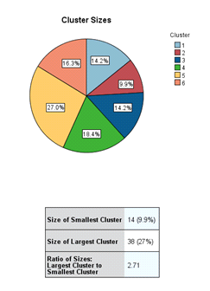
Number of clusters

Slide 40
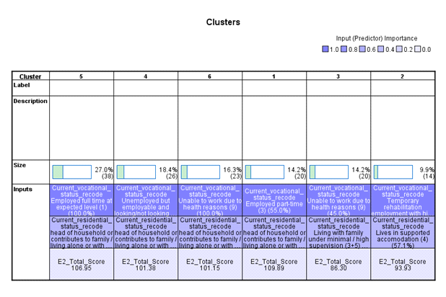

Slide 41
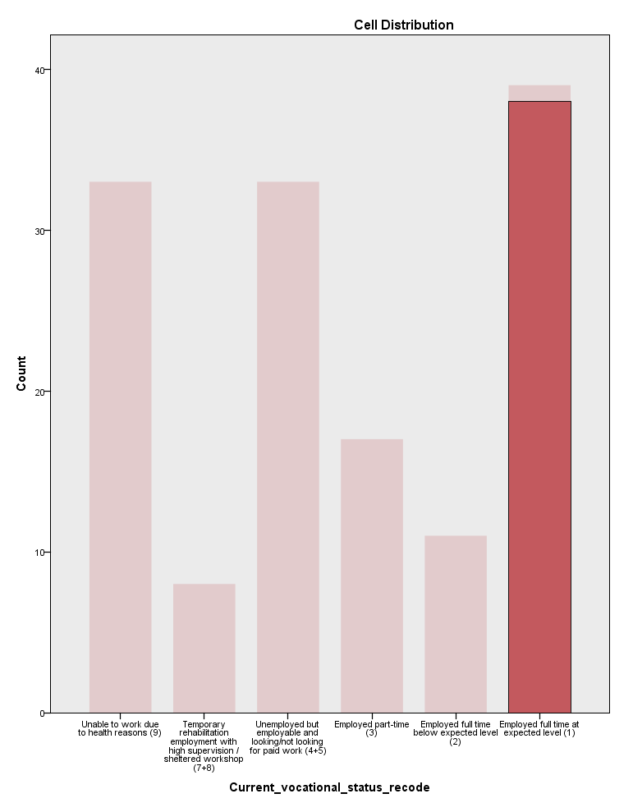
Cluster 5
In cluster 5 the grouping by vocational is very “clean” or decisive because almost all subjects in the group chose “employed full time at expected level”.

Slide 42
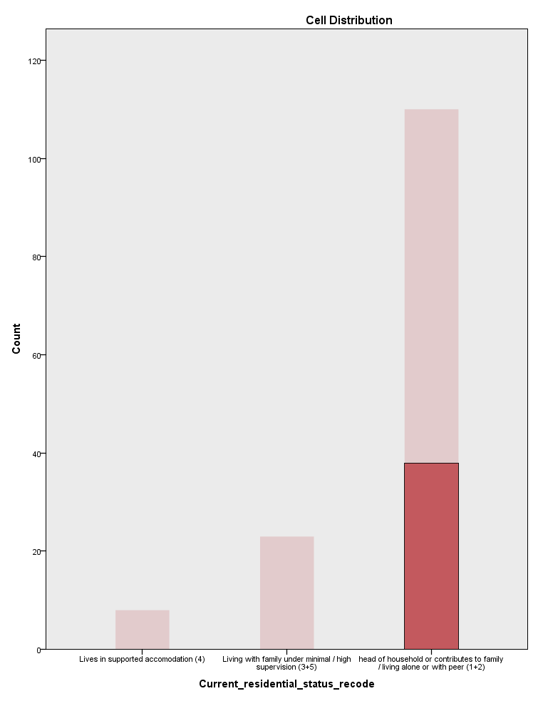
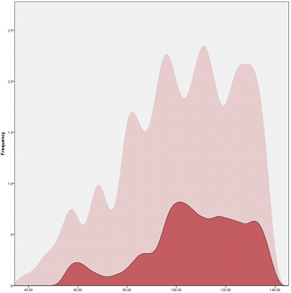
Cluster 5

Slide 43
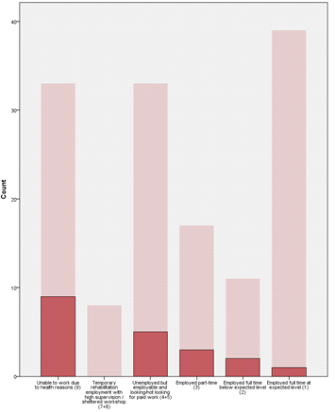
Cluster 3: Messy

Slide 44
Cluster 5: The best
The clustering pattern suggests that Cluster 5 has the best cluster quality in terms of the homogeneity in the partition. In addition, the subjects in Cluster 5 did very well in all three measures, and therefore it is tantalizing to ask why they could recover so well.
But cluster analysis is a means rather than an end. Further analysis is needed based on the clusters.

Slide 45
Multinomial logistic regression
By default in JMP logistic regression modeling treats the event coded in the last category as the focal interest. However, in this study the most interesting group that the team wants to predict is Cluster 5. Thus, Cluster 6 was recoded to Cluster 0 so that Cluster 5 became the last category.
SPSS allows you to choose the reference group. Why didn't I use SPSS?

Slide 46
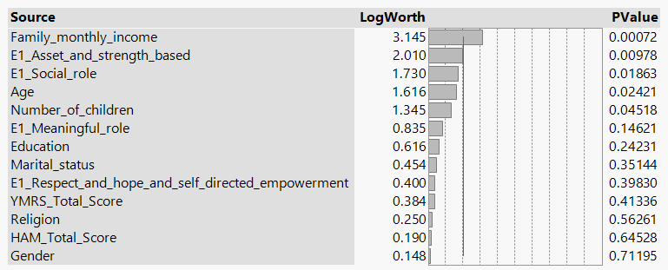
LR summary

Slide 47
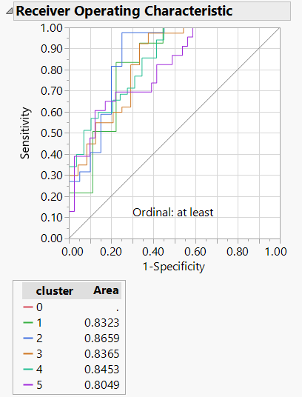
ROC Curve
The gray line is the chance model.
Group 0 is the reference
Y: hit
X: miss
Lift the curves towards Y →
more hit, less miss

Slide 48
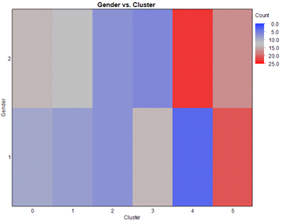
Heat map again
This is regression. Why do we have Chi-square?
The heat map is a visual version of a cross-tab table.
Chi-sq → fitness of cell counts
Heat map → patterns in cells

Slide 49
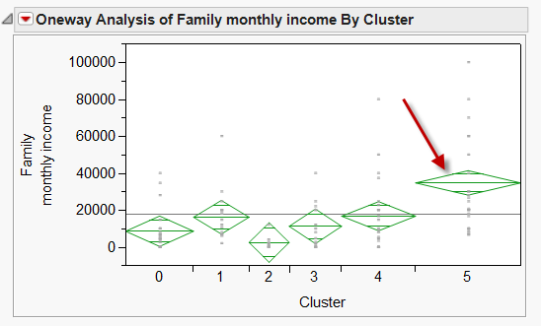
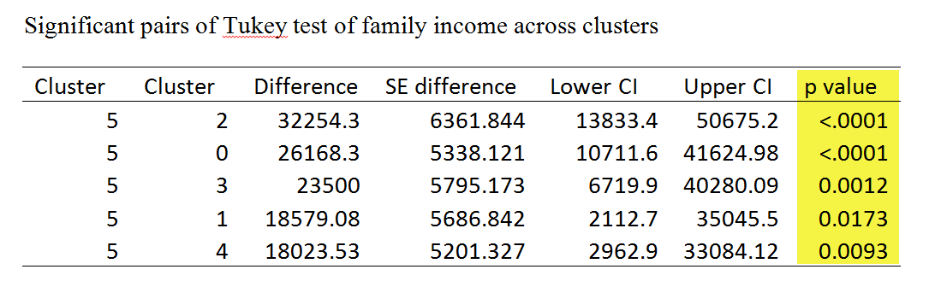

Slide 50
Family income: Cause or effect?
Cluster 5 (the best group in terms of both subject and objective recovery) has a significantly higher income level than all other groups.
Plausible explanation 1: they recovered and are able to find a full time job, resulting in more income.
Plausible explanation 2: the family have more money and thus more resources to speed up the recovery process.

