Slide 1
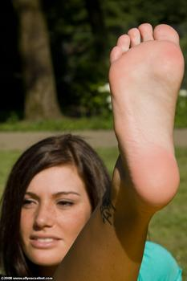
A very brief introduction to Structural Equation Modeling
You may need to take your socks off to do a SEM
Chong Ho Yu (Alex)

Slide 2
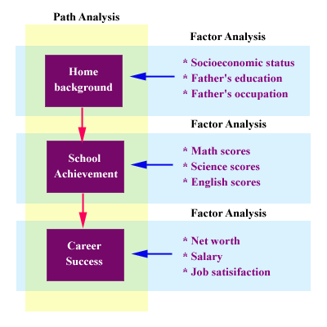
What is a SEM?
Factor (measurement) model + path model
In psychology, it is always the case that the mental state causes the observed behaviors. And the arrow always go from the latent construct to the observed items.
In sociology and economics, the direction of the arrows can be reversed.

Slide 3
Common challenges
Degrees of freedom (Can the model be identified/testable)?
High sample size requirement (Do you have enough observations to test the model?)
Model equivalency (Are there alternate models that can fit the data and the model equally well?)

Slide 4
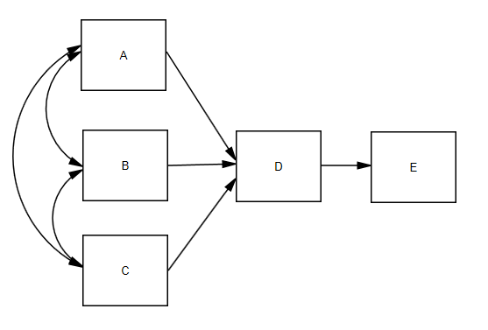
Example of a path model
All are observed or latent variables, NO measurement models
DF = the number of distinct elements in the covariance matrix - the number of free parameters to be estimated
Distinct elements: p(p+1)/2 = 5(6)/2 = 15
Four regression (path) coefficients: A→D, B→D, C→D, D→E
Five variances: A, B, C, D, E
Three pairs of covariance among the variables: A <-> B, A <-> C, B <-> C.
Parameters: 12
DF = 15 – 12 = 3

Slide 5
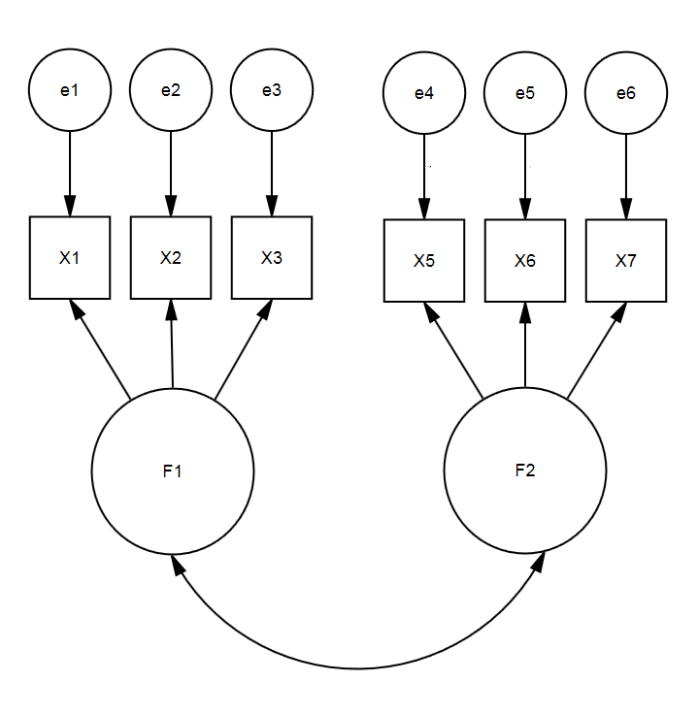
A much better example of factor model
DF = (p * (p + 1)/2)-(2 * p)-(F * (F - 1)/2)
(p * (p + 1)/2): # of distinct elements. 6 observed variables, the number of unique elements is 6*(6+1)/2 = 21.
2 * p : # of model parameters. In each observed item there are two free parameters: measurement error terms and factor loadings. 2 * p = 12.
F(F - 1)/2 : # of free parameters associated with the covariance of the latent factors. 2 * (2 - 1)/2 = 1.
DF = 21 – 12 – 1 = 8

Slide 6

Count your toes
If you have a relatively simple model, you can count the elements and the parameters by hand (if you run out of fingers, please count your toes).
But what if you have a fairly complicated model? You can use AMOS.
If you have a full version of SPSS, you can access AMOS from the pull down menu “Analyze”.

Slide 7
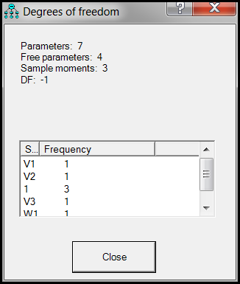
Degrees of freedom
In SPSS AMOS you can easily compute the degrees of freedom (DF) and the number of free parameters (FP).
If you have negative degrees of freedom, go home and there is nothing you can do; otherwise, use DF to find out the minimum sample size.
Learn more abut DF: http://www.creative-wisdom.com/pub/df/index.htm

Slide 8
Four ways to determine n
Nicolaou and Masoner compared four ways of setting the sample size for CFA/SEM.
  Traditional rule of thumb: 10 observations per variable.
  Overall fitness: e.g. Root Mean Square Error Adjusted (RMSEA) or Chi-square
  Cohen's effect size: it is applicable to path analysis (SEM) rather than CFA. In a path model one latent variable is caused by another.
  Barebones : It is based on the notion of competing theories or model comparison. There are always some rival models (2-factor model, 3-factor model...etc.). As the number of factors increases, the required sample size gets smaller and smaller.

Slide 9
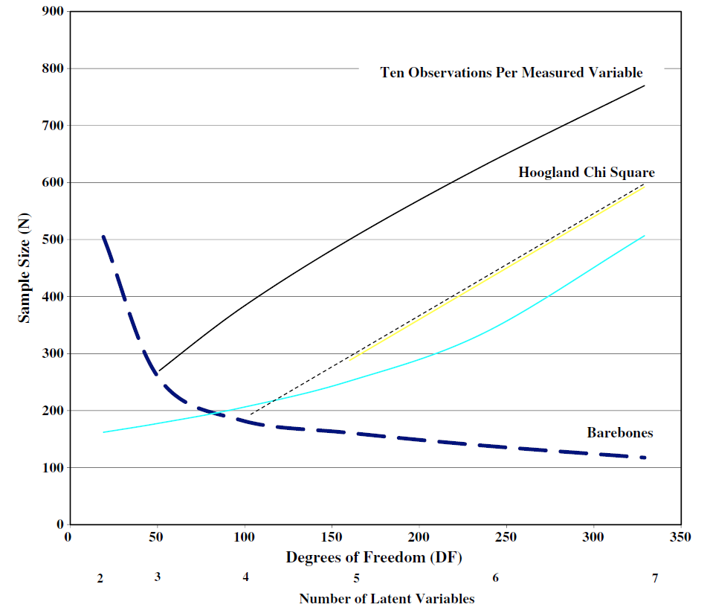
Example
10 obs. per variable: 300 DF → 750 subjects
Chi-square fitness: 300 DF → 550 subjects
Cohen’s ES: 300 DF → 450 subjects
Barebones: 6 factors → 150 subjects
Nicholaou, A. I., & Masoner, M. (2013). Sample size requirements in structural equation models under standard conditions. International Journal of Accounting Information Systems, 14, 256-274.

Slide 10
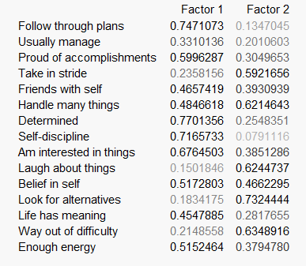
EFA and CFA
You cannot use the same sample for EFA, CFA, and examining treatment effectiveness. When you fit your proposed model into the same data, it always looks good. If I set up a rubric to grade my own paper, I must get an “A”!
You can use two different samples, or partitioning the sample into two subsets: one is for EDA and the other is for CFA. The logic is similar to cross-validation in resampling.

Slide 11
Causal modeling?
SEM is said to be a form of causal modeling that can unveil the cause and effect relationships among variables.
How? What elements in SEM algorithms make it a causal modeling?
The truth is: Nothing in the math can uncover the causal structure.

Slide 12
Let’s travel back to time
In the early 20th century, biologist Sewall Wright developed a methodology named path analysis, the precursor to SEM.
A Pearson’s correlation coefficient is non-directional. The statement “A and B are significantly correlated” can be pictorially illustrated as “A ↔ B”.
A path coefficient in the path model is A → B: a causal path from A to B.
A path coefficient was just a standardized regression coefficient.

Slide 13
LISREL
In 1970 Duncan and his colleagues organized a conference in Madison, Wisconsin. At the Madison conference Joreskog introduced the idea of Linear Structural Equation (LISREL), the first software application for SEM.
The key to uncover causal structures is path searching: Consider the alternatives.
There are more than one way to construct a model i.e. you can rearrange the circles and the paths.

Slide 14
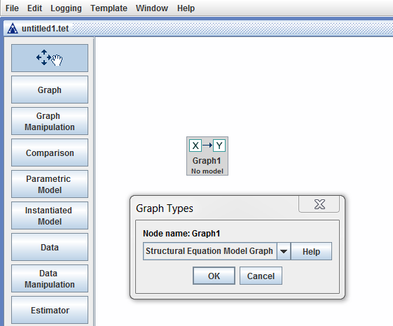
Path searching to counteract model equivalency
TETRAD
A project led by a philosopher, Dr. Clark Glymour
http://www.phil.cmu.edu/projects/tetrad/current.html

Slide 15
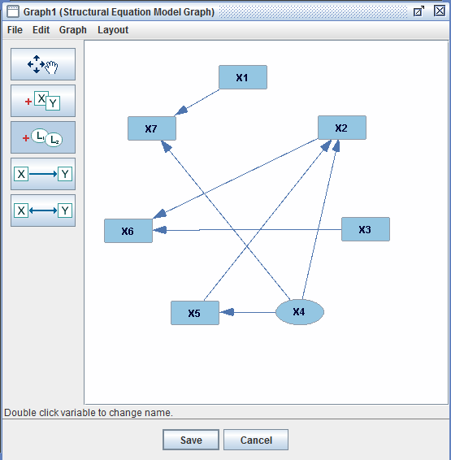
This is one model

Slide 16
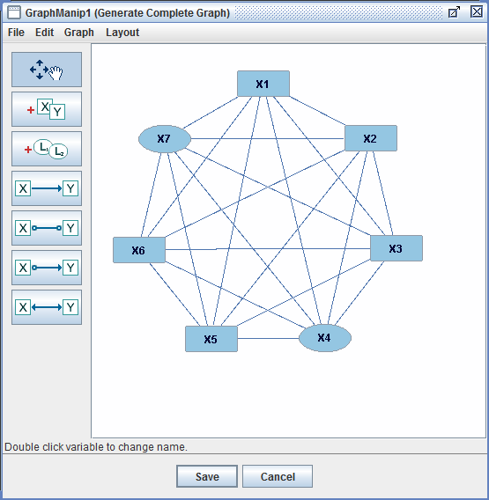
All path combinations

Slide 17
Auto Path searching to counteract model equivalency
Merit: automated; it can exhaust almost all possible combinations
Problem: sometimes it doesn’t make sense e.g. things that happened in the future cannot affect things that happened in the past (2014 GNP → 2011 faculty salary → 2010 APU enrolment) Time travel! Are you watching too much Star Trek?
We need manual model comparison: SAS (PROC CALIS, TCALIS) and JMP

Slide 18
Example: Data source and variables
World Development Indictors (WDI) and Global Development Finance (GDF)
  Sci 2003 : the percentage of people who graduated from college or university in 2003 with a major in science.
  EMC 2003: the percentage of people who graduated from college or university in 2003 with a major related to engineering, manufacturing, or construction (EMC).
  Paper 2005: the number of scientific and technical papers published in peer-review journals in 2005.
  Patent 2005: the number of patents applied for by residents in 2005.
  Productivity 2007: Gross domestic product per person employed in 2007.

Slide 19
Conjecture
The number of graduates in science and EMC in a given year might positively influence the number of scientific papers published in peer-review journals and the number of patents applied by residents two years later.
Subsequently, new ideas and new innovations manifested in research papers and patents could eventually improve productivity.

Slide 20
No automated path searching
Path searching cannot be used in this situation because automated path searching algorithm is blind to the temporal nature of variables.
It is impossible to build a model like the following: 2007 variables→2005 variables→2003 variables.
The following is a manual path searching implemented in SAS/JMP.

Slide 21
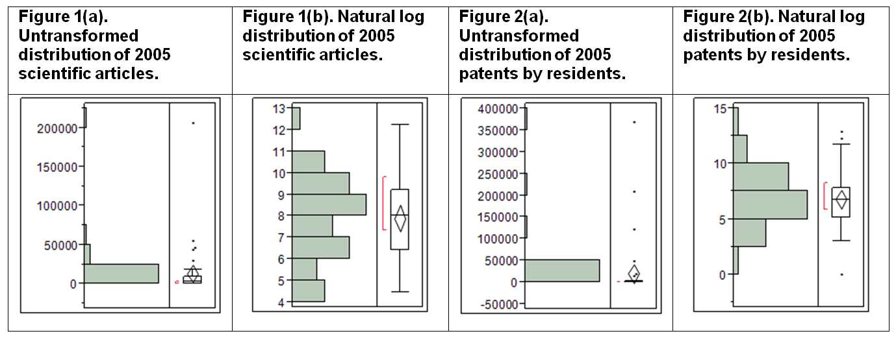
Data transformation
Figure 1(a) and 2(a) depict the untransformed distributions of 2005 scientific papers and patents. Both are extremely skewed distributions because scientific research and innovations tend to concentrate on very few developed nations. As a remedy, natural logarithm transformation was utilized

Slide 22
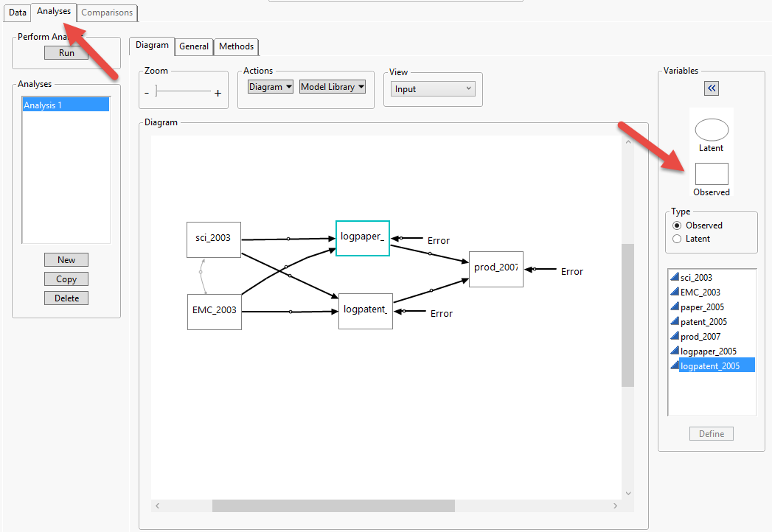
Palette
In the drawing mode the analyst can simply drag and drop the variables into a canvas to construct a model based on the preliminary regression analysis or prior theoretical framework.

Slide 23
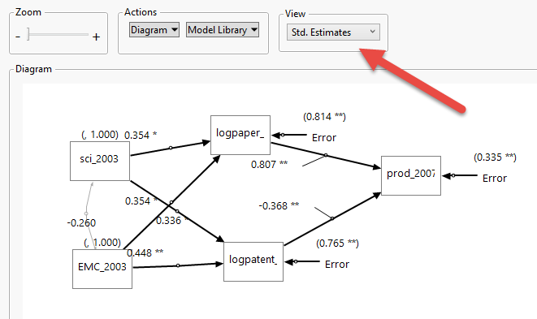
Results
The parameters with the sign “*” or “**” are considered significant. One asterisk indicates that p < 0.05 whereas two asterisks indicate that p < 0.01

Slide 24
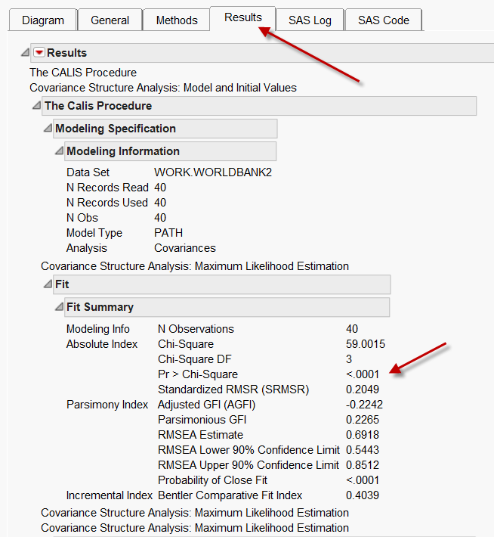
Chi-square
The chi-square statistics suggest that the model does not seem to be promising (X²=59.0015, p<.0001).
In other tests rejecting the null is good. Here it is bad. Why?
Root mean square error of approximation (RMSEA) is good when the lower and upper bounds are between 0 and 0.08.

Slide 25
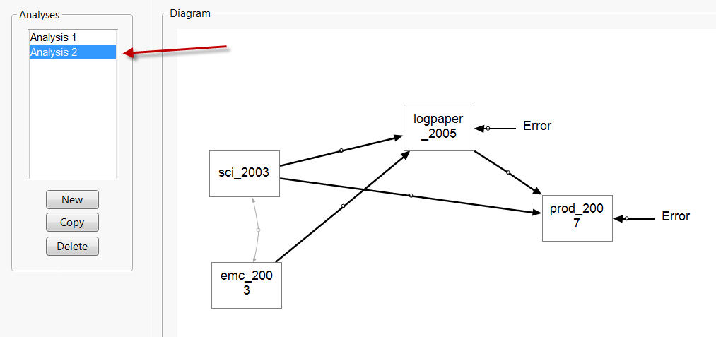
Explore alternate model
To rectify the poor fit, an alternate model should be proposed and thoroughly examined. JMP provides the user with a “Copy” button to modify the existing model into a new analysis (Analysis 2).

Slide 26
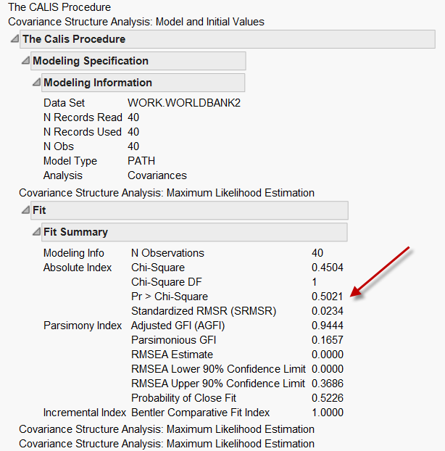
Better!
The fitness has been substantively improved. Some researchers might want to stop at this point and accept this one as the final.
In the past running SEM is very involved and time-consuming. However, being equipped with the JMP interface, today the user can afford further exploration with minimal efforts.

Slide 27
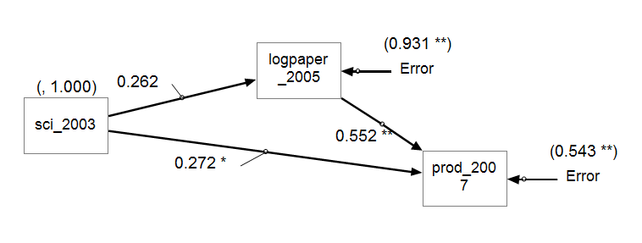
A very parsimonious model
If EMC graduates have no significant effects on productivity, could this variable be dropped, too? This time only three variables remained in the model

Slide 28
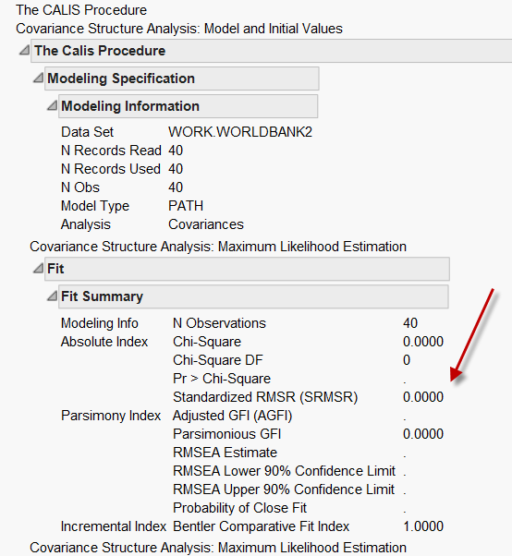
Saturated model
Both the Chi-square and the degree of freedom show a “zero” while the p value is missing.
There is no discrepancy between the expected model and the observed data.
The model is said to be saturated, meaning that the model can perfectly reproduce all of the variances, covariance, and means.

Slide 29

Fit indices: Cut score?
While degree of model fitness is a continuum, the cutoff points of conventional fitness indices force researchers to make a dichotomous decision.
Suzanne and Preston (2015): Replacing arbitrary cutoffs with AIC and BIC
No cutoff in AIC or BIC.
Explores alternate models and then select the best fit based on the least AIC or BIC.

Slide 30
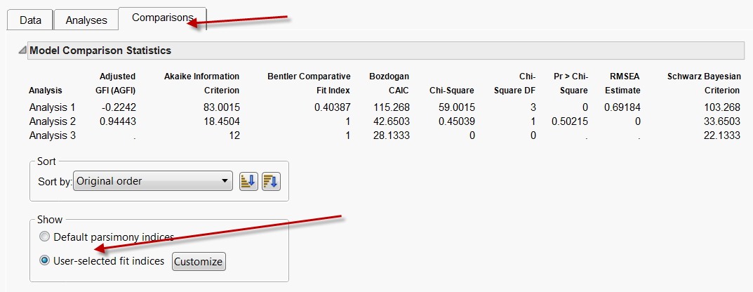
Fit indices: Beyond Chi-square
The modeler can perform a model comparison by using Akaike Information Criteria (AIC), Bozdogan CAIC, Schwartz Bayesian Information Criterion (BIC), and RMSEA.
Adjusted GFI: 0.9 or greater is good.

Slide 31
Conclusion
A high percentage of graduates majoring in science could lead to better scientific research, indicated by a higher volume of research papers.
And better research might eventually benefit productivity. Indeed, even the variable “2003 science graduates” alone is a strong predictor of 2007 productivity.
This finding contradicts the popular belief that engineering and applied science is more valuable than pure science in terms of helping the economy.

Slide 32
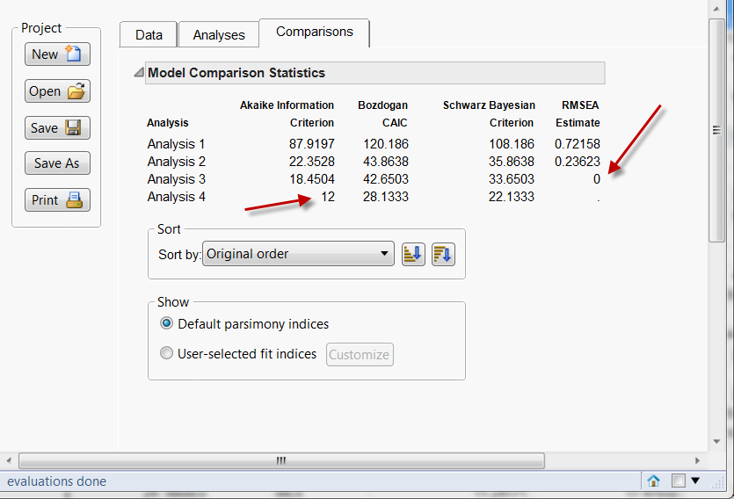
Caution:
There is always something “better”. You may spend 1-2 years in model-comparison and searching, searching, searching, searching…. (The best is around the corner. Keep searching) Just take what works or you will not publish!

Slide 33
Counterfactual
The logic of path searching or model comparison is counterfactual
  Factual: what had happened.
  Counterfactual: What could have happened.
When X happens, Y happens. But you cannot affirm that X must cause Y.
You need to check: had X not been happened, what would have happened to Y.

Slide 34

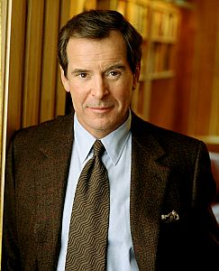
Common criticism
You cannot ask hypothetical question! If things had already happened, hypothetical questions are meaningless.
For example, you cannot answer questions like this: “If I go to University of British Columbia instead of Azusa Pacific University, would my life be better? I might learn more research methods in a better school. My GPA might be higher. I might meet a handsome, kind, and intelligent Canadian man…”

Slide 35

We use counterfactuals all the time!
In modal logic it is called subjunctive conditional.
In history and science it is call thought experiment.
E.g. “What If?: The World's Foremost Military Historians Imagine What Might Have Been”: If Chiang Kai-shek did not lose his best troops in Northeast China after World War II, the Communist might not take over the entire China.

Slide 36
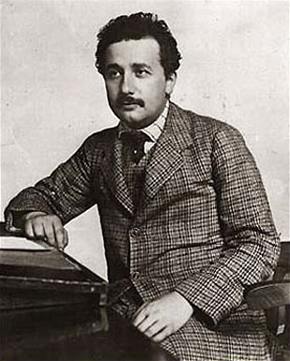
We use counterfactuals all the time!
Einstein: “What would happen if I chase after a beam of light? Would I se a still light” It is impossible to do it physically. Einstein imagined the answer.

Slide 37
We use counterfactuals all the time!
If I drive too fast, crash my car and injure myself, I would regret it and say, "If I didn't drive that fast, I would not have lost my car or be in the hospital now."
Nonetheless, no reasonable person would negate my statement by saying, "Your reasoning is flawed because it had already happened. You cannot go backward in time and drive 50 miles per hour to learn what the alternative history is. Since there is no observable comparison, there is no causal link between your reckless driving and injury."

Slide 38
Summary
Inputting numbers into the SEM program does not automatically yield a causal conclusion.
You need to conceptualize alternate models by path searching and model comparison.
But it is not bullet-proof.
Missing variable argument, “no cause in, no cause out” (Nancy Cartwright): relevant variables and genuine causes are not included at the beginning, then the elimination approach (exhausting all combination and pick the best) is useless.

