Slide 1
A Comparison of Text Mining Approaches
Chong Ho Yu, Ph.D.

Slide 2
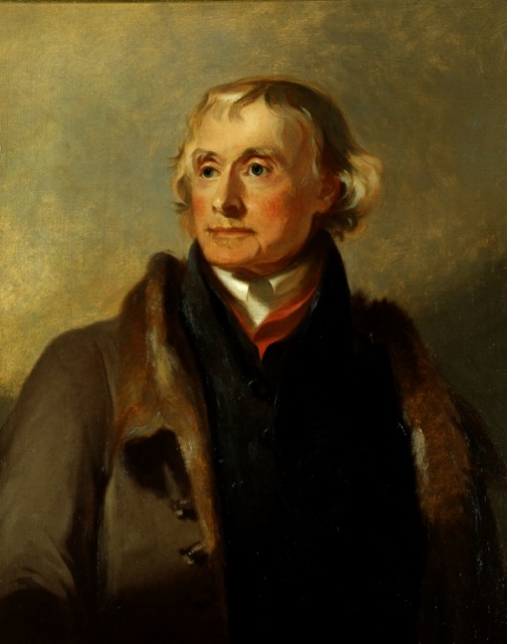
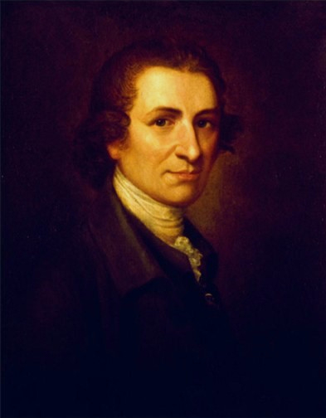
Question 1
Some scholars argue that America is not a Christian nation in the sense that the Christian belief is not the foundational ideology shared by our founding fathers.
Indeed several founding fathers and influential figures are deists, such as Thomas Jefferson and Thomas Paine.
How can you respond to this question?

Slide 3

Question 2
How is American idols related to text mining?
Idolstats.com

Slide 4

What is text mining?
Also known as text analytic.
A process of extracting useful information from document collections through the identification and exploration of interesting patterns (Feldman & Sanger, 2007).

Slide 5
What is text mining?
While data mining is often used to analyze structured data, which is a small percentage of existing data sources, text mining is the ideal tool for tapping into under-utilized, unstructured data.
You! yes, you created textual data everyday! Whenever you send emails and post messages on your Facebook, these become data!

Slide 6
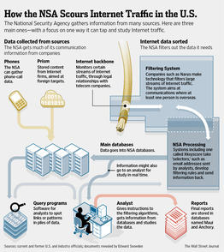
How is anti-terrorism related to text mining?
NSA veteran William Benny estimates that NSA had collected between 15 and 20 trillion transactions in 11 years.

Slide 7
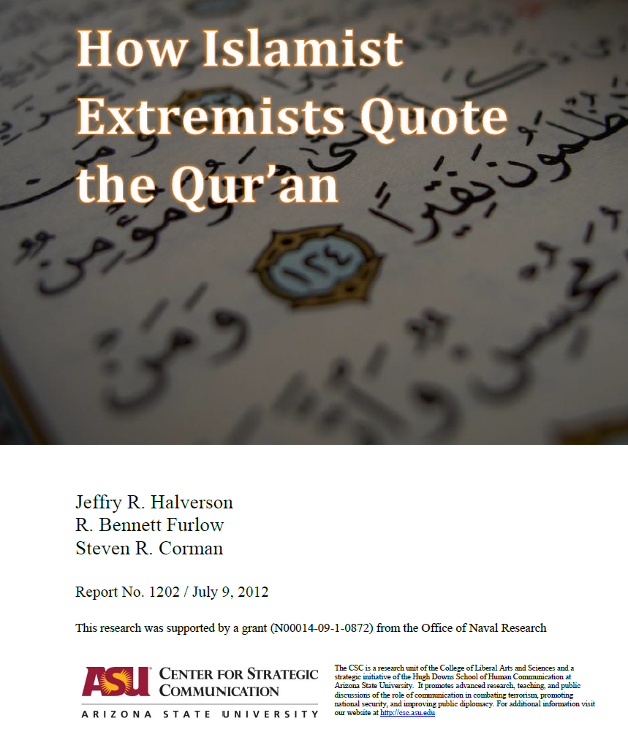
How is anti-terrorism related to text mining?
DoD funded ASU rearchers to study the messages posted by Islamists.
They concluded that verses extremists cite from the Quran do not emphasize conquest of infidels.

Slide 8
The forerunners of TM
TM is not entirely new.
Qualitative researchers have been doing content analysis and grounded theory (362 Research Methods)
E.g. Yu, C. H. & Marcus-Mendoza, S. (1993). Attitudes of correctional staff. In B. R. Fletcher, L. D. Shaver, & D. G. Moon (Eds.), Women prisoners: A forgotten population (pp.111-118). Westport, Connecticut: Praeger.

Slide 9


Qualitative method
Classify how correctional officers perceive the objective of imprisonment by reading their responses to open-ended questions.
  Retribution
  Deterrence
  Rehabilitation/restoration
This is tedious to read through the documents! Today we have AI!

Slide 10
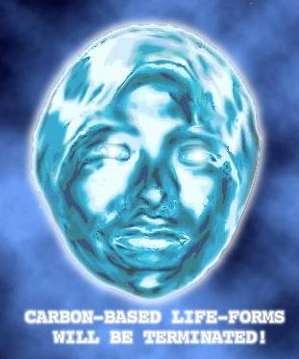
Artificial intelligence
TM utilizes the technology of natural language processing, a subfield of artificial intelligence (AI) & computational linguistics.
Why do we need natural language processing in data mining?
The software app must be smart enough to understand the context.

Slide 11
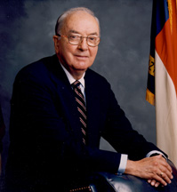
Natural Language Processing
They don’t mean the same thing
I book a ticket to Paris.
Hanna read Dr. Yu’s boring book.
Maryann is a senior at Azusa Pacific University.
Alex Yu received a senior discount at TJX (soon).
Age and sex are included in the demographic data.
Jesse Helms proposed an amendment to ban sex education.

Slide 12
Artificial intelligence
Well, I don’t work at NSA. I don’t have AI software. What I have is the opposite of artificial intelligence: genuine stupidity.
Can I still do something about text mining?

Slide 13

World Wide trend of interest
Yes, you can do it!
Sociologists said that the world is going through the process of secularization.
Security thesis:
  People in the well-developed world are losing interest in Christianity.
  People in developing countries, which are less secure, are still interested in supernatural protection (Christianity).
Is it true?

Slide 14
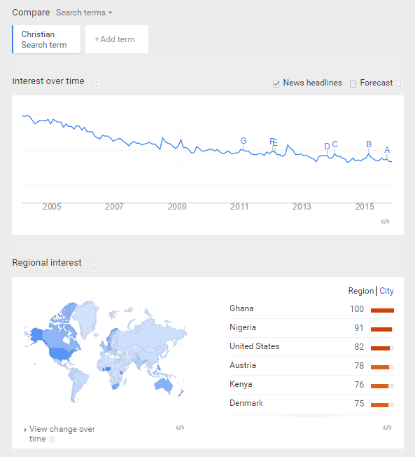
World Wide trend of interest
You can use Google Trends: Very basic and simple text mining
The frequency of search for Christianity or Christian is declining.
Most searchers are from Africa.

Slide 15
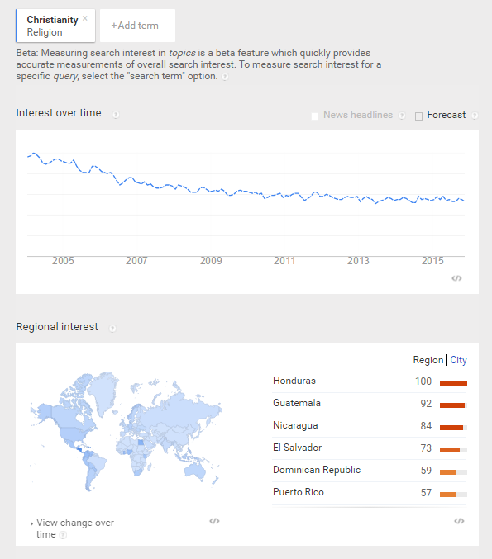

Slide 16
US Trend in search for Christianity
The same trend is found in the US and the UK.

Slide 17
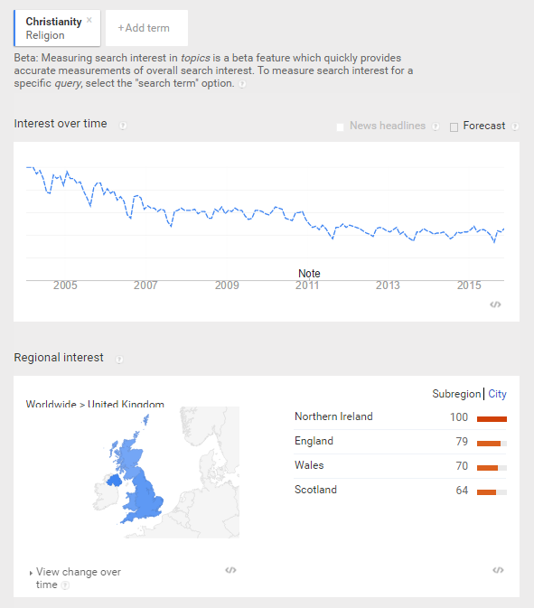
UK Trend in search for Christianity
The same trend is found in the US and the UK.

Slide 18
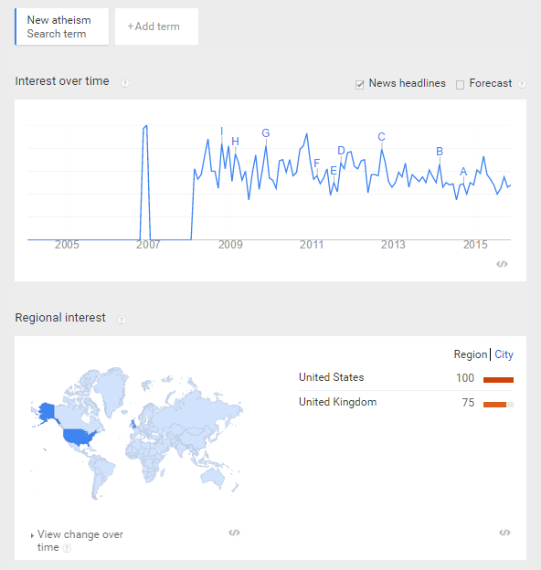
Demand for New atheism
Demand for New atheism is steady.
It pops up in late 2006.
But almost all the searches are in the US and UK.

Slide 19
Risk of text mining
NLP aims to deal with the complexity and multiple connotations of natural languages. A single word can mean different things in different contexts.
E.g. “book” in the phrase “he books tickets” is completely different from the same word in the phrase “he reads books.” Relying on a computer to conduct text analysis could be dangerous if the software is not well-written.

Slide 20
What can TM do?
Hypothesis generation by Swanson process.
Based on the idea of concept linking, Swanson (1986) carefully scrutinized the medical literature and identified relationships between some apparently unrelated events, namely, consumption of fish oils, reduction in blood viscosity, and Raynaud’s disease.

Slide 21
Hypothesis generation
His hypothesis that there was a connection between the consumption of fish oils and the effects of Raynaud’s syndrome was eventually validated by experimental studies (DiGiacomo., Kremer, & Shah, 1989).
Using the same methodology, the links between stress, migraines, and magnesium were also postulated and verified

Slide 22
Software modules
We will compare the results of several text mining packages, including:
  TextStat (Freeware)
  AutoMap (Freeware)
  IBM SPSS Text Analytics: No pre-built category (Commercial)
  IBM SPSS Text Analytics: Customer survey category (Commercial)

Slide 23
Software modules
IBM SPSS Text Analytics used to be a standalone program.
Now it is a part of IBM SPSS Modeler i.e. You cannot buy/install Text Analytics without Modelers, meaning: $$$$$

Slide 24
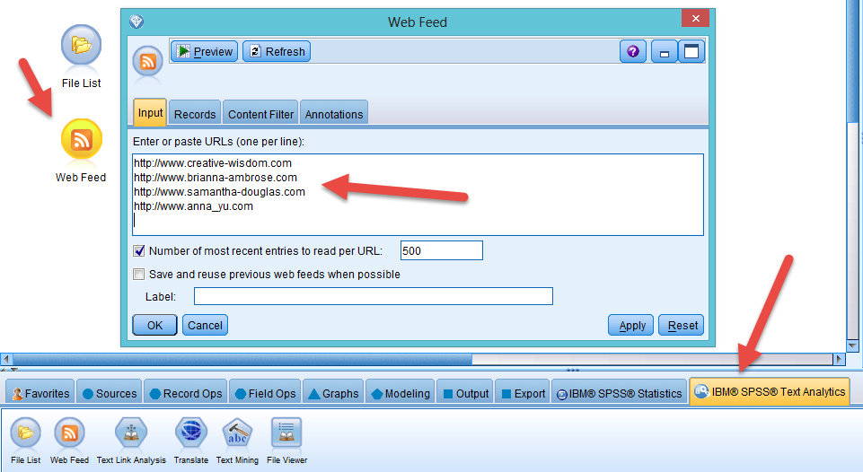
IBM SPSS Text Analytics
You can do text mining on the World Wide Web.

Slide 25
Example 1
The same data source, which encompasses responses to an open-ended survey item collected from a US Southwestern university, was used for extracting common threads.
“If you had the ability to design your ideal online learning environment--What would you like to see? How would it look and feel? What features would it have?”
Effective sample size: 3,193

Slide 26
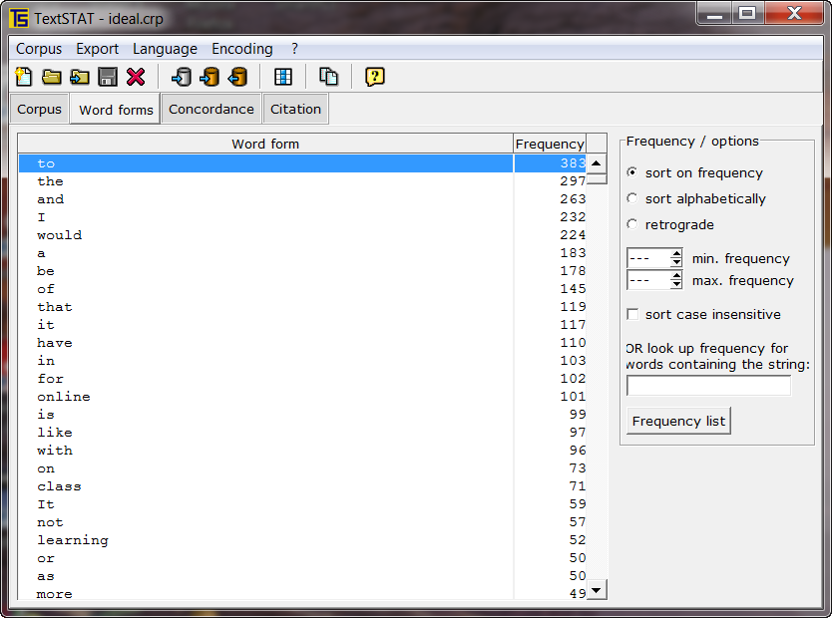
TextStat
A lot of “noise” and there is no word filter.

Slide 27
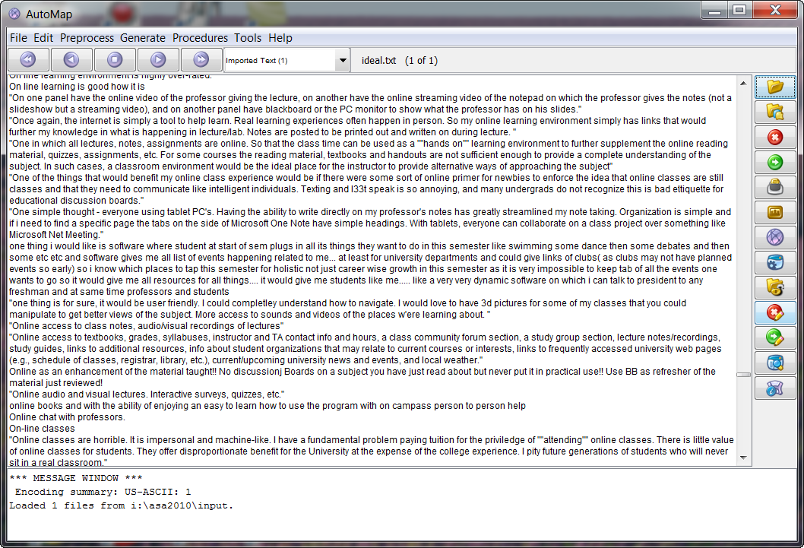
AutoMap: Input

Slide 28
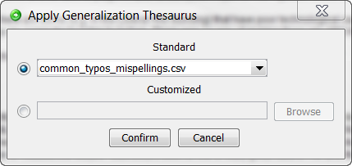
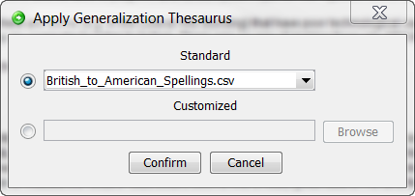
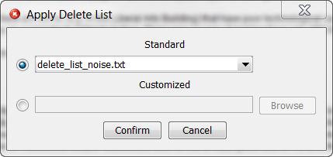
Generalizations
Can remove typos, noise (senseless words) or recognize different types of English.

Slide 29
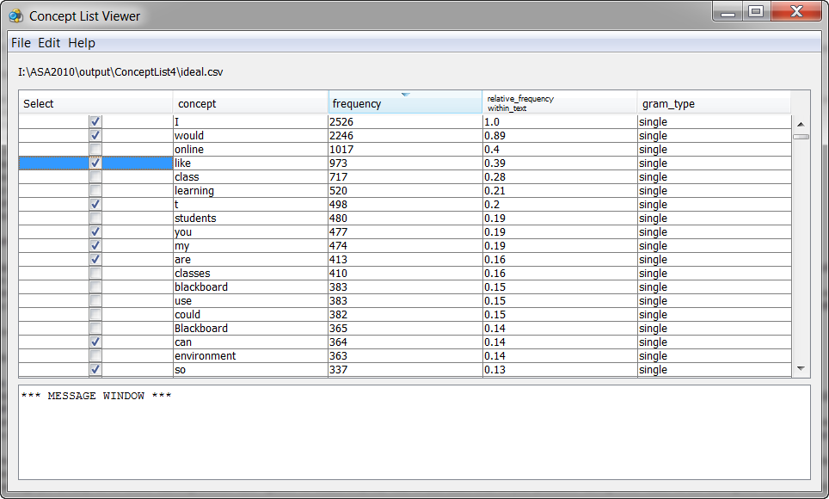
AutoMap:
Check for words to be deleted.

Slide 30
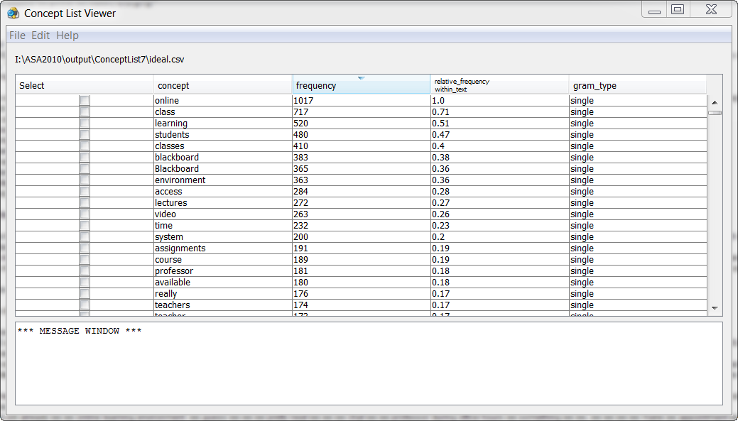
Common concept lists

Slide 31
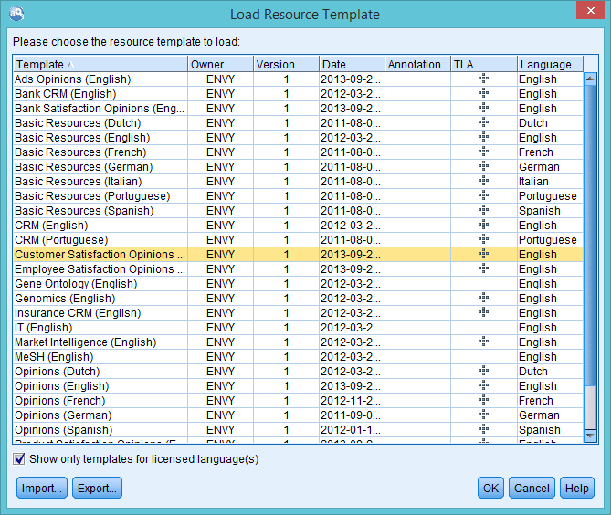
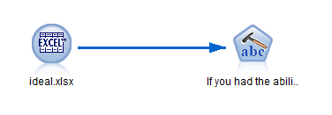
IBM SPSS: Text extraction
SPSS Modeler can handle multiple languages. In this study English data are used.

Slide 32
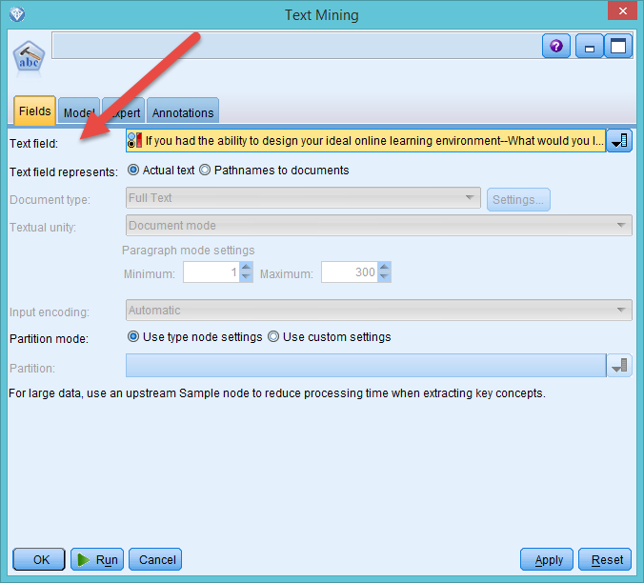
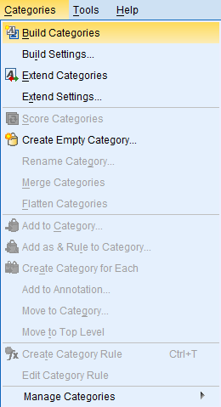
IBM SPSS: Text extraction

Slide 33
Categorization
Modeler has pre-built categories. E.g. customer survey. This extraction is not based on any pre-built categories.

Slide 34
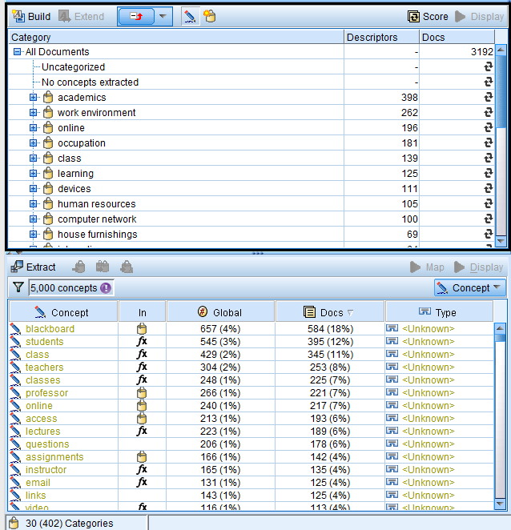
Categorization
Modeler counts the frequency of terms and words
Based on the words it builds categories and concepts.

Slide 35
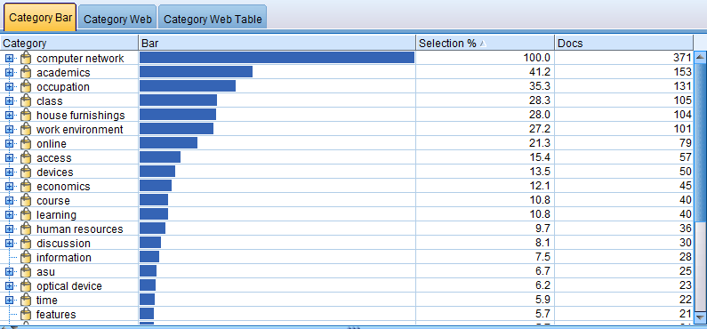
Category Bar by frequency

Slide 36
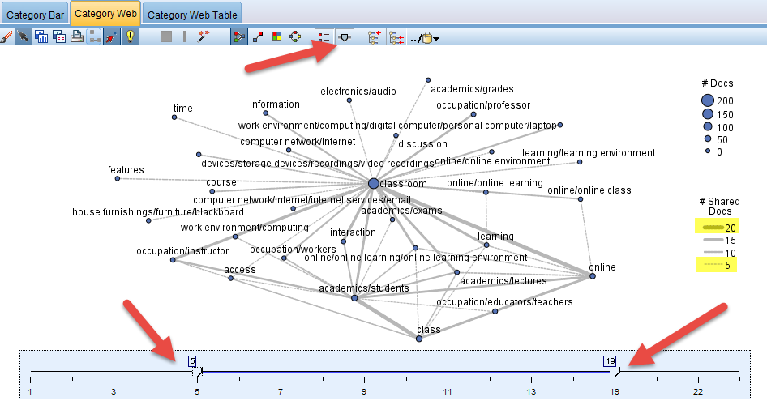
Category Web:
Show how concepts are related.

Slide 37
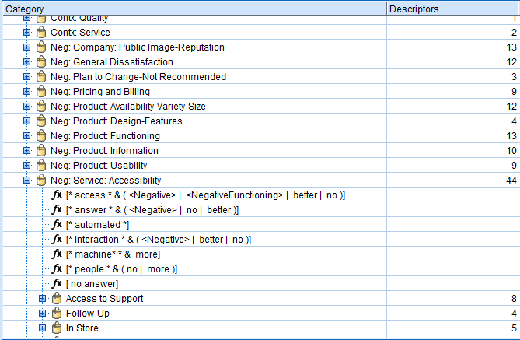
Pre-built categorization: Customer Survey
When the pre-built category package, customer survey) is used, the result is different.
Text analysis looks for “usability”, “functioning”, “accessibility”…etc.

Slide 38
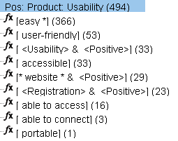
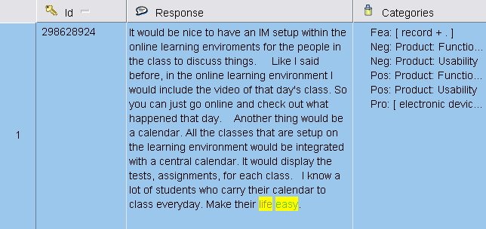
Example of sub-categories
The researcher can drill down the category to view the sub-categories.
The original responses are highlighted for the researcher to cross-examine.

Slide 39
Results of comparison
After removing “noise” (e.g. is, am, are, a, an, the…etc), all text analysis packages, as expected, produce the same results in word frequency. However, word frequency alone is not useful for analysis.
Categorization and concept web are more important. In concept map or semantic net, AutoMap and Text Analysis yield completely different results.

Slide 40
Results of comparison
As expected, doing text mining using a pre-built category and without using one return vastly different results.
Without pre-built categorization the result is very hard to interpret. Using a pre-built one can facilitate a more meaningful interpretation.
However, not every open-ended responses can fall into one of the pre-built categories provided by the software package. The researcher might need to build their own categories based on some preconceptions.

Slide 41
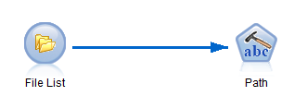
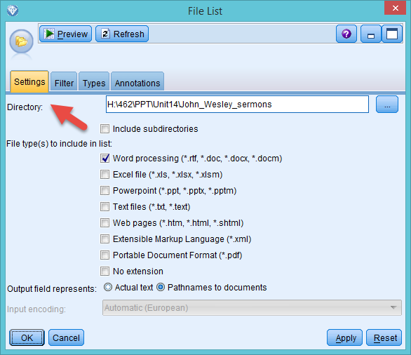
Mine documents
You can save documents (e.g. Word, PDF…etc,) in a folder and make Modeler to scan all files on the list.

Slide 42
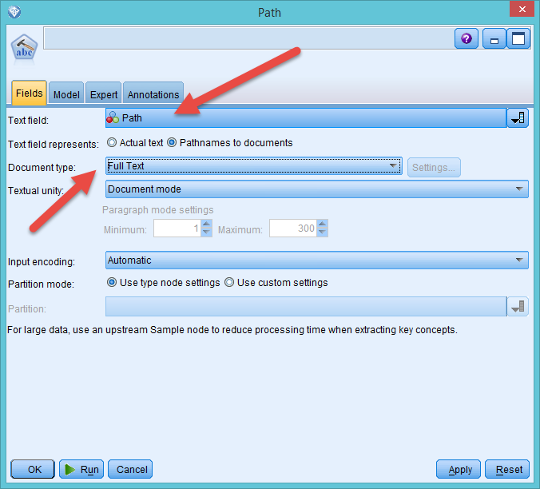
Mine documents

Slide 43
Recommendation
Some authors (e.g. Bennett, Dumais, & Horvitz, 2005) suggest ensemble methods, such as using multiple text mining tools and assigning reliability index to each of the results.
Next, the research can select the best text classifier or combining all results to generate a meta-result.

Slide 44
Need a conceptual framework
The text miner should have some preconception of what they are looking for (e.g. customer satisfaction? Technical support issues? Student expectation?).
In this sense, only one set of categorization is considered proper and comparison across different text mining results is not necessary.

Slide 45
Example 2:
Psychology of religion
Yu, C. H. (2015). Are positive trait attributions for the deceased caused by fear of supernatural punishments?: A triangulated study by content analysis and text mining. Journal of Psychology and Christianity, 34, 3-18.
This project is a replicated and enhanced study of Jesse Bering’s research on perceptions of dead agents.
Utilizing the framework of cognitive psychology and evolutionary psychology, Bering hypothesized that humans have a natural tendency to perceive that cognitive systems continue to function after death, and this disposition might be the psychological foundation of religion.

Slide 46

Context
Bering and his associates conducted a content analysis by extracting trait attributions from 496 obituaries published in the New York Times. The trait attributions were classified according to the categories in the Evaluation of Other Questionnaire (EOOQ).

Slide 47
Context
Bering found that in those obituaries pro-social and morality-related attributes of the dead people appeared more frequently than other types of qualities, such as achievements.
Along with the findings form other similar studies, Bering and his colleagues asserted that this behavioral pattern might result from adaptions during the evolutionary process.

Slide 48

Specifically, if dead agents were believed to be aware of what the living people said and did, it could strengthen our moral framework.

Slide 49
Limitation of Bering’s study
Bering’s study has certain limitations. It is important to point out that 41% Americans attend church on a regular basis, and Christianity has major impacts on every aspect of people’s life.
A Gallup poll shows that 92% Americans believe in the existence of God. Thus, the wording patterns found in New York Times obituaries and the idea of afterlife among the Americans could be a cultural product, instead of a natural tendency.

Slide 50
Purpose
Another sample is needed in order to further examine Bering’s notion. In contrast to the US, in the UK churchgoers are 10% of the entire population, and 44% of UK citizens believe in God.
UK is more secular than the US. If the perception of active dead agents is really natural or a-cultural, then the trait attributions found in the US sample should also be observed in the UK.
In this project 400 obituaries were sourced from two UK newspapers, namely, Guardian and Independent.

Slide 51
Methodology
Replicate the study using content analysis based on EOOQ and data-driven categories in MAXQDA
Triangulate data analysis using both Automap (freeware) and SPSS Text Analytics (Commercial product)
Content analysis relies on human coders whereas text mining is automated by natural language processing and computational linguistics.
Different text mining packages, which utilize different algorithms, may yield different results.
Coded variables were exported to JMP for quantitative analysis

Slide 52
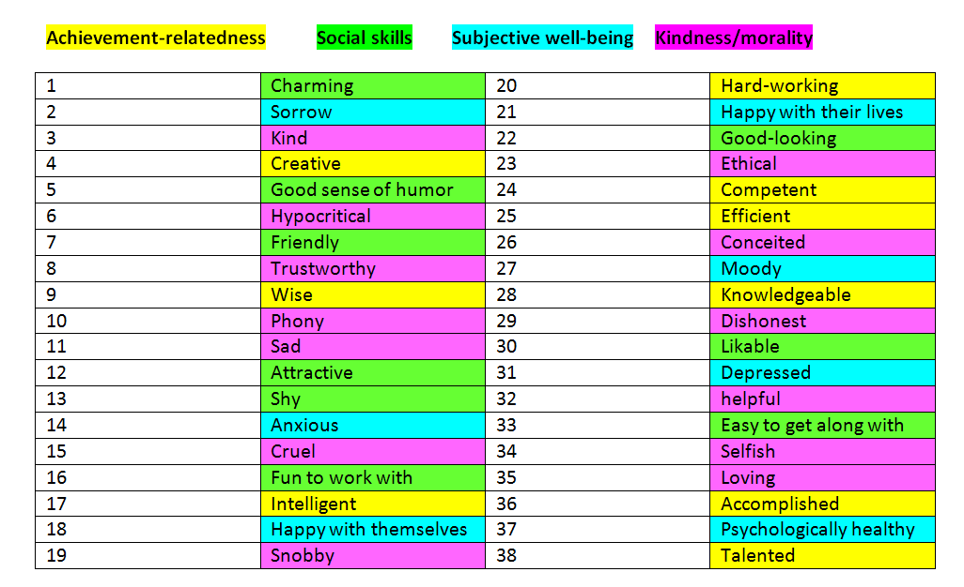
EOOQ
It is extremely rare to see negative attributes, such as “hypocritical” and “selfish” in those obituaries, and thus these categories are not useful.

Slide 53
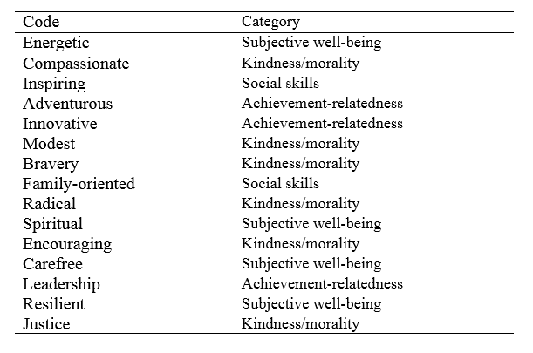
New categories driven by the data
Some new categories were created by the coders.

Slide 54
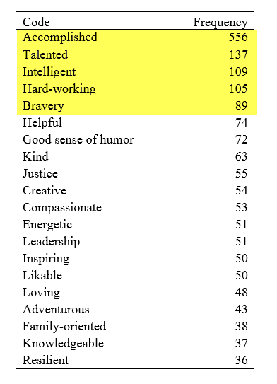
Content analysis results
The most frequent recurring traits are achievement-related.

Slide 55
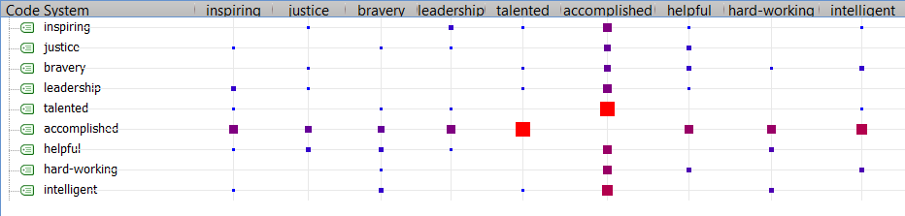
Code relation chart
Accomplished tends to co-occur with inspiring, justice, bravery, talented, leadership, helpful, hard-working, and intelligent.

Slide 56
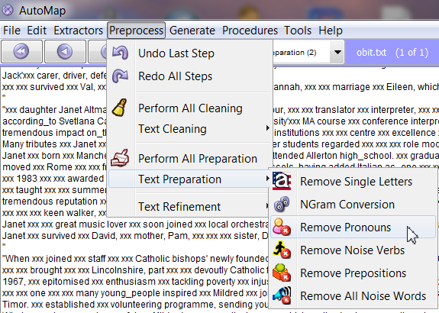
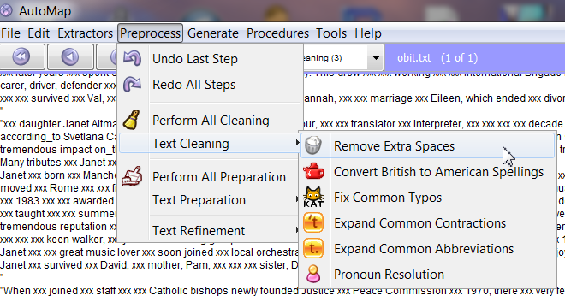
Automap requires a lot of data cleaning and pre-processing

Slide 57
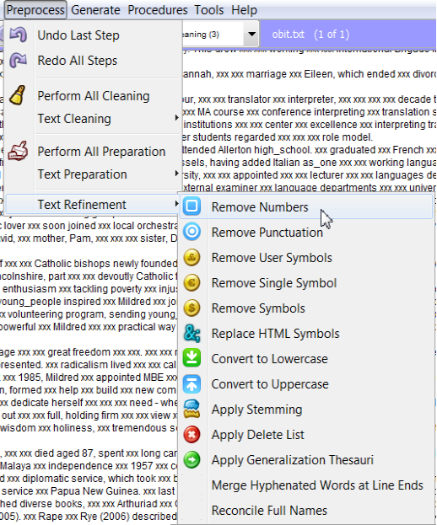
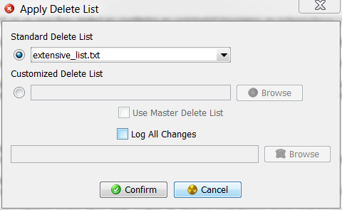
Automap requires a lot of data cleaning and pre-processing

Slide 58
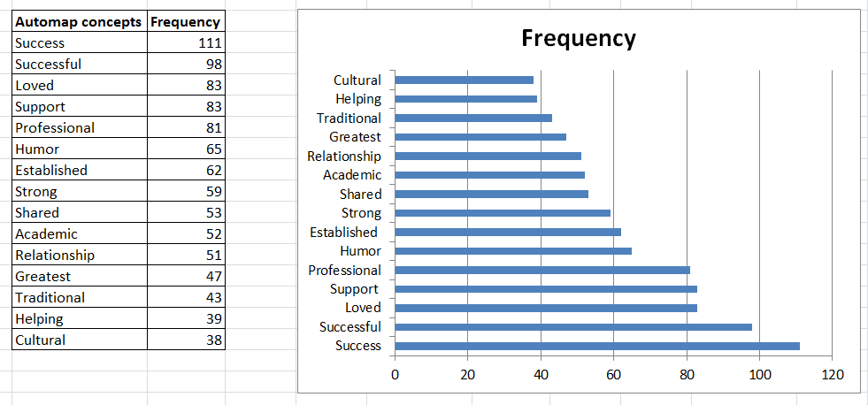
Automap results

Slide 59
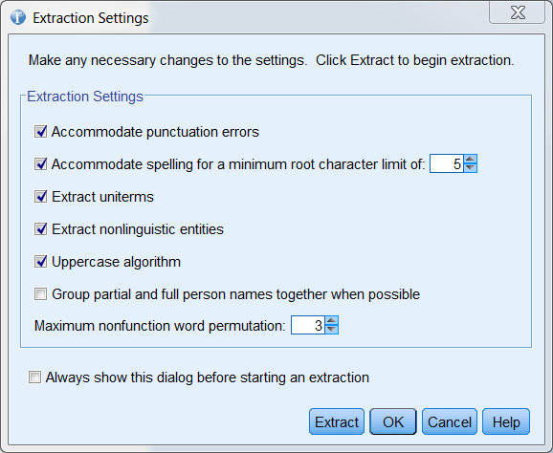
SPSS Text Analytics does not require a lot of data cleaning or pre-processing. Usually the analyst can accept the default settings and proceed.

Slide 60
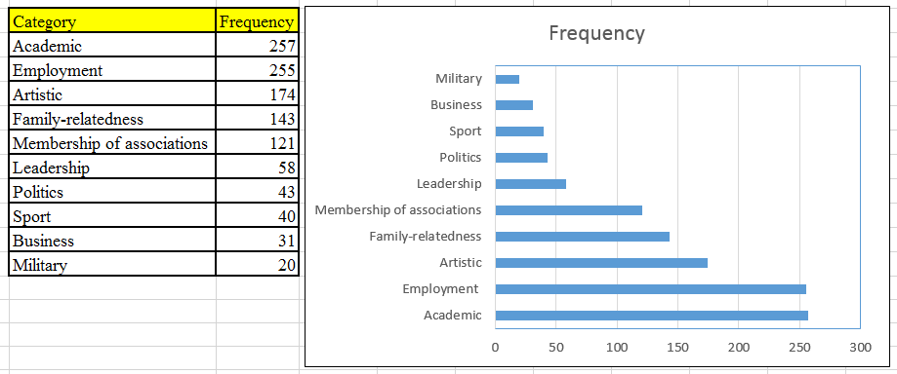
SPSS results

Slide 61
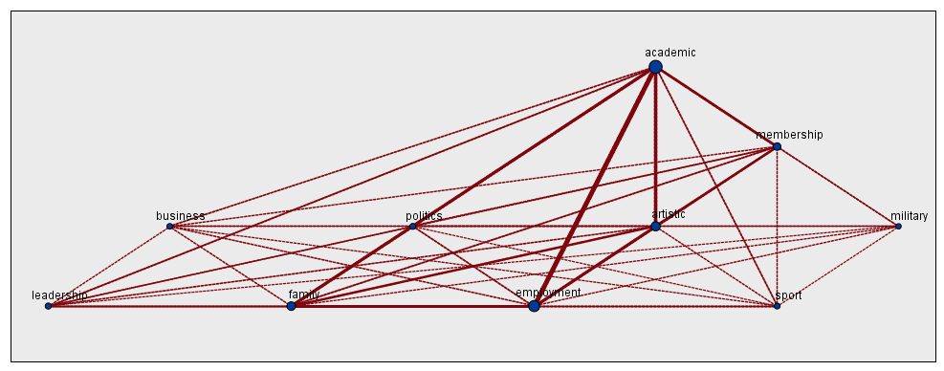
SPSS Category web
Similar to Code relation chart in MAXQDA
Thicker line → stronger relationship (more co-occurrence)

Slide 62
Conclusion
The study is triangulated by analyses performed in two software packages (MAXQDA & SPSS Text Analytics) in two different modes: content analysis by human coders and text mining by algorithms.
In the UK sample achievement-oriented traits occurred more often than pro-social and morality-related traits. This finding suggests that the alleged perception of dead agents may be more cultural than natural.

Slide 63
Assignment 14
Download five-eight Federalist papers from http://www.foundingfathers.info/federalistpapers/fedi.htm
Use SPSS Modeler in the Psychology lab next to Chick-fil-a to run text mining.
What are the common themes (categories) in these Federalist papers? Write a summary based on the frequency table (category bar) and the category web.

