Slide 1
Ungraded quiz
Unit 11

Slide 2
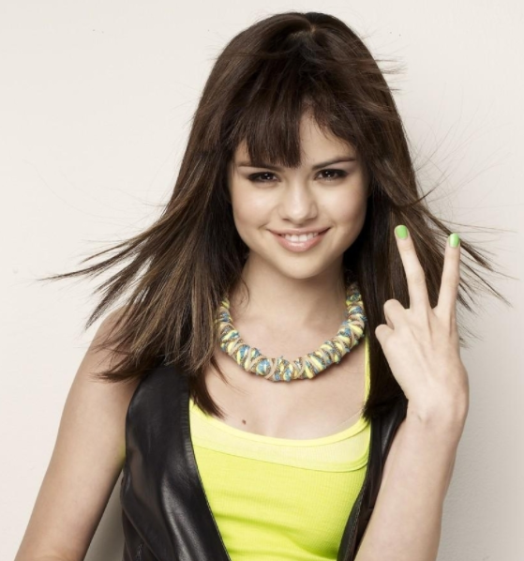
Show me your fingers
Do not shout out the answer, or your classmates will follow what you said.
Use your fingers
  One finger (the right finger) = A
  Two fingers = B
  Three fingers = C
  Four fingers = D
  No finger = I don’t know. I didn’t study

Slide 3
Which of the following statement is true?
William James is opposed to free will.
B. F. Skinner is opposed to determinism.
Benjamin Libet used fMRI to conduct his experiment on readiness potential.
In his experiment John Haynes could predict whether a participant would push the right or left button before that participant is aware of his or her choice.

Slide 4
Which of the following scholar(s) denied the existence of God and free will?
Same Harris
Jerry Coyne
D’Holbach
All of the above

Slide 5
Which of the following scholars proposed the astonishing hypothesis?
Same Harris
Jerry Coyne
D’Holbach
Francis Crick

Slide 6
Which of the following are arguments against determinism?
Pascal triangle: the same input cannot lead to exactly the same outcome..
We make habits and habits make us: Internal compulsion is compatible with free will.
Moral agent: If there is no free will, we are not responsible for our behaviors.
All of the above

