Slide 1
Quantitative research design Guide
Chong Ho Yu
Department of Psychology, APU

Slide 2
Components
Research Problem
Research purpose
Research question
Hypothesis (if there is any)
Guiding theory
Brief literature review: Background information
Research design
Instrument for data collection
Data analysis
Expected findings
References

Slide 3
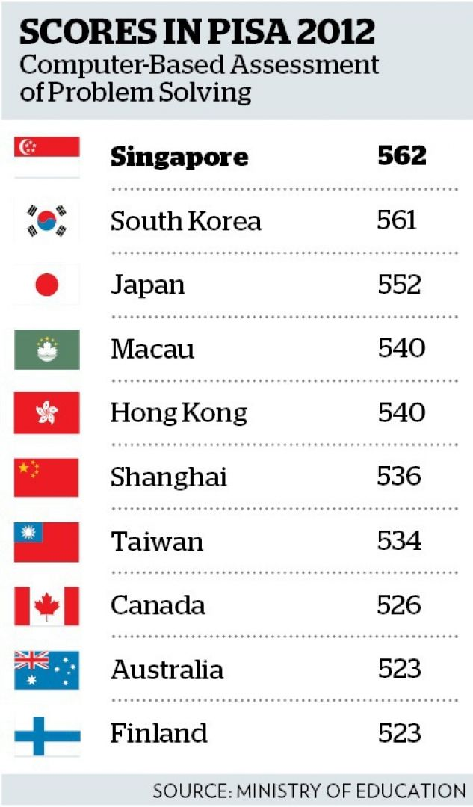
Research problem
An issue that is significant enough to require our attention.
Example:
  International assessments, such as Program for International Student Assessment (PISA) and Trends for International Math and Science Study (TIMSS), indicate that 15-year old American students are far behind to international peers in math and science test performance.

Slide 4

Research problem
What you are interested in may not be a significant issue to other people.

Slide 5

Research purpose
What do you want to accomplish? What is the rationale of doing so?
This is not a reason: “There is a gap in the literature. No one has done it before.” Perhaps no one has done it before because it is not important.
  Example: Identify an effective treatment program to improve student learning in math and science.

Slide 6

Research question
A testable question (be specific)
  Example: Can visualization of mathematical and scientific concepts improve comprehension of math and science, as measured by objective tests?
  Counter-example: Can better teaching lead to better learning in math and science?

Slide 7
Hypothesis (if necessary)
Testable null and alternative hypotheses
Example:
  Null: There is no significant difference between learners who use visualization tutorials and those who don't in understanding math and science, as measured by objective tests.
  Alternate: There is a significant difference between learners who use visualization tutorials and those who don't in understanding math and science, as measured by objective tests.
Additional information: http://www.creative-wisdom.com/computer/sas/hypothesis.html

Slide 8
Data-driven
Conventional hypothesis testing, as the name implies, is hypothesis-driven or theory-laden.
Big data analytics (data mining) is so named because it is data-driven.
You don’t need a very specific hypothesis in big data analytics.
If you use a huge archival data set, you might have 200+ variables and 10,000 observations.
Explore all of them and let the data speak for themselves!

Slide 9
Theoretical framework
In program evaluation the question is about whether the treatment works or not.
In academic research the researcher needs to go one step further: How and why? What is the theory behind the observed effect?
  Example: Cognitive psychology indicates that humans absorb information via multiple channels. Information encoded in text, number, and graph can reinforce comprehension and retention.

Slide 10

Literature review
Prior research related to this topic.
Background information that can help the readers understand the issue.
References should be reliable sources (e.g. scholarly books, professional journals…etc.).
Introductory textbooks/books, magazine articles, and websites that are not affiliated with authoritative organizations can only be cited with caution.

Slide 11
Research design
What are the dependent variable and independent variable?
  Example: DV – Test score; IV – Visualization tutorials
What is the research design and the rationale?
  Example: This is a pre- and post-test between-subject design. Subjects will be randomly assigned into two groups (R). One group will use visualization tutorials to learn vector geometry and the other will use conventional textbooks and lectures (X). A pretest will be used as a baseline (covariate) for adjusting the posttest performance (O).

Slide 12
Research design
What are the potential threats against the internal and external validity of this design? How can these threats be minimized?
  http://www.creative-wisdom.com/teaching/WBI/threat.shtml
What is the target population to which your inference is made?
  Example: All American Grade 10 students.
What is the accessible population from which you will draw samples?
  Example: Grade 10 students in a local high school.

Slide 13
Research design
What is your sampling method?
  Example: Convenience sampling. I will go to several classes in Azusa High School to recruit subjects who are willing to participate in this study.
How will you choose the alpha level, effect size, power level, and sample size?
  http://www.creative-wisdom.com/teaching/WBI/power_es.shtml
  Example: Given that the alpha level is .05, the effect size is .25, and the power level is .80, the desirable sample size should be 128.

Slide 14
Instrument
Do not make up your own test or survey (e.g. Dr. Yu’s test of IQ, Ashley’s test of mental health)
The instrument (e.g. test, survey) must be psychometrically sound.
  E.g. reliability and validity
  http://www.creative-wisdom.com/teaching/assessment/reliability.html
If you download archival data from a trustworthy source (e.g. OECD), you don’t need to address the above. Just cite the source.

Slide 15
Data analysis
The procedure for data analysis must fit your data type and research purpose (e.g. hypothesis-testing or exploratory).
If you have a large data set, it is inappropriate to use any conventional statistical procedure.
How large is large? If the statistical power is close to .99, then any trivial effect would be mis-identified as significant.
Use big data analytics for big data.

Slide 16
References
APA style
Please read the following documents for additional information:
  http://www.creative-wisdom.com/teaching/512/Others/APA.doc
  http://www.creative-wisdom.com/teaching/512/Others/use_of_literature.doc

