Slide 1
512 Orientation
Chong Ho (Alex) Yu

Slide 2

About the instructor
He has a dark side!!!
Multiple personalities!!!
http://www.creative-wisdom.com/pub/pub.html

Slide 3
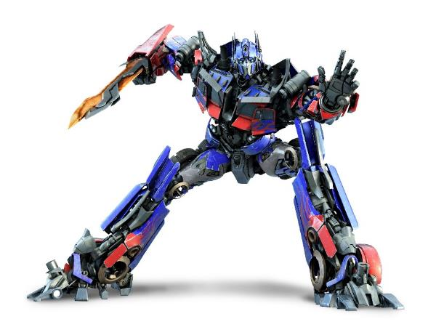
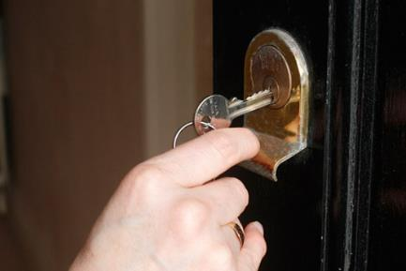
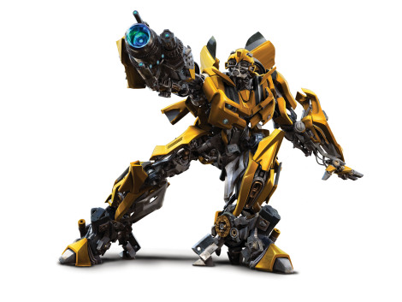
Master research methods
You will be a key to unlock all doors
a train for all tracks
a transformer!
a researcher demanded by everyone!

Slide 4
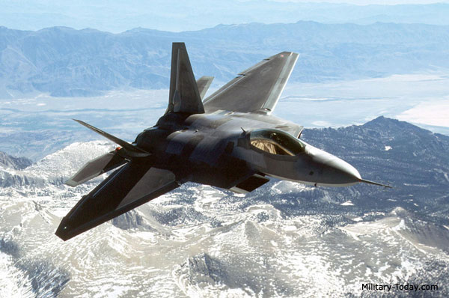

How can I go there?
Question: You are a pilot in the US Air Force. Which airplane will you use to fight a battle?

Slide 5
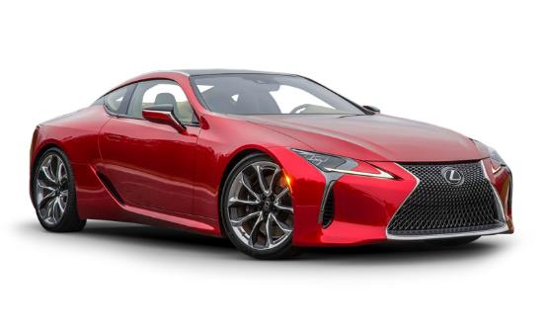
To be a proficient researcher
You need the best tools and the skills in high demand
http://indeed.com
http://www.payscale.com/research/US/Country=United_States/Salary
The 21 Most Valuable Career Skills Now
You can buy a Lexus!

Slide 6
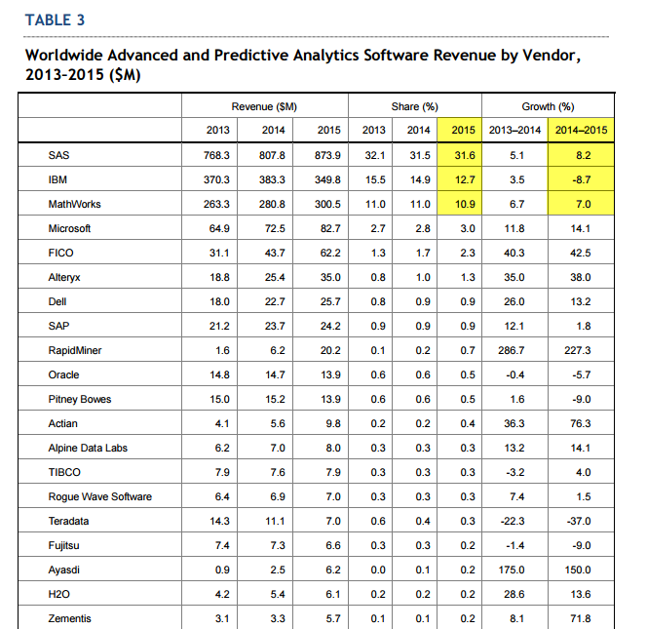

Slide 7
What is SAS?
SAS = Statistical Analysis System, or Short and Sweet, Sing Along Song, South African Society, Saudi Arabia Soldiers.
 | Price | Pros | Cons
SAS programming environment | $$$$$$$ | Versatile Automation Deal with extremely large & complex data set | Steep learning curve $$$$$$
SAS Enterprise Guide | Free to students | Graphical user interface (GUI)
SAS Enterprise Miner | $$$$$$$ | Good for data mining | $$$$$$
SAS on Demand | Free to students | Full features | Web-based application
SAS University Edition | Free to students | In your desktop | Partial features
JMP | We have a license | GUI | No advanced features
JMP Pro | We have a license | GUI + advanced features

Slide 8

Question
What can you do with $12?
You can buy a meal at Red Lobster (with a coupon)
But you can also use $12 to change your life!

Slide 9
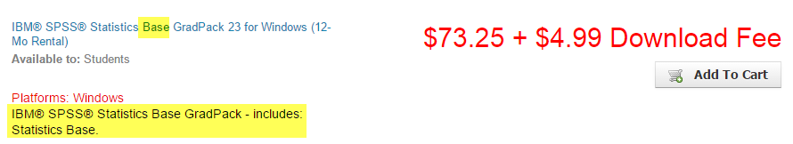
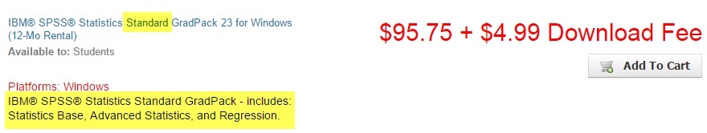
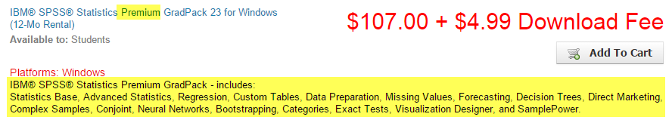
Difference between stanard and Premium SPSS: $12

Slide 10
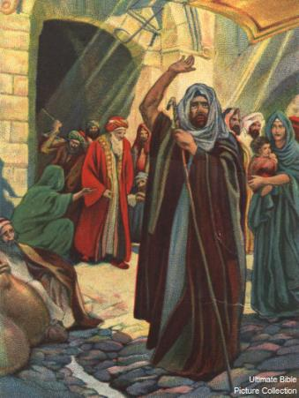
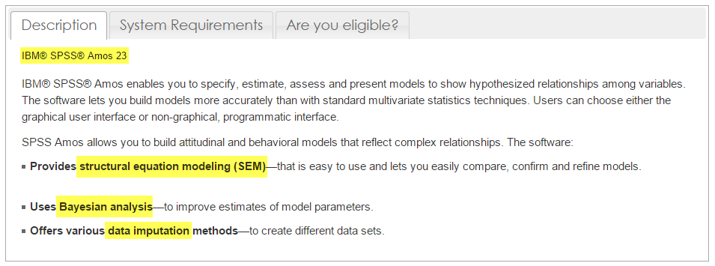
AMOS for CFA and SEM
It is better to get AMOS, too.
Not this AMOS →

Slide 11


You need modeling!
Not this kind of modeling

Slide 12
IBM SPSS Modeler
SPSS statistics is more for conventional statistics
SPSS Modeler is for data mining, text mining, and predictive analysis.
We have a license!

Slide 13

Cool!
I want to buy a Lexus!
I will be a key that can unlock all door!
I will be a train for all tracks!
I will a transformer!
I will be a researcher in high demand!
But, there is no free lunch!
My story

Slide 14
82% chance you will fail!
National Institute of Health (NIH) received 51,073 research project grant applications
Funded: 9,241, resulting
Success rate: 18.1 percent.

Slide 15
82% chance you will fail!

Slide 16
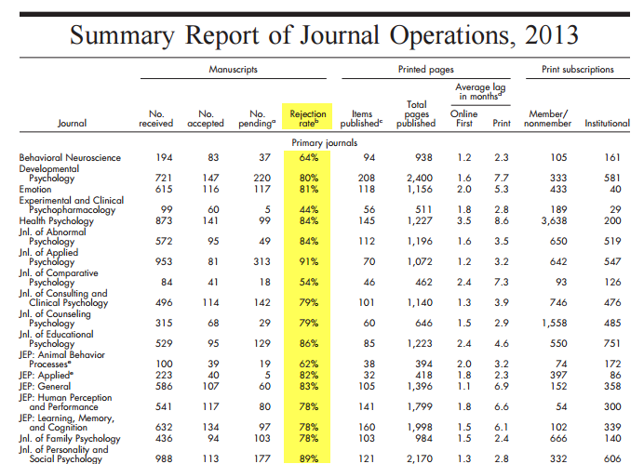
Peer review: Rejection is normal

Slide 17
Harsh comments are normal
“The paper was not well written by professional journal standards. A reviewer said confidentially that he thought it was written by an undergraduate student. I read and immediately saw that much of the introduction was a too-long general overview of the area instead of a tight, focused, logical argument that lead directly to this study. It should have been at most half its present length, maybe less. Stated in summary notation: There were redundancies. There were wording problems, lots of them. There were things said that need not be said because the readers already know them -- plenty of them. “

Slide 18
But don’t be discouraged
The manuscript was submitted to another journal and was accepted.
Yu, C. H. (2015). Are positive trait attributions for the deceased caused by fear of supernatural punishments?: A triangulated study by content analysis and text mining. Journal of Psychology and Christianity, 34, 3-18.

Slide 19
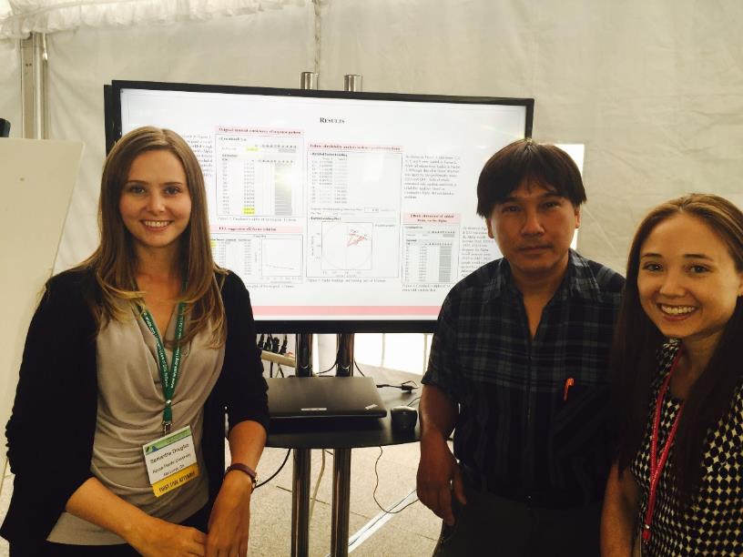
Besides a thick skin, what else?
Go beyond APU, attend conferences!

Slide 20
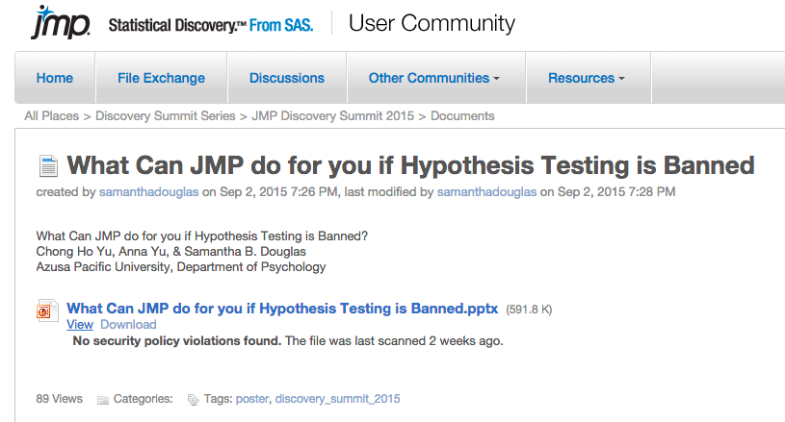
JMP Conference

Slide 21
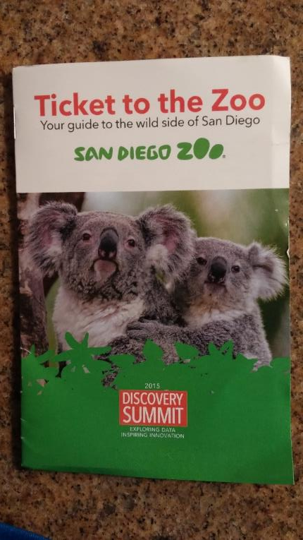
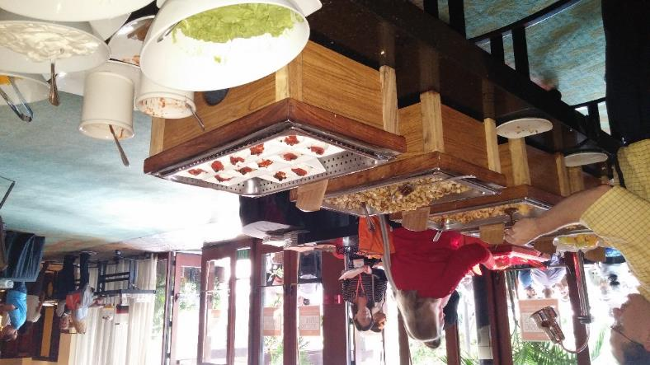
It is fun!
Breakfast, lunch, dinner, snack, entertainment…etc. are all included

Slide 22
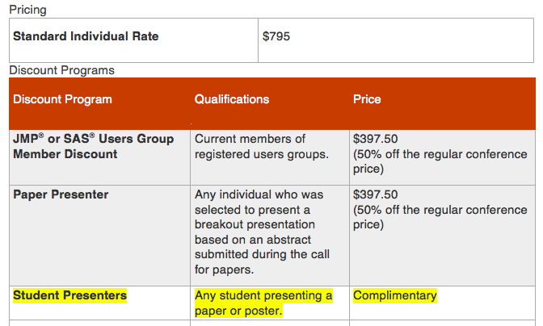
How much?

Slide 23
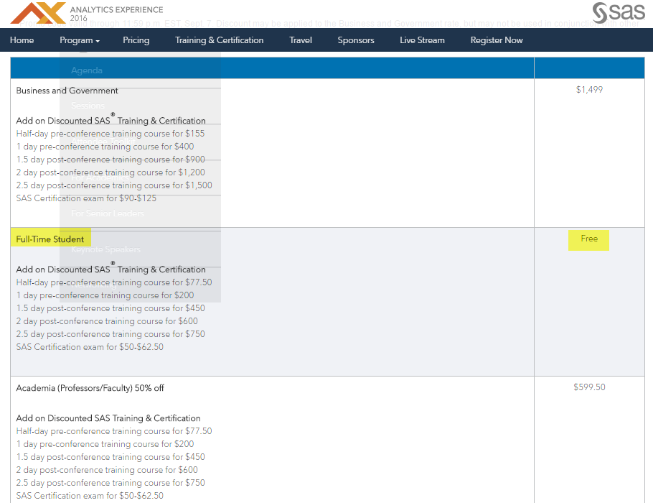

Slide 24
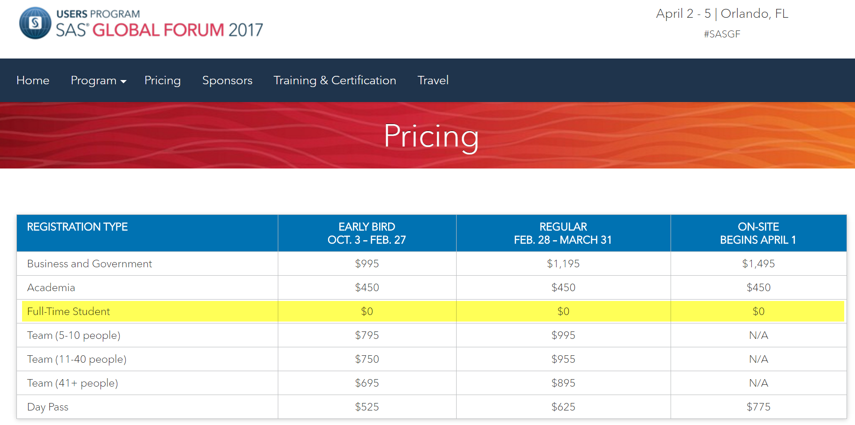
2017 SAS Conference in Orlando

Slide 25

“I don’t have money to travel”

Slide 26
