Slide 1
Week 3
512 Non-experimental research methods

Slide 2
What is experiment?
Random sampling: a sampling method in which each member of a set has independent chances to be selected (the notion of "equal chances" is a theoretical ideal mentioned by many textbooks, but there are always some hidden bias or disposition in the real world).
Randomization: randomly assign subjects into the control group and the treatment group.
Experimenter manipulation: directly manipulate variables to test cause-and-effect relationships e.g. alter the amount of drug given to the patients.
Experimenter control: involves control of all other extraneous variables or conditions that might have an impact on the dependent variables.

Slide 3
What is non-experiment?
You have none of the above.
“Is there a relationship between IQ and resiliency?”
Ex post facto (after the fact)
Observational study
Causal-comparative (misnomer)
Survey research
Archival research

Slide 4
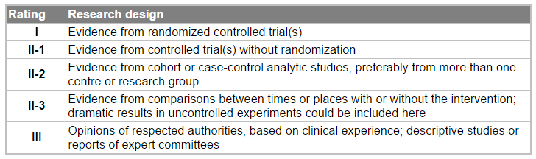
Is experimentation the Gold standard?
Canadian Task Force for Preventive Health Care (2003)

Slide 5

Is that true?
Amanda conducted an experiment in a controlled setting whereas Crystal did an non-experimental study in a naturalistic setting.
Amanda said to Crystal, “Ha! Ha! My thesis is an experimental study. I can draw a firm causal conclusion but you cannot. I am the best!”

Slide 6
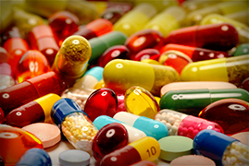
Gaps between the real world & the lab
Essock et al. (2003) observed the discrepancy between the "real world" and the lab settings. Many drug treatment studies last about four to eight weeks only. Short-term drug tests may cost less to implement, but usually these studies do not yield the statistical significance that is found in long-term experiments.

Slide 7
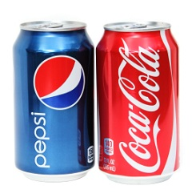
Pepsi Challenge
In experimental settings, most participants prefer Pepsi to Coke.
However, this so-called "Pepsi Challenge" is based on the unrealistic "sip test" method.
Most tasters would favor the sweeter of two beverages when they make a single sip only, but the result is reversed when the entire can or bottle is consumed

Slide 8

Is that true?
Jessica conducted an experiment with 50 subjects recruited from APU. Ashley downloaded an archival data set from the United Nations. The sample is 100,000 but the data are observational (non-experimental). Every member nation reported to the UN about what had happened in its society.
Jessica said to Ashley, “Ha! Ha! My thesis is an experimental study and yours is not. My conclusion is more trustworthy than yours.”

Slide 9


Paradigm shift: The era of Big Data
Today many agencies and corporations make decisions based on big data analytics.
Every day 2.5 Quintillion* bytes of data are created. Everyone creates data. Everything you do leaves a trace.
“Extremely large data sets that may be analyzed computationally to reveal patterns, trends, and associations, especially relating to human behavior and interactions.”
* a thousand raised to the power of six (10^18)

Slide 10
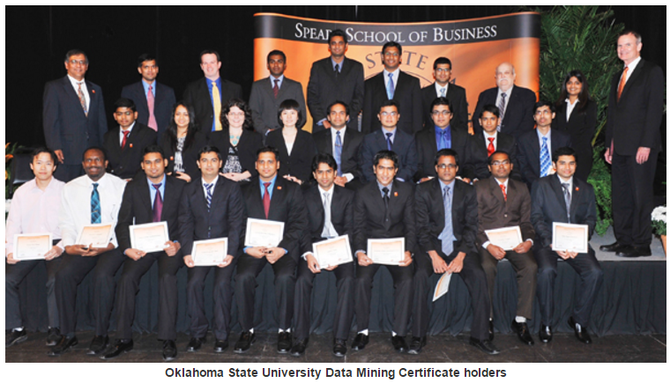
SAS Certification Program
SAS Global Academic Program
  You don’t need to take the external SAS exam.
  The joint-certificate is awarded after completing the program.
  Peers: Purdue University, Texas A & M, University of Denver, UC-San Diego, Oklahoma State University

Slide 11
SAS Certification Program
SAS Global Certification Program
  You need to pass the SAS exam to be certified
  Designed for individuals who can manipulate and gain insights from big data with a variety of SAS and open source tools, make business recommendations with complex machine learning models, and then deploy models at scale using the flexible, robust SAS environment
What is Big data?
What is machine learning?
  The sample is partitioned into subsets. Some subsets are used for training. The computer algorithm can “learn” from previous models to improve subsequent models.

Slide 12
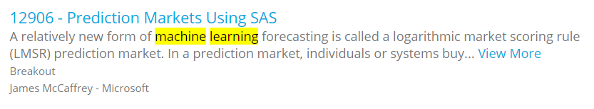
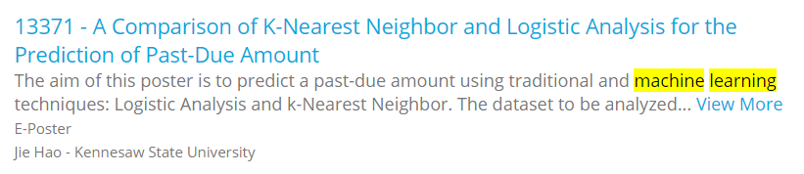
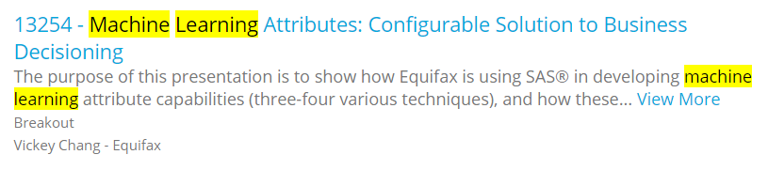
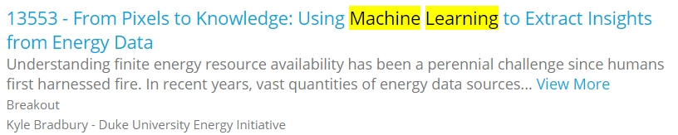
SAS Analytics Experience Conference

Slide 13
Basic JMP
Contextual menu and dynamic graphic
The output is not “frozen” (done). You can determine what to do next by looking at the output.
You can ask “what-if” questions by exploring alternate approaches.
Please do not try to follow what I do when I am doing a demo. You will have a chance to practice.

Slide 14
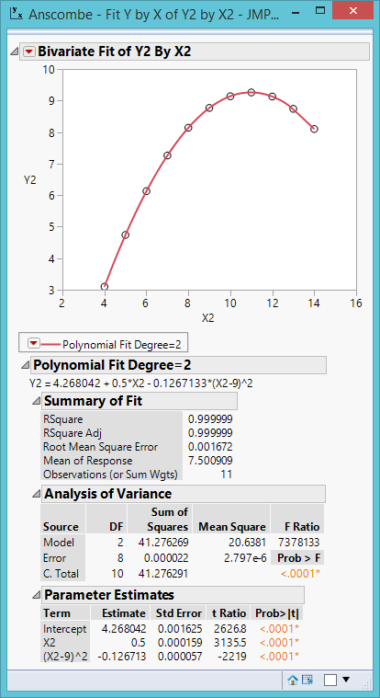
Anscombe data
Non-linear fit

Slide 15
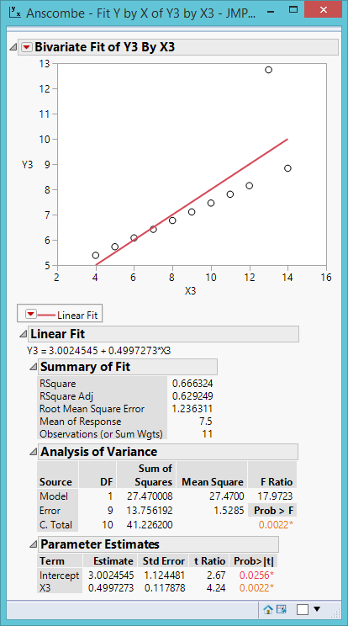
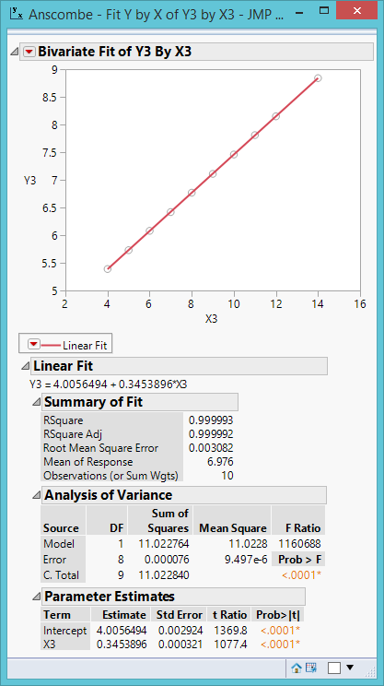
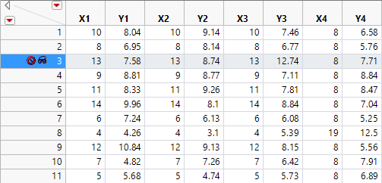
Anscombe data
Remove outlier

Slide 16
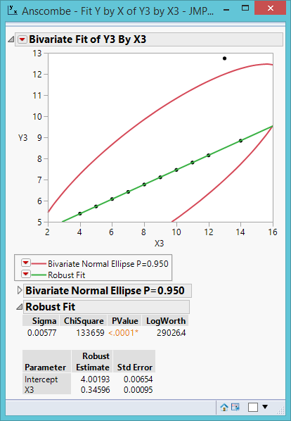
Anscombe data
Robust fit
Robust against outliers

Slide 17
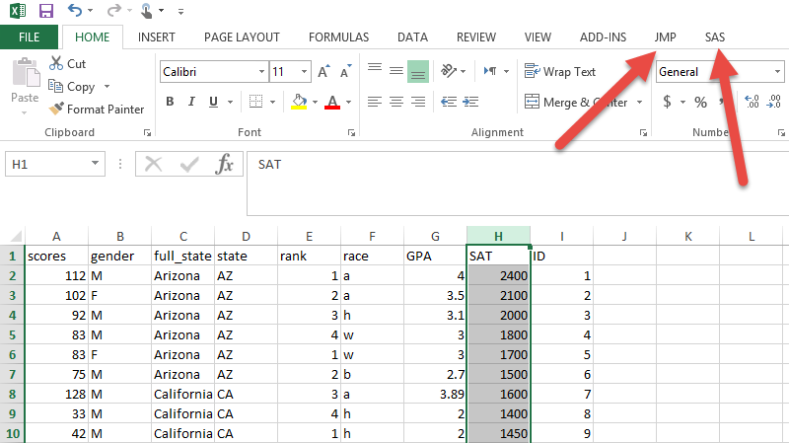
Input
JMP
SAS
HTML
SPSS
Import Excel
Invoke JMP from Excel (Window only)

Slide 18
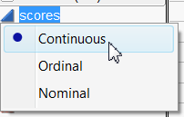
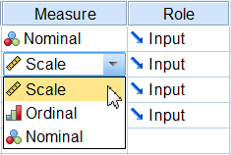
Three levels of measurement in practice
In theory there are four levels of measurement.
In computation there is no difference between interval and ratio
No matter whether the scale has an absolute or not, it won’t affect the statistical procedure.

Slide 19
Output
Report with embedded data: JRP
Script
PowerPoint
PDF
PNG
Interactive HTML
RTF
MS Word
Many others
Windows:
  Save as
Mac:
  Save as
  Export
Copy and paste

Slide 20
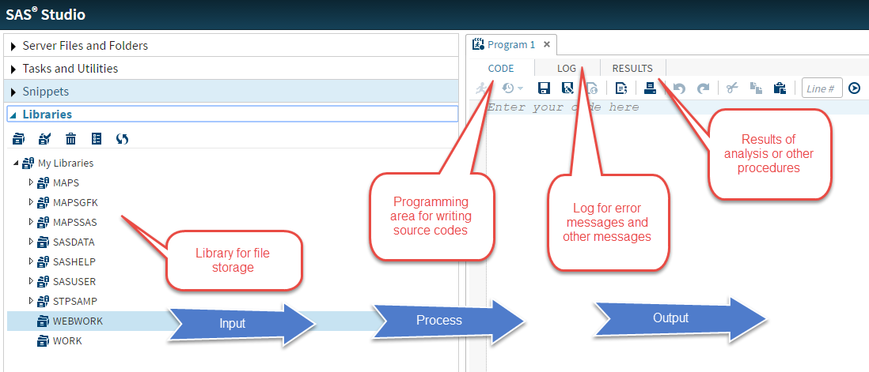
SAS Basic

Slide 21
SAS Basic
Data steps
  Data one; set thesis.anxiety;
  Data two; set anxiety; /* assume the data set “anxiety” is in the work library
Procedure steps;
  PROC MEANS; var X1 X2 Y; run;
  PROC REG; model y = X1 X2; run;

Slide 22
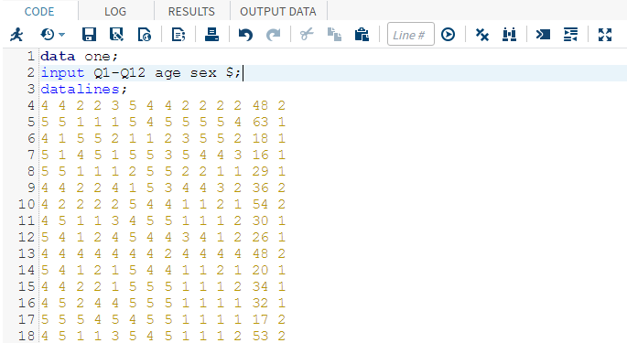
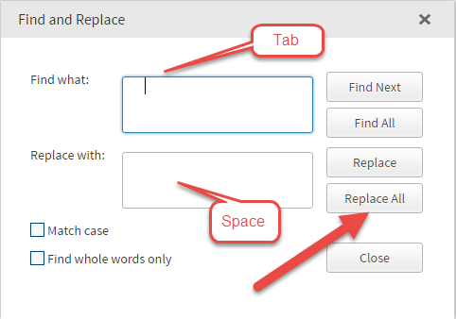
Input: Copy and paste

Slide 23
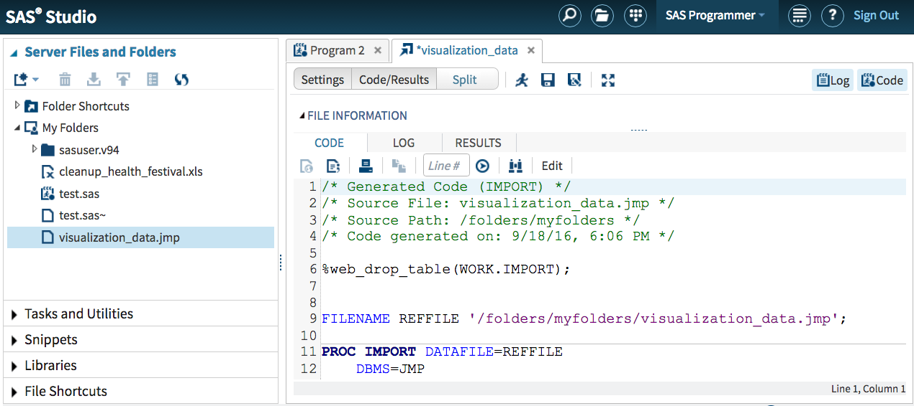
Input: MyFolder
Drag and drop

Slide 24
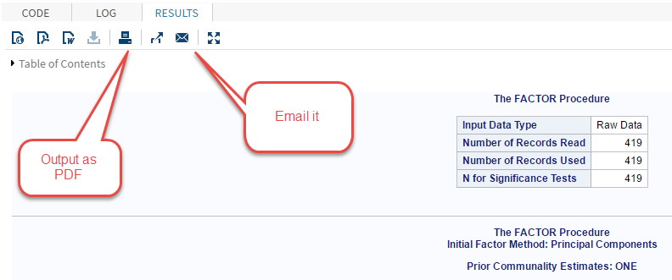
Output
Specify journal style in Output Delivery System (ODS)
SAS on demand: Email or save as/print as
SAS UE: Save as

