Slide 1
Week 4:
Data management and cleaning
Chong Ho (Alex) Yu

Slide 2
Good research depends on good data
No sophisticated statistical procedures can rescue a project flooded with faulty or/and messy data.
Good research design and good planning of data collection will make things easier and better in the subsequent stages.

Slide 3
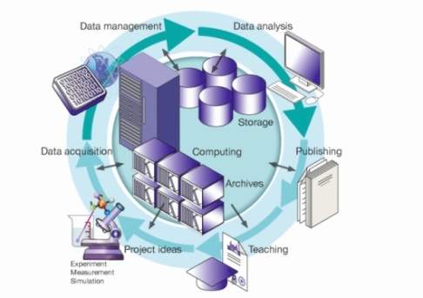
Data Management and cleaning
Data management:
  Proactive
  Avoid messy or confusing data when writing the test/survey items
Data cleaning:
  After the fact
  Check data integrity using the dynamic environment.

Slide 4
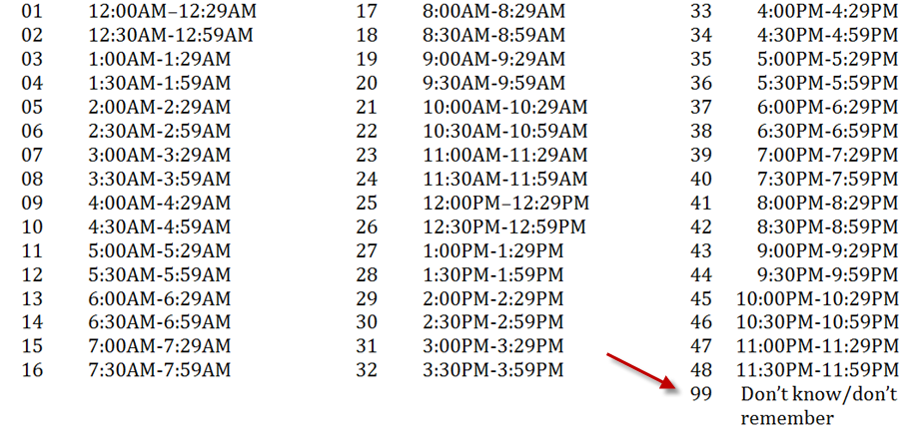
Examples
What time usually do you go to work?

Slide 5
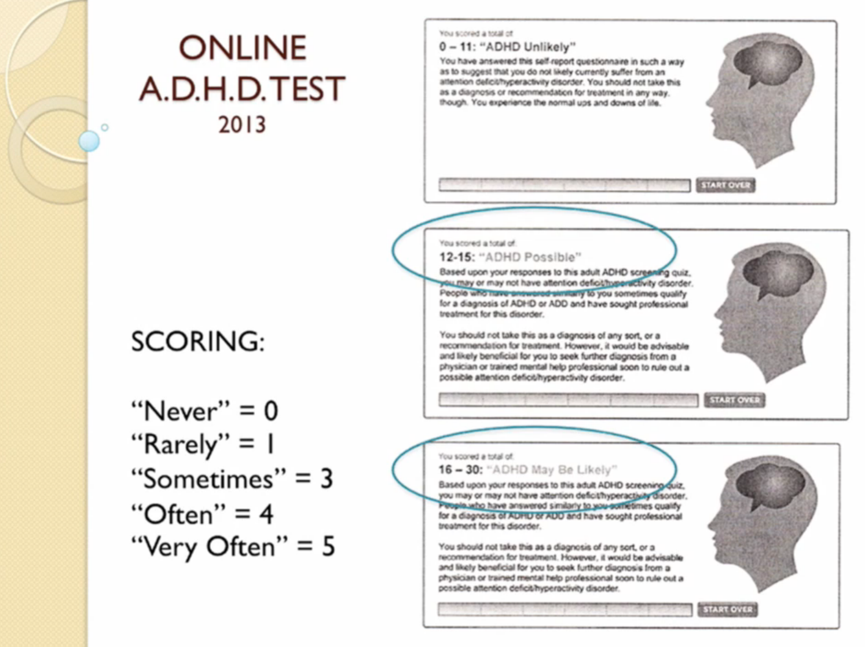
Examples
Source: Alan Schwarz (2015). Keynote of SAS Global Forum. Dallas, TX

Slide 6
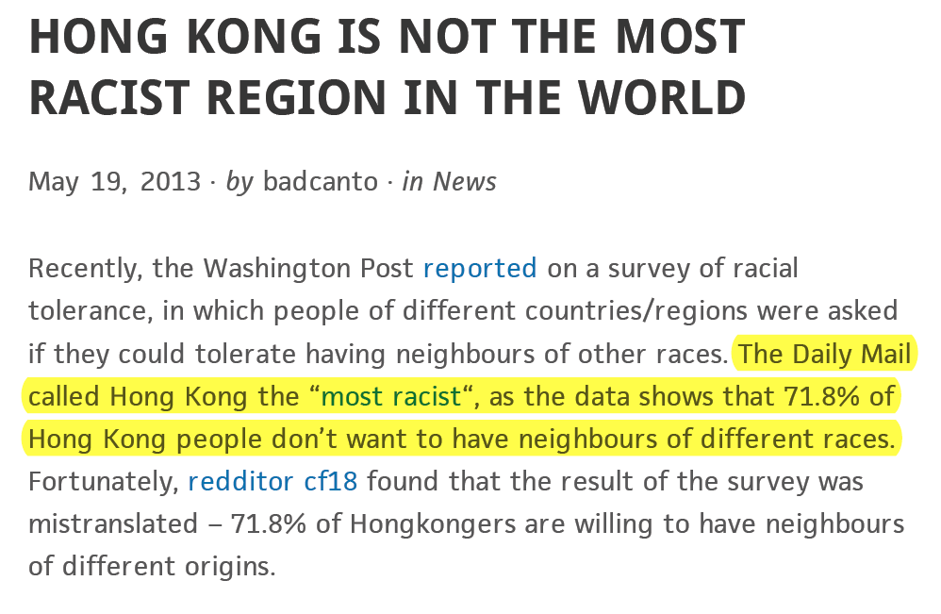
Examples

Slide 7
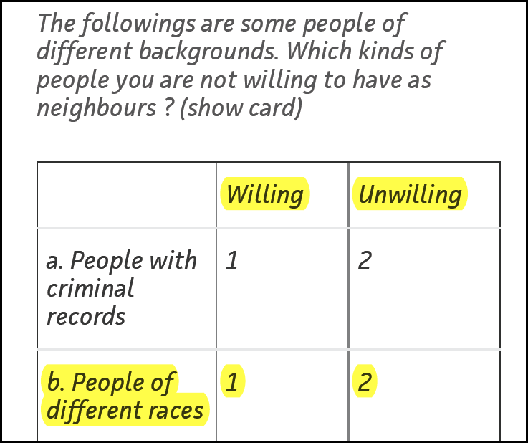
Examples
By common sense:
Yes = 1
No = 0
Why “not willing” = 2?

Slide 8
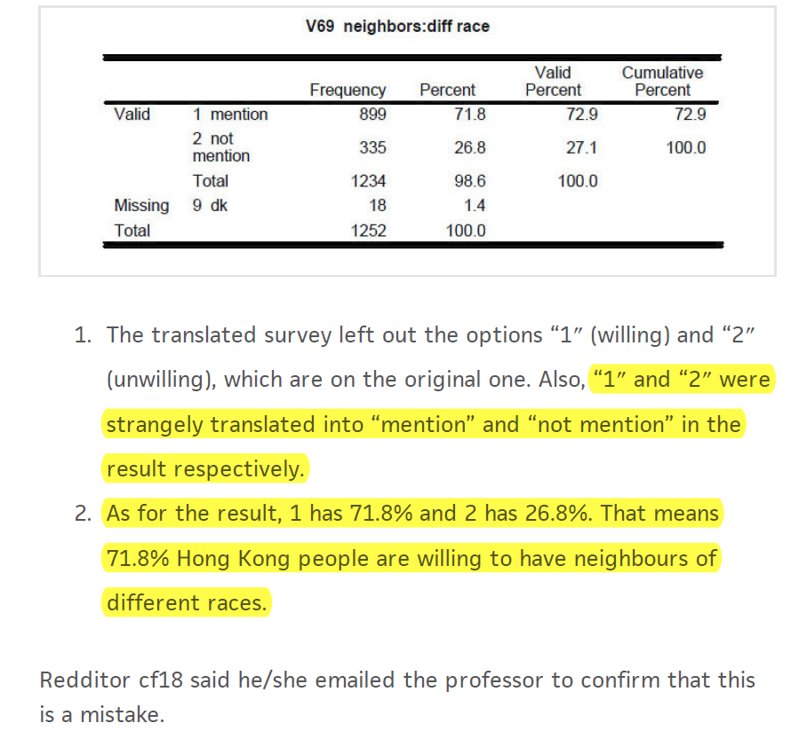

Slide 9
What is the best codebook?
The best codebook is no codebook or fewer codes!
Many people code the data in this way:
  Gender : Male = 1, Female = 2
  Race: White = 1, Black = 2, Hispanic = 3, Native American = 4, Asian = 5
Why not directly put down “M” as Male, “F” as female, “W” as white, “B” as black, “Y” as yes, and “N” as no…etc.? The letters are intuitive and you will never make any mistake by miscoding.

Slide 10
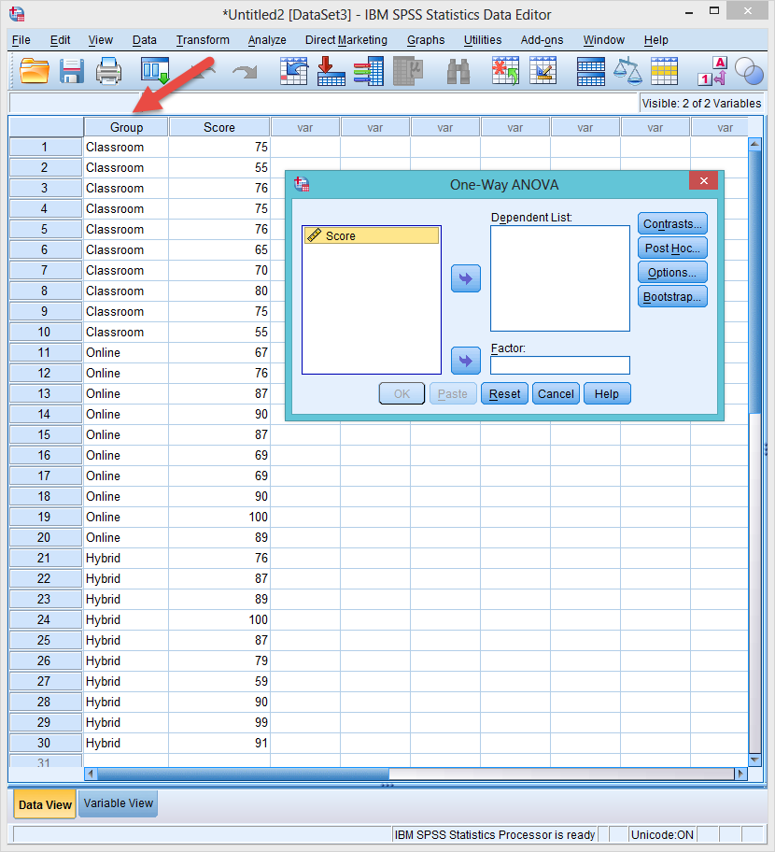
Disappearing factor
Sometimes it is understandable why people use numbers.
In SPSS when letters are used in a grouping factor, it cannot show up!

Slide 11
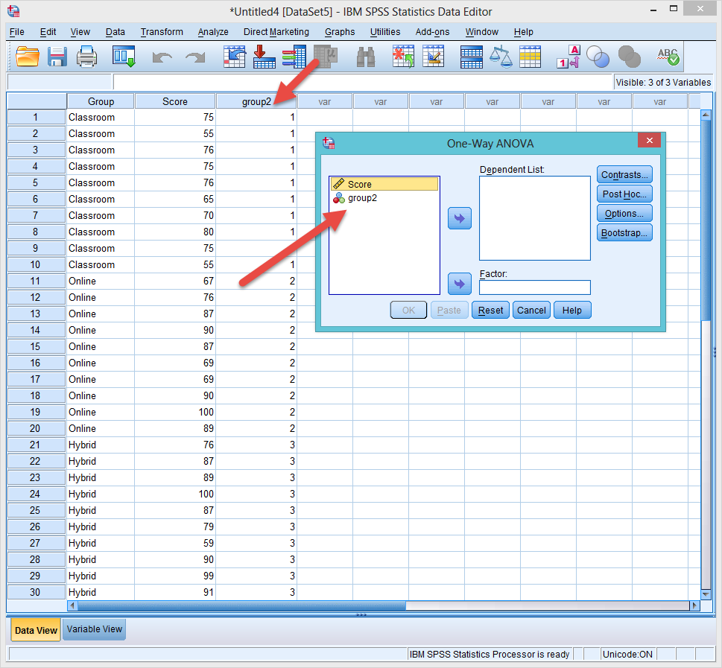
Recode to numbers
To see the grouping factor, you need to recode the letters to numbers.

Slide 12
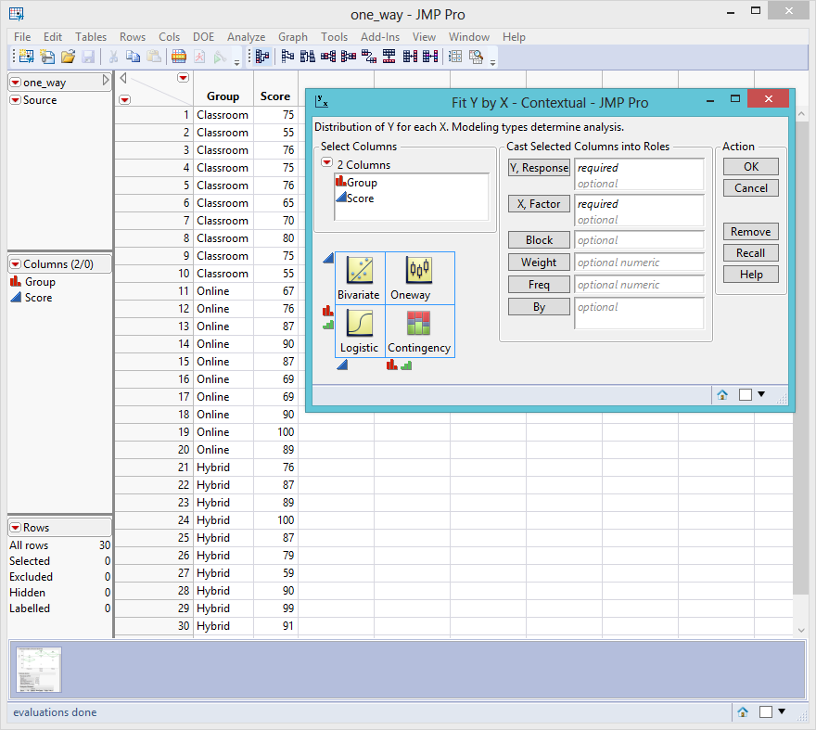
SAS and JMP are OK with numbers

Slide 13
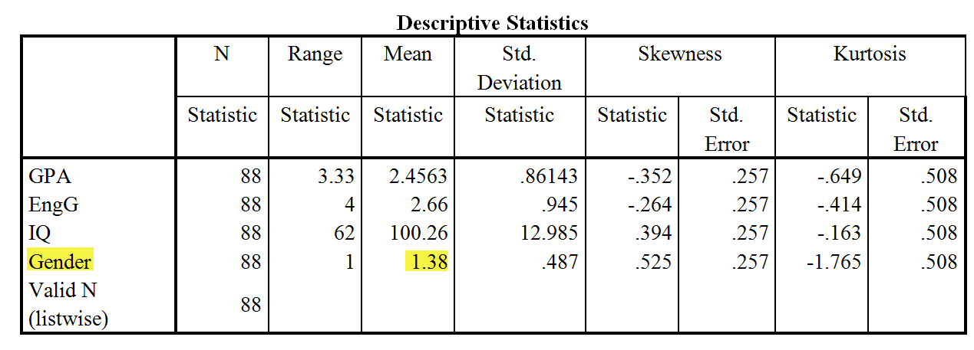
Don’t make these mistakes!
The following is a real report produced by a real student.
What’s wrong in the following table?

Slide 14
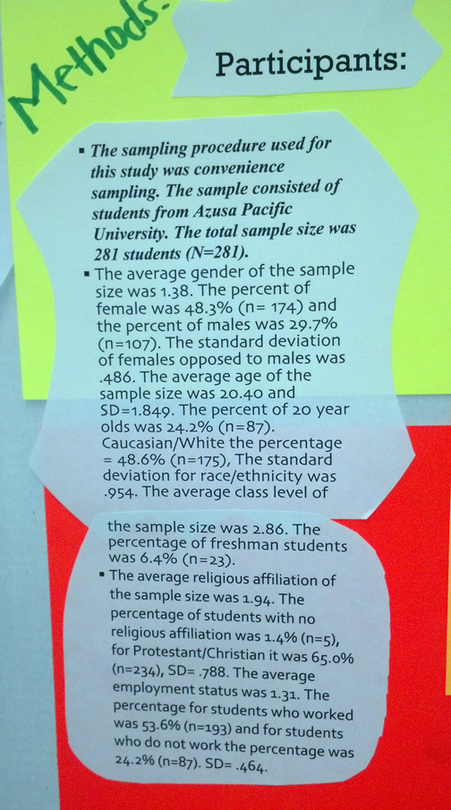
Don’t make these mistakes!
What’s wrong in this poster presentation?

Slide 15
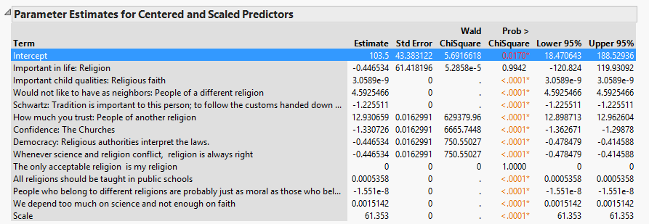
Your life is easier if…
I use very descriptive labels. I can work much faster in my analysis.
The output is ready to be pasted into the paper without changing the names.

Slide 16
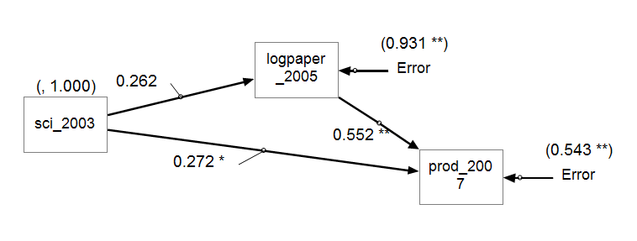
Exception 1: CFA/SEM
If you run Confirmatory Factor Analysis (CFA) or/and Structural Equation Model (SEM) in SPSS’s AMOS, JMP, or SAS, you have to use shorter labels.
  These programs cannot accept long variable names.
  Even if they can, you confuse yourself when the long names jam together on the small icons.

Slide 17
Exception 2: Programming
Data one; input Q1 Q1b Q1c Q1d Q1other Time_SH Time_Wk Com_Ex Web_Ex Res_Ex Q4a Q4b Q5c Q5d; cards; | Data one; input Q1-Q26; cards;
If you handle large databases and write programs for automation, use numbers at the end of variable names rather than characters.
In SAS you can assign variables as "Q1-Q26," but you cannot assign variables as "Qa-Qz."
If you use numeric variable names, you can be more efficient by saving time from typing and from matching the names on the hard copy and the variable names on the screen. When you have many variables, using character labels makes referencing extremely difficult.

Slide 18
Exception 2: Programming
Data one; input Q1 Q1b Q1c Q1d Q1other Time_SH Time_Wk Com_Ex Web_Ex Res_Ex Q4a Q4b Q5c Q5d; cards; | Data one; input Q1-Q26; cards;
When someday you want to rename the variables, using numeric names will be very convenient. For example, to rename Q1-Q100 as Question1-Question100, the code is: data new(rename=(q1-q100 = question1-question100));
When you want to do array manipulation, you will find that it is much easier to assign an array like array question(*) question1-question100;

Slide 19
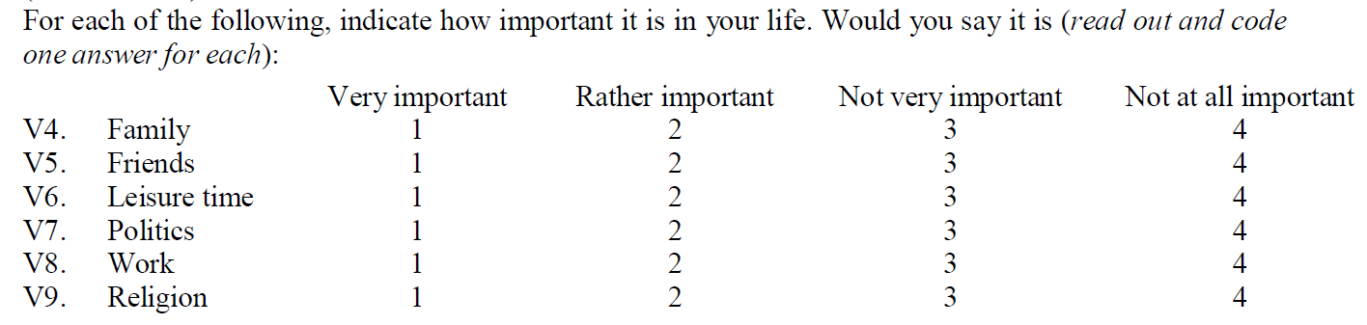
If you use numbers…
This example items are found in “World value survey”.
Sometimes you have to use numbers when you want to treat the data as continuous.
If so, use a more “natural” or “intuitive” way: bigger is better! e.g. 4 is “very important” and 1 is “not important”

Slide 20
If you use numbers…
It will be very difficult and confusing to interpret the result. You have to make mental reversal.
Sometimes you may forget and give the opposite conclusion!
One may argue that you can reverse the scale while doing data analysis. But why not do it right at the beginning?

Slide 21
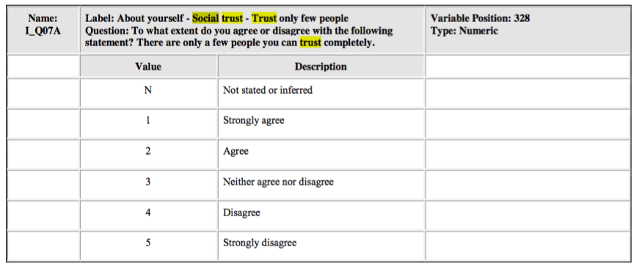
This problem is common!
OECD: PIAAC code book

Slide 22
One column contains only one data element
The column “range” is not computable.
It should be decomposed into two columns .
range | min | max
5.1-32.1 | 5.1 | 32.1
7.27-10.65 | 7.27 | 10.65
6.51-11.42 | 6.51 | 11.42
6.2-10.3 | 6.2 | 10.3
4.2-6.7 | 4.2 | 6.7
6.2-8.4 | 6.2 | 8.4
9.3-24.5 | 9.3 | 24.5
3-7 | 3 | 7
5.4-12.4 | 5.4 | 12.4
5.3-10.6 | 5.3 | 10.6
5.5-11.6 | 5.5 | 11.6
5.1-32.1 | 5.1 | 32.1
9.3-24.5 | 9.3 | 24.5
6.2-10.3 | 6.2 | 10.3
2.3-56.2 | 2.3 | 56.2
2-39.5 | 2 | 39.5

Slide 23
Basic tools to clean up data
Change one variable
  Cols: Recode
  Can output a new variable
  Cols: Column Info
Change multiple
  Standardize attributes
Inspect a chunk of observations
  Tables: Subset

