Slide 1
Survey research
Chong Ho (Alex) Yu

Slide 2
Survey research
Also known as descriptive research
Ask people about facts (e.g. age, how often do you do binge drinking?)
Ask people about opinions (e.g. Rate the following statement using a 4-point scale, where 1 is strong disagree and 4 is strong agree: Professor Yu is a nice man)

Slide 3
Common mistake:
Double-barreled question
"Do you agree that low enrollment in Program X is due to lack of interest among current users?"
If the user replies, "agree," it could mean:
  I agree that the enrollment is low
  I agree that people are not interested in it.
  I agree that low enrollment is caused by lack of interest.

Slide 4
Common problem: What is “3”?
Do you agree that Obama’s affordable care is a good policy? Rate this statement using a 5-point Likert scale:
  1= strong disagree
  2=disagree
  3=neutral (neither agree nor disagree)
  4=agree
  5=strongly agree

Slide 5
Common problem: What is “3”?
Peter, Paul, and Mary chose "3".
Peter's position: "I am not sure. There are both pros and cons in this policy."
Paul's position: "I already have my own insurance. I don't care."
Mary's position: "I am a new immigrant. I don't know what Obama’s affordable care is. No idea!"
Are these "neutral" answers the same?

Slide 6
Common problem: What is “3”?
Are these "neutral" answers the same?
Today many surveys use a 4-point scale.
No neutrality! You are either with us or against us!

Slide 7
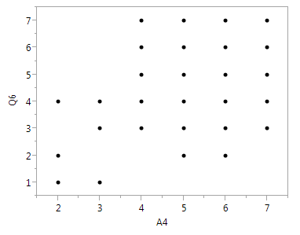
Can we treat a single
Likert scale as continuous?
You can, but…
When you look at the scatterplot, you will not see a clear associational pattern
Why? The scale is too narrow (1-7).

Slide 8
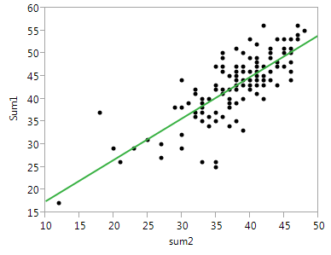
Use composite (sum) scores
The correlational pattern is clear.
Why? The composite score forms a wider distribution (7 X 8 = 56; 7 X 7 = 49).

Slide 9
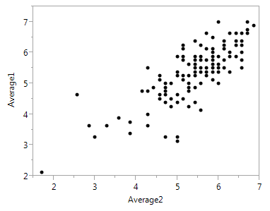
Use composite (sum) scores
It works if and only if there are no missing data. If there are “holes” in the spreadsheet, you can use the average scores instead. The result will be the same.
When averaging the scores, the formula will not take the missing cell into the equation. For example, suppose there are five items. If the scores are 4, 5, missing, 3, 1, the sum of 4, 5, 3, 1 will be divided by 4, not 5.

Slide 10
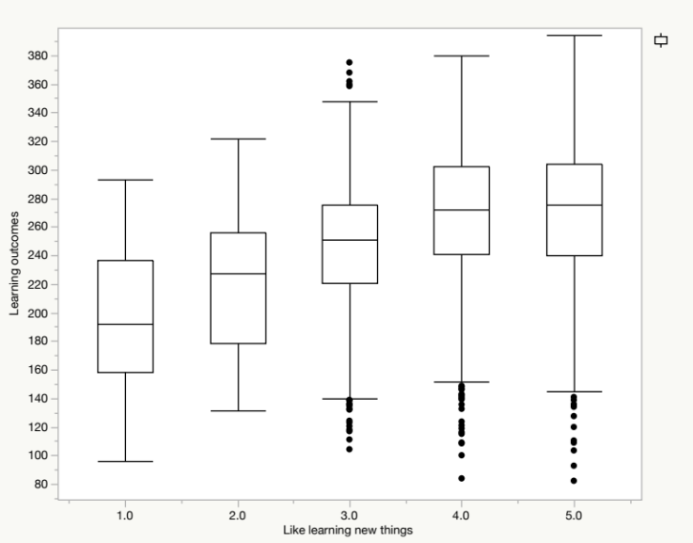
Exception
When you have a large sample size, it is OK to treat a single, narrow Likert scale as continuous.
The scatterplot might not show a pattern. But median smoothing can.

Slide 11

Example: DUREL
Duke University Religion Index (DUREL): A brief measure of religiosity
Five items and three dimensions:
  Organizational religious activity: Attending church
  Non-organizational religious activity: Prayer, meditation
  Intrinsic religiosity: Subjective

Slide 12
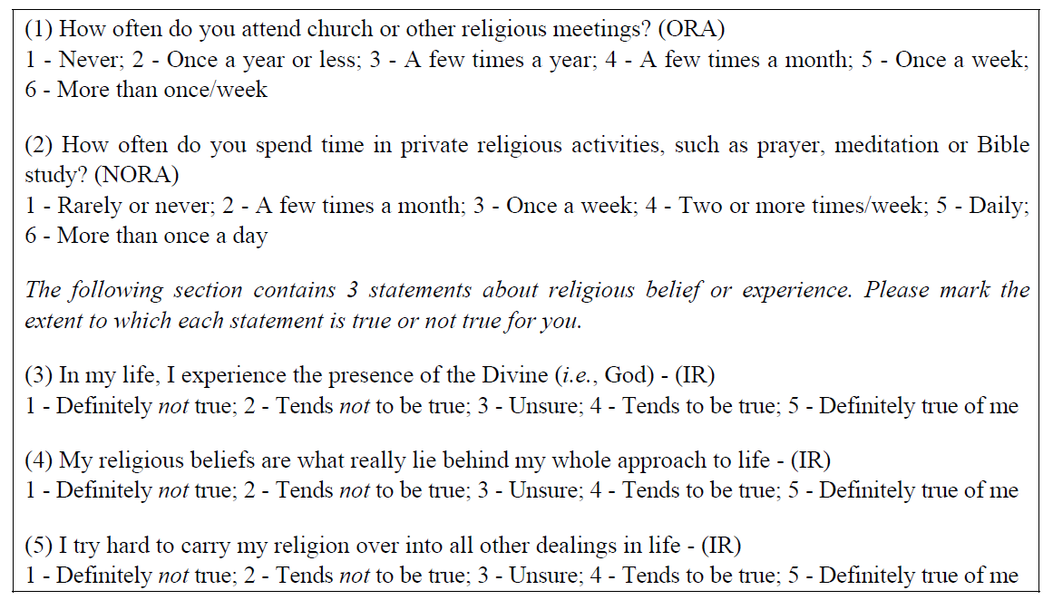
What are these items? Ordinal? Continuous?

Slide 13
Advantages of Online Survey
Lower error rate: If you collect data using papers, you need to enter the data into the database later. Needless to say, there would be errors during the data entry process. On the other hand, an online survey directly captures the data and the error rate is virtually zero.

Slide 14
Advantages of Online Survey
Lower cost: If you collect data using papers, you need to print hard copies and then mail them to your potential participants. Because the printing and mailing fees are high, you must be very selective in sampling. However, if you use the online approach, you can reach a larger accessible population. The survey will be sent with recycled electronics.

Slide 15
Advantages of Online Survey
More freedom: Some survey engines allow you to make a question compulsory, randomize the question order or/and the option order. Prior research shows that item order would affect the participants’ responses (carry-over effect). Randomizing item order can rectify this situation. You can also do this in hard copies but it is tedious to create many versions of the same survey.

Slide 16
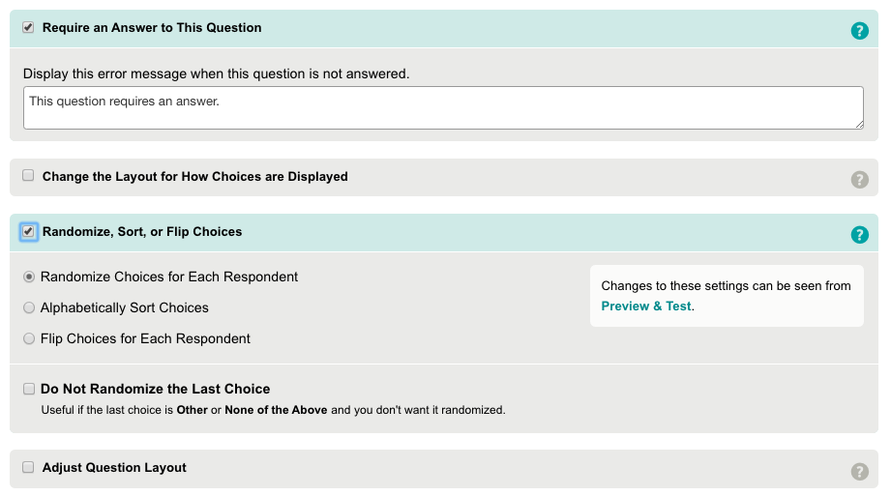
Example: Survey Monkey

Slide 17
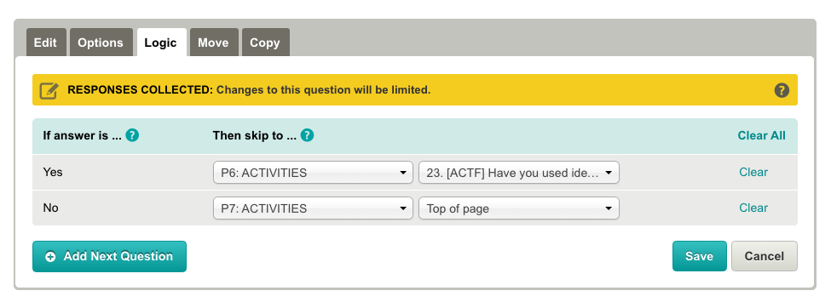
Advantages of Online Survey
More freedom: In addition, you can use skip logics in most online survey engines. It is more difficult to do so in a hard copy e.g.
If yes, go to Page 6; if no, go to Page 7.

Slide 18
Advantages of Online Survey
Higher response rate: People tend to respond to an online survey because it is easy. But if you ask the potential participant to mail back the survey, most people are unwilling to cooperate.
Higher completion rate: Some survey engines show the progress bar at the bottom. People tend to complete the survey if they can see how much longer it will take to finish.

Slide 19
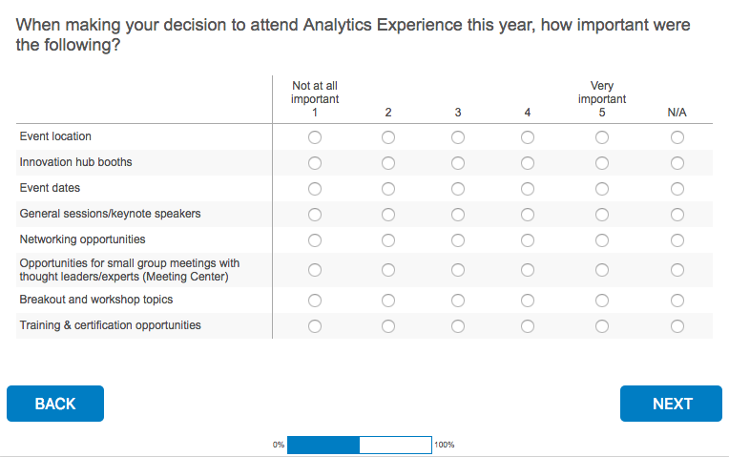
Progress bar

Slide 20
Advantages of Online Survey
Less intrusive: Unlike a phone survey, you can do an online survey anywhere anytime.
More flexibility in sampling: You can use Amazon Mturk to recruit participants from all over the world. The sample will be more diverse and the sample size will be larger.

Slide 21
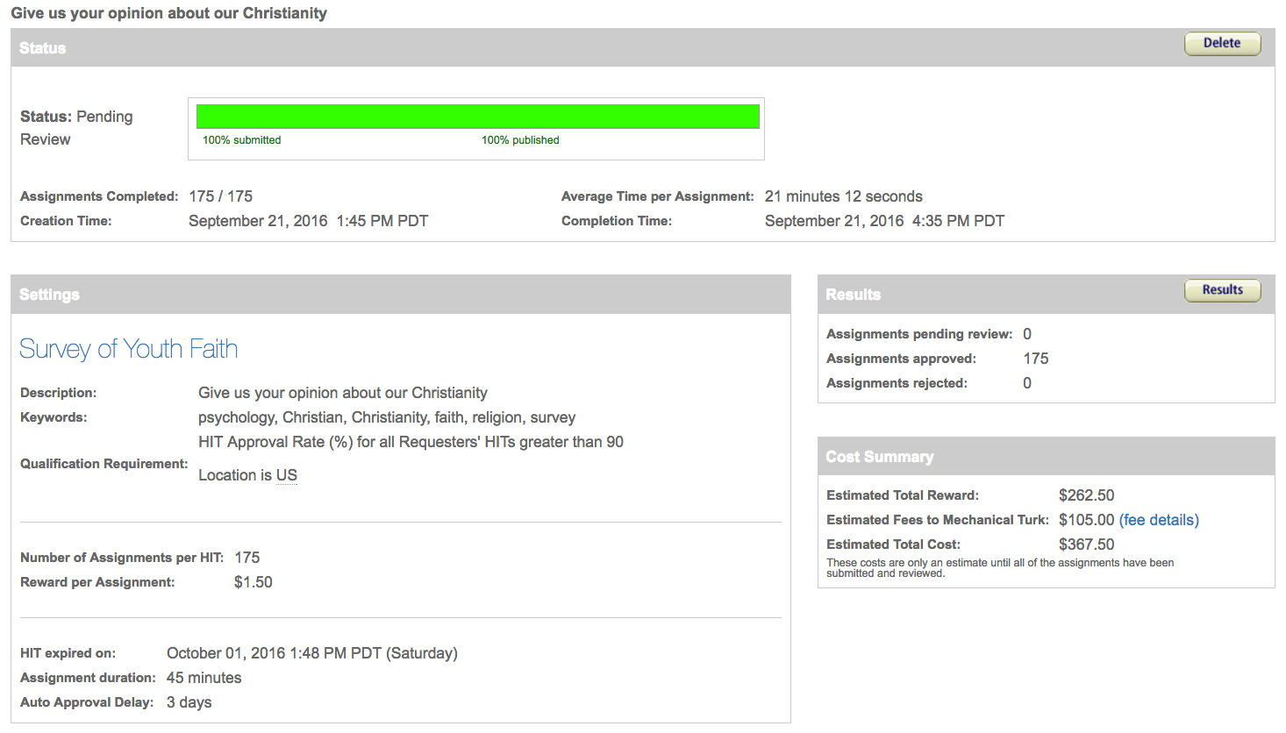
Example: Mturk

Slide 22
Pilot study
The purpose of a pilot study is to identify any additional problems with the wording of survey items, and to check the online user interface. Data collected during the pilot should not be used in the actual data analysis. Based on the pilot study, the surveys can be refined in the following ways:

Slide 23
Pilot study
Testing clarity of wording: If any item causes confusion, the item will be reworded and retested.
Testing user-interface: If any object (e.g. icon, button, menu…etc.) on the webpage causes inconvenience or confusion, the researcher should redesign the interface and retest the revised version.

Slide 24
Pilot study
Timing: Each survey is not supposed to take more than 30 minutes. If, on average, the pilot testers spend more than 30 minutes, the research team might consider shortening the survey.
Assessing whether the research protocol is realistic and functioning: If the protocol has any issues, the research team will revise it and retest the new version.

Slide 25
Pilot study
Identifying logistical problems that might occur in the process: Potential logistic problems include lack of access to computers or the Internet, incompatibility between the survey engine (e.g. SurveyMonkey) and certain platforms, etc. If any issues are discovered, the research team will find ways to resolve them.

Slide 26
Pilot study
Refining survey items and options: Most survey items provide the participants with forced options only. Based on the responses to the open-ended questions, the research team might modify the survey items, such as including new options and even creating new items.

Slide 27
Achilles’s heel
Reliability of self-report data
Will the subjects tell you the truth?
Opinion polls indicated that more than 40 percent of Americans attend church every week. However, church attendance records showed that the actual attendance was fewer than 22 percent.
http://www.creative-wisdom.com/teaching/WBI/memory.shtml

Slide 28
Solution
Turn to “behavioral” data e.g. Look at data in Netflix, Youtube, Amazon, Google, Ebay to find out what people actually do rather than what they say.
“Google and the end of free will”: Google may know more about you than yourself.
https://www.ft.com/content/50bb4830-6a4c-11e6-ae5b-a7cc5dd5a28c?siteedition=intl

Slide 29
Sampling methods
Convenience sampling (especially online survey)
Simple random sampling (in theory only, self-selection is common)
Multi-stage sampling
  Cluster: group the homogenous population segments as clusters (“natural clusters”)
  Stratified: divide the population segments into strata.

Slide 30
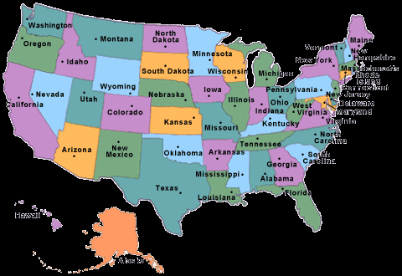
Nationwide sample
Number 1 challenge to survey research: Can the sample speak for the population?
If you randomly select subjects from USA, what would happen?

Slide 31
Survey research
You may obtain a lot of participants from New York and California, but a few or even no one from Idaho and Montana.
Use multi-stage sampling instead of simple random sampling e.g:
  State
  County
  City
  School district
  School
  Students

Slide 32
Sampling weights
Sometimes it is necessary to oversample certain smaller subsets. For instance, the researcher may include 10% Rhode Islanders (105,130) but only 1% Californians (376,919) into her sample.

Slide 33
Sampling weights
In this case, a sample weight is required to compensate for the over- or under-sampling segments of the population. If the sampling scheme entails a multi-stage design, then there will be several sampling weights.

Slide 34
What is weighting?
An easy example: When we have unequal sample sizes, we need the weighted mean. Assume that I teach three classes. The average GPA and the size of each class is as follows:
  Class A 3.76 n = 30
  Class B 3.67 n =100
  Class C 3.54 n = 10

Slide 35
What is weighting?
The chairperson would like to know the average GPA of all my students but she has no access to individual student records.
Can she sum all three scores and then divide the sum by 3? No, she should put the sample size into account and so the weighted mean is:
  (3.76 * 30) + (3.67 * 100) + (3.54 * 10) / (30+100+10)
Weighting is for adjusting disparity

Slide 36
TIMSS
Trends for International Mathematics and Science Study (TIMSS) adopted a multi-stage sampling scheme.
In the first stage, schools are sampled with probability proportional to size.
Next, one or more intact classes of students from the target grades were drawn at the second stage.

Slide 37
Example (Optional)
School weight: The school weight is computed by the inverse of the probability of a school being selected from the region.
For example, if there are 10 schools in the region and 2 were selected, then the weight is 1/(2/10) or 10/2 = 5.
In other words, each school in this region represents itself and four other schools.

Slide 38
Example (Optional)
Student weight: The student weight is computed by the inverse of the probability of a student being sampled from the school.
For example, if there are 100 students in the school and 10 participated in the survey study, then the student weight is 1/(10/100) or 100/10 = 10. In other words, each student in this school speaks for himself and other nine students.

Slide 39
Example (Optional)
Raw sampling weight: The overall raw sampling weight is computed by multiplying the school weight and the student weight.
Because the weighed frequency is much bigger than the original frequency, it is counter-intuitive and is difficult to interpret.

Slide 40
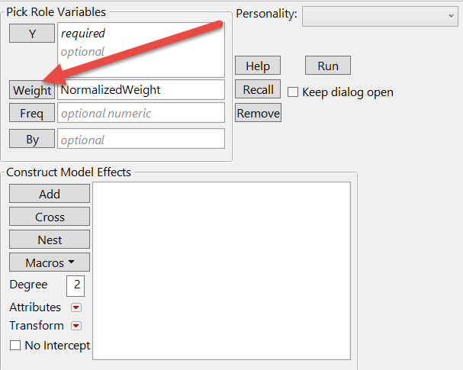
Example (Optional)
Normalized sampling weight: To rectify the preceding situation, the raw sampling weights were converted into normalized sampling weights by dividing the raw weights by the mean of the raw weights.

Slide 41
Example
Besides TIMSS, many other large-scale studies also use multiple-stage sampling and sample weights. E.g.
  Programme for International Student Assessment (PISA)
  Programme for International Adult Assessment of Competencies (PIAAC)

Slide 42
SAS procedures for survey research
These procedures take sample weights into account to compute:
  The mean of survey data: PROC surveymean
  The frequency count of survey data: PROC surveyfreq
  Regression analysis for survey data: PROC surveyreg

Slide 43
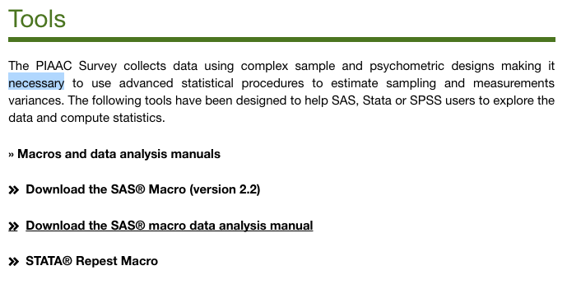
PIAAC’s SAS tools

Slide 44
Survey research
Sometime you don’t need to partition the population into clusters or strata at all.
If I want to conduct a survey research at a big university, do I need to select samples from:
  School/college?
  Department?

Slide 45
Survey research
No! I sent email invitations to ALL students.
In the past you need to be selective because printing and mailing surveys cost money.
Now you can push a button and the emails will be sent with recycled electronics.
Carpet the entire population → more likely to get more responses.

Slide 46
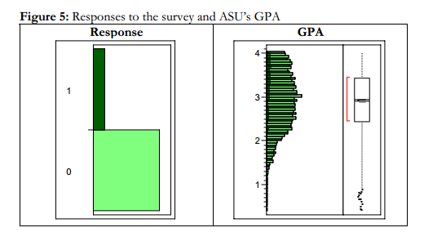
Survey research
How can I know whether the sample can represent the population?
I have access to the full population (all students). I can compare the attributes of the respondents with all other students.

Slide 47
Example
DiGangi, S., Kilic, Z., Yu, C. H., Jannasch-Pennell, A, Long, L., Kim, C., Stay, V., & Kang, S. (2007). 1 to 1 computing in higher education: A survey of technology practices and needs. AACE Journal, 15(4) Retrieved from http://www.creative-wisdom.com/pub/mirror/article_22813.pdf
Yu, C. H., Jannasch-Pennell, A., DiGangi, S., Kim, C., & Andrews, S. (2007). A data visualization and data mining approach to response and non-response analysis in survey research. Practical Assessment, Research and Evaluation, 12(19). Retrieved from http://pareonline.net/getvn.asp?v=12&n=19

