Slide 1
Archival research
Chong ho yu

Slide 2
Secondary data analysis
Meta analysis:
  Greek word Meta means beyond and after
  Synthesize research results of other studies
  http://www.creative-wisdom.com/teaching/WBI/es.shtml
Archival research
  Use the raw data collected by others

Slide 3
Advantages of archival research
Don’t need to worry about IRB
Save money and time
Sample size is much much much much bigger: Big data analytics
Data are collected by a big organization; Data quality is usually better.
provides a basis for comparing the results of secondary data analysis and your primary data analysis (e.g. National health study vs. APU health survey).

Slide 4
Shortcomings and limitations
Your research question is confined by the data.
You cannot control the data quality; sometimes data cleaning is needed.
Contradictory information from different data sources (e.g. happiness and wellbeing)

Slide 5
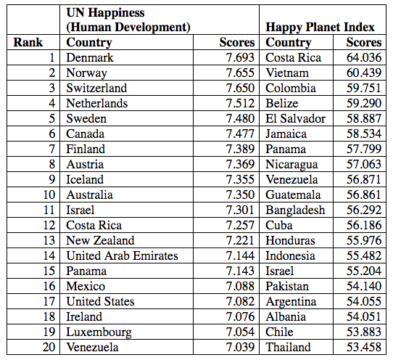
Why are they different?

Slide 6
Examples: values and opinions
European Values Survey (EVS): http://www.europeanvaluesstudy.eu/
World Values Survey (WVS): http://www.worldvaluessurvey.org/wvs.jsp
National Opinion Survey Center (NORC): https://gssdataexplorer.norc.org/

Slide 7
Examples: wellbeing
Center for Collegiate Mental Health (CCMH): http://ccmh.psu.edu/
Happy Planet Index (HPI): http://www.happyplanetindex.org/
Gallup Global Wellbeing (GGW): http://www.gallup.com/poll/126965/gallup-global-wellbeing.aspx
United Nations Human Development Programme (UNDP): http://hdr.undp.org/en/data-explorer

Slide 8
Examples: education and skill
Programme for International Student Assessment (PISA): https://www.oecd.org/pisa/pisaproducts/
Programme for the International Assessment of Adult Competencies (PIAAC): http://www.oecd.org/site/piaac/publicdataandanalysis.htm
Trends for International Math and Science Study (TIMSS): http://timssandpirls.bc.edu/

Slide 9
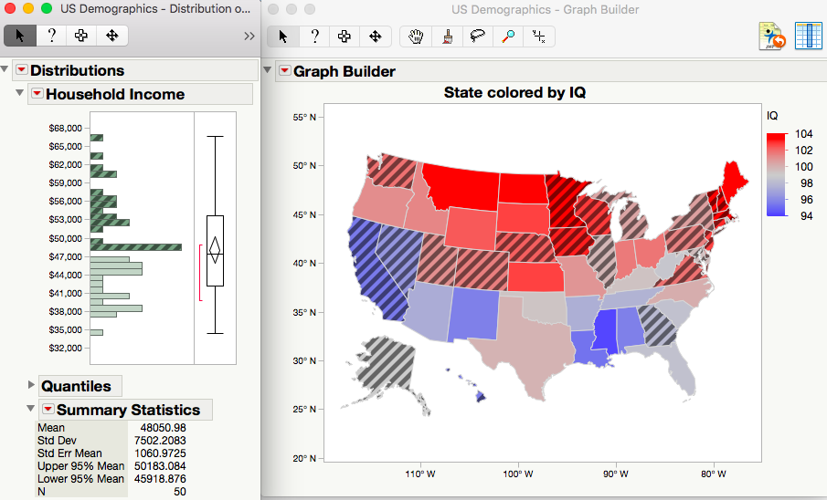
Nationwide and cross-cultural comparisons
Very often big data are nationwide or even international.
You can do state-to-state comparison or cross-cultural comparison.

Slide 10
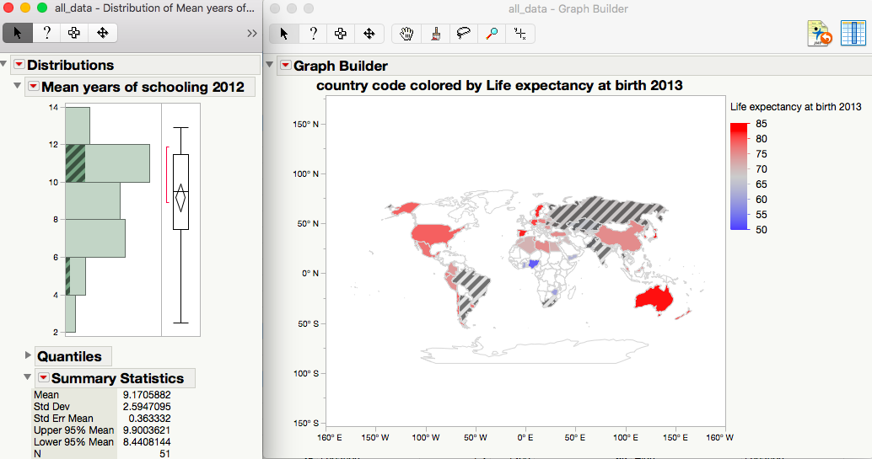
Transnational comparison

Slide 11
Example of archival research
OECD data (PISA, PIAAC) enables cross-cultural comparison
Find out our rank in academic level and skill level in the world.

Slide 12
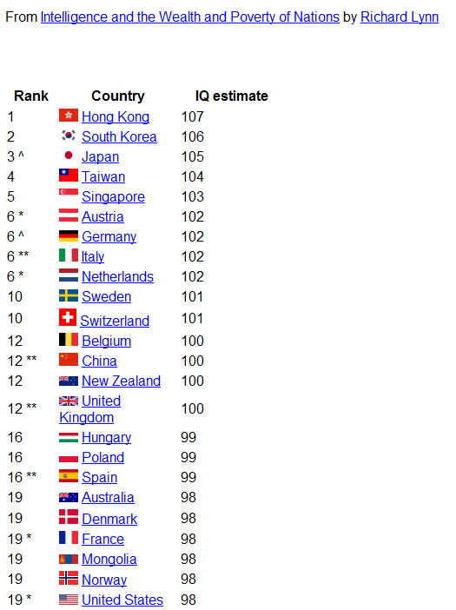

Slide 13
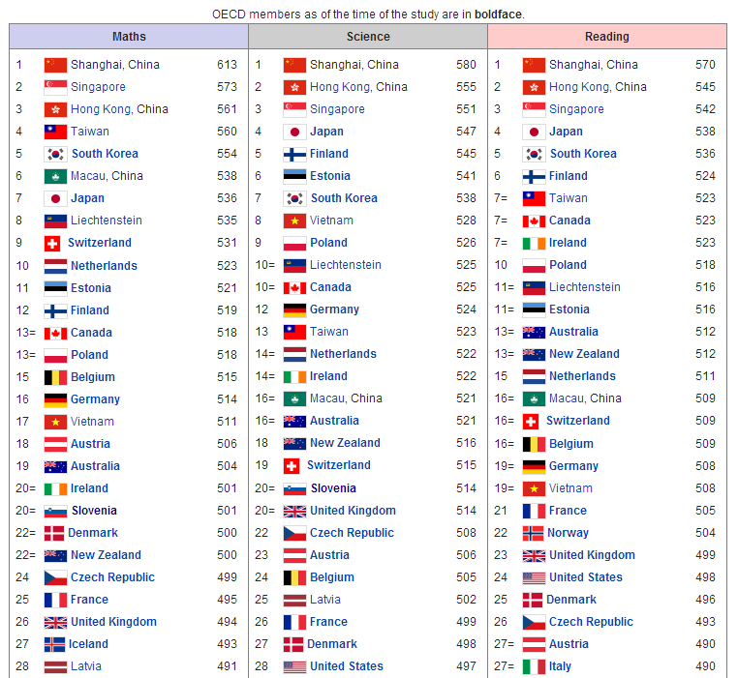

Slide 14
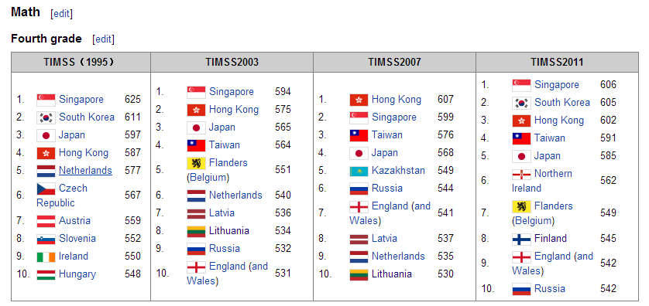

Slide 15
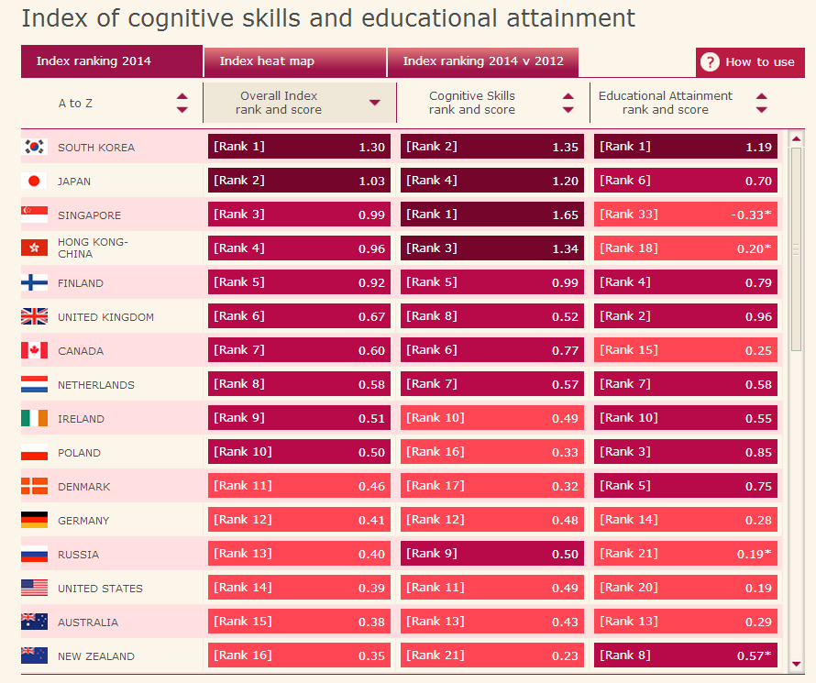

Slide 16

Obama’s response
In 2011 President Obama and Secretary advocated for the American Recovery and Reinvestment Act.

Slide 17
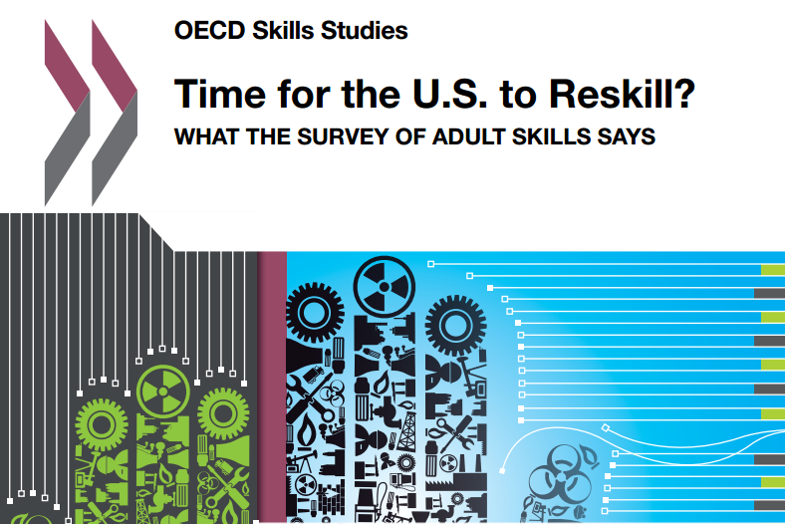
Counter-argument: Late boomer

Slide 18
2014 Program for the International Assessment of Adult Competencies (PIAAC)
Adults: age 16-65
Young adults: 16-25
Three categories:
  Numeracy
  technological proficiency
  literacy
5 levels
US ranks at the bottom in numeracy and technological proficiency
Thirty-six million American adults have low skills.

Slide 19
OECD skill studies
Numeracy:
  8% US adults achieve at Level 4/5,
  OECD average: 13%
  Japan and Finland: 19%
  A third of adults in the U.S. scored below Level 2
Problem solving in technology
  About one-third (31%) of US adults score at least at Level 2
  OECD average: 34%

Slide 20

Round 1 PIAAC
Top 5 scores in literacy:
  Japan
  Finland
  Netherlands
  Australia
  Sweden
The United States placed at #17 out of 23.

Slide 21

Round 1 PIAAC
Top 5 scores in numeracy:
  Japan
  Finland
  Flanders (Belgium)
  Netherlands
  Sweden
The United States placed at #21 out of 23

Slide 22
Round 1 PIAAC
Top 5 scores in problem solving:
  Japan
  Finland
  Australia
  Sweden
  Norway
The United States placed #18 out of 20.

Slide 23
Round 2 PIAAC
After adding the data of nine more countries into the analysis, the US ranked 18th in literacy, 27th in numeracy, and 16th in problem-solving.
Younger Singaporeans (aged 16-24) outperformed the older generation (aged 55-64) in literacy, but older Americans had better literacy skill than young adults.
Many older Americans reached Level 2 and 3 in problem-solving skill level, and the US was second to the top performer, New Zealand. However, the problem-solving skill of young Americans was among the bottom six.

Slide 24

Zakaria’s view based on Round 1
The tests show that a universal pattern:
  develop skills and knowledge at young ages
  peak in proficiency at 30
  decline afterwards.
If people start out with poor foundation, those disadvantages will persist throughout their lives.

Slide 25

Counter-argument 3:
US Dominion
Ravitch said, “The Soviet Union launched its Sputnik satellite in 1957. We did not respond by raising our test scores on international assessments… something is wrong with those international assessments, if our allegedly terrible public schools continue to produce the greatest workers, thinkers, leaders, and innovators that created the greatest economy in the world. The Soviet Union is gone, but we are still here!”

Slide 26

“US continue to dominate”
Since the 1960s US students have never been doing well in international math and science tests
But “US continues to dominate in these fields”
Don’t push people to learn math and science.
Liberal education is the key to inventiveness.

Slide 27
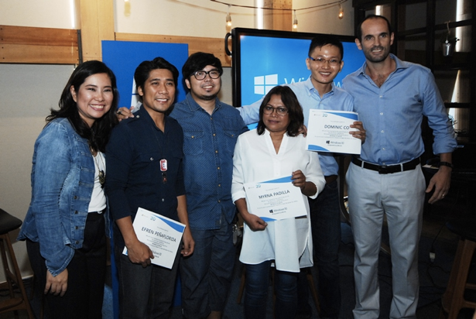
US domination relies on immigrants
Foreign-born doctorate holders in workforce:
  Engineering and computer science: 50%
  Physical sciences: 37%
  Mathematics: 43% (National Science Board, 2010)

Slide 28
International graduate students in the US
2013 National Foundation for American Policy (NFAP)
  Electrical engineering: 70%
  Computer science: 63%
  Industrial engineering, economics, chemical engineering, materials engineering and mechanical engineering: 50%+

Slide 29

International graduate students
2014 National Center for Science and Engineering Statistics (NCSES)
  US graduate students: 2.1 % decline
  Foreign graduate students: 13.1 % increase

Slide 30
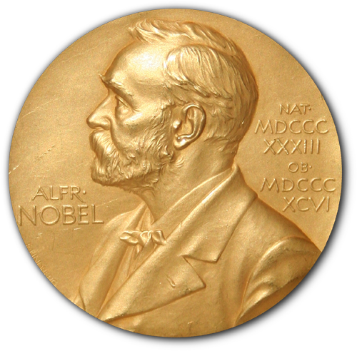
Nobel prizes
Between 1950 and 2005, 27 of the 87 American Nobel Prize winners were born outside the US (Vilcek & Cronstein, 2006).
Counting from 1990, about half of the US Nobel laureates in the scientific and technical disciplines were foreign-born.

Slide 31


Why not using OLS Regression?
Ordinal least squares (OLS) regression was discovered by Legendre (1805) and Gauss (1809) when our great grandparents were born.
Multi-collinearity
It is incapable of dealing with big data (many rows and columns)

Slide 32

Big data analytics/data mining
Machine-learning algorithm
able to fine-tune the model based on repeated analyses
The results are combined to reach a converged conclusion
Much more accurate than a single analysis: See the forest, not the trees.

Slide 33
Ensemble method
Don’t out all eggs into one basket
Divide and conquer
Repeated analyzes
Boosting
Bagging (not this begging →)

Slide 34
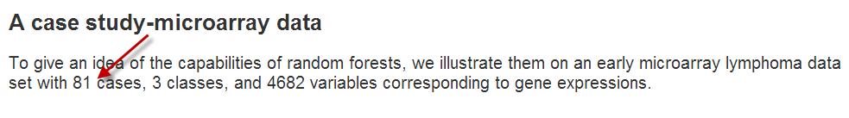
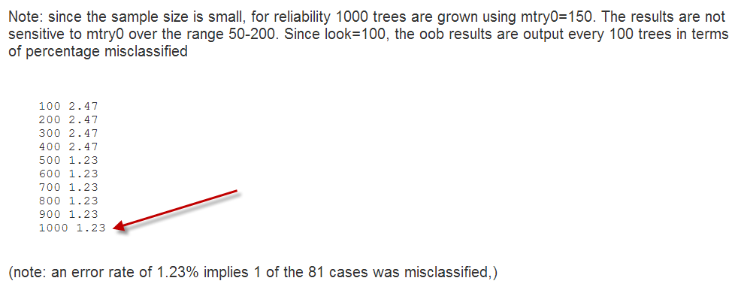
The power of data mining

Slide 35
Example 1: PIAAC study
Some Factors affecting PIAAC learning outcome
  Readiness to learn
  Political efficacy
  Cultural engagement
  Social trust

Slide 36
Dependent variables of PIAAC study
Literacy
Numeracy
Technology-based problem-solving
Every participant has 10 plausible values (PV)!

Slide 37
multiple computerized adaptive testing (MCAT)
CAT: Your next question depends on your response to the previous question.
MCAT: The items are grouped as testlets.
Not everyone answered the same questions
Data imputation for missing
A distribution of scores: Plausible values

Slide 38
Random selection of PV, not averaging
If the police are searching for a missing person and there are ten reports of sighting the person, it is definitely not a good strategy to calculate the centroid of the ten locations and then deploy the search team there.
The chance of spotting the missing person is higher if one of the ten locations is randomly searched.
http://www.creative-wisdom.com/computer/sas/PV_excel.html

Slide 39
Correlation of literacy, numeracy, and problem solving
If they are strongly correlated, I can put them together as a single composite score.
Don’t count on the p values to judge their inter-relationships.

Slide 40
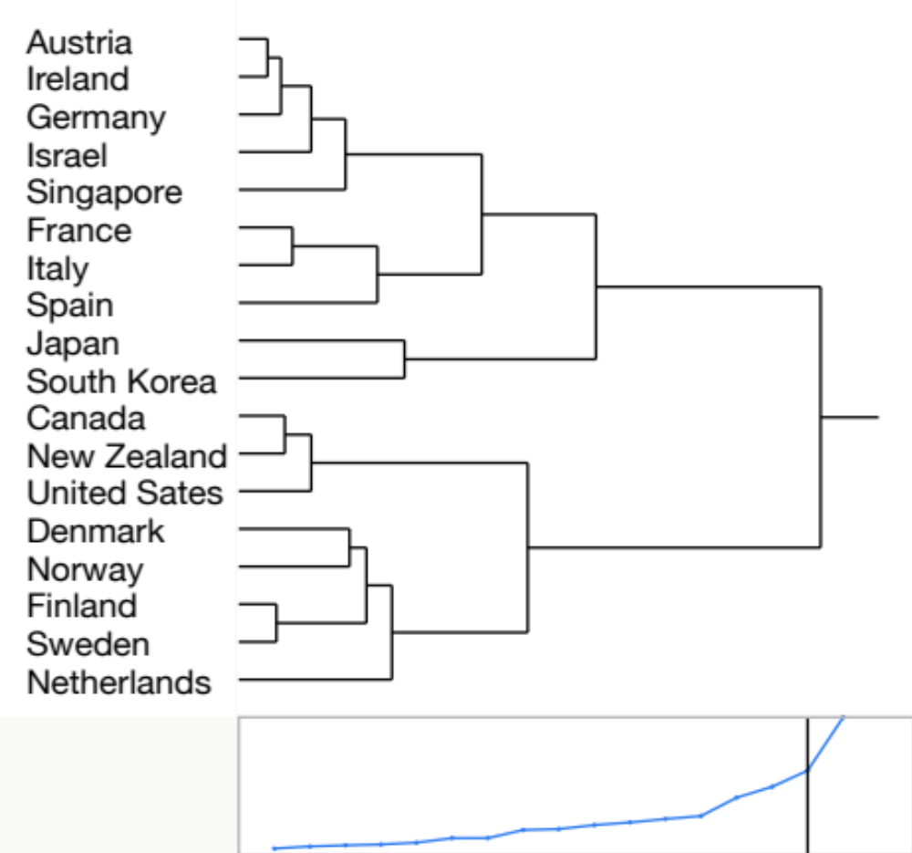
Cluster analysis
Cluster = group
Instead of comparing all nations, use cluster analysis to select a few nations that resemble USA
Based on the commonalities of response patterns to the independent variables.

Slide 41
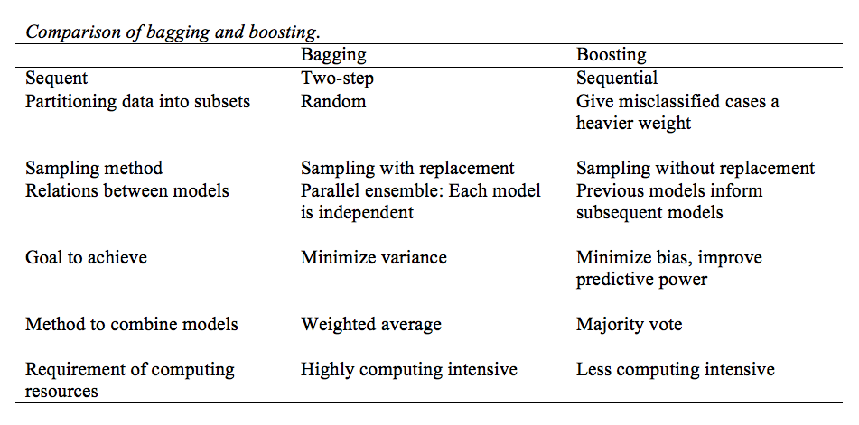
Ensemble method

Slide 42
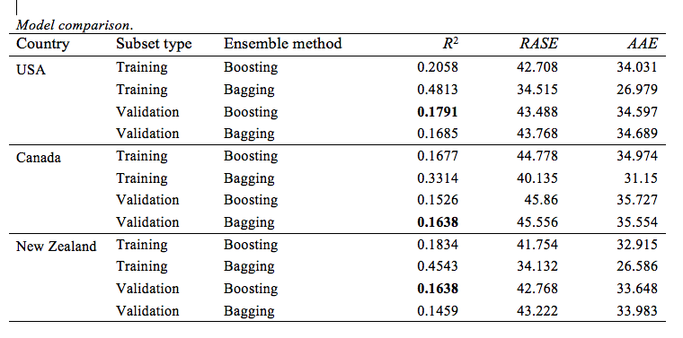

Slide 43
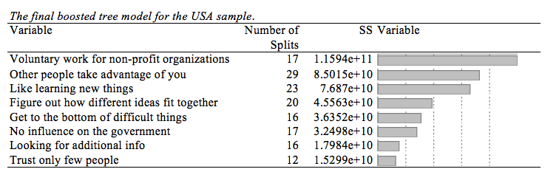

Slide 44
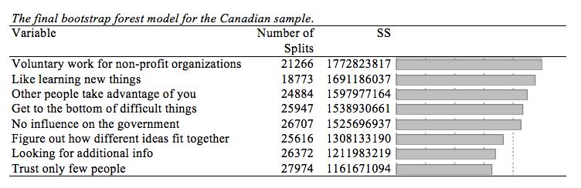

Slide 45
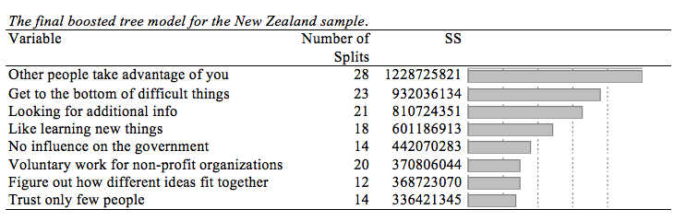

Slide 46
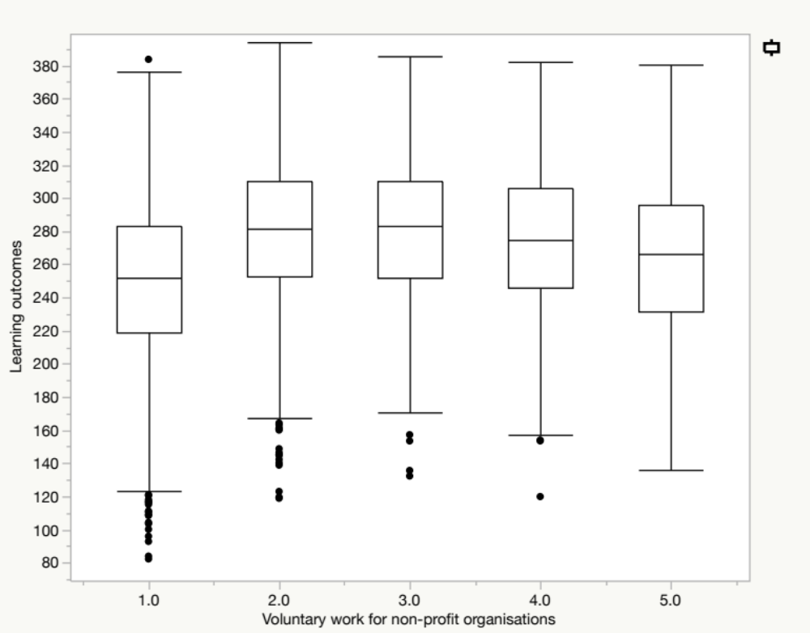
Median smoothing plot of learning outcomes and cultural engagement in the US sample
You need data visualization rather than reporting numbers only.
Too data points?
No problem.

Slide 47
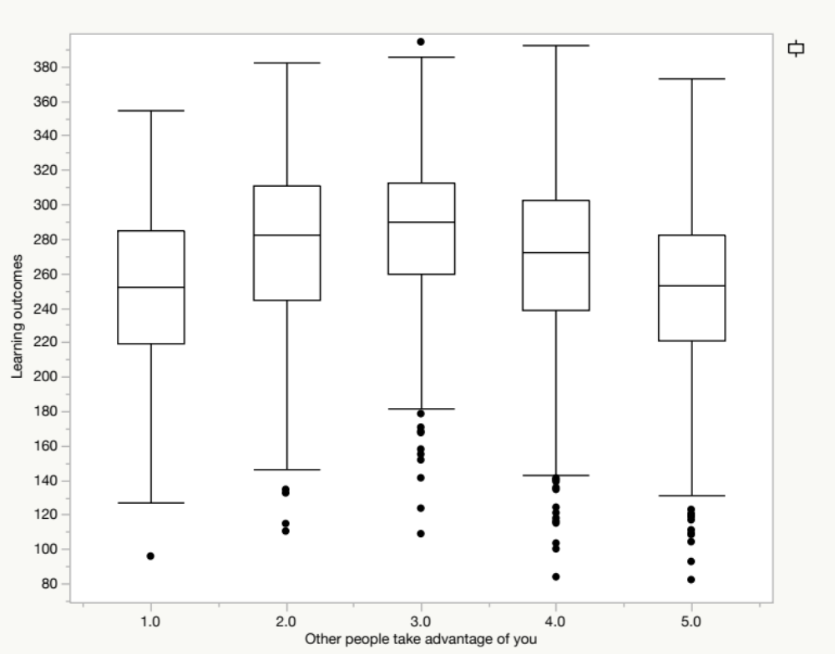
Social trust and learning outcome

Slide 48
Highlight: social trust
If one accepts every piece of information given by others without a doubt, this individual is likely to be misinformed or obtain false knowledge.
Having too many doubts will also result in isolation of knowledge. Thus, having the ability to trust and learn, but also be skeptical at times is more likely to create better learning outcomes.

Slide 49
Highlight: cultural engagement
Without volunteering in the community, one has fewer opportunities to widen the horizon, resulting in a limited learning experience.
Spending too much time in volunteering services could also disrupt one’s regular learning schedule.

Slide 50
Example 2: PISA study
PISA: 15 years old students
Subjects
  Reading
  Math
  Science
Method: Bagging (bootstrap forest)

Slide 51
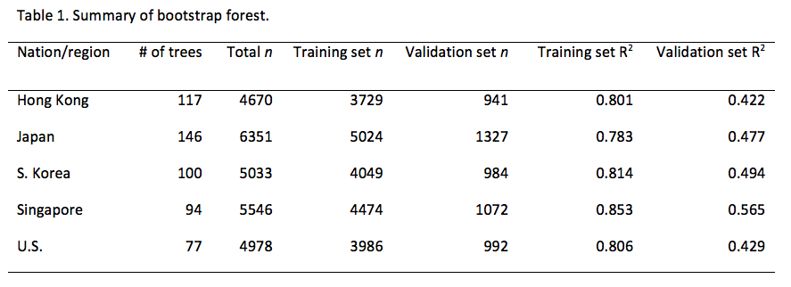
Summary

Slide 52
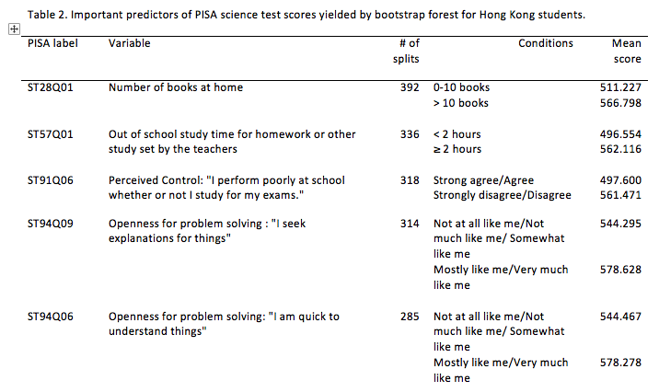
Hong Kong

Slide 53
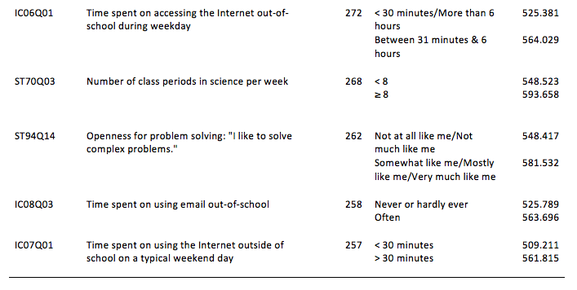
Hong Kong (Continued)

Slide 54
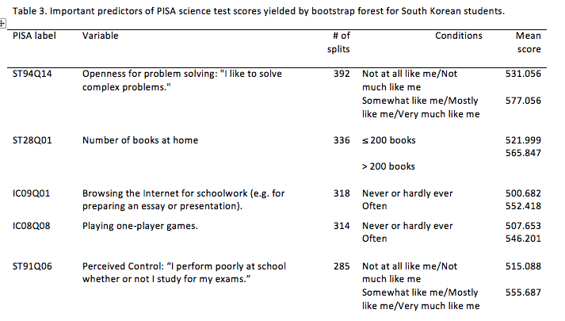
South Korea

Slide 55
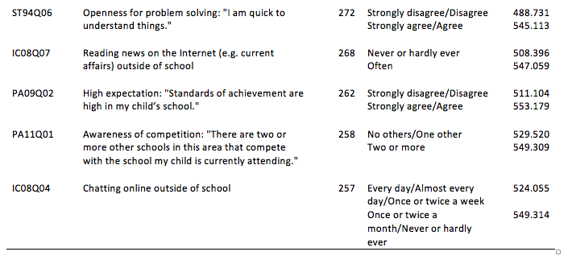
South Korea (continued)

Slide 56
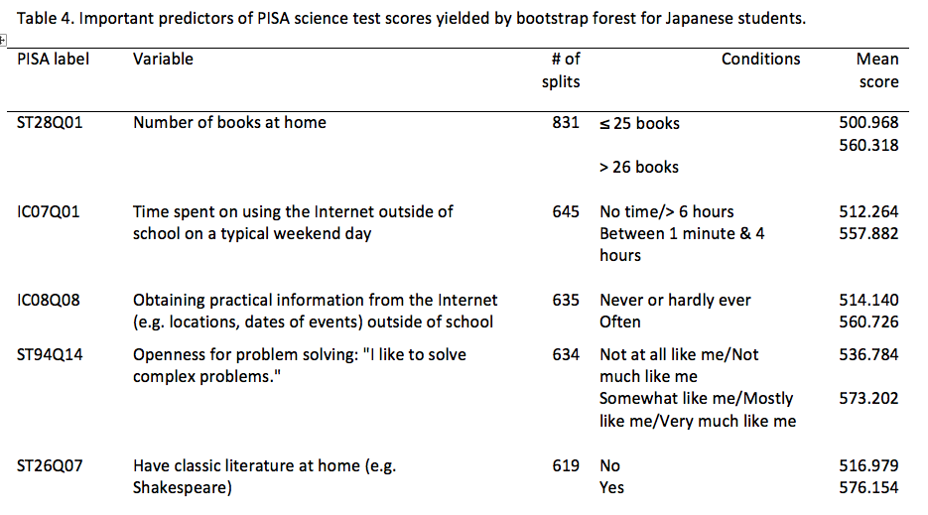
Japan

Slide 57
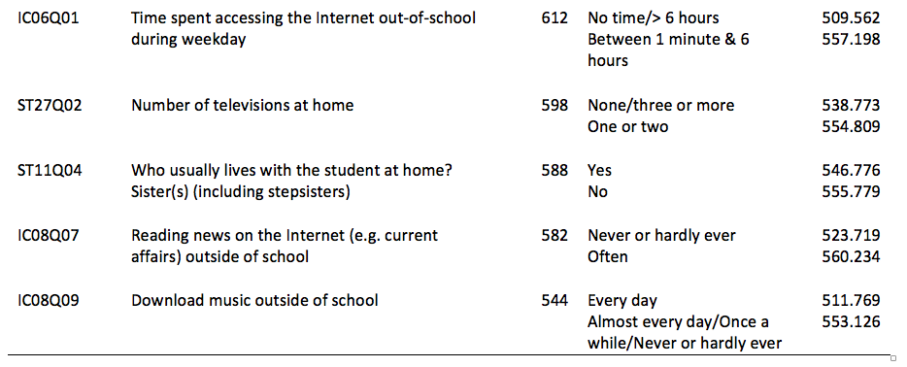
Japan (continued)

Slide 58
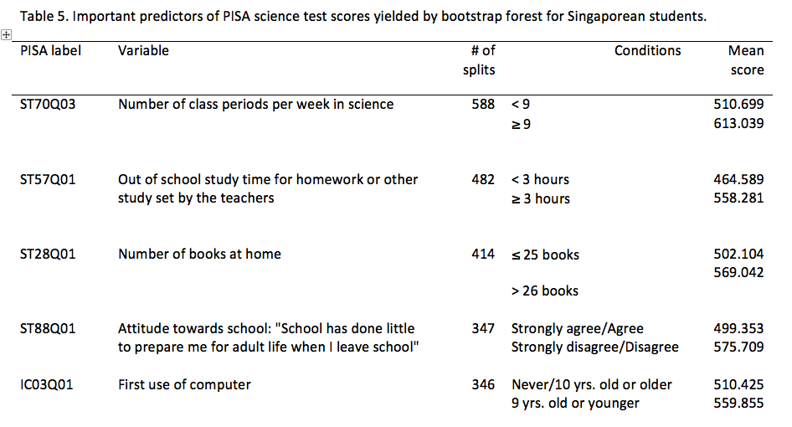
Singapore

Slide 59
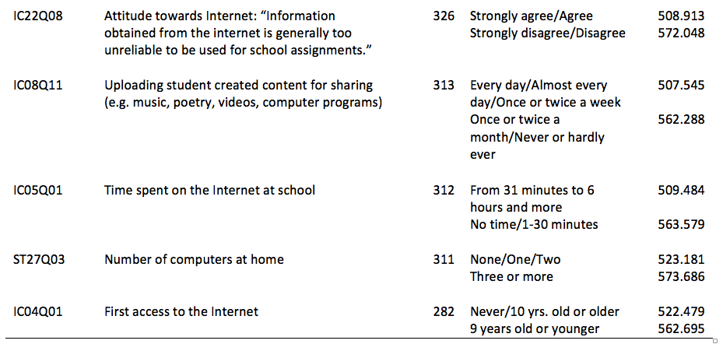
Singapore (Continued)

Slide 60
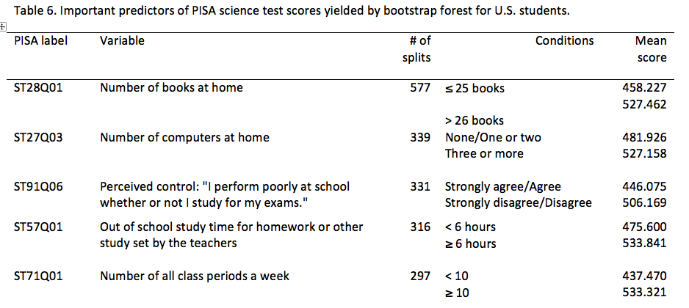
USA

Slide 61
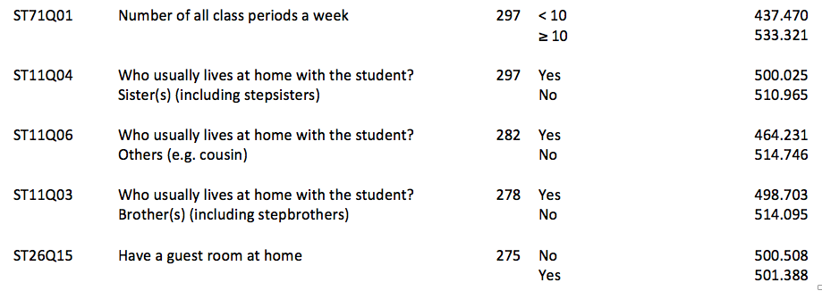
USA (Continued)

Slide 62
Highlights
Hong Kong: 3 out of ten significant predictors are concerned with openness for problem solving.
The number of books at home is the number one, number two, or number three predictors of science performance in all Asian samples and the U.S. sample.

Slide 63
Highlights
3 out of ten crucial factors in the U.S. sample are concerned with who lives with the student, i.e., brothers, sisters, or others such as cousin(s).
Student usage of technology out of school is found to be significant predictors of test performance in all Asian samples.

Slide 64
Highlights
None of the variables on the school survey, such as school type (private or public), class size, student-computer ratio, teacher qualification and professional development, school activity, parent participation in school, school management, etc., had any effect on science performance in any chosen sample.

Slide 65
Implications
For the last several decades U.S. schools have been investing tremendous resources in instructional technologies.
But U.S. student performance on both PISA and TIMSS stalled.
Learn from Hong Kong: Create a home and school culture that promotes openness for problem solving.

Slide 66
For more information, please read:
Yu, C. H., Wu, F. S., & Magan, C. (2015). Identifying crucial and malleable factors of successful science learning from the 2012 PISA. In Myint Swe Khine (Ed.), Science Education in East Asia: Pedagogical Innovations and Best Practices (pp. 567-590). New York, NY: Springer.
Yu, C. H. (2012). Beyond Gross National Product: An exploratory study of the relationship between Program for International Student Assessment Scores and well-being indices. Review of European Studies, 4. doi:10.5539/res.v4n5p119 Retrieved from http://www.ccsenet.org/journal/index.php/res/article/view/20478/14159

Slide 67
For more information, please read:
Yu, C. H. (2012). Examining the relationships among academic self-concept, instrumental motivation, and TIMSS 2007 science scores: A cross-cultural comparison of five East Asian countries/regions and the United States. Educational Research and Evaluation, 18, 713-731. DOI:10.1080/13803611.2012.718511. Retrieved from http://www.tandfonline.com/doi/full/10.1080/13803611.2012.718511
Yu, C. H., Kaprolet, C., Jannasch-Pennell, A., & DiGangi, S. (2012). A data mining approach to compare American and Canadian Grade 10 students in PISA 2006 Science test performance. Journal of Data Science, 10, 441-464. Retrieved from http://www.jds-online.com/file_download/362/JDS-1064.pdf
Yu, C. H., DiGangi, S., & Jannasch-Pennell, A. (2012). A time-lag analysis of the relationships among PISA scores, scientific research publication, and economic performance. Social Indicators Research, 107, 317-330. doi: 10.1007/s11205-011-9850-5.

Slide 68
Contact Info
Chong Ho (Alex) Yu
Associate Professor of Psychology and University Quantitative Research Consultant
http://creative-wisdom.com/pub/pub.html
cyu@apu.edu

