Slide 1
Reliability
Chong Ho Yu

Slide 2
What’s a “Good Test?”
Reliability
  temporal stability
  form equivalency
  Internal consistency
  rater agreement
Validity
  The test measures what it purports to measure
Reliability is a necessary, but not sufficient condition for validity. Reliability is a prerequisite of validity.
Other considerations
  Administration, scoring, cost, bias/fairness, interpretation

Slide 3

Common usage
“My boyfriend is reliable. Whenever I need him, he is always there.”
  It means that he is trustworthy and dependable.
“My Toyota is very reliable. I have been driving the vehicle for 8 years and so far no major repair is needed.”
  It means it is durable and robust.
In psychometrics, the meaning of “reliability” is different.

Slide 4
New trend:
Reliability and precision
When a test is said to be reliable, it means that it can yield results that are consistent and stable. But it can be consistently wrong!
If my scale is not calibrated, everyday it under-reports my weight by 10 pounds (I want this scale). The scale is reliable, but it is imprecise. Two raters may agree with each other, but both can be wrong.
2014 Standards for Educational and Psychology Testing (AERA, APA, & NCME): shifted focus from reliability alone to reliability and precision together.

Slide 5
Temporal stability
This type of reliability utilizes the same form of a test on two or more separate occasions to the same group of examinees (Test-retest).
On many occasions this approach is not practical because the behaviors of the examinees could be affected by repeated measurements. For example, the examinees might be adaptive to the test format and thus tend to score higher in later tests.

Slide 6
Temporal stability
Test-retest reliability (TRR) is not the same as repeated measures (RM) that you learned in 362 Research Methods.
In RM the subjects might be exposed to some treatment. You look for the treatment effect manifested by the test scores and thus you expect changes across time. If the scores are unstable (e.g. Test 5 scores are significantly higher than Test 1 scores), it is good!
In TRR you look for reliability expressed by temporal stability. If the test scores vary across time, it is bad!

Slide 7
Temporal stability
Test-retest reliability is arguably the most important concept because all forms of reliability share a common theme: are the data reproducible?
For more information, please read (optional): Yu, C. H. (2005). Test-retest reliability. In K. Kempf-Leonard (Ed.), Encyclopedia of social measurement, Vol. 3 (pp. 777-784). San Diego, CA: Academic Press.

Slide 8
SD and variance
If the measurement results from the instrument do not vary much, we expect a lower variation.
If there is only one tester (you), the quickest and easiest way to check variability is standard deviation (SD) statistics.
You can do it in SAS, JMP, SPSS, or Excel.
In Excel you can use the function =stdev.s
If many people test the speed repeatedly, we can use intraclass correlation coefficient, which is also used in inter-rater reliability (which be discussed later).

Slide 9
Application of reliability in real life
The Internet connection at your home is slow. You used https://www.speedtest.net to test the download speed to verify that it is really slow. You called the Internet provider and they tested the speed using https://fast.com. They insisted that there is nothing wrong at their end. You suspect whether their speed test is reliable or not. What can you do?

Slide 10


In-class activity
Go to speedtest.net and fast.com in tandem.
Test Internet speed test in both.
Repeat the same test three to four times.
Compute the SD for both. Which test has a bigger variability?

Slide 11
Form equivalence
This approach requires two different test forms based on the same content (Alternate form).
It is common to use different versions (forms) to preempt cheating (e.g. students in the morning session “share” the questions with their friends in the evening session) or pattern recognition due to item exposure (e.g. the testees anticipate what will be on the tests based on the past exam patterns).

Slide 12

Form equivalence
Because the different forms have different items, an examinee who took Form A earlier could not "help" another student who takes Form B later.
By the same token, when you take your driver license paper and pencil test, don’t bother to look at the answers of the testee next to you. He or she has a different form.

Slide 13
Form equivalence
But how can we know the two forms are equivalent? If one version is easier than the others, it will be unfair to some students.
The technique to equate two or more forms of the same test is called test equating.
For more information, please read (optional): Yu, C. H., & Osborn-Popp, S. (2005). Test equating by common items and common subjects: Concepts and applications. Practical Assessment Research and Evaluation, 10.

Slide 14
Internal consistency
The key is "internal”: The response patterns of all items should be similar (consistent).
Today the most common way to check internal consistency is Cronbach Alpha.
Before that people used the Kuder Richardson (KR) Formula, or split-half Reliability Coefficient.
Split-half can be viewed as a one-test equivalent to alternate form and test-retest, which use two tests. In split-half, you treat one single test as two tests by dividing the items into two subsets.

Slide 15
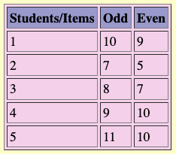
Split-half
Reliability is estimated by computing the correlation between the two subsets. For example, let's assume that you calculate the subtotal scores of all even numbered items and the subtotal of all odd numbered items.

Slide 16
Split-half
You can simply calculate the correlation of these two sets of scores to check the internal consistency.
Unlike test-retest and alternate form that require another test as an external reference, split-half uses test items within the same test as an internal reference.
If the correlation of the two sets of scores is low, it implies that some people received high scores on odd items but received low scores on even items while other people received high scores on even items but received low scores on odd items.
In other words, the response pattern is inconsistent.
What is the drawback of Split-half?

Slide 17
Split-half
The drawback is that the outcome is determined by how you group the items. The default of SPSS is to divide the test into first half and second half. A more common practice is to group odd-number items and even-number items. Therefore, the reliability coefficient may vary due to different grouping methods.
Cronbach Alpha is the mean of all possible split-half coefficients.

Slide 18
Cronbach Alpha:
Internal consistency
Cronbach Alpha can be used for both binary (1 or 0), fairly spread (e.g. 1- 7), or widely-spread (e.g., 1-100) data.
Efficient: It takes one test only while test-retest requires two or more and the alternate form needs two or more versions.

Slide 19
What is Cronbach Coefficient Alpha?
The theory behind it is that the observed score is equal to the true score plus the measurement error (Y = T + E).
For example, I know 80% of the materials but my score is 85% because of lucky guessing. In this case, my observed score is 85 while my true score is 80. The additional five points are due to the measurement error.

Slide 20
What is Cronbach Coefficient Alpha?
A reliable test should minimize the measurement error so that the error is not highly correlated with the true score.
On the other hand, the relationship between true score and observed score should be strong. Cronbach Alpha examines this relationship.

Slide 21
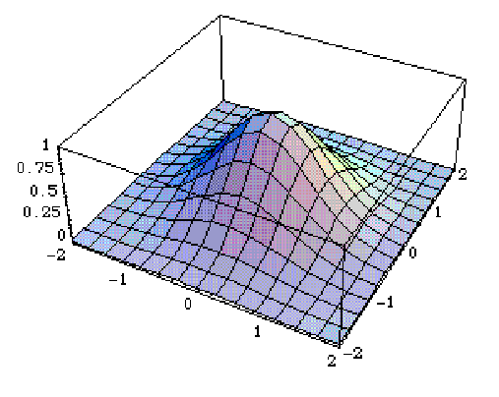

What is Cronbach Coefficient Alpha?
Two types of Cronbach Alpha:
  Standardized: based on item correlation
  Raw: based on item covariance matrix
What is covariance?
  One variable: one distribution, one variance
  Two variables: co-variance (Mexican hat)

Slide 22
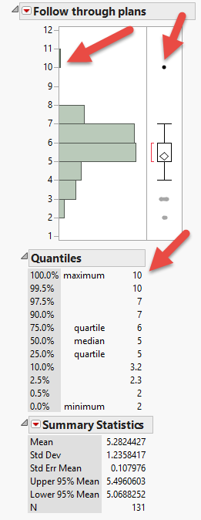
Always check the data accuracy!
Before doing any computation, we should always check the accuracy of the data.
The easiest way is to look at the distributions.
The scale is from 1 to 7. “10” must be a typo!

Slide 23
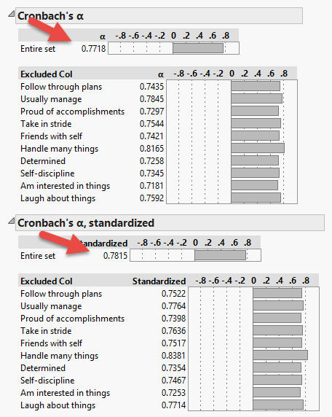
Entire set
Cronbach Alpha is about the entire scale.
There is NO alpha for a single item.
The number next to each item tells you: if this column is excluded (excluded Col), how would the alpha be changed?
This scale is OK, but not great (Cronbach alpha = .7726; .7821)

Slide 24

Remove the bad apple (item)!

Slide 25
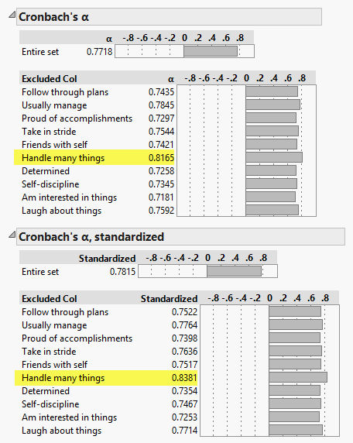
Remedies
You need to remove the item “Handle many things” to make the alpha better.
Reporting standardized alpha (based on covariance) makes it a bit better.

Slide 26
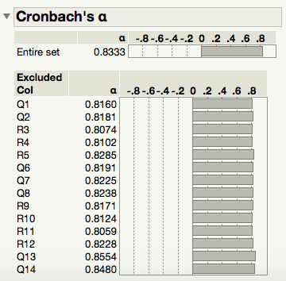
Caution!
Cronbach Alpha cannot be used for big data analytics!
These are 14,819 responses to the Consideration of Future Consequences Scale (CFCS).
When the n is huge, even random numbers might appear to be good.
To demonstrate the problem, Q13 and Q14 are randomly generated.

Slide 27
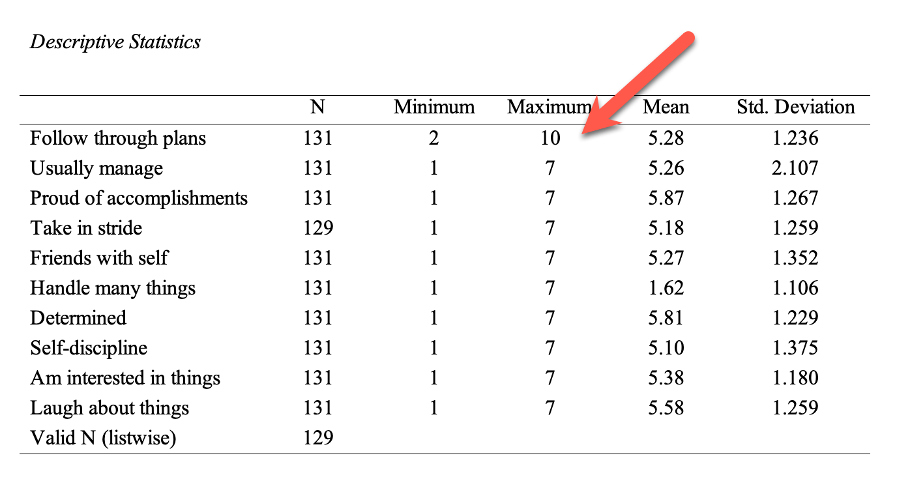
Check data in SPSS
Analyze → Descriptive Statistics → Descriptives

Slide 28
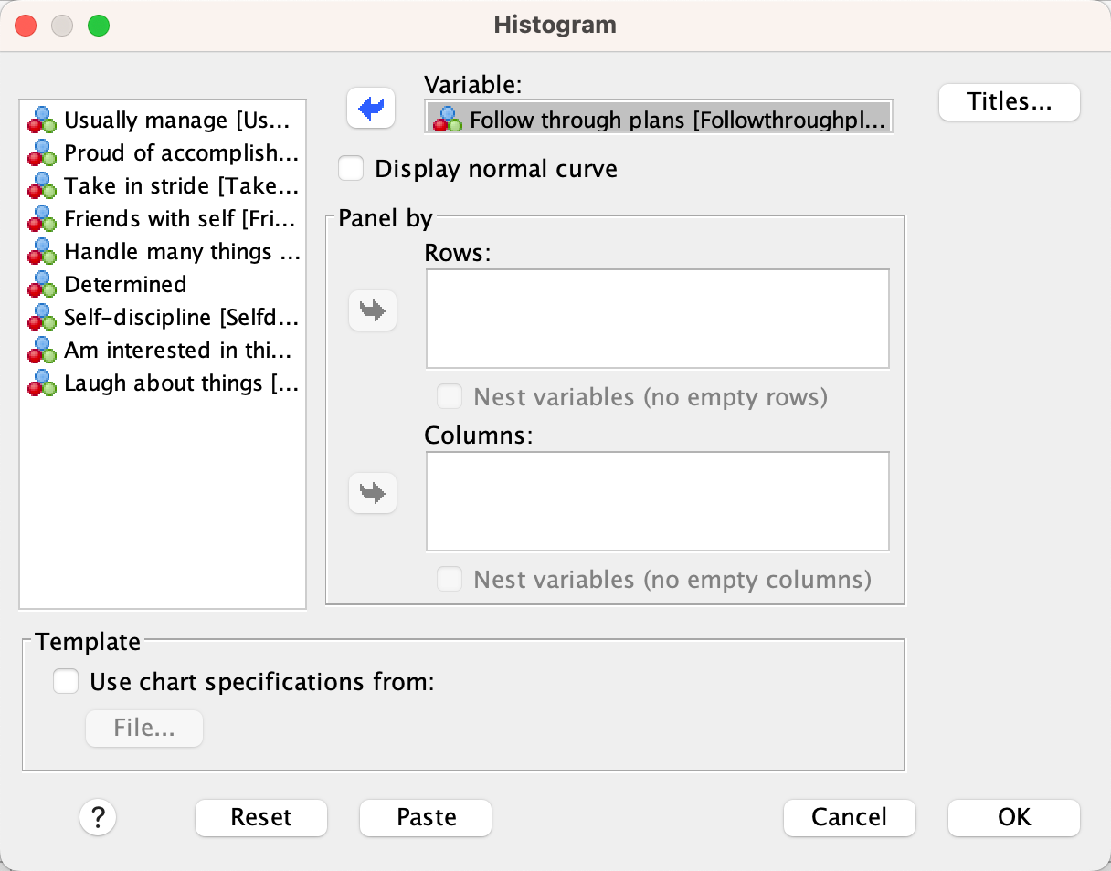
Histogram in SPSS
Use Chart Builder or Legacy Dialogs
Cannot do multiple, only one at one time.

Slide 29
Histogram in SPSS
It shows the error (10). Clear the observation.

Slide 30
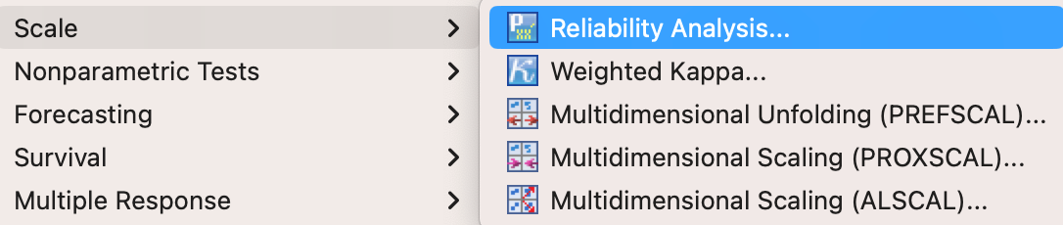
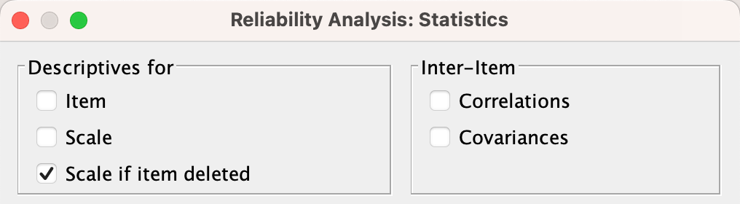
Cronbach Alpha in SPSS
Select Analyze → Scale → Reliability Analysis
Click on Statistics

Slide 31
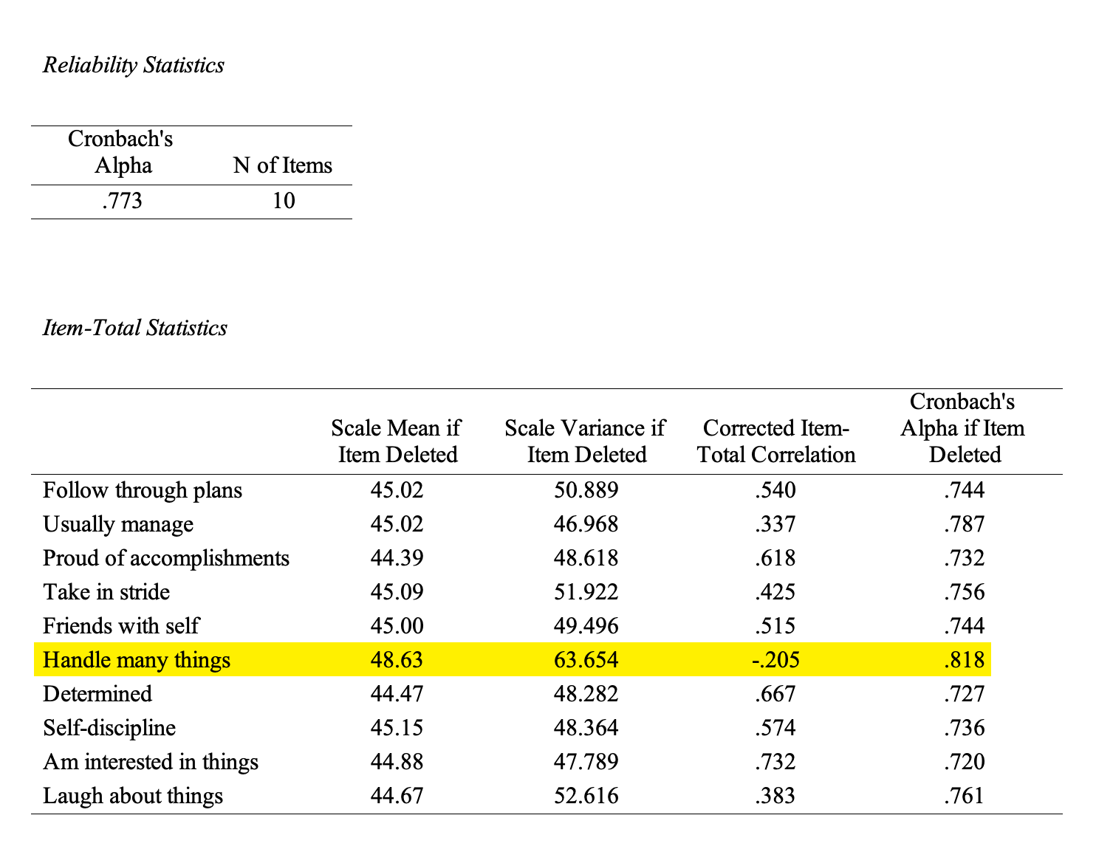
Cronbach Alpha in SPSS
SPSS output provides more information than JMP e.g, item-total correlation

Slide 32
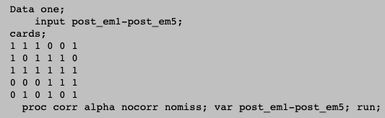
Cronbach Alpha in SAS
proc corr alpha nocorr nomiss data = alex.PIAAC;
var C1-C6;
run;

Slide 33
What does Cronbach Alpha imply?
Some researchers said that if Alpha is high and the response patterns are consistent, then all questions measure one single construct (unidimensional).
If the Alpha is low, there must be subscales measuring different constructs and pointing to different dimensions.
So, run factor analysis first to create subscales (multiple dimensions), and then compute Cronbach Alpha on each subscale.
It is not always true.

Slide 34
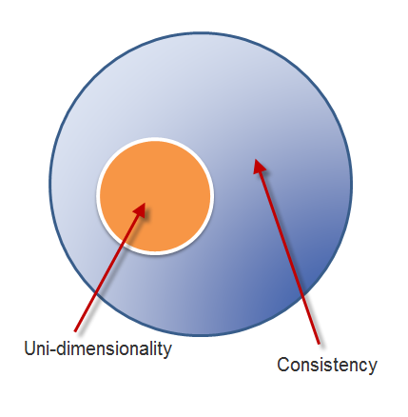
Consistency is NOT uni-dimensionality
Actually consistency and dimensionality must be assessed separately.
Uni-dimensionality is a subset of consistency. If a test is uni-dimensional, then it will show internal consistency.
But if a test is internally consistent, it does not necessarily entail one construct.

Slide 35
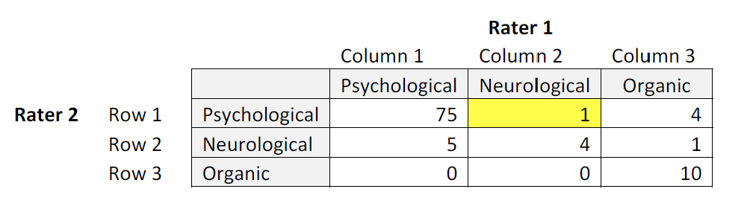
Kappa
This example is based on the data set from Fleiss (1981). In this example, 100 clients were diagnosed by two health care professionals. The subjects were classified into three categories. Obviously, these two experts did not totally agree with each other.

Slide 36
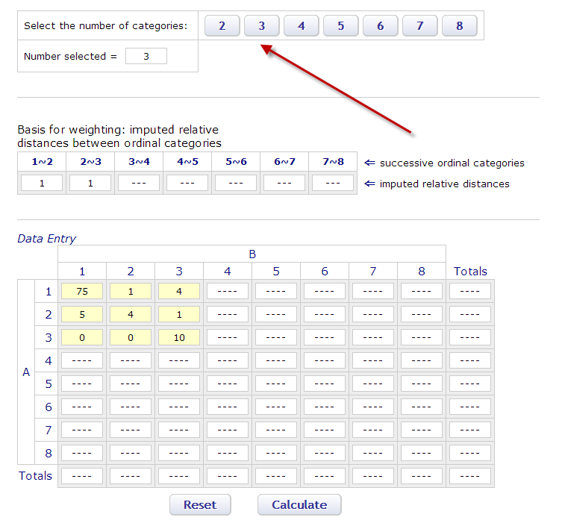
Online Kappa calculator
http://vassarstats.net/kappa.html

Slide 37
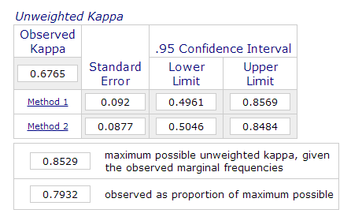
Kappa output
If you do not assign weights to different categories, the user can simply report the unweighted Kappa.
Standard error: you want an unbiased estimator, but there are always bias and errors.
.95 Confidence interval (the possible range in the population)

Slide 38
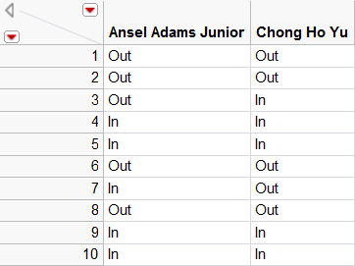
JMP
A photo contest is flooded by many entries. In response to this, the contest organizer hired two photographers (Ansel Adams Junior and Chong Ho Yu) to conduct the first round of screening.

Slide 39
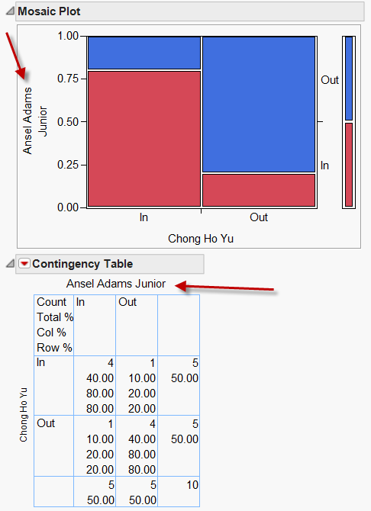
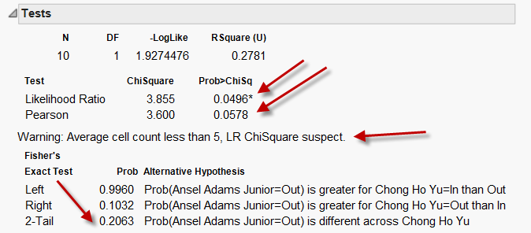
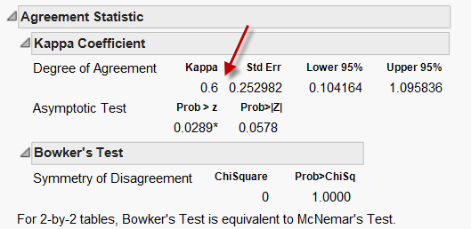

Slide 40
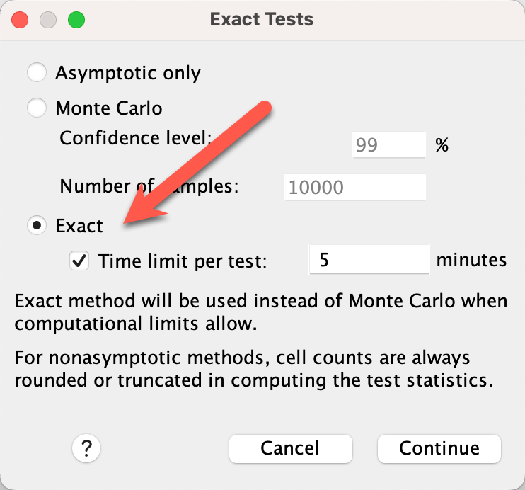
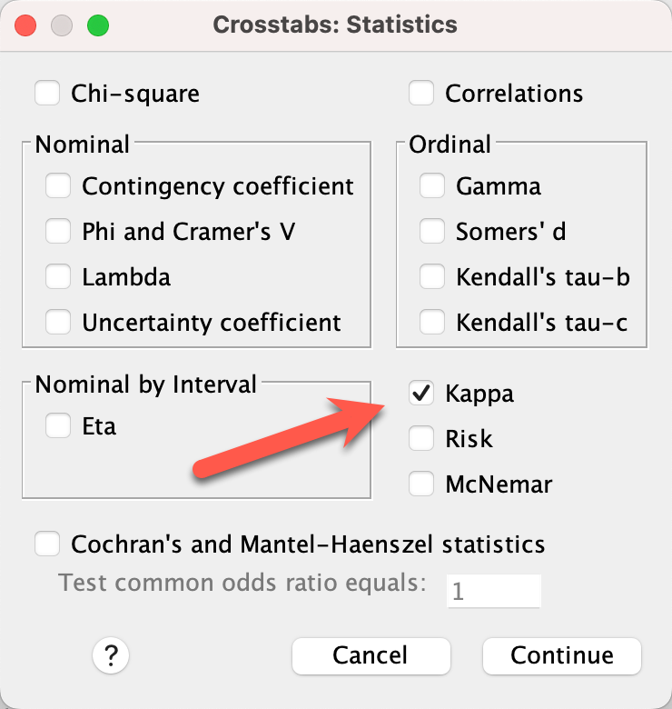
Kappa in SPSS
Analyze → Descriptive Statistics → Crosstab

Slide 41
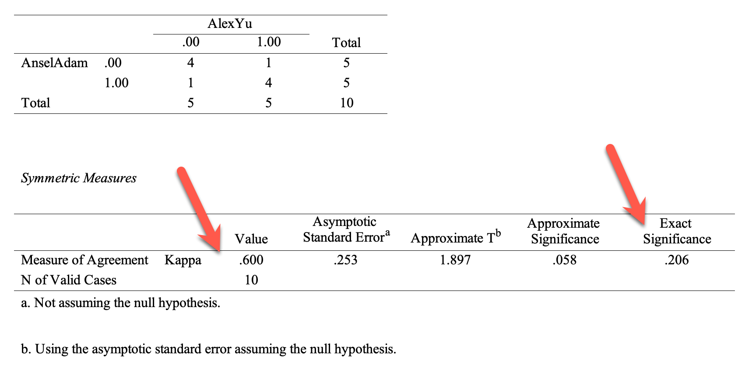
Kappa in SPSS
Analyze → Descriptive Statistics → Crosstab

Slide 42
In-class activity
Pair with a classmate. It is an honor that both of you are hired by National Geographic to serve on a panel.
Look at twenty photos on the screen. Each of you can give either “1” (in) or “0” (out) to each entry.
Enter the data in JMP or SPSS. Make sure that the variable is nominal or ordinal.
Compute the Kappa coefficient. Do you and your peer tend to agree with each other?

Slide 43
Pearson’s r
After the first screening, now the two judges assign a score between 1 and 10 to each photo, where 1 is the worst and 10 is the best.
These are Continuous scale data. Use Pearson’s r, of course.
Sometimes the coefficient alone might be misleading. If I tell you that the Pearson’s r of Rater A’s scores and Rater B’s scores is .8797, what will be your natural response?

Slide 44
Pearson’s r
You may say, “Wow! High coefficient! The two raters tend to ‘agree’ with each other. We can trust the panel.”
You may even go further to say, “If the two raters ‘agree’ with each other, using two raters are redundant. To make it cost-effective, we should hire one of them only.”

Slide 45
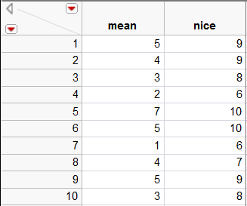
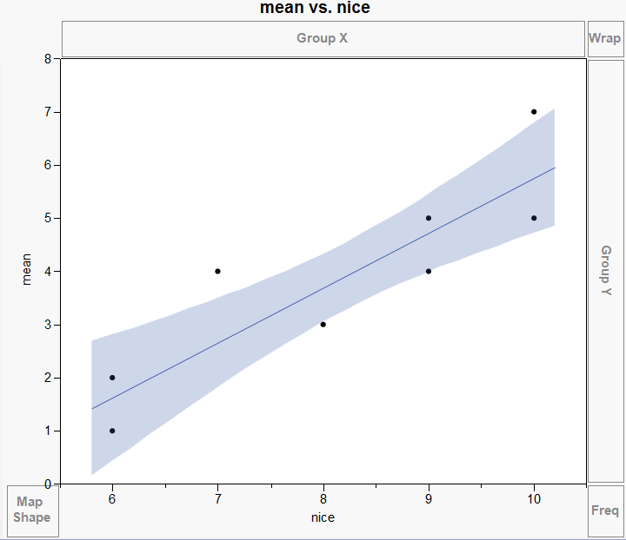
Pearson’s r
Pearson’s r = .8797.

Slide 46
Shortcomings of Pearson’s r
One rater consistently gives low scores and the other rater consistently gives high scores.
The r looks good: .8797, but actually they don’t agree!
Pearson’s r can handle two raters only. If there are three or more raters, it cannot be used.

Slide 47
Shortcomings of Pearson’s r
Pearson’s r is based on continuous scaled data. If the data are ordinal (e.g. Likert scale), it should be widely spread (1-10).
However, in many contests the participants are the best of the best. The scores may concentrate on the high end (e.g. 8, 9, 10 on a 10-point scale) and thus the distribution is skew. When you look at the scatterplot, the data points do not scatter at all.
No variance → nothing you can do; little variance → not much you can do

Slide 48
Intraclass correlation coefficient
One way to overcome the limitation of Pearson’s r is Intraclass correlation coefficient (ICC).
ICC can look for absolute agreement.
ICC can handle more than two judges or raters.
ICC can handle low variation.

Slide 49
Intraclass correlation coefficient
Analyze → Scale → Reliability Analysis
Input the variables into Items
Click on Statistics
Check the box “Intraclass correlation coefficient”
Choose “Two-Way Random” from Model: Both the raters are randomly chosen from the population.
Choose “Absolute Agreement” from Type: It looks at whether the raters give similar scores to the same contestants. If “consistency” is chosen, it has the same problem as Pearson’s r.

Slide 50
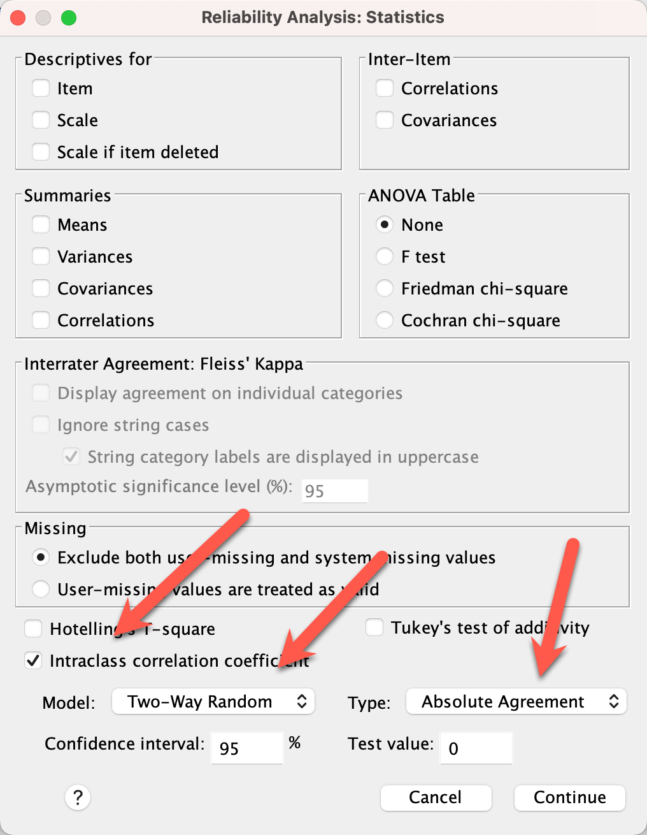

Slide 51
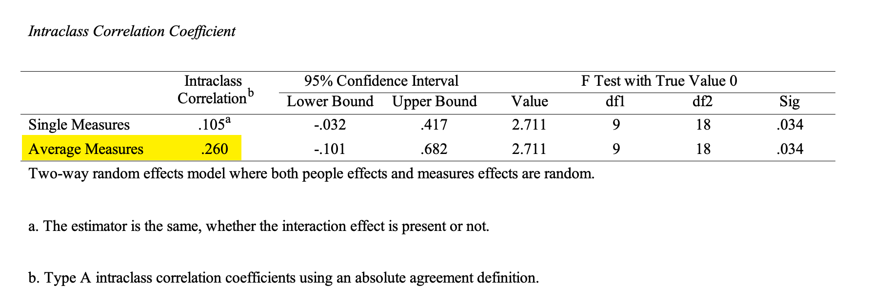
Intraclass correlation coefficient
An ICC of .7 is acceptable; .8 or above is good. In this example, .26 is very bad.

Slide 52
Intraclass correlation coefficient
ICC can also be applied to compute test-retest reliability.
“Mean”, “nice”, “middle” could be Test 1, Test 2, and Test 3.

