Slide 1
Validity
Chong Ho Yu

Slide 2


Caution
(Red alert! This is not a drill)
Validity in the context of measurement is different from that in the context of research design (e.g. internal validity, external validity)
Even graduate students are confused!

Slide 3
Caution
(Red alert! This is not a drill)
Validity in measurement: whether the test can measure what it intends to measure.
Validity in research design
  Internal validity: given the research design, can the data support the conclusion?
  External validity: given the research design, can the conclusion be generalized to a wider population?

Slide 4
Face validity
Face validity simply means that the validity is taken at face value. As a check on face validity, test/survey items are sent to teachers or other subject matter experts to obtain suggestions for modification. Because of its vagueness and subjectivity, some psychometricians have abandoned this concept for a long time.
Although many textbooks mention it, I discourage you from using it.

Slide 5
Common approaches of validity
Content validity
Criterion
  Predictive: how well the test scores of one test can predict performance in another test or situation e.g., Does SAT predict college GPA?
  Concurrent: whether one measure can substitute another e.g., Can SAT provide the same information as ACT in terms of student readiness for colleges?
  Postdictive: How well does the scale retrospectively “predict” a measure/outcome previously in time? e.g., Does trust of a company scale predict prior purchasing behavior?

Slide 6
Common approaches of validity
Construct:
  Convergent: whether two tests measure related skills or knowledge e.g. Are self-esteem and confidence related? Concurrent validity emphasizes prediction or postdiction whereas convergent validity focuses on relationship.
  Discriminant: different tests measure different things. Convergent validity and discriminant validity are the two sides of the same coin.
  Discriminant group validity: The scale should make the distinction between two or more groups e.g., a test of mental health should distinguish healthy people from those who need psychotherapy.

Slide 7
Procedures to check validity
Those types of validity focusing on relationship or prediction can be tested with regression analysis and Pearson’s r.
Discriminant group validity can be verified by the t-test or ANOVA.
Any software can do it, but…

Slide 8
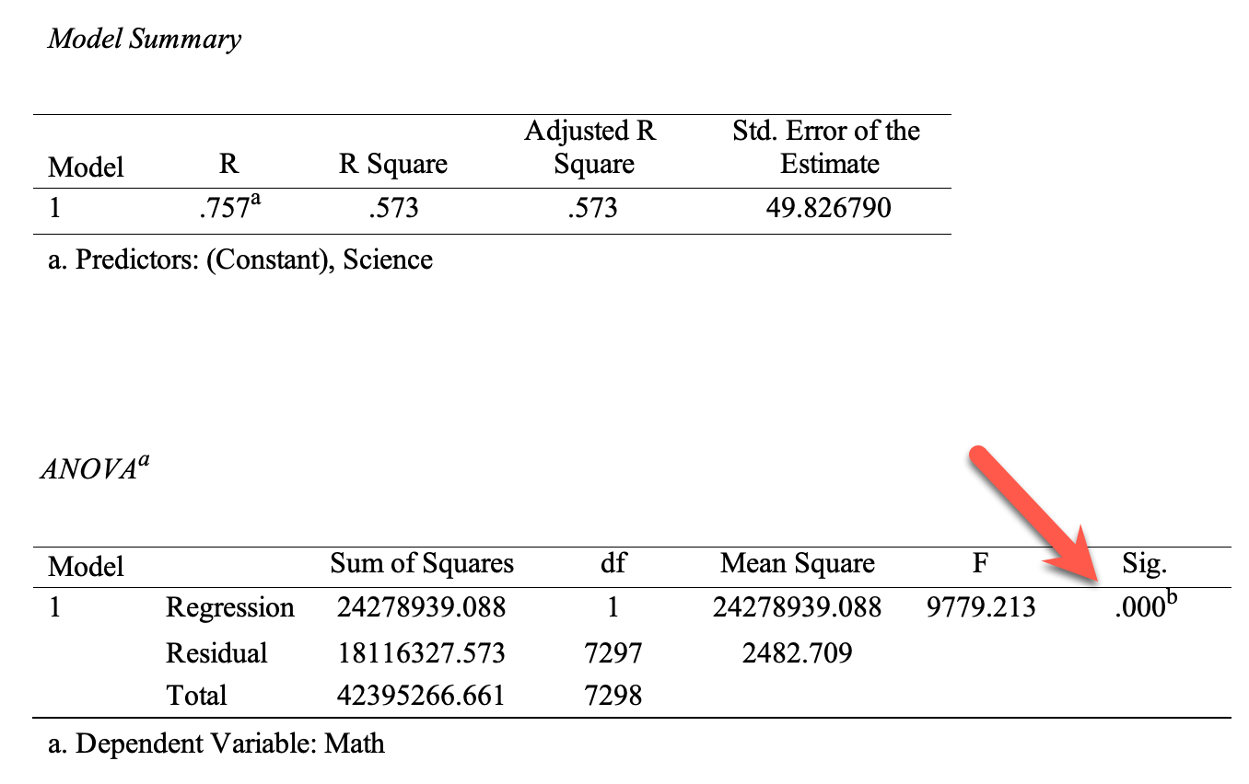
Procedures to check validity
SPSS regression output: What is the problem?

Slide 9
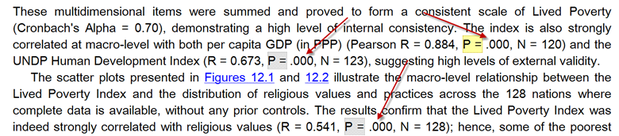
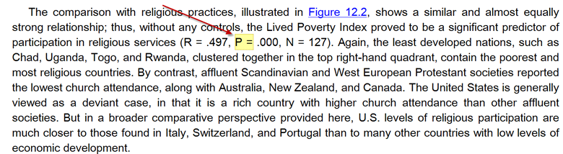
Many researchers don’t understand what a p value is!

Slide 10
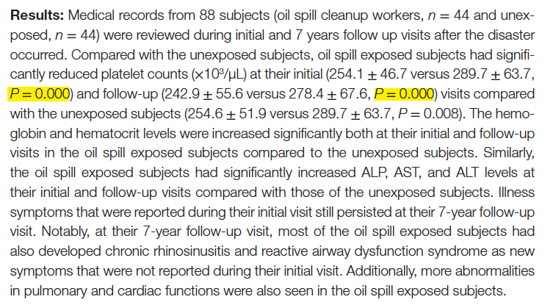
Many researchers don’t understand what a p value is!
Notes:
Source: The Development of Long-Term Adverse Health Effects in Oil Spill Cleanup Workers of the Deepwater Horizon Offshore Drilling Rig Disaster
Mark A. D’Andrea and G. Kesava Reddy

Slide 11
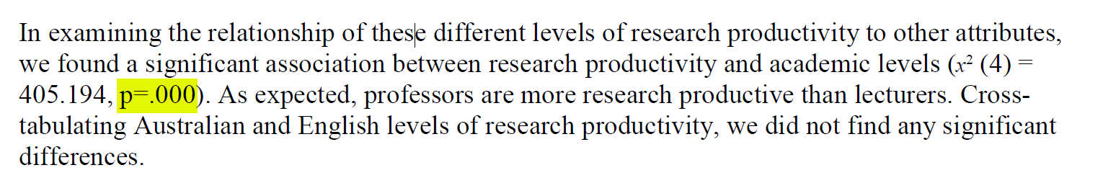
Many researchers don’t understand what a p value is!

Slide 12
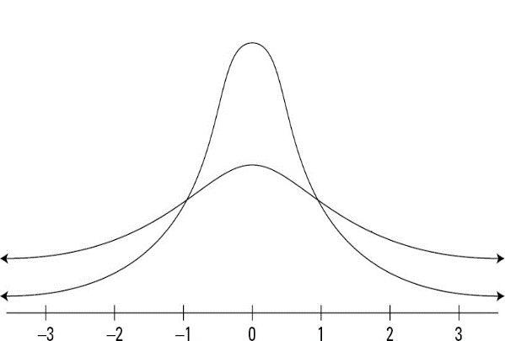
Can p be .000?
P = probability that the statistics can be observed in the long run.
“Long run” is expressed in terms of sampling distributions, in which sampling, in theory, is repeated infinitely.
The two tails never touch down the x-axes.
In an open universe anything has a remote probability.

Slide 13
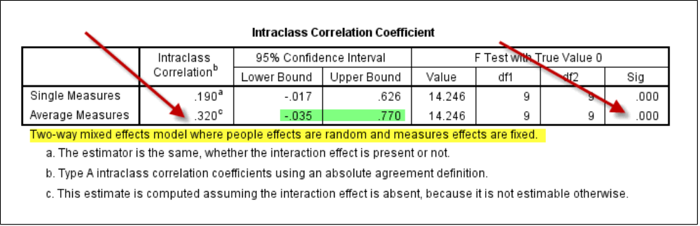
Can p be .000?
If p = 0.000, then it means there is no chance for such an event to happen. Does it make any sense?
Why do you bother to study a phenomenon that never happened?

Slide 14
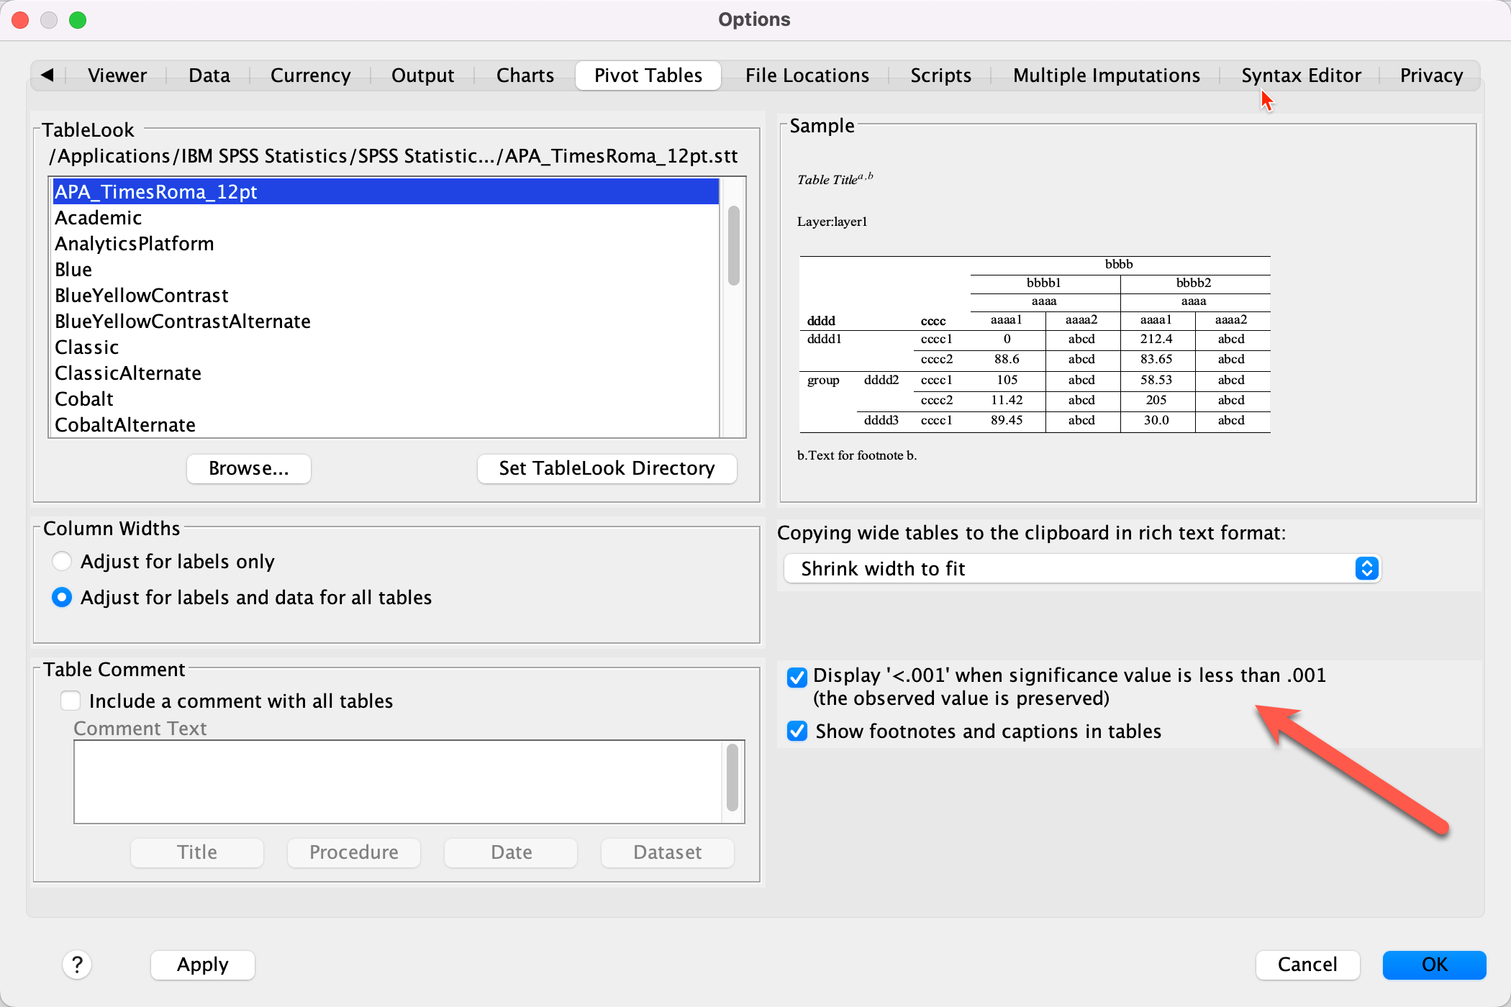
Remedy
Newer versions of SPSS allow you to display a small p value as p < .001.

Slide 15
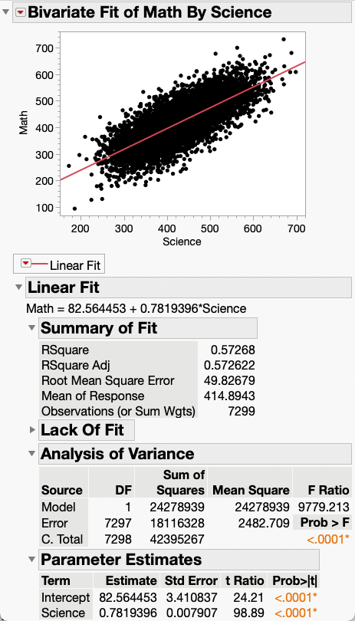
Procedures to check validity
Other software apps (SAS, JMP…etc.) do not have this problem.
e.g. In JMP when the p value is too small, it shows p < .0001.

Slide 16
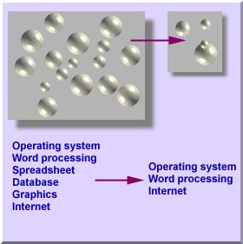
Content validity
In the context of content validity, we draw an inference from the test scores to a larger domain of items similar to those on the test. Thus, content validity is concerned with sample-population representativeness. i.e. the knowledge and skills covered by the test items should be representative to the larger domain of knowledge and skills.

Slide 17

Content validity
Computer literacy includes skills in operating system, word processing, spreadsheet, database, graphics, internet, and many others.
It is difficult to administer a test covering all aspects of computing. Therefore, only several tasks are sampled from the universe of computer skills.

Slide 18


Content validity
Content validity is usually established by content experts.
Take computer literacy as an example again. A test of computer literacy should be written or reviewed by computer science professors or senior programmers in the IT industry because it is assumed that computer scientists should know what are important in his own discipline.

Slide 19
Content validity
At first glance, this approach looks similar to the validation process of face validity, but yet there is a subtle difference.
In content validity, evidence is obtained by looking for agreement in judgments by judges. In short, face validity can be established by one person only, but content validity should be checked by a panel, and thus usually it goes hand in hand with inter-rater reliability (Kappa!)

Slide 20
Content validity
This approach has some drawbacks. Usually experts tend to take their knowledge for granted and forget how little other people know. It is not uncommon that some tests written by content experts are extremely difficult.
Sometimes we cannot totally rely on experts. For example, we need the patient perspective to develop the measurement scale for fatigue.

Slide 21
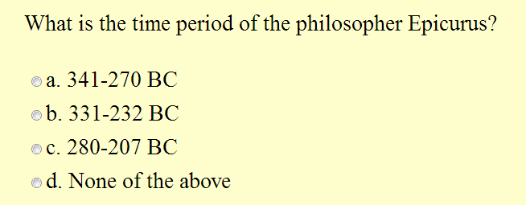
Content validity
Second, very often content experts fail to identify the learning objectives of a subject. Take the following question in a philosophy test as an example:

Slide 22
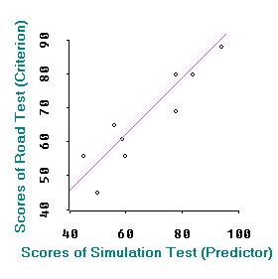
Criterion
When the focus of the test is on criterion validity, we draw an inference from test scores to performance. A high score of a valid test indicates that the test taker has met the performance criteria.
Regression analysis can be applied to establish criterion validity. An independent variable could be used as a predictor variable and a dependent variable, the criterion variable. The correlation coefficient between them is called validity coefficients.

Slide 23
Construct
When construct validity is emphasized, as the name implies, we draw an inference form test scores to a psychological construct. Because it is concerned with abstract and theoretical construct, construct validity is also known as theoretical validity.

Slide 24
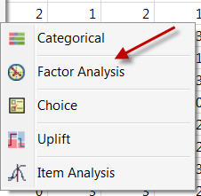
Factor analysis
Exploratory factor analysis (EFA): Propose a factor model
Confirmatory factor analysis (CFA): confirm/verify the proposed factor model.
We will discuss them in Unit 3 and 5.

Slide 25
Test bias
Test bias is a major threat against construct validity, and therefore test bias analyses should be employed to examine the test items (Osterlind, 1983).
The presence of test bias definitely affects the measurement of the psychological construct.
The absence of test bias does not guarantee that the test possesses construct validity. The absence of test bias is a necessary, but not a sufficient condition.

Slide 26
Possible bias and unfair situations
Not all examinees in the population have access to the resources.
There are irrelevant elements in the test that can substantively affect test performance e.g. in a speed test people who can type faster have advantages; in an online test people who have access to a faster network have advantages.

Slide 27
What should be done?
Standards for Educational and Psychological Testing (AERA, APA, & NCME, 2014):
  Use a “universal” test design to remove barriers
  Remove elements that might restrict an examinee’s ability to show what they know
Examples
  Individuals with disabilities
  Individuals from diverse language and cultural backgrounds
  Older adults who are not familiar with technologies

Slide 28
Controversies
Don’t assume that the textbook or the convention must be correct. There are many debates and new developments about reliability and validity.
For example, in 2004, Lee Cronbach, the inventor of Cronbach Alpha, wrote, "I no longer regard the formula (of Cronbach Alpha) as the most appropriate way to examine most data.”
For more information, please read the second part of the website below (optional):
https://creative-wisdom.com/teaching/assessment/reliability.html

