Slide 1
Issues that might affect data quality (reliability and validity) and possible solutions
Chong Ho (Alex) Yu

Slide 2
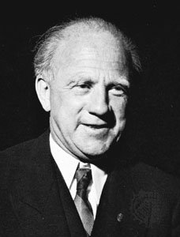
Reactivity of measurement
Physics: Heisenberg principle
The measurement by the observer can change the event.
The act of answering the question may prompt the respondent to think about this issue for the first time, and the person may either form an opinion for the first time or report an opinion even if he or she does not have an opinion.
The data are produced by the measurement!

Slide 3

Reactivity of measurement
Example: If you ask people whether they will vote one day before the election, they are more likely to vote!
Thaler, R. (2008). Nudge. Yale University Press.
One solution is not to tell participants that they are being observed, but this raises ethical problems (invasion of privacy).
Indeed, it is happening now! How?

Slide 4
Data quality of self-report data
Will the subjects tell you the truth?
The seven sins of memory (Schacter, 1999): “How many books did you read last year?” Can you remember?
Social desirability: Opinion polls indicated that more than 40 percent of Americans attend church every week. However, church attendance records showed that the actual attendance was fewer than 22 percent.
http://www.creative-wisdom.com/teaching/WBI/memory.shtml

Slide 5

Desirability of outcome
Aschengrau & Seage III (2008)
The reliability of our memory is tied to the desirability of the outcome.
When a medical researcher tries to collect data from mothers whose babies are healthy and mothers whose kids are malformed, the data from the latter is usually more accurate than that of the former.
Why?

Slide 6
One more sin:
Desirability of outcome
The outcome of the latter is not desirable.
Mothers of malformed babies have been carefully reviewing every illness that occurred during the pregnancy, every drug taken, every detail directly or remotely related to the tragedy in an attempt to find an explanation.
Mothers of healthy infants do not pay much attention to this information.

Slide 7
People lie!
In 2016 election all polls indicate that more voters prefer Clinton to Trump.
The result is the opposite. Why? What happened?

Slide 8

Everybody lies!
In survey most voters said that the race of the candidate doesn’t matter. Google search data show the otherwise!
https://www.youtube.com/watch?v=g0m4UQ3frws
https://trends.google.com/trends/

Slide 9
Behavioral data
Look at data on Netflix, YouTube, Amazon, Google, EBay to find out what people actually do rather than what they say.
People show their true faces in naturalistic settings (No one is watching).
“Big Data, Google and the end of free will”: Google may know more about you than yourself.
https://www.ft.com/content/50bb4830-6a4c-11e6-ae5b-a7cc5dd5a28c

Slide 10

Fraud
Mturk workers are paid to take surveys.
Some Mturk workers who live outside of the US lied about their identity.
~30-50% of participants do not read the questions carefully and provide random answers.
Cloud Research: Low quality participants show several signs of fraud (e.g., using the same device to submit multiple surveys)

Slide 11
Fraud detection
Insert attention-checking questions.
What is the age range of the current president of the US?
  A. 40-50 B. 51-60 C. 61-70 D. 70+
Can you remember the plot of every episode of Star Trek?
  A. Yes B. No

Slide 12
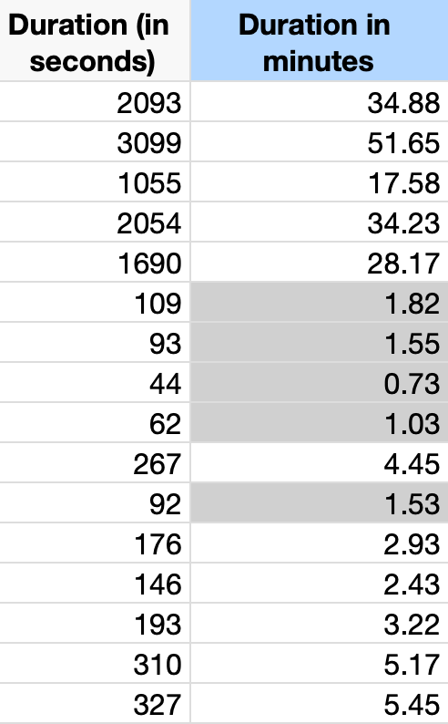
Fraud detection
Time-stamp filtering
If it takes at least 2 minutes to finish the survey but the respondent spent less than 2 minutes, it smells fishy.

Slide 13
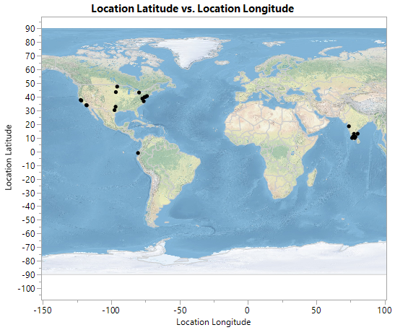
Fraud detection
Geolocation filtering
One of the inclusion criteria is “US teachers.”
Qualtrics records the location of the respondent. This information can be used to detect fraud.
Data set: US teacher survey

Slide 14
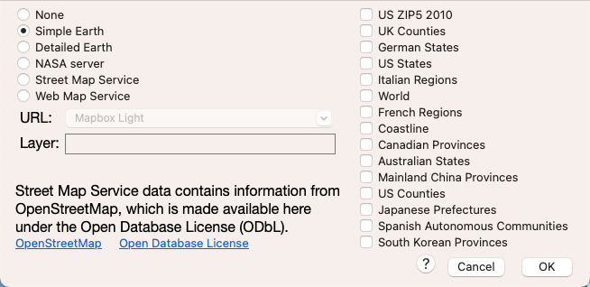
Fraud detection
In JMP open Graph → Graph Builder
Put Latitude into Y and Longitude into X
Deselect the line by clicking the second top icon from the left
Do a right-click and select Graph → Background Earth → Simple Earth.

Slide 15
Common mistakes made by researchers:
Lack of sensitivity
Options are limited (“Are you depressed?” 0 = No, 1 = Yes)
If I am a bit depressed, I will select ”No” and the researcher is unable to capture my information.
Use a 5-point or 7-point rating rate.

Slide 16
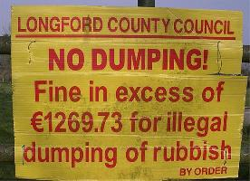
Common mistakes:
False sense of precision
How about a 10-point scale or a 100-point scale?
On a very wide scale, can people tell the difference between 5 and 6, 7 and 8?

Slide 17
Common mistake: Redundancy
Very long survey
People lost their patience and didn’t read the questions carefully.
“It is good to know…”

Slide 18
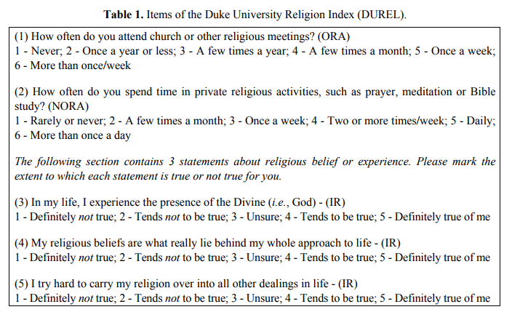
Solution: Less is more!
A five-item survey: DUREL

Slide 19
Common mistake:
Double-barreled question
"Do you agree that low enrollment in Program X is due to lack of interest among current users?"
If the user replies, "agree," it could mean:
  I agree that the enrollment is low
  I agree that people are not interested in it.
  I agree that low enrollment is caused by lack of interest.

Slide 20
Double-barreled question
I am so afraid of computers I avoid using them (Options: 5-point scale, Strong agree – Strong disagree)
Source: Earlier version of Computer anxiety test
Can you see a problem?
A better version: I try to avoid using computers whenever possible.

Slide 21
Double-barreled question
Source: New Americans Museum, San Diego
Can you see a problem in these questions? What should be done?

Slide 22
Common problem: What is “3”?
Do you agree that Obamacare is a good policy? Rate this statement using a 5-point Likert scale:
  1=strong disagree
  2=disagree
  3=neutral (neither agree nor disagree)
  4=agree
  5=strongly agree

Slide 23
Common problem: What is “3”?
Peter, Paul, and Mary chose "3".
Peter's position: "I am not sure. There are both pros and cons in this policy."
Paul's position: "I already have my own insurance. I don't care."
Mary's position: "I am a new immigrant. I don't know what Obamacare is. No idea!"

Slide 24
What is ”3”?
Should we assign the same value (3) to all these "neutral" answers? If not, please explain.
To rectify the situation, today many surveys use a 4-point scale: No neutrality! You are either with us or against us! Is it a good solution? Why or why not?
Form a small group to discuss this question: What other solutions would you recommend?

Slide 25
What is “0”?
Some researchers treat no answer as “0”. What is the problem?
If you asked me to rate the movie “Avengers” on a 5-point scale and I told you I never watched this movie, would you put a zero into the data file?
It should be missing (uncounted), otherwise it will drag down the average!

Slide 26
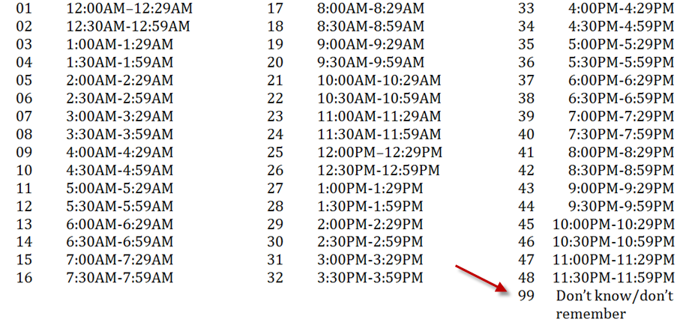
Common mistakes:
Unnecessary complication
What time usually do you go to work?

Slide 27
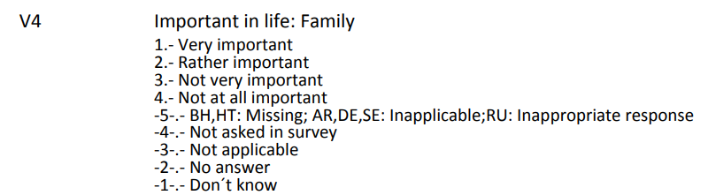
Common Mistakes: Poor coding
What are the problems?

Slide 28
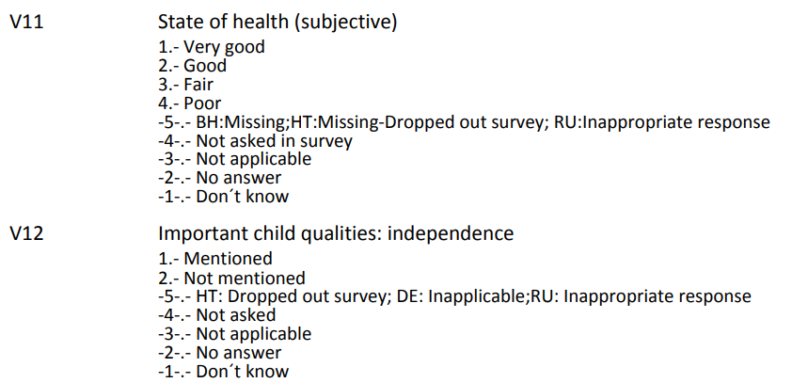
Common Mistakes: Poor coding
What are the problems?

Slide 29
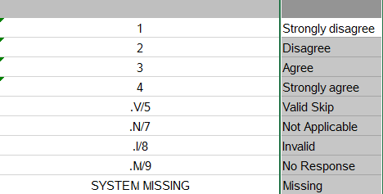
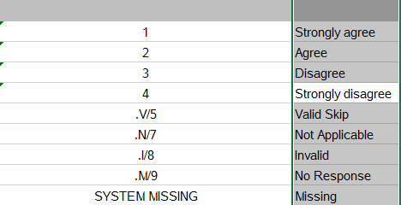
Common Mistakes: Poor coding
In the same survey! PISA

Slide 30
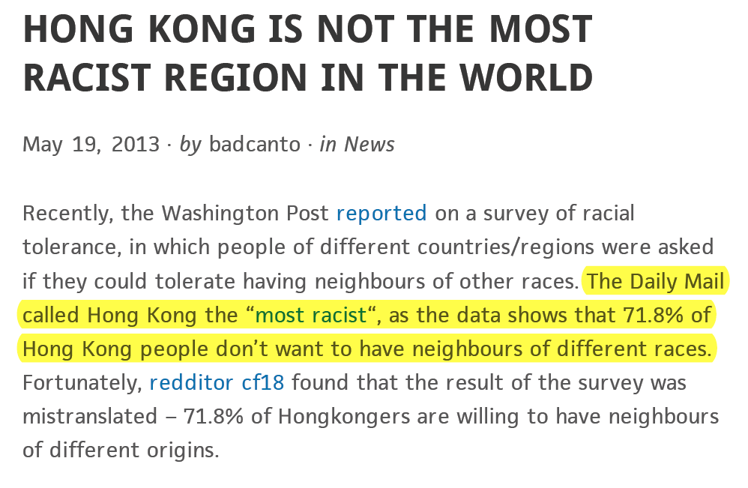
Common Mistakes: Poor coding

Slide 31
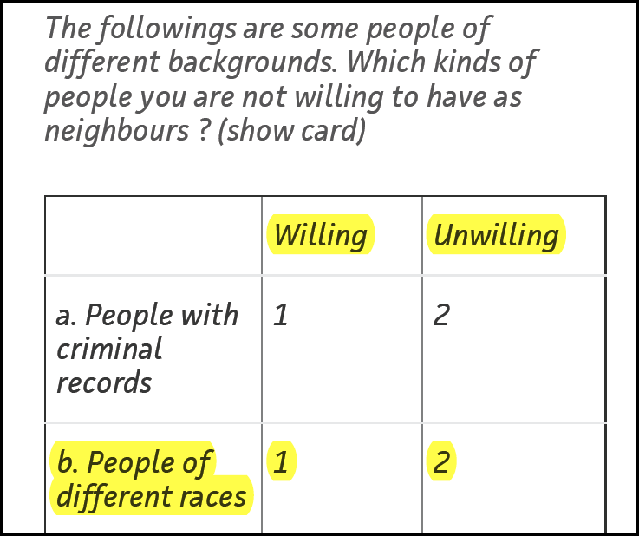
Examples
By common sense:
Yes = 1
No = 0
Why “not willing” = 2?

Slide 32
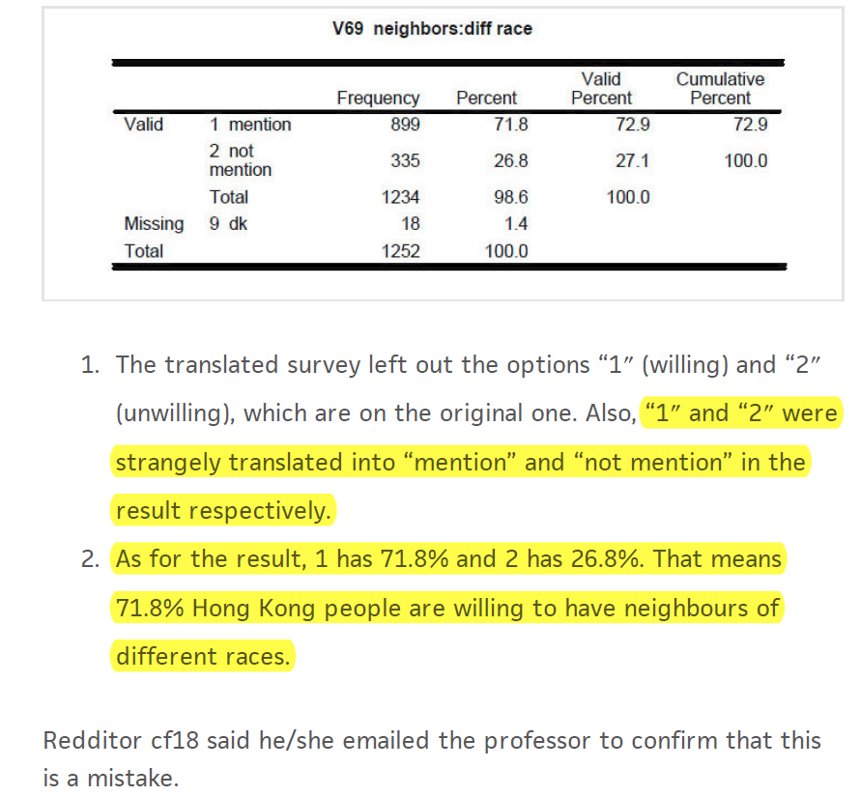

Slide 33
What is the best codebook?
The best codebook is no codebook or fewer codes!
Many people code the data in this way:
  Gender : Male = 1, Female = 2
  Race: White = 1, Black = 2, Hispanic = 3, Native American = 4, Asian = 5
Why not directly put down “M” as Male, “F” as female, “W” as white, “B” as black, “Y” as yes, and “N” as no…etc.? The letters are intuitive and you will never make any mistake by miscoding.

Slide 34
Sometime coding is necessary
In some cases coding is necessary e.g. country code.
America is also known as United States, United States of America.
Great Britain is also called United Kingdom and England.
The official name of South Korea is Republic of Korea.
We need two-letter or three-letter country codes for identification and merging data.
US, GB, KR
USA, GBR, KOR

Slide 35
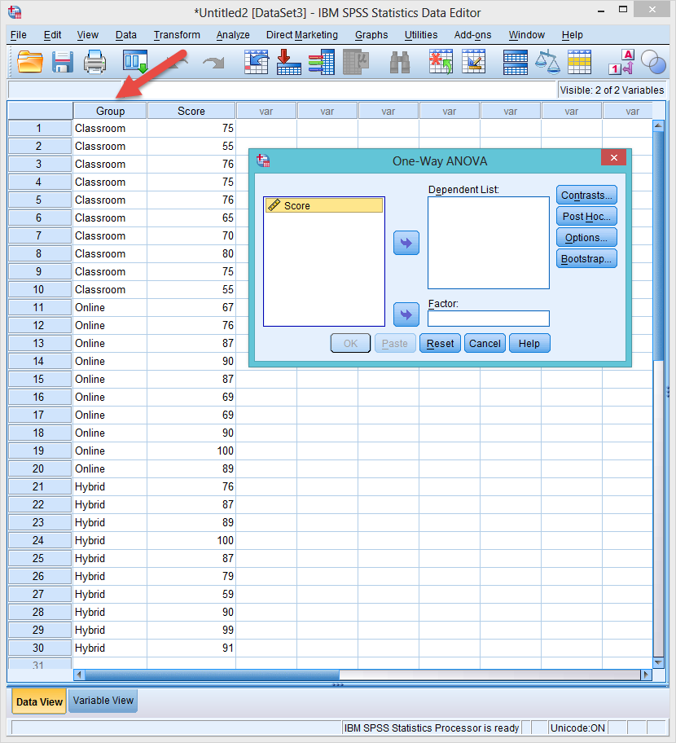
Disappearing factor
Sometimes it is understandable why people use numbers.
In SPSS when letters are used in a grouping factor, it cannot show up!

Slide 36
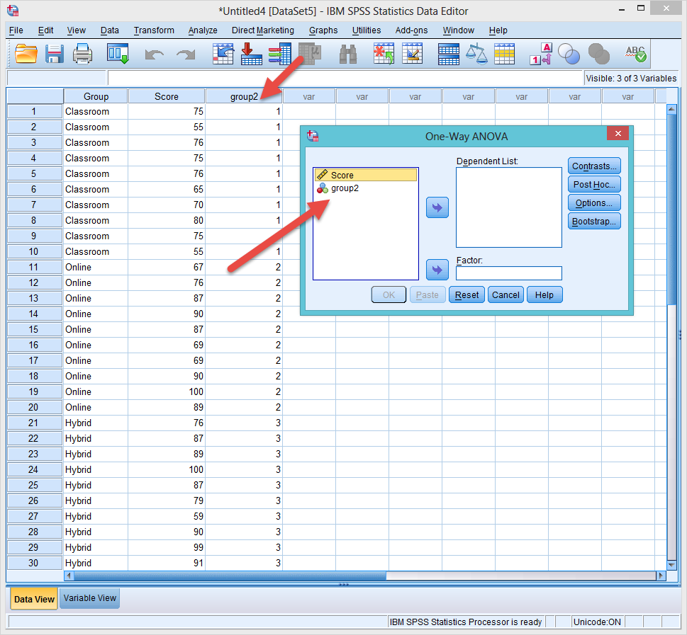
Recode to numbers
To see the grouping factor, you need to recode the letters to numbers.

Slide 37
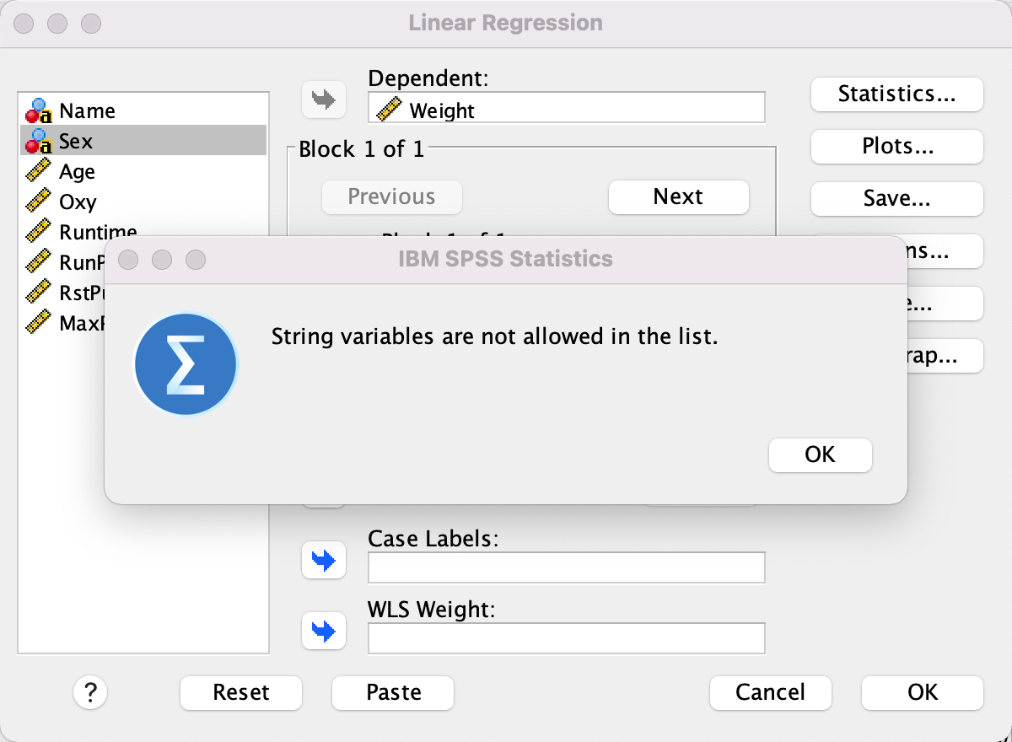
Same issue in regression

Slide 38
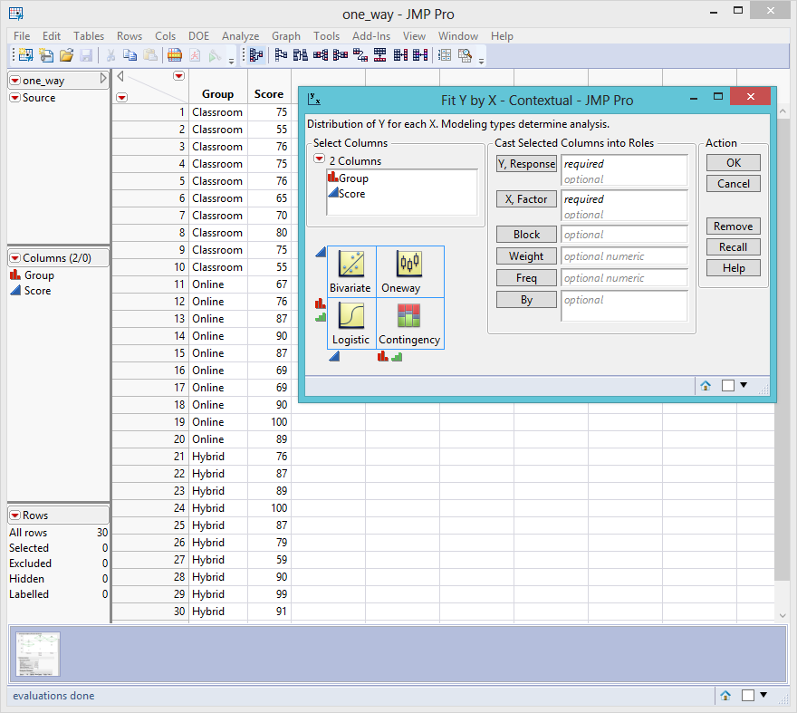
SAS and JMP are OK with texts

Slide 39
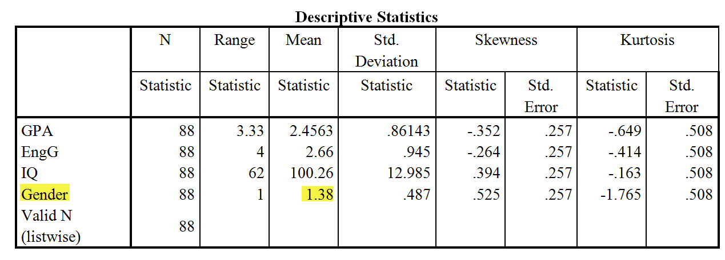
Don’t make these mistakes!
The following is a real report produced by a real student.
What’s wrong in the following table?

Slide 40
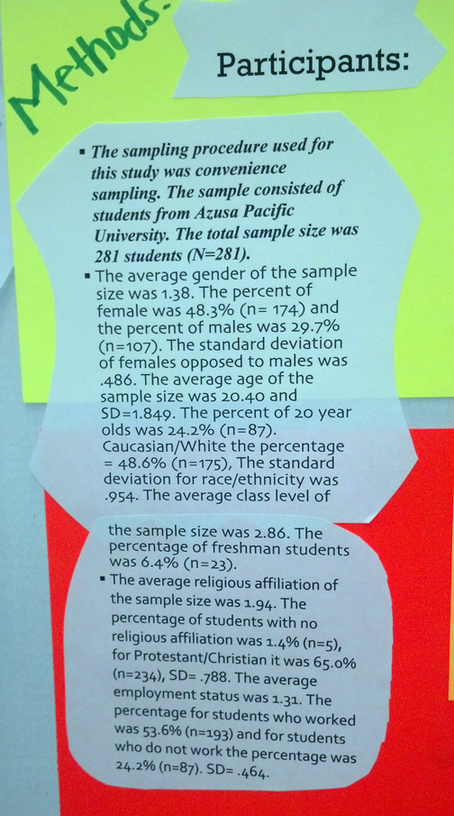
Don’t make these mistakes!
What’s wrong in this poster presentation?

Slide 41
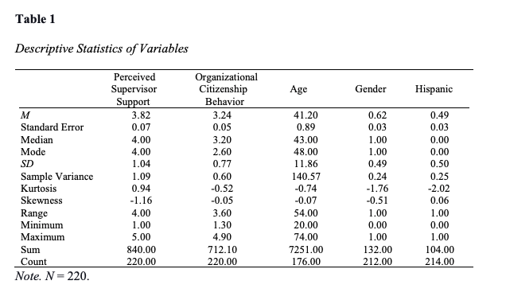
Don’t make these mistakes!
What’s wrong in this table?

Slide 42
Advantages of Online Survey
Lower error rate: If you collect data using papers, you need to enter the data into the database later. Needless to say, there would be errors during the data entry process. On the other hand, an online survey directly captures the data and the error rate is virtually zero.

Slide 43
Advantages of Online Survey
Lower cost: If you collect data using papers, you need to print hard copies and then mail them to your potential participants. Because the printing and mailing fees are high, you must be very selective in sampling. However, if you use the online approach, you can reach a larger accessible population. The survey will be sent with recycled electronics.

Slide 44
Advantages of Online Survey
More freedom: Some survey engines allow you to make a question compulsory, randomize the question order or/and the option order. Prior research shows that item order would affect the participants’ responses (carry-over effect). Randomizing item order can rectify this situation. You can also do this in hard copies but it is tedious to create many versions of the same survey.

Slide 45
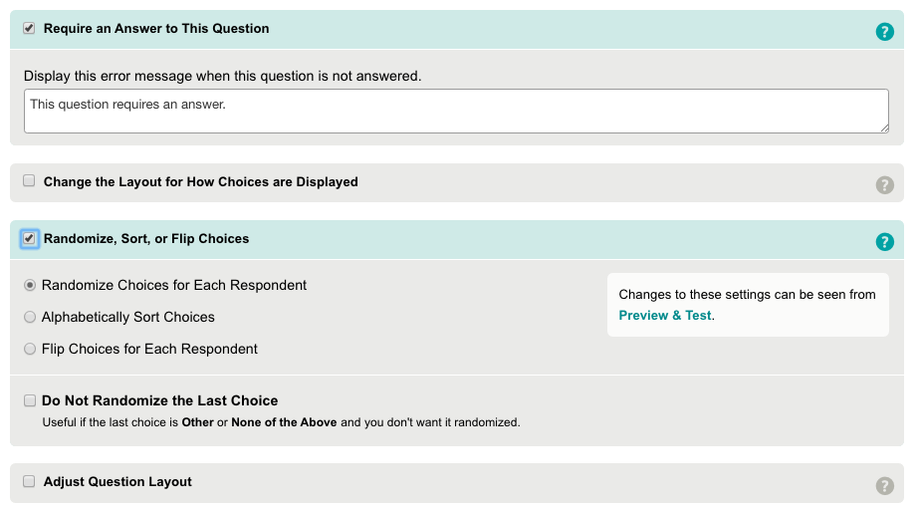
Example: Survey Monkey

Slide 46
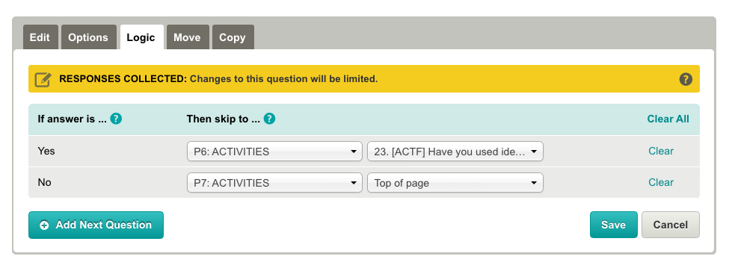
Advantages of Online Survey
More freedom: In addition, you can use skip logics in most online survey engines. It is more difficult to do so in a hard copy e.g.
If yes, go to Page 6; if no, go to Page 7.

Slide 47
Advantages of Online Survey
Higher response rate: People tend to respond to an online survey because it is easy. But if you ask the potential participant to mail back the survey, most people are unwilling to cooperate.
Higher completion rate: Some survey engines show the progress bar at the bottom. People tend to complete the survey if they can see how much longer it will take to finish.

Slide 48
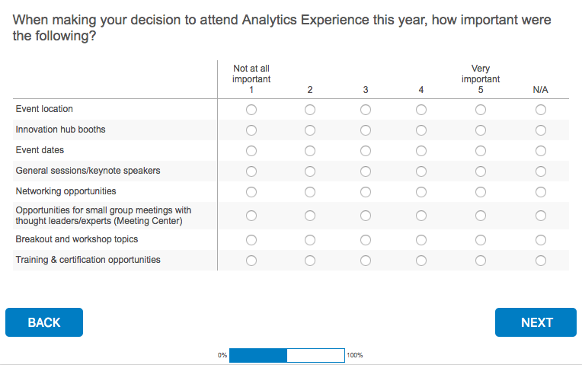
Progress bar

Slide 49
Advantages of Online Survey
Less intrusive: Unlike a phone survey, you can do an online survey anywhere anytime.
More flexibility in sampling: You can use Amazon Mturk to recruit participants from all over the world. The sample will be more diverse and the sample size will be larger.

Slide 50
Pilot study
The purpose of a pilot study is to identify any additional problems with the wording of survey items, and to check the online user interface. Data collected during the pilot should not be used in the actual data analysis. Based on the pilot study, the surveys can be refined in the following ways:

Slide 51
Pilot study
Testing clarity of wording: If any item causes confusion, the item will be reworded and retested.
Testing user-interface: If any object (e.g. icon, button, menu…etc.) on the webpage causes inconvenience or confusion, the researcher should redesign the interface and retest the revised version (Check all browsers e.g., Chrome, Firefox, Safari, and Edge)..

Slide 52
Pilot study
Timing: Each survey is not supposed to take more than 20 minutes. If, on average, the pilot testers spend more than 20 minutes, the research team might consider shortening the survey.
Assessing whether the research protocol is realistic and functioning: If the protocol has any issues, the research team will revise it and retest the new version (e.g. parental consent).

Slide 53
Pilot study
Identifying logistical problems that might occur in the process: Potential logistic problems include lack of access to computers or the Internet, multiple computers in the same location sharing the same IP address using a proxy server, etc. If any issues are discovered, the research team will find ways to resolve them.

Slide 54
Pilot study
Refining survey items and options: Most survey items provide the participants with forced options only. Based on the responses to the open-ended questions, the research team might modify the survey items, such as including new options and even creating new items.

