Slide 1
Exploratory Factor Analysis
Chong Ho Yu, Ph.D., D. Phil.

Slide 2
Factor model
A factor model identifies the relationship between observed items and latent factors. For example, when a psychologist wants to study the causal relationships between Math anxiety and job performance, first he/she has to define the constructs “Math anxiety” and “job performance.”
To accomplish this step, the psychologist needs to develop items that measure the defined construct.

Slide 3
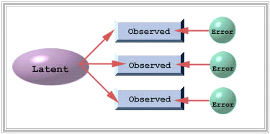
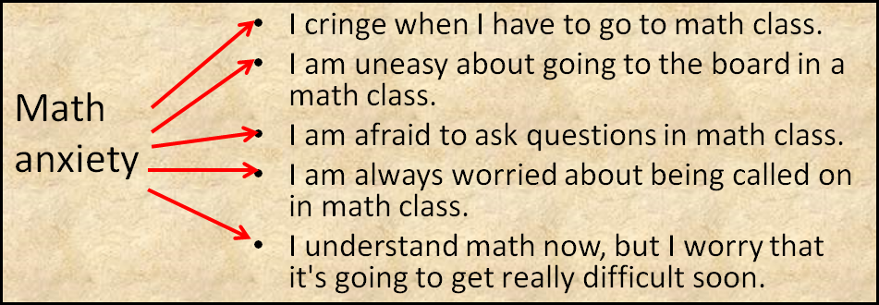
Why do we use factor analysis?
Find out what observed items can indicate latent constructs.

Slide 4
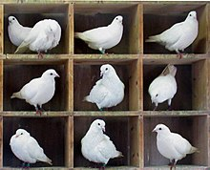
What is/isn’t a construct?
Constructs should not be pigeonholes.
Pigeonholing is a process that attempts to classify entities (e.g., personality, mental state…etc.) into a few categories. So, what is the problem?
People can be classified into "introverted" and "extroverted”, but most people exhibit both traits to some degree.

Slide 5

What is/isn’t a construct?
Learners can be classified into “intrinsically” and “extrinsically motived”.
A professor might do basic research without commercial application (intrinsically motivated). But publishing in a journal and eventually receiving a promotion is an external reward.
A Microsoft programmer might be highly motivated by his six-figure income, but he may also enjoy a sense of self-actualization when the Windows OS revolutionizes the field of computing.

Slide 6
What is/isn’t construct?
A construct is an open concept; it is NOT an operationalized definition.
An operationalized variable is exhaustive e.g. X is nothing but a + b + c
Intelligence is nothing more than logical reasoning + response time + memory + verbal clarity
People and people’s attributes are defined by a single number (e.g., IQ, GPA…etc.)

Slide 7
A controversial example
What is intelligence? How should we define and measure it?
Is there only one aspect of intelligence or multi-faceted?
Is the standard IQ test valid and fair?

Slide 8
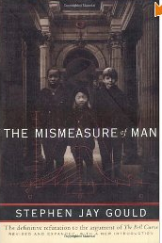
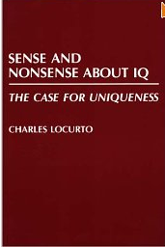
"Determinists arguments for ranking people according to a single scale of intelligence, no matter how numerically sophisticated, have recorded little more than social prejudice." (Gould, 1981, pp. 27-28) Gould’s book is controversial because some people said that he mis-cited certain studies.

Slide 9
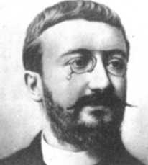
Alfred Binet
The purpose of IQ tests is to identify the children who need help and special education, not to classify normal people.
He declined to define IQ as fixed, inborn intelligence.
He refused to accept IQ as an absolute measure; intelligence is too complex to be captured by a single number. The scale is a rough guide only.

Slide 10
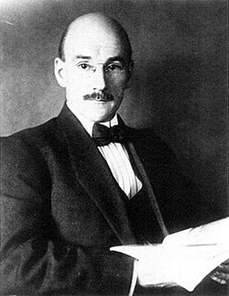
Henry H. Goddard
Invented the term “moron”: a person with a mental age in adulthood of between 8 and 12 (IQ of 51-70) on the Binet scale.
1914: testified in court that people with below-average intelligence should have limited criminal responsibility.

Slide 11
G Factor
All standardized tests of academic aptitude or achievement measure this general factor to some degree, but IQ tests expressly designed for that purpose--measure it more accurately (Spearman, 1904)
At the turn of the 20th century Charles Spearman (1863-1945) used statistical methods such as Correlation and Factor Analysis to define mental abilities as factors.
When two apparently different abilities are shown to be highly correlated, Spearman took this as evidence for the existence of a general factor G.

Slide 12
Other views
Thorndike: intelligence contains several unique factors
Thurstone: seven uncorrelated factors.
Guilford: three factors.
The Wechsler Adult Intelligence Scale – fourth edition (WAIS-IV): 4 dimensions
  verbal comprehension (VCI)
  perceptual reasoning (PRI)
  working memory (WMI)
  processing speed (PSI)

Slide 13
Multiple Intelligences
Gardner asserted that there are eight dimensions of intelligence and all eight intelligences are of equal intrinsic value. It is the culture and social context that determine the value and importance of the dimension.
Scientists from the University of Sheffield, England, provided evidence that numerical reasoning and linguistic ability may be two independent entitles. They examined several patients who suffered severe damage to the language faculty of their brains, and found that their mathematical ability is intact.

Slide 14
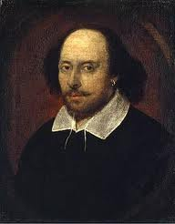
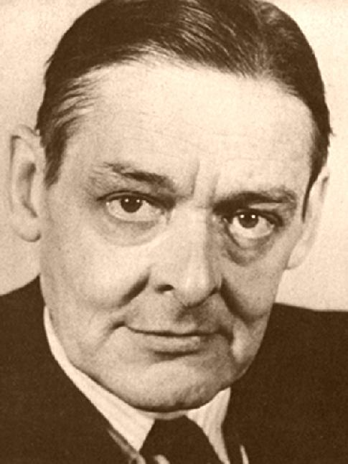
Linguistic

Slide 15
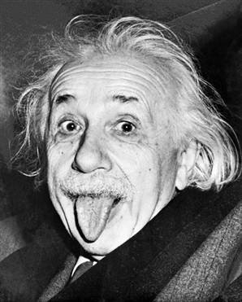
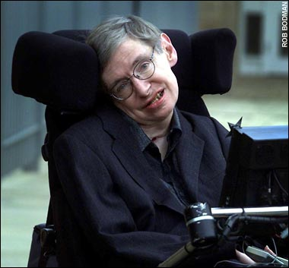
Logical-mathematical

Slide 16
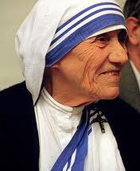
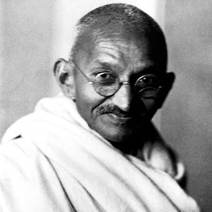
Interpersonal

Slide 17
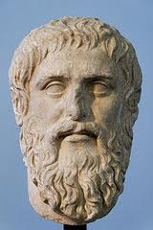
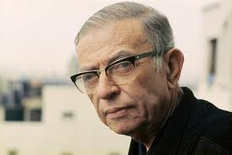
Intrapersonal

Slide 18

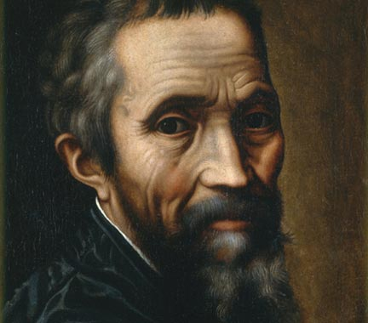
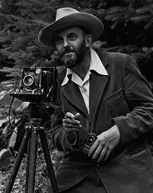
Artistic-spatial

Slide 19
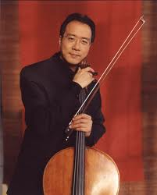

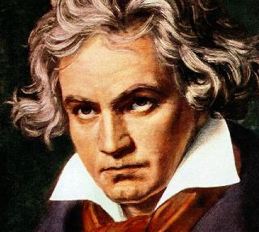
Musical

Slide 20



Kinesthetic

Slide 21
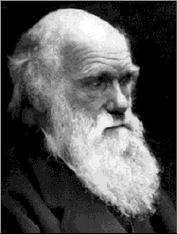
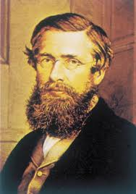
Naturalist

Slide 22
Ungraded discussion
Form a group of 3 to 4 people to discuss the following issue: The current Wechsler IQ test covers four aspects: Verbal comprehension, perceptual reasoning, working memory, and processing speed.
Gardner maintained that intelligence has eight dimensions.
Some people argued that some dimensions of Gardner’s model are “untestable” or too difficult to measure, such as interpersonal, intrapersonal, and naturalistic, and therefore we should adopt the Wechsler’s model rather than the Gardner’s model in standard assessments of IQ.
Can we develop a factor model of intelligence based on Gardner’s theory?

Slide 23
Construct, dimension, subscale, factor
If the construct of intelligence has eight dimensions, then we need eight subscales.
The factor structure has eight factors.

Slide 24
From reliability to validity
A psychologist employs Cronbach’s alpha to evaluate the internal consistency of observed items, and also applies factor analysis to extract latent constructs from these consistent observed variables.
If the factor structure indicates that the observed items cluster around one concept (construct), the construct is said to be unidimensional.

Slide 25
Uni-dimensional vs. multi-dimensional
A survey/test measures a single psychological construct → unidimensional
A survey/test has subscales to measure more than one constructs → multidimensional
Sometimes it is good to have one and only one dimension: The construct is fairly simple and there is not much debate. And your goal is to measure this particular construct, nothing else!

Slide 26
Overall Cronbach
Coefficient Alpha
One may argue that when a high Cronbach Alpha indicates a high degree of internal consistency, the test or the survey must be uni-dimensional rather than multi-dimensional. Thus, there is no need to further investigate its subscales.
Is it true?

Slide 27
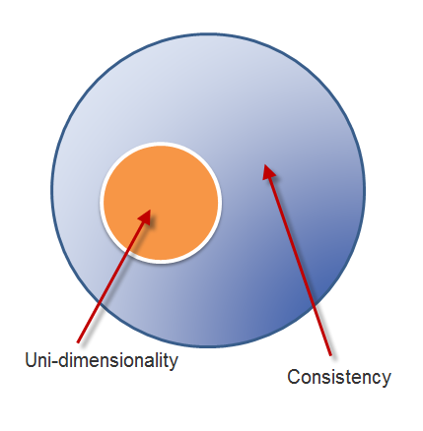
Consistency is NOT uni-dimensionality
Actually consistency and dimensionality must be assessed separately.
Uni-dimensionality is a subset of consistency. If a test is uni-dimensional, then it will show internal consistency.
But if a test is internally consistent, it does not necessarily entail one construct.

Slide 28
Consistency is NOT uni-dimensionality
Cronbach Alpha is a measure of common variance shared by test items.
The Cronbach Alpha could be high when each test item shares variance with at least some other items; it does not have to share variance with all other items.

Slide 29

First case
Variance explained is often visualized by sets. When two sets are intersected, the overlapped portion denotes common variance. The non-overlapped portion indicates independent information.
All nine sets have no overlapped area, and thus all nine items share no common variance. They are neither internally consistent nor uni-dimensional. Interpreting a low Alpha as the absence of uni-dimensionality is correct.

Slide 30

Second case
The second scenario is exactly opposite to the first one. It shows the presence of a high degree of internal consistency and uni-dimensionality because all items share common variance with each other.
Interpreting a high alpha as an indication of the presence of one single construct could be accepted.

Slide 31

Third case
Several items share variance with some others.
Subscales exist inside the instrument even though the Alpha is high and the instrument is internally consistent.
Interpreting a high Alpha as a sign of uni-dimensionality is problematic.

Slide 32
Fallacy
If I am a man, I must be a human. But if I am a human, I may not be a man (could be a woman). The logical fallacy that "if A then B; if B then A" is termed as "affirming the consequent."
Nonetheless, after you created subscales, it is still a good practice to compute the specific Cronbach Alpha for each subscale.

Slide 33
PCA and EFA
Principal components analysis: find the optimal way of collapsing many correlated variables into a small number of subsets so that the study is more manageable. The subsets do not need to make any theoretical sense. It is for convenience only.
Exploratory factor analysis: identify the underlying theoretical structure of diverse variables. If certain items are loaded into a subscale called intrinsic religious orientation, then the items must be related to this construct both mathematically and conceptually.

Slide 34
Example of PCA:
Insurance policy
The policy variables (Maitra & Yan):
Fire Protection Class
Number of Building in Policy
Number of Locations in Policy
Maximum Building Age
Building Coverage Indicator
Policy Age

Slide 35
Why is it “exploratory”?
Haig: EFA is abductive.
You should consider different alternate factor models.
Haig, B. (2014) Investigating the Psychological World: Scientific Method in the Behavioral Sciences (Life and Mind: Philosophical Issues in Biology and Psychology)

Slide 36
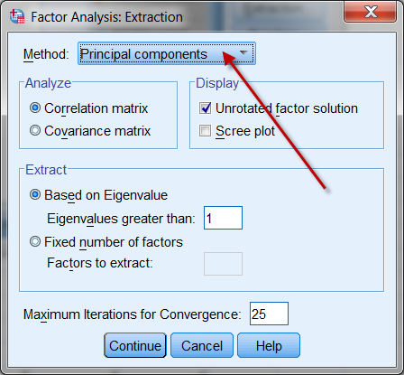
Confusion between PCA & EFA
Although factor analysis and PCA are two different procedures, some researchers found that the procedures yield almost identical results on many occasions. SPSS makes PCA as the default when EFA is requested.

Slide 37
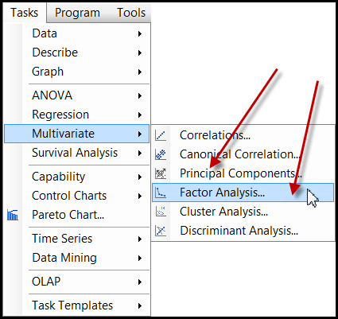
SAS Enterprise Guide
Less confusing in SAS Enterprise Guide. Both PCA and EFA are shown in the Tasks menu.
But if you do programming, PROC FACTOR in SAS makes PCA as the default method.

Slide 38
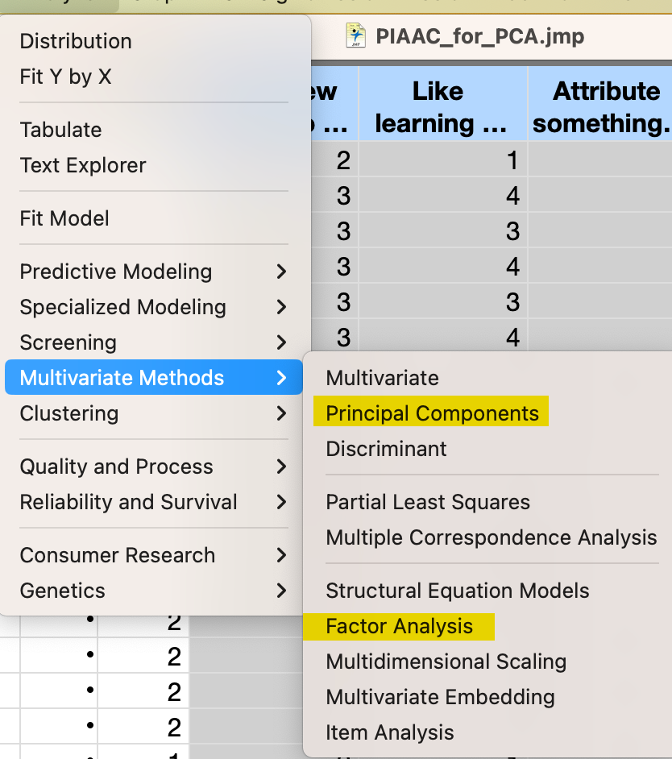
JMP Pro
In JMP PCA and factor analysis are separated.

Slide 39
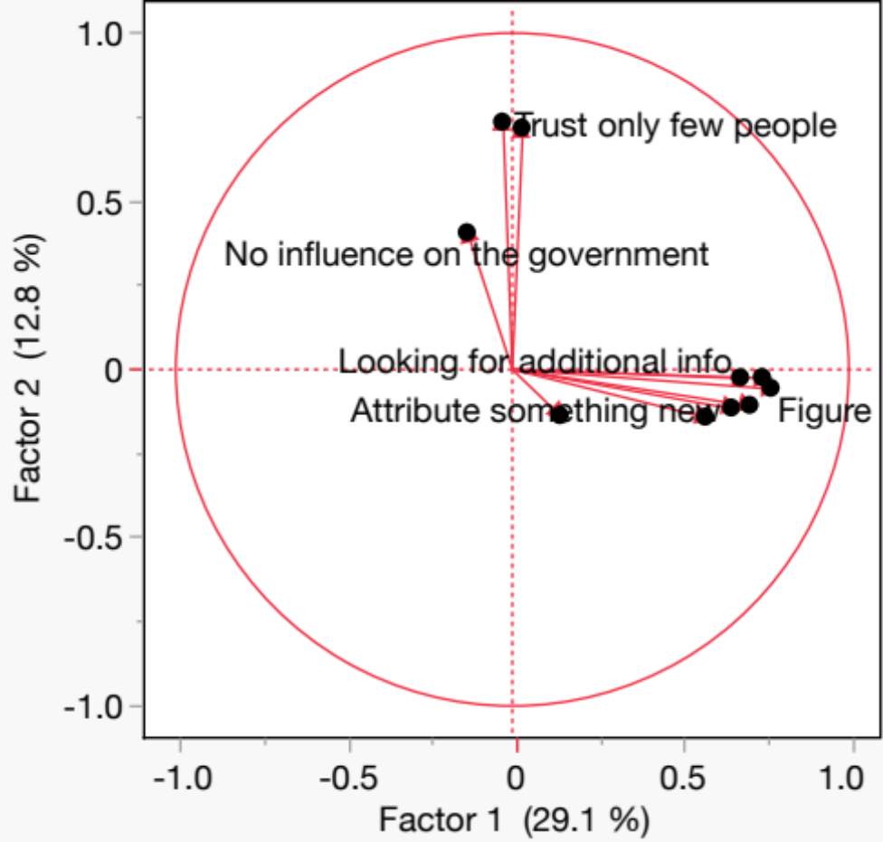
EFA in JMP
Use the data set “PIAAC_for_EFA”
Analyze → Multivariate Methods → Factor Analysis
Accept the default
Check the loading plots

Slide 40
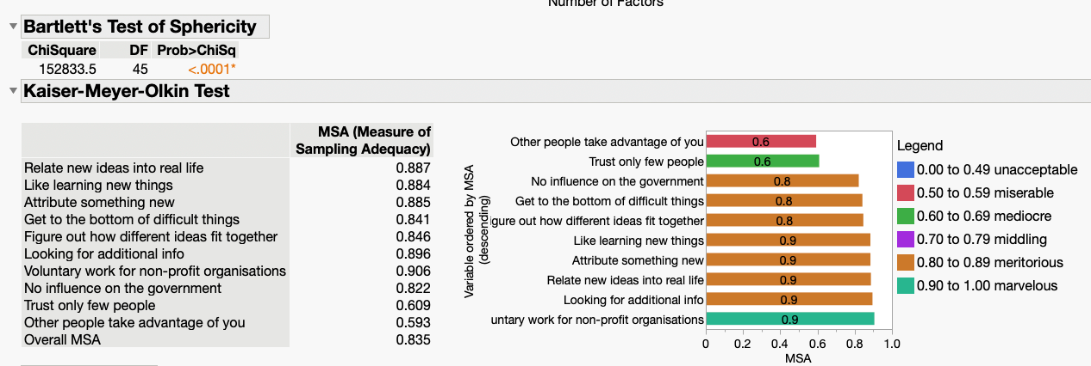
EFA in JMP Pro
From the inversed read triangle, you can run Bartlett’s and KMO tests to check whether the data are good for FA.

Slide 41
Vector
A mathematical object with a numeric value is called a scalar.
A mathematical object that has both a numeric value and a direction is called a vector.
If I just tell you to drive 10 miles to reach my home, this instruction is definitely useless. I must say something like, "From Claremont drive 10 miles West to Azusa."

Slide 42
Vector
Vector-based graphics: the image is defined by the relationships among vectors instead of the composition of pixels.
For example, to construct a shape, the software stores the information like "Start from point A, draw a straight line at 45 degrees, stop at 10 units, draw another line at 35 degrees..."

Slide 43
Vector
In quantitative analysis, vectors help us to understand the relationships among variables.
The word eigen, coined by Hilbert in 1904, is a German word, which means "own“ or "peculiar“.
An Eigenvalue has a numeric property while an eigenvector has a directional property. They define the attributes of a variable.
“Eigen” emphasizes the unique nature of a specific transformation in Eigenvalues.

Slide 44
Data as matrix
 | GRE-Verbal | GRE-Quant
David | 550 | 575
Sandra | 600 | 580
This is an old example. Currently the high possible score for each subject of GRE is 170.
The columns denote the subject space, which are {550, 600} and {575, 580}. The subject space tells you that how GRE-Verbal and GRE-Quantitative scores are distributed between two subjects, David and Sandra.
The rows reflect the variable space, which are {550, 575} and {600,580}. The variable space indicates that across the variables GRE-V and GRE-Q, how the scores of the subjects are distributed.

Slide 45
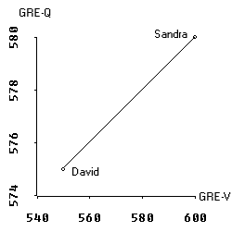
Variable space
In a scatterplot we deal with the variable space.
In the scatterplot GRE-V lies on the X-axis whereas GRE-Q is on the Y-axis.
The data points are the scores of David and Sandra. In a two data-point case, the regression line is perfect, of course.

Slide 46
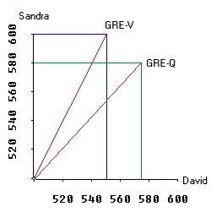
Subject space
The graph on the right is a plot of subject space.
The X axis and Y axis represent Sandra and David. In GRE-V David scores 550 and Sandra scores 600. A vector is drawn from 0 to the point where Sandra's and David's scores meet.

Slide 47
Subject space
The scale of the graph is not of the right proportion. Actually it starts from 500 rather than 0 in order to make other portions of the graph visible.
The vector for GRE-Q is constructed in the same manner.

Slide 48
Hyperspace
When subject space and variable space are combined, we call it the hyperspace.
In reality, a research project always involves more than two variables and two subjects.
In a multi-dimensional hyperspace, the vectors in the subject space can be combined to form an eigenvector, which depicts the Eigenvalue.
The longer the length of the eigenvector is, the higher the Eigenvalue is and the more variance it can explain.

Slide 49
Various criteria
Kasier criterion
the scree plot
parallel analysis
Many studies had verified that by far PA is the most accurate method (Buja & Eyubuglu, 1992; Glorfeld, 1995; Horn, 1965; Hubbard & Allen, 1987; Humphreys & Montanelli, 1975; Velicer et al., 2000; Zwick & Velicer, 1986).

Slide 50
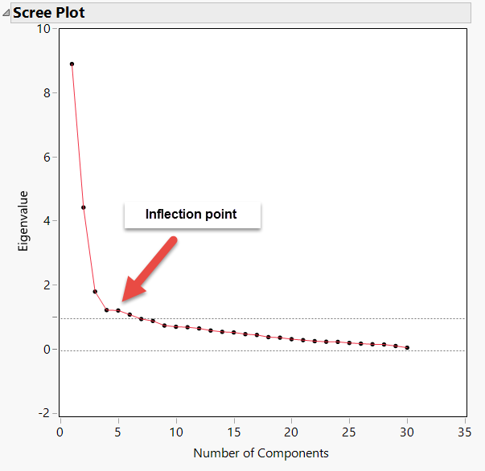
Scree plot
Determine the number of factors
How much additional information can I get by adding more complexity into the factor model?

Slide 51
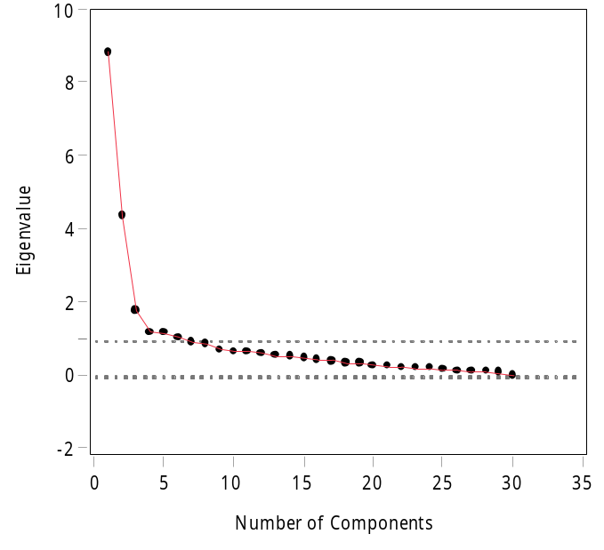
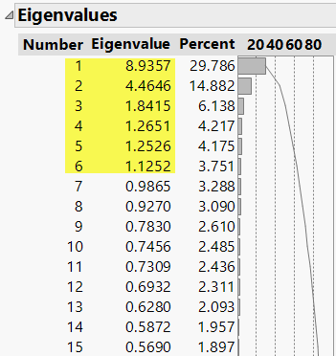
Kasier criterion
Just like the cutoff using p value < .05, Kaiser’s criterion (Eigenvalue => 1) is just a convention.
If necessary, you should override it.
Dr. Shaynah Neshama developed a scale with two constructs, but EFA suggests six factors based on Kasier criterion => 1.

Slide 52
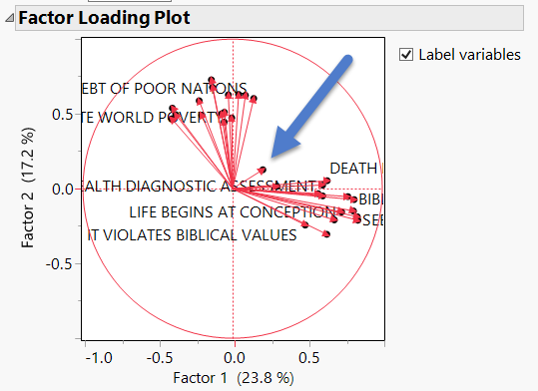

Factor loading plot
I forced EFA to use a 2-factor solution. When the variables are represented as vectors, it is clear that there are two clusters. Only one item does not belong to any group. Cut it!

Slide 53
PA: Resampling
The logic of parallel analysis resembles that of resampling: the number of factors extracted should have eigenvalues greater than those in a random matrix.
The algorithm generates a set of random data correlation matrices by bootstrapping the data set (resampling with replacement), and then the average eigenvalues and the 95th percentile eigenvalues are computed.

Slide 54
PA: Resampling
The observed eigenvalues are compared against the re-sampled eigenvalues, and only factors with observed eigenvalues greater than those from re-sampling are retained.
The resampled result functions as a sampling distribution, in which the observed is compared against. The rationale of using the 95th percentile of the resampled data eigenvalues is that this is analogous to setting the value of alpha to .05 in hypothesis testing (Cho, Li, & Bandalos, 2009).

Slide 55
Underfactoring vs. overfactoring
Parallel analysis can be used with PCA or EFA. Which one should be used?
PA with PCA tends to under-factoring (extract fewer factors than what it should be).
PA with EFA tends to over-factoring (extract more factors than what it should be).

Slide 56
Underfactoring vs. overfactoring
Under-factoring is a more serious problem than over-factoring.
In the former scenario the researcher totally misses some information.
In the latter the result may include some meaningless factors (Crawford, Green, Levy, Lo, Scott, Svetina, & Thompson, 2010), but the researcher can always trim the redundant factors later.

Slide 57
Underfactoring vs. overfactoring
It is better to over-prepare than under-prepare.
Consider this analogy: I travel with 2-3 cameras. If I don't need the backup, it is fine. But if I have one camera only and it malfunctions, there is nothing I can do!
If your coauthor sends you a 50-page draft, you can remove the redundant information. If she sends you two pages only, there is nothing you can do!

Slide 58
Scree plot: Raw, PA means and 95th percent

Slide 59
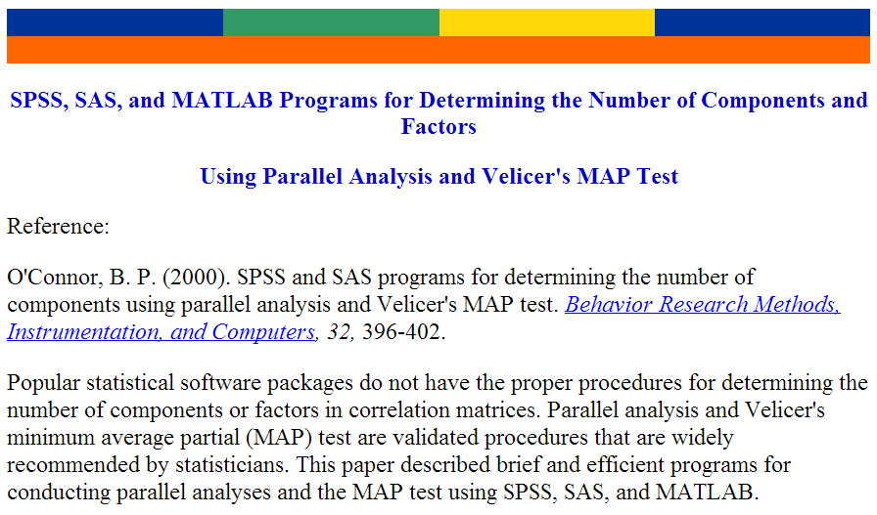
EQS, SAS or SPSS

Slide 60

SAS
Caution: You must have clean data to run the PA program. If you have missing data, you have to remove those observations, otherwise it won't run.
It is better to retain only the items that will be used for PA. Nothing else. It will be much easier to read the data. e.g. read all numeric variables into the raw data set.

Slide 61
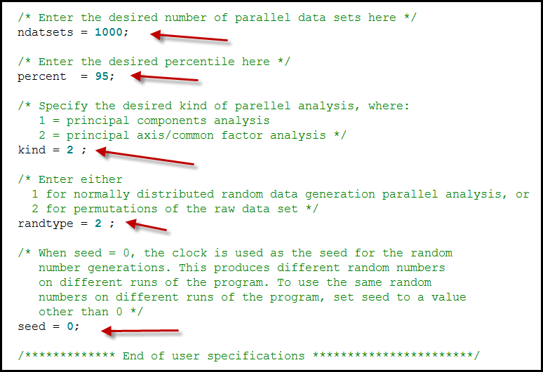
SAS

Slide 62
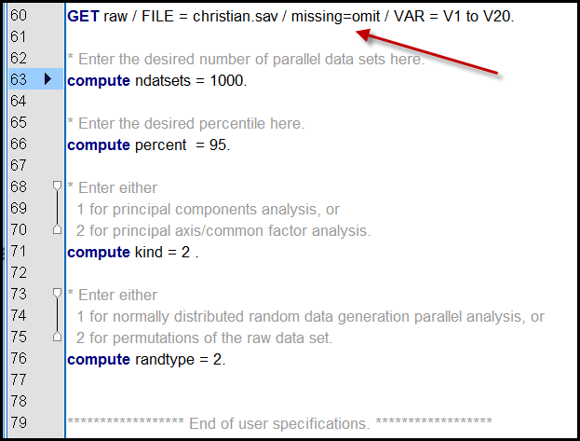
SPSS
SPSS can omit missing.

Slide 63
Compare the four methods
When you determine how many factors should be retained, you can also check which items are loaded into which factors.
Kasier’s criterion, Scree plot, parallel analysis can tell you the proper number of factors, whereas the loading plot can tell you the number of factors and which items belong to which factor.

Slide 64
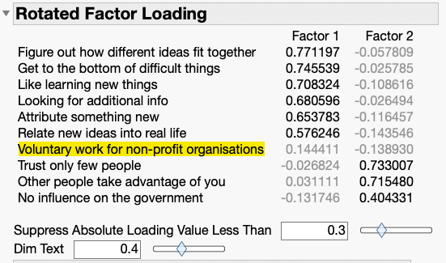
Factor loading
The largest factor loading → loaded into the factor (ignore the sign + or -)

Slide 65
Factor loading
Factor 1: Cognitive, learning
Factor 2: Social
“Voluntary work…” is indetermined.

Slide 66
Factor rotation
If the factor model is not desirable, you can rotate the vectors to look for a better solution.
Orthogonal and Oblique Methods
Orthogonal Methods: There is no correlation between the factors (e.g., Varimax, Quartimax)
Oblique Methods: This is a correlation between the factors, more realistic in social sciences (e.g., Promax, Oblimin).

Slide 67
Factor rotation
Varimax
  The most common orthogonal method
  Goal: Get the most amount of variance in factors
Quartimax
  Goal: Larger differences in loadings across the variables
Equimax
  Combines varimax and quartimax
Promax
  Very common
  Goal: Similar to varimax, factors are correlated.

Slide 68
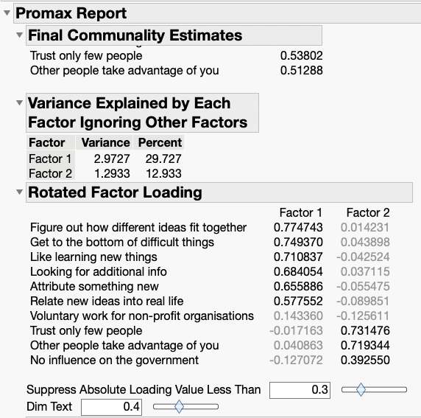
Factor rotation
Promax: It doesn’t work well!

Slide 69
EFA in SPSS
Analyze → dimension reduction → Factor
Click on Descriptive
Check KMO and Barlett’s test of sphericity
Click on Extraction
Choose Principal axis factoring
Check Scree plot

Slide 70
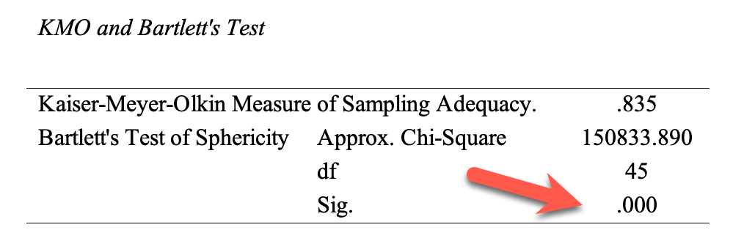
EFA in SPSS
Unlike JMP, you receive an overall KMO measure of sampling adequacy.
No diagnosis of individual items, meaning that you don’t know which problematic items should be removed, if there is any.
P value = .000

Slide 71
EFA in SPSS
The scree plot suggests the proper number of factors.
No loading plot

Slide 72
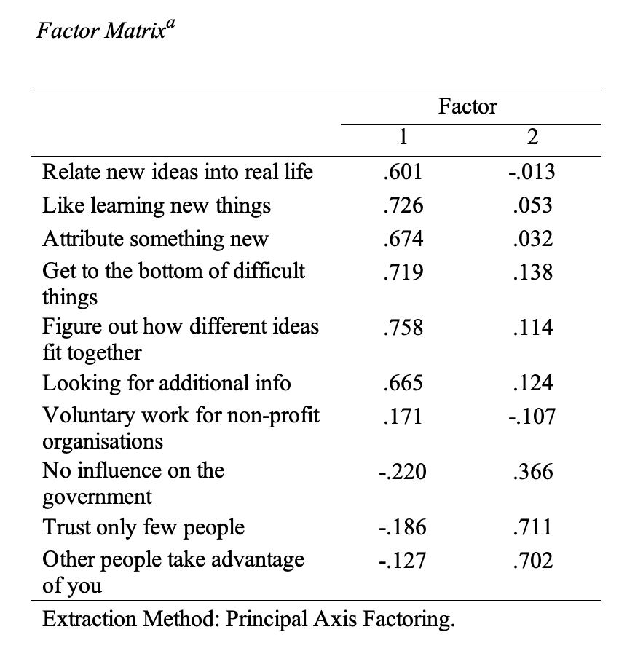
EFA in SPSS
Unlike JMP, you need to look at the factor loading to find out which items belong to which factor.

Slide 73
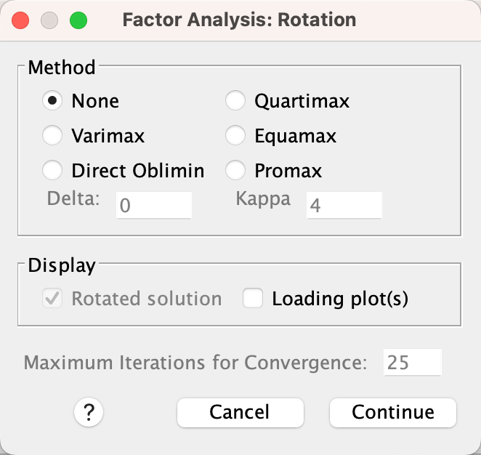
EFA in SPSS
If you want to rotate the vectors, click on rotation.
Fewer options than SAS/JMP.

Slide 74
Sample size for EFA
No absolute min. sample size requirement.
With a variable-to-factor ratio of at least 7 (e.g. you have 3 factors and 21 items or 4 factors and 28 items), the min. n can be between 150-180.
Mundfrom, D., Shaw, D., & Ke, T. L. (2005). Minimum sample size recommendations for conducting factor analyses. International Journal of Testing, 5, 159-168.

Slide 75
EFA is not enough
We need confirmatory factor analysis (CFA)? Why?
'EFA is an error-prone procedure even when the scale being analyzed has a strong factor structure, and even with large samples. Our analyses demonstrate that at a 20: 1 subject to item ratio there are error rates well above the field standard alpha = .05 level…It should be used only for exploring data, not hypothesis or theory testing, nor is it suited to “validation” of instruments.'
Osborne, J. W. (2014). Best practices in exploratory factor analysis (Kindle Locations 2305-2310). Amazon Digital Services.

