Slide 1
Confirmatory Factor Analysis
Chong Ho Yu

Slide 2
Difference between
EFA and CFA
EFA
CFA
Determines the factor structure
Explains the amount of variance in the factors
Confirm the model previously established by EFA
  Number of factors
  Factor loadings
Supported by theory/previous research
Show how much error/unfit
Some exploration is allowed

Slide 3
EFA and CFA
You cannot use the same sample for EFA, CFA, and examining treatment effectiveness. When you fit your proposed model into the same data, it always looks good. If I set up a rubric to grade my own paper, I must get an “A”!
You can use two different samples, or partition the sample into two subsets: one is for EFA and the other is for CFA. The logic is similar to cross-validation in resampling.

Slide 4
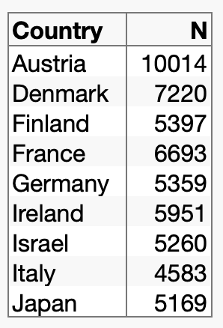
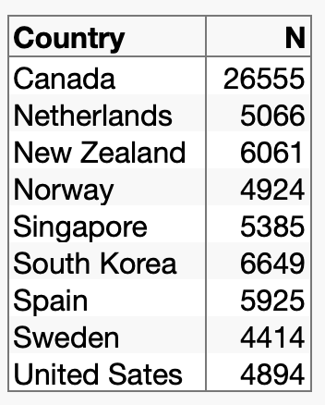
Example
The PIAAC data set is partitioned into two subsamples.
For EFA
For CFA

Slide 5
Example
The two subsets are grouped by country. The individual observations are not randomly assigned into two subgroups. Is there a problem?
The participants were randomly selected in each country.
It is better to select all observations of a country into a subset so that you can perform subgroup analysis, if necessary.
Example: Is the USA factor model the same as the Canadian one?

Slide 6

Confirmatory factor analysis
• You cannot do CFA in the SPSS Statistics.
• You can use:
  IBM SPSS AMOS (not this Amos→)
  SAS/JMP
  EQS
  Mplus
  Python
  R

Slide 7
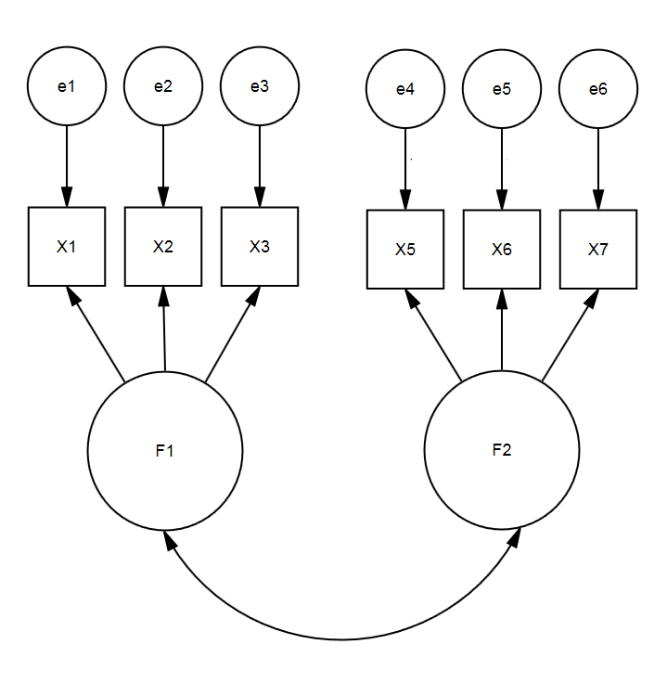
Need sufficient degrees of freedom
DF = the number of distinct elements in the covariance matrix - the number of free parameters to be estimated.
The concept of DF will be explained in the unit “IRT”.
Don’t worry about how to compute DF. Software (e.g. AMOS, SAS, JMP…etc.) will do it for you.
If you have 3 or more observed items for each factor (construct), it will be OK.

Slide 8
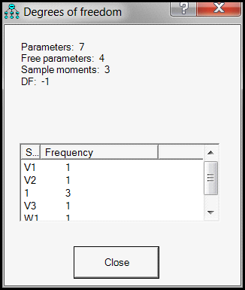
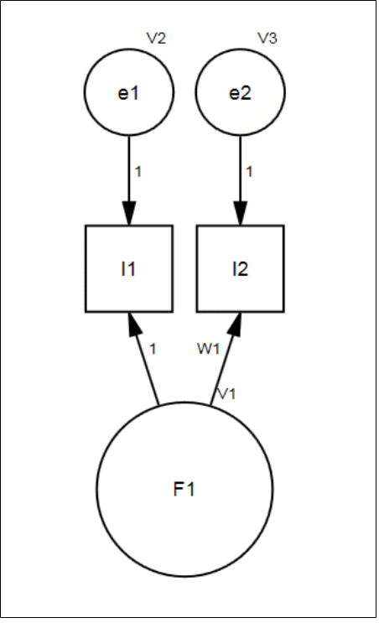
Worst case scenario of factor model
Verify whether your factor model is “doable” in CFA. If you have two only, you will have negative DF!

Slide 9
Counter-example: Brief COPE
Measure coping with adversary
Original COPE: 60 items, 4 items per subscale (factor), too long and patients become impatient.
Brief COPE: reduces to 2 items per subscale.
Carver, C. (1997). You want to measure coping but your protocol's too long: Consider the brief COPE. International Journal of Behavioral medicine, 4, 92-100.

Slide 10
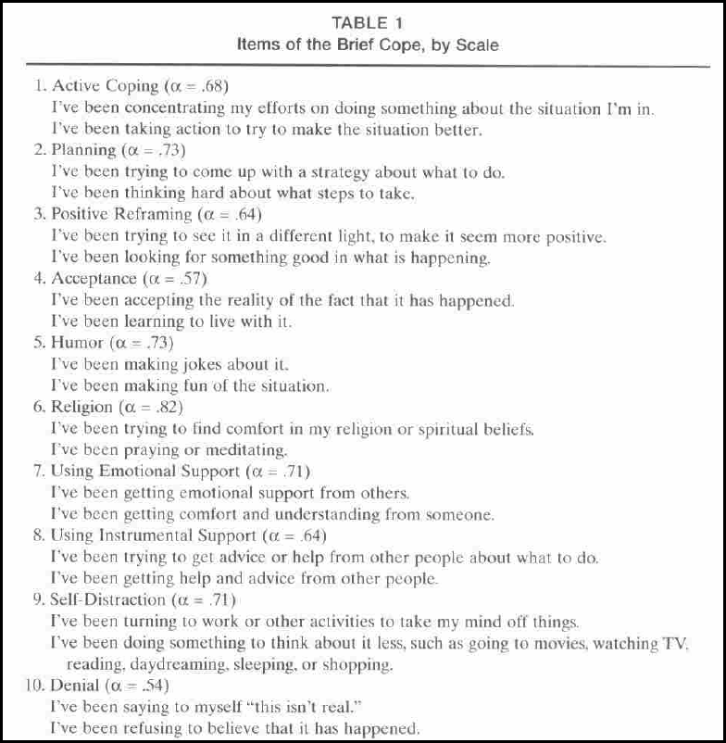

Slide 11
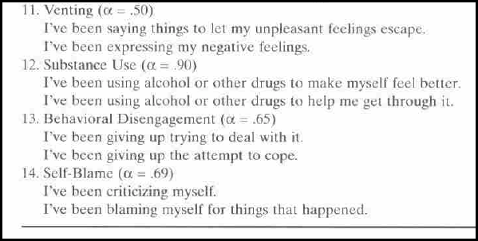
Is it acceptable?
Only EFA is used, no CFA.

Slide 12
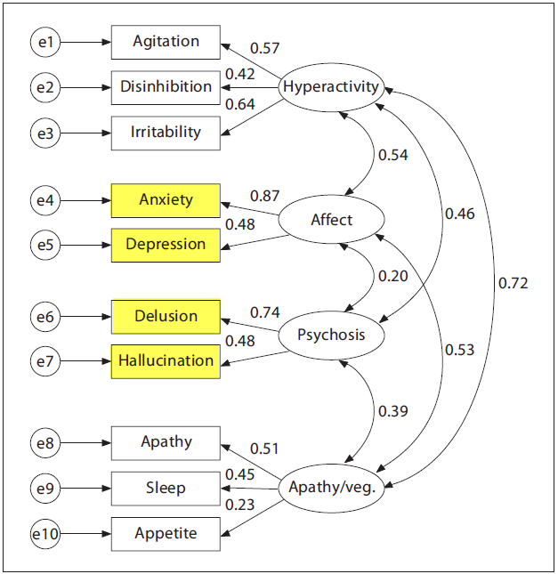
How about NPI?
Neuropsychiatric Inventory has two-items factor.
The model is validated in CFA.
The degrees of freedom is 34.

Slide 13
Someone says it is OK
Raubenheimer (2004): “Scales with more than one factor may be identified with as little as two items per factor...” (p.60)
Yeah! It is OK! Cite this:
Raubenheimer, J. (2004). An item selection procedure to maximize scale reliability and validity. SA Journal of Industrial Psychology, 30, 59-64.

Slide 14
Why do you use exceptional models?
Please cite the entire passage:
“Scales with more than one factor may be identified with as little as two items per factor, although these should be seen as the exception. The usual case is that a minimum of 3 items must load significantly on each factor in a multidimensional scale, for all of the subscales to be successfully identified” (p.60)

Slide 15

Example: DUREL
• Duke University Religion Index (DUREL): A brief measure of religiosity
• Five items and three dimensions:
• Organizational religious activity: Attending church
• Non-organizational religious activity: Prayer, meditation
• Intrinsic religiosity: Subjective

Slide 16
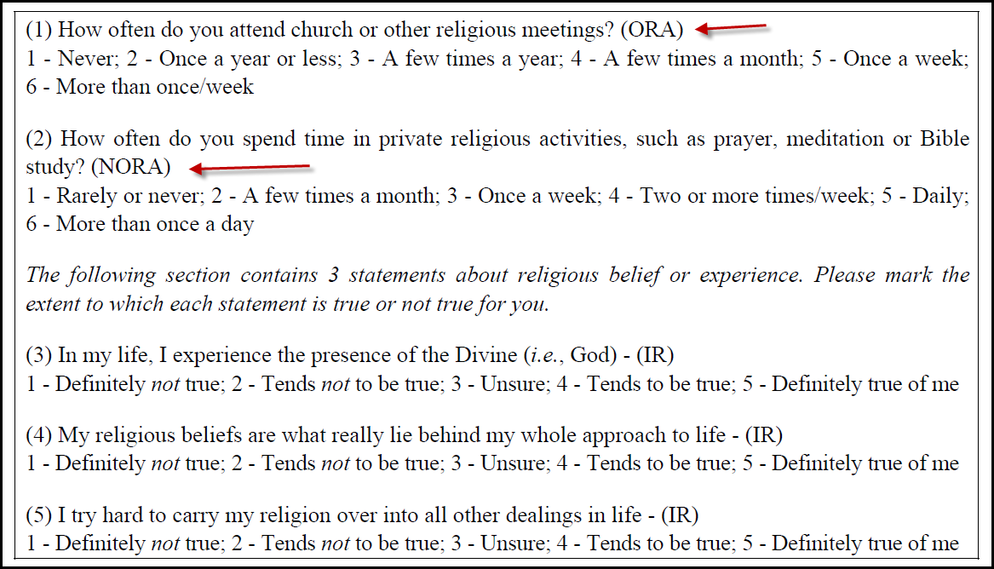
How about one item in a subscale?
Can we do that?

Slide 17

Yes, we can!
The single item must be treated as ordinal. In CFA it is like an observed item instead of a construct. There will be no issue about DF. But you cannot get Cronbach Alpha from a single-item.
The scores of the three-item subscale can be summed together to form a composite or average score. The number can be treated as continuous.

Slide 18


CFA is a component of Structural Equation Modeling (SEM). You test specific hypotheses based on fitness. You can either reject or fail to reject the hypothesis.

Slide 19
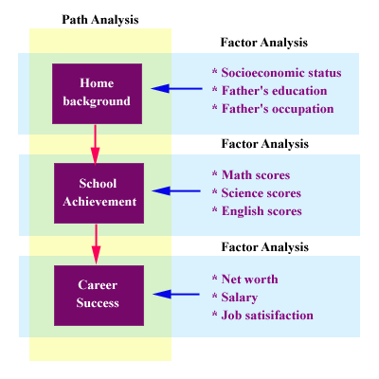
Relationship between CFA and SEM
Factor (measurement) model + path model
In psychology, it is always the case that the mental state causes the observed behaviors. The arrow always goes from the latent construct to the observed items.
In sociology & economics, the direction of the arrows can be reversed.

Slide 20
CFA in JMP
CFA is done through SEM
Use PIAAC_for_CFA
Analyze → Multivariate Methods → Structural Equation Modeling
Select observed items

Slide 21
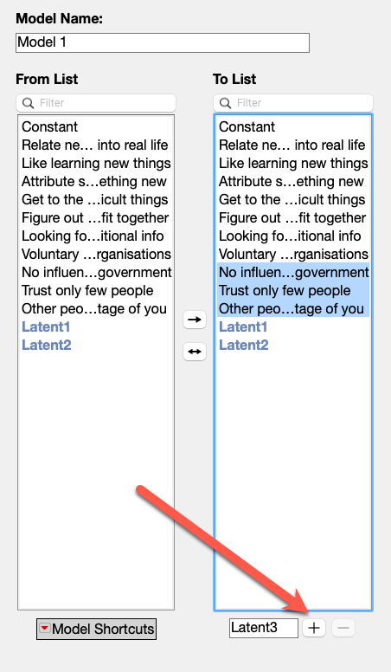
CFA in JMP
In “To list” select cognitive items and click on the + sign next to Latent 1
Select social items and click on the + sign next to Latent 2.
It loads the items into Latent 1 and 2.
Ignore “Voluntary work for non-profit organizations”.

Slide 22
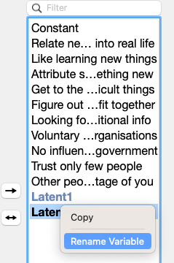
Rename
You can name the latent construct e.g., social, cognitive…etc.
You can do it anytime. The diagram and all others will be updated (JMP is a dynamic system).

Slide 23
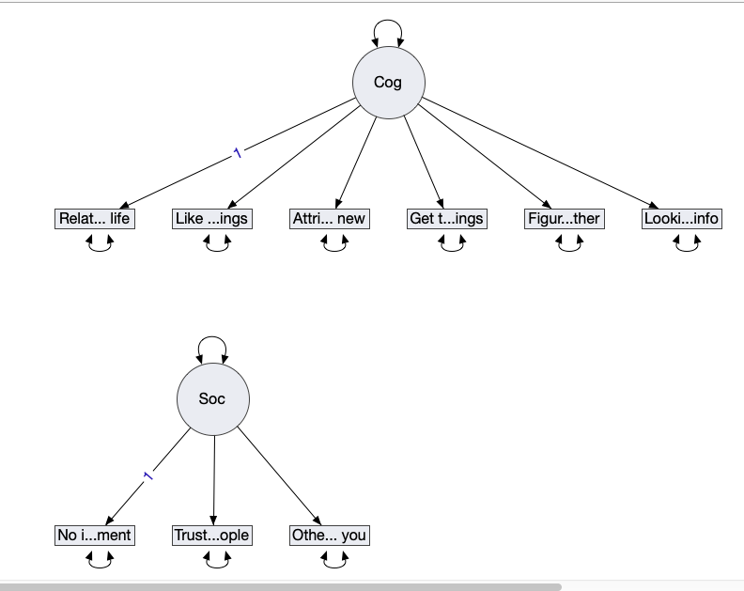
Check diagram
Click on the diagram tab to check the model visually.

Slide 24
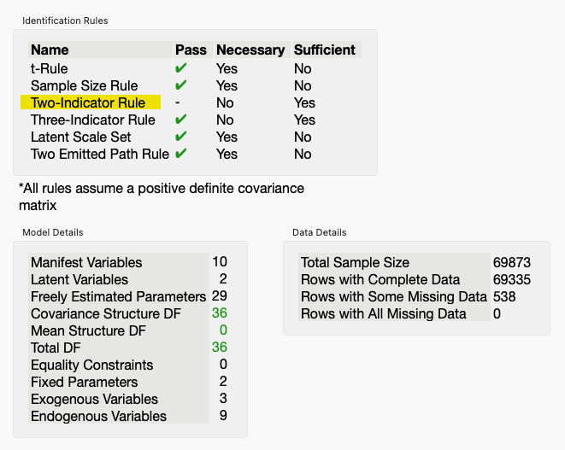
Check status (Green is good)
Do you have:
a large enough sample size?
sufficient degrees of freedom?
at least three items per factor?

Slide 25
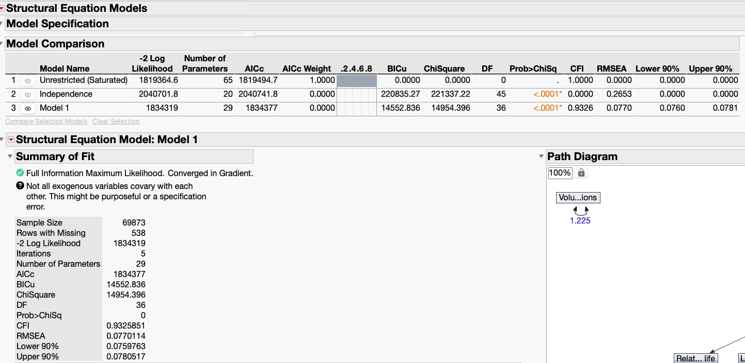
Output model
Click Run

Slide 26
Fitness
Chi-square (p < .0001): reject the null is not good. Why?
Null hypothesis: There is no significant discrepancy between the model and the data.
Reject the null → there is a discrepancy! What should we do?
Ignore Chi-square and the p value because it is subject to n. Large n → smaller p.

Slide 27
Fitness
RMSEA = .0770
RMSEA values less than 0.05 are good, values between 0.05 and 0.08 are acceptable, values between 0.08 and 0.1 are marginal, and values greater than 0.1 are poor.
Error of approximation: .95 → 5% unexplained variance.

Slide 28
Fitness
CFI = 0.9326
It is called “comparative”? What is compared against?
CFI = [df(null model) – df(proposed model)]/df(null model)
.9+ was considered acceptable. Recent studies suggested. 95+ as good.

Slide 29
Model comparison
In theory, “voluntary work for non-profit organizations” is about social relationships.
From EFA we learned that the loading is not clear-cut, but it doesn’t mean I have to abandon the item.
What if I put it into Latent 2?
Select Latent 2 and press the – sign.
Recreate Latent 2 by including the last four items.

Slide 30
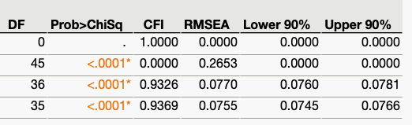
Model comparison
Both CFI and RMSEA improve a bit!
CFI is up and RMSEA is down!

Slide 31
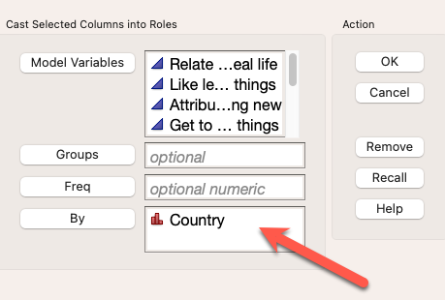
Subgroup analysis
Sometimes we want a global model that can be generalized to all cultures.
Sometimes we want a local model specific to a particular culture.
You can put Country into the By field to perform subgroup factor analysis.

Slide 32
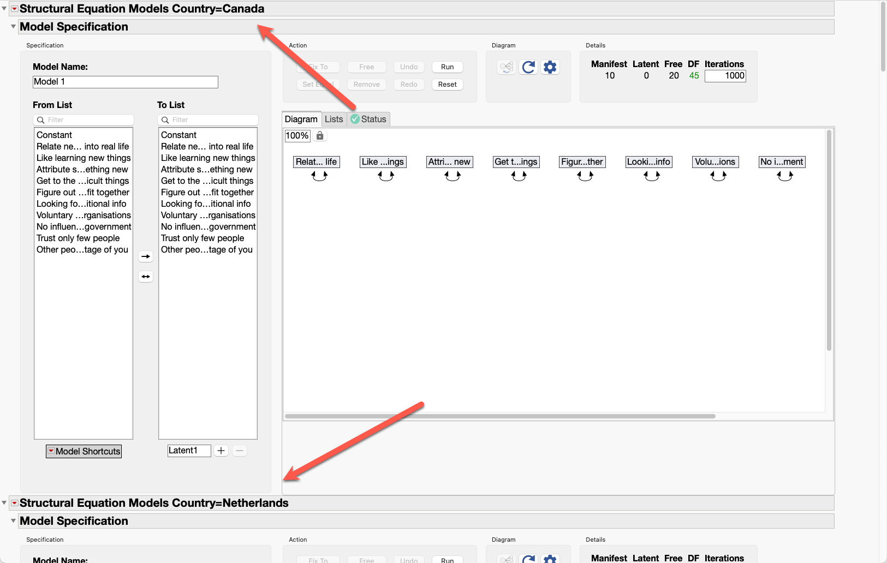
Subgroup analysis

Slide 33
Ungraded class activity
Choose any two countries in PIAAC_CFA
Run two separate analyses
Are the fitness indices of the two models similar?

Slide 34
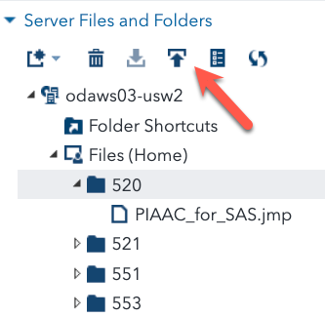
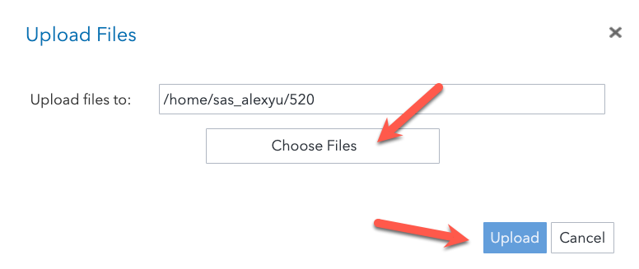
CFA in SAS
Upload the SAS data PICCA_for_SAS.jmp
Select the folder and then click the up arrow button.
Select the data set in the hard drive.
Press the upload button

Slide 35
CFA in SAS
From the multi-dot icon choose New Import Data.
Drag the data set into the canvas.
You can accept the default and press the Run icon. It will put the file in the temporary library.
You can also press the Change button to put the data into a permanent library.

Slide 36
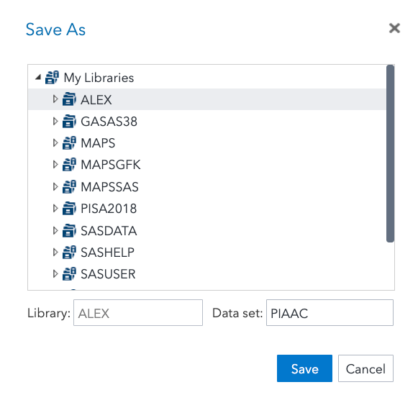
CFA in SAS
It is advisable to put it into a permanent library so that next time the data can be accessed quickly.

Slide 37
Use the multi-dot icon to open a new SAS program. Copy the code below into the program.
/* Alex is my library name. Your library might have another name */
proc calis data = alex.PIAAC plots=pathdiagram;
factor
/* C1 to C6 belong to the latent construct "cognitive" */
/* S2 to S4 belong to the latent construct "social" */
/* the number of loadings must correspond to the number of observed items */
cog ===> C1-C6 = load1 load1 load1 load1 load1 load1 ,
soc ===> S2-S4 = load2 load2 load2;
pvar
/* set all the factor variances to 1 */
cog = 1.,
soc = 1.;
run;

Slide 38
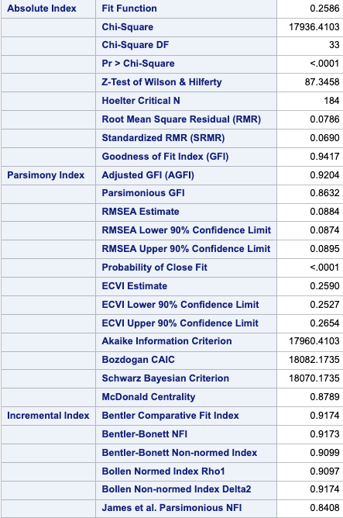
Fitness indices
SAS provides many more fitness indices. There are three categories:
  Absolute
  Parsimony
  Incremental

Slide 39
Absolute
Absolute: do not use an alternative model as a baseline for comparison.
Parsimonious
  Prefer simpler models, penalize complex models
  Used infrequently in the literature, so I suspect most researchers do not favor them.
Incremental (relative, comparative)
  Recommended

Slide 40
Fitness indices
All incremental indices are above 0.9 except James et al.

Slide 41
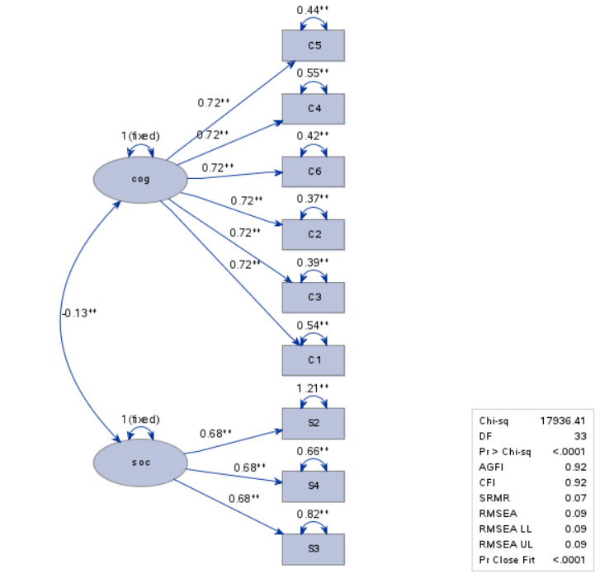
Path Diagram
Cognitive and social factors are uncorrected and distinct (-0.13) → Divergent validity

Slide 42
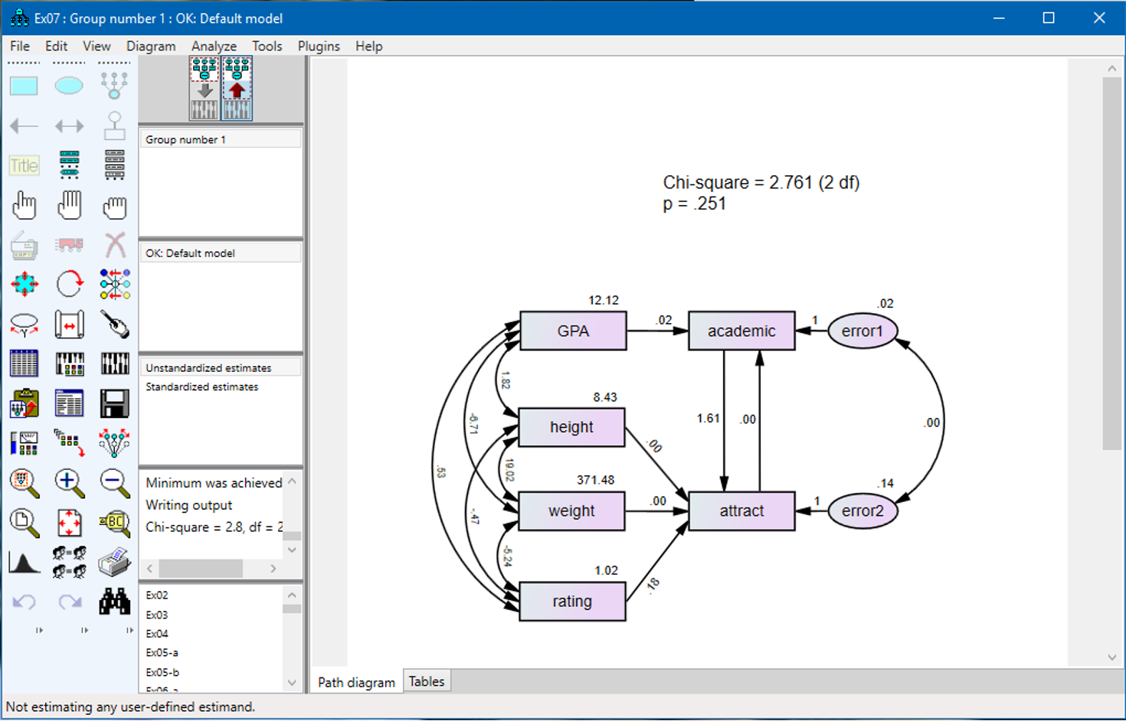
CFA in SPSS
SPSS has a standalone module for CFA and SEM: AMOS.
It is less expensive for graduate students, but for most researchers it is not cost-effective to buy a specialized software package for a single purpose.

