Slide 1
Ungraded quiz
Unit 1

Slide 2
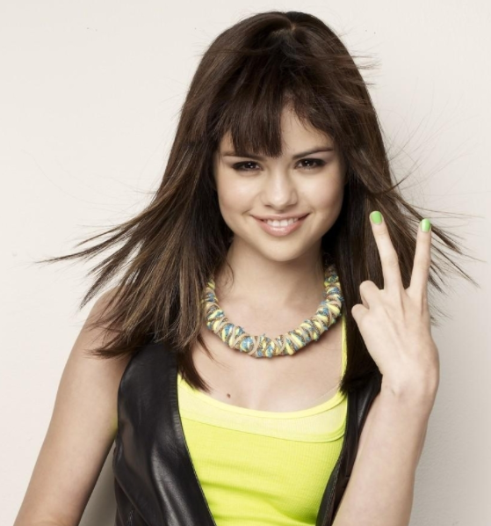
Show me your fingers
Do not shout out the answer, or your classmates will follow what you said.
Use your fingers
  One finger (the right finger) = A
  Two fingers = B
  Three fingers = C
  Four fingers = D
  No finger = I don’t know. I didn’t study

Slide 3
What is the logic of conventional hypothesis testing?
Given the data, what is the best hypothesis or hypothesis that can explain the data or the phenomenon?
Given the hypothesis, what is the probability of observing the data at hand without invoking a sampling distribution?
Given the hypothesis, what is the probability of observing the data in the long run, as expressed in terms of sampling distribution?
Given the data, what is the pattern and the magnitude of the effect?

Slide 4
What is the fallacy of “if A then B; B is observed, A is proven”?
Empirical adequacy
Affirming the consequent
Absence of evidence is equated with evidence of absence
Confirmation bias

Slide 5
The current form of hypothesis testing is a fusion of the research traditions introduced by:
R. A. Fisher and Edgar Pearson
R. A. Fisher, Jerzy Neyman, and Edgar Pearson
R. A. Fisher and Jerzy Neyman
R. A. Fisher, Jerzy Neyman, and Karl Pearson

Slide 6
Which of the following is/are considered a shortcoming/shortcomings of conventional hypothesis testing:
Easy to reject the null hypothesis
The alpha level is arbitrary
Lack reproducibility
All of the above

